Slide 1
IMAGE FILTERING
A Comprehensive Study

Slide 2
What is image processing?
An image is defined as a 2-d function f(x,y) where x and y are spatial coordinates and amplitude of f at any pair of coordiantes (x,y) is called the intensity or grey level of image at that point. The image consists of number of elements called pixels and we process these pixels .
Digital image processing refers to processing digital images such they are used for human or autonomous machine interpretation

Slide 3
steps in digital image processing
* Image acquisition
* image enhancement
* image restoration
* color image processing
* wavelets and multiresolution processing
* compression
* morphological processing
* segmentation
* representation and description
* object recognition

Slide 4
Image Enhancement
Objective of enhancement is to process image so that result is more suitable than original image for specific application.
Enhancement approaches fall into two broad categories spatial domain : direct manipulation of pixels in an image and frequency domain : manipulation of fourier transform of an image.

Slide 5
Spatial domain methods directly operate on the pixels, they are represented using expression g(x,y) = T [ f(x,y) ] where f(x,y) is input image g(x,y) is processed image and T is an operator on f defined over some neighborhood of (x,y) which is usually defined a square subimage centered at(x,y).
The operator T is applied at each location (x,y) to yeild output g at that location. The process uses pixels in the area of image spanned by neighbourhood.

Slide 6
Frequency domain is space defined by the values of fourier transform and its frequency variables.
Compute the discreet fourier transform F(u,v)of an imagef(x,y)
Multiply F(u,v) by the filter function H(x,y)
Compute inverse Fourier transform on the result.

Slide 7
Considering continuous function f(x) of a single variable x representing distance
The Fourier transform of that function is denoted F(u), where u represents
spatial frequency is defined by
The inverse Fourier transform for regenerating f(x) from F(u) is given by
consider a particular function f(x) defined as

Slide 8
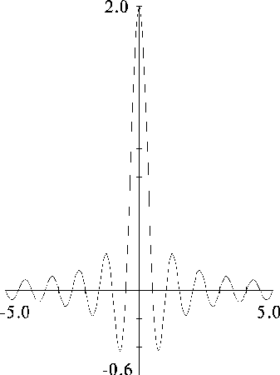
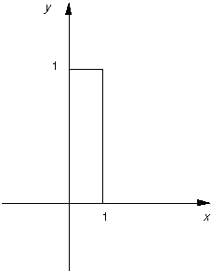
top hat funtion Fourier transform

Slide 9
Two Dimensional fourier transform
If f(x,y) is a function, for example the brightness in an image, its Fourier transform is given by
and the inverse transform, as might be expected, is

Slide 10
Spatial domain techniques
Order statistic filters
Mean, Median and Mode Filters
Digital Laplacian filter
Gradient filter
Horizontal and vertical edge detection
+45 and -45 degree edge detection

Slide 11
Frequency domain techniques
Ideal Low Pass Filter
Ideal high pass filter
Butterworth low pass filter
Butterworth high pass filter
Gaussian low pass filter
Gaussian high pass filter

Slide 12
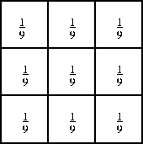
Order statistic filters
Mean filtering is a simple, intuitive and easy to implement method of smoothing images, i.e. reducing the amount of intensity variation between one pixel and the next. It is often used to reduce noise in images
The idea of mean filtering is simply to replace each pixel value in an image with the mean (`average') value of its neighbours, including itself. This has the effect of eliminating pixel values which are unrepresentative of their surroundings
Computing the straightforward
convolution of an image with this
kernel carries out the mean filtering
process.

Slide 13
The two main problems with mean filtering are:
A single pixel with a very unrepresentative value can significantly affect the mean value of all the pixels in its neighbourhood.
When the filter neighbourhood straddles an edge, the filter will interpolate new values for pixels on the edge and so will blur that edge. This may be a problem if sharp edges are required in the output.
Both of these problems are tackled by the median filter. The median filter is often a better filter for reducing noise than the mean filter, but it takes onger to compute.

Slide 14
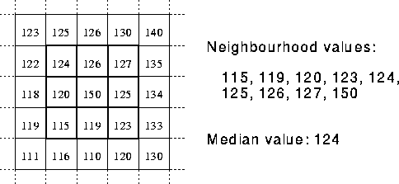
Median filter
The median filter is normally used to reduce noise in an image, somewhat like the mean filter. However, it often does a better job than the mean filter of preserving useful detail in the image.
Instead of simply replacing the pixel value with the mean of neighbouring pixel values, it replaces it with the median of those values. The median is calculated by first sorting all the pixel values from the surrounding neighbourhood into numerical order and then replacing the pixel being considered with the middle pixel value

Slide 15
Mode
The mode filter computes the mode of the grey-level values (the most frequently occurring grey-level value) within the filter window surrounding each pixel. Mode filtering is ideal for cleaning up thematic maps for presentation purposes, in that it replaces small "island" themes by their larger, surrounding themes.
Consider the following window
| 5 3 3 |
| 3 5 3 | <-- Filter window
| 3 4 5 |
Filtered pixel of filter window (3,3,3,3,3,4,5,5,5) is set to 3.

Slide 16

Digital Laplacan
The Laplacian is a 2D isotropic measure of the 2nd spatial derivative of an image. The Laplacian of an image highlights regions of rapid intensity change and is therefore often used for edge detection . The Laplacian is often applied to an image that has first been smoothed with something approximating a Gaussian smoothing filter in order to reduce its sensitivity to noise. The operator normally takes a single greylevel image as input and produces another greylevel image as output.
The Laplacian L(x,y) of an image having pixel intensity values I(x,y) is given by
Since the input image is represented as a set of discrete pixels, we have to find a discrete convolution mask that can approximate the second derivatives in the definition of the Laplacian. Three commonly used small masks are shown

Slide 17
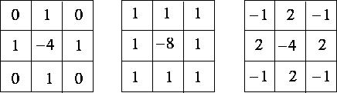
Three commonly used discrete approximations to the Laplacian filter. (Note, we have defined the Laplacian using a negative peak because this is more common, however, it is equally valid to use the opposite sign convention
Using one of these masks, the Laplacian can be calculated using standard convolution methods. However, because these masks are approximating a second derivative measurement on the image, they are very sensitive to noise. To counter this, the image is often Gaussian smoothed before applying the Laplacian filter. This pre-processing step reduces the high frequency noise components prior to the differentiation step.

Slide 18

In fact, since the convolution operation is associative, we can convolve the Gaussian smoothing filter with the Laplacian filter first of all, and then convolve this hybrid filter with the image to achieve the required result. Doing things this way has two advantages:
Since both the Gaussian and the Laplacian masks are usually much smaller than the image, this method usually requires far fewer arithmetic operations.
The LoG (`Laplacian of Gaussian') mask can be precalculated in advance so only one convolution needs to be performed at run-time on the image.
The 2D LoG function centered on zero and with Gaussian standard deviation has the form:

Slide 19
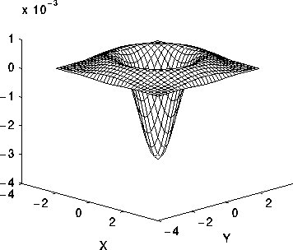
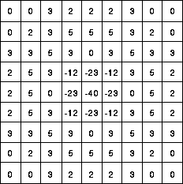
A discrete mask that approximates
this function (for a Gaussian of 1.4)
The 2D Laplacian of Gaussian (LoG) function

Slide 20
The LoG operator calculates the second spatial derivative of an image. This means that in areas where the image has a constant intensity (i.e. where the intensity gradient is zero), the LoG response will be zero. In the vicinity of a change in intensity however, the LoG response will be positive on the darker side, and negative on the lighter side. This means that at a reasonably sharp edge between two regions of uniform but different intensities, the LoG response will be:
Zero at a long distance from the edge.
Positive just to one side of the edge.
Negative just to the other side of the edge.
Zero at some point in between, on the edge itself.

Slide 21
Gradient
The gradient of the image intensity at each point, gives the direction of the largest possible increase from light to dark and the rate of change in that direction. The result therefore shows how "abruptly" or "smoothly" the image changes at that point, and therefore how likely it is that that part of the image represents an edge, as well as how that edge is likely to be oriented. In practice, the magnitude (likelihood of an edge) calculation is more reliable and easier to interpret than the direction calculation.
Mathematically, the gradient of a two-variable function (here the image intensity function) is at each image point a 2D vector with the components given by the derivatives in the horizontal and vertical directions.
The Sobel operator represents a rather inaccurate approximation of the image gradient, but is still of sufficient quality to be of practical use in many applications

Slide 22


Sobel operators

Slide 23
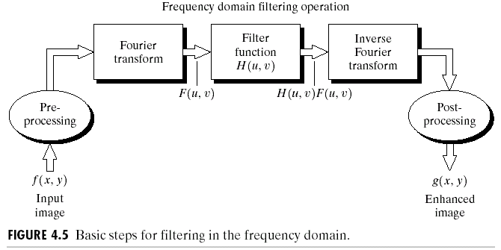
Frequency Domain Filtering

Slide 24
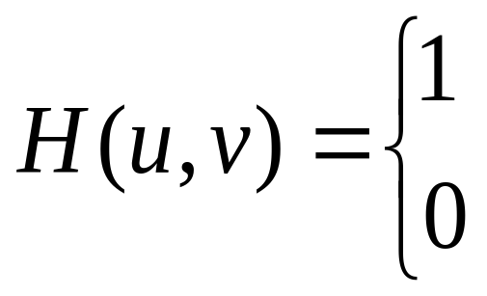
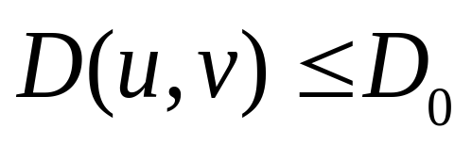
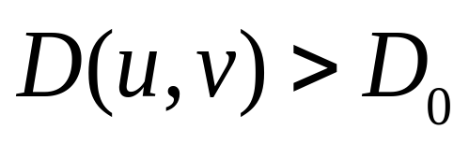
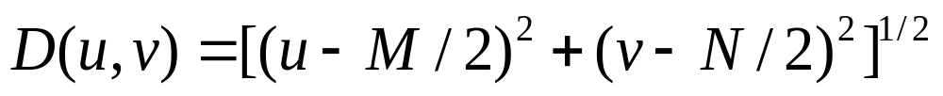
Ideal Low Pass Filtering
The most simple lowpass filter is the ideal lowpass. It suppresses all frequencies higher than the cut-off frequency and leaves smaller frequencies unchanged:

Slide 25
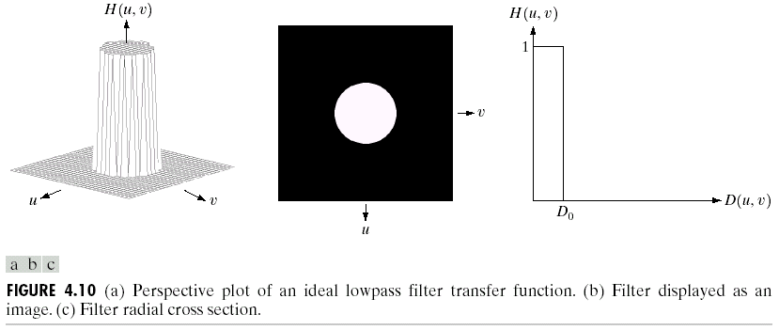
Frequency domain
L
Shape of ideal low pass filter
Spatial domain

Slide 26
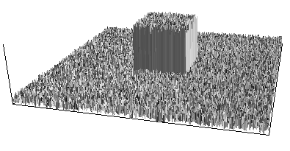
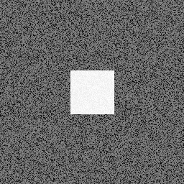
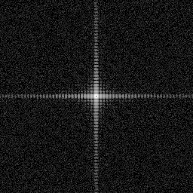
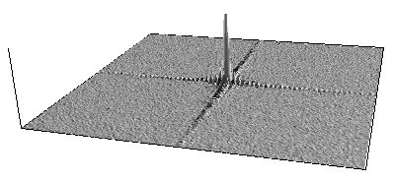
The drawback of this filter function is a ringing effect which occurs along the edges of filtered real domain image. The drawback of this filter function is a ringing effect which occurs along the edges of the filtered real domain image. The following example will apply "ideal" low, high, and band pass filters to a 2 dimensional rectangular pulse with low level added noise
two representations will be given, the image and a surface rendering.
The fourier transform of the rectangular pulse is the two dimensional equivalent

Slide 27
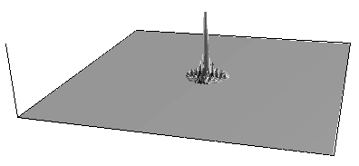
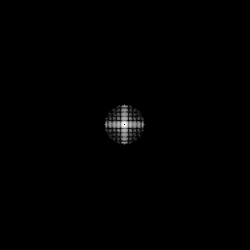

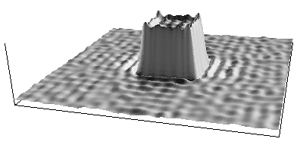
low pass filter zeroies all frequency components above a cutoff .
The result transformed back into the spatial domain.
As expected the high frequency components have been removed.
The rectangular pulse is "rounded" since high frequency components
were required for the transition

Slide 28
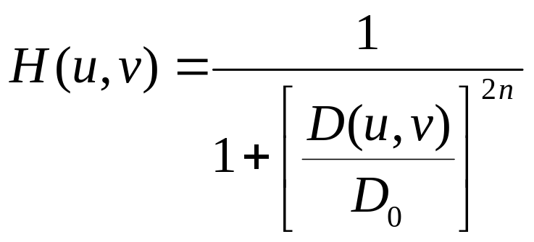
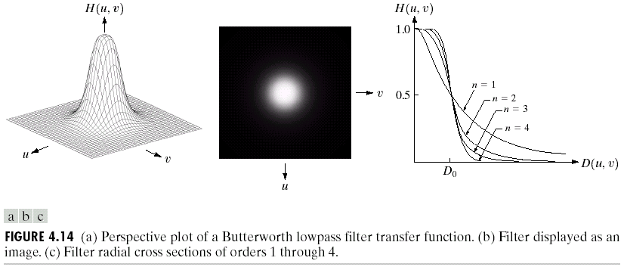
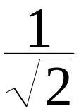
Butterworth Lowpass Filters
Smooth transfer function, no sharp discontinuity, no clear cutoff frequency.

Slide 29
The vertical edges and sharp corners of Ideal low pass filter are non-realizable in the physical world. Although we can emulate these filter masks with a computer, side effects such as blurring and ringing become aparent.

Slide 30
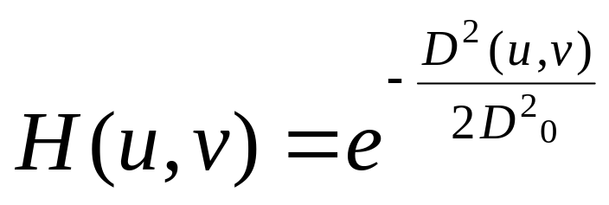
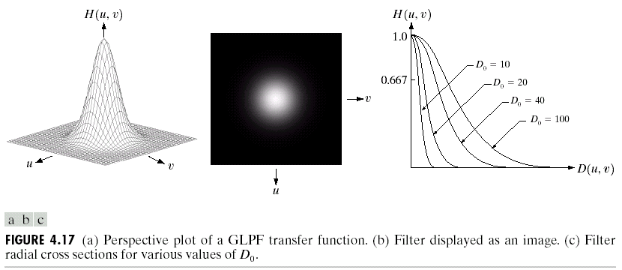
Gaussian Lowpass Filters (GLPF)
Smooth transfer function and smooth response and no ringing
Smooth transfer function, smooth impulse response, no ringing
Smooth transfer function, smooth impulse response, no ringing

Slide 31
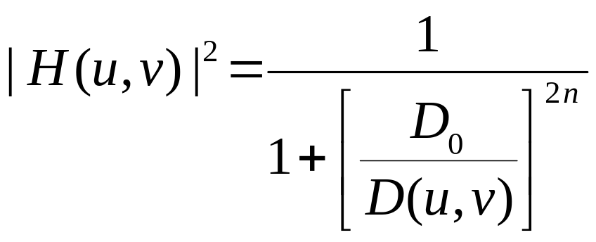
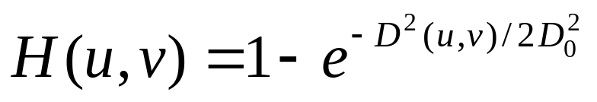
High-pass Filters
Ideal
Butterworth:
Gaussian:

Slide 32
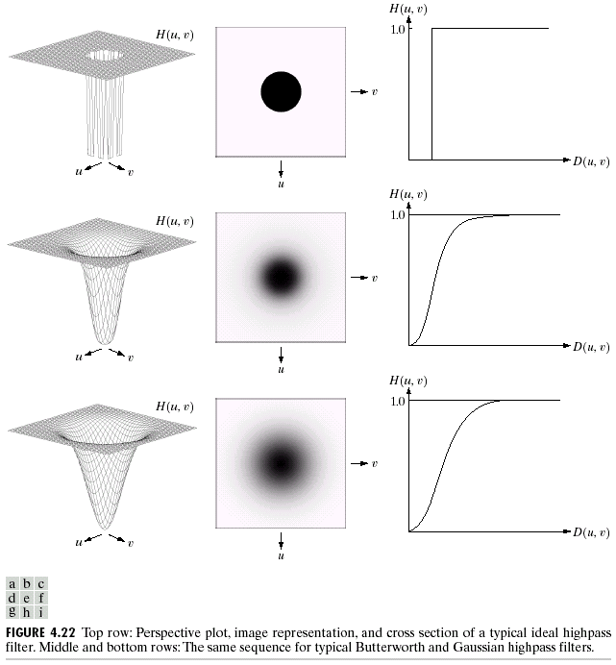

Slide 33
Implementation Details
This system is designed to accept 256 bitmap image with size of 64x64 pixels as input.
The developed system uses the Discrete Fourier Transform algorithm to carry out the image transform operation

Slide 34
Software and Hardware Requirements
Hardware Specifications:
Processor with minimum 400 MHz clock speed
128 Kb L2 Processor Cache
Minimum 32 MB RAM
Hard Disk Drive of capacity not less than 4GB
14’ SVGA Color Monitor
Standard Keyboard
Software Specifications:
Operating System – Microsoft Windows 9x
Turbo c

Slide 35
Implementation of spatial domain filters
Read a BMP image from file .
Read the bitmap data and the pixel data from the bitmap image header of the file
Convolve image with appropriate masks
display input and output images on the console

Slide 36
Implementation of frequency domain filters
Read a BMP image from file .
Read the bitmap data and the pixel data from the bitmap image header of the file
Perform the Fourier transform on the given image data and apply one of the proposed filters to it.
Perform inverse Fourier transform on the intermediate transform data to get a filtered output image.
generate histogram and display input and output images on the console

Slide 37
OUTPUTS

Slide 38




Original image
Ideal low pass filter
Cut off freequency 15 30 80

Slide 39



Butterworth low pass filter

Slide 40



Gaussian low pass filter outputs at 15 30 and 80 cut off freequencies

Slide 41


Ideal High Pass Filter
Cut off frequencies 15 and 30

Slide 42




Butterworth high pass filter cut offs 15,30 80 and 200

Slide 43




Gaussian High Pass filter at cut offs 15,30,80 and 200

Slide 44
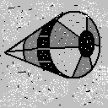


Mean Median And Mode
MEAN MEDIAN MODE

Slide 45
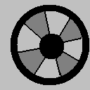
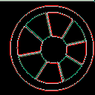
DIGITAL LAPLACAN
ORIGINAL IMAGE FILTERED IMAGE

Slide 46
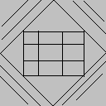
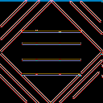
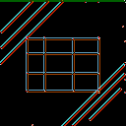
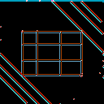

GRADIENT FILTER
ORIGINAL IMAGE
GRADIENT USING SOBEL FILTERS

