Slide 1
Digital colors

Slide 2
Agenda
What are digital colors ?
What are color spaces ?
Why do we have different color spaces?

Slide 3
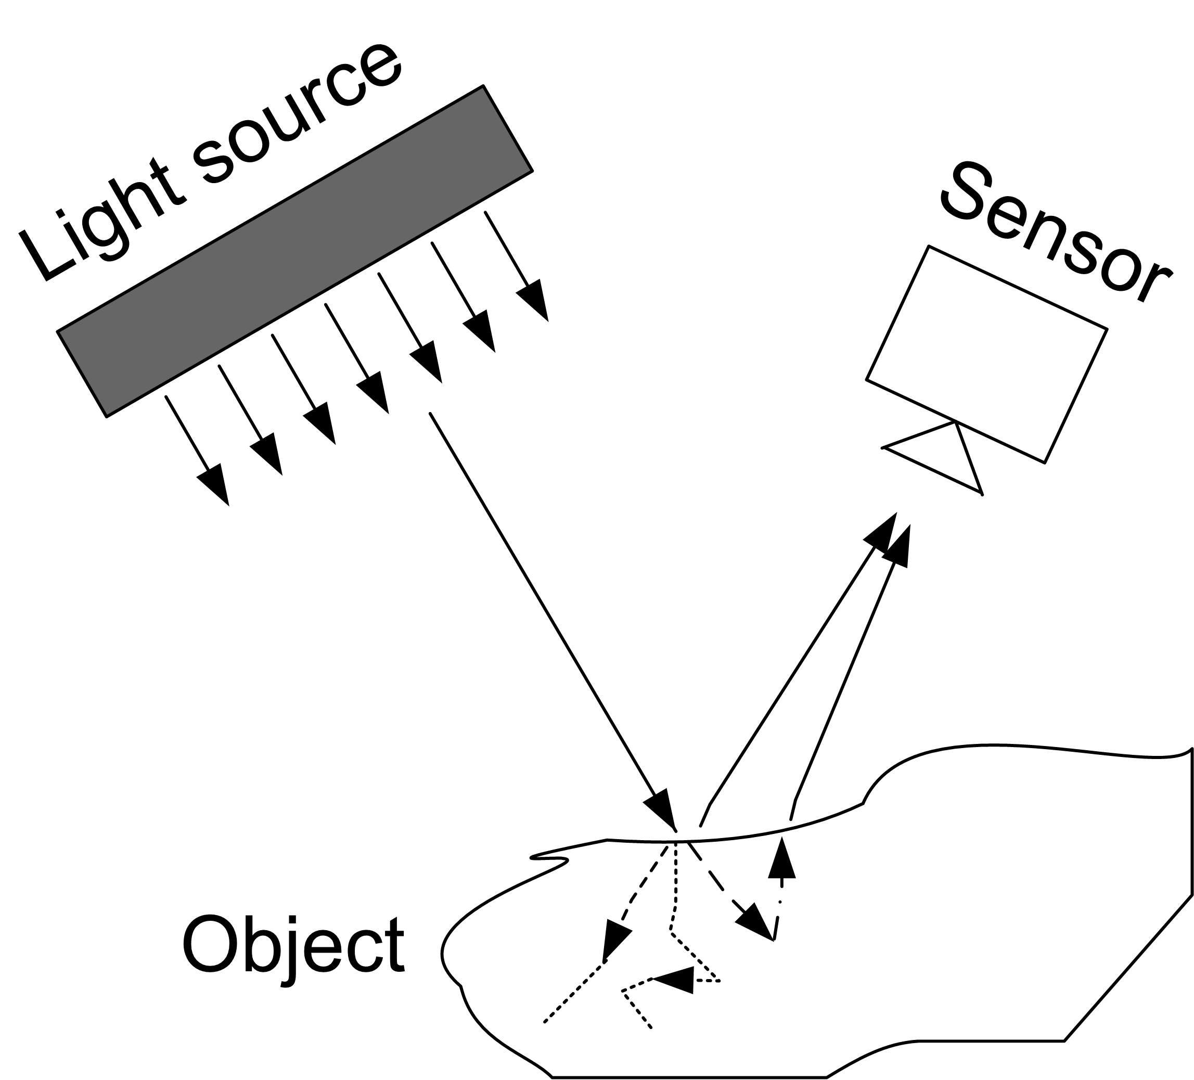
What are Colors?
The colors that humans and cameras perceive are determined by the nature of the light reflected from an object!
Green objects reflect “green” light!

Slide 4

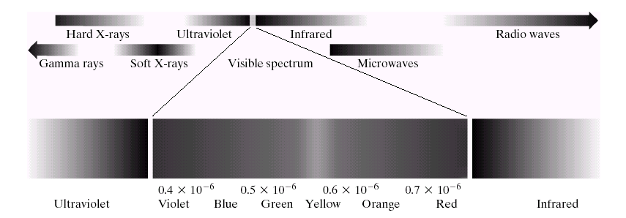

What are Colors?
Achromatic: Only intensities (amount of light)
  Gray levels as seen on black/white TV-monitor
  Ranges from black to white
Chromatic: Light waves; Visual range: 400nm-700nm

Slide 5
Red, Green, Blue
R,G,B are called Primary Colors
R,G,B where chosen due to the structure of the human eye
R,G,B are used in cameras

Slide 6
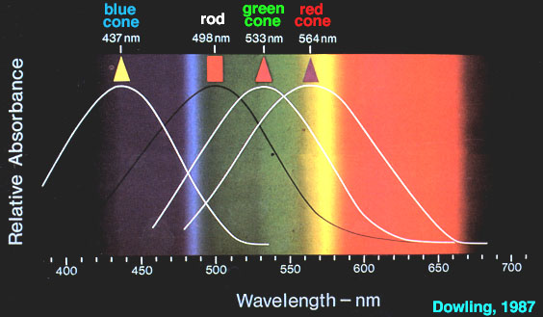
Receptivity of the Eye Cells

Slide 7
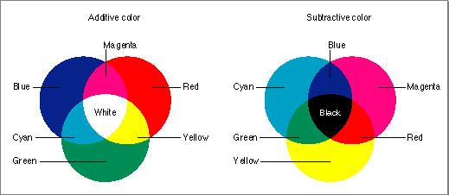
R+G+B=White? Really?!?
So why don’t we get white, when we use paint? Subtractive Color!
But why does it work for the TV? Additive Color!

Slide 8
Additive/Subtractive Color
Additive Color: Sum of light of different wave lengths. That light reaches our eye directly.
  Examples: TV, Multimedia Projector
Subtractive Color: White Color is emitted by the sun and is only partly reflected from an object!
  Red paint filters all light, except red!
  Yellow paint absorbs blue, but reflects red and green
  Examples: Paint

Slide 9
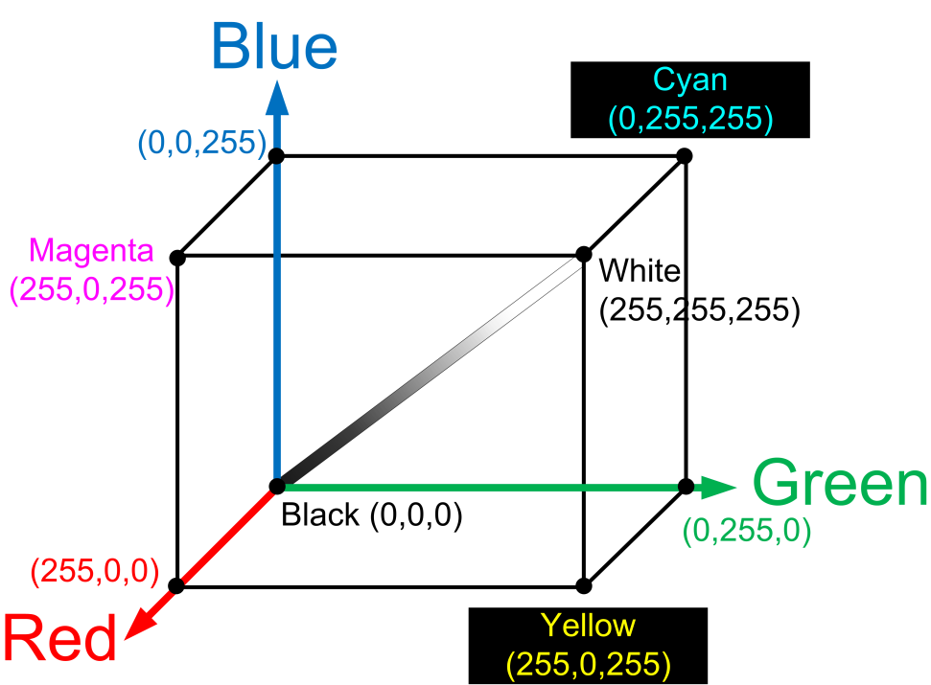
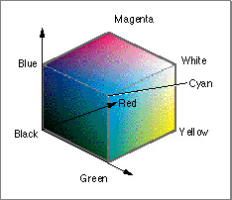
RGB Color Space
The “classical” Computer Color space
3 different colors: Red, Green, Blue
Similar to the human visual system!
If R,G,B have the same energy, we perceive a shade of grey

Slide 10
RGB Color Space
A single pixel consists of three components: [0,255].
Each pixel is a Vector.
(0,0)
128 | 251 | 60
=
Pixel-Vector in the computer memory
Final pixel in the image
Caution! Sometimes pixels are not stored as vectors. Instead, first is stored the complete red component, then the complete green, then blue.

Slide 11
Exercises
How many different colors exist for a 24bit pixel?
How many different 512x512 color (24bit) images exist?
How is color represented in HTML?

Slide 12
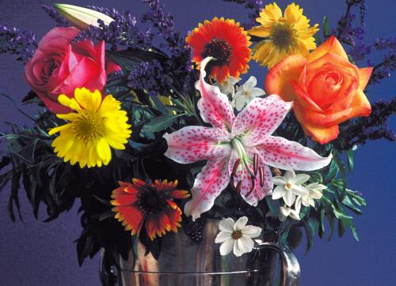
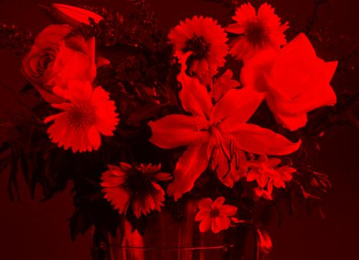
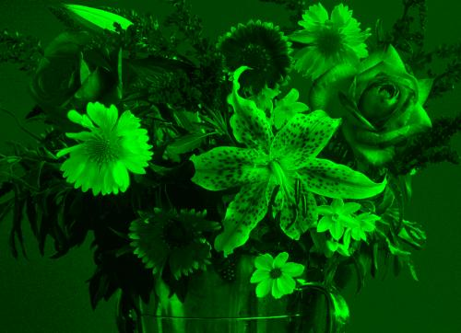
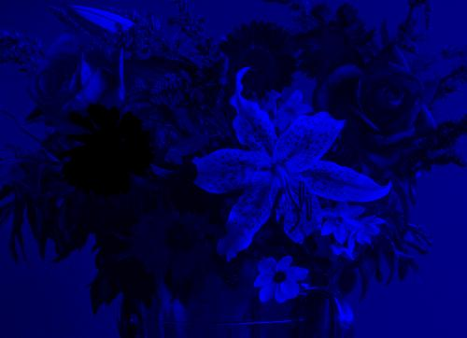
Example RGB
Original Image
R-Component
G-Component
B-Component

Slide 13
Convert color to grayscale
?
I = (R+G+B) / 3
I = a1*R + a2*G + a3*B a1+a2+a3=1
(
)
+
+
/ 3 =

Slide 14
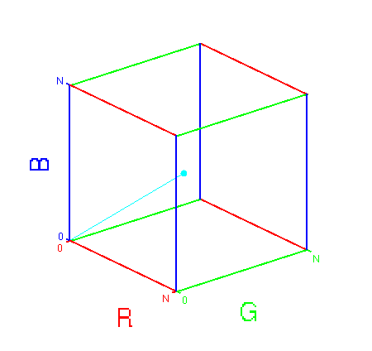
Color thresholding
For example: we want to detect red objects using the color
3D thresholding in RGB
If: TH_red_min < R < TH_red_max AND
TH_green_min < G < TH_green_max AND
TH_blue_min < B < TH_blue_max
Then: object pixel
Else: non-object pixel
Problem:
  If the intensity changes, we need larger TH => non-object pixels will be detected
Solution:
  Seperate color and intensity

Slide 15
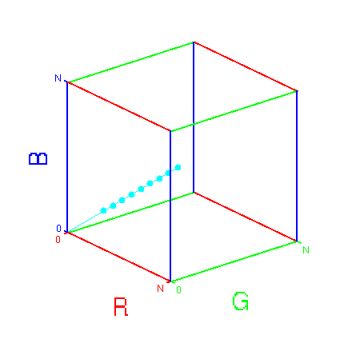
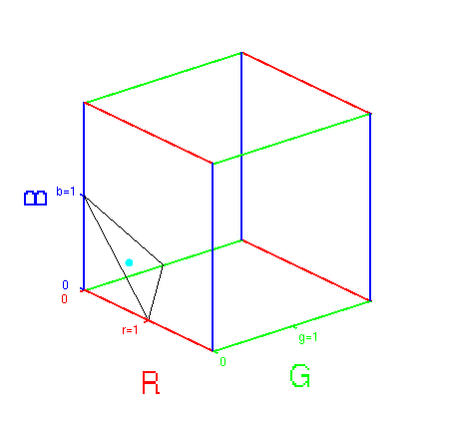
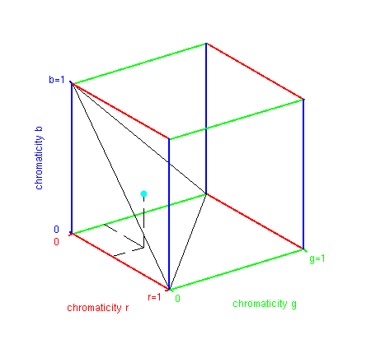
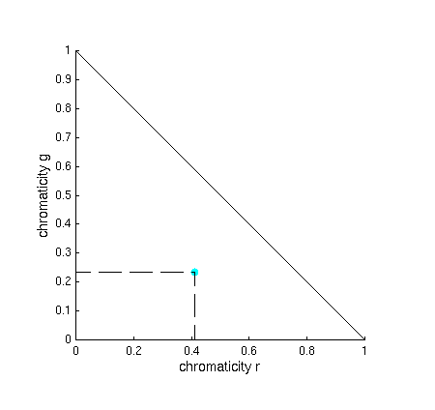
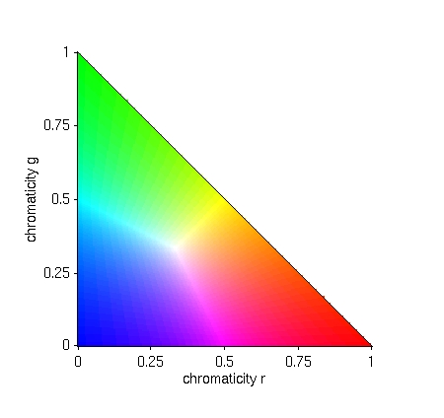

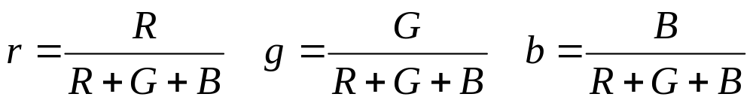
Color and Intensity are mixed
RGB to Chromaticities
Chromaticity Plane
Colour Cube
Same Colour, different intensities
Used in Computer Vision: normalised RGB
Notes:
The sensor/spectral integration gives for each pixel a 3D vector containing the RGB values.
If the illumination intensity changes the same material will always lie on that vector, just the length changes
Therefore 1. Norm or chromaticities, that means independent of the brightness
r+g+b=1
sufficient to look into 2D
all colours
Representation of colour vector C independent of intensity

Slide 16
Color thresholding
For example: we want to detect red objects using the color
3D thresholding in RGB
If: TH_red_min < R < TH_red_max AND
TH_green_min < G < TH_green_max AND
TH_blue_min < B < TH_blue_max
Then: object pixel
Else: non-object pixel
Problem: if the intensity changes, we need larger TH => non-object pixels will be detected
Solution: Do thresholding in chromaticities, e.g., r,g:
If: TH_r_min < r < TH_r_max AND
TH_g_min < g < TH_g_max
Then: object pixel
Else: non-object pixel

Slide 17
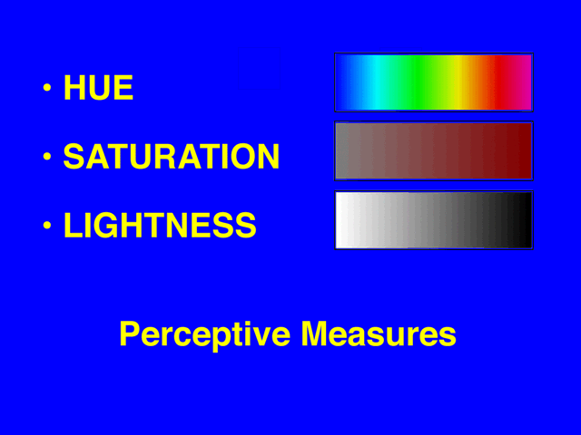
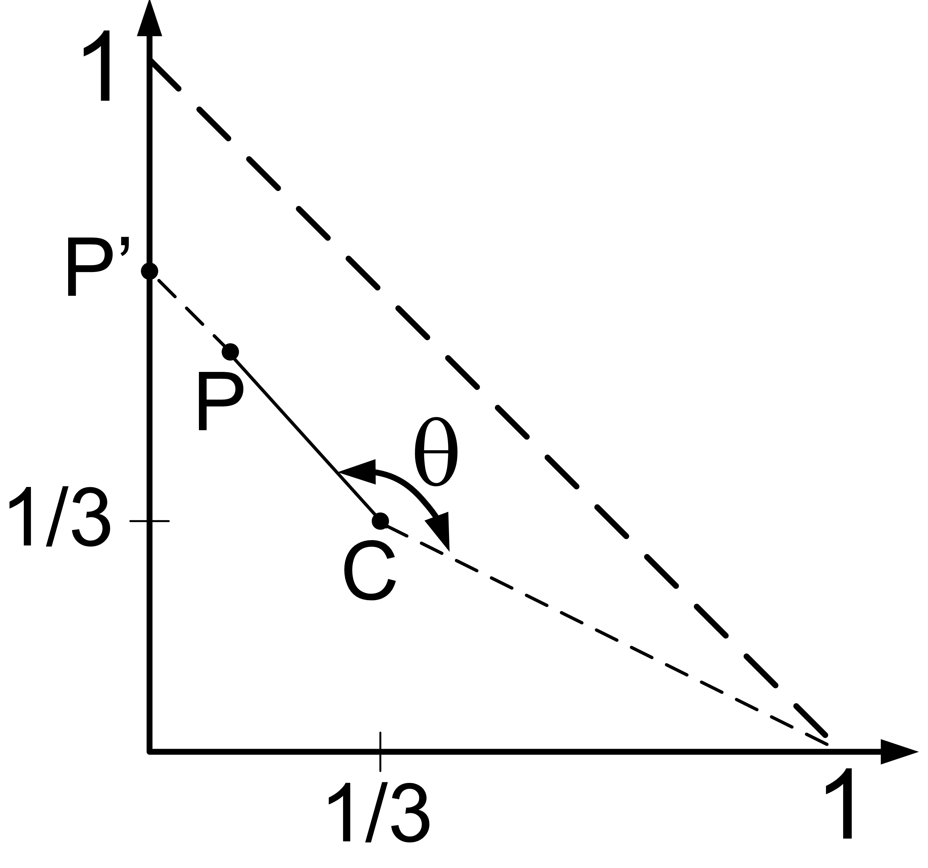
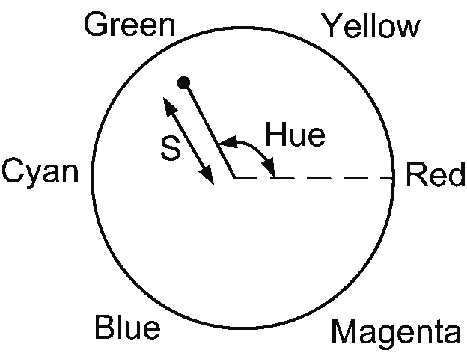
HSI
H=Hue S=Saturation I=intensity
H and S may characterize a color: Chromaticities
Hue: The dominant wavelength in the mixture of light waves, as perceived by an observer.
  Hue is the color attribute that describes a pure color
Saturation: relative purity; inverse of the amount of white light mixed with hue
  Example: Pure colors are fully saturated. Not saturated are for example pink (red+white)

Slide 18

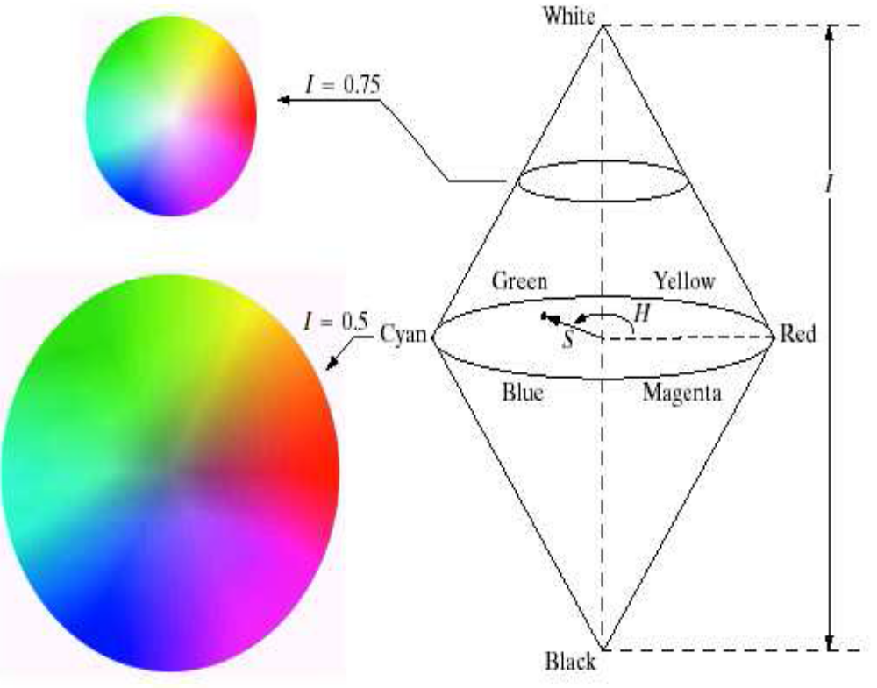
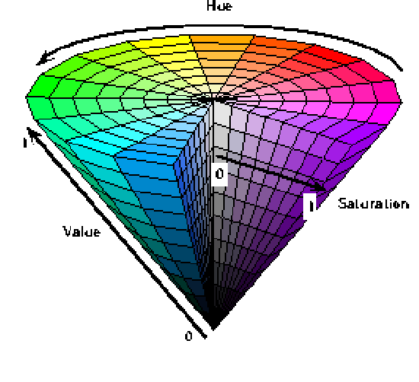
HSI color space
Perhaps the most intuitive color representation!
Used in Computer Graphics (and computer vision)

Slide 19
HSI Color Space
A single pixel consists of three components.
Each pixel is a Vector
(0,0)
128 | 251 | 60
=
Pixel-Vector in the computer memory
Final pixel in the image
Caution! Sometimes pixels are not stored as vectors. Instead, first is stored the complete hue component, then the complete sat., then the intensity.

Slide 20
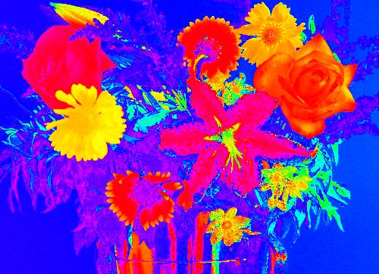
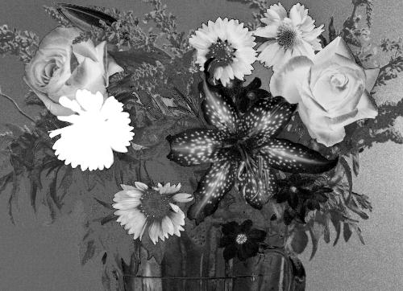
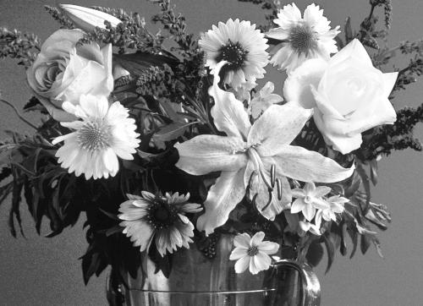
Example HSI
Original Image
Hue
Saturation
Intensity

Slide 21
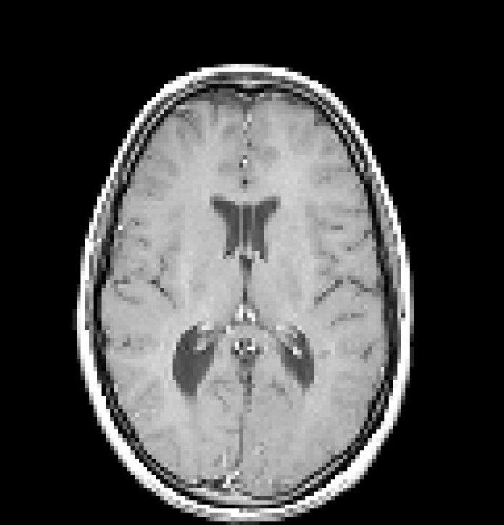
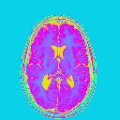
Full Color / Pseudo Color
Full Color: acquired by a TV camera/scanner
Pseudo Color: Assigning a shade of color to a monochrome intensity or range of intensities

Slide 22
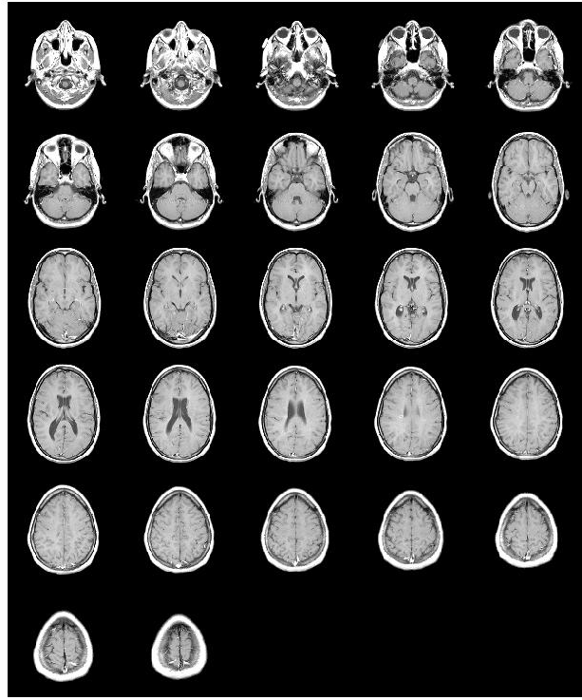
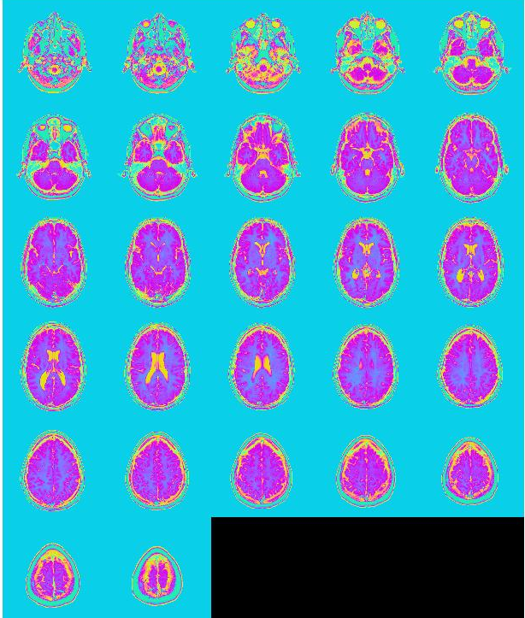
Mapping of Gray Values into Pseudo Color Images

Slide 23
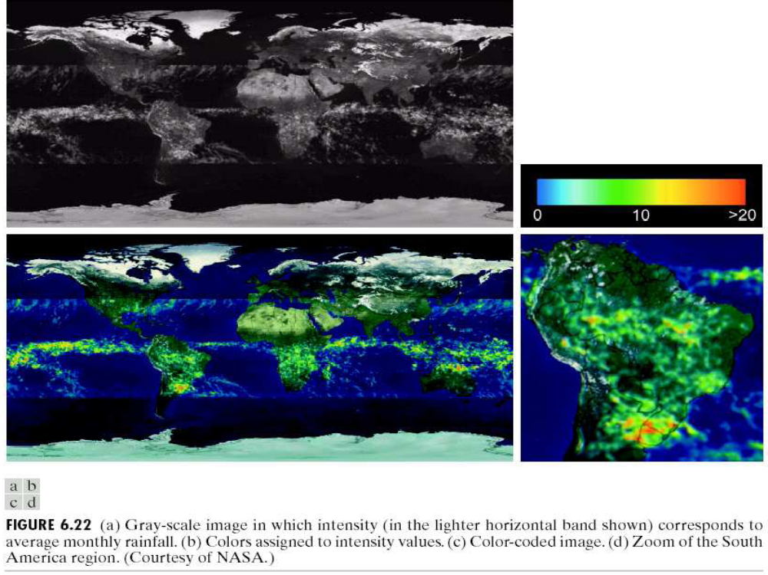
Pseudo Color

Slide 24
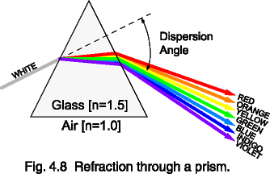
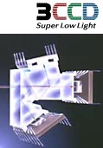
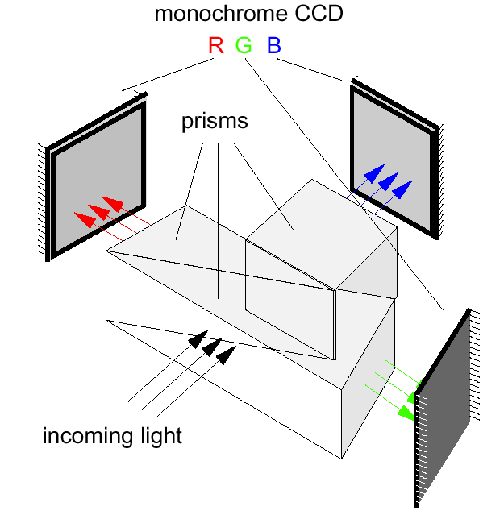
3CCD Camera

Slide 25
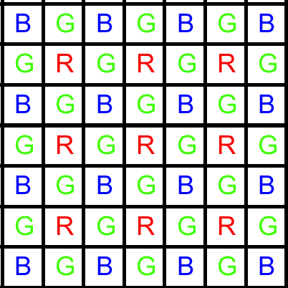
Single Sensor Color
Bayer Pattern

Slide 26
What to remember
Achromatic versus Chromatic
Subtractive Color versus Additive Color
Color Spaces
  RGB: Used in cameras and the HSV
  Normalised RGB: Decouples intensity and color
    Used in Computer Vision
  HSI: Decouples intensity and color (used in CG and CV)
Color thresholding
Pseudo Color : represent greyscales as colours
Miniproject

Slide 27
Mini-projekt
Emner:
  Birn-gruppen: Canny’s Edge Detector
  Skilte-gruppen: Affine transformation (incl. forskellige former for interpolering)
Rapportering
  Hvad er det, hvordan virker det, hvad kan det bruges til, implementering, test resultater, dokumentation (til nabo-gruppen + til rapporten)
Deadline for afrapportering: Mandag d. 17/3-10
Præsentation (for nabo-gruppen):
  Onsdag d. 19/3-10 kl. 12.30

Slide 28
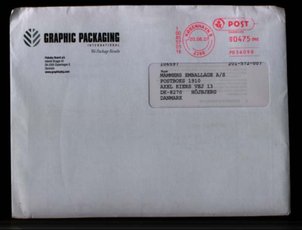
Exercises (1/2)
Discuss the questions related to this chapter (see web-site for the book)
How would you threshold this image (brev.png) in order to find the red ”stamp”?
  Use imageJ (image => color)
  to see that you are wrong!!
  Explain why

Slide 29
Exercises (2/2)
The image below has been captured by a Bayer pattern sensor. Use demosaicing (the algorithm on page 76 in the book) to convert the image into a RGB image
Input
100 | 10 | 110 | 11
9 | 50 | 8 | 49
105 | 12 | 112 | 9
14 | 52 | 15 | 54

Slide 30
Xtra

Slide 31
YUV Color Space
YUV: used in commercial color TV broadcasting and video signals
We need a format that decouples grayscale and color: HSI
“Poor-man’s” HSI
  Much easier to compute from RGB, than HSI

Slide 32
YUV Color Space
A single pixel consists of three components.
Each pixel is a Vector
(0,0)
128 | 251 | 60
=
Pixel-Vector in the computer memory
Final pixel in the image
Same Caution as before applies here!

Slide 33
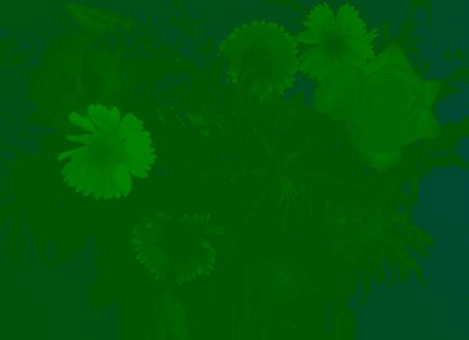
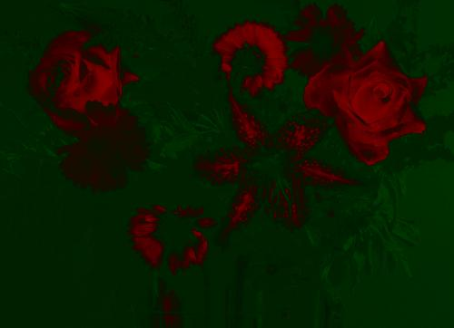
Example YUV
Original Image
Intensity
U-Component
V-Component

