Slide 1
Image Enhancement
T-61.182, Biomedical Image Analysis
Seminar presentation 24.2.2005
Hannu Laaksonen
Vibhor Kumar

Slide 2
Overview of part I
Subtraction imaging
Gray-scale transforms
Histogram transforms
  Global and local

Slide 3
Introduction, part I
Goal is to improve image quality
One is sometimes forced to an ad hoc approach
  Try several methods to see if they help
Result depends on the nature of the image and how well it matches with the assumptions of the enhancement method

Slide 4
Subtraction imaging
Digital Subtraction Angiography (DSA)
  Difference in images between before and after injecting contrast agent
Dual-energy and energy subtraction X-ray imaging
  Hard and soft tissues absorb energy differently
Temporal subtraction

Slide 5
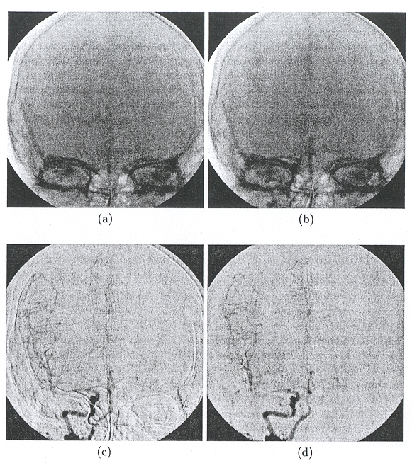
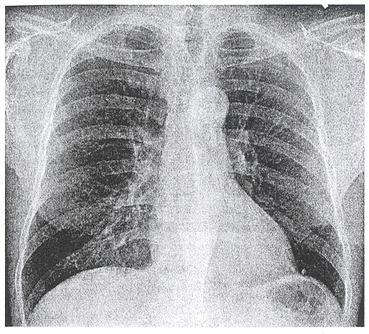
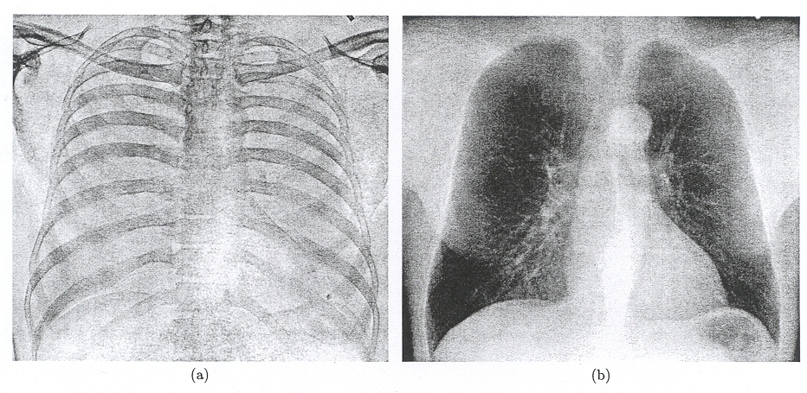
Subtraction imaging, examples

Slide 6
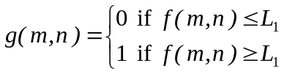
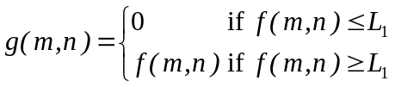
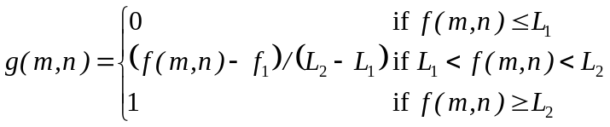

Gray-scale transforms
Thresholding
  Binary images or limited intensity values
Gray-scale windowing
  Use only a narrow band of intensity values
Gamma correction

Slide 7
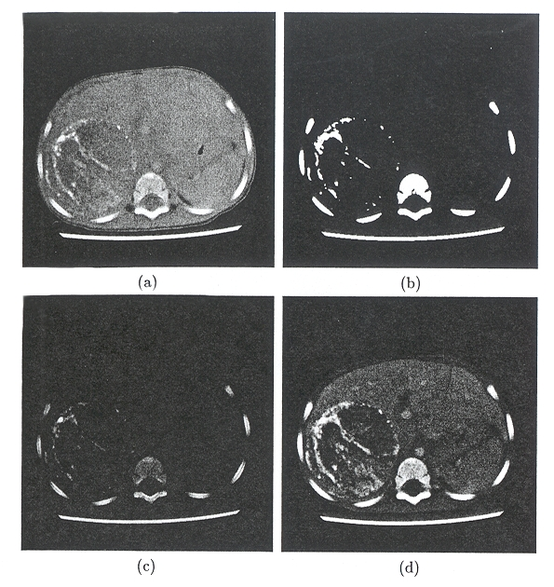
Gray-scale transforms, examples
Original CT image
Thresholded image, binary
Thresholded image, gray values preserved
Gray-scale windowed image

Slide 8
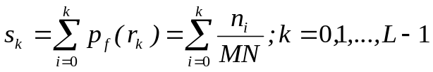
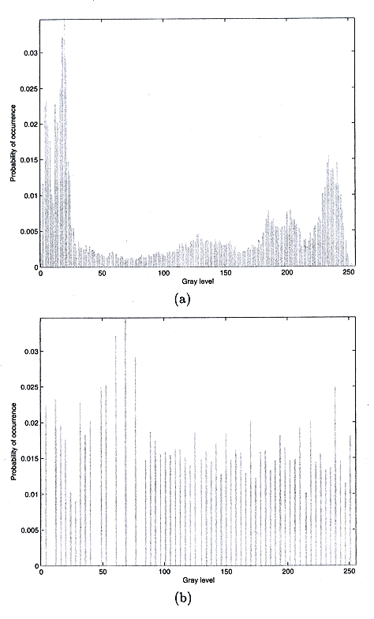
Histogram transforms
Histogram equalization
  Normalize the histogram to match uniform distribution
  Implemented via a look-up table
Histogram specification
  Use a prespecified spectrogram as a model
Global operations

Slide 9
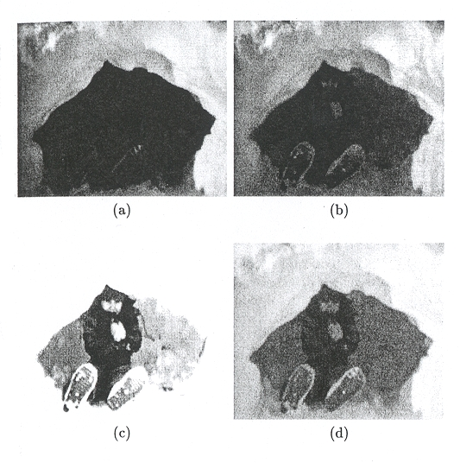
Histogram equalization, examples
Original image
Image after histogram equalization
Image after histogram equalization and windowing
Image after gamma correction (gamma = 0.3)

Slide 10
Local-area and adaptive-neighborhood methods
Local-area histogram equalization (LAHE)
  Histogram transformation is done in a moving-window with fixed size
Adaptive-neighborhood histogram equalization
  Histogram transformation is done in a region with similar properties.
  The region is grown from a seed pixel.

Slide 11
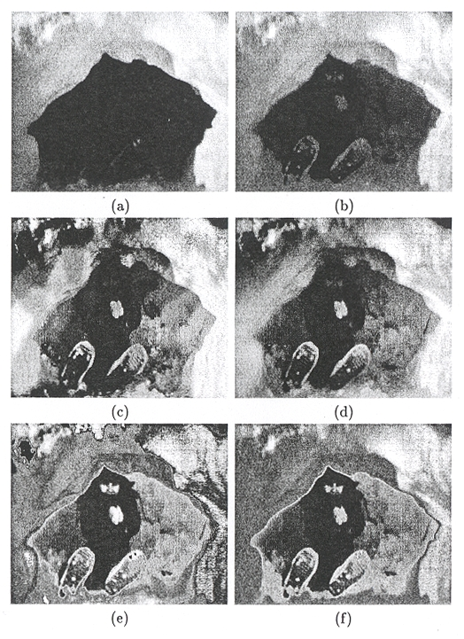
Local-area and adaptive-neighborhood methods, examples
Original image
Histogram equalization
LAHE with 11 x 11 window
LAHE with 101 x 101 window
Adaptive neighborhood (growth tolerance 16, background width 5)
Adaptive neighborhood (growth tolerance 64, background width 8)

