Slide 1
Image Restoration
Hung-Ta Pai
Laboratory for Image and Video Engineering
Dept. of Electrical and Computer Engineering
The University of Texas at Austin
Austin, TX 78712-1084
Copyright, 1996 © Dale Carnegie & Associates, Inc.

Slide 4
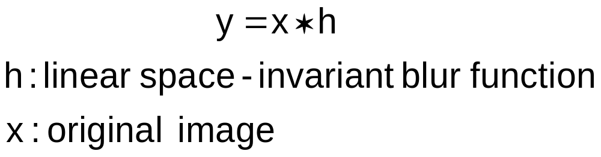
Degradation Model
In noise-free cases, a blurred image can be modeled as
In the DFT domain, Y(u,v) = X(u,v) H(u,v)

Slide 5
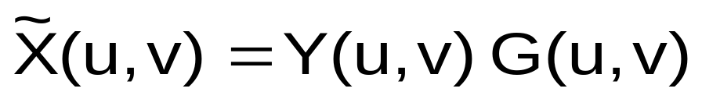
Inverse Filtering
Assume h is known (low-pass filter)
Inverse filter G(u,v) = 1 / H(u,v)

Slide 6
Implementing Inverse Filtering

Slide 7
Lost Information

Slide 8
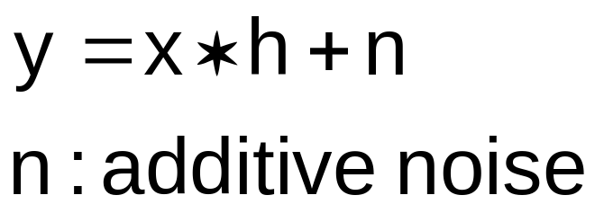
Problems with Inverse Filtering
H(u,v) = 0, for some u, v
In noisy case,

Slide 9
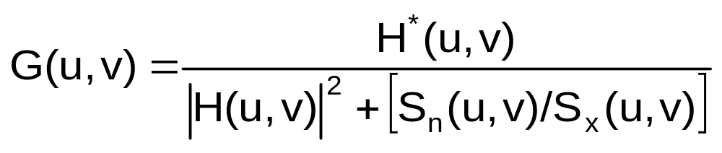
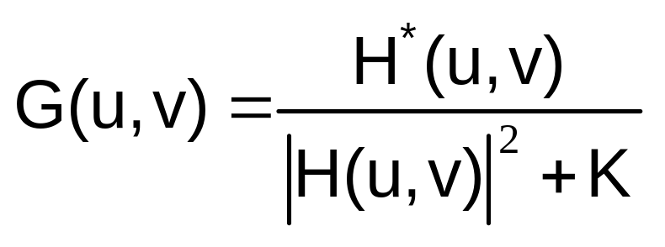
Wiener Filter Formulation
Least Mean Square Filter
In practice

Slide 10
Wiener Filter Results

Slide 11

Maximum-Likelihood (ML) Estimation
h is unknown
Assume parametric models for the blur function, original image, and/or noise
Parametric set θ is estimated by
Solution is difficult

Slide 12
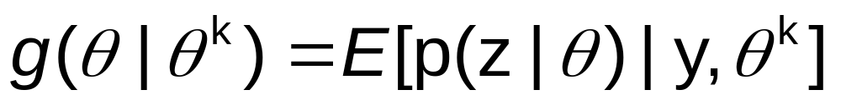
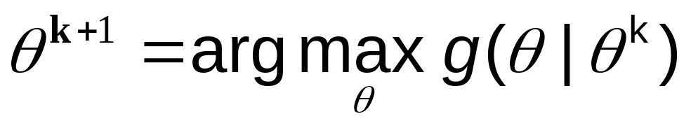
Expectation-Maximization (EM) Algorithm
Find complete set Ζ: for z ∈ Ζ, f(z)=y
Choose an initial guess of θ
Expectation-step
Maximization-step

Slide 13
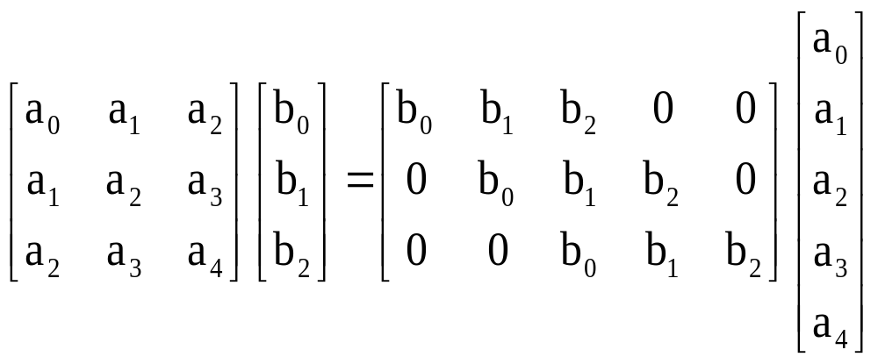
Subspace Methods
Observe

Slide 14
Subspace Methods
Several blurred versions of original image are available
Construct a block Hankel matrix Χ of blurred images
Χ = Η Σ, where Η is a block Toeplitz matrix of the blur functions and Σ is a block Hankel matrix of the original image

Slide 15
Subspace Methods Results

Slide 16
Conclusions
Noise-free case: inverse filtering
Noisy case: Weiner filter
Blind case: Maximum-Likelihood approach using the Expectation-Maximization algorithm
Multichannel blind case: subspace methods

Slide 17
Further Reading
M. R. Banham and A. K. Katsaggelos "Digital Image Restoration, " IEEE Signal Processing Magazine, vol. 14, no. 2, Mar. 1997, pp. 24-41.
D. Kundur and D. Hatzinakos, "Blind Image Deconvolution," IEEE Signal Processing Magazine, vol. 13, no. 3, May 1996, pp. 43-64.

