Slide 1
Image ENHANCEMENT
in the
SPATIAL DOMAIN
Part 2

Slide 2
Most of these slides base on the textbook
Digital Image Processing
by Gonzales/Woods
Chapter 3

Slide 3
Histograms
So far (part 1) :
Histogram definition
Histogram equalization
Now:
Histogram statistics

Slide 4
Histograms
Remember:
The histogram shows the number of pixels having a certain gray-value
number of pixels
grayvalue (0..1)

Slide 5
Histograms
The NORMALIZED histogram is the histogram divided by the total number of pixels in the source image.
The sum of all values in the normalized histogram is 1.
The value given by the normalized histogram for a certain gray value can be read as the probability of randomly picking a pixel having that gray value

Slide 6
Histograms
What can the (normalized) histogram tell about the image ?

Slide 7
Histograms
The MEAN VALUE (or average gray level)
M = Σ_{g} g h(g)
1*0.3+2*0.1+3*0.2+4*0.1+5*0.2+6*0.1=
2.6
0.3
0.2
0.1
0.0
1 2 3 4 5 6

Slide 8
Histograms
The MEAN value is the average gray value of the image, the ‘overall brightness appearance’.

Slide 9
Histograms
2. The VARIANCE
V = Σg (g-M)² h(g)
(with M = mean)
or similar:
The STANDARD DEVIATION
D = sqrt(V)

Slide 10
Histograms
VARIANCE gives a measure about the distribution of the histogram values around the mean.
0.3
0.2
0.1
0.0
0.3
0.2
0.1
0.0
V1 > V2

Slide 11
Histograms
The STANDARD DEVIATION is a value on the gray level axis, showing the average distance of all pixels to the mean
0.3
0.2
0.1
0.0
0.3
0.2
0.1
0.0
D1 > D2

Slide 12
Histograms
VARIANCE and STANDARD DEVIATION of the histogram tell us about the average contrast of the image !
The higher the VARIANCE (=the higher the STANDARD DEVIATION), the higher the image’s contrast !

Slide 13
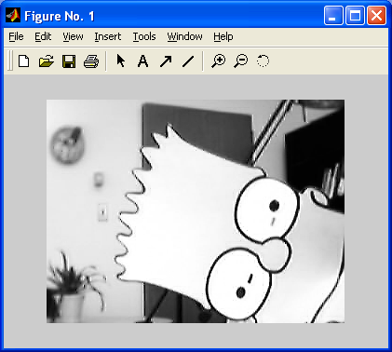
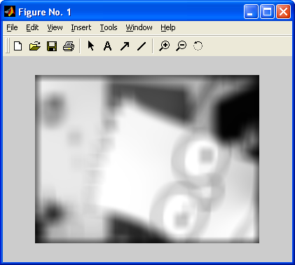
Histograms
Example:
Image and blurred version

Slide 14
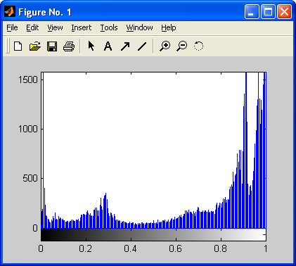
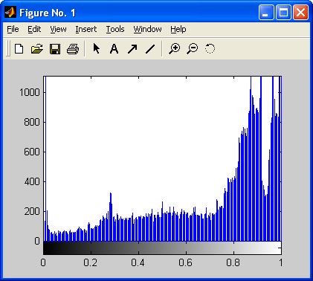
Histograms
Histograms with MEAN and
STANDARD DEVIATION
M=0.73 D=0.32
M=0.71 D=0.27

Slide 15
Histograms
Exercise:
Design an autofocus system for a digital camera !
The system should analyse an area in the middle of the picture and automatically adjust the lens such that this area is sharp.

Slide 16
Spatial Filtering
End of histograms.
And now to something completely different …

Slide 17
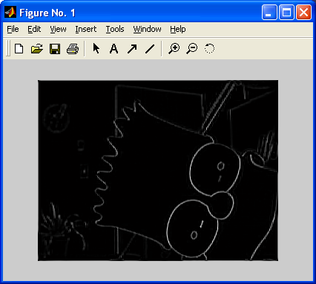
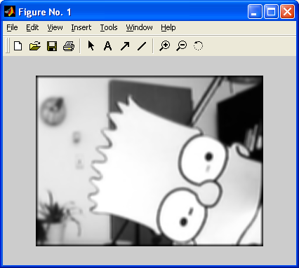
Spatial Filtering
Spatial Filtering

Slide 18
Spatial Filtering
Spatial Filtering:
Operation on the set of ‘neighborhoods’ N(x,y) of each pixel
6
8
(Operator: sum)
12
200
6
8
2
0
226
12
200
20
10

Slide 19
Spatial Filtering
Neighborhood of a pixel p at position x,y is a
set N(p) of pixels defined relative to p.
Example 1:
N(p) = {(x,y): |x-x_{P}|=1, |y-y_{P}| = 1}
P
Q

Slide 20
Spatial Filtering
More examples of neighborhoods:
P
P
P
P
P
P

Slide 21
Spatial Filtering
Usually neighborhoods are used which are close to discs, since properties of the eucledian metric are often useful.
The most prominent neighborhoods are the
4-Neighborhood and the 8-Neighborhood
P
P

Slide 22
Spatial Filtering
We will define spatial filters on the
8-Neighborhood and their bigger relevants.
P
P
P
N8
N24
N48

Slide 23
Spatial Filtering
Index system for N8:
n1
n2
n3
n4
n5
n6
n7
n8
n9

Slide 24
Spatial Filtering
Motivation: what happens to P if we apply the
following formula:
P = ∑_{i} n_{i}
n1
n2
n3
n4
n5=P
n6
n7
n8
n9

Slide 25
Spatial Filtering
What happens to P if we apply this formula:
P = ∑_{i} a_{i} n_{i}
with a_{i} given by:
a1=1
a2=1
a3=1
a4=1
a5=4
a6=1
a7=1
a8=1
a9=1

Slide 26
Spatial Filtering
Lets have a look at different values of a_{i} and
their effects !
This MATLAB
program creates an
interesting output:
% Description: given an image 'im', % create 12 filtered versions using % randomly designed filters
for i=1:12
a=rand(7,7); % create a % random 7x7 % filter-matrix
a=a*2 - 1; % range: -1 to 1
a=a/sum(a(:)); % normalize
im1=conv2(im,a);% Filter
subplot(4,3,i);
imshow(im1/max(im1(:)));
end

Slide 27
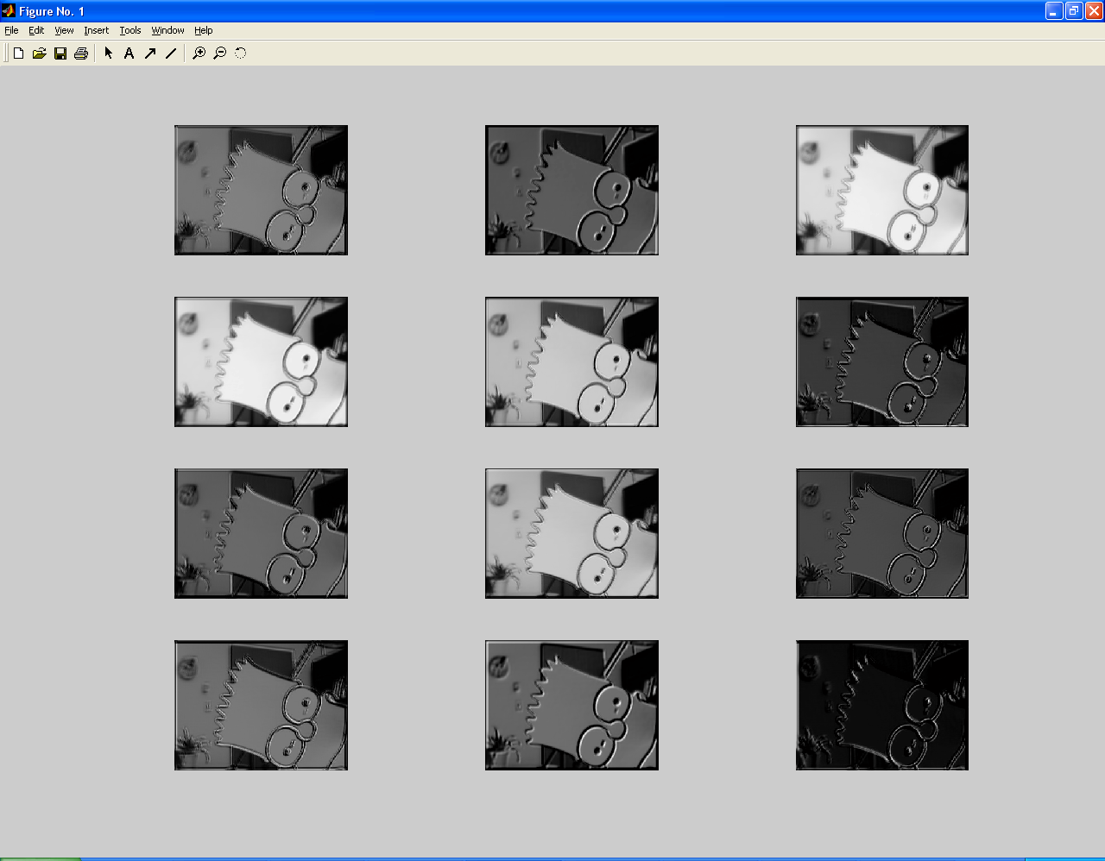
Spatial Filtering

Slide 28
Spatial Filtering
Different effects of the previous slides included:
Blurring / Smoothing
Sharpening
Edge Detection
All these effects can be achieved using different coefficients.

Slide 29
Spatial Filtering
Blurring / Smoothing
(Sometimes also referred to as averaging or lowpass-filtering)
Average the values of the center pixel and its neighbors:
Purpose:
Reduction of ‘irrelevant’ details
Noise reduction
Reduction of ‘false contours’ (e.g. produced by zooming)

Slide 30

Spatial Filtering
Blurring / Smoothing
1
1
1
1
1
1
* 1/9
1
1
1
Apply this scheme
to every single pixel !

Slide 31

Spatial Filtering
Example 2:
Weighted average
1
2
1
2
4
2
* 1/16
1
2
1

Slide 32
Spatial Filtering
Basic idea:
Weigh the center point the highest, decrease weight by distance to center.
The general formula for weighted average:
P = ∑_{i} a_{i} n_{i} / ∑_{i} a_{i}
Constant value, depending on mask, not on image !

Slide 33
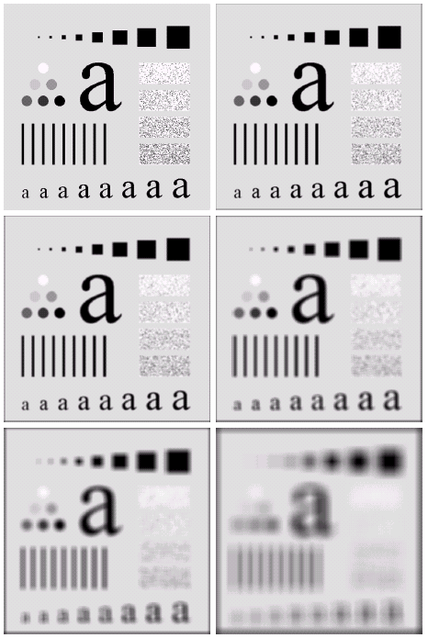
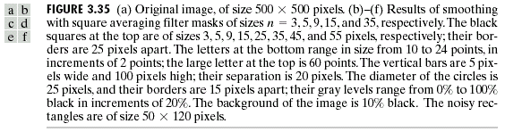
Spatial Filtering
Blurring using different
radii (=size of
neighborhood)

Slide 34
Spatial Filtering
EDGE DETECTION

Slide 35
Spatial Filtering
EDGE DETECTION
Purpose:
Preprocessing
Sharpening

Slide 36
Spatial Filtering
EDGE DETECTION
Purpose:
Preprocessing
Sharpening

Slide 37
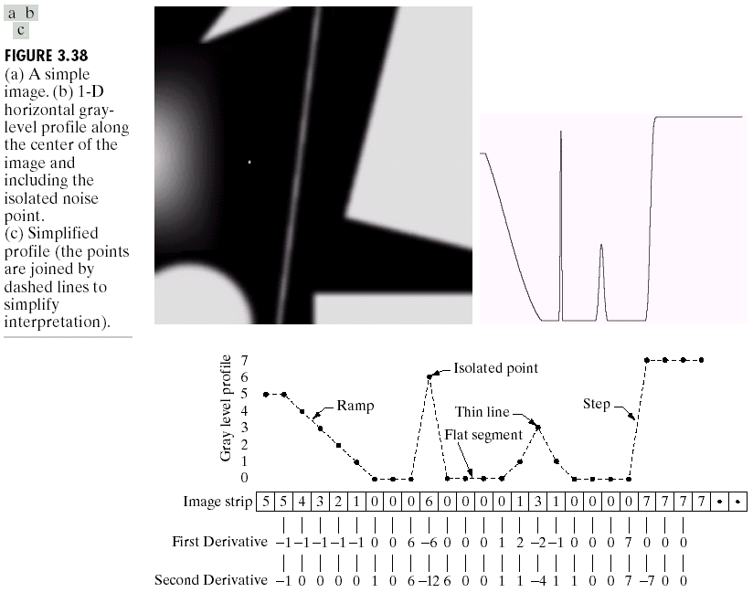
Spatial Filtering
Motivation: Derivatives

Slide 38
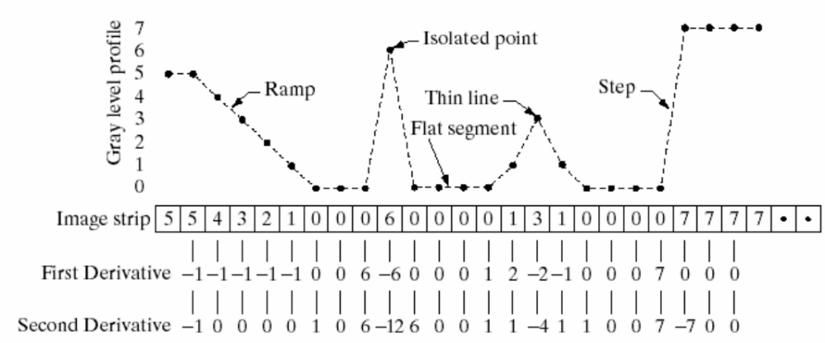
Spatial Filtering
First and second order derivative

Slide 39
Spatial Filtering
First and second order derivative
1st order generally produces thicker edges
2nd order shows stronger response to detail
1st order generally response stronger to gray level step
2nd order produce double (pos/neg) response at step change

Slide 40
Spatial Filtering
Definition of 1 dimensional discrete 1st order derivative:
dF/dX = f(x+1) – f(x)
The 2nd order derivative is the derivative of the 1st order derivative…

Slide 41
Spatial Filtering
The 2nd order derivative is the derivative of the 1st order derivative…
F(x-1)
F(x)
F(x+1)
derive
F(x)-F(x-1)
F(x+1)-F(x)
F(x+2)-F(x+1)
F(x+1)-F(x) – (F(x)-F(x-1))
F(x+1)-F(x) – (F(x)-F(x-1))= F(x+1)+F(x-1)-2F(x)

Slide 42
Spatial Filtering
One dimensional 2nd derivative in x direction:
F(x+1)-F(x) – (F(x)-F(x-1))= F(x+1)+F(x-1)-2F(x)
1
-2
1
One dimensional 2nd derivative, direction y:
1
-2
1

Slide 43
Spatial Filtering
TWO dimensional 2nd derivative:
0
0
0
0
1
0
0
1
0
+
=
1
-2
1
0
-2
0
1
-4
1
0
0
0
0
1
0
0
1
0
This mask is called the ‘LAPLACIAN’
(remember calculus ?)

Slide 44
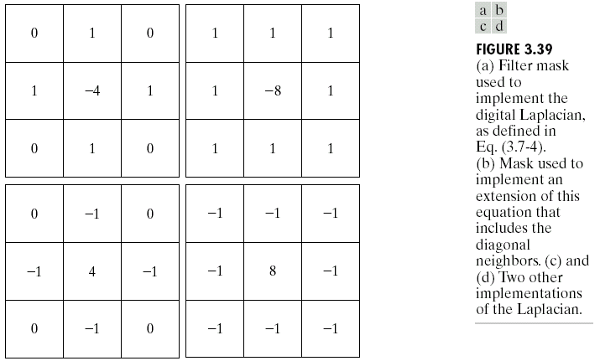
Spatial Filtering
Different variants of the Laplacian

Slide 45
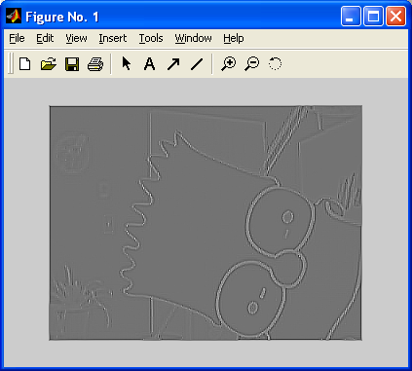
Spatial Filtering
Effect of the Laplacian… (MATLAB demo)
im = im/max(im(:));
% create laplacian
L=[1 1 1;1 -8 1; 1 1 1];
% Filter !
im1=conv2(im,L);
% normalize and show
im1=(im1-min(im1(:))) / (max(im1(:))-min(im1(:)));
imshow(im1);

Slide 46
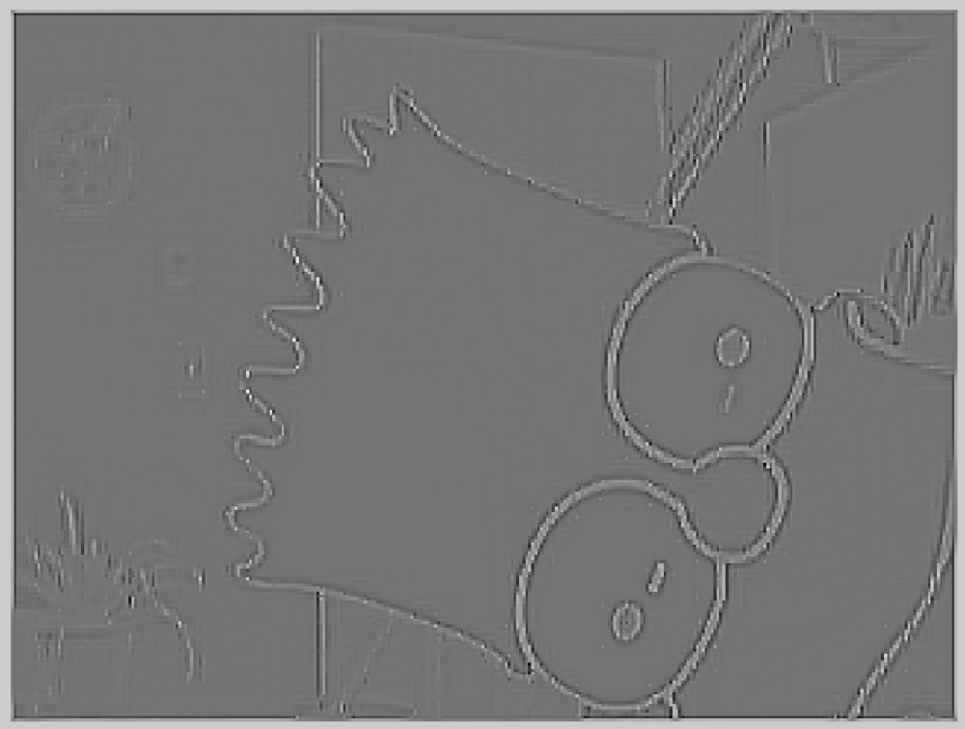
Spatial Filtering

Slide 47
Spatial Filtering
Edges detected by the Laplacian can be used to sharpen
the image !
+

Slide 48
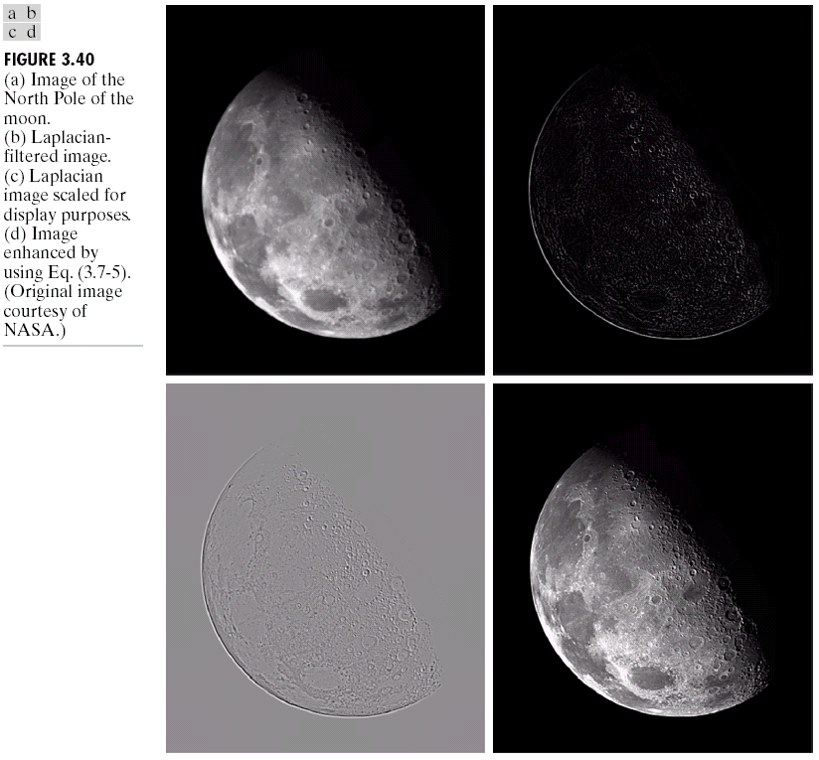
Spatial Filtering

Slide 49
Spatial Filtering
Sharpening can be done in 1 pass:
0
-1
0
0
0
0
0
-1
0
+
=
-1
4
-1
0
1
0
-1
5
-1
0
-1
0
0
0
0
0
-1
0
LAPLACIAN
Original Image
Sharpened Image

Slide 50
Spatial Filtering
Sharpening in General:
Unsharp Masking
and
High Boost Filtering

Slide 51
Spatial Filtering
Basic Idea (unsharp masking):
Subtract a BLURRED version of an image from the image itself !
F_{sharp} = F – F_{blurred}

Slide 52
Spatial Filtering
Variation: emphasize original image
(high-boost filtering):
F_{sharp} = a*F – F_{blurred} , a>=1
0
-1
0
0
0
0
0
1
0
=
-
-1
a-1
-1
0
a
0
1
1
1
0
-1
0
0
0
0
0
1
0

Slide 53
Spatial Filtering
Different Examples of High-Boost Filters:
0
-1
0
a=1
-1
0
-1
0
-1
0
0
-1
0
a=6
-1
5
-1
0
-1
0
0
-1
0
-1
1e7
-1
a=1e7+1
0
-1
0
Laplacian + Image !

Slide 54
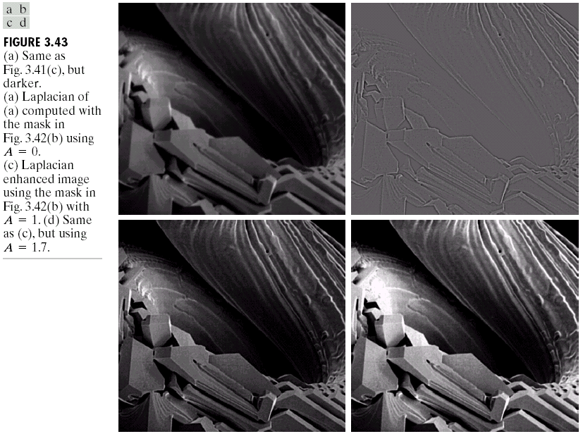
Spatial Filtering

Slide 55
Spatial Filtering
Enhancement using the First Derivative:
The Gradient
Definition: 2 dim. column vector,
∇(f) = [G_{x} ; G_{y}], G is 1st order derivative
MAGNITUDE of gradient:
Mag(∇(f))= SQRT(G_{x}² + G_{y}²)

Slide 56
Spatial Filtering
For computational reasons the magnitude is often approximated by:
Mag ~ abs(G_{x}) + abs(G_{y})

Slide 57
Spatial Filtering
Mag ~ abs(G_{x}) + abs(G_{y})
-1
0
1
-1
-2
-1
-2
0
2
0
0
0
-1
0
1
1
2
1
“Sobel Operators”

Slide 58
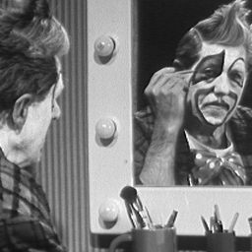
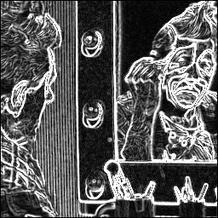
Spatial Filtering
Sobel Operators are a pair of operators !
Effect of Sobel Filtering:

Slide 59
Spatial Filtering
Remember the result some slides ago:
First and second order derivative
1st order generally produces thicker edges
2nd order shows stronger response to detail
1st order generally response stronger to gray level step
2nd order produce double (pos/neg) response at step change

Slide 60
Spatial Filtering
In practice, multiple filters are combined to enhance images

Slide 61
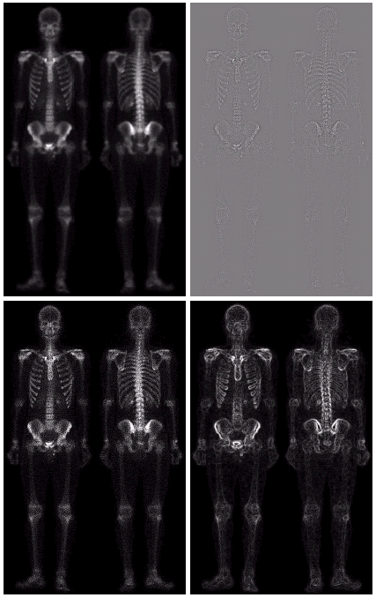
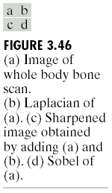
Spatial Filtering
…continued

Slide 62
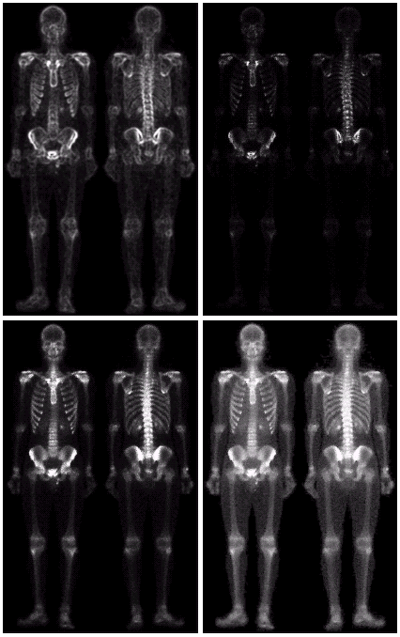
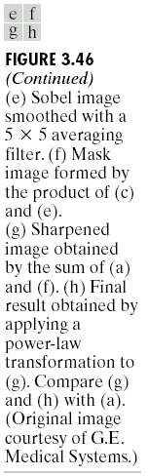
Spatial Filtering

Slide 63
Spatial Filtering
Non – Linear Filtering:
Order-Statistics Filters
Median
Min
Max

Slide 64
Spatial Filtering
Median:
The median M of a set of values is such that half the values in the set are less than (or equal to) M, and half are greater (or equal to) M.
1
2
3
3
4
5
6
6
6
7
8
9
9

Slide 65
Spatial Filtering
Most important properties of the median:
less sensible to noise than mean
an element of the original set of values
needs sorting (O(n log(n))

Slide 66

Spatial Filtering
Median vs. Mean

Slide 67
Spatial Filtering
Min and Max
2
5
7
3
MIN
3
4
2
3
3
4
8
3
MAX
3
3
3
3

Slide 68
Spatial Filtering
Min and Max:
Basics of Morphological Filtering
(blackboard and MATLAB examples)

