Slide 1
Using Information Theory:
21 21 21 95 169 243 243 243
21 21 21 95 169 243 243 243
21 21 21 95 169 243 243 243
21 21 21 95 169 243 243 243
Gray level | Count | Probability
21 | 12 | 3/8
95 | 4 | 1/8
169 | 4 | 1/8
243 | 12 | 3/8
First order entropy =
2*(3/8)*log₂(8/3)+2*(1/8)*log₂8
=1.81 bits/pixel

Slide 2
Gray level pair | Count | Probability
(21,21) | 8 | ¼
(21,95) | 4 | 1/8
(95,169) | 4 | 1/8
(169,243) | 4 | 1/8
(243,243) | 8 | ¼
(243,21) | 4 | 1/8
Second-order entropy = 2*(1/4)*log₂4+4*(1/8)*log₂8=1+1.5=2.5 bits/pair = 1.25 bits/pixel.

Slide 3
The fact that the second order entropy (in bits/pixel) is less than the first order entropy, indicates the presence of inter-pixel redundancy. Hence variable length coding alone will not lead to the most optimum compression in this case.
Consider mapping the pixels of the image to create the following representation:
21 0 0 74 74 74 0 0
21 0 0 74 74 74 0 0
21 0 0 74 74 74 0 0
21 0 0 74 74 74 0 0

Slide 4
Here, we construct a difference array by replicating the first column of the original image and using the arithmetic difference between adjacent columns for the remaining elements.
Gray level or difference | Count | Probability
0 | 16 | ½
21 | 4 | 1/8
74 | 12 | 3/8
First order entropy of this difference image = 1.41 bits/pixel

Slide 5
Near optimal variable length codes:
Huffman codes require an enormous number of computations. For N source symbols, N-2 source reductions (sorting operations) and N-2 code assignments must be made. Sometimes we sacrifice coding efficiency for reducing the number of computations.

Slide 6
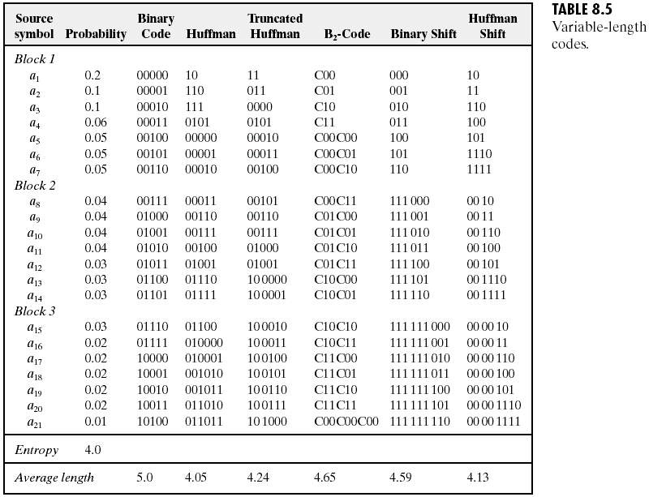

Slide 7
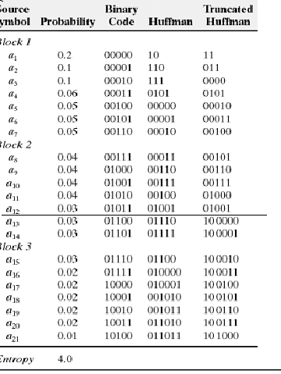

Slide 8
Truncated Huffman code:
A truncated Huffman code is generated by Huffman coding only the most probable M symbols of the source, for some integer M (less than the total N symbols). A prefix code followed by a suitable fixed length is used to represent all other source symbols. In the table in the previous slide, M was arbitrarily selected as 12 and the prefix code was generated as the 13th Huffman code word. That is a 13th symbol whose probability is the sum of the probabilities of the symbols from 13th to 21st is included in the Huffman coding along with the first 12 symbols.

Slide 9
B-code:
It is close to optimal when the source symbols probabilities obey a law of the form:
P(a_{j}) = c j^{-β}
In the B-code, each code word is made up of continuation bits, denoted C, and information bits, which are binary numbers. The only purpose of the continuation bits is to separate individual code words, so they simply toggle between 0 and 1 for each new code word. The B-code shown here is called a B₂ code, because two information bits are used per continuation bit.

Slide 10
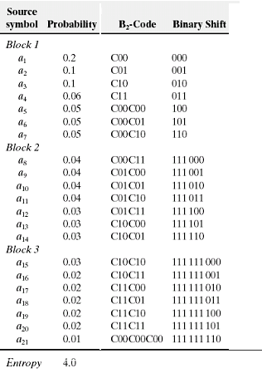

Slide 11
Shift code:
A shift code is generated by
Arranging the source symbols so that their probabilities are monotonically decreasing
Dividing the total number of symbols into symbol blocks of equal size.
Coding the individual elements within all blocks identically, and
Adding special shift-up or shift-down symbols to identify each block. Each time a shift-up or shift-down symbol is recognized at the decoder, it moves one block up or down with respect to a pre-defined reference block.

Slide 12
Arithmetic coding:
Unlike the variable-length codes described previously, arithmetic coding, generates non-block codes. In arithmetic coding, a one-to-one correspondence between source symbols and code words does not exist. Instead, an entire sequence of source symbols (or message) is assigned a single arithmetic code word.
The code word itself defines an interval of real numbers between 0 and 1. As the number of symbols in the message increases, the interval used to represent it becomes smaller and the number of information units (say, bits) required to represent the interval becomes larger. Each symbol of the message reduces the size of the interval in accordance with the probability of occurrence. It is supposed to approach the limit set by entropy.

Slide 13
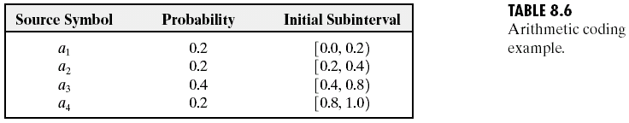
Arithmetic coding
Let the message to be encoded be a₁a₂a₃a₃a₄

Slide 14
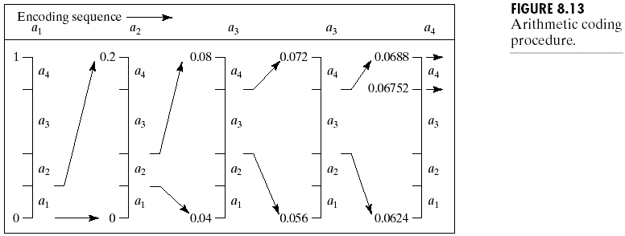
0.8
0.16
0.072
0.0688
0.4
0.08
0.056
0.0624
0.06496
0.2
0.048
0.0592
0.06368
0.04

Slide 15
So, any number in the interval [0.06752,0.0688) , for example 0.068 can be used to represent the message.
Here 3 decimal digits are used to represent the 5 symbol source message. This translates into 3/5 or 0.6 decimal digits per source symbol and compares favourably with the entropy of
-(3x0.2log₁₀0.2+0.4log₁₀0.4) = 0.5786 digits per symbol

Slide 16
As the length of the sequence increases, the resulting arithmetic code approaches the bound set by entropy.
In practice, the length fails to reach the lower bound, because:
The addition of the end of message indicator that is needed to separate one message from another
The use of finite precision arithmetic

Slide 17
Decoding:
Decode 0.572.
Since 0.8>code word > 0.4, the first symbol should be a₃.
1.0
0.8
0.72
0.592
0.5728
0.8
0.72
0.688
0.5856
0.57152
Therefore, the message is a₃a₃a₁a₂a₄
0.4
0.56
0.624
0.5728
056896
0.2
0.48
0.592
0.5664
0.56768
0.0
0.4
0.56
0.56
0.5664

Slide 18
LZW (Dictionary coding)
LZW (Lempel-Ziv-Welch) coding, assigns fixed-length code words to variable length sequences of source symbols, but requires no a priori knowledge of the probability of the source symbols.
The n^{th} extension of a source can be coded with fewer average bits per symbol than the original source.
LZW is used in:
Tagged Image file format (TIFF)
Graphic interchange format (GIF)
Portable document format (PDF)
LZW was formulated in 1984

Slide 19
The Algorithm:
A codebook or “dictionary” containing the source symbols is constructed.
For 8-bit monochrome images, the first 256 words of the dictionary are assigned to the gray levels 0-255
Remaining part of the dictionary is filled with sequences of the gray levels

Slide 20
Example:
39 39 126 126
39 39 126 126
39 39 126 126
39 39 126 126

Slide 21
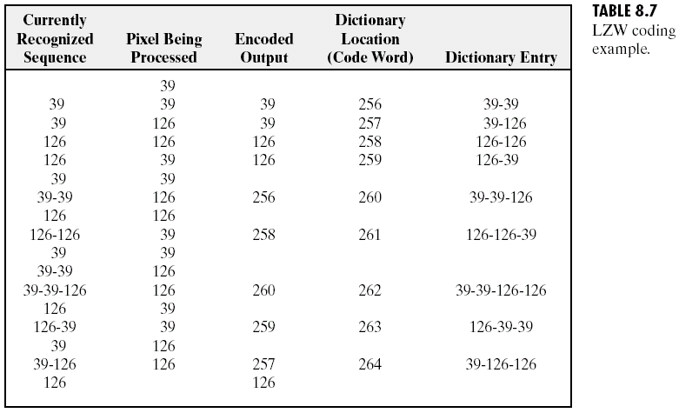

Slide 22
Compression ratio = (8 x 16) / (10 x 9 ) = 64 / 45 = 1.4
Important features of LZW:
The dictionary is created while the data are being encoded. So encoding can be done “on the fly”
The dictionary need not be transmitted. Dictionary can be built up at receiving end “on the fly”
If the dictionary “overflows” then we have to reinitialize the dictionary and add a bit to each one of the code words.
Choosing a large dictionary size avoids overflow, but spoils compressions

Slide 23
Decoding LZW:
Let the bit stream received be:
39 126 126 256 258 260 259 257 126
In LZW, the dictionary which was used for encoding need not be sent with the image. A separate dictionary is built by the decoder, on the “fly”, as it reads the received code words.

Slide 24
Recognized | Encoded value | pixels | Dic. address | Dic. entry
 | 39 | 39
39 | 39 | 39 | 256 | 39-39
39 | 126 | 126 | 257 | 39-126
126 | 126 | 126 | 258 | 126-126
126 | 256 | 39-39 | 259 | 126-39
256 | 258 | 126-126 | 260 | 39-39-126
258 | 260 | 39-39-126 | 261 | 126-126-39
260 | 259 | 126-39 | 262 | 39-39-126-126
259 | 257 | 39-126 | 263 | 126-39-39
257 | 126 | 126 | 264 | 39-126-126

Slide 25
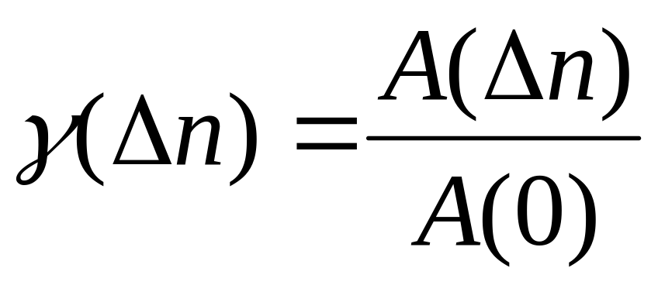
INTERPIXEL REDUNDANCY
Variable length coding will produce identical compression ratios for the two images shown on the next slide, however we can achieve higher compression ratios by reducing interpixel redundancy.
We can detect the presence of correlation between pixels (or interpixel redundancy) by computing the auto-correlation coefficients along a row of pixels

Slide 26
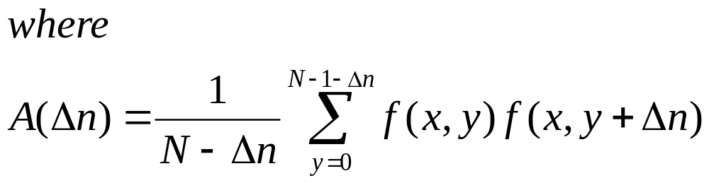
Maximum possible value of γ(Δn) is 1 and this value is approached for this image, both for adjacent pixels and also for pixels which are separated by 45 pixels (or multiples of 45).

Slide 27
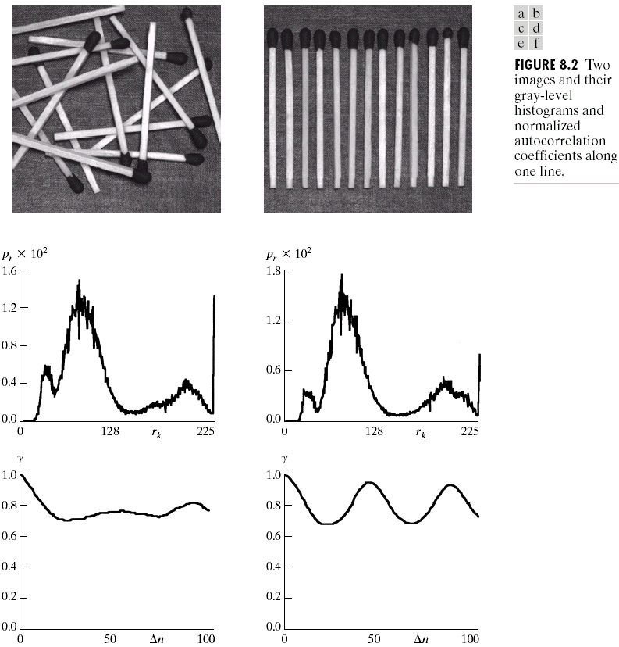
Chapter 8
Image Compression

Slide 28
RUN-LENGTH CODING (1-D)
Used for binary images
Length of the sequences of “ones” & “zeroes” are detected.
Assume that each row begins with a white(1) run.
Additional compression is achieved by variable length-coding (Huffman coding) the run-lengths.
Developed in 1950s and has become, along with its 2-D extensions, the standard approach in facsimile (FAX) coding.

Slide 29
Problems with run-length and LZW coding:
Imperfect digitizing
Vertical correlations are missed

Slide 30
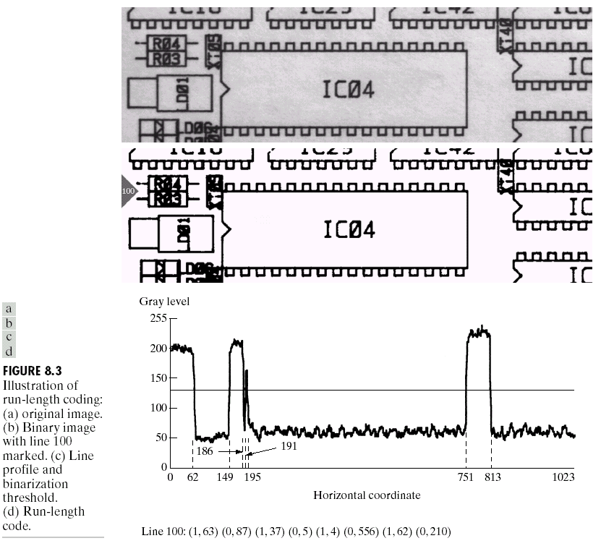

Slide 31
An m-bit gray scale image can be converted into m binary images by bit-plane slicing. These individual images are then encoded using run-length coding.
However, a small difference in the gray level of adjacent pixels can cause a disruption of the run of zeroes or ones.
Eg: Let us say one pixel has a gray level of 127 and the next pixel has a gray level of 128.
In binary: 127 = 01111111
& 128 = 10000000
Therefore a small change in gray level has decreased the run-lengths in all the bit-planes!

Slide 32
GRAY CODE
Gray coded images are free of this problem which affects images which are in binary format.
In gray code the representation of adjacent gray levels will differ only in one bit (unlike binary format where all the bits can change.

Slide 33
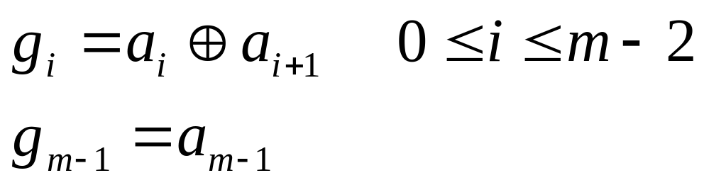
Let g_{m-1}…….g₁g₀ represent the gray code representation of a binary number.
Then:
In gray code:
127 = 01000000
128 = 11000000

Slide 34
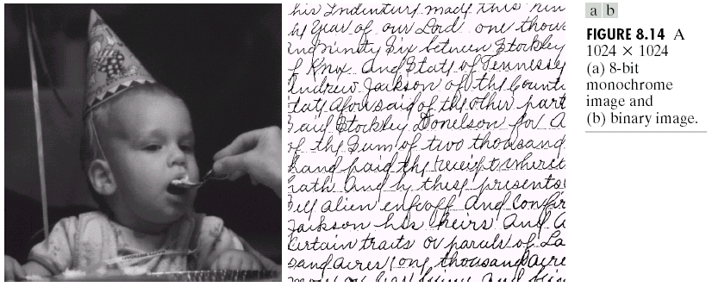

Slide 35
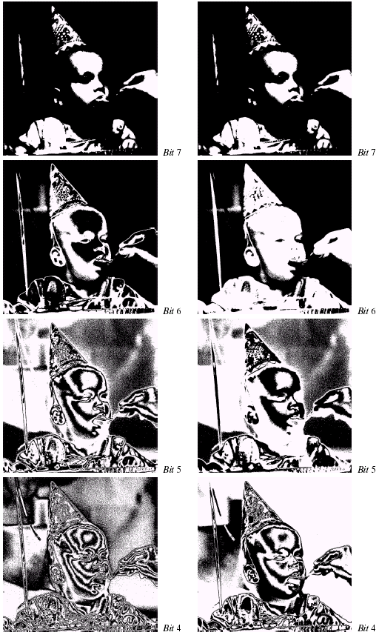
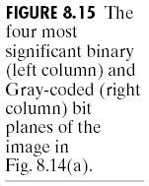

Slide 36
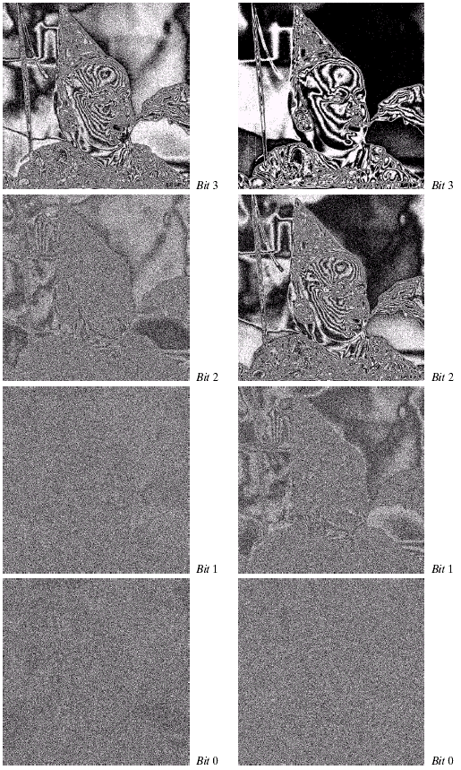
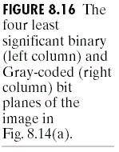

Slide 37
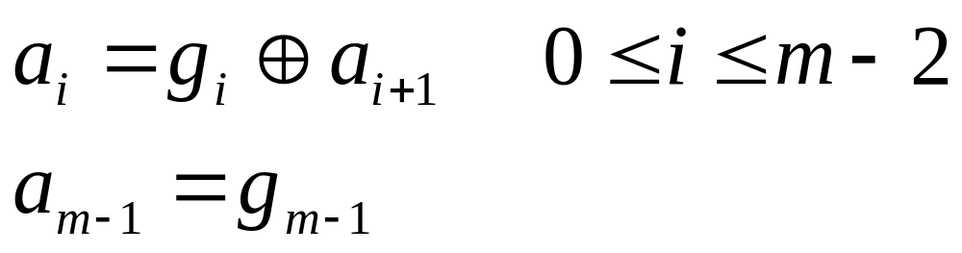
Decoding a gray coded image:
The MSB is retained as such,i.e.,

Slide 38
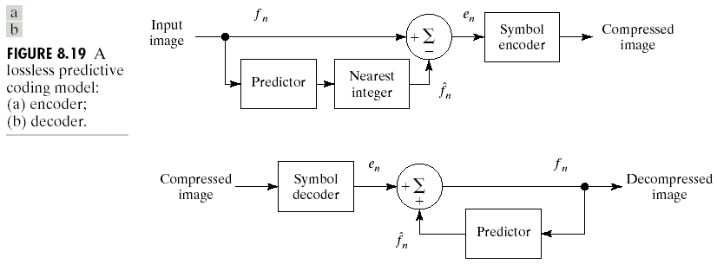
Lossless Predictive Coding

Slide 39

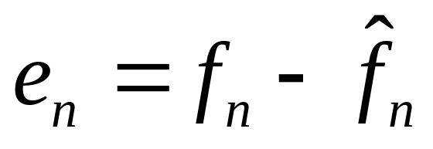
Based on eliminating the interpixel redundancy in an image
We extract and code only the new information in each pixel
New information is defined as the difference between the actual (f_{n}) and the predicted value, of that pixel.

Slide 40
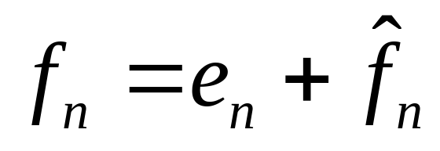
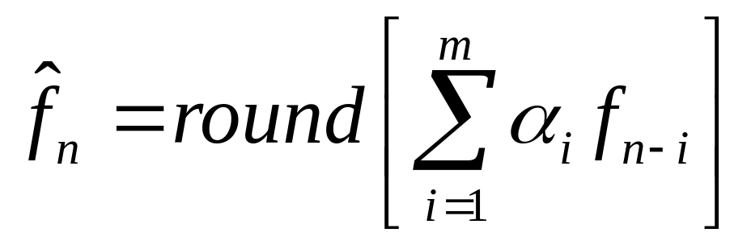
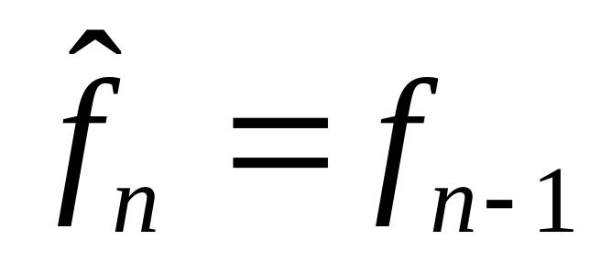
Decompression:
Most general form :
Most Simple form

Slide 41
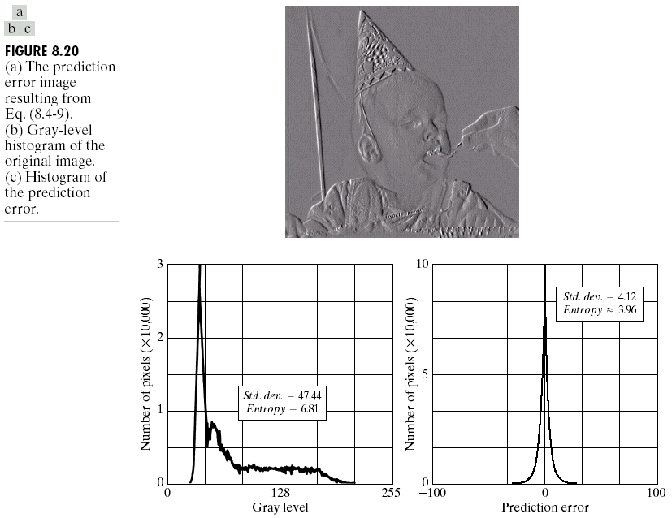
Example for Lossless Predictive coding

Slide 42
Lossy compression
Lossless compression usually gives a maximum compression of 3:1 (for monochrome images)
Lossy compression can give compression upto 100:1 (for recognizable monochrome images) 50:1 for virtually indistinguishable images
The popular JPEG (Joint Photographic Experts Group) format uses lossy transform-based compression.

Slide 43
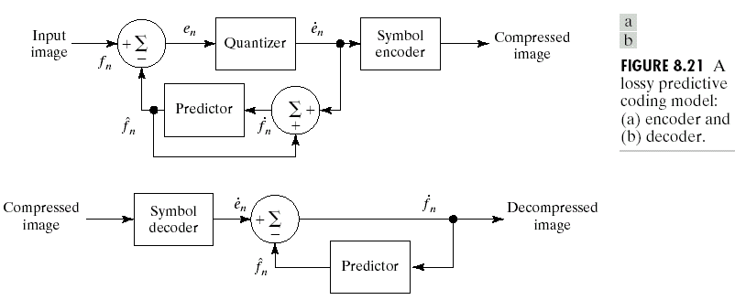
Lossy predictive Coding

Slide 44
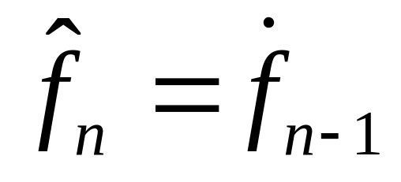
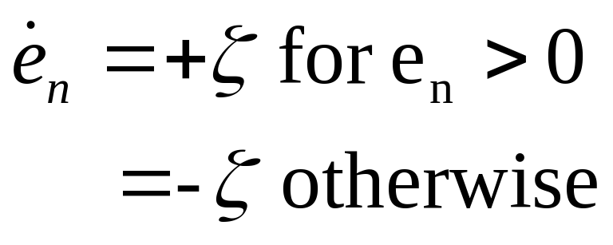
Delta modulation (DM) is a well-known form of lossy predictive coding in which the predictor and quantizer are defined as:

Slide 45
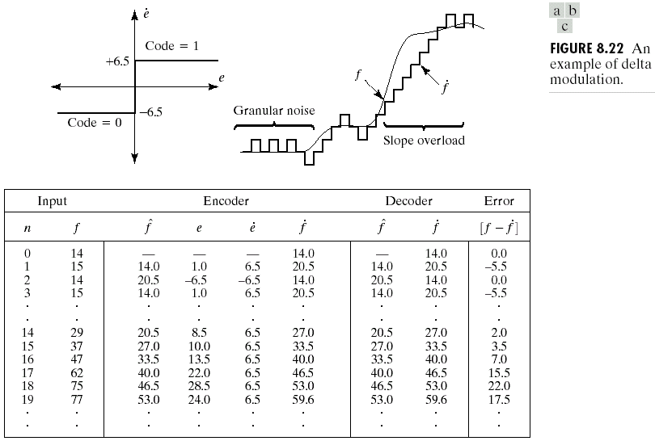
DELTA MODULATION

Slide 46
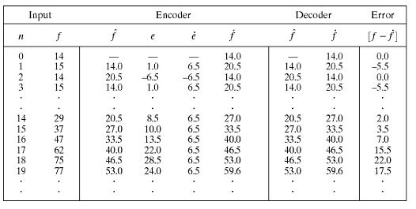

Slide 47
TRANSFORM CODING
A linear, reversible transform (such as the Fourier transform) is used to map the image into a set of transform co-efficients, which are then quantized and coded.
For most natural images, a significant number of (high frequency) coefficients have small magnitudes and can be coarsely quantized with little image distortion
Other than the DFT, we have the Discrete Cosine Transform (used in JPEG) and the Walsh Hadamard Transform

Slide 48
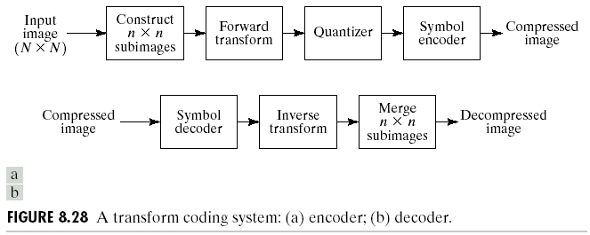
TRANSFORM CODING

Slide 49
THE JPEG STANDARD FOR LOSSLESS COMPRESSION
User chooses :
Huffman or Arithmetic code
One out of 8 predictive coding methods
Predict the next pixel on the line as having the same value as the last one.
Predict the next pixel on the line as having the same value as the pixel in this position on the previous line
Predict the next pixel on the line as having a value related to a combination of the previous , above and previous to the above pixel values.

Slide 50
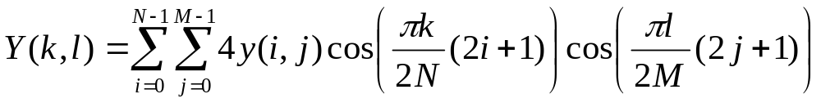
The JPEG Standard for Lossy Compression
The Lossy compression uses the Discrete Cosine Transform (DCT), defined as:
In the JPEG image reduction process, the DCT is applied to 8 by 8 pixel blocks of the image.
The lowest DCT coefficients are trimmed by setting them to zero.
The remaining coefficients are quantized (rounded off), some more coarsely than others.

Slide 51
Zig-zag coding is done after the quantization as shown below
4.32 | 3.12 | 3.01 | 2.41
2.74 | 2.11 | 1.92 | 1.55
2.11 | 1.33 | 0.32 | 0.11
1.62 | 0.44 | 0.03 | 0.02
4
3
3
2
3
2
2
2
2
1
0
0
2
0
0
0
4333222122200000

