Slide 1
Image Restoration

Slide 2
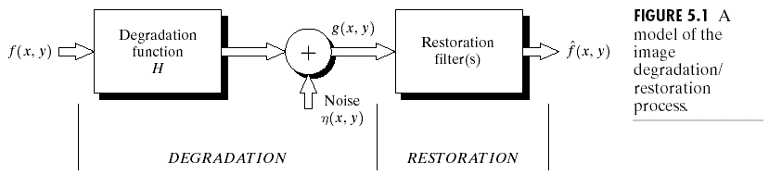
What is Image Restoration
The purpose of image restoration is to restore a degraded/distorted image to its original content and quality.
Distinctions to Image Enhancement
  Image restoration assumes a degradation model that is known or can be estimated.
  Original content and quality ≠ Good looking

Slide 3
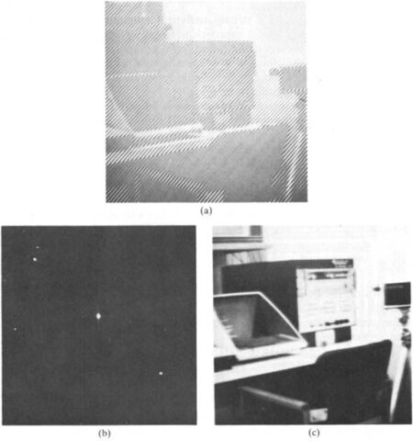
Interactive Restoration
Example 1 (periodic noise):
Manually detect peaks
In the spectrum and
Construct a band-reject
filter.

Slide 4
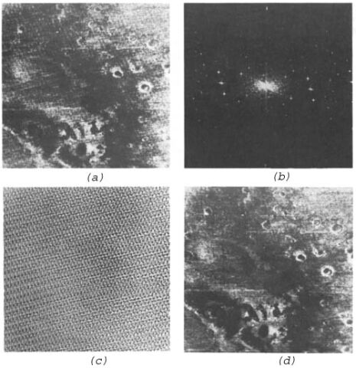
Interactive Restoration
Example 2:
Take the IDFT of the
peaks in the spectrum
and construct the noise
image (e.g. Image c here)
Subtract locally weighted
noise image from the
degraded image. The
weights can be estimated
by trying to minimize the
variance of the resulting
image
(a)Original (b) Spectrum (c) IDFT of the peaks (d) Result

Slide 5
Image Degradation Model
Spatial variant degradation model
Spatial-invariant degradation model
  Frequency domain representation

Slide 6
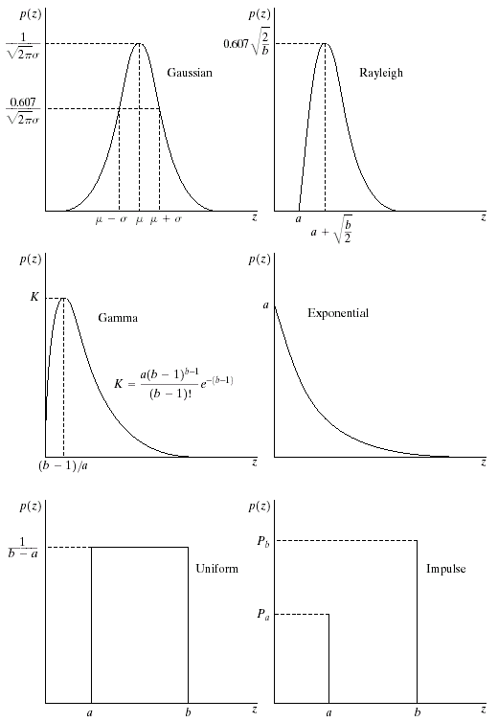
Noise Models
Most types of noise are modeled as known probability density functions
Noise model is decided based on understanding of the physics of the sources of noise.
  Gaussian: poor illumination
  Rayleigh: range image
  Gamma, exp: laser imaging
  Impulse: faulty switch during imaging,
  Uniform is least used.
Parameters can be estimated based on histogram on small flat area of an image

Slide 7
Noise Removal Restoration Method
Mean filters
  Arithmetic mean filter
  Geometric mean filter
  Harmonic mean filter
  Contra-harmonic mean filter
Order statistics filters
  Median filter
  Max and min filters
  Mid-point filter
  alpha-trimmed filters
Adaptive filters
  Adaptive local noise reduction filter
  Adaptive median filter

Slide 8
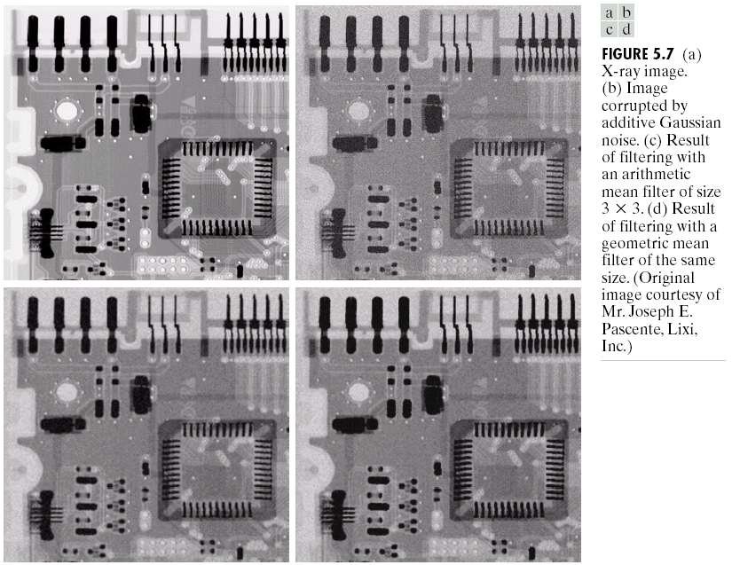
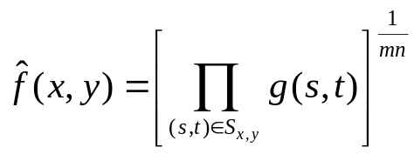
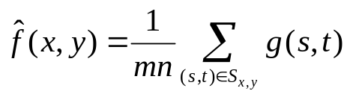
Mean Filters

Slide 9
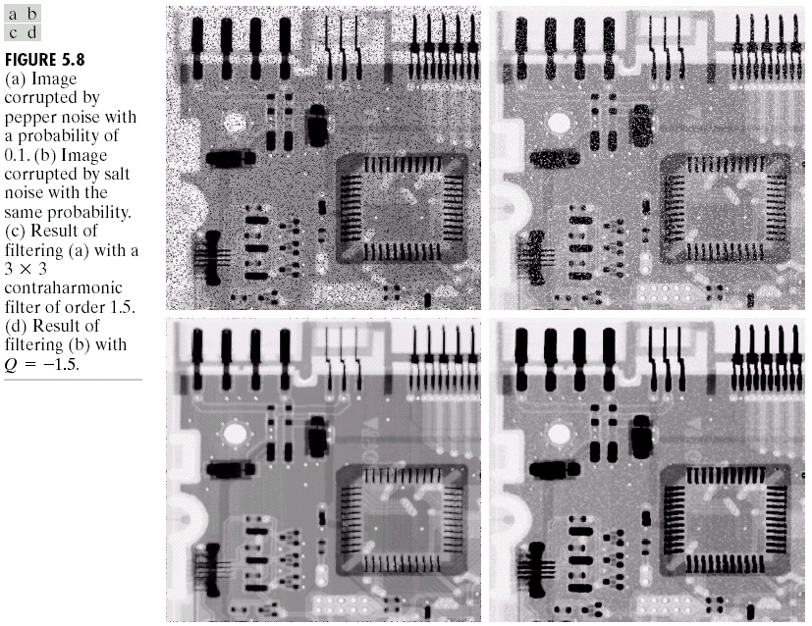
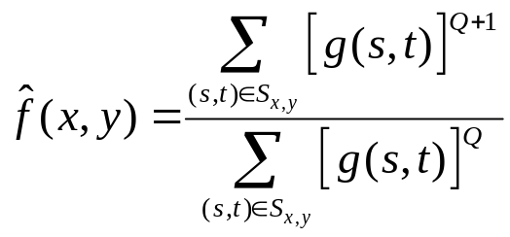
Contra-Harmonic Filters

Slide 10
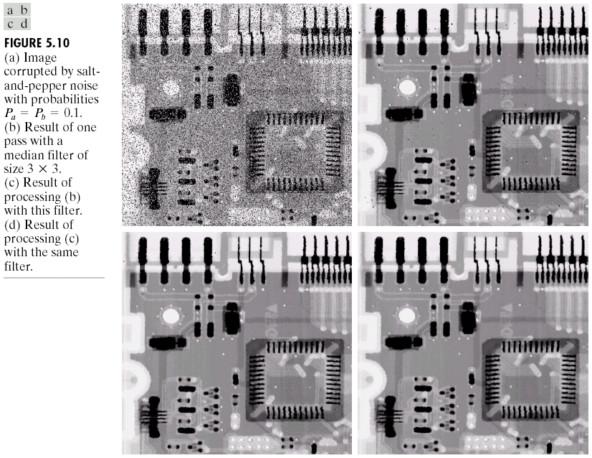
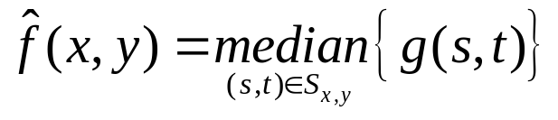
Median Filter
Effective for removing salt-and-paper (impulsive) noise.

Slide 11
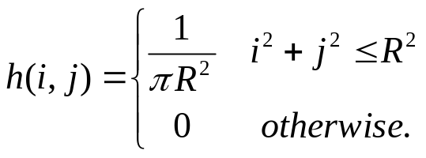
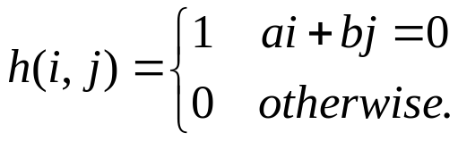
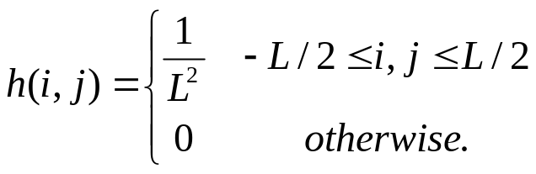
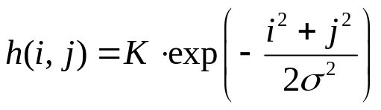
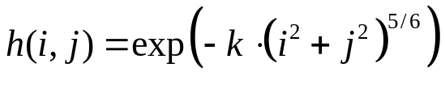
LSI Degradation Models
(Linear Space Invariant)
Motion Blur
  Due to camera panning or fast motion
Atmospheric turbulence blur
  Due to long exposure time through atmosphere
  Hufnagel and Stanley
Uniform out-of-focus blur:

Slide 12
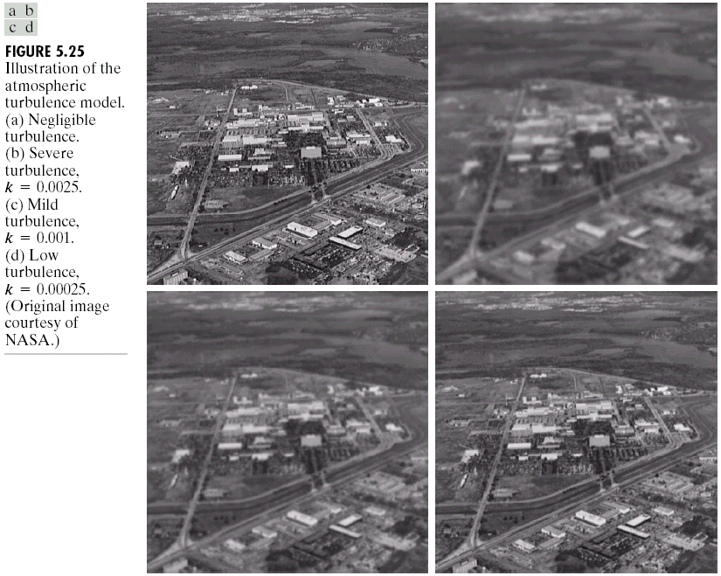
Turbulence Blur Examples

Slide 13
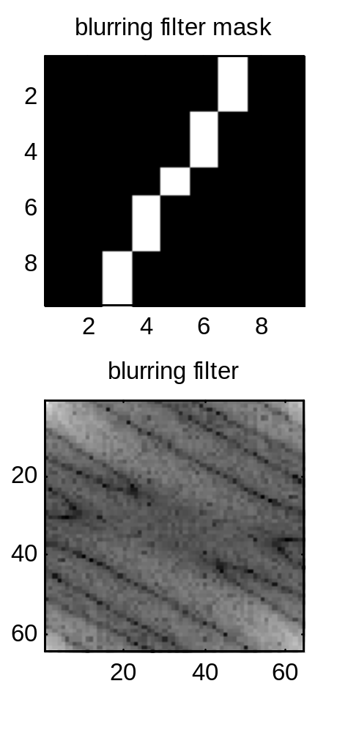
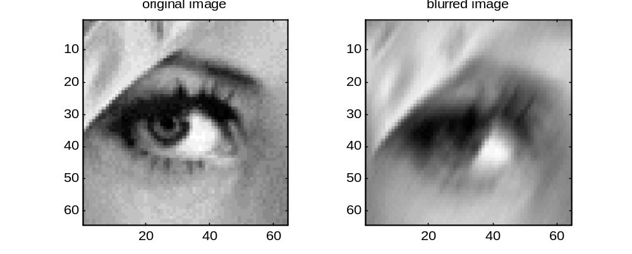
Motion Blur
Often due to camera panning or fast object motion.
Linear along a specific direction.
Blurdemo.m

Slide 14
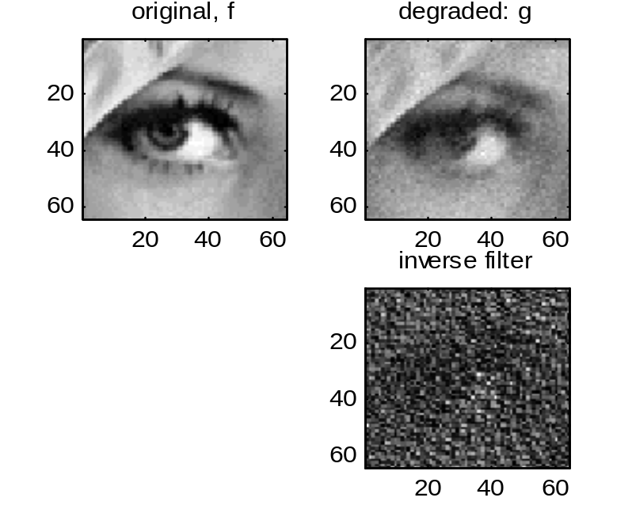
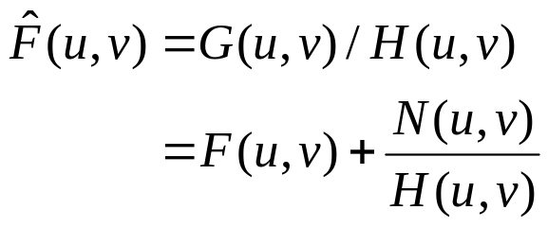
Inverse Filter
Recall the degradation model:
Given H(u,v), one may directly estimate the original image by
At (u,v) where H(u,v) ≈ 0, the noise N(u,v) term will be amplified!
Invfildemo.m

Slide 15
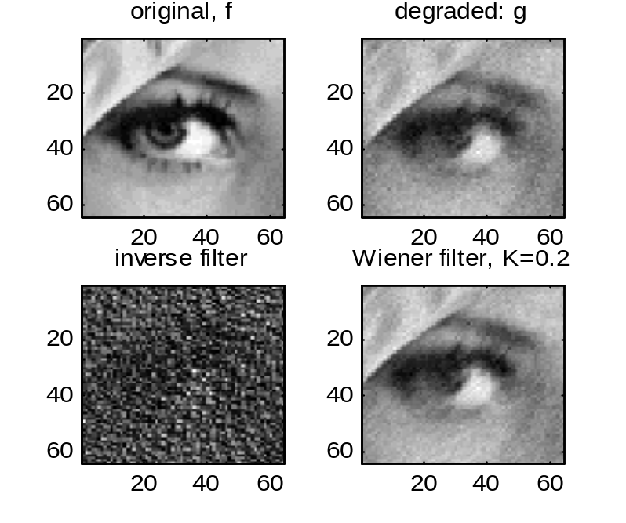
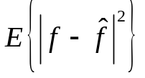
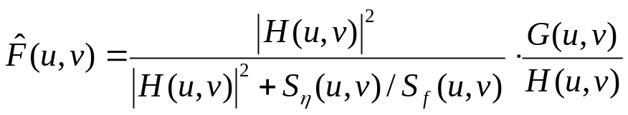
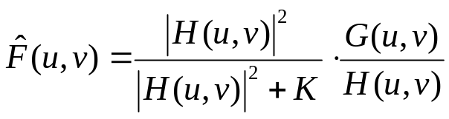
Wiener Filtering (Least Mean Square Filtering)
Minimum mean-square error filter
  Assume f and η are both 2D random sequences, uncorrelated to each other.
  Goal: to minimize
  Solution: Frequency selective scaling of inverse filter solution!
  White noise, unknown S_{f}(u,v):

Slide 16
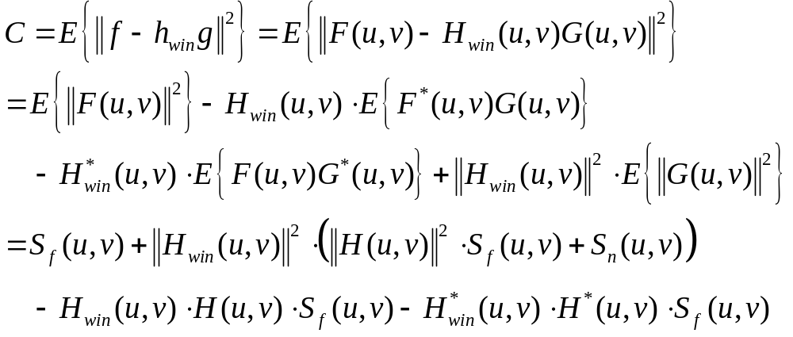
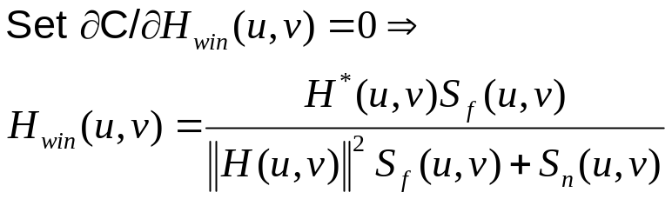
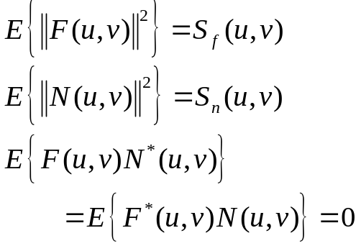
Derivation of Wiener Filters
Given the degraded image g, the Wiener filter is an optimal filter h_{win} such that E{|| f – h_{win**}g||²} is minimized.
Assume that f and η are uncorrelated zero mean stationary 2D random sequences with known power spectrum S_{f} and S_{n}. Thus,
**

Slide 17
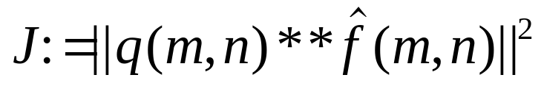

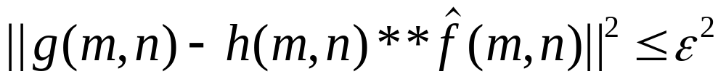

Constrained Least Square (CLS) Filter
Minimize:
where is an operator that measures the “roughness” (e.g. a second derivative operator)
Subject to constraint:
where

Slide 18
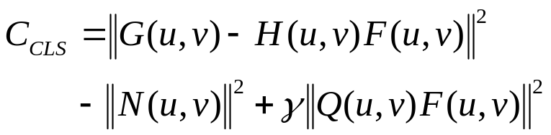

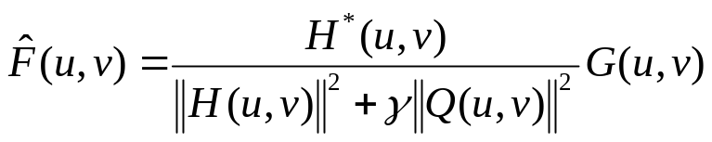
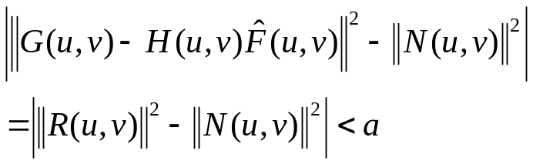
Solution and Iterative Algorithm
Iterative algorithm (Hunt)
1. Set initial value of γ,
2. Find , and compute R(u,v).
3. If ||R||² - ||N||² < - a, set γ = B_{L}, increase γ, else if
||R||² - ||N||² > a, set γ = B_{u}, decrease γ , else stop iteration.
4. γ_{new} = (B_{u}+B_{L})/2, go to step 2.
To minimize C_{CLS}, Set
∂C_{CLS}/ ∂F = 0. This yields
The value of γ however, has to be determined iteratively! It should be chosen such that

Slide 19
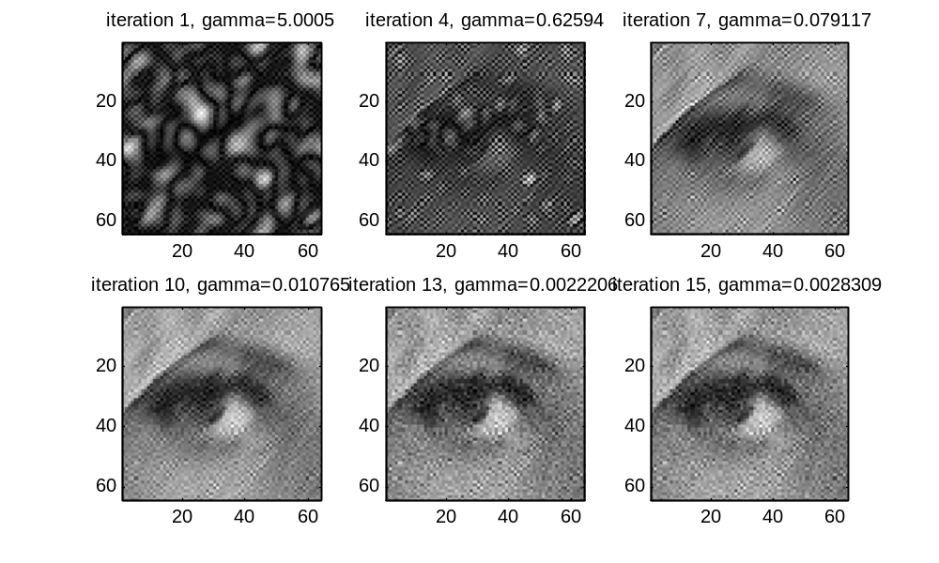
CLS Demonstration

