Slide 1
Digital Image Processing
“The EYE: Seeing is Believing”
Deepak Kumar Rout
Assistant Professor
Image Analysis & Computer Vision Lab
Dept. of Electronics & Telecommunication Engineering
www.deepakrout.webs.com

Slide 2
The Human Eye and Vision
The structure of the eye
  Iris
  Cornea
  Lens
Focusing
  Cornea
  Accommodation
The Retina
  Photoreceptors
  Processing time
  Sensitivity

Slide 6
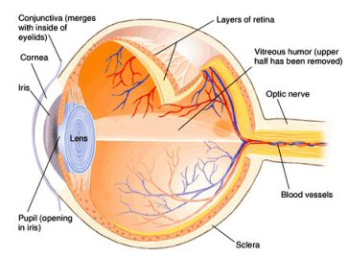
Structure of the Eye
The iris is roughly equivalent to the diaphragm in a camera, the cornea and the lens are both lens-like objects, and the retina is where the image is recorded, similar to a CCD sensor or film.

Slide 7
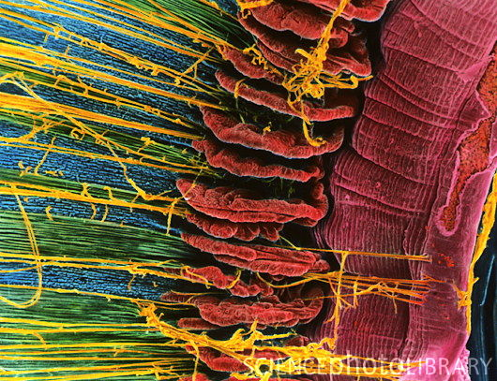
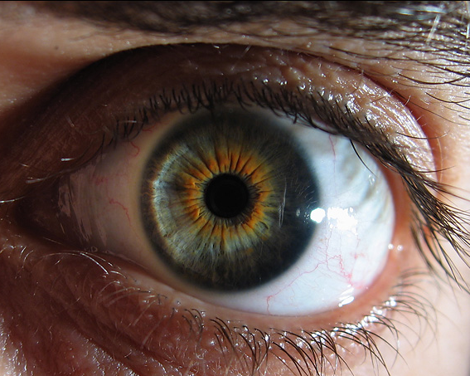
Structure of the Eye: Iris
The iris is similar to the diaphragm in a camera
Your iris widens in dim light and narrows in bright light
The f-number of your eye varies from f/2 (large opening) to f/8 (small opening)
Compare this to the range of an average camera lens, which may have f-numbers from f/2.8 to f/22.

Slide 8
Structure of the Eye: Iris
With a range of only f/2 – f/8, your iris can only reduce the light coming into your eye by a factor of 20.
The range of intensities that your eye can respond to is a factor of 10¹³
The main function of the iris is not to control the intensity of light coming into your eye
Main functions of iris
  Reduce aberrations, sharpen image
  Increase depth of field

Slide 9


Structure of the Eye: Cornea and Lens
Retina
Cornea
Eyelens
There are two lenses in your eye, the cornea and the eyelens.
The cornea, the front surface of the eye, does most of the focusing in your eye
The eyelens provides adjustable fine-tuning of the focus

Slide 10
Structure of the Eye: Cornea and Lens
Retina
cornea: n ≈ 1.4
eyelens: n ≈ 1.4
air: n = 1
humors: n ≈ 1.3
This is because the cornea-air surface has a large change in the index of refraction, so light bends a lot
The power of the cornea lens is ~43 diopters (focal length 2.3 cm)
The eyelens is surrounded by the humors, which have a very similar index of refraction as the lens itself.

Slide 11

How a Camera Lens Focuses
A camera is focused by changing the distance, x_{i}, from the lens to the image at the back on the film or CCD as the distance to the object, x_{o}, changes.
Focal length (fixed)
Object distance
(varies)
Image distance
(changes to satisfy equation when x_{o} changes)

Slide 12

How Your Eye Focuses
The eyelens is a fixed, unchanging distance, x_{i}, from the retina at the back of the eyeball where the image is created
Object distance
(varies)
Focal length (changed to satisfy the equation when x_{o} changes)
Image distance (fixed)

Slide 13
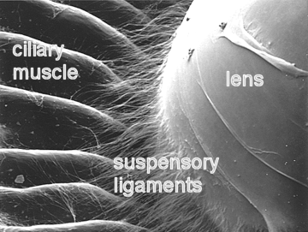
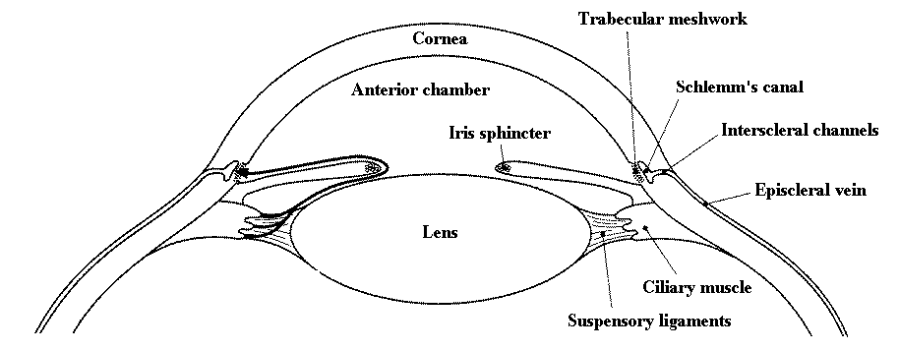
The Eyelens: Accommodation
The eyelens changes its focal length by changing its shape. Ligaments pull on the lens to change the amount of “bulge”

Slide 14
Eyelens: Accommodation
Muscles contract, ligaments relax, more bulge, more bending power, shorter focal length
Ligaments
Eyelens
Muscles relax, ligaments contract, less bulge, less bending power, longer focal length

Slide 15
How Your Eyelens Focuses
Your eyelens has a small depth of field
  You can't see something close and far with both objects in focus at the same time
Hold out your thumb about a foot away from your eye
  Then, alternately focus on thumb and me (right above your thumb)
Note that you cannot see both me and your thumb sharply (in focus) at the same time
  You focus on one or the other by changing the bulge of your eyelens

Slide 16



Accommodation
thumb is out of focus
less bulgy, longer f
professor is in focus
thumb is in focus
more bulgy, shorter f
professor is out of focus

Slide 17
Concept Questions on Focusing
You can't see the Flatirons and your thumb clearly at the same time
  because your pupil is too small
  because your iris can't change fast enough
  because your eye cannot accommodate
  because your eye does not have enough depth of field

Slide 18
Concept Questions on Focusing
When you see someone out-of-focus
  There is no image anywhere
  There is an in-focus image on your fovea
  There is an out-focus image on your retina
  There is an image in-focus either in front or in back of your retina

Slide 19
Concept Questions on Focusing
In order to focus on close objects
  your eyelens needs to bulge
  your eyelens needs to flatten
  your cornea needs to bulge
  your cornea needs to flatten
  the distance (x_{i}) between your eyelens and retina needs to change

Slide 20
Structure of the Eye: Retina
The retina is the sensor or film of your eye.
Its layers do three things
  Provide blood and nutrients (choroid)
  Absorb light and convert to an electrical signal (photoreceptors)
  Transfer the signal to the brain (nerve cells)
Light
Plexiform layer (nerve cells)
Rods and Cones (photoreceptors)
Choroid (blood vessels)

Slide 21
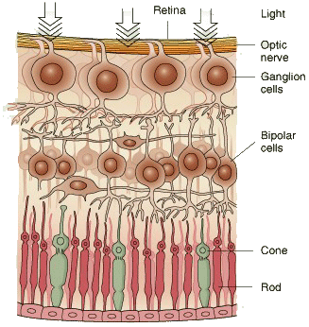
Structure of the Retina
Light
← Nerve cells
← Photoreceptors
← Choroid

Slide 22
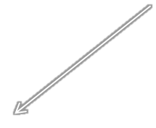
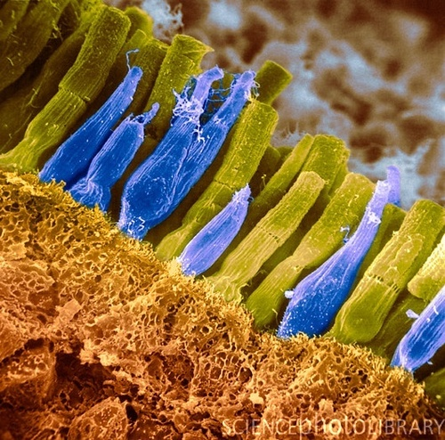
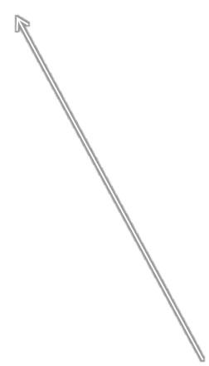
Photoreceptors: Rods and Cones
rod
Light is detected and converted to an electrical signal by the photoreceptors in the retina. There are two main kinds of receptors, rods and cones
This is a false color image, rods and cones are not actually different colors
cone

Slide 23
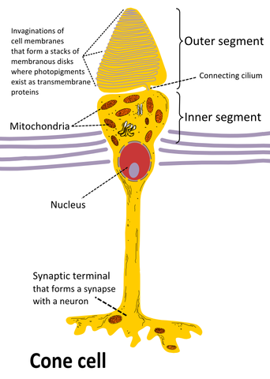
Photoreceptors: Cones
Cones are responsible for our fine detailed and color vision
Cones are clustered near the center of your retina, called the fovea
There are 5 million cones in the average retina

Slide 24
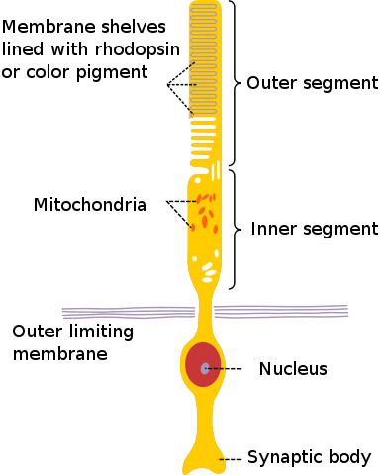
Photoreceptors: Rods
Rods are responsible for low light and peripheral vision
They are present everywhere in the retina except the fovea
There are 125 million rods in the average retina

Slide 25
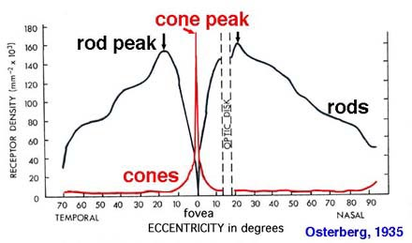
Rods and Cones
Because of their different functions, rods and cones are present in varying densities in the retina. The blind spot is due to the connection of the optic nerve

Slide 26
Processing Time: Shutter Speed?
The closest thing your eye has to a shutter speed is called “persistance of response”
This is the time during which the photoreceptor is active and responding to light
It varies between ¹/₂₅ s in low light to ¹/₅₀ s in bright light
Compare this to a camera, which has shutter speeds from more than 1 s to ¹/₁₀₀₀ s

Slide 27
Light Sensitivity
We said earlier that your eye can respond to a range of light intensities (basically “brightnesses”) that vary by a factor of 10¹³
Clearly the iris and the response time of the photoreceptors is not enough to allow this
How then do our eyes respond to such an enormous range of light intensities?

Slide 28
Light Sensitivity: Analogy to Film Speed
We didn’t talk about film, but for those of you who know about it:
In low light, you can use “fast” film, which has lower resolution (coarser grain) and is often black and white
In bright light, you can use “slow” film, which is fine grain and color
In it is not practical to change the film in your camera every time you walk from a dark building out into the sun, but this is what your retina does!

Slide 29
Light Sensitivity
Remember we talked about rods and cones
Cones:
  Sensitive to bright light, photopic conditions
  Densely packed in the fovea
  Only a few cones per nerve fiber
Rods:
  Sensitive to low light, scotopic conditions
  Widely distributed across the retina
  Up to 1000s of rods per nerve fiber (think of this as many many drops falling into the same pipe, one drop can’t be detected, but many drops generate some water flow that can be measured)

Slide 30
Dark Adaption
Even within the cone and rod system, your retina adjusts its sensitivity in response to the overall light level
When you walk into a dark room, you can’t see anything, but after a few minutes, you adapt and can start to see things
When you walk out into the bright sunlight, everything is blindingly white, but gradually things look “normal” again

Slide 31
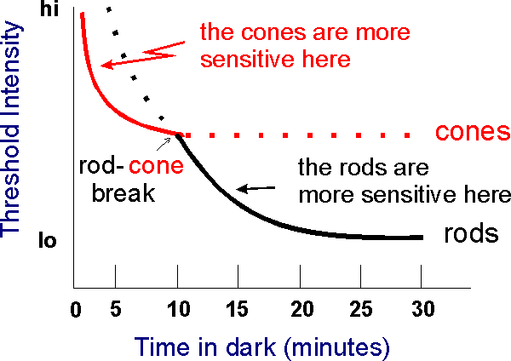
Dark Adaptation
Object must be very bright to be seen
Dim objects can be seen

Slide 32


Dark Adaptation
After about thirty minutes, your eyes are completely dark adapted and can see an amount of light equivalent to a candle 10 miles away.
Dark adaptation is a slow process, but allows us to see in a huge range of light levels
10 miles!

Slide 33
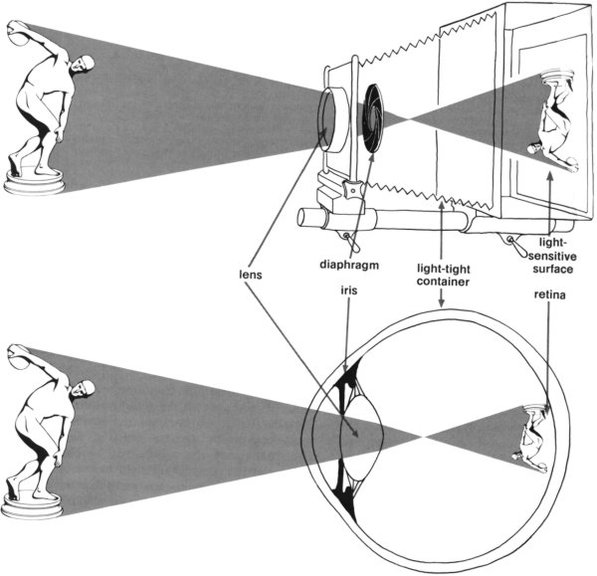
Eye and Camera: A comparison

