Slide 1
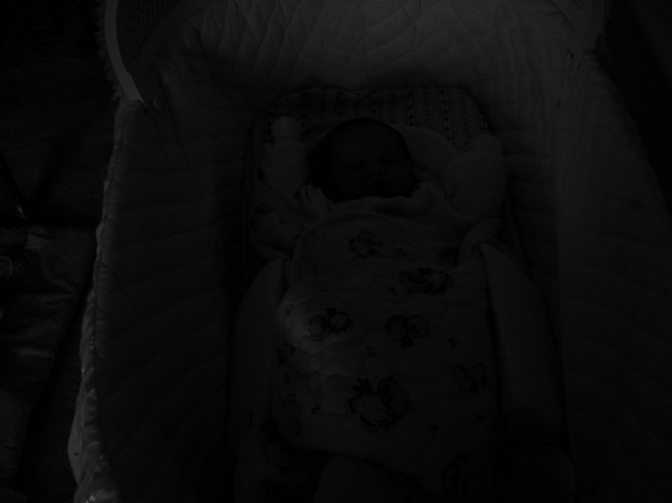
Image is NOT Perfect Sometimes
Introduction to Digital Image Processing

Slide 2
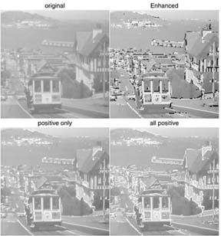
Image Enhancement for Visually Impaired Patients
http://www.eri.harvard.edu/faculty/peli/projects/enhancement.html

Slide 3
Image Enhancement
Introduction
Spatial domain techniques
    Point operations
    Histogram equalization and matching
    Applications of histogram-based enhancement
Frequency domain techniques
    Unsharp masking
    Homomorphic filtering*

Slide 4
Recall:
There is no boundary of imagination in the virtual world
In addition to geometric transformation (warping) techniques, we can also photometrically transform images
  Ad-hoc tools: point operations
  Systematic tools: histogram-based methods
  Applications: repair under-exposed or over-exposed photos, increase the contrast of iris images to facilitate recognition, enhance microarray images to facilitate segmentation.

Slide 5
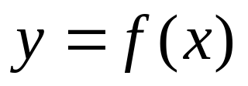
Point Operations Overview
Point operations are zero-memory operations where
a given gray level x∈[0,L] is mapped to another
gray level y∈[0,L] according to a transformation
y
L
x
L
L=255: for grayscale images

Slide 6
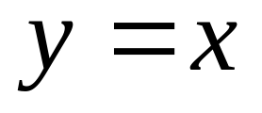
Lazy Man Operation
y
L
x
L
No influence on visual quality at all

Slide 7

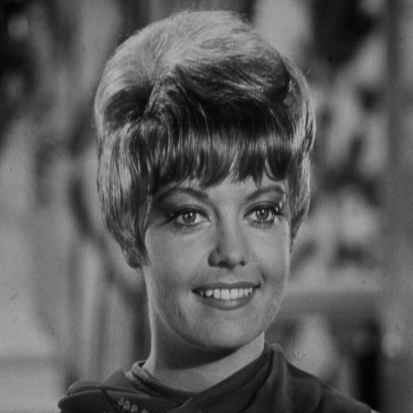
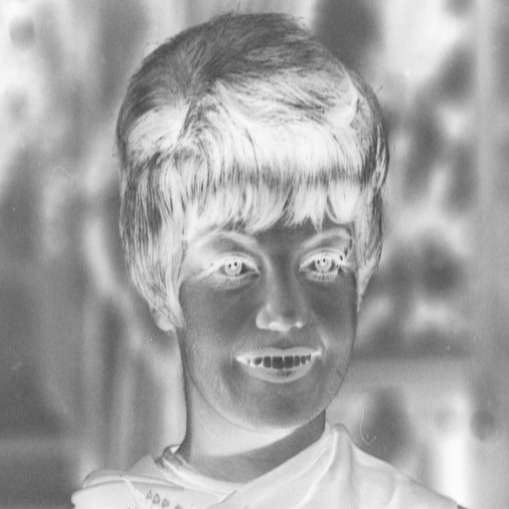
Digital Negative
L
x
0
L

Slide 8
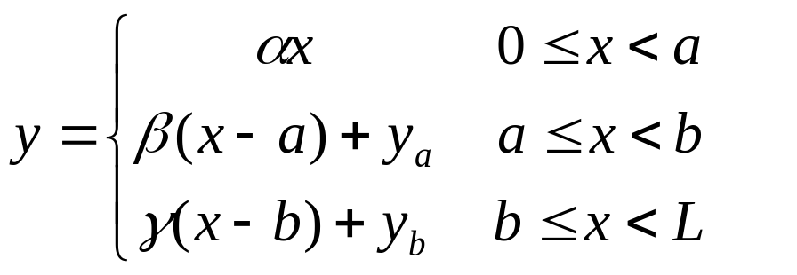
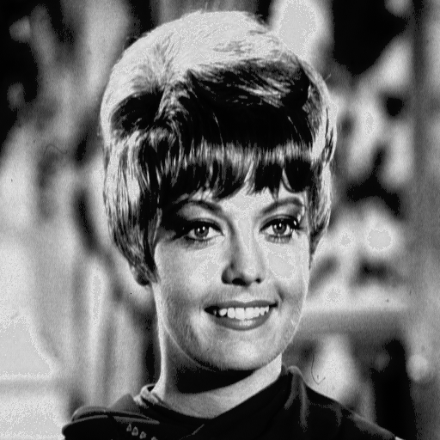
Contrast Stretching
y_{b}
y_{a}
a
b
x
0
L

Slide 9
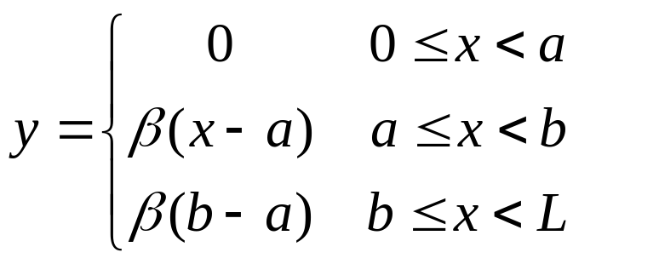
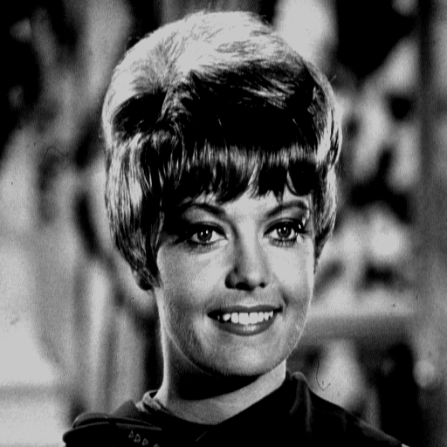

Clipping
a
b
x
0
L

Slide 10
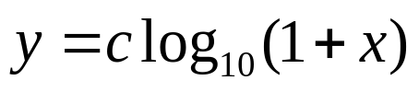
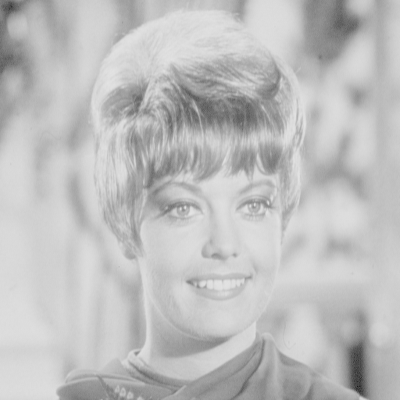
Range Compression
x
0
L
c=100

Slide 11
Summary of Point Operation
So far, we have discussed various forms of mapping function f(x) that leads to different enhancement results
  MATLAB function >imadjust
The natural question is: How to select an appropriate f(x) for an arbitrary image?
One systematic solution is based on the histogram information of an image
  Histogram equalization and specification

Slide 12
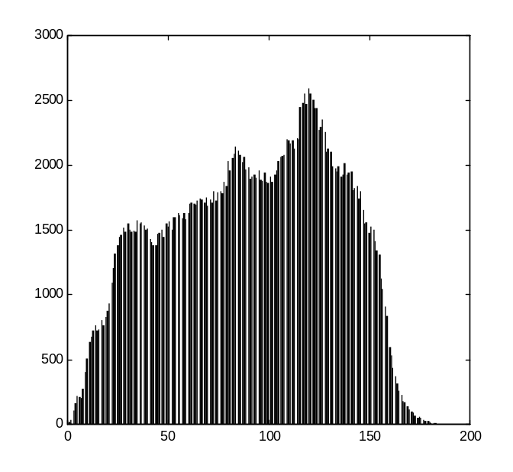
Histogram based Enhancement
Histogram of an image represents the relative frequency
of occurrence of various gray levels in the image
MATLAB function >imhist(x)

Slide 13
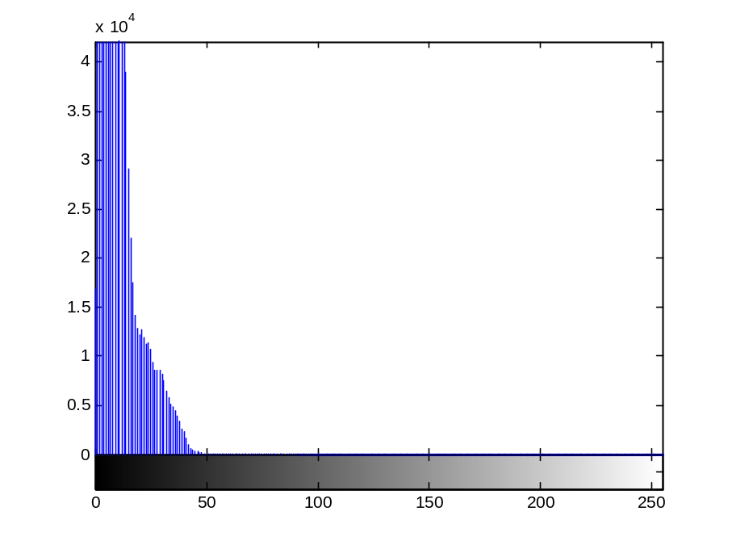
Why Histogram?
It is a baby in the cradle!
Histogram information reveals that image is under-exposed

Slide 14
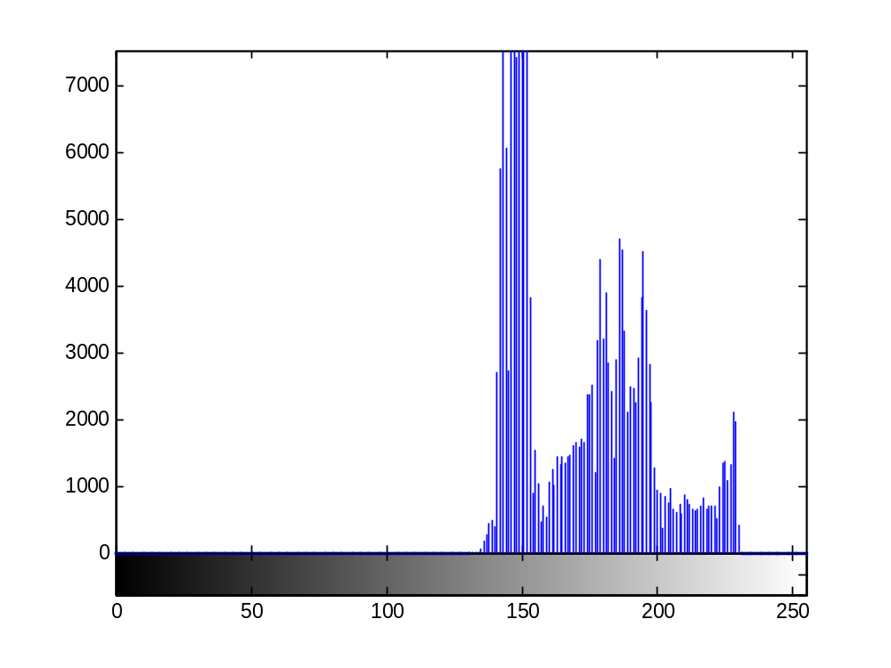
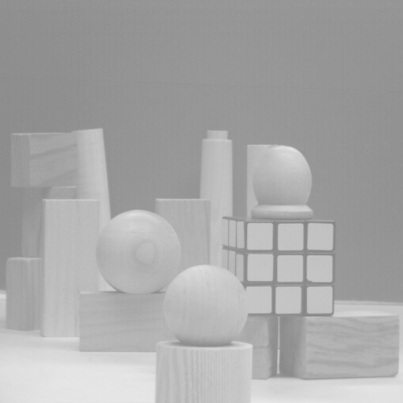
Another Example
Over-exposed image

Slide 15
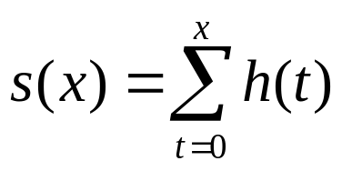
How to Adjust the Image?
Histogram equalization
  Basic idea: find a map f(x) such that the histogram of the modified (equalized) image is flat (uniform).
  Key motivation: cumulative probability function (cdf) of a random variable approximates a uniform distribution
Suppose h(t) is the histogram (pdf)

Slide 16
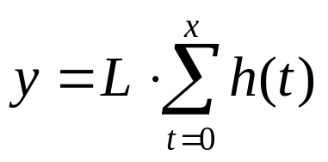
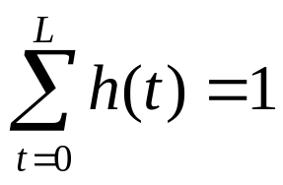
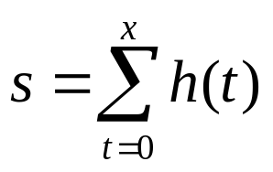
Histogram Equalization
Uniform
Quantization
Note:
y
cumulative probability function
L
1
x
0
L
http://en.wikipedia.org/wiki/Inverse_transform_sampling

Slide 17
MATLAB Implementation
function y=hist_eq(x)
[M,N]=size(x);
for i=1:256
h(i)=sum(sum(x= =i-1));
End
y=x;s=sum(h);
for i=1:256
I=find(x= =i-1);
y(I)=sum(h(1:i))/s*255;
end
Calculate the histogram
of the input image
Perform histogram
equalization

Slide 18
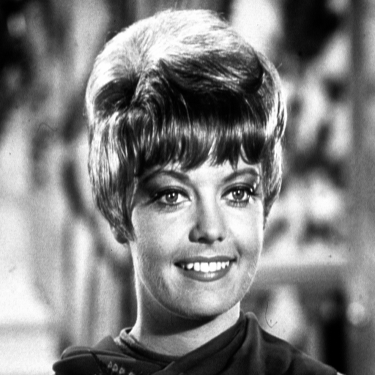
Image Example
before
after

Slide 19
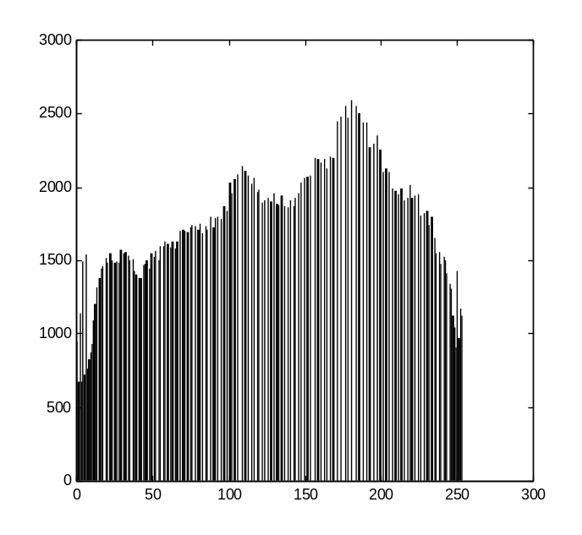
Histogram Comparison
before equalization
after equalization

Slide 20
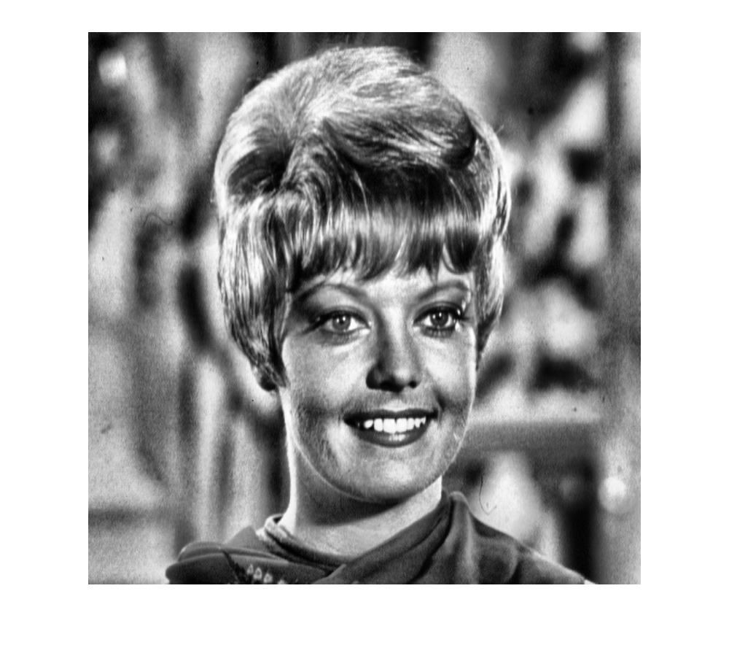
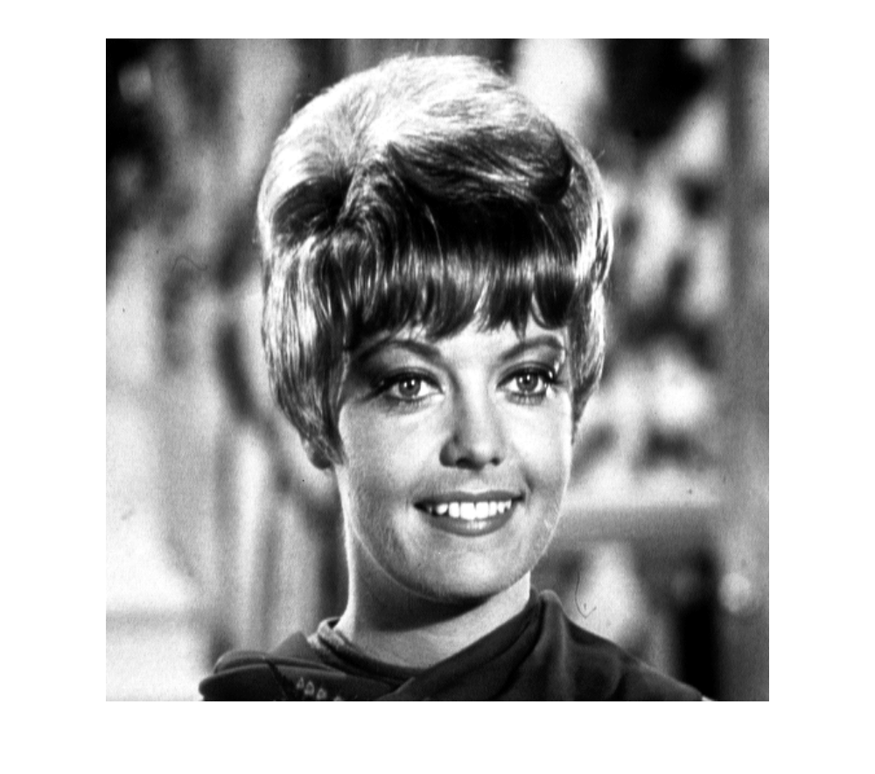
Adaptive Histogram Equalization
http://en.wikipedia.org/wiki/Adaptive_histogram_equalization

Slide 21
Histogram Specification/Matching
Given a target image B, how to modify a given image A such that
the histogram of the modified A can match that of target image B?
histogram₁
histogram₂
S⁻¹*T
T
S
?

Slide 22
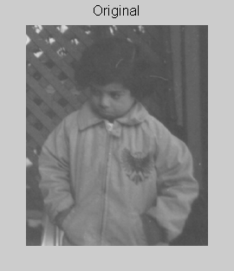
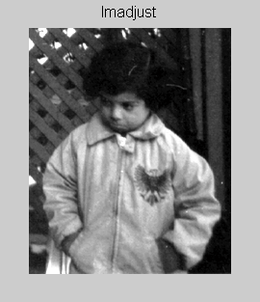
Application (I): Digital Photography

Slide 23
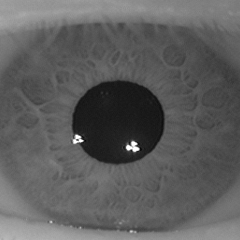
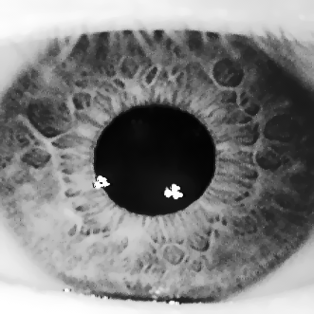
Application (II): Iris Recognition
before
after

Slide 24
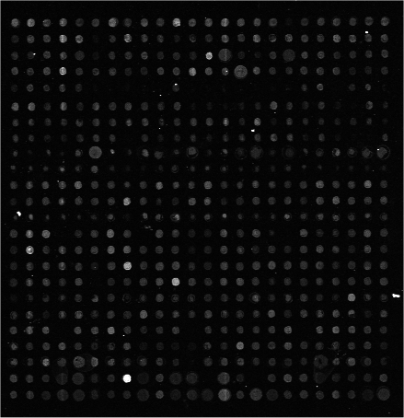
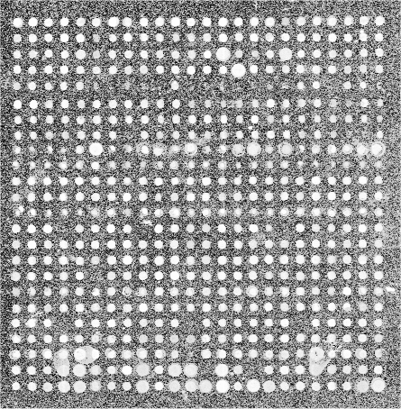
Application (III): Microarray Techniques
before
after

Slide 25
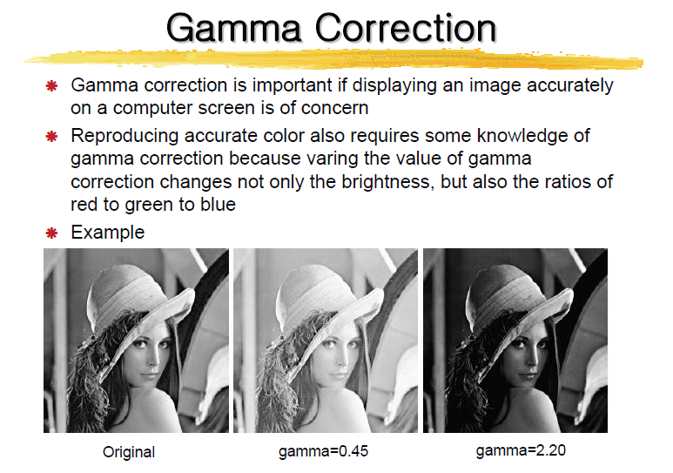
Application (IV)

Slide 26
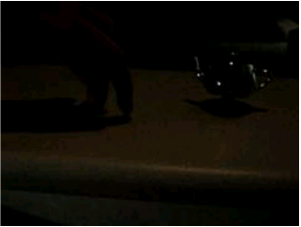
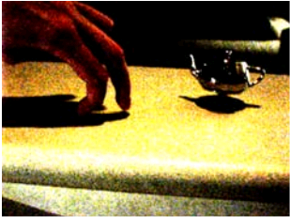
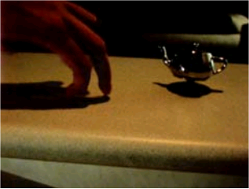
Application (V): Entertainment
Adaptive histogram
-equalized¹
Histogram-equalized
LDR video
¹Eric P. Bennett and Leonard McMillan. “Video enhancement using per-pixel virtual exposures,” In ACM SIGGRAPH 2005

Slide 27
Image Enhancement
Introduction
Spatial domain techniques
    Point operations
    Histogram equalization and matching
    Applications of histogram-based enhancement
Frequency domain techniques
    Unsharp masking
    Homomorphic filtering*

Slide 28
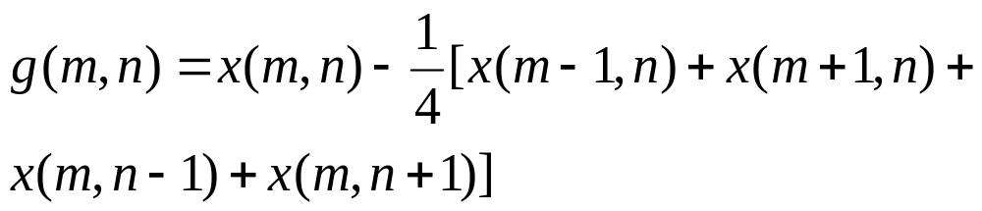
Frequency-Domain Techniques (I): Unsharp Masking
g(m,n) is a high-pass filtered version of x(m,n)
• Example (Laplacian operator)

Slide 29
MATLAB Implementation
% Implementation of Unsharp masking
function y=unsharp_masking(x,lambda)
% Laplacian operation
h=[0 -1 0;-1 4 -1;0 -1 0]/4;
dx=filter2(h,x);
y=x+lambda*dx;

Slide 30
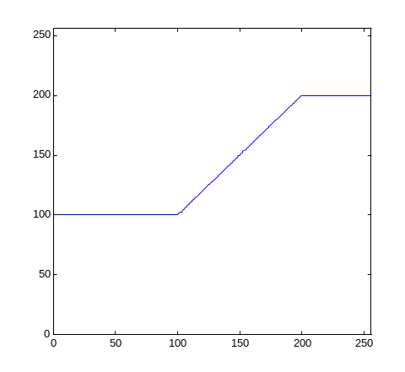
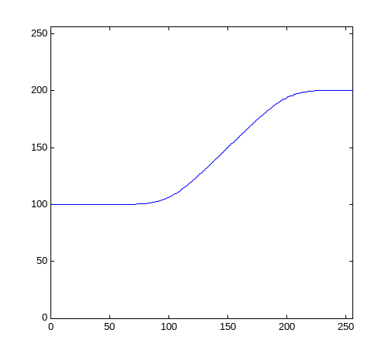
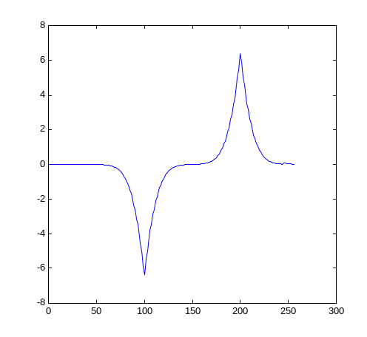
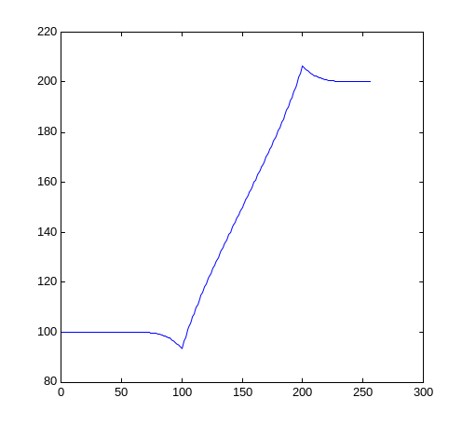

1D Example
x(n)
x_{lp}(n)
g(n)=x(n)-x_{lp}(n)

Slide 31
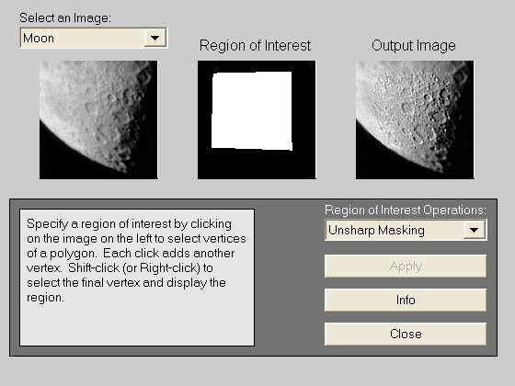
2D Example
MATLAB command
>roidemo

Slide 32



Frequency-Domain Techniques (II): Homomorphic filtering
Basic idea:
Illumination
(low freq.)
reflectance
(high freq.)
freq. domain enhancement

Slide 33
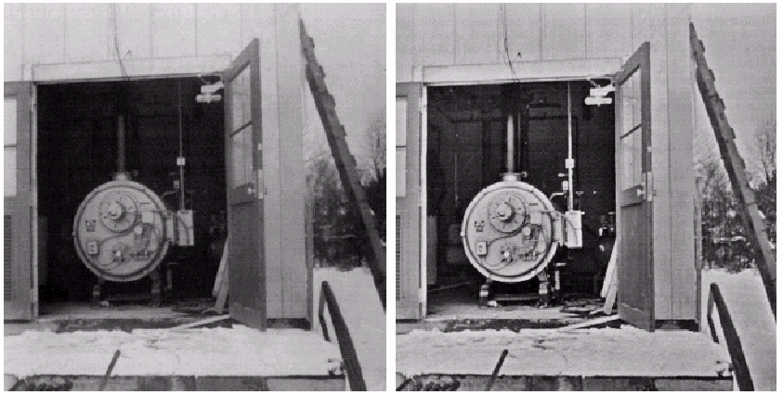
Image Example
before
after

Slide 34
Summary of Nonlinear Image Enhancement
Understand how image degradation occurs first
  Play detective: look at histogram distribution, noise statistics, frequency-domain coefficients…
  Model image degradation mathematically and try inverse-engineering
Visual quality is often the simplest way of evaluating the effectiveness, but it will be more desirable to measure the performance at a system level
  Iris recognition: ROC curve of overall system
  Microarray: ground-truth of microarray image segmentation result provided by biologists

