Slide 1
Fundamentals of
Image Processing I
Computers in Microscopy, 14-17 September 1998
David Holburn University Engineering Department, Cambridge

Slide 2
Why Computers in Microscopy?
This is the era of low-cost computer hardware
Allows diagnosis/analysis of images quantitatively
Compensate for defects in imaging process (restoration)
Certain techniques impossible any other way
Speed & reduced specimen irradiation
Avoidance of human error
Consistency and repeatability

Slide 3
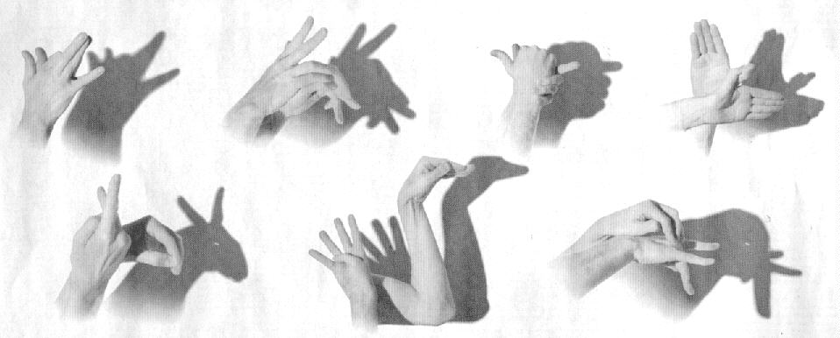
Digital Imaging
Digital Imaging has moved on a shade . . .

Slide 4
Digital Images
A natural image is a continuous, 2-dimensional distribution of brightness (or some other physical effect).
Conversion of natural images into digital form involves two key processes, jointly referred to as digitisation:
  Sampling
  Quantisation
Both involve loss of image fidelity i.e. approximations.
Notes:
An image is a representation, likeness or imitation of an object; e.g.
f(x,y) = i(x,y) r(x,y) s(x,y)
where in this hypothetical case i(x,y) represents the light incident on the scene; r(x,y) the ability of the scene to reflect light; s(x,y) the sensitivity of the imaging instrument.
In natural images, the range and domain of the function f(x,y) are finite and non-zero.
A GREY LEVEL is a specific value of brightness
The GREYSCALE is the set of acceptable grey levels
Conversion of continuous natural images into digital form involves two key processes:-
1. Sampling | Jointly referred
2. Quantisation | to as DIGITISATION
Both of these operations represent approximations; i.e. they result in a loss of fidelity and of information from the image.

Slide 5
Sampling
Sampling represents the image by measurements at regularly spaced sample intervals. Two important criteria:-
  Sampling interval
    distance between sample points or pixels
  Tessellation
    the pattern of sampling points
The number of pixels in the image is called the resolution of the image. If the number of pixels is too small, individual pixels can be seen and other undesired effects (e.g. aliasing) may be evident.
Notes:
Sampling represents the image by measurements at regularly spaced intervals. The samples are usually treated as small, often rectangular or square cells or pixels. Two important criteria:-
Sampling interval - the distance between sample points - this determines the spatial resolution;
Tessellation - the pattern of sample points. The most common:-
(a)
(b)
(c)
(a) is most commonly used for computing purposes, but can cause problems when connectivity is considered.

Slide 6

Quantisation
Quantisation uses an ADC (analogue to digital converter) to transform brightness values into a range of integer numbers, 0 to M, where M is limited by the ADC and the computer.
where m is the number of bits used to represent the value of each pixel. This determines the number of grey levels.
Too few bits results in steps between grey levels being apparent.
Notes:
The table below details memory requirements for images of various sizes.
Choice of spatial and greyscale resolution depends on many factors:-
Cost
Accuracy required and amount of available data
Time available for computation

Slide 7
Example
For an image of 512 by 512 pixels, with 8 bits per pixel:
Memory required = 0.25 megabytes
Images from video sources (e.g. video camera) arrive at 25 images, or frames, per second:
Data rate = 6.55 million pixels per second
The capture of video images involves large amounts of data occurring at high rates.
Notes:
We have seen that a digital image consists of a number of picture elements or pixels. Each pixel stores the intensity of a point in the image as a binary number.
A typical digital image consists of 512 pixels horizontally by 512 pixels vertically, with each pixel stored as 8 binary digits or bits. The memory required to store this size of image is 256K bytes.
The modern trend is towards larger images of pixel dimensions 1024 x 768 or more, and up to 32 bits stored per pixel. It can be seen that the memory requirement for digital images is very large.
As well as requiring large amounts of memory, images from video sources such as video cameras arrive at 25 images, or frames, per second. For a 512 by 512 image, this works out as a data rate of over 6.5 million pixels per second, or one pixel must be captured in less than 150 nanoseconds. The capture of video images involves large amounts of data occurring at high rates. Conventional computers and their input/output devices are unable to cope with these two problems, and so a special device, called a framestore, is used for handling digital images.

Slide 8
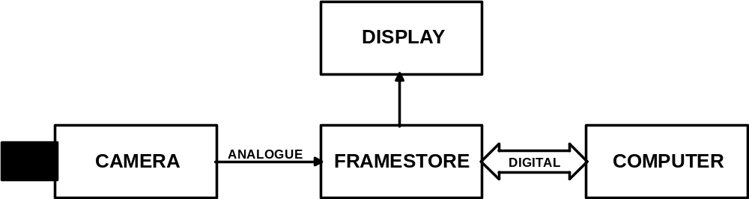
Why Use a Framestore?
Notes:
A framestore is typically an extra card that fits within a computer such as an IBM compatible in a similar way to video display card. More complex framestores which include processing facilities may be a rack of cards.
A framestore may be divided into four basic sections as shown above.
Framestore memory • Video input
Video output • Computer interface
The main component of the framestore is the memory. Each pixel of the image is stored as a location in the memory. Typically a framestore wil store 512 x 512 pixels of 8 bits (and in many cases significantly more than this). The framestore memory is made up of random access memories (RAMS). In a conventional RAM device, the location to be accessed is specified by an address.
Data is either read from or written to the memory location. However only one read or write operation may take place at a time.
Computer Interface
The computer interface to the framestore allows the computer to access the image data and to perform various image processing and analysis operations on the images. The interface must be designed so that the capturing and displaying of images is not interrupted by the computer access to the framestore, as this would result in noise appearing in the images.
In SEM, the framestore may also be responsible for supplying the electronic waveforms that control the position of the focussed beam at the specimen.

Slide 9
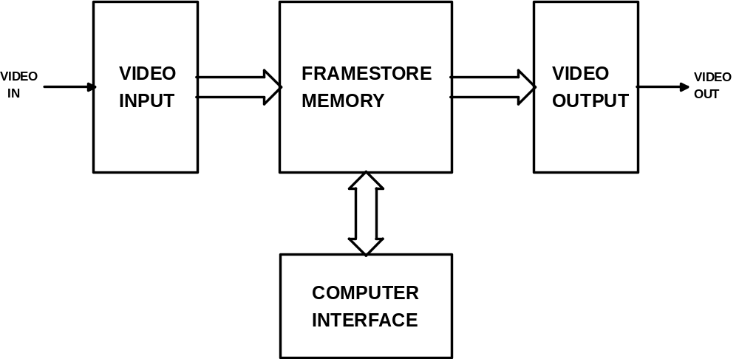
Framestore Structure
Notes:
Video input
The output from a video camera is an analogue video signal, the intensity of the image is represented by a varying voltage. Some means of converting the analogue video signal into a digital form is required.
The video input section of the framestore converts the analogue video signal into digital data for storage in the framestore memory. An analogue to digital converter (ADC) outputs a binary code corresponding to the voltage appearing at its input. The video voltage typically varies from 0 to 0.7 volts. This is encoded as a binary number in the range 0 to 255 for an 8 bit analogue to digital converter. The video input section also contains circuitry to synchronise the input of image data to synchronisation pulses present in the video signal.
In electron microscopy, the slower speed of operation often allows the use of ADCs with 10 or 12 bits of data. This may also be a requirement in scanning densitometry. Framestores intended for these purposes are generally designed to store 16 or more bits per pixel.
Video Output
The video output section of the framestore produces a video signal from the image data. so it may be displayed on a monitor. A digital to analogue converter (DAC) produces an output voltage corresponding to the binary data appearing at its input. This is combined with video synchronisation pulses to produce the required video signal.

Slide 10
Framestore Memory Accesses
The framestore must be accessed in 3 ways:
  Capturing image, over 6.5 million accesses/sec.
  Displaying image, over 6.5 million accesses/sec.
  Computer access, over 1 million accesses/sec.
The framestore must be able to be accessed over 14 million times per second .
Conventional memories can only handle a maximum of 4-8 million accesses per second.
Notes:
The memory of the framestore needs to be accessed in 3 ways:
1. For storage of pixel from the image being captured, over 6.5 million accesses per second
2. For display of stored image, over 6.5 million accesses per second
3. For computer access, over 1 million accesses per second
The framestore must be able to be accessed in excess of 14 million times per second. Conventional RAM devices can only be accessed 4 to 8 million times per second. So special design techniques or special memory devices must be used in framestores to achieve the high speeds required.

Slide 11
Basic operations
The grey level histogram
Grey level histogram equalisation
Point operations
Algebraic operations

Slide 12
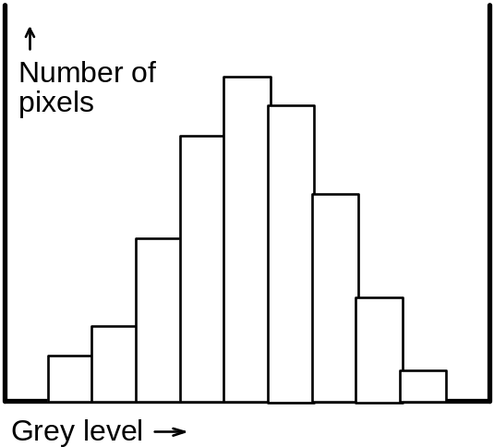
The Grey-level Histogram
One of the simplest, yet most useful tools.
Can show up faulty settings in an image digitiser.
Almost impossible to achieve without digital hardware.
The GLH is a function showing for each grey level the number of pixels that have that grey level.
Notes:
The grey level histogram is one of the simplest yet most useful diagnostic tools available in digital image processing. It is virtually impossible to obtain without recourse to digital processing.
Consider a digitised image whose grey scale z extends from 0 to M.
Then the grey level histogram (GLH) is a function h(z) showing for each grey level z, the number of pixels in the image (or selected part of the image) having that grey level.
The GLH is unique for any image; however, the converse is not true. Since the GLH contains no spatial information from the image, a given histogram could correspond to any of a very large number of totally different images.

Slide 13
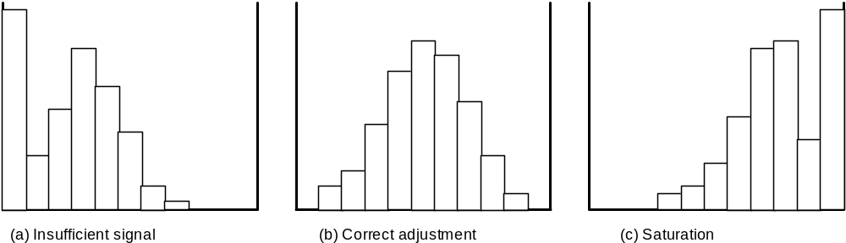
Correcting digitiser settings
Inspection of the GLH can show up faulty digitiser settings
Notes:
Inspection of the GLH can show up faulty settings in an image digitiser.
An image detector with insufficient gain may produce an image whose grey-level histogram is skewed towards the lower intensity levels, with only small numbers of pixels at the higher levels.
Conversely, with improper adjustment, the digitised histogram may be skewed such that an excessive proportion of pixels lie at or near the maximum grey level (saturation).
Note the characteristic appearance of the histogram in each of these extreme cases. Using this approach these situations can readily be recognised, without ambiguity. Other methods for detecting incorrect adjustment are liable to be affected by the presence of random noise in the image.

Slide 14
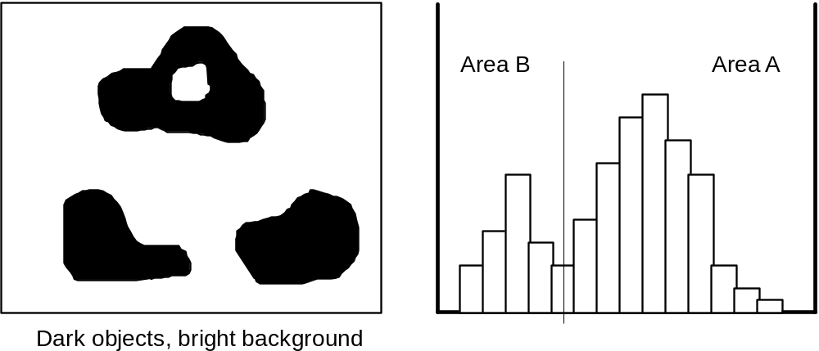
Image segmentation
The GLH can often be used to distinguish simple objects from background and determine their area.
Notes:
The area of a simple object in an image can often be determined by studying the grey level histogram of the image.
Where the image consists of a limited number of components or phases, and these can be distinguished on the basis of their brightness (grey-level), the grey-level histogram often displays a characteristic double-peak, as shown.
In the example given, the left peak corresponds to the set of darker (object) pixels, while the right peak corresponds to the brighter, background pixels. The size of each peak is proportional to the number of pixels of each kind, and so by assigning a suitable threshold value and counting pixels within a range of values in the histogram, the proportion of the image occupied by object (or background) pixels can be deduced.
Note that with this simple approach it is not possible to distinguish separate objects, nor to discount background pixels that may be visible through an object containing a hole.

Slide 15
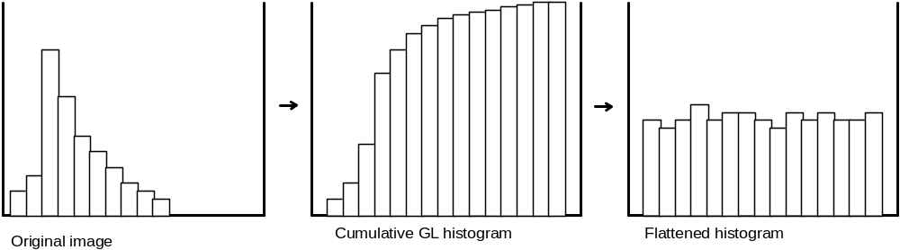
Grey Level Histogram Equalisation
In GLH equalisation, a non-linear grey scale transformation redistributes the grey levels, producing an image with a flattened histogram.
This can result in a striking contrast improvement.
Notes:
Image detectors may produce an image whose grey-level histogram is skewed towards the lower intensity levesl, with small numbers of pixels at higher levels. Redistributing the grey levels in the image P according to a non-linear grey scale transformation to produce an image Q with a flattened GLH can bring about a striking improvement in contrast. This is known as Grey Level Histogram Equalisation.
Equalisation stretches the grey levels in the populated regions of the histogram, and copmpresses them in others.
The piecewise linear greyscale transformation to achieve equalisation in any instance requires detailed knowledge of the GLH. It can be derived from the following inequality:-
where grey levels z₀ to z_{k0-1} in P are to be set to grey level z₀ in Q; p_{i} and q_{i} represent the numbers of pixels at grey level z_{i} in P and Q.

Slide 16
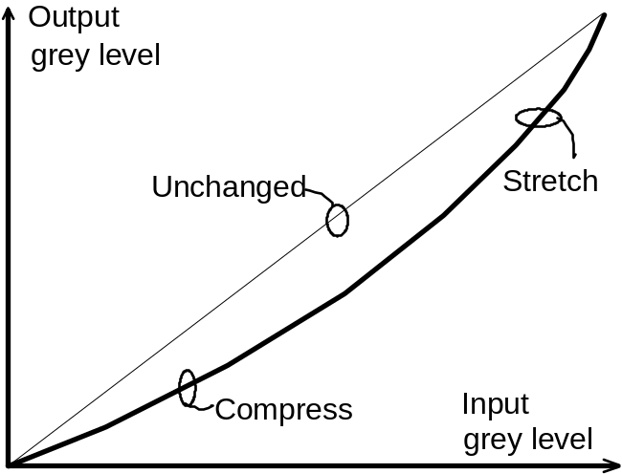
Point Operations
Point operations affect the way images occupy greyscale.
A point operation transforms an input image, producing an output image in which each pixel grey level is related in a systematic way to that of the corresponding input pixel.
A point operation will never alter the spatial relationships within an image.
Notes:
Point operations allow modification of the way in which an image occupies the available grey scale. A point operation takes a single input image and transforms it to a single output image so that each output pixel is related in some systematic way the the grey level of the corresponding input pixel. Point operations can never modify the spatial relationships within an image (cf neighbourhood operations in which pixels at many sites may determine the value of any given output pixel).
It is often convenient to express the relationship between input and output pixels in a graphical way. A straight line of unit slope corresponds to no change; a steeper slope corresponds to grey level or contrast stretching (i.e. a small change in input grey level is amplified to a greater change in output grey level), while a shallower slope implies local compression of the grey scale (grey level changes are attenuated).
Image processing systems often provide ways of specifying a piece-wise linear relationship between output and input pixel grey levels. This allows contrast stretching and compression to be introduced selectively to chosen parts of the grey scale.
Analytic functions may be used to correct for known or predicted distortions of the greyscale introduced during digitisation - for example, in gamma correction,in which the non-linear response of a phosphor screen or photographic film may be compensated by application of a power-law relation.

Slide 17
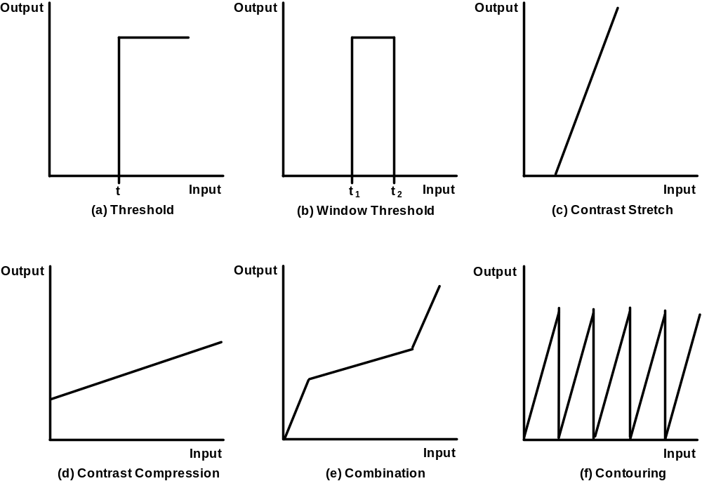
Examples of Point Operations
Notes:
Piece-wise linear functions for point operations
(a) Thresholding. All pixels with grey level t or greater are shown as maximum grey level in the output image; all others are shown as grey level 0.
(b) Modified form of thresholding. Pixels with grey levels from t1 to t2 are shown at maximum grey level. The remainder are shown as grey level 0.
(c) Contrast stretch (slope > 1).
(d) Contrast compression (slope < 1)
(e) Piece-wise linear transformation showing combined contrast stretch and contrast compression.
(f) Contouring. Selected pixels are set to extreme grey level values by use of a form of cyclic contrast stretch. The result is to superimpose brightness contour lines on the image and emphasising intensity gradients
Point operations can often conveniently be carried out using hardware lookup tables (LUTs). These allow the effect of greyscale transformations to be seen without altering pixel values in the original image.

Slide 18




Algebraic operations
A point form of operation (with >1 input image)
Grey level of each output pixel depends only on grey levels of corresponding pixels in input images
Four major operations:
  Addition:
  Subtraction
  Multiplication:
  Division:
Other operations can be defined that involve more than 2 input images, or using (for example) boolean or logic operators.
Notes:
Algebraic operations resemble point operations in that the grey level of each pixel in the output image depends only on the grey levels of the corresponding pixels in the participating input images. The four major operations are the arithmetic ones (see above).
Some special conditions may have to be imposed on the form of arithmetic used, in response to the fact that all output pixels must assume values within a permitted range. Adding or multiplying grey levels may generate values that overflow this range. Subtracting may generate negative values.
Other operations may be defined in terms of other arithmetic or logical operators - for example, AND, OR, XOR and useful meanings may be attached to the results. Operations with more than two input images may also be defined.

Slide 19
Applications of algebraic operations
Addition
  Ensemble averaging to reduce noise
  Superimposing one image upon another
Subtraction
  Removal of unwanted additive interference (background suppression)
  Motion detection

Slide 20
Applications (continued)
Multiplication
  Removal of unwanted multiplicative interference (background suppression)
  Masking prior to combination by addition
  Windowing prior to Fourier transformation
Division
  Background suppression (as multiplication)
  Special imaging signals (multi-spectral work)

Slide 21
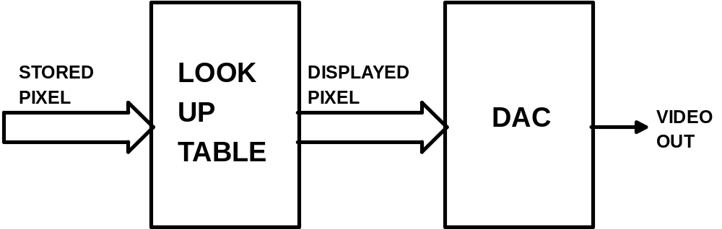
Look Up Tables
Notes:
Lookup Tables
Many framestores have a look up table between the framestore memory and the digital to analogue converter, see Figure 3. The look up table looks the input value up in a table and outputs the corresponding result. It may be thought of as a graph of stored values against displayed values and allows point operations such as contrast stretching to be performed at high speed. Look up tables are implemented using high speed memories. The input pixel value is used as the address for the memory and the data read out is the output pixel value.

Slide 22
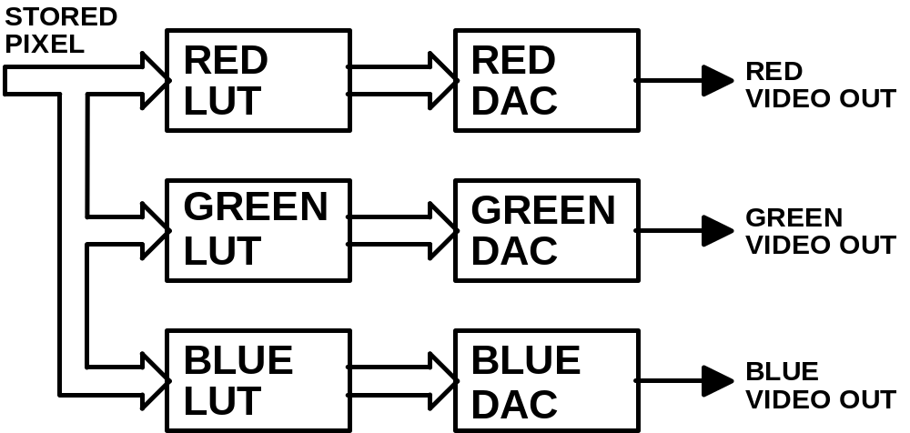
Pseudo-colour
Notes:
Pseudo-colouring uses three look up tables to map the grey level stored in the framestore into a colour display, see Figure 4. One look up table is used for each of the red, blue and green components of the displayed colour image. Pseudo-colouring is a useful technique since the human eye is able to perceive more colours than it can grey levels. The colours may be arranged so that a slight change in grey levels produces contrasting colours, high-lighting details in an image. However, mis-use of pseudo colour can seriously confuse the observer and may hide the original information present in the image.
To avoid this, a smooth variation of colour assignments is usually chosen - for example a colour-temperature representation starting with dark red, passing via orange and yellow to white, and beyond to blue.
A full colour system, which captures, stores and displays full colour images, effectively requires the use of three framestores, one for each of the red, blue and green colour components. This is why colour systems are more expensive.

Slide 23
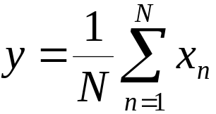
Noise Reduction
An important noise reduction technique is frame averaging.
A number of frames are averaged. The random noise is averaged out, resulting in a much improved image of the sample. Frame averaging may be written as:
where N is the number of images averaged, x are the images to be averaged and y is the averaged image.
Notes:
Image Improvement
In electron microscopy, the quality of the images obtained is important. Image processing systems can be used to greatly improve images. Although the cost of these systems may seem to be high, the cost must be considered in relation to the cost of the microscope and the improvement in images. The next sections cover some of the techniques available.
Noise Reduction
Electron microscopes often produce noisy images, similar to the "snow" in a poor TV picture obtained with a poor aerial. An important noise reduction technique is frame averaging. The video picture produced by the electron microscope consists of the image of the sample being looked at with noise superimposed on it. The sample, which we want to see, does not change from frame to frame. The noise, which we want to remove, changes from frame to frame. If a number of frames are averaged, the noise is averaged out as it is random, leaving behind a much improved image of the sample.
A mathematical expression for the averaging process is given.
where: N is the number of images averaged, x are the images to be averaged and y is the averaged image

Slide 24
Frame Averaging contd.
This has some disadvantages:
  The averaged image is built up slowly. The display starts dark and gradually increases in brightness.
  An output is only obtained once every N frames.

Slide 25
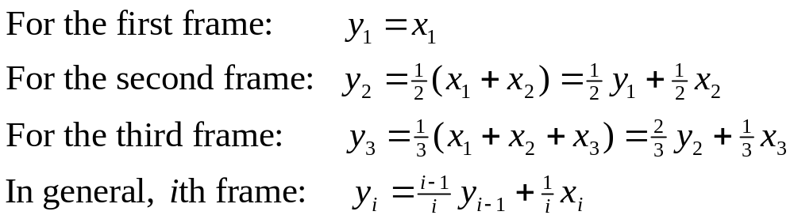
Kalman Averaging
The Kalman averager overcomes these problems by calculating the average of the frames input so far. The image displayed starts noisy and gradually improves as more frames are averaged. The Kalman filter is calculated by:
where x is the input image and y is the averaged image.

Slide 26

Recursive Averaging
The most useful averaging technique for microscopes is recursive averaging. The current displayed image is a combination of the current input image and the previous displayed image. This may be written as:
where 0<k<1, x is the input image, y is the averaged image. The constant k can be considered as a time constant. The longer the time constant, the more the noise is reduced.
Notes:
Perhaps the most useful averaging technique for electron microscopy is recursive averaging. The current displayed image is a combination of the current input image and the previous displayed image, the previous displayed image being a combination of past input images.
where: x is the input image and y is the averaged image
As the next image is calculated, the past input images are reduced by k and so after a certain time a past image will be reduced to less than the smallest number that can be stored. Thus the constant k defines how long an input image is significant in the output image, and can be considered as a time constant. The longer the time constant, the more the noise is reduced. However, with a long time constant it is difficult to focus the microscope or move the sample. So a short time constant should be used whilst adjustments are made to the microscope.

Slide 27


Background Shading Correction
Background image q distorts the ideal microscope image p to give image x, the output from the camera. The distortion process is modelled by:
  To correct for the background distortion, the imaging system is uniformly illuminated. The ideal image p is now a constant C and the output from the camera x’ is given by:
Notes:
Background Shading Correction
Defects in the image formation system can degrade the image. These defects include burn-out spots on the camera, and sensitivity variations across the camera and optics. These defects can be modelled as a background image q that distorts the ideal microscope image p to give image x, the output from the camera. It is found that the distortion process is best modelled by multiplication, so that:

Slide 28
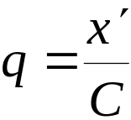
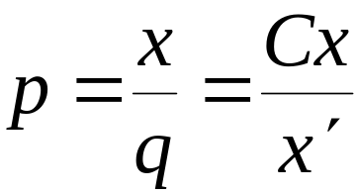
Shading Correction contd.
From this we can find the background image q:
  To find an estimate of the ideal image p from the image x obtained from the camera we divide by q:
Notes:
We wish to find a way to correct for the background distortion. If the imaging system is uniformly illuminated, for example by removing the sample, the background defects may be found and where C is a constant.
where: x' is the image output when viewing the constant image
So to correct for the background defects and find an estimate of the ideal image p, we must divide the image from the microscope by the image obtained by viewing uniform illumination..

Slide 29
Real Time Processing
Processing video at the same speed as the images are occurring is known as real time processing.
For a 512 by 512 image, the recursive averaging requires two multiplies and one addition per pixel, or nearly 20 million operations per second.
Recursive averaging and background correction may be performed in real time by the use of an arithmetic unit in conjunction with the framestore.
Notes:
Real Time Processing
When performing image processing operations on video, it is often desirable to perform the processing at the same speed as the images are occurring. This is known as real time processing. For a 512 by 512 image, real time processing requires the calculation over 6.5 million results per second. For example, the recursive averaging operation above requires two multiplies and one addition per pixel, or nearly 20 million operations per second. This is beyond the capability of most computers. Special hardware is required to perform real time image processing. Recursive averaging and background correction may be performed in real time by the use of an arithmetic unit in conjunction with the framestore.

Slide 30
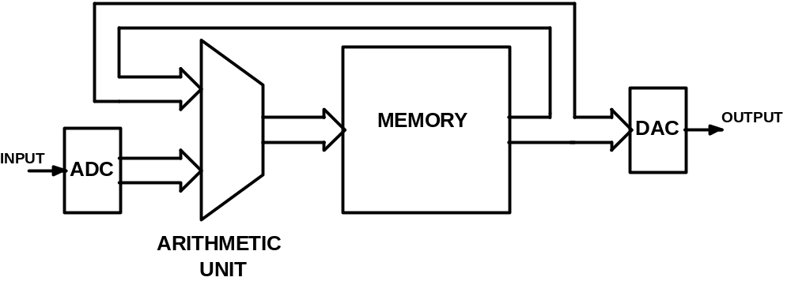
Recursive Averaging Framestore
Notes:
Recursive averaging
In recursive averaging, the pixel from the input image and the corresponding pixel from the framestore are fed to the arithmetic unit, see above. The arithmetic unit multiplies each pixel by the required constant and adds the results together. The output from the arithmetic unit is stored in the framestore. The constants are stored in registers in the arithmetic unit and are programmed by the computer. The framestore generally stores 16 bits per pixel to prevent rounding and truncation errors.
For background shading correction, a second framestore memory is required to store the background image. To set the system up, the uniform illuminated image x' is captured. This is inverted by the computer to give C/x' and this is stored in the second framestore page. In use, the pixel of the image being captured is fed to the arithmetic unit and is multiplied by the corresponding pixel from the framestore memory containing the inverted background image, see Figure 6. The output of the arithmetic unit is the corrected image and is stored in the first framestore memory.

Slide 31
Fundamentals of
Image Processing II
Computers in Microscopy, 14-17 September 1998
David Holburn University Engineering Department, Cambridge

Slide 32
Local Operations
In a local operation, the value of a pixel in the output image is a function of the corresponding pixel in the input image and its neighbouring pixels. Local operations may be used for:-
  image smoothing
  noise cleaning
  edge enhancement
  boundary detection
  assessment of texture
Notes:
Local or neighbourhood operations are those in which an output image is derived for an input image (or images); each output grey level may depend not only on the grey level of the corresponding pixel, but also on the grey level of certain of its neighbours.
Local operators may be used for
image smoothing
noise cleaning (removal of random noise spikes) from a single image
edge enhancement
boundary detection
assessment of texture
Image smoothing is an example of low-pass filtering

Slide 33
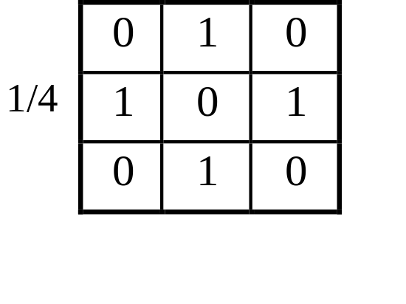
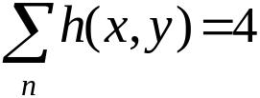

Local operations for image smoothing
Image averaging can be described as follows:-
The mask shows graphically the disposition and weights of the pixels involved in the operation.
Total weight =
Image averaging is an example of low-pass filtering.
Notes:
A form of image averaging can be described as follows:-
Averaging is the discrete analogue of spatial integration over the image. It results in:
noise reduction and image smoothing
low-pass filtering
subdued edges and ‘smeared’ grey levels
blurring
It is often convenient to use a graphical illustration to identify the pixels that participate in the operation. The mask or kernel h(x,y) shows the weights and disposition of the pixels participating in the operation. The total weight is the accumulated sum of the individual weights, and is used as a scaling factor to reduce the value of g(x,y) to the acceptable range of grey levels.

Slide 34
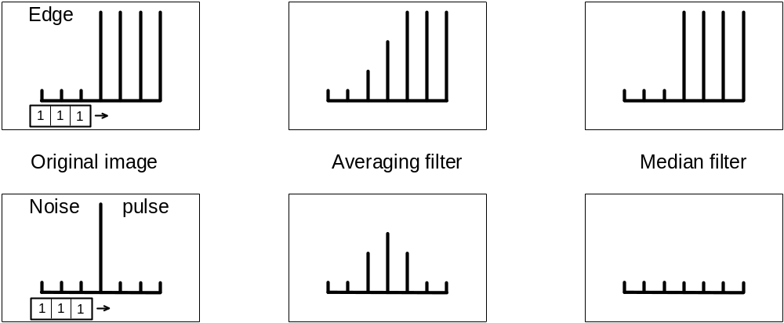
Low Pass and Median Filters
The low-pass filter can provide image smoothing and noise reduction, but subdues and blurs sharp edges.
Median filters can provide noise filtering without blurring.
Notes:
The diagrams show the effect of a simple 1 x 3 averaging mask applied to a 1D image consisting of
an abrupt edge
a noise pulse
The averaging filter is seen to spread out the effect of the noise pulse making it less evident to the viewer. However, it also blurs the abrupt edge, reducing the clear distinction between the regions it delineates.
Median filters can provide noise filtering without blurring. These evaluate the statistical median of the pixel neighbourhood. The median of a set of k pixel grey-levels is that grey level for which k/2 are smaller or equal, and k/2 are larger or equal. Median filtering consists of generating an output image whole pixels are the median of sets of near-neighbour pixels.
Note that the choice of neighbourhood over which the median is computed has a significant influence over the filter’s effect on edges, corners and other image discontinuities.

Slide 35
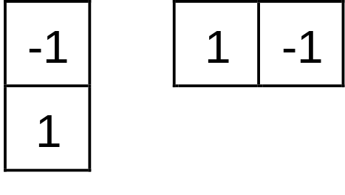
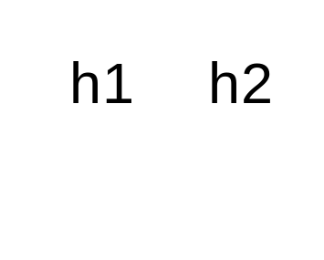
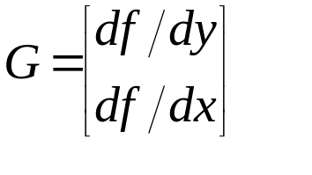
High Pass Filters
Subtracting contributions from neighbouring pixels resembles differentiation, and can emphasise or sharpen variations in contrast. This technique is known as High Pass Filtering.
The simplest high-pass filter simulates the mathematical gradient operator:
h1 gives the vertical, and h2 the horizontal component. The two parts are then summed (ignoring sign) to give the result.
Notes:
High Pass Filters
Summing grey levels from neighbouring pixels has the effect of blurring the image, and produces averaging or integration. By contrast, subtracting contributions from neighbouring pixels closely resmbles differentiation, and can sharpen the variations in contrast. This technique is often known as high pass filtering since the high frequency variations in grey level remain while lower frequencies are attenuated. Subtraction can be achieved by the simple expedient of allowing negative values in the convolution kernel. Many high pass filters operators are based on the rate of change of grey level, often known also as the gradient.
For a digital image the mathematical gradient is approximated by differences, as shown in the slide. These are fast to compute, but the result can only be an approximation to the true gradient, and is usually an underestimate. Since in many cases, high pass filters are used to emphasise visual aspects of images, the errors implicit in the approximation are of little consequence.
It is often convenient to represent edge detectors in a graphical way, by means of masks consisting of a small 2D arrays of numeric coefficients.
Note that the sum of the elements within each mask is typically 0 or 1. Conceptually each of these is applied shifting it over the entire image, stopping at each pixel position in turn, as for low pass filtering. Each pixel value is then multiplied by the corresponding coefficient, and the result for that position is taken as the sum of these products.
Three passes through the data are required here: one to compute horizontal contributions, one to determine vertical contributions, and a final pass to merge the results.

Slide 36
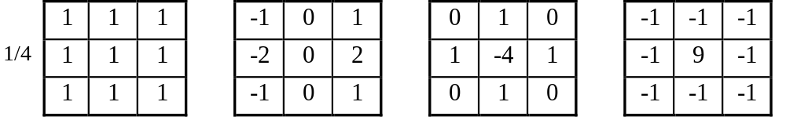
Further examples of filters
These masks contain 9 elements organised as 3 x 3. Calculation of one output pixel requires 9 multiplications & 9 additions. Larger masks may involve long computing times unless special hardware (a convolver) is available.
(a) Averaging (b) Sobel (c) Laplacian (d) High Pass

Slide 37
Frequency Methods
Introduction to Frequency Domain
The Fourier Transform
Fourier filtering
Example of Fourier filtering
Notes:
The use of frequency methods in image processing is well established. It owes its existence partly to the regular use of this approach in electrical engineering and electronic signal processing; many of the benefits that have accrued in these activities have also extended to 2D imaging (as well as 3D and other forms). There are a number of operations in measurement and processing of images that can be performed with great convenience in the frequency domain, but can only be achieved in the (more familiar) spatial domain with significantly greater computational effort.
In some cases frequency methods receive less attention than they possibly deserve, perhaps because their notation is regarded by many as intimidating and the underlying theory is somewhat mathematical.
Frequency methods are applied in imaging work for several different reasons. In some cases these lead to methods of image compression, in which the amount of data used to represent the image can be reduced without objectionable loss in fidelity. Frequency methods lead to an elegant method for performing spatial filtering as an alternative to the spatial convolution approach (already encountered as low-pass and high-pass filter masks). They are also widely used in reconstruction of 2D and 3D images from 1D and 2D ‘slices’, in the procedure known as tomography.

Slide 38
Frequency Domain
Frequency refers to the rate of repetition of some periodic event. In imaging, Spatial Frequency refers to the variations of image brightness with position in space.
A varying signal can be transformed into a series of simple periodic variations. The Fourier Transform is a well known example and decomposes the signal into a set of sine waves of different characteristics (frequency and phase).
Notes:
Frequency methods: the Fourier Transform
FREQUENCY refers to the RATE OF REPETITION of some periodic event. In imaging, SPATIAL FREQUENCY is the rate at which the brightness of an image changes with position in space. High spatial frequencies correspond to rapidly varying, fine detail; low spatial frequencies correspond to slowly changing brightness.
Theory shows that any varying signal (1D or 2D) can be decomposed or TRANSFORMED into a series of simple periodic variations. The Fourier Transform is one of the best known techniques for performing such a decomposition, and decomposes the signal into a set of sine waves of different frequencies.

Slide 39
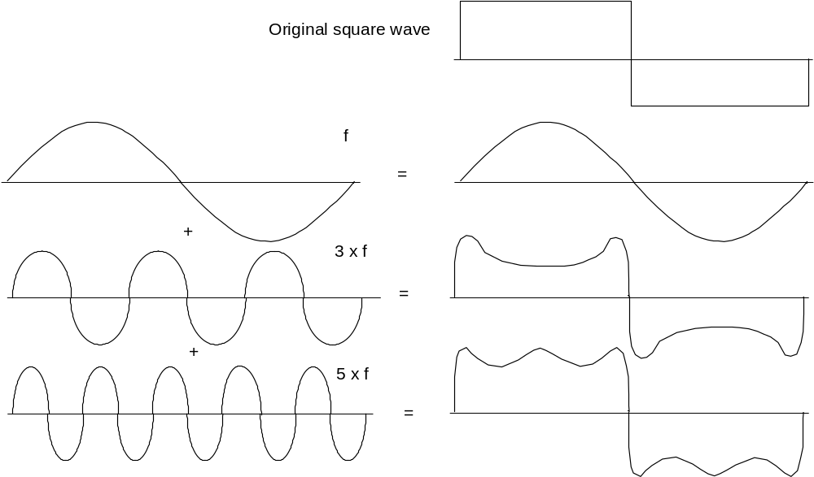
The Fourier Transform
Notes:
For example, a square wave (which might represent a pair of sharp edges in an image) can be thought of as the combined sum of a set of sine waves at frequencies 1f, 2f, 3f, .. (f is the frequency of the square wave). The more sine waves included in the summation, the more the resulting sum resembles the original square wave.
The set of waves used to represent a waveform as frequency components is referred to as its SPECTRUM. A complete spectrum specifies:
the AMPLITUDE of each frequency, which is related to the amount of ENERGY in the signal at that frequency, and:
how it must be positioned with respect to the other frequency components (PHASE).
Waveforms other than the square wave just discussed can be represented by their own characteristic spectra, with differing amplitudes and phases for the contributing frequency components.
The Fourier Transform is a mathematical technique for determining the amplitude and phase of the spectral components of a wave.

Slide 40
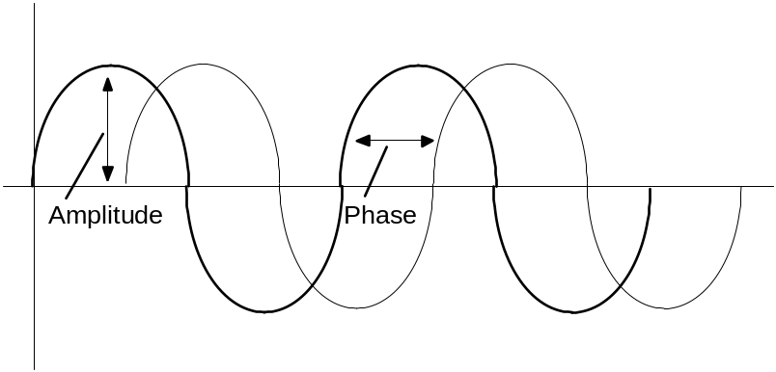
Amplitude and Phase
The spectrum is the set of waves representing a signal as frequency components. It specifies for each frequency:
  The amplitude (related to the energy)
  The phase (its ‘position’ relative to other frequencies)
Notes:
The Fourier Transform in 2D images
The same ideas are valid for 2-dimensional spatial signals (images). The spectrum now represents the amplitudes and phases of sine waves corresponding to the x and y spatial directions of the image.
Duality of spatial and frequency representations
Given any image, we can deduce its spectrum (using the Fourier Transform), and, correspondingly, given a spectrum, we can deduce the original signal. The spectrum is interchangeable with the original image, containing the same information, but in a different arrangement.
For this duality to hold, we must take account of both the amplitude information and the phase information in the spectrum. Some applications may use only the amplitude information, simply discarding the phase information, on the basis that only the quantity (or energy) of each frequency, and not its phase, is important. Another justification sometimes stated for ignoring the phase information is that it is often difficult to interpret in a meaningful way. Often, in image processing, we may look at a graph or display of the square of the amplitudes (known as the POWER SPECTRUM) to get some feel for the frequencies involved. It is vital to remember that without the additional phase information, the original image cannot be reconstructed.

Slide 41
Fourier Filtering
The Fourier Transform of an image can be carried out using:
  Software (time-consuming)
  Special-purpose hardware (much faster)
using the Discrete Fourier Transform (DFT) method.
The DFT also allows spectral data (i.e. a transformed image) to be inverse transformed, producing an image once again.
Notes:
The discrete Fourier Transform
The theory just discussed applies to CONTINUOUS FUNCTIONS. However, an image processed by computer is defined as a discrete set of values. A corresponding theory applies in these cases. The discrete Fourier Transform (DFT), and the computational techniques employed to determine it are covered in other sheets.
When we compute the DFT of a 2D image, the spectrum that results is a pair of 2-dimensional arrays representing the REAL and IMAGINARY parts from which the amplitude and phase can be deduced.
Sampling effects
Just as a digitised image is an approximation to the natural image from which it was obtained, so is the DFT (i.e. the spectrum) of an image an approximation. This arises for two main reasons:
Firstly, the DFT assumes that the digital image is just one period of an infinite periodic function. If values at the opposite edges are not the same, discontinuities are seen. They can be reduced by smoothing the image down to 0 towards its edges.
High frequency components in the original image can sometimes be mistaken for low frequency components in the digitised image. The high frequency is said to be ALIASED with the low frequency. The solution is to filter the image (before digitising) to impose a limit on the highest frequency present.

Slide 42
Fourier Filtering (continued)
If we compute the DFT of an image, then immediately inverse transform the result, we expect to regain the same image.
If we multiply each element of the DFT of an image by a suitably chosen weighting function we can accentuate certain frequency components and attenuate others. The corresponding changes in the spatial form can be seen after the inverse DFT has been computed.
The selective enhancement/suppression of frequency components like this is known as Fourier Filtering.
Notes:
Fourier filtering
If we compute the DFT of a given image, then immediately perform the Inverse DFT computation on the resultant spectrum, we expect to end up with the same image.
If, prior to performing the Inverse DFT, we multiply each element of the Fourier Transform of an image by a suitably chosen WEIGHTING FUNCTION, certain frequency components will be amplified, and others attenuated. This will produce corresponding changes in the spatial form, which can be seen after the Inverse DFT has been computed. The selective enhancement/suppression of frequency components in this way is known as filtering.
Filters are generally used to compensate for known defects in images. For example, noise in spatial images is often due to random high frequency components, and can be removed by an appropriate choice of weighting function. In images that have been subject to electromagnetic interference (e.g. mains hum), characteristic patterns may obliterate the wanted image information. Use of a filter to suppress these frequencies only can produce a dramatic improvement in image quality. Correct selection of filter weighting function is the key to effective filtering, and it is usually necessary to study the spectrum with some care before determining the form of the weighting function.

Slide 43
Uses of Fourier Filtering
Convolution with large masks (Convolution Theorem)
Compensate for known image defects (restoration)
Reduction of image noise
Suppression of ‘hum’ or other periodic interference
Reconstruction of 3D data from 2D sections
Many others . . .
Notes:
Often FTs are displayed graphically, as though they were images. Scientists accustomed to analysing optical diffractograms find this form of presentation helpful, since the power spectrum and the optical diffractogram are essentially the same. The main frequency components in the original image can quickly be identified.
With most spectra, certain frequency components (particularly the zero frequency) are much larger - perhaps by a factor of thousands - than others, and swamp detail in other parts of the spectrum. To overcome this, the logarithm of (1 + spectral value) is often plotted, so that huge variations are compressed into much smaller changes in brightness.
Other uses
The CONVOLUTION THEOREM states that:
FT (f * g) = FT (f) FT (g)
where f is an image, g is a kernel, FT means 'Fourier Transform of', and f * g signifies the convolution of f and g. In other words, convolution can be performed by means of the following sequence of operations:
Compute the Fourier Transform of image f.
Compute the Fourier Transform of mask g
Multiply the results together, element by element.
Compute the Inverse Fourier Transform of the product.
This may be much faster for large masks than direct spatial convolution.

Slide 44
Transforms & Image Compression
Image transforms convert the spatial information of the image into a different form e.g. fast Fourier transform (F.F.T.) and discrete cosine transform (D.C.T.). A value in the output image is dependent on all pixels of the input image. The calculation of transforms is very computationally intensive.
Image compression techniques reduce the amount of data required to store a particular image. Many of the image compression algorithms rely on the fact the eye is unable to perceive small changes in an image.
Notes:
Transforms and Image Compression
Another class of image processing operations are transforms, for example fast Fourier transform (F.F.T.) and discrete cosine transform (D.C.T.). An image transform transforms the spatial information of the image into a different form. A value in the output image is dependent on all pixels of the input image. The calculation of transforms involves a large number of terms and is very computationally intensive. Again special processing hardware is required to perform transforms in real time. Image compression techniques reduce the amount of data required to store a particular image. Many of the image compression algorithms rely on the fact the eye is unable to perceive small changes in an image. Transforms are applied to blocks of the image and certain information is thrown away to reduce the amount of data used to store the image. Chips are available to perform transforms including F.F.T. and D.C.T. and also to perform image compression algorithms such as the JPEG standard, greatly increasing the speed of calculation.

Slide 45
Other Applications
Image restoration (compensate instrumental aberrations)
Lattice averaging & structure determination (esp. TEM)
Automatic focussing & astigmatism correction
Analysis of diffraction (and other related) patterns
3D measurements, visualisation & reconstruction
Analysis of sections (stereology)
Image data compression, transmission & access
Desktop publishing & multimedia

Slide 46
Fundamentals of
Image Analysis
Computers in Microscopy, 22-24 September 1997
David Holburn University Engineering Department, Cambridge

Slide 47
Image Analysis
Segmentation
  Thresholding
  Edge detection
Representation of objects
Morphological operations

Slide 48
Segmentation
The operation of distinguishing important objects from the background (or from unimportant objects).
Point-dependent methods
  Thresholding and semi-thresholding
  Adaptive thresholding
Neighbourhood-dependent
  Edge enhancement & edge detectors
  Boundary tracking
  Template matching
Notes:
A primary objective in the processing and analysis of grey scale images is the identification of "objects" bearing some significance to the analytical task being undertaken. Successful identification will result in an image consisting of just two kinds of pixel, representing object and NOT object.
Two approaches to the object identification problem are often distinguished.
thresholding
in which objects are discriminated on the basis of some pixel property - for example brightness, and groups of pixels with similar properties are assumed to belong to the same (kind of) object. Thresholding is a point operation in which an appropriate mapping function is applied to each pixel of the image.
edge detection
in which a discontinuity or edge in the pixel property is interpreted as an object boundary. Edge detection is a neighbourhood or local operation, in which functions involving a number of pixels distributed about the point of interest (the neighbourhood) are applied. Much relevant information about shape can be deduced from the boundary edge alone. In some cases it may be necessary to enhance the contrast of the edges so they may be detected more easily. This is called edge enhancement or image sharpening, and these terms are often interchangeable - some algorithms do both.
Although thresholding and edge detection appear superficially to have much in common, a radically different form of mathematical technique is required for each.

Slide 49
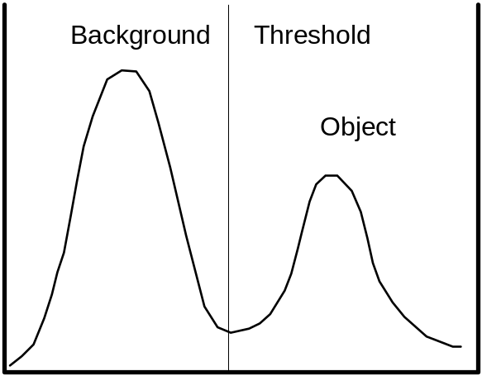
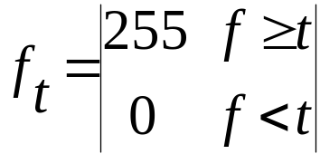
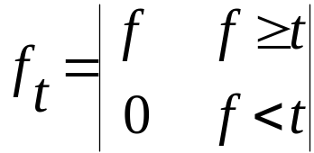
Point-dependent methods
Operate by locating groups of pixels with similar properties.
Thresholding
Assign a threshold grey level which discriminates between objects and background. This is straightforward if the image has a bimodal grey-level histogram.
(thresholding)
(semi-thresholding)
Notes:
In point-dependent methods we seek to identify groups of pixels with similar properties (usually grey level, colour, etc). Thresholding is a well-known simple example of this approach, in which we define a range of grey-levels in the original image, select the pixels within this range as belonging to the foreground or object(s), and reject all of the other pixels as belonging to the background.
The resultant image is then displayed as a binary image, using black & white or other colours to distinguish the regions.
The grey level histogram is often used to determine a suitable threshold value, t, to distinguish between object(s) and background. In the simplest implementation, a single value for t must be identified. In many image processing systems, the GLH is used directly by the operator to select a suitable value. If the image has a bi-modal histogram this operation is greatly facilitated; however, in many instances there is no clear distinction between background and object - for example, there may be several superimposed peaks at different levels which obscure the distinction between object and background, and no obvious threshold can be identifiedthe brightness levels of pixels are not simply related to the structure of the scene being imaged, and no clear threshold can be determined. Sometimes it is possible to use image processing techniques to transform grey level values to yield a new image in which pixel values represent some derived parameter which can be more effectively thresholded.

Slide 50
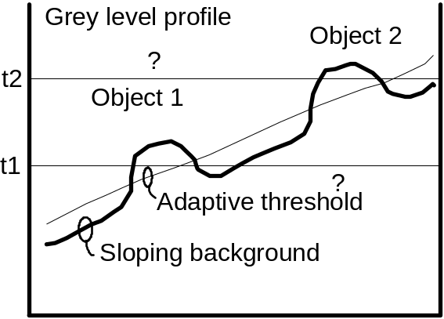
Adaptive thresholding
In practice the GLH is rarely bimodal, owing to:-
  Random noise - use LP/median or temporal filtering
  Varying illumination
  Complex images - objects of different sizes/properties
Background correction (subtract or divide) may be applied if an image of the background alone is available. Otherwise an adaptive strategy can be used.
Notes:
Even if the scene being imaged is of simple composition, i.e. object and background, it may be difficult to determine a suitable threshold, owing to:
severe random noise
which may cause significant numbers of object pixels to have background value, and vice versa. In these cases significant spatial low-pass filtering, median filtering, or temporal filtering of successive frames may be necessary to reduce the effects of noise.
varying illumination or conditions of acquisition
for example, the scene may be partly shaded from illumination by an overhanging feature, or the illumination source may be inappropriately positioned. In such cases, background correction through arithmetic image operations (e.g. subtraction or division), possibly using an image of the background alone, or the use of an adaptive threshold may help.
Adaptive thresholding - one approach
Vary the threshold t over the image to suit the local conditions. In one implementation, the image is divided into a number of smaller, overlapping sub-images, and the grey level histogram is computed for each of these. In many cases, these will be bi-modal as required; for those sub-images whose GLH is not bi-modal, threshold values determined by interpolation from neighbouring sub-images may be used.

Slide 51
Neighbourhood-dependent operations
Edge detectors
  Highlight region boundaries.
Template matching
  Locate groups of pixels in a particular group or configuration (pattern matching)
Boundary tracking
  Locate all pixels lying on an object boundary

Slide 52
Edge detectors
Most edge enhancement techniques based on HP filters can be used to highlight region boundaries - e.g. Gradient, Laplacian. Several masks have been devised specifically for this purpose, e.g. Roberts and Sobel operators.
Must consider directional characteristics of mask
Effects of noise may be amplified
Certain edges (e.g. texture edge) not affected
Notes:
(a) Edge detectors
Region boundaries typically occur as more or less abrupt transitions (between the pixel values corresponding to the object and those corresponding to the background); edge-enhancement operators can play a useful role in emphasising these boundaries. Many operators have been devised, each with its own particular response to boundaries of different magnitudes and directions.
Noise
Edge enhancement operators respond strongly to abrupt changes in pixel value, image noise, which may be regarded as occurrences of pixels with statistically abnormal values, is liable to be accentuated by these operators. This can lead to serious difficulties when attempting to determine object boundaries. In a noisy picture where noise and edge have similar contrast, the noise response may be greater than that from the edges. The effects of noise on the response of a difference operator can often be reduced using techniques based on averaging. In practice this may be achieved by carrying out a neighbourhood averaging operation (in which each pixel becomes the average, computed over a predetermined local neighbourhood) before commencing the edge detection operation. This inevitably has the effect of muting edges and lines, but, most important, the dominance of noise in the high-pass filter response is subdued
Texture edge
In texture edges, adjacent regions may be made up of pixels with similar properties, but there is some statistical variation in the frequency giving rise to a perceived boundary - for example, newsprint, in which the effect of grey scale images is produced by varying the size of black dots of fixed density (or grey level). A different approach to edge detection may be required for such cases.

Slide 53
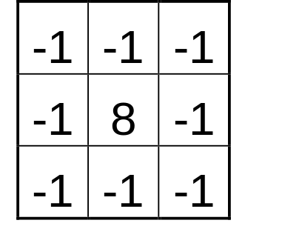
Template matching
A template is an array of numbers used to detect the presence of a particular configuration of pixels. They are applied to images in the same way as convolution masks.
This 3x3 template will identify isolated objects consisting of a single pixel differing in grey-level from the background.
Other templates can be devised to identify lines or edges in chosen orientations.
Notes:
(b) Template matching
A template is an array of numbers used to detect the presence of a particular configuration of pixels. This is achieved by evaluating the degree of similarity or of dissimilarity (or mismatch) between the template and groups of pixels in every possible position in the image, using a convolution-like approach.
Several methods exist for determining the degree of mismatch; in one very simple implementation, the arithmetic difference between the grey levels of the corresponding pixels in the template and the group under test is determined; where the template and the group are identical, the arithmetic differences will be exactly zero. Where the two sets are not identical, non-zero difference values would be expected.
This simple approach needs to be refined to deal with the fact that grey level differences may be positive or negative, and to produce useful results when pixel groups which are similar to the template but uniformly brighter or darker (grey level offset) are tested.
The template shown in the slide will detect single pixels differing in grey level from the surroundings. Other templates can be devised to distinguish lines and edges in different orientations; of course, they may be of greater dimensions than 3x3, but this has an inevitable impact on the time taken to carry out the operation.

Slide 54
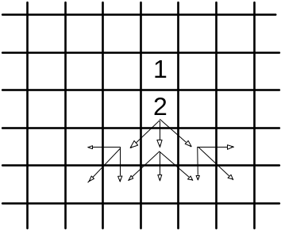
Boundary tracking
Boundary tracking can be applied to any image containing only boundary information. Once a single boundary point is found, the operation seeks to find all other pixels on that boundary. One approach is shown:-
  Find first boundary pixel (1);
  Search 8 neighbours to find (2);
  Search in same direction (allow deviation of 1 pixel either side);
  Repeat step 3 till end of boundary.
Notes:
(c) Boundary tracking
Methods (a) and (b) involve the application of ‘filters’ using the convolution operation, and deal with every region of the image in a regular sequence.
Boundary tracking may be applied to a gradient image (or any other image containing only boundary information -- for example, images produced by the application of edge detectors (a).
Once a single point on the boundary has been identified - simply by locating a grey level maximum - analysis proceeds by following or tracking the boundary, assuming it to be closed shape, with the aim of finding all other pixels on that specific boundary, and ultimately returning to the starting point before investigating other possible boundaries.
In one implementation, the search for high grey-level pixels continues in broadly the same direction as in the previous step, with deviations of one pixel to either side permitted, to accommodate curvature of the boundary.
The simple method illustrated is liable to fail under conditions of high noise, when the boundary makes seemingly random and abrupt changes of direction which cannot successfully be tracked in this way. Substantial low-pass filtering (or perhaps temporal filtering) is needed beforehand to reduce noise, unless the algorithm used is refined or assisted manually.

Slide 55
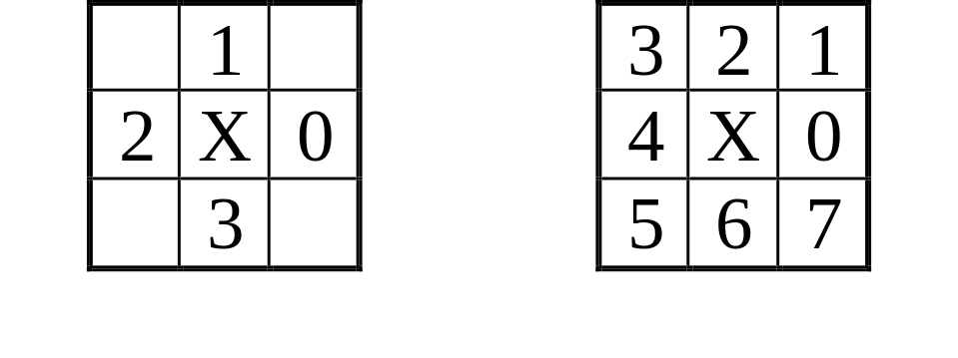
Connectivity and connected objects
Rules are needed to decide to which object a pixel belongs.
Some situations easily handled, others less straightforward.
It is customary to assume either:
  4-connectivity
    a pixel is regarded as connected to its four nearest neighbours
  8-connectivity.
    a pixel is regarded as connected to all eight nearest neighbours
4-connected pixels 8-connected pixels
Notes:
Connectivity and connected objects
When we try to distinguish the separate objects that form a binary image, we have to formulate some rules by which we decide to which object an object pixel belongs. Some situations are easily handled: if we encountered a single OBJECT pixel in the middle of a region consisting otherwise only of BACKGROUND pixels, we might deduce that it represents a very small, isolated object, one pixel in size. However, other configurations are less straightforward to deal with.
Digital image analysis systems using pixel arrays to represent images customarily assume either 4- or 8-connectivity of object pixels. In 4- connectivity, any pixel is defined as being connected to its four horizontal and vertical nearest neighbours (but NOT to the four diagonal neighbours); in 8-connectivity, a pixel is defined as being connected to all eight nearest neighbours (that is, horizontal, vertical and diagonal neighbours). This is illustrated by the two diagrams in the figure below, in which the neighbours are numbered according to their position relative to the central pixel (marked X).
If it is assumed that four- connectivity holds, whenever we find an object pixel with one or more 4- connected neighbours that are also object pixels, then those pixels are connected, and belong to the same object. However, if only diagonal neighbours are of object type, they belong to different objects. With 8-connectivity, any neighbouring pixel of object type, at whichever of the eight possible sites it may lie, is connected to the same object.

Slide 56
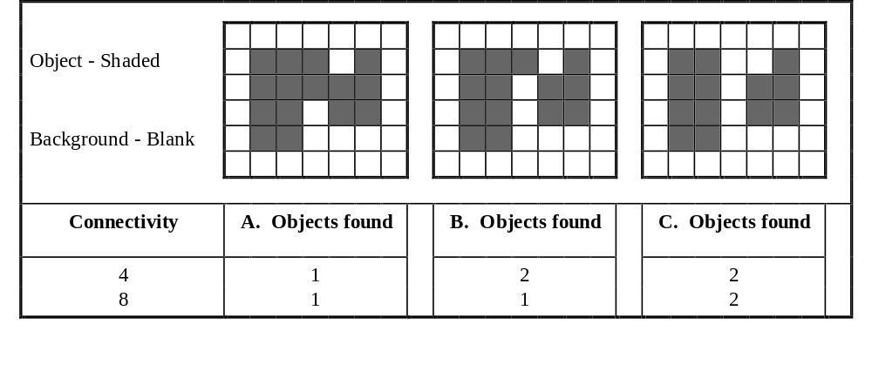
Connected components
Results of analysis under 4- or 8- connectivity
A hidden paradox affects object and background pixels
Notes:
Connectivity and connected objects (cont)
The figure above illustrates how different definitions of connectivity can lead to different results when the same assembly of object and background pixels are subjected to image analysis. In the figure, three typical binary images A, B and C are shown, in which each differs from the next by just one object pixel. Shaded squares are used to indicate OBJECT pixels, while BACKGROUND pixels are left blank. The table beneath indicates how many objects would be detected in each image, according to whether 4- or 8-connectivity is assumed.
With 4-connectivity assumed, image B is interpreted as consisting of two distinct objects. If 8-connectivity is assumed, these objects are treated as connected (i.e. as a single object). Image A is interpreted as a single object, and image C as two objects, irrespective of the connectivity chosen.
There is a hidden paradox arising from these definitions. We might reasonably expect to be able to apply the same set of connectivity rules to background pixels as to object pixels. However, in practice, it is necessary to assume 8-connectivity for background pixels if 4-connectivity is used for object pixels, and, conversely, to assume 4-connectivity for background pixels if 8-connectivity is used for object pixels.

Slide 57
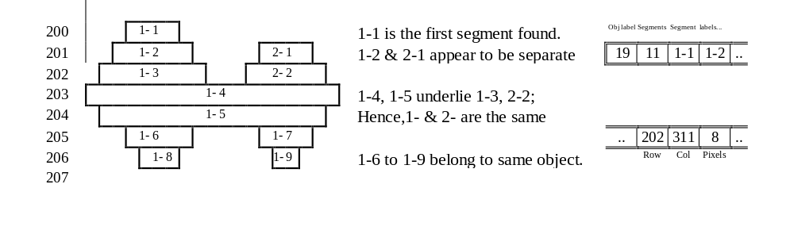
Line segment encoding
Objects are represented as collections of chords
A line-by-line technique
Requires access to just two lines at a time
Data compression may also be applied
Feature measurement may be carried out simultaneously
Notes:
Techniques for representation of objects (cont)
(b) Line segment encoding
This is a line-by-line technique in which objects are represented as collections of chords oriented parallel to the image lines. It has the advantage of requiring simultaneous access to only two lines of the image during its creation, making it suitable for applications where very large images are held on disk and cannot be accessed in a truly random fashion. The algorithm examines the image, line-by-line, working down from the top, looking for adjacent object pixels - see the example above.
Line 200 1-1 is the first segment found.
201/2 1-2 and 2-1 appear to be separate objects at this stage.
203/4 1-4 and 1-5 underlie 1-3 and 2-2, hence 1- & 2- are the same object.
205/6 Segments 1-6, 1-7, 1-8 & 1-9 are all part of the same object.
207 Object 1 complete.
In practice, each chord may be represented (as shown) by the coordinate of its starting point, and its length in pixels. A worthwhile compression or saving may thus be effected over simpler schemes. (This is a variation of the method of run-length coding, often encountered in compression of digital data, and which will be discussed elsewhere.) Furthermore, measurement of parameters such as object area, perimeter, horizontal and vertical extent, etc., may be conveniently built into the object extraction step. In this way, several important feature measurements are known by the time the object extraction is complete.

Slide 58
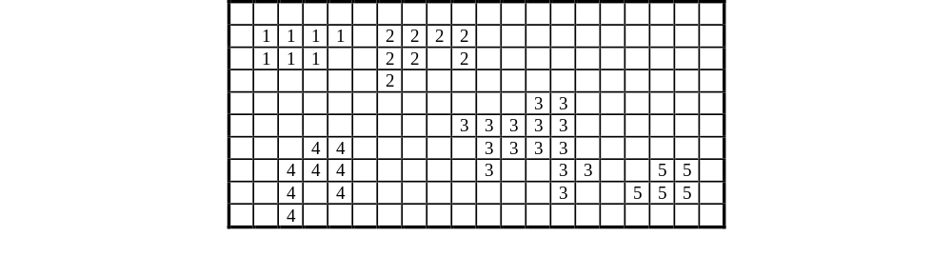
Representation of objects
Object membership map (OMM)
An image the same size as the original image
Each pixel encodes the corresponding object number,
e.g. all pixels of object 9 are encoded as value 9
Zero represents background pixels
  requires an extra, full-size digital image
  requires further manipulation to yield feature information
Example OMM
Notes:
Techniques for representation of objects
Once thresholding or edge detection has been performed to isolate objects, it is necessary to store information about each object for use in feature extraction, and to assign a unique identifier to it. Three ways of maintaining this information are commonly recognised.
(a) Object membership map (OMM)
The Object Membership Map consists of an image of the same spatial dimensions as the original image, in which the value of each pixel encodes the sequence number of the object (if any) to which the corresponding pixel in the original image belongs. For example, all pixels belonging to object 9 are encoded with the value 9. Zero may be retained for pixels not belonging to any object. The OMM is a perfectly general approach, but requires considerable further manipulation to yield feature information; it requires an extra, full-size digital image to describe a scene containing even a single small object.

Slide 59
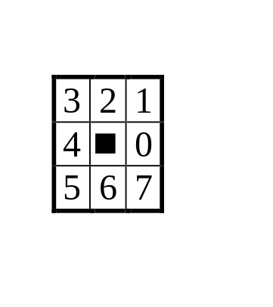
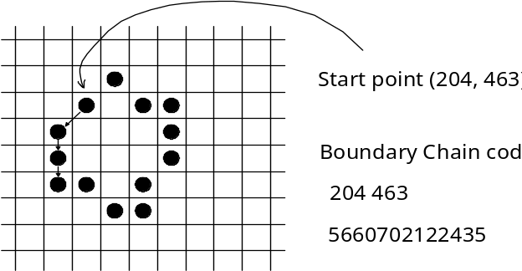
Representation of objects
A compact format for storing object information about an object
Defines only the position of the object boundary
Takes advantage of connected nature of boundaries.
Economical representation; 3 bits/boundary point
Yields some feature information directly
  Choose a starting point on the boundary (arbitrary)
  One or more nearest neighbours must also be a boundary point
  Record the direction codes that specify the path around the boundary
Notes:
Techniques for representation of objects (cont)
(c) Boundary Chain Code (BCC)
The BCC is a compact format for storing information about an object. It defines only the position of the object boundary, the silhouette and location of interior points being obtained by inference. It also takes advantage of the fact that boundaries are connected paths. The BCC begins by taking an arbitrary starting point (x,y) on the boundary. That pixel has eight nearest neighbours, and at least one of these must also be a boundary point. The eight possible directions to the neighbours are assigned numbers 0 to 7 - see the diagram. The BCC then consists of the start coordinates, followed by the set of direction codes that specify the path around the boundary back to the starting point.
Since only three bits are required to represent a number 0-7, the representation of an object with n boundary pixels requires only 3n bits, plus the requirement for the starting coordinate. This may facilitate a significant saving relative to the other representation methods described. One possible disadvantage of this method is that tracing the boundaries requires true random access to the image data, and does not fit well with line-by-line processing.
Approximate information about object perimeter is available simply from the number of pixels in the boundary. Other feature measurements (including area, horizontal extent, vertical extent, perimeter, and many other derived features) may be deduced from suitable manipulation of the BCC.

Slide 60
Size measurements
Area
A simple, convenient measurement, can be determined during extraction.
The object pixel count, multiplied by the area of a single pixel.
  Determined directly from the segment-encoded representation
  Additional computation needed for boundary chain code.
Simplified C code example
a = 0; // Initialise area to 0
x = n; y = n; // Arbitrary start coordinates
for (i=0; i<n; i++)
switch (c[i]) // Inspect each element
{ // 0246 are parallel to the axes
case 0: a -= y; x++; break;
case 2: y++; break;
case 4: a += y; x--; break;
case 6: y--; break;
}
printf ("Area is %10.4f\n",a);
Notes:
Size measurements
Area
This is a simple and convenient measurement and can be determined during extraction. It is simply the number of pixels, within and including the boundary, multiplied by the area of a single pixel. This may be determined directly from the segment-encoded representation, but additional computation is required to derive the object area from the boundary chain code.
The C code fragment above illustrates how this may be achieved. It is assumed that the BCC is held in array c[], and consists of n entries. The basic principle is to augment the area variable as the boundary is tracked across vertical columns of pixels in the direction of positive x; the variable is decremented as columns are passed in the opposite direction. No action is taken in response to movements in the y direction; these represent pixels that have been, or are about to be processed. For diagonal elements, the end pixel of the column is regarded as contributing only half its area to that of the object. Since the boundary is closed, the choice of arbitrary starting values for x and y has no effect on the result.

Slide 61
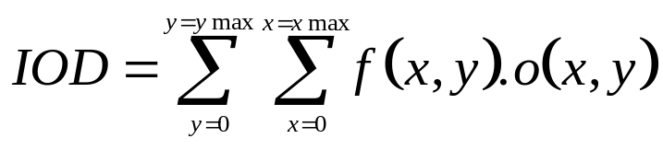
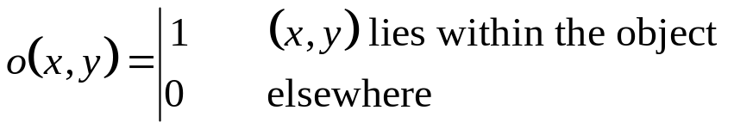
Integrated optical density (IOD)
Determined from the original grey scale image.
IOD is rigorously defined for photographic imaging
In digital imaging, taken as sum of all pixel grey levels over the object:
where:
  may be derived from the OMM, LSE, or from the BCC.
  IOD reflects the mass or weight of the object.
  Numerically equal to area multiplied by mean object grey level.
Notes:
Size measurements (cont)
Integrated optical density (IOD)
This parameter cannot be computed solely from the binarised object image, nor from any of the three representations described, but requires in addition the original grey scale image. Although the integrated optical density is rigorously defined in the context of photographic imaging in terms of optical density (measured using a photometer or similar instrument), in general imaging it is taken to be the sum of all pixel grey levels assessed over the whole of the region (i.e. the object) under consideration.
Formally, then, the IOD is given by the double summation shown above, where o is derived from the segmented image and takes the value unity for a pixel contained in the object of interest, zero elsewhere.
The function o may easily be derived from the OMM or line segment form, or, less directly, from the BCC. The IOD reflects the mass or weight of the object. It is numerically equal to the area multiplied by the mean object grey level.

Slide 62
Length and width
Straightforwardly computed during encoding or tracking.
  Record coordinates:
    minimum x
    maximum x
    minimum y
    maximum y
  Take differences to give:
    horizontal extent
    vertical extent
    minimum boundary rectangle.
Notes:
Size measurements (cont)
Length and width
Length and width may be computed straightforwardly during encoding or tracking processes. A record is simply maintained of the maximum and minimum x and y coordinates encountered. A difference may then be taken of the corresponding maxima and minima to give the horizontal and vertical extent. This approach is easily adapted to yield the size and position of the minimum boundary rectangle.

Slide 63

Perimeter
May be computed crudely from the BCC simply by counting pixels
More accurately, take centre-to-centre distance of boundary pixels
For the BCC, perimeter, P, may be written
where:-
  N_{E} is the number of even steps
  N_{O} is the number of odd steps
taken in navigating the boundary.
Dependence on magnification is a difficult problem
Consider area and perimeter measurements at two magnifications:
    Area will remain constant
    Perimeter invariably increases with magnification
Presence of holes can also affect the measured perimeter
Notes:
Size measurements (cont)
Perimeter
Perimeter may be computed in a crude way from the boundary chain code, simply by counting the number of pixels passed in navigating the boundary. A more accurate result is obtained by determining the accurate centre-to-centre distance of adjacent boundary pixels, which depends whether the step is parallel to the axes or diagonal. For the boundary chain code described earlier, the perimeter, P, may be written as shown in the slide above, where N_{E} is the number of even steps and N_{O} the number of odd steps taken in navigating the boundary. Similar principles apply to the other forms of encoding.
A problem when using perimeter as a classification feature is its dependence on magnification. Consider examining an image containing a single rough object, determining its area and perimeter. If the same measurements are then repeated with the magnification set to (say) twice the original value, the new area will be virtually the same as the first measurement (when the new pixel dimension is taken into account). However, the perimeter will almost certainly be significantly greater. This is because the increase in magnification spreads the same object over a larger number of pixels, making it possible to identify smaller protuberances (which contribute to the perimeter).
Also, the presence of holes in the object can greatly affect the measured perimeter. Some image analysers are equipped with a hole fill utility which can help circumvent this problem.

Slide 64
Number of holes
Hole count may be of great value in classification.
A fundamental relationship exists between:-
    the number of connected components C (i.e. objects)
    the number of holes H in a figure
    and the Euler number:-
E = C - H
A number of approaches exist for determining H.
  Count special motifs (known as bit quads) in objects.
These can give information about:-
    Area
    Perimeter
    Euler number
Notes:
Size measurements (cont)
Number of holes
The number of holes in an object (that is, regions of background totally surrounded by the object) may be of great value in its classification. There is a fundamental relationship between the number of connected components C (i.e. objects) and the number of holes H in a figure, called the Euler number:-
E = C - H
A number of approaches exist for the determination of H. One is due to Grey, and involves the counting of the number of occurrences of certain motifs (known as bit quads) associated with the objects in the figure. The bit quads are a set of 2x2 pixel patterns, as shown on the following slide.

Slide 65
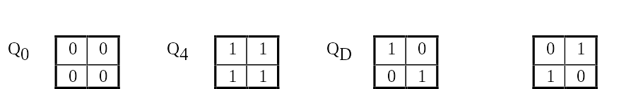
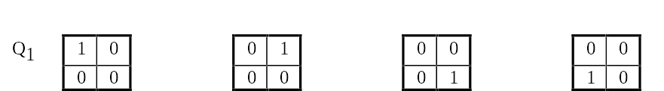

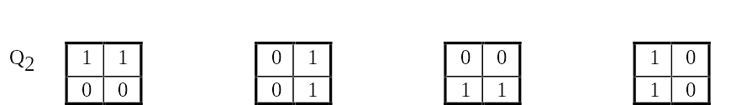


Bit-quad codes
For 1 object alone, H = 1 - E
Disposition of the 16 bit-quad motifs Equations for A, P and E
Notes:
Size measurements (cont)
Number of holes
The area A, perimeter P, and Euler number E can be computed very simply from the number of bit quads in the image associated with each object, using the three equations given un the slide, which are simple linear combinations of the bit-quad counts.
If a single object is under consideration, the number of holes it contains is simply
H = 1 - E

Slide 66
Derived features
For example, shape features
Rectangularity
Ratio of object area A to area A_{E} of minimum enclosing rectangle
  Expresses how efficiently the object fills the MER
  Value must be between 0 and 1.
  For circular objects it is
  Becomes small for curved, thin objects.
Aspect ratio
The width/length ratio of the minimum enclosing rectangle
  Can distinguish slim objects from square/circular objects
Notes:
Derived features
A number of representative features may be deduced as mathematical functions of the measurements already described. A number of these allow objects to be distinguished by their shape. Shape features may be used in combination with size measurements for the purposes of classification.
Rectangularity
This parameter consists of the ratio R of the area A of the object to that area of the minimum enclosing rectangle, expressing how efficiently the object fills this. Its value must be between 0 and 1. For circular objects it takes on the value , but becomes small for curved, thin objects.
A related shape feature is the aspect ratio W/L which is the width/length ratio of the minimum enclosing rectangle. This can distinguish slim objects from roughly square or circular objects.

Slide 67
Derived features (cont)
Circularity
  Assume a minimum value for circular shape
  High values tend to reflect complex boundaries.
One common measure is:
C = P²/A
(ratio of perimeter squared to area)
  takes a minimum value of 4π for a circular shape.
  Warning: value may vary with magnification
Notes:
Derived features (cont)
Circularity
A group of shape features are referred to as circularity measures because they are minimised by the circular shape. High values tend to reflect complex boundaries. A common circularity measure is given in the slide, and represents the ratio of perimeter squared to area, which takes on a minimum value of for a circular shape.

Slide 68
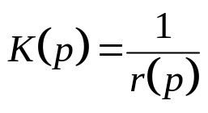
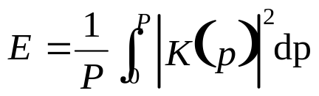
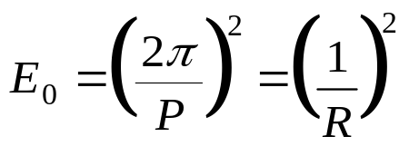
Derived measurements (cont)
Boundary energy is derived from the curvature of the boundary.
Let the instantaneous radius of curvature be r(p),p along the boundary.
The curvature function K(p) is defined:
This is periodic with period P, the boundary perimeter.
The average energy for the boundary can be written:
A circular boundary has minimum boundary energy given by:
where R is the radius of the circle.
Notes:
Derived features (cont)
Boundary energy
A related measurement is described as the boundary energy which is derived from the curvature of the boundary. If the instantaneous radius of curvature is r(p), p being the distance along the boundary from some arbitrary starting point, the curvature function is defined by the reciprocal expression in the slide.
This expression is periodic with period P, the boundary perimeter. The average energy for the boundary can be written as an integral as shown.
The minimum boundary energy is given by a perfectly smooth circular boundary, whose boundary energy is given by the expression 1/R².
where R is the radius of the circle. A discrete expression for E may be computed from the boundary chain code.

Slide 69
Texture analysis
Repetitive structure cf. tiled floor, fabric
How can this be analysed quantitatively?
One possible solution based on edge detectors:-
determine orientation of gradient vector at each pixel
quantise to (say) 1 degree intervals
count the number of occurrences of each angle
plot as a polar histogram:
  radius vector α number of occurrences
  angle corresponds to gradient orientation
Amorphous images give roughly circular plots
Directional, patterned images may give elliptical plots
Notes:
Texture analysis
In many applications it may be necessary to assess the character of any repetitive structure (e.g. pattern of a tile floor, fabric texture) in regions of an image. Several possible definitions of texture have been proposed; however, none immediately leads to a simple quantitative texture measure.
One possible measure of texture may be developed from the edge detection approach described earlier. The principle will be outlined for the gradient operator, but similar reasoning applies to other kinds of edge detector. Since the direction of the gradient lies in the direction of maximum rate of change of pixel value, the direction of the vector field assessed over the region of interest is related to the anisotropy of the image, and hence to the texture of the region.
In order to present this information, at each point in the image the angle of the gradient vector is computed (see slide) and quantised to the nearest degree. For each quantised angle in the range 0-360 degrees a count is maintained of the number of occurrences of that angle over the required part of the image. The result is presented in the form of a polar histogram, the radius vector being proportional to the number of occurrences of that particular angle.

Slide 70
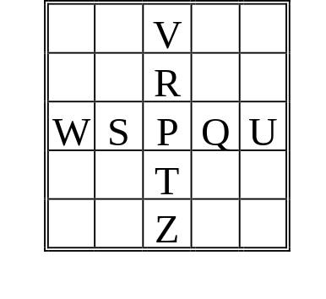
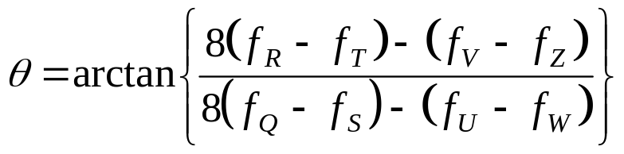
Texture analysis (cont)
Simple expression for angle gives noisy histograms
  Extended expression for θ gives greater accuracy
  Resultant histogram has smoother outline
  Requires larger neighbourhood, and longer computing time
Extended approximation
Notes:
Use of the simple gradient operator for determining the angle of the gradient vector results in somewhat noisy histograms, since the differences computed may be rather small integer values.
To improve the determination of the angle, an extended approximation (shown in the slide) may be developed using a Taylor expansion of the expression. This requires consideration of a larger neighbourhood, and extends the computing time, but gives a smoother histogram.
The polar histogram is generally elliptical in form. The quantitative information it can provide includes:-
the direction in which the largest number of grey-level changes occurs
(the major axis). The pattern is aligned predominantly perpendicular to this.
the ‘strength’ of the texture, or degree of alignment, given by the ratio of the lengths of major axis to minor axis. A specimen with no identifiable texture or alignments would have a roughly circular polar histogram
The form of the histogram broadly resembles that of the Fourier transform of the image; however, its information content is very much lower; unlike with the FT, it is not possible to regenerate the original image given its polar histogram.

Slide 71
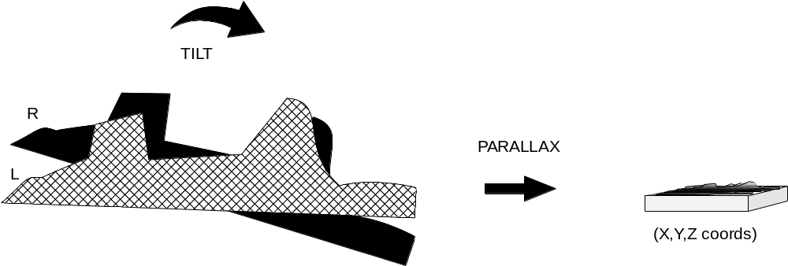
3D Measurements
Most imaging systems are 2D; many specimens are 3D.
How can we extract the information?
Photogrammetry - standard technique for cartography
Either the specimen, or the electron beam can be tilted.
Notes:
With most imaging systems, the information has traditionally been processed and even visualised in 2-dimensional form, while many scenes or specimens contain 3D information (depth). The elucidation of depth information is by no means trivial and cannot normally be accomplished with a single 2D image. The scanning electron microscope (SEM) is a prime example. It is ideally suited to inspection of rough surfaces or samples, as it has a large optical depth of field. However, the 2D image produced contains no direct information about the heights or depths of specimen features.
Cartographers have for years addressed the problem using stereophotogrammetry, in which a pair of 2D images of the same scene, taken from different viewpoints, provides information about the third dimension through parallax shifts which occur when the viewpoint is changed. These techniques are now well understood but demand large amounts of tedious computation; map-makers nowadays make intensive use of computing techniques to circumvent this difficulty, and these same techniques have been adapted and refined for use in robotic and machine vision systems..
In SEM, early stereo work was carried out with the specimen tilted mechanically. However, the same effect can be achieved by tilting the incident electron beam. This may be much more convenient as it can be accompished electronically, and lends itself well to electronic display systems.

Slide 72
Visualisation of height & depth
Seeing 3D images requires the following:-
Stereo pair images
  Shift the specimen (low mag. only)
  Tilt specimen (or beam) through angle α
Viewing system
  lens/prism viewers
  mirror-based stereoscope
  twin projectors
  anaglyph presentation (red & green/cyan)
  LCD polarising shutter, polarised filters
Stereopsis - ability to fuse stereo-pair images
3D reconstruction (using projection, Fourier, or other methods)
Notes:
Microscopy (optical/EM/SEM) produce a 2D image typically containing information corresponding to a specific height or depth in the specimen. What methods are available to help elucidate the 3D nature of the specimen?
Seeing 3D images requires the following:-
Stereo-pair images - generate parallax by viewing the object from different viewpoints. Parallax depends upon height differences.
shift the specimen (or camera) - central projection - low magnification only
tilt the specimen or camera/beam Use larger tilt to achieve greater parallax
Viewing system
Simple lens viewer
one or two prism viewer
System Nesh, twin prism viewer
Mirror stereoscope
twin projectors, polaroid filters, screen
Lenticular overlays (cf 3D postcards)
Anaglyph - red & green/cyan filters, colour TV/projector
LCD polarising shutter on CRT display, polaroid filters
Stereopsis
Eye-brain combination ‘fuses’ stereo-pair to give 3D impression
About 10% of population are unable to achieve this
This ability not necessary to achieve stereo measurement

Slide 73
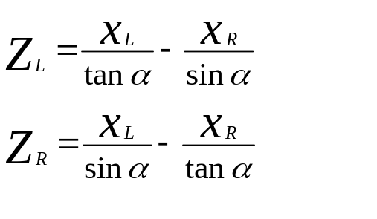
Measurement of height & depth
Measurement by processing of parallax measurements
Three cases:-
Low magnification, shift only parallax
Low magnification, tilt only
High magnification, tilt only (simple case)
  requires x_{L}, x_{R}, tilt change α and magnification M
Notes:
Measurement technique required depends on how the parallax was generated. The aim is to recover (X,Y,Z) coordinates of features of interest. Three cases often distinguished
Low magnification, shift-only parallax (central projection)
Requires parallax shift p, working distance D, and base shift B
Low magnification, tilt-only parallax (central projection).
Requires x_{L}, x_{R}, y_{L}, y_{R}, working distance D, magnification M, and tilt angles φ_{L} and φ_{R}. Formulae are complex, dictating use of a computer.
High magnification, tilt-only parallax (parallel projection)
Requires only x_{L}, x_{R}, tilt change α and magnification M in simplest cases.
z_{R}
z_{L}
beam
α
x_{R}
x_{L}

Slide 74
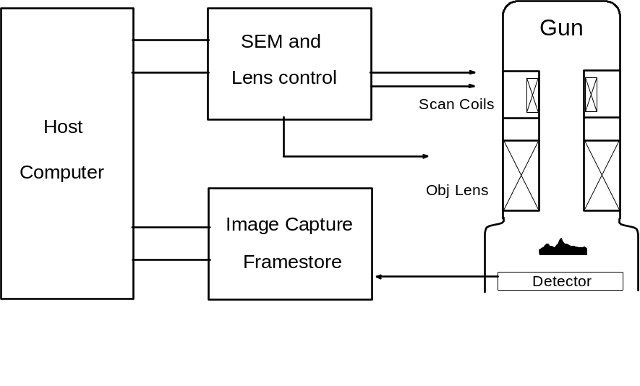
Computer-based system for SEM
Acquisition of stereo-pair images
Recording of operating parameters
Correction for distortion
Computation of 3D values from parallax
Notes:
A modest computer-based system can be used to help in 3D analysis of images in the SEM. The various steps in image manipulation are:-
acquisition of a stereopair image, using image processing techniques as required; tilt settings may be adjusted with the guidance of the computer in order to define the viewpoints as required. The stereo pair may be viewed using the stored images (i.e. without further irradiating the specimen) if a suitable viewer is available.
recording of operational parameters, e.g. tilt settings, magnification
interactive identification of corresponding features in the stereo pair;
correction for known distortions and non-linearities
computation of 3D data from parallax shifts; the computer is ideally suitaed to handling the tedious computations that arise. Direct data entry is avoided, so eliminating a potential source of error.
tabulation of computed 3D data with options for graphic rendering (sections and perspective profiles)
automated recognition of corresponding features, removong the need for operator interaction.

Slide 75


3D by Automatic Focussing
Notes:
In this approach to height measurement, the SEM is used in a ‘range-finding’ mode to measure the heights of features of interest in a rough surface. It directs the electron beam to these features and automatically makes adjustments to the magnetic objective lens until each one in turn is optimally focussed. When focus has been achieved, the objective lens excitation may be interpreted directly as a measure of the separation between the lens and the feature. The computer uses an image processing approach to determine optimal focus. The interfaces required include:-
two 12-bit DACs to control the beam position
a 16-bit DAC to regulate the objective lens excitation
an 8-bit ADC to sample the SEM video signal
The SEM video signal is used to estimate the rate of change of grey level in the vicinity of the feature of interest. The parameter evaluated is:-
R
P
Q
the summation being over the vicinity of the feature. This parameter peaks at focus.
The computer scans the beam over the region around the feature of interest while progressively sweeping the objective lens excitation through a pre-determined range. The maximum G value encountered indicates the lens setting corresponding to focus, and the height of the feature may be deduced. Further refinements are needed:-
to guard against electronic noise and magnetic hysteresis in the lens;
to compensate for field curvature
to select a suitable set of features and to display the results.

Slide 76

Combined Stereo/Autofocus
Sample tilting is simple but awkward to implement
Beam tilting allows real time viewing but requires extra stereo tilt deflection coils in the SEM column
Notes:
In SEM, early stereo work was carried out with the specimen tilted mechanically. However, the same effect can be achieved by tilting the incident electron beam. This may be much more convenient as it can be accompished electronically, and lends itself well to electronic display systems.
Initial work with electronic beam tilt made use of pairs of additional deflection coils installed above and below the objective lens of the instrument. The use of complementary pairs of coils allows the beam to be deflected so that its angle of incidence is changed (to left or right) but the field scanned remains substantially unaffected. However, this approach led to considerable complexity, as the objective lens imposes a rotation on the scanned pattern, leading to uncertainty in the orientation of the tilt axis.
In the case study to be described, a novel approach to tilting was employed which made use of existing deflection coils (i.e. no requirement for dedicated stereo beam tilt coils) but which circumvents the difficulty described, and allows beam tilts of up to + 3 degrees with no serious performance limitation.

Slide 77

Novel Beam Tilt method
Uses Gun Alignment coils
No extra deflection coils required
Tilt axis follows focal plane of final lens with changes in working distance
No restriction on working distance
Notes:
In the modified electronic tilt technique, scanning waveforms are applied to a set of gun alignment coils situated close to the electron gun (note that in normal use these coils are driven with an adjustable but static excitation). This results in tilting, as required, but also results in a shift in the position of the (virtual) electron source.
This is remedied by driving a further set of coils (the micro shift coils) with complementary waveforms to bring the tilted beam back onto axis. Again, in normal usage, these coils are driven statically.
With this approach, no dedicated stereo deflection coils are required.
Also, the tilt axis is insensitive to changes in the working distance brought about by the use of different specimens, remaining in the focal plane.

Slide 78
Measurement Technique
In situ measurement technique
  Beam tilt axis lies in focal plane of final lens
  Features above/below focal plane are laterally displaced
Features are made to coincide
  By changing excitation/focus of lens
  Change in excitation gives measure of relative vertical displacements between image features
Can readily be automated
  by use of a computer to control lenses and determine feature coincidence
Notes:
With the electron optical deflection system as described, the beam tilt axis lies in the focal plane of the objective lens.
As a result, features lying within the focal plane will appear to coincide in the left- and right-hand members of the stereo pair.
Features outside the focal plane will appear deflected laterally in the left-hand member of the stereo-pair, and also in the right-hand member, but in the opposite direction.
By changing the excitation of the objective lens, the position of the tilt axis may be changed to coincide with any desired feature, whose images will then appear to coincide in the stereo-pair images. The change in lens excitation then gives a measure of the relative vertical displacement between image features imaged in this way.
The state of excitation of the objective lens may readily be controlled by means of a high precision DAC; however, a means of detecting coincidence between features in the members of the stereo pair is required.
This is achieved by using cross-correlation. A dedicated, high-performance digital signal processing card is installed in the controlling computer, and determines by cross-correlation a parameter which peaks when the images of the feature under consideration are optimally aligned (as a function of objective excitation).

Slide 79

Automated height measurement
System determines:-
  spot heights
  line profiles
  area topography map
  contour map
Display shows a line profile taken across a 1 μm polysilicon track
Notes:
The instrument is built around an SEM made by Leica Cambridge with LaB₆ electron gun, controlled by an IBM PC compatible computer equipped with the necessary interfaces.
The computer is programmed to carry out the necessary adjustments, scanning the electron beam digitally over a 16-bit field, and to capture the stereo-pair images used to determine coincidence. In addition, it contains software to:-
compensate for displacement of the focal plane due to tilting
compensate for field curvature with large scan fields
control the lens excitation to avoid problems with eddy currents and magnetic hysteresis
The cross-correlation unit transforms the captured images into the Fourier domain. It is capable of 25 x 10⁶ floating-point operations per second, independent of the controlling PC.
The user interface comprises image and data display windows and function controls which are executed through “buttons” operated with a mouse. An automatic set-up procedure is provided to align the tilt axis with the focal plane prior to measurement. Three modes of height measurement are implemented:-
Spot mode, used to define a point of reference relative to which the heights of other individual features may be determined;
Line profile: reference, start and stop points are selected with the mouse, and heights are measured at regular intervals between the start- and stop-points.
Area topography map: the heights of features are determined at the points of intersection of an imaginary net cast over the surface of the specimen.

Slide 80
Remote Microscopy
Modern SEMs are fully computer-controlled instruments
Networking to share resources - information, hardware, software
The Internet explosion & related tools
Don’t Commute --- Communicate!

Slide 81

Remote Microscopy with NetSEM

Slide 82
Automated Diagnosis for SEM
Fault diagnosis of SEM
  Too much expertise required
  Hard to retain expertise
  Verbal descriptions of symptoms often ambiguous
  Geographical dispersion increases costs.
Amenable to the Expert System approach.
  A computer program demonstrating expert performance on a well-defined task
  Should explain its answers, reason judgementally and allow its knowledge to be examined and modified

Slide 83

An Expert System Architecture

Slide 84
Remote Diagnosis
Stages in development
  Knowledge acquisition from experts, manuals and service reports
  Knowledge representation --- translation into a formal notation
  Implementation as custom expert system
  Integration of ES with the Internet and RM
Conclusions
  RM offers accurate information and SEM control
  ES provides engineer with valuable knowledge
  ES + RM = Effective Remote Diagnosis

Slide 85
Image Processing Platforms
Low cost memory has resulted in computer workstations having large amounts of memory and being capable of storing images.
Graphics screens now have high resolutions and many colours, and many are of sufficient quality to display images.
However, two problems still remain for image processing:
  Getting images into the system.
  Processing power.
Notes:
Workstations and Image Processing Platforms
Memory is now available in large capacities at low cost. This has resulted in computer workstations having large amounts of memory and being capable of storing images. Graphics screens have also greatly improved, with high resolutions and many colours. Many graphics screens are of sufficient quality to display images. However, two problems still remain for image processing. The first is the problem of getting images into the system. A framestore is still required to capture images from a video source and convert them into digital form for access by the computer. The second problem is that of processing power. Whilst the processing power of computer workstations is ever increasing, image processing operations such as convolution filters or fast Fourier transforms are of such complexity that to perform them in real time requires more computing power than is available. For many applications that require a single image to be processed and analysed, real time processing is not necessary and the time for the workstation to perform the calculations may be adequate. Framestores incorporating high speed processors, which have been optimised for image processing operations, increase the speed of processing images.

Slide 86
Parallel Processing
Many image processing operations involve repeating the same calculation repeatedly on different parts of the image. This makes these operations suitable for a parallel processing implementation.
The most well known example of parallel computing platforms is the transputer. The transputer is a microprocessor which is able to communicate with other transputers via communications links.
Notes:
Parallel Processing
Many image processing operations involve repeating the same calculation repeatedly on different parts of the image. This makes these operations suitable for a parallel processing implementation, with several similar processors performing the same operation on different parts of the image. The most well known example of parallel computing platforms is the transputer. The transputer is a microprocessor which is able to communicate with other transputers via communications links. A transputer array consists of a number of processing elements each consisting of a transputer with local memory connected to a number of other processing elements, see Figure 9.

Slide 87

Transputer Array

Slide 88

Parallel Processing contd.
The speed increase is not linear as the number of processing elements increases, due to a communications overhead.
Notes:
Processing power may be increased by adding more transputers. However, the speed increase is not linear, that is the speed increase is not directly proportional to the number of transputers used. This is because there is a processing overhead associated with the communication between the transputers. The communications links of the transputer are serial links, which have are a limited bandwidth and are not ideally suited for the transmission of images around the processing array.

Slide 89
Windowed Video Displays
Windowed video hardware allows live video pictures to be displayed within a window on the computer display.
This is achieved by superimposing the live video signal on the computer display output.
The video must be first rescaled, cropped and repositioned so that it appears in the correct window in the display. Rescaling is most easily performed by missing out lines or pixels according to the direction.
Notes:
Windowed Video
Recent advances in computer technology have led to graphical user interfaces (GUIs) and windowing software. This has provided the user with easier to use software with a consistent interface. Whilst it is not possible to display video directly on to a windowed computer display, hardware is available which allows video to be superimposed within a window. To achieve this, the input video is first digitised. Repositioning, cropping and scaling of the data then takes place to match the required window size. The new data is stored into the frame memory. This acquisition process is synchronised to the input video. Rescaling is most easily performed vertically by missing out lines and horizontally by missing out pixels.

Slide 90

Windowed Video Displays contd.
Notes:
The digital data from the frame memory is converted into a video signal by the DAC. The output from the frame memory is synchronised to the computer display and is asynchronous to the the input video acquisition. At the relevant times, the output to the computer monitor is switched between the computer display driver and the DAC of the windowed video hardware, so that the video is superimposed into a window on the computer display, see above.

Slide 91
Framestores - conclusion
The framestore is an important part of any image processing system, allowing images to be captured and stored for access by a computer. A framestore and computer combination provides a very flexible image processing system.
Real time image processing operations such as recursive averaging and background correction require a processing facility to be integrated into the framestore.

Slide 92
Digital Imaging
Computers in Image Processing and Analysis
SEM and X-ray Microanalysis, 8-11 September 1997
David Holburn University Engineering Department, Cambridge

Slide 93
Fundamentals of
Digital Image Processing
Electron Microscopy in Materials Science
University of Surrey
David Holburn University Engineering Department, Cambridge

Slide 94
Fundamentals of
Image Analysis
Electron Microscopy in Materials Science
University of Surrey
David Holburn University Engineering Department, Cambridge

Slide 95
Image Processing & Restoration
IEE Image Processing Conference, July 1995
David Holburn University Engineering Department, Cambridge
Owen Saxton University Dept of Materials Science & Metallurgy, Cambridge

