Slide 1


Digital Image Processing
Wavelet and Multiresolution Processing
(Chapter 7)

Slide 2
Introduction
What is a Transform and Why do We Need One?
Transform: A mathematical operation that takes a function or sequence and maps it into another one
Transforms are good things because…
  The transform of a function may give additional /hidden information about the original function, which may not be available /obvious otherwise
  The transform of an equation may be easier to solve than the original equation
  The transform of a function/sequence may require less storage, hence provide data compression / reduction
  An operation may be easier to apply on the transformed function, rather than the original function (recall convolution)

Slide 3
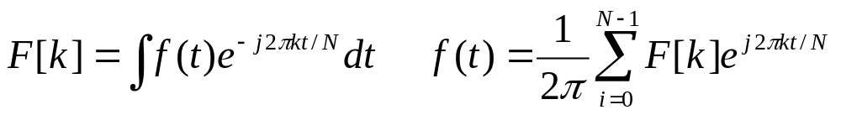
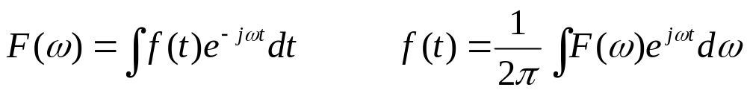
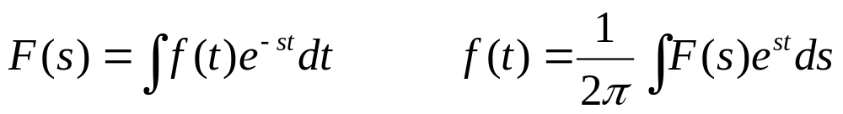
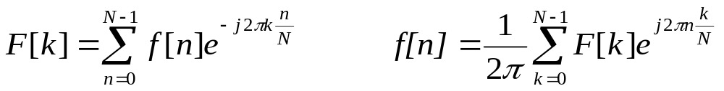
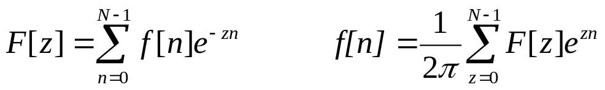
Introduction
What Transforms are Available?
Fourier series
Continuous Fourier transform
Laplace transform
Discrete Fourier transform
Z-transform
H.R. Pourreza

Slide 4
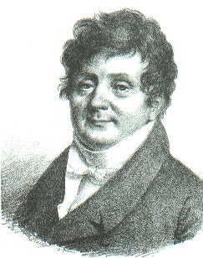
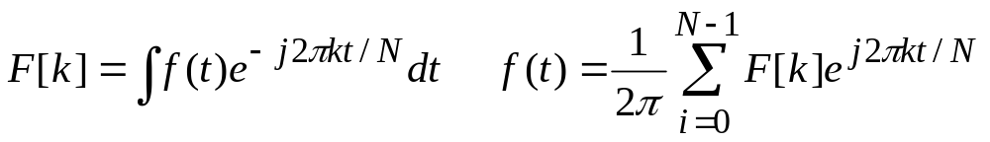
Introduction
Fourier Who …?
“An arbitrary function, continuous or with discontinuities, defined in a finite interval by an arbitrarily capricious graph can always be expressed as a sum of sinusoids”
J.B.J. Fourier
December, 21, 1807
Jean B. Joseph Fourier
(1768-1830)
Notes:
He announced these results in a prize paper on the theory of heat.
The judges: Laplace, Lagrange and Legendre
Three of the judges found it incredible that sum of sines and cosines could add up to anything but an infinitely differential function, but...
Lagrange: Lack of mathematical rigor and generality
Denied publication….
After 15 years, following several attempts and disappointments and frustration, he published his results in Theorie Analytique de la Chaleur in 1822 (Analytical Theory of Heat).
In 1829, Dirichlet proved Fourier’s claim with very few and non-restricting conditions.
Next 150 years: His ideas expanded and generalized. 1965: Cooley and Tukey--> Fast Fourier Transform==> Computational simplicity==>King of all transforms…Many applications engineering, finance, etc.

Slide 5
Introduction
Wavelet Transform
Analysis windows of different lengths are used for different frequencies:
  Analysis of high frequencies➔ Use narrower windows for better time resolution
  Analysis of low frequencies ➔ Use wider windows for better frequency resolution
This works well, if the signal to be analyzed mainly consists of slowly varying characteristics with occasional short high frequency bursts.
Heisenberg principle still holds!!!
The function used to window the signal is called the wavelet

Slide 6
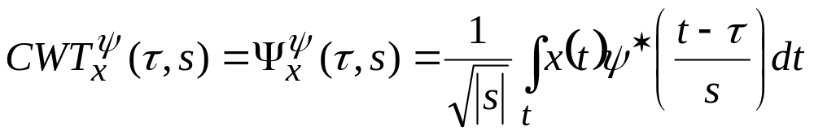
Introduction
Wavelet Transform
Translation parameter, measure of time
Scale parameter, measure of frequency
A normalization
constant
Signal to be analyzed
Continuous wavelet transform of the signal x(t) using the analysis wavelet ψ(.)
The mother wavelet. All kernels are obtained by translating (shifting) and/or scaling the mother wavelet
Scale = 1/frequency

Slide 7
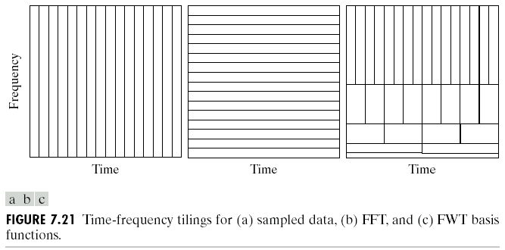
Introduction
Time and Frequency Resolution

Slide 8
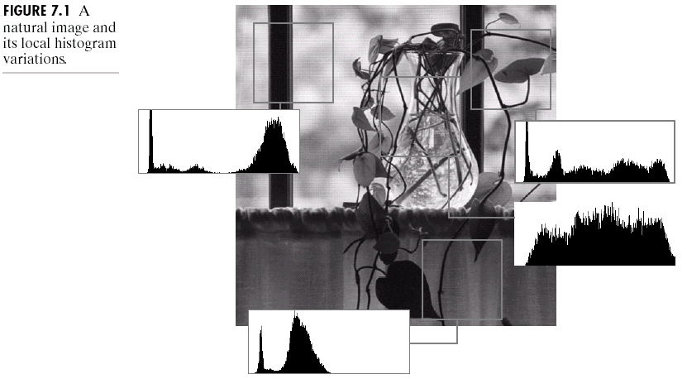
Background

Slide 9
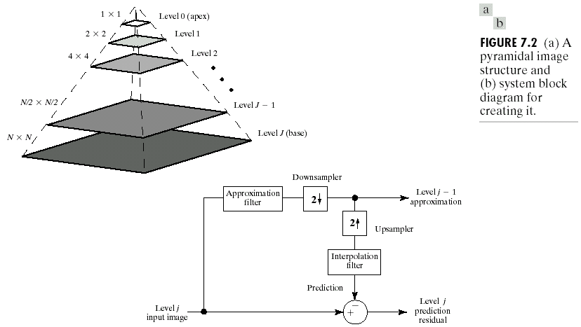
Image Pyramids

Slide 10
Image Pyramids
Compute a reduced-resolution approximation of the input image
  Filtering (Averaging, Gaussian)
  Down-sampling
Up-sample the output of the previous by a factor 2
Compute the difference between the prediction of step 2 and the input to Step 1.

Slide 11
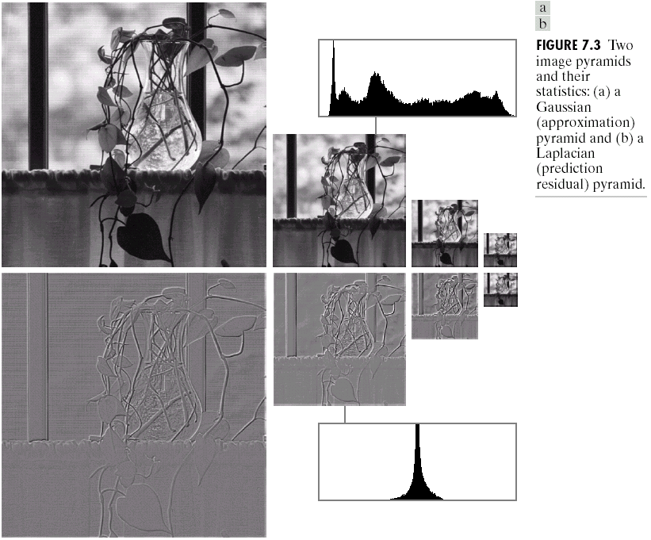
Image Pyramids

Slide 12
Multi-Resolution Expansion
In Multi-resolution Analysis (MRA), a Scaling Function is used to create a series of approximations of a function or image, each differing by a factor 2 from its nearest neighboring approximations. Additional functions, called Wavelet, are used to encode the difference in information between adjacent approximation

Slide 13
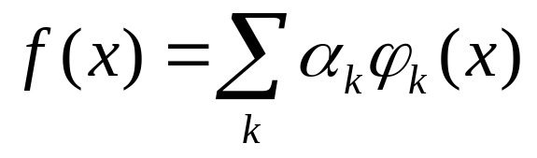




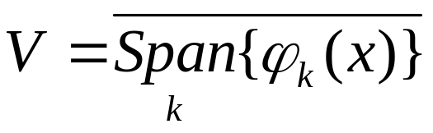
Multi-Resolution Expansion
Series Expansion
Real-valued expansion coefficients
Real-valued expansion functions
If the expansion is UNIQUE- that is, there is only one set of for any given - the are called basis functions, and the expansion set, , is called a BASIS for the class of functions that can be so expressed.
The expressible functions form a function space that is referred to as the close span of the expansion set

Slide 14
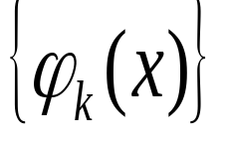
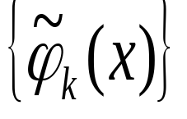
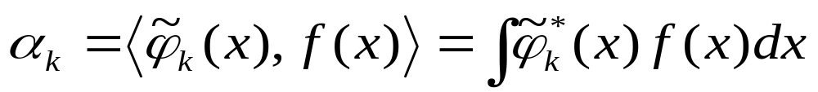
Multi-Resolution Expansion
Series Expansion
Dual Functions

Slide 15
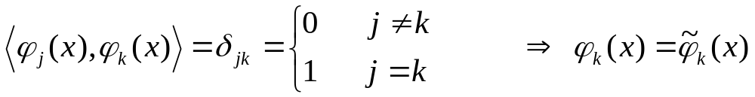
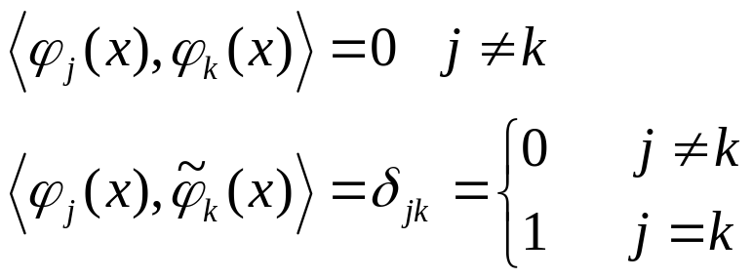
Multi-Resolution Expansion
Series Expansion
CASE 1: Expansion functions form an orthonormal basis
CASE 2: Expansion functions are not orthonormal, but are an orthogonal basis (biorthogonal basis)
CASE 3: Expansion set is not a basis

Slide 16

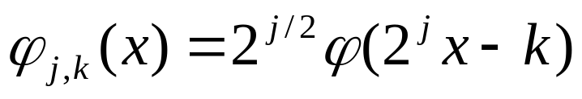

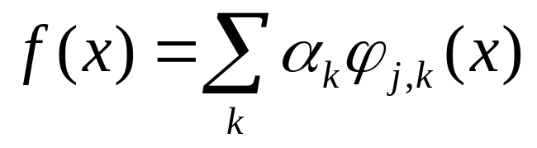
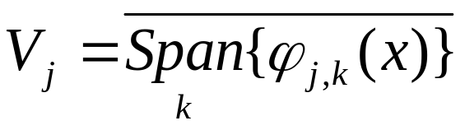
Multi-Resolution Expansion
Scaling Functions

Slide 17
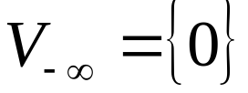
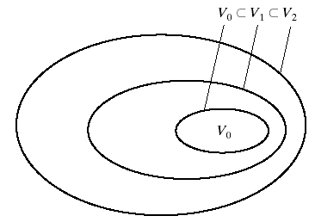
Multi-Resolution Expansion
MRA Requirements
  The scaling functions is ORTHOGONAL to its integer translations.
  The subspace spanned by the scaling function at low scales are nested within those spanned at higher scales.
  The only function that is common to all V_{j} is f(x)=0
  Any function can be represented with arbitrary precision

Slide 18
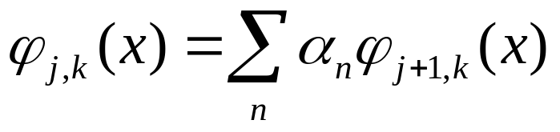
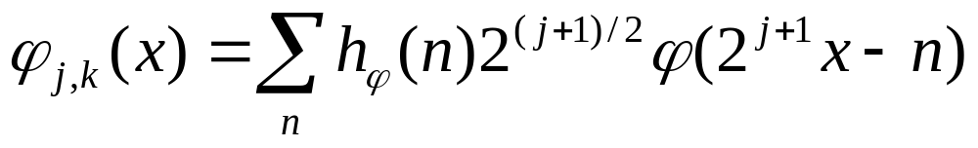
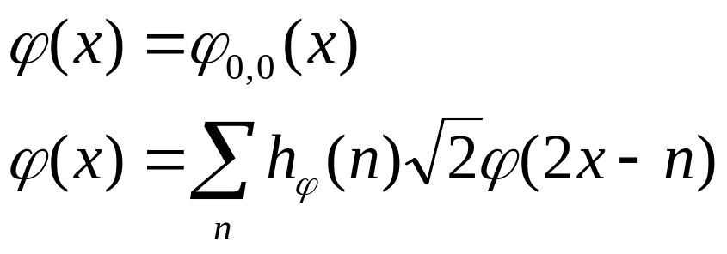
Multi-Resolution Expansion
MRA Requirements
Scaling Vector

Slide 19
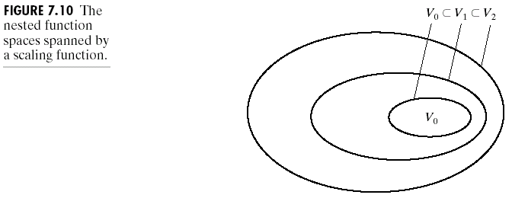
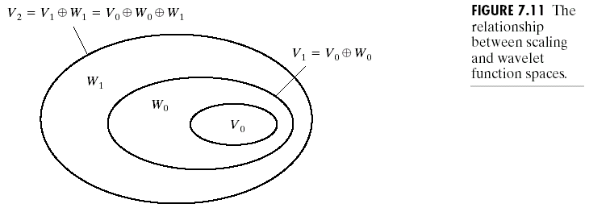
Multi-Resolution Expansion
Wavelet Functions
Union of Spaces

Slide 20
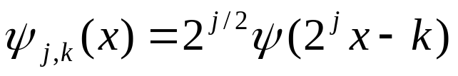
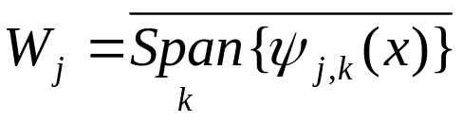
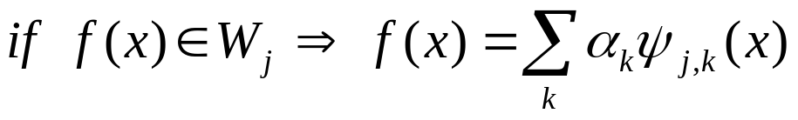



Multi-Resolution Expansion
Wavelet Functions
The all members of V_{j} are orthogonal to the W_{j}
We can now express the space of all square integrable functions as:
or
or

Slide 21
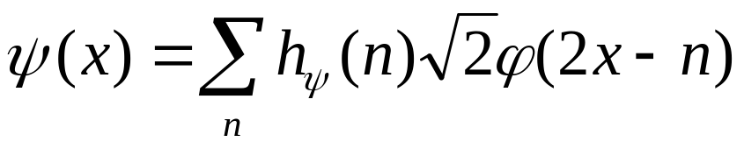
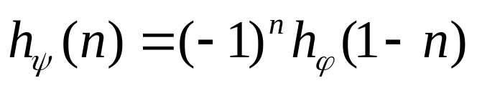
Multi-Resolution Expansion
Wavelet Functions
Approximation of f(x)

Slide 22
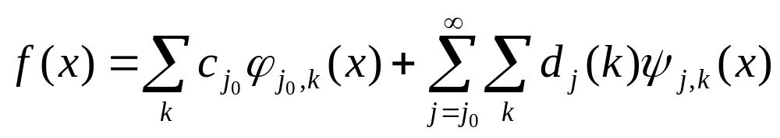
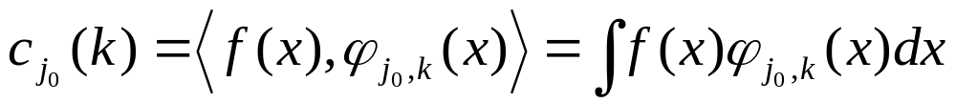
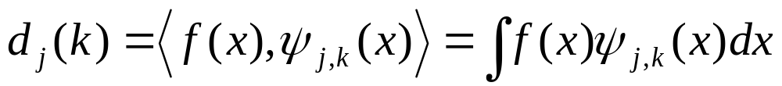
Wavelet Transform
Wavelet Series Expansion
Approximation (Scaling) Coefficients
Detail (Wavelet) Coefficients
If the expansion functions form an orthonormal basis:

Slide 23
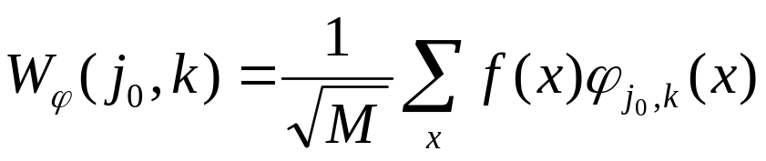
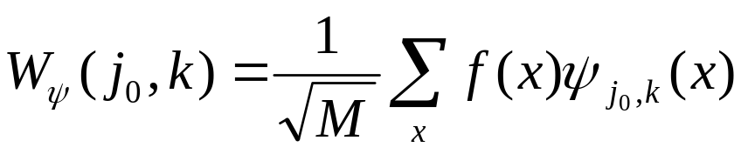
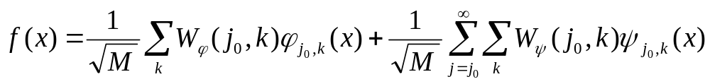
Wavelet Transform
Discrete Wavelet Transform (DWT)

Slide 24
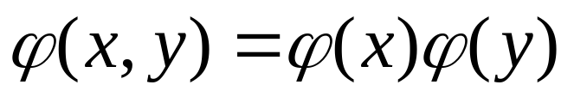
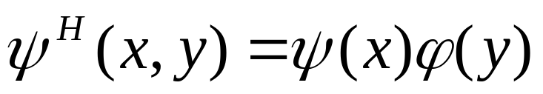
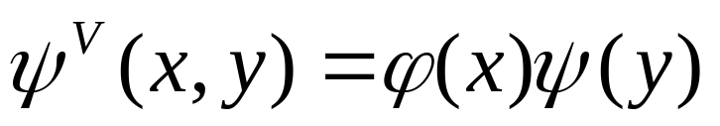

Wavelet Transform: 2-D
Scaling function:
Wavelet functions:
Horizontal direction
Vertical direction
Diagonal direction

Slide 25
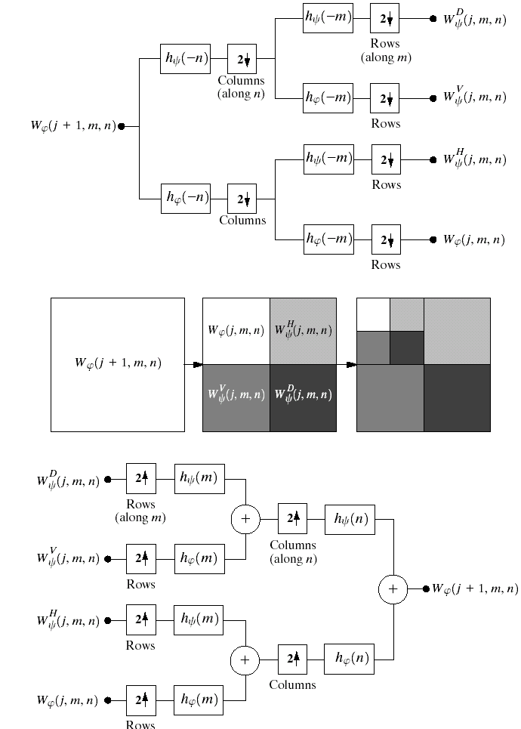
2-D Wavelet Transform: Decomposition

Slide 26
2-D Wavelet Transform: Reconstruction

Slide 27
