Slide 1
Clinically Inspired Hierarchical Multi Label Classification of Chest X rays with a Penalty Based Loss Function

Slide 2
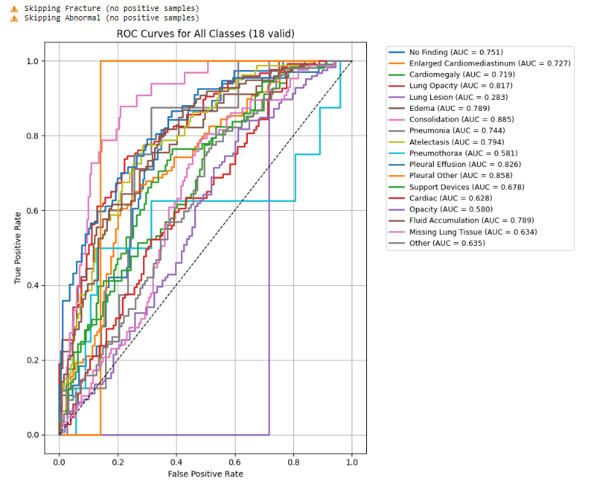
Result

Slide 3
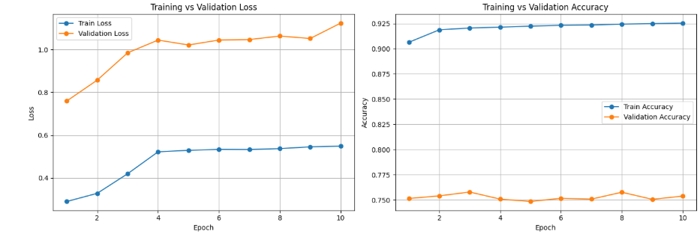
Result

Slide 4
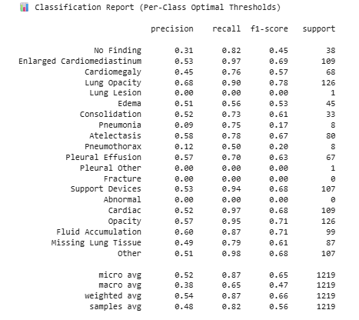
Result

Slide 5
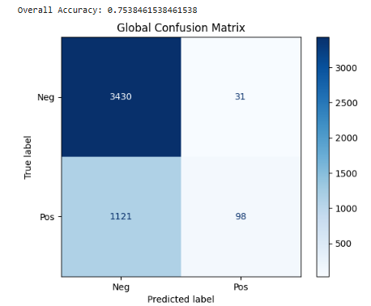
Result

Slide 6
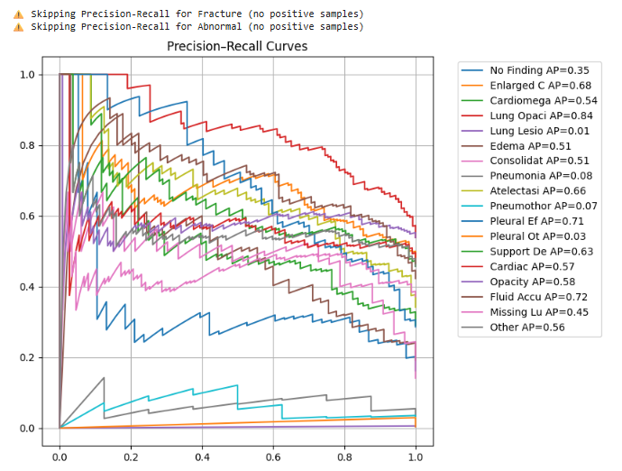
Result

Slide 7
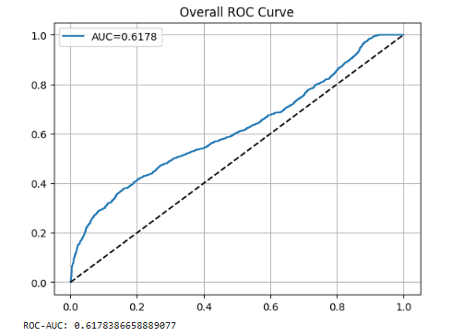
Result

Slide 8
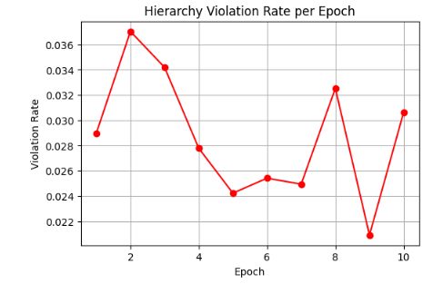
Result

Slide 9
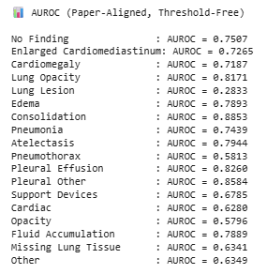
Result

