Slide 1

CAPITAL ASSET PRICING MODEL
BY: VASAVA KIRTIBEN ARJUNBHAI

Slide 2
PROJECT SUMMARY
The primary objective of the project is to apply the Capital Asset Pricing Model(CAPM) to analyze and determine the required compensation that an investor should expect given the risk to invest in an asset.The project begins by first estimating expected stock returns, followed by calculating the betas, determining the market return, and obtaining the risk-free rate. Finally, the project involves performing CAPM calculations and visualizing results to provide a comprehensive understanding of the stock's risk and investor expected compensation. Finally, culminating in a discussion of the results of this analysis.

Slide 3
INTRODUCTION
The Capital Asset Pricing Model (CAPM) is a widely used financial model within the finance industry that helps in estimating the expected return on an investment based on its risk level. It considers the relationship between the asset's beta, which measures its volatility compared to the overall market, and the risk-free rate of return. By incorporating these factors, CAPM provides a framework for investors to assess the appropriate compensation they should receive for taking on the investment risk.
CAPM Formula: rf + (beta * (rm-rf))

Slide 4
PROBLEM STATEMENT
The objective is to determine the expected return on a stock using the Capital Asset Pricing Model (CAPM). This involves calculating the expected return by taking into account the risk-free rate, the expected return of the market, and the stock's beta, which measures its sensitivity to market movements. By using the CAPM formula, E(Ri)=Rf+βi(Rm−Rf)E(R_i) = R_f + \beta_i (R_m - R_f)E(Ri )=Rf +βi (Rm −Rf ), investors can assess the stock's risk relative to the overall market and predict its expected return based on systematic risk. This model helps in making informed investment decisions by quantifying the trade-off between risk and return.

Slide 5
DATA COLLECTION PROCESS
The database I am using from kaggle.
Which contains data from 2012 to 2020 and contains around 2000 rows.
And also 10 columns coins stocks detais of google ,ibm ,amazon tesla etc.
the data is also based on the close price of the stocks.

Slide 6



TOOLS AND LIBRARIES
PYTHON
JUPYTER NOTEBOOK
PANDAS
NUMPY
PLOTLY.EXPRESS

Slide 7
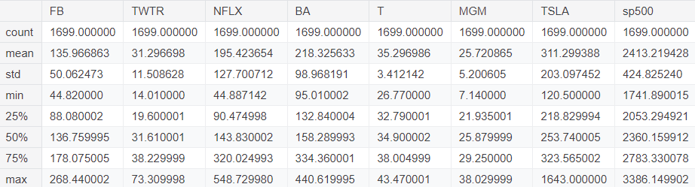
BUIDING A PROJECT
STEP 1: IMPORT LIBRARIES
STEP 2:IMPORT DATASET:

Slide 8
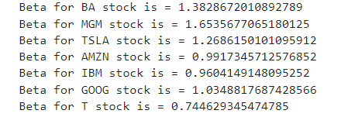
STEP 3: ANALYZING AND CLEANING :
#beta represents the volatility of a stock in relation to the overall market movements. Where the market movement is equal # to 1, stock beta that is greater than 1 suggests that a stock is more volatile than the market and a beta of less than 1 # represents a stock with lower volatility than the market.

Slide 9
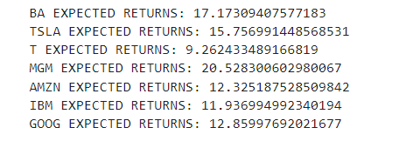
STEP 3.2:CALCULATING THE EXPECTED RETURN USING THE CAPM:
# The CAPM formula is expressed as: rf + (beta * (rm-rf)) # these results are in percentages (%). # Risk-free premium = rf # beta = stock beta # rm = market rate of return

Slide 10
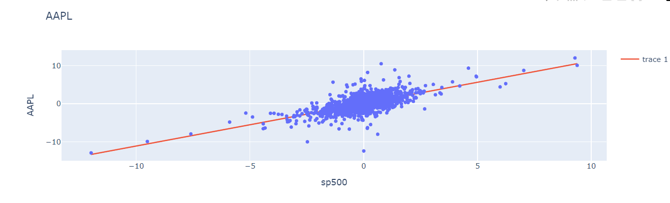
STEP 4:VISULIZING THE DATA (INTERACTIVE):
#Plotting the daily returns of stocks vs S&P 500 daily returns
1.APPLE

Slide 11
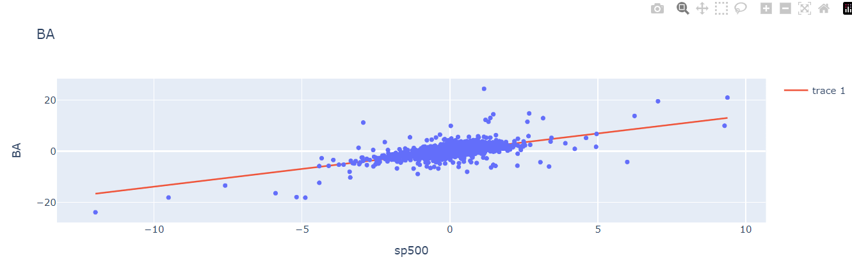
2.BOING CO:

Slide 12
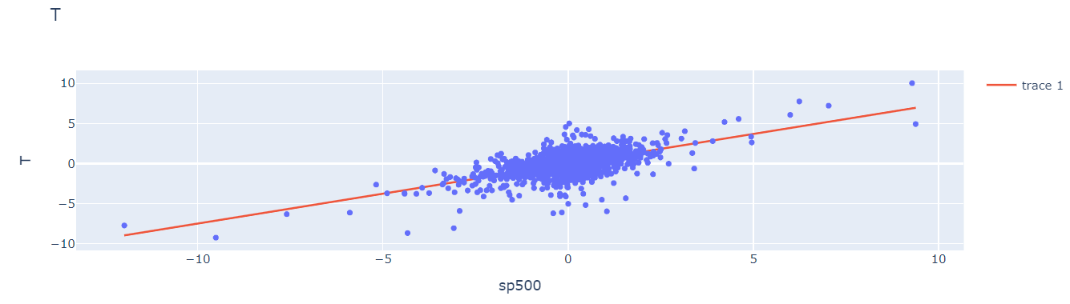
3.TELECOM:

Slide 13
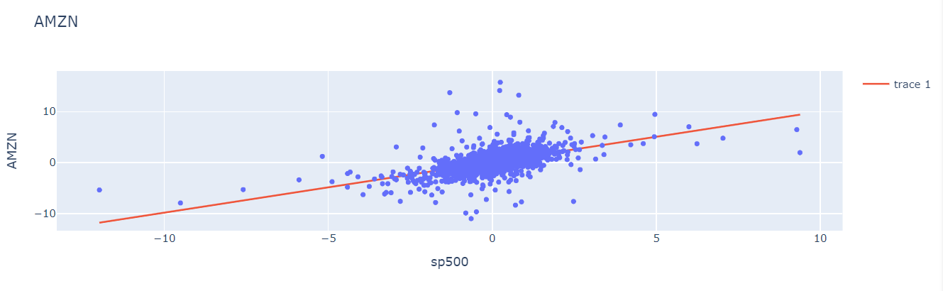
4.AMAZON:

Slide 14
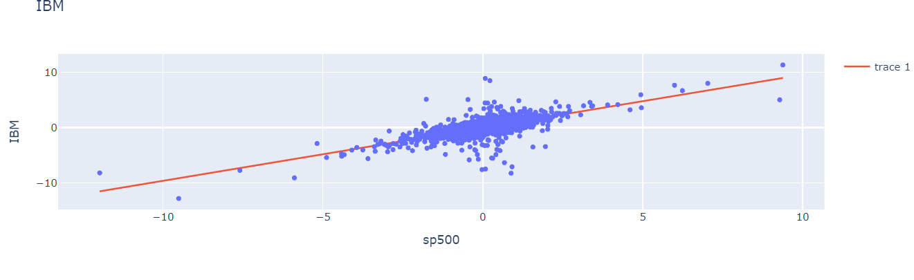
5.IBM

Slide 15
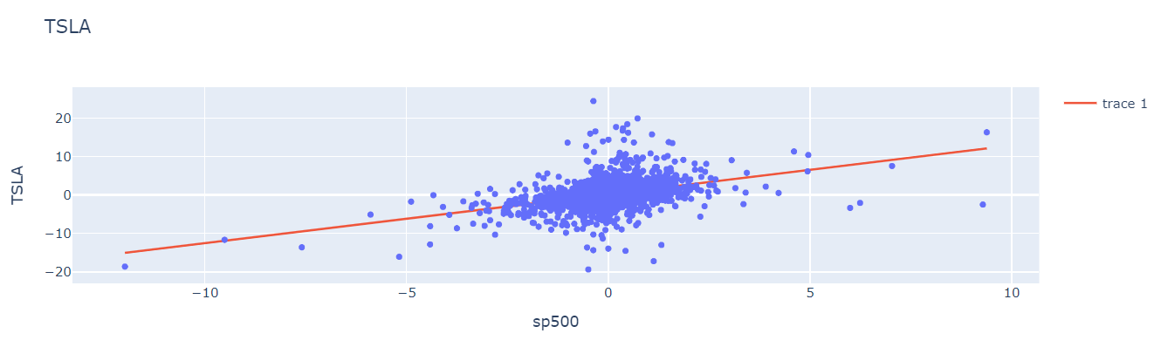
6.TESLA

Slide 16
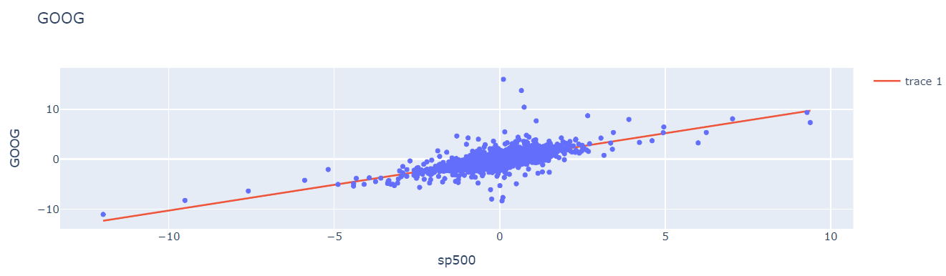
7.GOOGLE

Slide 17
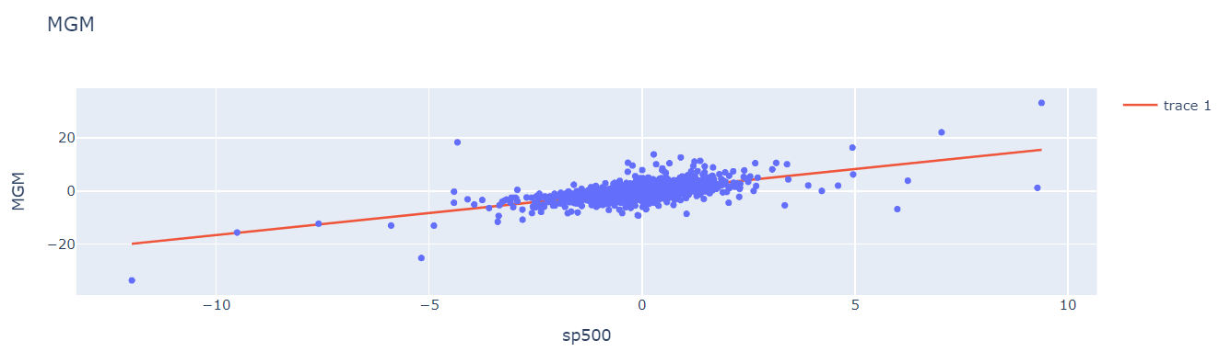
8.MGM

Slide 18
RESULT
The CAPM analysis yielded the following results:
Capital Asset Pricing Model Results:
Boeing: 16.05% Tesla: 15.77% google12.86%, amazon: 12.33% T: 8.46%
These figures represent the estimated returns investors should expect based on the risk associated with each stock. Higher expected returns generally indicate higher levels of risk.

Slide 19
Among the stocks analyzed, MGM stands out with the highest expected return of 20.53%, this suggests a relatively higher level of risk compared to the other stocks analyzed. On the other hand, T has the lowest expected return of 9.26%, indicating a relatively lower level of risk compared to the other stocks.
These findings provide insights into the potential returns of each stock during the specified time period, assisting investors in evaluating their investment strategies and allowing them to make more informed decisions.
CAPM should not be the only metric an investor relies on to invest. Instead, an investor should consider a confluence of metrics and financial analysis in order to gain better insight into their preferred assets.

Slide 20
PROJECT CONCLUSION
In conclusion, the Capital Asset Pricing Model (CAPM) is a valuable tool for assessing the expected return of an asset based on its systematic risk in relation to the overall market. By calculating the beta coefficient, which represents the asset's sensitivity to market movements, CAPM provides insights into the risk-reward tradeoff for investors. Our analysis of various stocks using CAPM revealed interesting levels of risk and expected returns.
Stocks such as Boeing and Tesla exhibited higher betas, indicating greater volatility and risk with the potential for higher returns. On the other hand, AT&T displayed a lower beta, suggesting relatively lower risk and expected returns with lower risk.
These findings can help investors make informed decisions in terms of their investment portfolios goals. However, it's important to note that CAPM relies on certain assumptions, such as efficient markets and the use of historical data, which may limit its accuracy in real-world scenarios.
Nevertheless, CAPM is a valuable framework for evaluating investment opportunities and understanding the relationship between risk and expected returns.

Slide 21


