Slide 1
EcoWatt Advisor
AI-Powered Electricity Forecasting & Energy-Saving Advisor for Households
SDG 7 — Affordable and Clean Energy | SDG 13 — Climate Action
Kirti Yadav
MSc Economics, Gokhale Institute of Politics and Economics (GIPE), Pune
1M1B AI for Sustainability Virtual Internship | July–Sep 2026 | In collaboration with IBM SkillsBuild & AICTE

Slide 2
The Problem
How might we use AI to forecast household electricity use so that families can cut avoidable energy waste and adopt more sustainable habits?
N
R
E
No visibility
Reactive, not proactive
Energy = emissions
Most Indian households get a single bimonthly bill number — no breakdown of what drives usage month to month.
Families only notice overuse after a high bill arrives; there's no early warning or forecast to act on.
Residential electricity is a major and growing share of urban carbon footprints, especially with rising AC ownership.
Context: 1 M1B AI for Sustainability internship encourages starting from problems visible around us — this one starts at home, with a data lens.
EcoWatt Advisor • Problem Statement

Slide 3
Who This Helps
Urban households
1
Middle-income families with rising appliance loads (AC, geysers) who want to manage bills without sacrificing comfort.
Housing societies / campuses
2
Facility managers overseeing shared meters, hostels, or campus buildings who need early warning on unusual usage spikes.
Utility & policy planners
3
Discoms and city energy programs that benefit from aggregated, anonymized demand-pattern insight for demand-side management.
EcoWatt Advisor • Target Users

Slide 4
Solution Overview
Two AI components working together — a forecasting model and a prompt-based advisory layer.
Household Data
Forecasting Model
Advisory Layer
Household Output
Monthly usage, household size, appliances (AC, geyser), local temperature
→
Regression model (Random Forest) predicts next month's kWh consumption
→
Prompt-engineered assistant turns the forecast into plain-language, personalized tips
→
Early warning + 2–3 concrete actions to reduce projected usage
Why AI is needed
Consumption depends on many interacting factors (weather, appliances, past behaviour) that are hard to reason about manually. A model learns these patterns from data to forecast usage ahead of the bill, and generative prompting turns a raw number into an actionable, easy-to-understand recommendation — something a static bill or spreadsheet can't do.
EcoWatt Advisor • Solution Overview

Slide 5
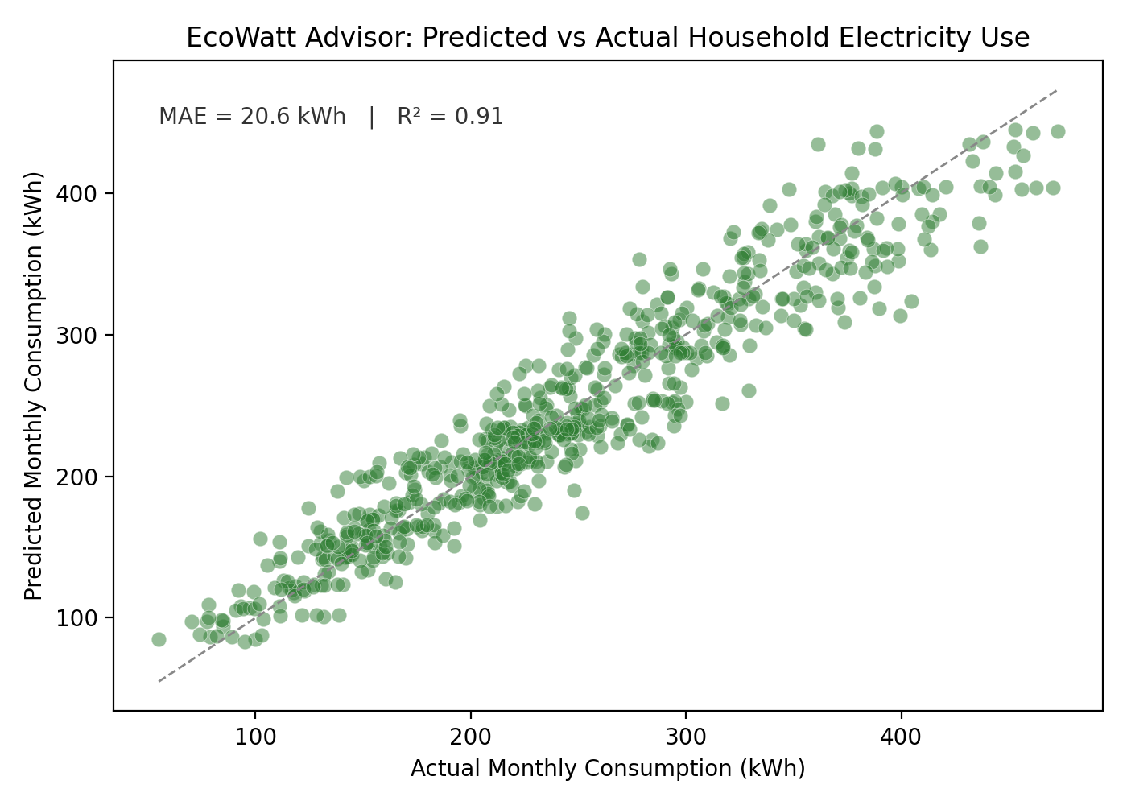
Prototype: Forecasting Model
A Random Forest regression model trained on 12 months of simulated household usage data (300 households).
Model performance
R² = 0.91
explains 91% of month-to-month variation in usage
MAE ≈ 21 kWh
average forecast error, on bills typically 100–400 kWh
Top predictors:
Previous month's usage (91%)
Average temperature (5%)
AC units & household size (combined ~4%)
EcoWatt Advisor • Prototype

Slide 6
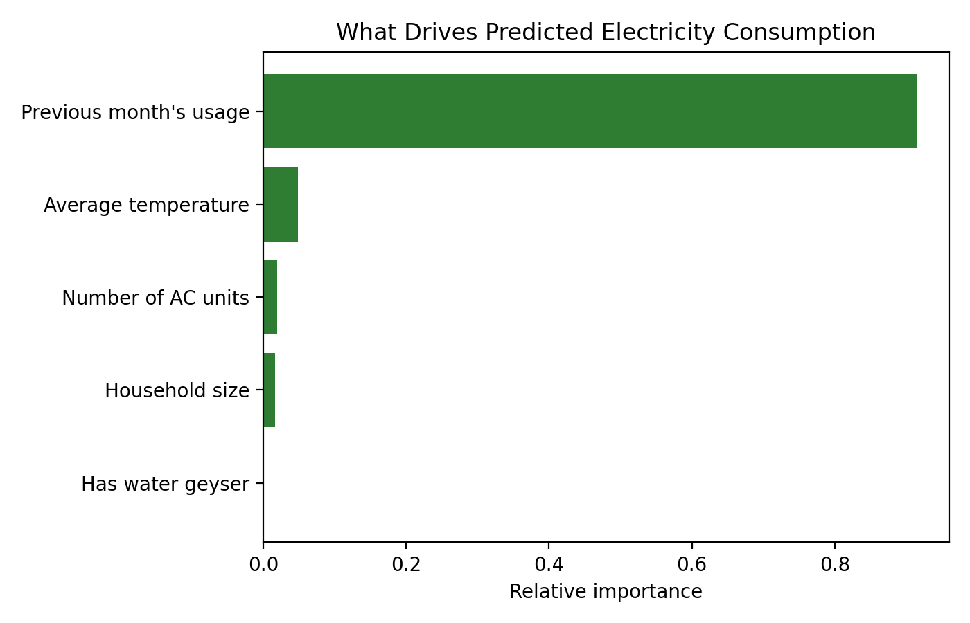
Prototype: What Drives Usage
Sample household forecasts
Household A
3 members, 1 AC
Prev: 132 kWh → Forecast: 132 kWh (On track)
Household B
5 members, 2 AC
Prev: 297 kWh → Forecast: 290 kWh (Stable, high base load)
Household C
1 member, no AC
Prev: 163 kWh → Forecast: 160 kWh (Slightly declining)
EcoWatt Advisor • Prototype

Slide 7
Prototype: Advisory Assistant
Prompt-engineered layer: turns the model's forecast into a personalized, plain-language recommendation.
System prompt template
"You are an energy-saving advisor. Given a household's forecasted electricity use, prior usage, and appliances, explain the forecast in one sentence and suggest 2 specific, low-effort actions to reduce it. Keep tone encouraging, avoid jargon, cite no more than 1 number."
Sample output — Household B (5 members, 2 AC units)
Your forecast: ~290 kWh next month, similar to last month's 297 kWh — your usage has been steady.
Two things that could help:
1. Your 2 AC units are the biggest driver. Setting them to 24°C instead of 20°C can cut cooling load by ~15–20% with minimal comfort loss.
2. Run high-load appliances (washing machine, water heater) outside 6–10 PM peak hours to ease demand and often reduce time-of-use charges.
EcoWatt Advisor • Prototype

Slide 8
Responsible AI Considerations
Fairness
Transparency
Model uses only usage-pattern and appliance data — no demographic or income proxies — so recommendations don't skew by household background.
Feature-importance output (previous usage, temperature, appliances) is shown alongside every forecast so users understand why the number was produced, not just what it is.
Ethics
Privacy
Advisory tips are optional suggestions, never automated appliance control — the household stays in control of any action taken.
Only aggregate usage metrics are used; no personal identity, location, or billing account data is required or stored by the model.
EcoWatt Advisor • Responsible AI

Slide 9
Expected Impact
10–15%
300
91%
typical household electricity savings from behavioural nudges alone, per prior demand-side studies
households represented in this prototype's forecasting dataset
of month-to-month usage variation explained by the model (R²)
If implemented at scale:
Households get an early, personalized signal before the bill arrives — shifting behaviour from reactive to proactive.
Aggregated, anonymized demand patterns can support utilities and city energy programs in planning for peak load and clean-energy transition.
Lower avoidable consumption directly reduces household carbon footprint, supporting SDG 13 alongside SDG 7.
This internship reinforced how a small, honestly-evaluated model paired with clear communication can do more for adoption than a more complex system nobody trusts.

