Slide 1
Task 1
Code available at /Task1/Task1_analysis_solution.ipynb or this link
Contents:
EDA
Conclusion
Experiments
Results
Final solution

Slide 2
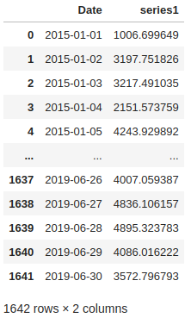
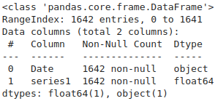

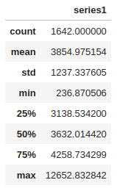
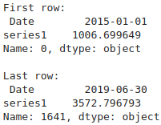
EDA. Initial view
Information about data types and NAN values counts
View of time series table.
Number of duplications and missing dates in time series
Basic statistics for series1 column.
First and last observations in time series

Slide 3
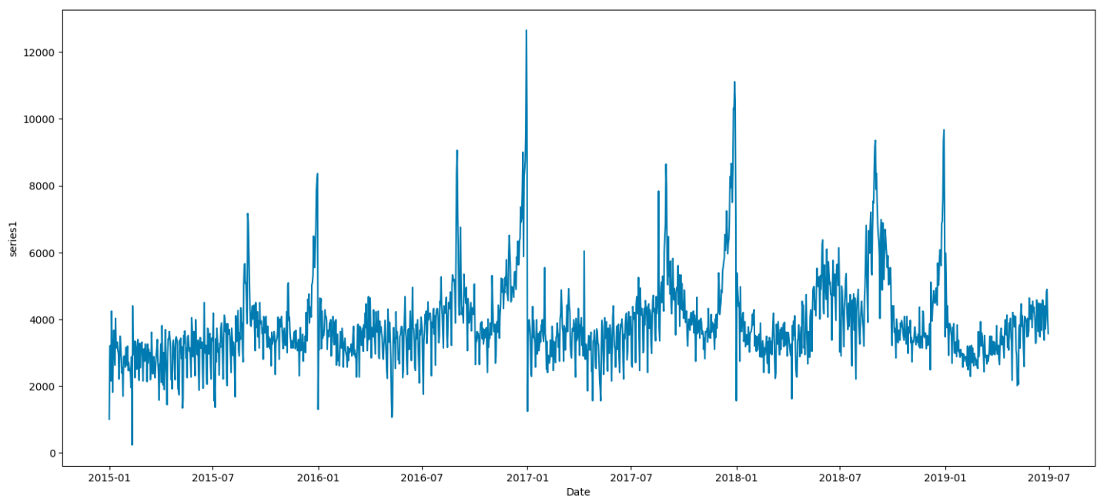
EDA. Time series visualization part 1/2
View of time series (all).

Slide 4
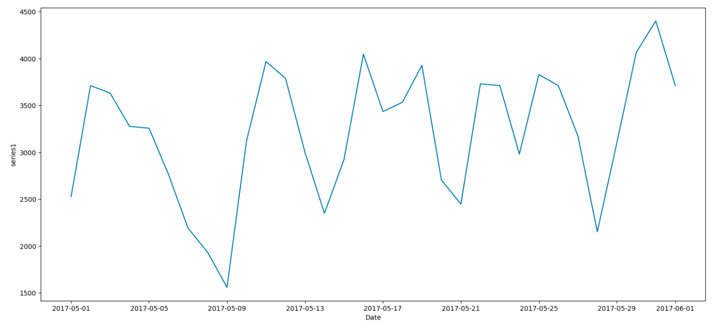
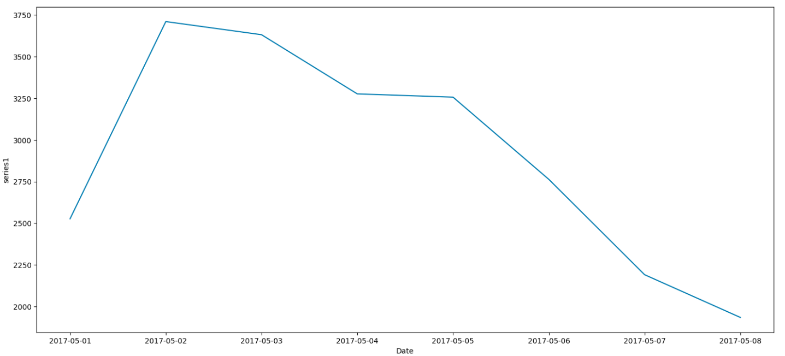
EDA. Time series visualization part 2/2
View of time series (monthly).
View of time series (weekly).

Slide 5
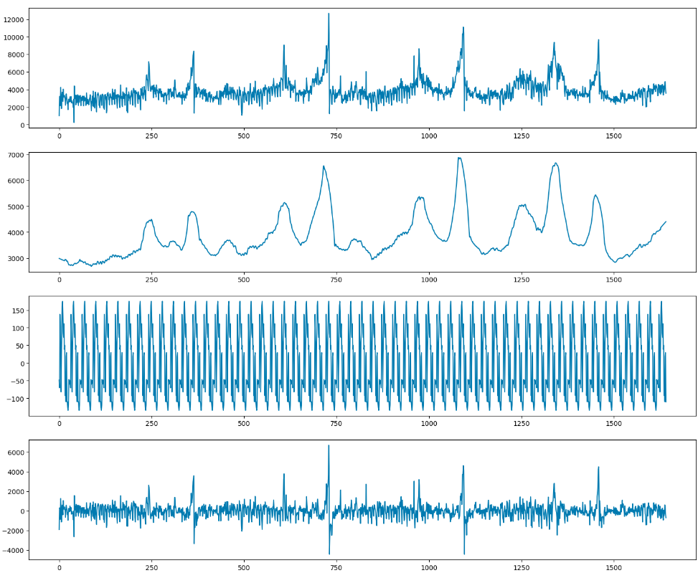
EDA. Seasonal-Trend decomposition
Seasonal trend decomposition, top down:
Observed(source time series)
Trend
Seasonal
Residual plots.
For create this decomposition i used additive model.

Slide 6


EDA. Stationarity tests
adfuller test
For check time series on stationarity i used Augmented Dickey-Fuller unit root test and KPSS test.
KPSS test

Slide 7
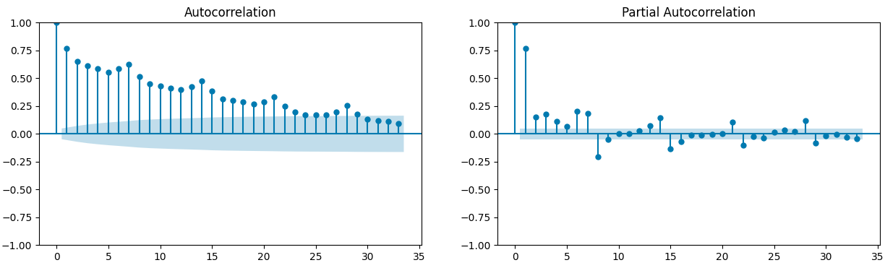
EDA. Autocorrelation and Partial autocorrelation
Autocorrelation and partial autocorrelation for series for 35 lags

Slide 8
EDA. Conclusion
In this forecasting task we work with daily time series with start on 2015.01.01 until 2019.06.30. Dataset has 1642 observations without any missing and NAN values. Most of series1 values in range 3138 to 4258. Data is stationarity by KPSS and adfuller tests (their p values less then 0.05) but autocorrelation function shows opposite.

Slide 9
Experiments. Introduction
For experiments i used RMSE/MAE/MAPE metrics. For splitting the data i used TimeSeriesSplit(sklearn) like method, as data for training, I took all the data up to 2018-09-01 date, then for each split, the dates were shifted by 90 days, the metrics were obtained for the next 90 days after the training date. I experimented on ARIMA, Exponential smoothing and additive regression model.

Slide 10
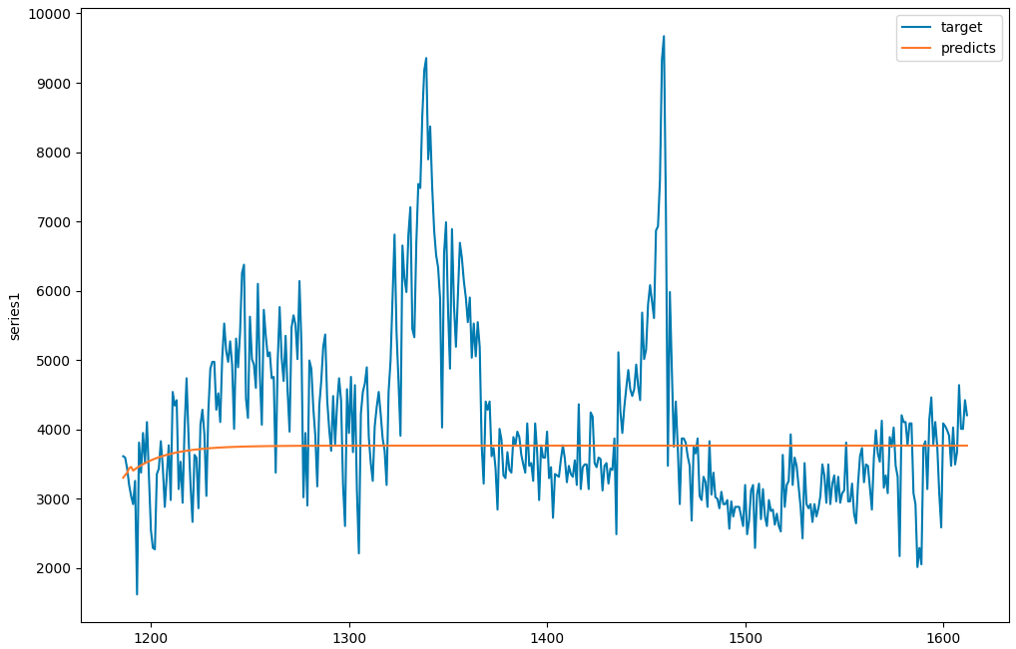
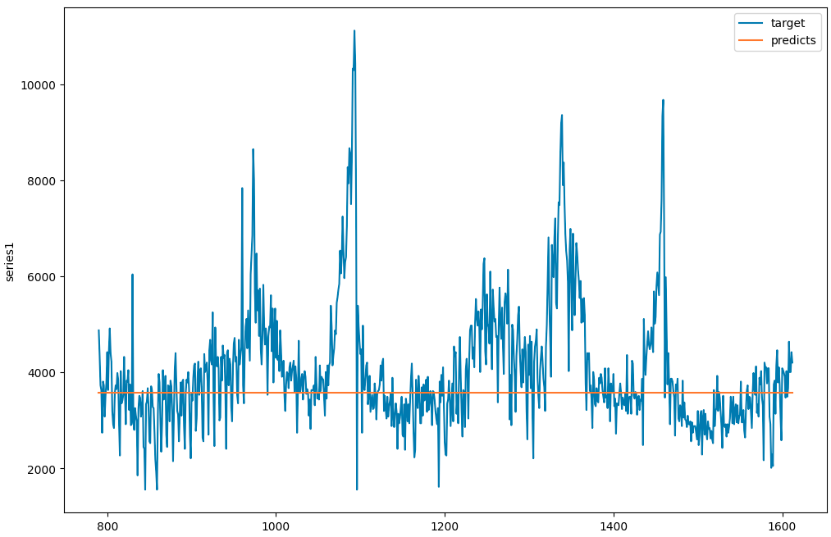
Experiments. Problem of ARIMA and Exponential Smoothing models
Metrics are misleading because models ARIMA and ExponentialSmothing failed to learn the seasonality of their metrics good in show terms but in the long run their result is wrong

Slide 11
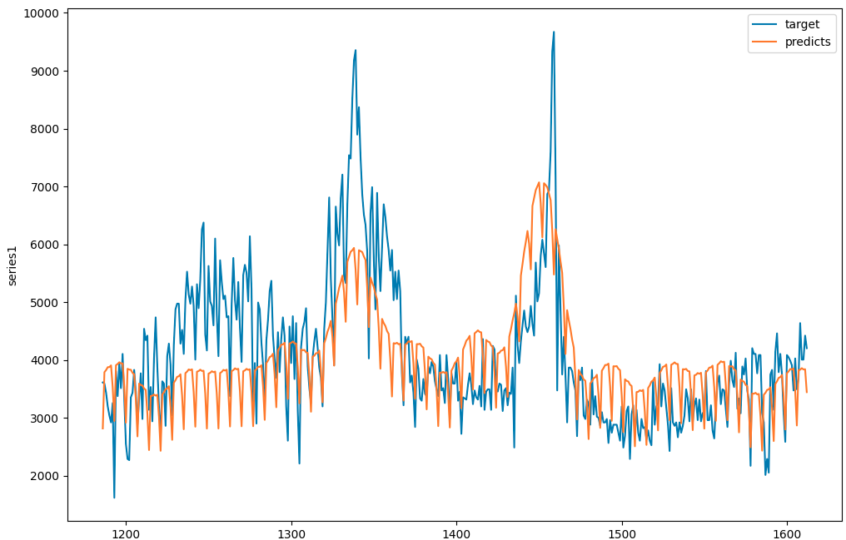
Experiments. Prophet
Prophet shows not bad metrics values and their ability to learn the seasonality of the time series in the long terms.

Slide 12
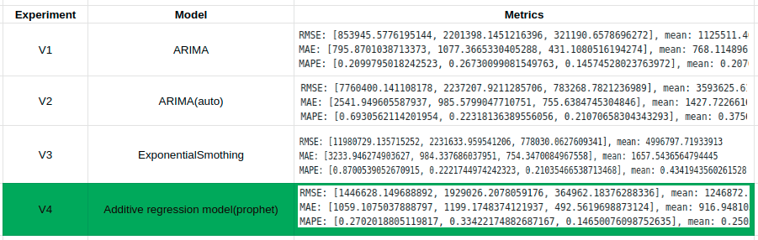
Experiments. Results
As the final model, additive regression model (highlighted green) was chosen as it has the best metrics and also quite good (compared to current models) visual results

