Slide 1
Task 2
Code available at /Task2/Task2_analysis_solution.ipynb or this link
Contents:
EDA
Conclusion
Experiments
Results
Final solution
ROC curve, important features
How to improve solution?

Slide 2
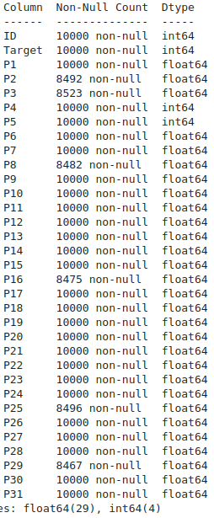
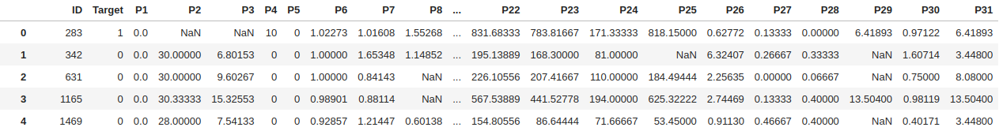
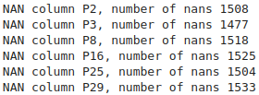

EDA. Initial view
View of training table.
Data types for columns of table (val. table have same data types).
Number of nans for columns.
Number of duplications in val/train sets.

Slide 3
EDA. Hypothesis and other
Distribution of target.
Percentage of rows in training set without any NAN values.
Hypothesis: ID is unique for each row.
Hypothesis: Validation set have same ID’s as in training set.

Slide 4
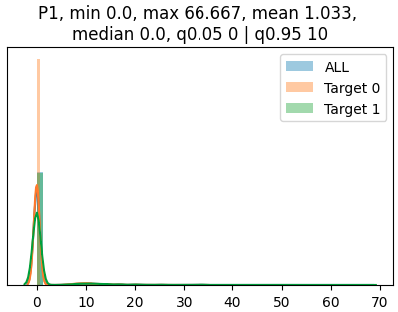
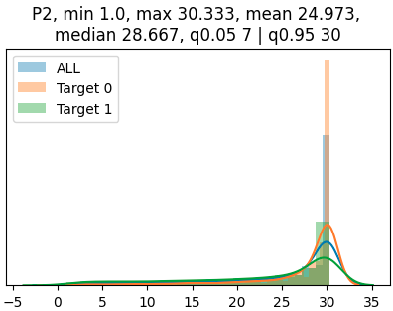
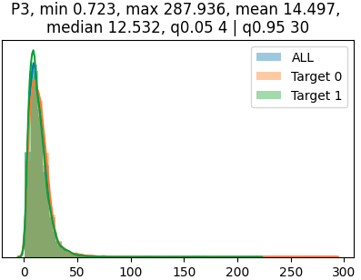
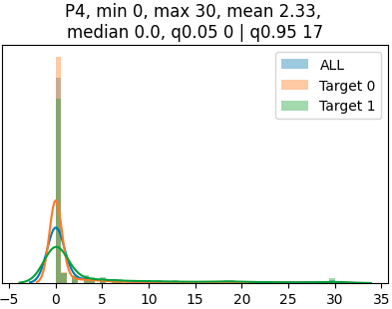
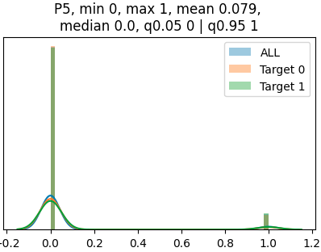
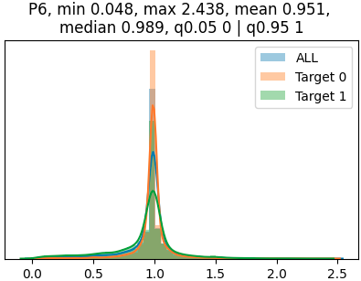
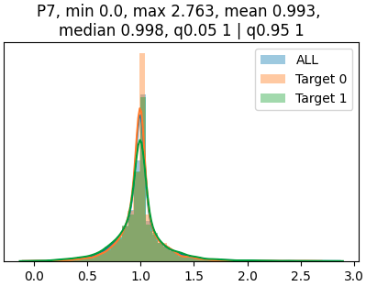
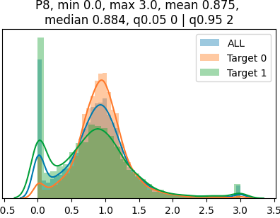
EDA. Features distribution, part 1/4
Note. Each plot contain feature name and information about data statistics, such as mean, median, min/max and 5/95 quantiles.

Slide 5
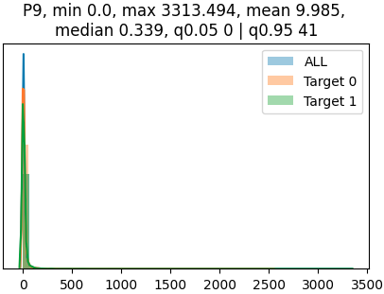
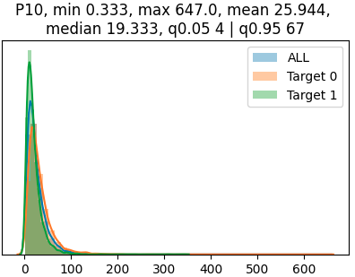
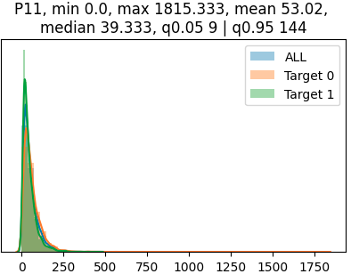
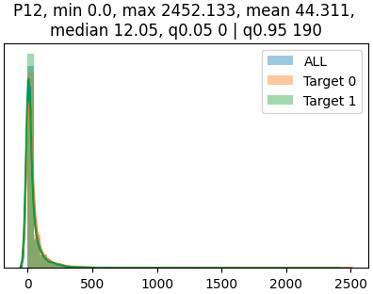
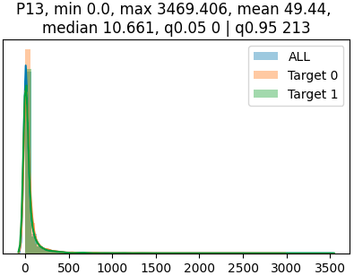
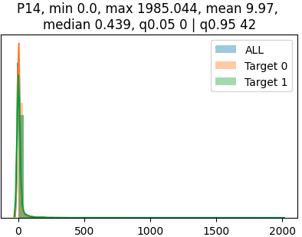
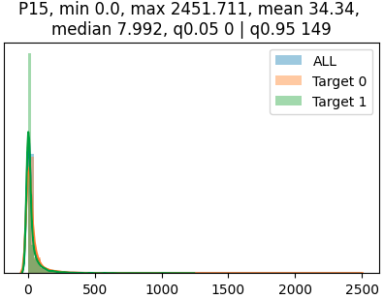
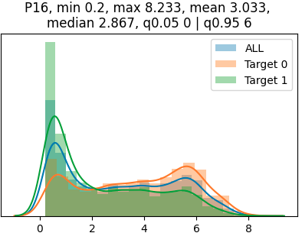
EDA. Features distribution, part 2/4

Slide 6
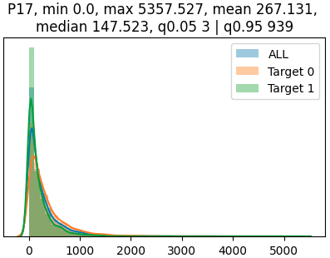
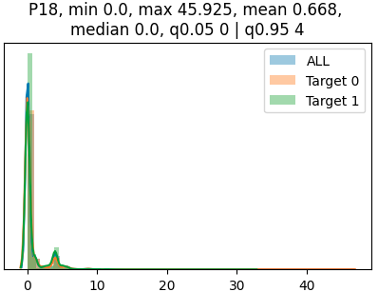
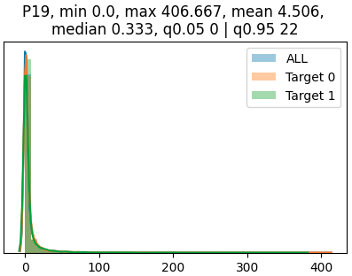
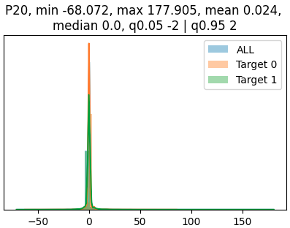
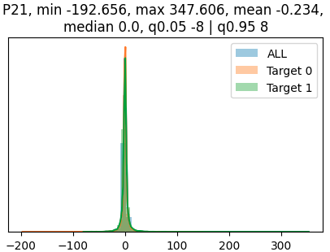
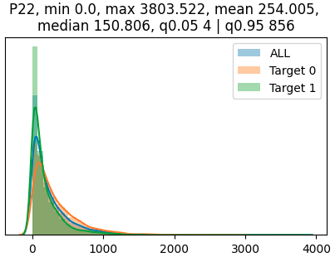
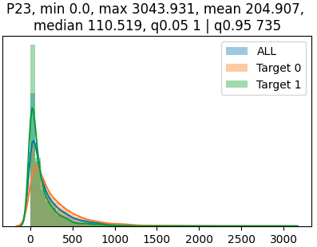
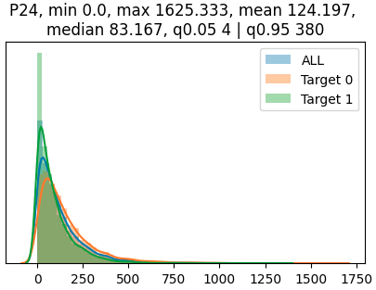
EDA. Features distribution, part 3/4

Slide 7
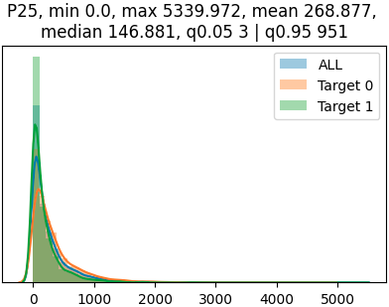
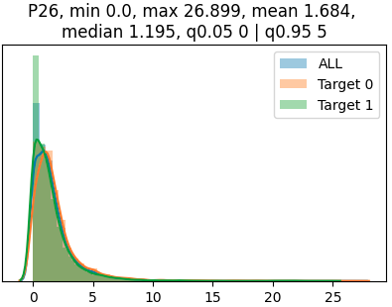
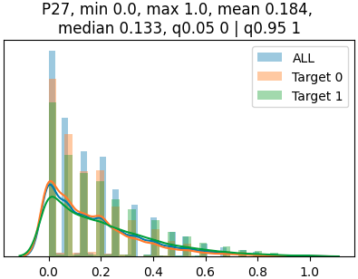
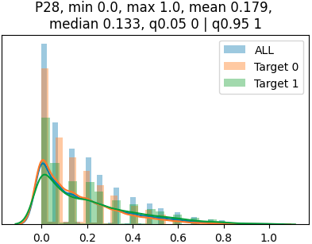
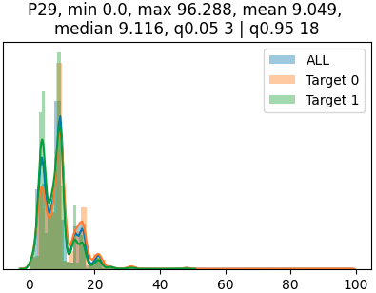
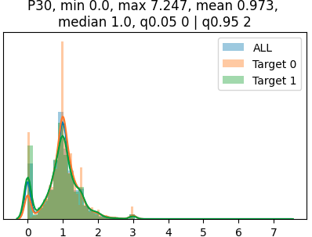
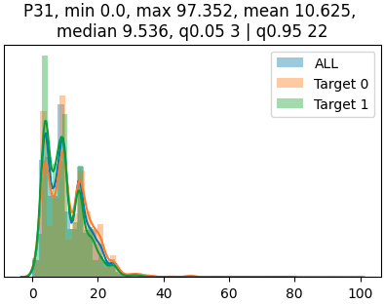
EDA. Features distribution, part 4/4
Note. I checked that validation and training sets have same distribution of features, i didn’t put plots with distribution of validation features set.

Slide 8
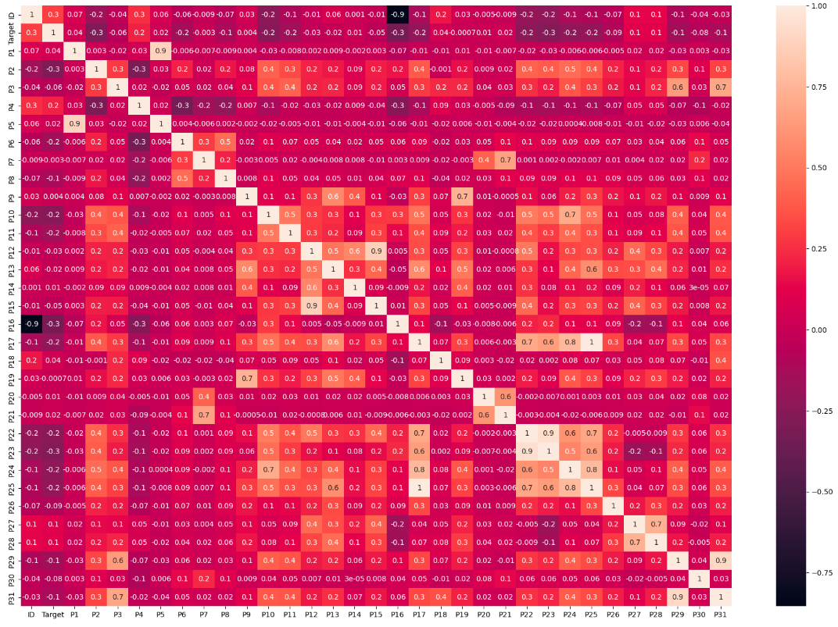
EDA. Pearson correlations between features and target
In presentation hard to see, but, target have weak correlation between p16/p22/p18/p23 and etc. features. It means that in this task we must try linear models (Pearson correlation show linear relationship between values).

Slide 9
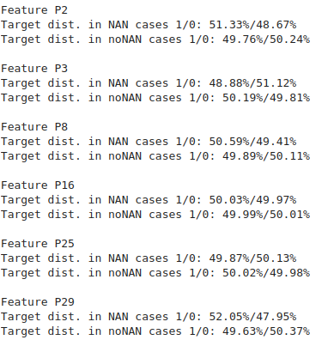
EDA. noNAN and NAN features
This is analysis of distribution of Target in rows with nan and without nan values. As we can see, some rows with features with NAN values may contain Target = 1 more frequently. Has the meaning experiment with feature indicator of NAN value such as ‘isNAN’

Slide 10
EDA. Conclusion
In this task we have deal with binary classification task. Target value is balanced. Data contain NAN values in 6 columns, some distributions of features can show that for target=1 is characterized by higher value of feature. All data is numerical and doesn’t contain any categorical features. Table(train/val) doesn’t contain duplicate rows. ID is unique for each row and train ID’s don’t contains in validation table(for this reason i deleted this feature). Table training contains only 36% of rows without any NAN’s. Features have outliers.

Slide 11
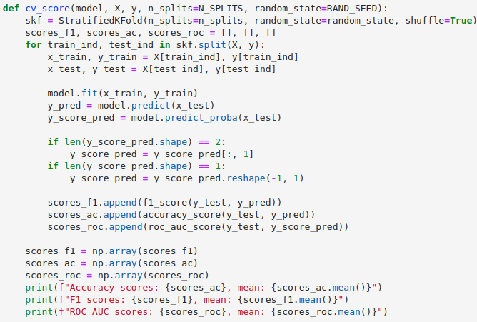
Experiments. How I experimented part 1/2
For getting scores for find best model, i defined function that by model and overall data, number of splits and random seed(for reproduction of experiments) print metrics that was computed by stratified split (each batch have same proportion of target classes)

Slide 12
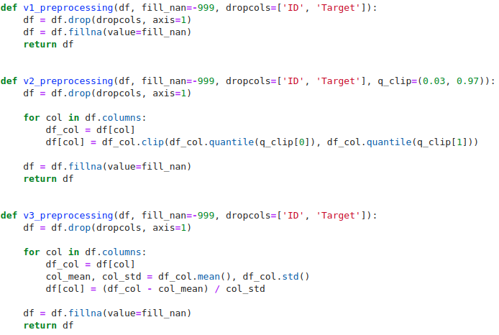
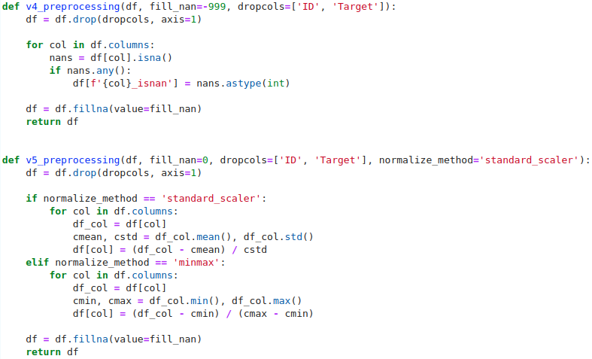
Experiments. How I experimented part 2/2
For different experiments i defined preprocessing functions for find out that function is better.

Slide 13
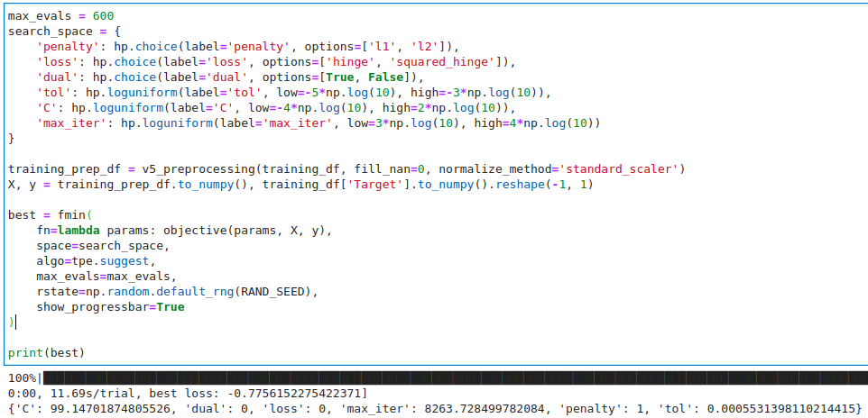
Experiments. Experiments description
V1_1/2: Baseline solution, work with random forest model and baseline preprocessing(v1), 1 and 2 subparts of exp. differ by value of filling NAN’s, 0 and -999 accordingly.
V7: Same as V4 experiment but with gradient boosting model(lightGBM).
V2: Baseline solution, work with random forest model and baseline preprocessing(fill value = -999, try clip outlier values of features by 0.05 and 0.95 quantiles)
V9: Same as v8 but try improve LinearSVC model by tuning using hyperopt
V3: Baseline solution, work with random forest model and preprocessing(fill value = -999, try normalize by STD feature values).
V4: Baseline solution, work with random forest model and baseline preprocessing(fill value = -999, add ‘isNAN’ indicator features.
V5/v6/v8: Work with v5 preprocessing(normalize features by STD and fill nan values on 0 value), test logistic regression, SVC and LinearSVC(same as SVC but linear kernel).

Slide 14
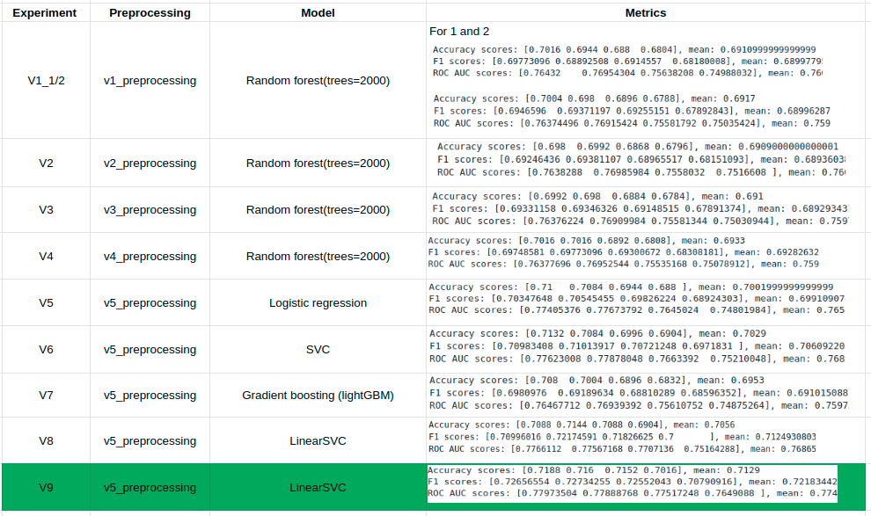
Experiments. Result
Final model is highlighted. This method and model was chosen due to good metric performance, real time learning, and inference.

Slide 15
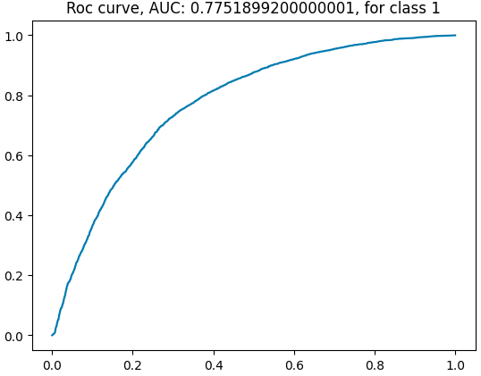
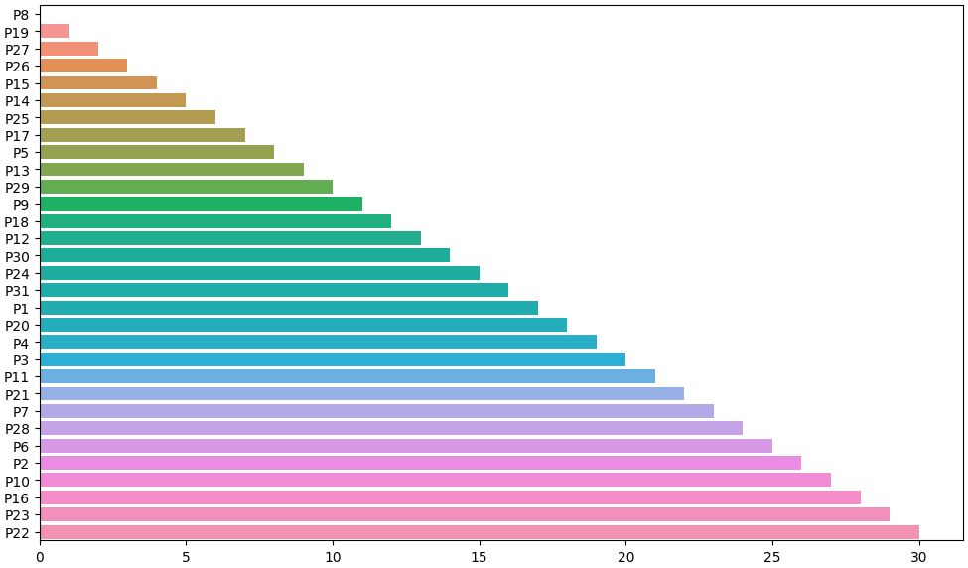
Final solution. ROC curve, important features
ROC curve for final model, ROC AUC = 0.7751
Important features, 3 most important: P16/P23/P22, method: backward feature elimination.

Slide 16
Final solution. How to improve solution?
Improve method of filling nans
Try other models / hyperparameters
Try neural method (tabNN, tabNET and other)

