Slide 1
Task 3
Code available at /Task3/Task3_analysis.ipynb or this link
Contents:
Tables visualization
Solution
Questions

Slide 2
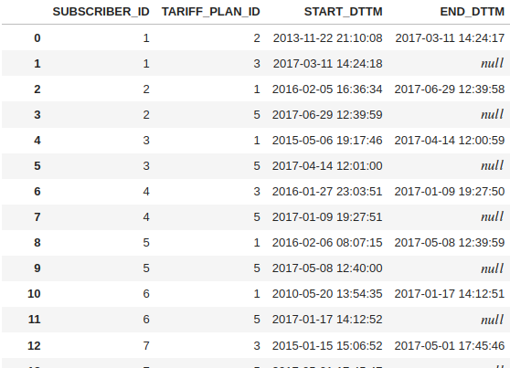

Tables visualization. Table ‘tariff_plans_change’
Note. In this task i use SQL for ease for use this data.
In the top - SQL request. In table ‘tariff_plans_change’ we can extract information about tariff changing.

Slide 3
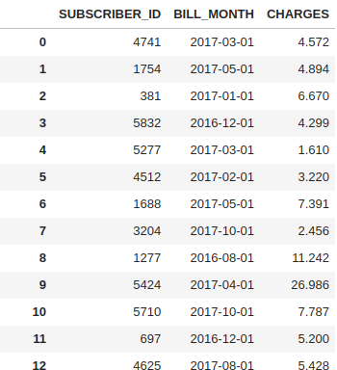

Tables visualization. Table ‘charges’
In the top - SQL request. In table ‘charges’ we can extract information about monthly costs for each SUBSCRIBER_ID.

Slide 4
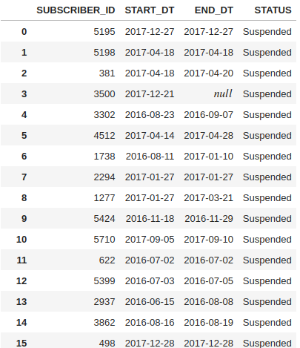

Tables visualization. Table ‘charges’
In the top - SQL request.

Slide 5
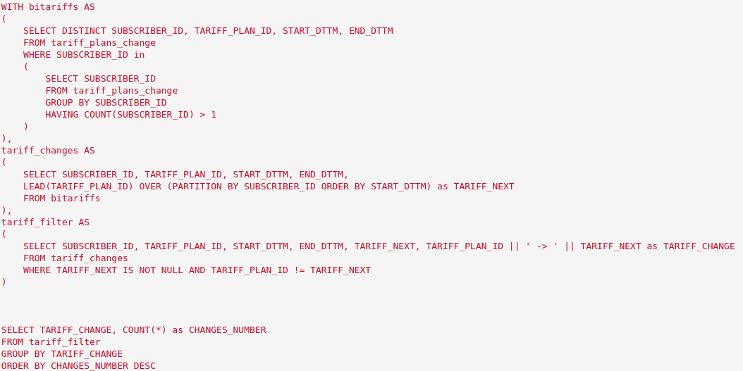
Solution. Question 1
Question 1: Направления смен тарифных планов: с каких тарифных планов и на какие шли
наибольшие перетоки? Визуализировать потоки миграций на диаграмме.
SQL code that return table with number of tariff changes for each change direction.

Slide 6
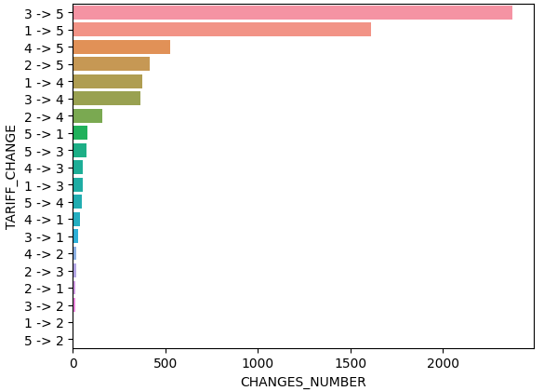
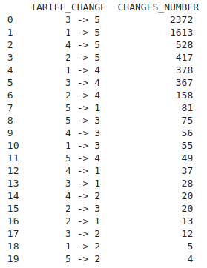
Solution. Question 1, answer
SQL request response. Table with tariff change directions and counts of changing. TARIFF_CHANGE - column with direction of tariff change. CHANGES_NUMBER - column with counts of tariff changings.
SQL request response. Visualization of tariff changings by number of changes, some of the most frequent destinations - 3->5, 1->5, 4->5, 2->5, 1->4, 3->4

Slide 7
Solution. Question 2
Question 2: Насколько изменился среднемесячный счет абонентов за период 3 месяца после месяца смены тарифного плана в сравнении с периодом 3 месяца до месяца смены тарифного плана. Какие направления смен тарифных планов характеризовались ростом среднего счета в трехмесячном периоде, а какие – сокращением.
Визуализировать результаты на диаграммах.

Slide 8
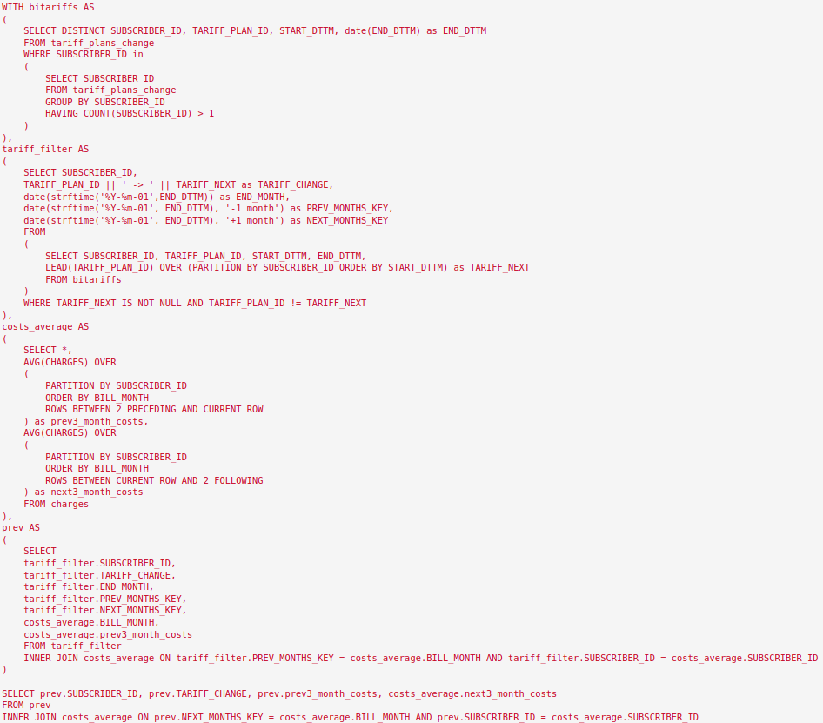
Solution. Question 2, answer part 1/4
SQL code that return table with. average costs for each SUBSCRIBER_ID for previous/next 3 months after tariff changing.

Slide 9

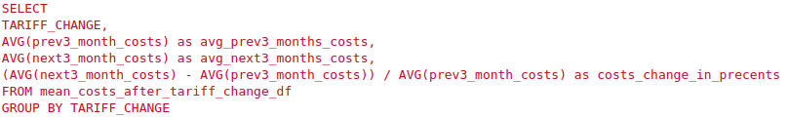
Solution. Question 2, answer part 2/4
SQL code that return table with. average costs for previous/next 3 months after tariff changing.
SQL code that return table with. average costs for previous/next 3 months after tariff changing for each tariff change direction.

Slide 10
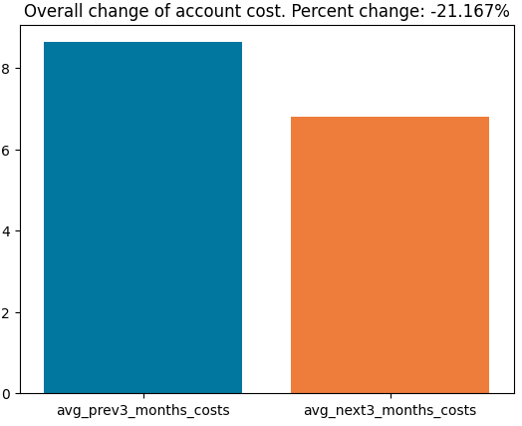
Solution. Question 2, answer part 3/4
SQL request response. Table with previous/next 3 months after tariff changing average for all SUBSCRIBER_ID. avg_prev3_months_costs/avg_next3_months_costs - mean costs for previous/next 3 months after change tariff, costs_change_in_percents - change costs in percent between previous and next 3 months towards previous 3 month costs.
In this diagram we can see that after the tariff change, the costs fall on average on 21%.

Slide 11
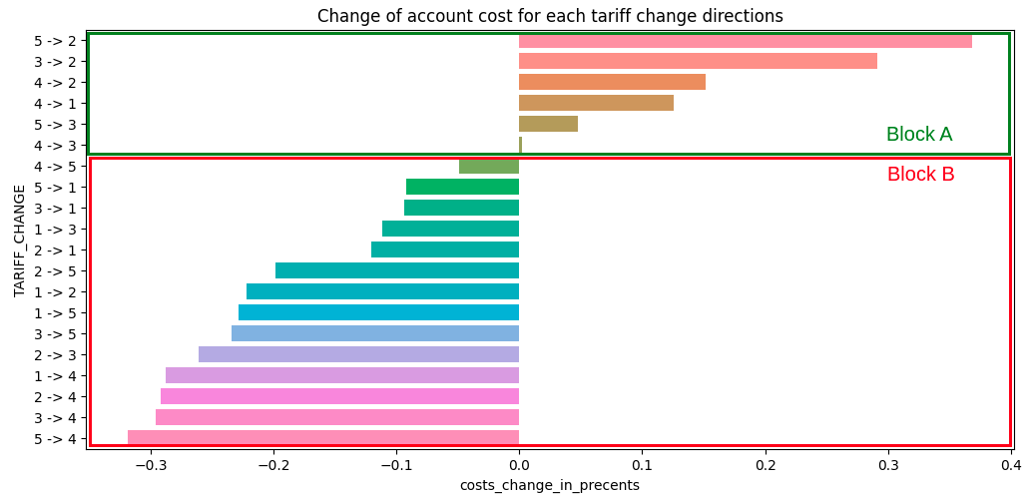
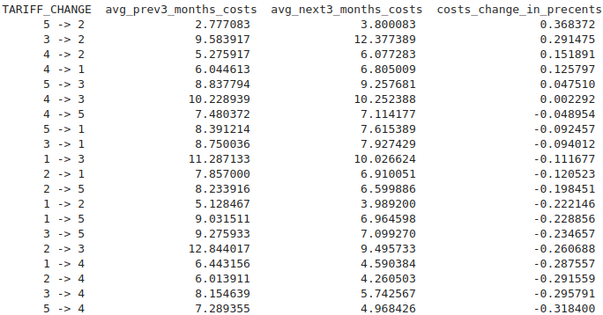
Solution. Question 2, answer part 4/4
SQL request response. Table with previous/next 3 months after tariff changing average for each tariff change direction (TARIFF_CHANGE column). avg_prev3_months_costs/avg_next3_months_costs - mean costs for previous/next 3 months after change tariff, costs_change_in_percents - change costs in percent between previous and next 3 months towards previous 3 month costs.
In this diagram we can see that after the tariff change, the costs:
Growth for block A, the 3 most revealing directions: 5->2(+36.8%), 3->2(+29.1%), 4->2(+15.1%)
Fall for block B, the 3 most revealing directions: 5->4(-31.8%), 3->4(-29.5%), 2->4(-29.1%)

Slide 12
Solution. Question 3
Аналогично п.2, только относительно изменения уровня блокировок: насколько
реже или чаще стали попадать в блокировки абоненты после миграции в целом и
для каждого направления миграции в отдельности. Для сравнения использовать те
же периоды: 3 месяца до месяца смены плана и 3 месяца после месяца смены.

Slide 13
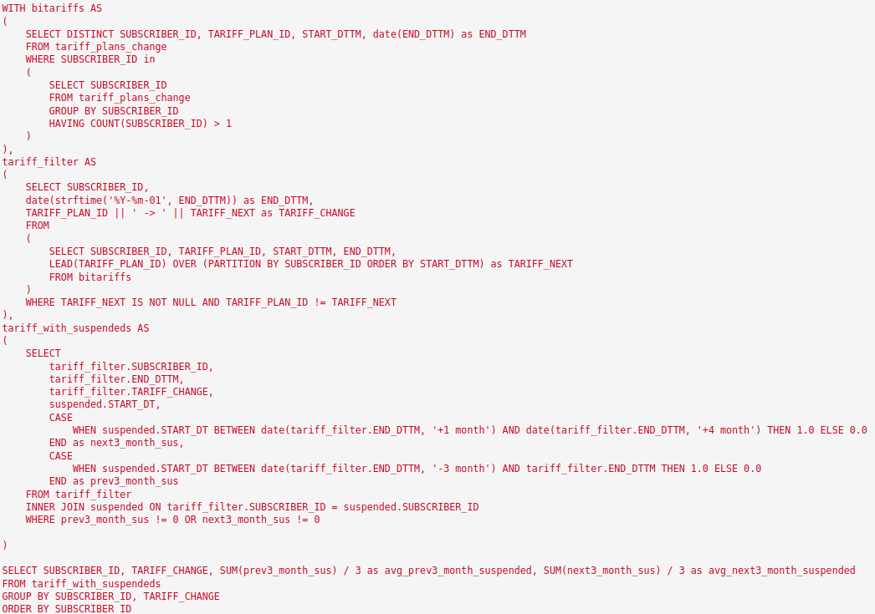
Solution. Question 3, answer part 1/4
SQL code that return table with. average cases of user suspendeds for previous and next 3 months of tariff change for each SUBSCRIBER_ID.

Slide 14
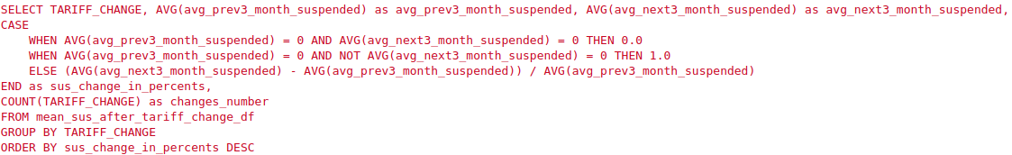
Solution. Question 3, answer part 2/4
SQL code that return table with. average cases of user suspendeds for previous and next 3 months of tariff change.
SQL code that return table with. average cases of user suspendeds for previous and next 3 months of tariff change for each tariff change direction.

Slide 15
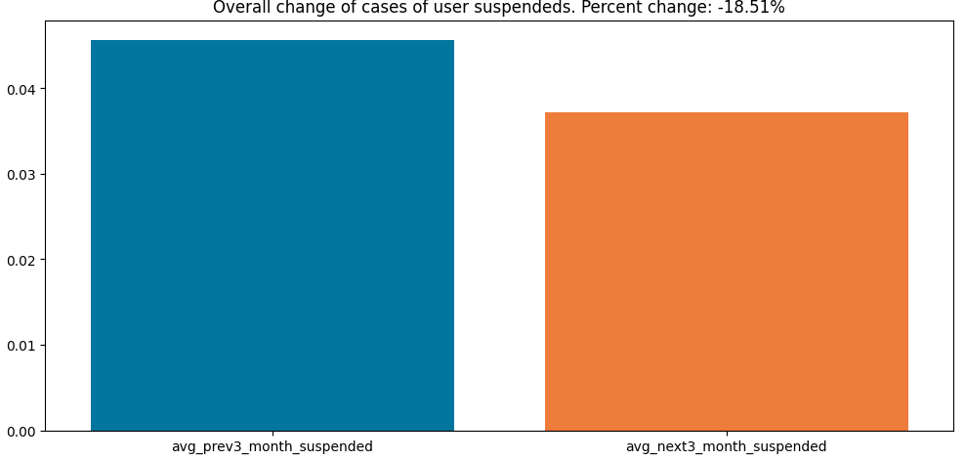
Solution. Question 3, answer part 3/4
SQL request response. Table with previous/next 3 months after tariff changing average for all SUBSCRIBER_ID. avg_prev3_months_suspended/avg_next3_months_suspended - mean suspended cases for previous/next 3 months after change tariff, sus_change_in_percents - change cases of suspendeds in percent between previous and next 3 months towards previous 3 month susp. cases.
In this diagram we can see that after the tariff change, the suspends cases fall on average on 18.5%.

Slide 16
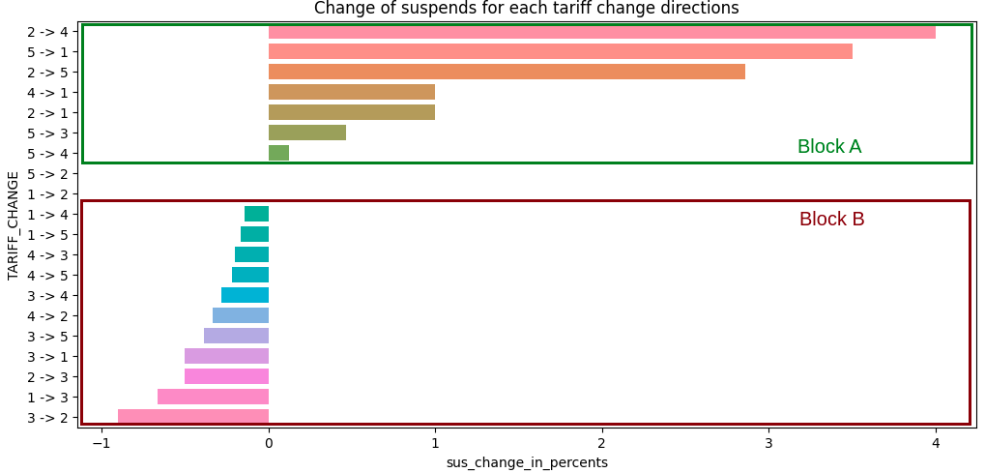
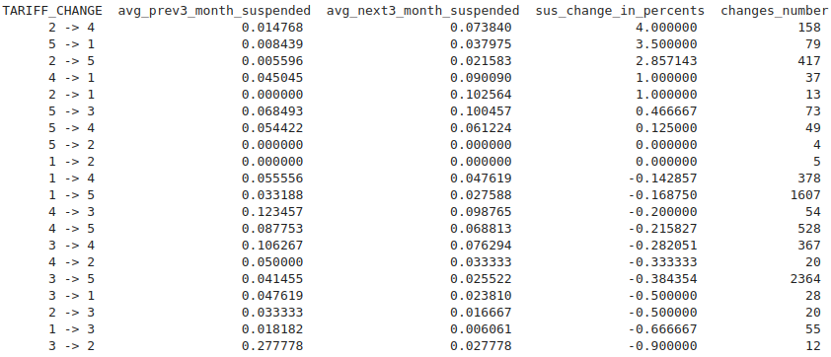
Solution. Question 3, answer part 4/4
SQL request response. Table with previous/next 3 months after tariff changing average for each tariff change. avg_prev3_months_suspended/avg_next3_months_suspended - mean suspended cases for previous/next 3 months after change tariff, sus_change_in_percents - change cases of suspendeds in percent between previous and next 3 months towards previous 3 month suspended cases. Column changes_number contains number of tariff change for direction.
In this diagram we can see that after the tariff change, the cases of suspended:
Growth for block A, the 3 top revealing directions: 2->4(+400%), 5->1(+350%), 2->5(+285%)
Fall for block B, the 3 top revealing directions: 3->2(-90%), 1->3(-66.6%), 2->3(-50%)
Directions of tariff changing 5->2 and 1->2 have very small count of changes, thus they don’t contains suspend cases.

