Slide 1

React JS
Presentation By
Kirubanidhi Ramachandran

Slide 2

What is React JS?
Frontend JavaScript Framework
JavaScript Library Created by Facebook

Slide 3

How React Works?
React creates Virtual DOM in Memory
No manipulation Browser DOM directly.
First Manipulates V-DOM before making any change on browser DOM.

Slide 4

Environment
Setting up React Environment
npm
node.js
Run the React Application.
Modifying React Application

Slide 5
React JS Features
React Components.
React Class
React Props
React Events

Slide 6
Components
Components
Header
Root (App Component)
Side Nav
Main Content
Side Nav
Footer

Slide 7
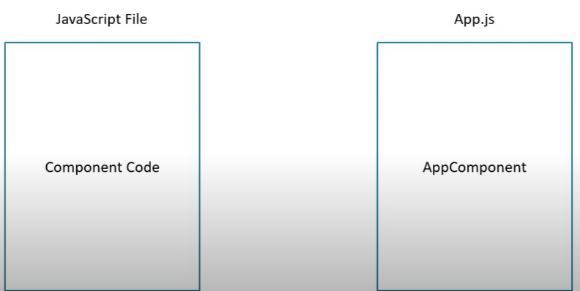
COMPONENTS
Java Script File [Component CODE]
App.JS [ APP COMPONENT]

Slide 8
Functional Component
Create COMPONENT FOLDER & COMPONENT FILE (JS File)
DEFINE Function in component File
EXPORT COMPONENT
IMPORT COMPONENT in APP COMPONENT
CALL COMPONENT IN RENDER METHOD in CLASS APP
import BY DIFFERENT component name (My component)

Slide 9
Functional Component
Properties(props)
Javascript Function
HTML(JSX)

Slide 10
Functional Component
Properties(props)
ES6 class
HTML(JSX)
State

Slide 11
CLASS Component
Create COMPONENT FOLDER & COMPONENT FILE (JS File)
Import 2 component (React, COMPONENT)
DEFINE CLASS in component File
Render Method HAS TO BE IN CLASS
RENDR METHOD CONTAINS RETURN
EXPORT RESPECTIVE COMPONENT
IMPORT COMPONENT in APP COMPONENT
CALL COMPONENT IN RENDER METHOD in CLASS APP

Slide 12
FUNCTIONAL VS CLASS Component
Functional VS COMPONENT
FUNCTIONAL
COMPONENT
Simple Function
Absence of this keyword
No state maintenance
Mainly responsible for UI
Stateless/Dumb/Presentational
More Feature Rich
Maintain their own private data-state
Complex UI logic
Provide lifecycle hook
Stateful/Smart/Container

