Slide 1
What is Git? Free and open source version control system
What is Version Control? Managament of changes to computer code, documents, websites or any collections of information.
Terms
Repository -> Project or the folder/place where your project is
Github -> Website to host your repositories
Git commands
clone -> Bring reposoitory from Github to your local machine
add -> track your files and changes on Git
commit -> save your files in Git
push -> upload Git commits to GitHub
pull -> download changes from remote repo to your local machine, opposite of push

Slide 2
Requirements
Get a GitHub account. I recommend to use a username reflecting your name.
Install git on your development machine.
Setup Github
git config --global user.name Surname Name
git config --global user.email you@provider.com
Setup a SSH key
ssh-keygen -t rsa -C "youremail@Miami.edu"
Generating public/private rsa key pair.
Enter file in which to save the key (/home/wuchtys/.ssh/id_rsa): ~/.ssh/id_rsa_github
ssh-add ~/.ssh/id_rsa_github
Copy the content of the ~/.ssh/id_rsa_github.pub and add it to your GitHub profile going to your
Profile -> SSH keys and GPG keys -> New SSH key.

Slide 3
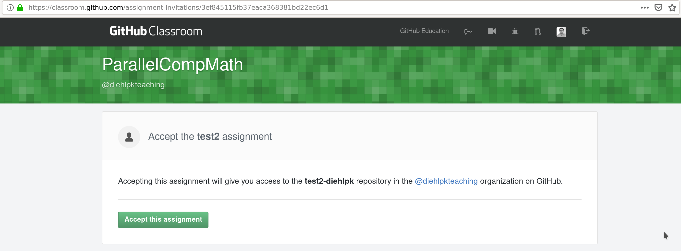
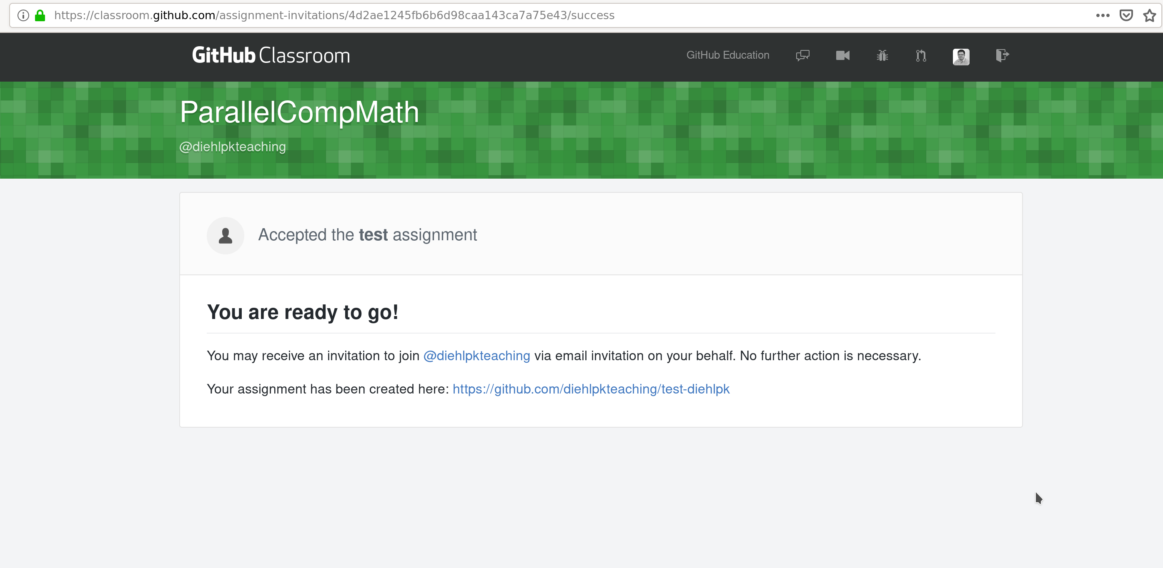
Working on your assignment
For each assignment you will get a link to your assignment on the exercise sheet.
After clicking on the link you will get the url to your git repository.

Slide 4
Use the commands to checkout and submit your homework.
git clone git@github.com:UM-CSC322-24S/labtask-1-yourname.git
cd labtask-1-yourname
git add homework.files # Work on your homework
git commit –m ‘message that you want to send’
git push

