Slide 1
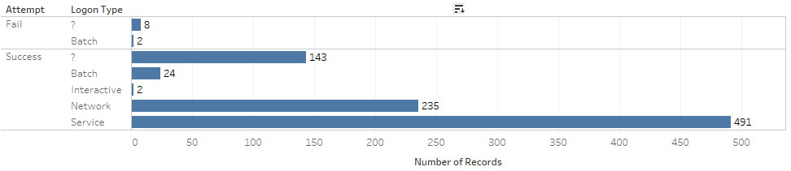
Data Analytics:
Sources: http://csr.lanl.gov/data/cyber1/
Dataset: auth.txt.gz
Github: https://github.com/kirundar/Cyber-Security--Data-Analysis
Kirun Dar- kirun.dar@gmail.com

Slide 2
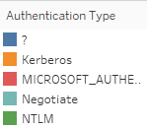
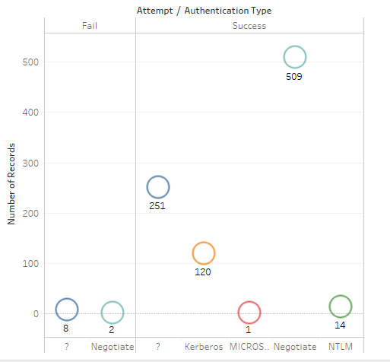
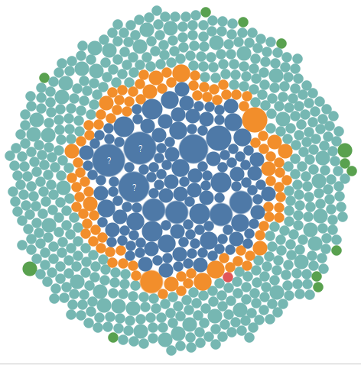
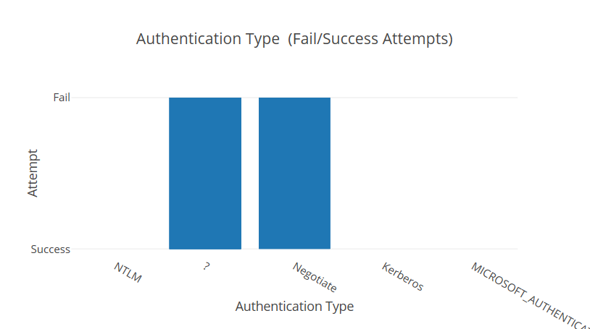

Slide 3
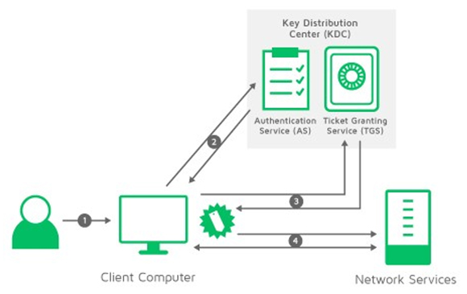
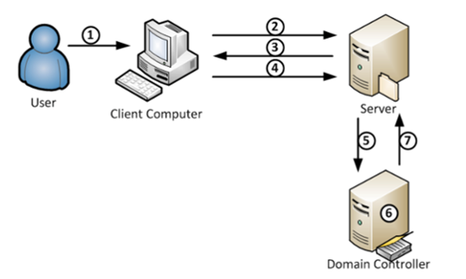
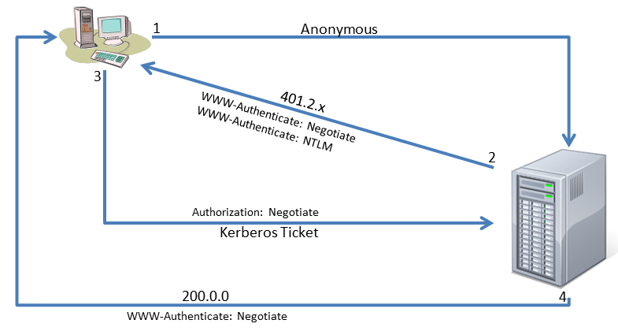
Kerberos Authentication Flow
NTLM Authentication Flow
Integrated (NTLM) authentication
NTLM, Kerberos, and Negotiate authentication are more secure forms of authentication because the user name and password are hashed before being sent across the network. When NTLM, Kerberos, or Negotiate authentication are enabled, the user's browser proves its knowledge of the password through a cryptographic exchange with your Forefront TMG server, involving hashing.
Network Authentication Flow

