Slide 1
HEART DISEASE PREDICTION USING OPTIMIZED SUPPORT VECTOR MACHINE
Kiruthiga. T
(23132016510622011)
Guided By: Dr. S. Priya, MCA., M.Phil., SET., NET., Ph.D.,
Assistance Professor

Slide 2
ABSTRACT
This study addresses heart disease prediction using an optimized Support Vector Machine (SVM) model. Traditional diagnostic methods face challenges like complex data interpretation and symptom variability. Machine learning offers a data-driven approach to improve early detection and patient care. The study compares Grid Search, Bayesian Optimization, and Randomized Search for hyperparameter tuning against a baseline FCMIM-SVM model. Using a dataset of 1,190 patients with 12 clinical attributes, feature selection via FCMIM enhances prediction. The optimized Grid Search SVM achieved the highest accuracy (89.49%), outperforming other models. Results emphasize the role of hyperparameter tuning in improving medical diagnosis.

Slide 3
INTRODUCTION
Heart disease is a major global health concern, requiring early and accurate diagnosis. Traditional methods struggle with data complexity, making prediction challenging. Machine learning, particularly optimized Support Vector Machines (SVM), enhances prediction accuracy. This study analyzes key clinical attributes such as age, sex, chest pain type, blood pressure, cholesterol, ECG results, and heart rate. By applying hyperparameter tuning techniques like Grid Search, Bayesian Optimization, and Randomized Search, the study compares optimized SVM models against a baseline FCMIM-SVM model. The goal is to improve prediction and support early diagnosis.

Slide 4
LITERATURE REVIEW
YEAR | AUTHOR | METHODOLOGY | DATASET | COMPARED METHODS | PARAMETER & RESULT
2022 | Sashank Yadav et al | Prediction: Naïve Bayes, Decision tree, Logistic regression, KNN, SVM, RF and Decision tree. | UCI ML Repository: heart disease dataset. 55.56% positive and 44.44% negative heart patient data | -- | Accuracy KNN – 85.18%
2021 | Harshit Jindal et al. | Prediction: Logistic Regression, KNN, and Random Forest | UCI Repository: Heart Disease dataset. 13 medical attributes and 304 patient records. 303 rows and 14 columns | Naïve Bayes | Accuracy: KKN – 88.52%

Slide 5
YEAR | AUTHOR | METHODOLOGY | DATASET | COMPARED METHODS | PARAMETER & RESULT
2023 | Chintan M. Bhatt et al | Prediction: Decision Tree Classifier (DT) Random Forest (RF) Multilayer Perceptron (MP) XGBoost (XGB) | Source: Kaggle Number of instances: 70,000 Split ratio: 80% for training and 20% for testing | -- | MP: Accuracy (with cross-validation): 87.28% Accuracy (without cross-validation): 86.94%
2020 | Vijeta Sharma et al. | Prediction: Random Forest, Support Vector Machine (SVM), Naive Bayes, and Decision Tree. . | UCI Repository: Cleveland Heart Disease dataset. 1025 instances 14 attributes | -- | Accuracy: Random Forest - 99%

Slide 6
Year | Author | Methodology | Datasets | Compared method | Parameter & Result
2023 | Nadikatla Chandrasek-har et al. | Prediction: Random Forest, K-Nearest Neighbor, Logistic Regression, Naïve Bayes, Gradient Boosting, and AdaBoost Classifier. Hyperparameter optimization: GridSearchCV Combining six algorithms: Soft voting ensemble classifier. | Dataset I: UC Irvine ML Repository-Cleveland, Name: Cleveland Source: UC Irvine ML Repository Instances: 303 Attributes: 14 Dataset II: IEEE Data port Heart Disease Source: IEEE Data port, Instances: 1190 Attributes: 12 | Dataset1: [28] [27] [16] [34] [59] Dataset2: [38] [39] [40] | Accuracy: LR -90.16% AB - 89.67%

Slide 7
PROBLEM STATEMENT
Heart disease remains a leading global cause of death, with accurate prediction still challenging. Issues such as class imbalance, redundant features, and unoptimized models affect prediction performance. This project tackles these challenges by developing an optimized SVM-based model, improving accuracy, reducing false predictions, and enhancing early detection of heart disease.

Slide 8
DATASET
The dataset, sourced from Kaggle, contains 1,190 patient records with 12 key attributes essential for heart disease prediction. These attributes include Age, Sex (0 = Female, 1 = Male), Chest Pain Type, Resting Blood Pressure, Cholesterol Level, Fasting Blood Sugar (1 = >120 mg/dl, 0 = Normal), Resting ECG, Maximum Heart Rate, Exercise-Induced Angina (0 = No, 1 = Yes), Oldpeak (ST depression), ST Slope, and the Target variable indicating heart disease presence (0 = No, 1 = Yes). These features help analyze patient health conditions and enhance predictive modeling for early diagnosis.

Slide 9
PROPOSED METHODOLOGY
DATA COLLECTON
DATA PREPROCESSING
Feature Extraction
FCMIM
Standard Scaling
DATA SET SPLITING
Train-Test
Model Training & Evaluation
Model Optimization
Grid
Random
Bayesian
APPLY SMOTE & SAVE THE OPTIMIZED MODEL
GET THE USER INPUT
CLASSIFY THE RESULT

Slide 10
PROPOSED MODEL:
The proposed approach uses an optimized SVM with Grid Search for heart disease prediction. It involves data preprocessing, feature selection (FCMIM), and class balancing (SMOTE) before splitting the dataset (80% training, 20% testing). Grid Search CV tunes hyperparameters (C, gamma, kernel) to enhance model performance. The best model is trained, evaluated, and saved for future predictions, ensuring accurate and efficient heart disease classification.

Slide 11
SCOPE
This project focuses on developing an optimized Support Vector Machine (SVM) model for heart disease prediction. It aims to improve predictive accuracy through hyperparameter tuning techniques such as Grid Search, Bayesian Optimization, and Randomized Search. The study compares optimized SVM models against a baseline FCMIM-SVM model to evaluate performance improvements. The findings will contribute to the advancement of machine learning in medical diagnostics, supporting early detection and better treatment outcomes for heart disease.

Slide 12
HARDWARE REQUIREMENTS
OS: Windows (or macOS, Linux)
RAM: 8 GB+
Storage: 50 GB+

Slide 13
Software Requirements:
Programming language: Python
Libraries: NumPy, Pandas, Scikit-learn, Matplotlib, Seaborn.
Development Environment: Google Cola

Slide 14
Dataset Splitting for Model Evaluation
Dataset Name | Train Size (80%) | Test Size (20%)
Heart Disease Dataset | 952 (80%) | 238 (20%)

Slide 15
Performance Comparison of FCMIM-SVM & Optimized SVM
Method | Accuracy (%) | Precision (%) | Recall (%) | F1-Score (%)
FCMIM-SVM[10] | 84.87 | 86 | 85 | 85
Grid-SVM | 89.50 | 89 | 89 | 89
Bayes-SVM | 87.39 | 88 | 87 | 87
Random-SVM | 89.50 | 89 | 89 | 89

Slide 16
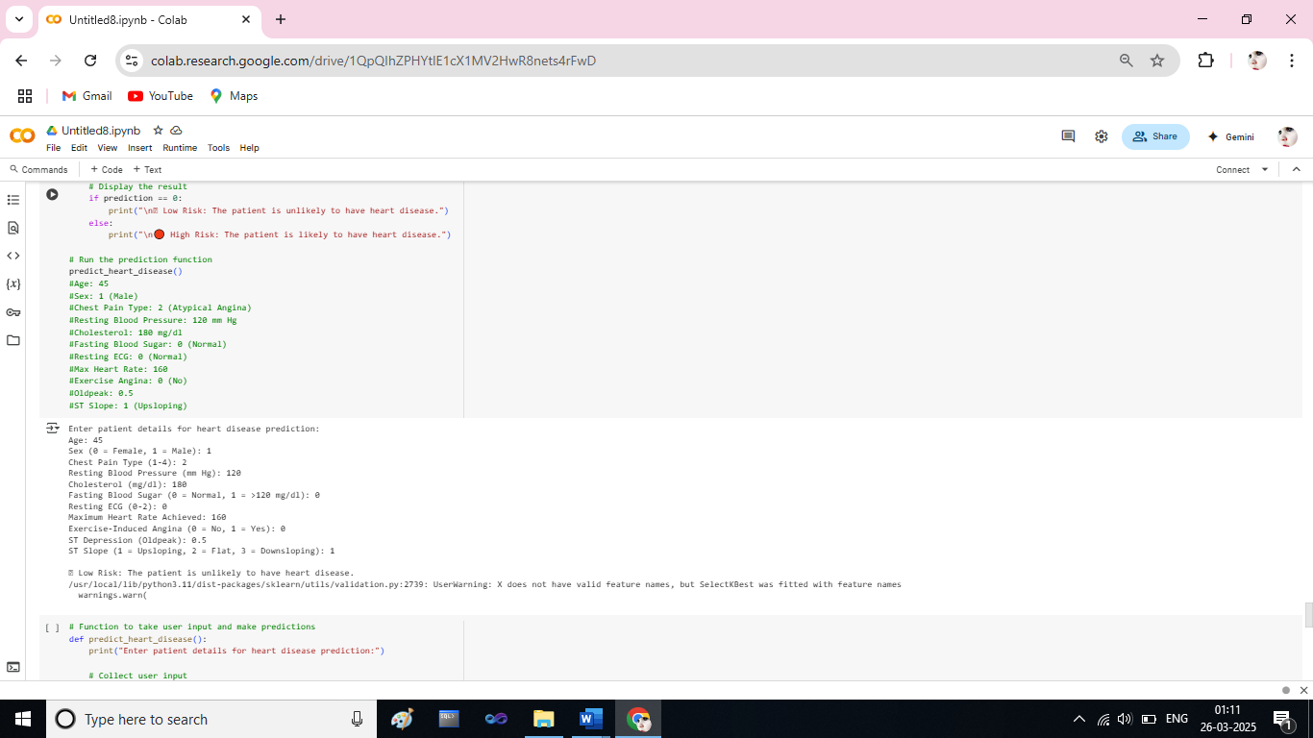
RESULT
Grid Search -SVM Classifier Result for User input

Slide 17
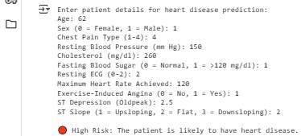
Grid Search -SVM Classifier Result for User input

Slide 18
CONCLUSION
This study optimizes SVM models for heart disease prediction, with Grid Search SVM achieving the highest accuracy (89.49%). Preprocessing techniques like SMOTE, data normalization, and hyperparameter tuning enhanced performance. The model serves as a reliable tool for early diagnosis, aiding healthcare professionals. Future work can explore deep learning and improved feature selection for better accuracy.

Slide 19
FUTURE ENHANCEMENTS
Future enhancements include web deployment for instant predictions, edge computing for real-time monitoring on wearable devices, and EHR integration to support clinical decision-making and improve patient care.

