Slide 1
Digital Portfolio
STUDENT NAME: KIRUTHIK.K
REGISTER NO AND NMID: 2428B0313
1938C6E38781979953F4BAAB572CBD05
DEPARTMENT: BSc.COMPUTER SCIENCE WITH DATA ANALYTICS
COLLEGE:KPR COLLEGE OF ARTS SCIENCE AND RESEARCH

Slide 2
PROJECT TITLE problem solving challanges solved (hackathon,etc)

Slide 3


AGENDA
Problem Statement
Project Overview
End Users
Tools and Technologies
Portfolio design and Layout
Features and Functionality
Results and Screenshots
Conclusion
Github Link
3/21/2024 Annual Review

Slide 4

PROBLEM STATEMENT
In today’s competitive technical environment, students, developers, and professionals participate in numerous problem-solving challenges such as hackathons, coding contests, and algorithm competitions. While they gain valuable experience and achievements from these events, there is no single, organized platform for them to showcase, track, and manage their accomplishments.
Participants often rely on scattered methods like spreadsheets, personal notes, or social media posts to record their achievements, which makes it difficult to present their problem-solving skills clearly to potential employers, mentors, or peers.
The challenge is to create a centralized, user-friendly web application where users can log, display, and manage their problem-solving challenges, providing a professional portfolio that highlights their coding and hackathon accomplishments efficiently.

Slide 5

PROJECT OVERVIEW
The Problem Solving Challenges Solved project is a web-based application designed to help students, developers, and professionals showcase their coding, hackathon, and algorithm competition achievements in a structured and visually appealing way.
The platform allows users to:
Record challenges they have participated in, including hackathons, coding contests, and algorithm competitions.
Provide details for each challenge such as name, platform, description, and optionally, date or result.
View their achievements in an interactive, card-based layout that is responsive across devices.
Add new challenges dynamically through a simple form, allowing real-time portfolio updates.
This project serves as a personal portfolio tool that highlights problem-solving skills, coding proficiency, and active participation in competitive programming. By presenting achievements in a professional and organized format, the application enhances credibility and makes it easier for users to share their accomplishments with peers, mentors, or potential employers.

Slide 6

WHO ARE THE END USERS?
Students
College or school students who participate in coding contests, hackathons, and other problem-solving challenges.
They can use the platform to track their achievements and showcase them in a professional format.
Developers & Programmers
Individuals looking to build a portfolio of coding contests, algorithm challenges, or open-source contributions.
Helps them present their problem-solving skills to recruiters or clients.
Hackathon Participants & Tech Enthusiasts
People participating in hackathons or technical competitions.
Can log projects or solutions, record results, and maintain a digital portfolio.
Recruiters, Mentors, & Educators
While not direct users, they benefit from quickly assessing a candidate’s problem-solving skills through a clean, organized presentation of challenges and achievements.
The application is designed to be simple, intuitive, and visually appealing, making it suitable for anyone who wants to showcase problem-solving and coding achievements without complicated setup.

Slide 7

TOOLS AND TECHNIQUES
Tools Used
HTML5 – For structuring the content of the web pages and creating forms, cards, and layout elements.
CSS3 – For styling the application, including responsive design, grid layouts, card designs, hover effects, and color schemes.
JavaScript (Vanilla JS) – For adding interactivity, dynamically rendering challenge cards, and handling form submissions.
Code Editor – VS Code or any preferred code editor for development.
Web Browser – Google Chrome, Firefox, or Edge for testing and previewing the application.
Techniques Used
Responsive Design – Grid layout and flexible elements to ensure the application works across desktops, tablets, and mobile devices.
Dynamic DOM Manipulation – JavaScript is used to dynamically create and display challenge cards based on user input.
Form Validation – Basic validation ensures users provide all necessary information before adding a new challenge.
Card-Based Layout – Challenges are presented in visually appealing cards for clarity and easy readability.

Slide 8
POTFOLIO DESIGN AND LAYOUT
Minimalist & Clean Design – A simple, professional interface without clutter, keeping the focus on the challenges and achievements.
Card-Based Layout – Each challenge is displayed as a card containing the Challenge Name, Platform, and Description, making it easy to read and visually organized.
Consistent Color Scheme – Uses a soft background with accent colors for headings and cards, creating a professional and modern look.
Responsive Design – Grid layout adapts to different screen sizes, ensuring the portfolio looks great on desktops, tablets, and mobile devices.
Interactive Elements – Hover effects on cards and buttons provide a modern, interactive experience.
Layout Structure
Header Section – Project title at the top center for clear identification.
Challenges Display Section –
Uses a grid system to arrange all challenge cards neatly.
Cards include Challenge Name, Platform, Description.
Dynamic addition of challenges updates the grid in real-time.
Add New Challenge Section –
Form placed below the cards for easy input of new challenges.
Includes input fields for Challenge Name, Platform, and Description and a Submit button.
8

Slide 9
FEATURES AND FUNCTIONALITY
The Challenge Portfolio Web Application provides a simple yet interactive platform that highlights problem-solving challenges, hackathons, and coding contest achievements. The project includes a card-based design, where each challenge is displayed in a clean and visually appealing layout with shadows, colors, and hover effects. Users can interact with the webpage by adding new challenges through a form, which dynamically updates the challenge list in real-time. The application uses JavaScript functionality to handle interactions such as adding new entries and rendering cards dynamically. The design is fully responsive, ensuring that the cards automatically adjust to different screen sizes for accessibility on desktops, tablets, and mobile devices. The combination of HTML for structure, CSS for styling, and JavaScript for interactivity makes the webpage functional, user-friendly, and visually engaging.

Slide 10
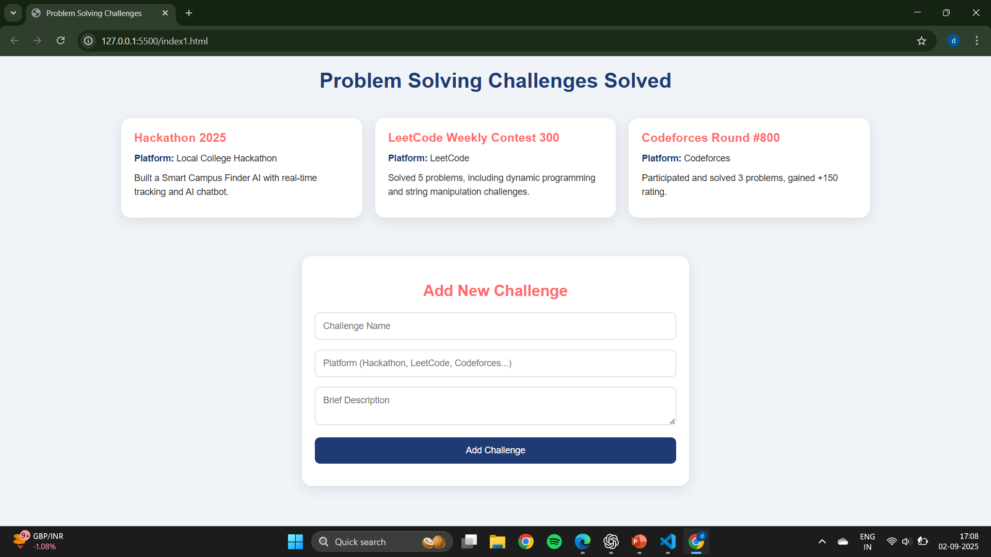

RESULTS AND SCREENSHOTS
3/21/2024 Annual Review
10

Slide 11
CONCLUSION
The Challenge Portfolio Web Application successfully provides a platform for users to showcase their problem-solving achievements in a clear and organized manner. It allows participants of hackathons, coding contests, and algorithm competitions to log, manage, and present their challenges dynamically. The combination of HTML, CSS, and JavaScript ensures a responsive, interactive, and visually appealing experience. By offering a professional and user-friendly interface, the application enhances the visibility of users’ skills and serves as a valuable tool for building a coding portfolio, impressing mentors, recruiters, or potential collaborators.
11

Slide 12
GITHUB LINK
https://kiruthik2006.github.io/Kiruthik/

