Slide 1
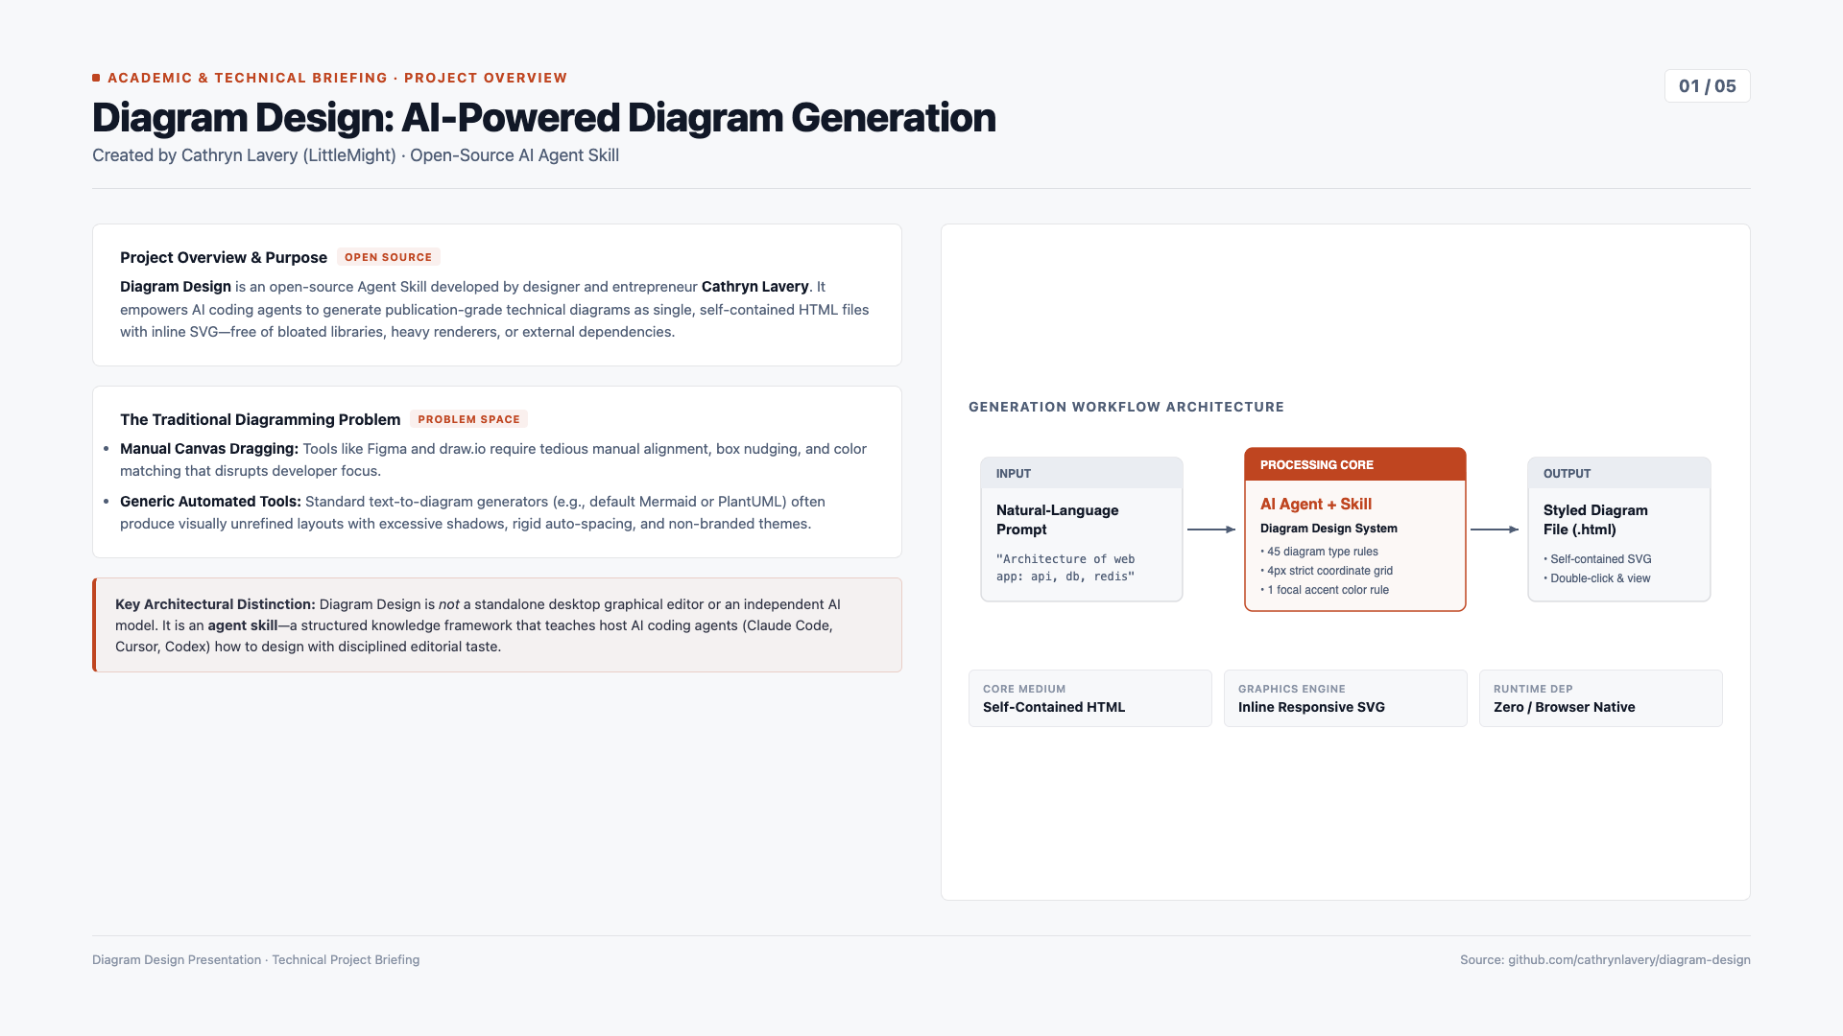
Notes:
Slide 1: About the Project
• Developer: Cathryn Lavery (founder of LittleMight).
• Project: Diagram Design is an open-source Agent Skill that enables AI coding agents to generate publication-grade technical diagrams as self-contained HTML + SVG files.
• Core Problem: Manual drag-and-drop diagramming tools (Figma, draw.io) demand high effort and break developer focus, while default code-to-diagram generators (e.g. raw Mermaid) often yield generic, unbranded, cluttered layouts.
• Key Architectural Distinction: Diagram Design is an agent skill, not a standalone graphical editor or a trained AI model. It supplies layout rules, 4px grid constraints, and editorial taste to general-purpose AI coding agents.

Slide 2
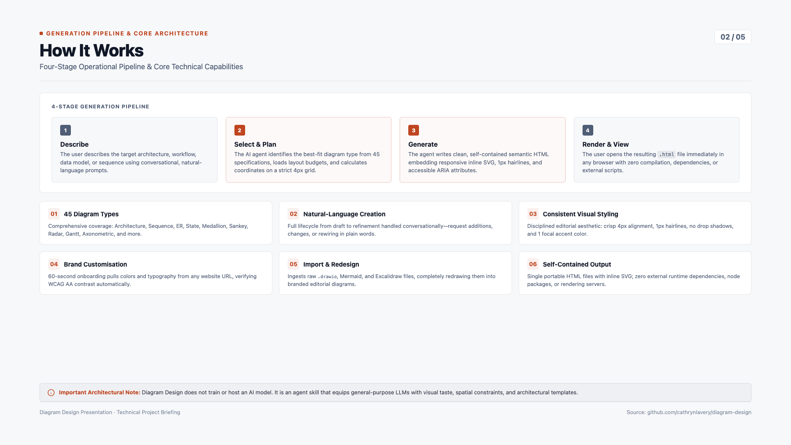
Notes:
Slide 2: How It Works & Key Capabilities
• 4-Stage Operational Pipeline:
1. Describe: User prompts the agent with natural language.
2. Select & Plan: Agent chooses from 45 diagram types and applies 4px grid constraints.
3. Generate: Agent writes clean, self-contained semantic HTML with inline SVG.
4. Render & View: User opens the .html file directly in any modern browser.
• Key Capabilities:
- 45 standardized diagram types.
- Conversational natural-language creation and iterative refinement.
- Disciplined visual hierarchy: 1px hairlines, 1 focal accent color, zero drop shadows.
- Brand customization via 60-second URL onboarding with WCAG AA contrast verification.
- Native import and editorial redesign of draw.io, Mermaid, and Excalidraw files.
- Self-contained HTML output with zero runtime dependencies.

Slide 3
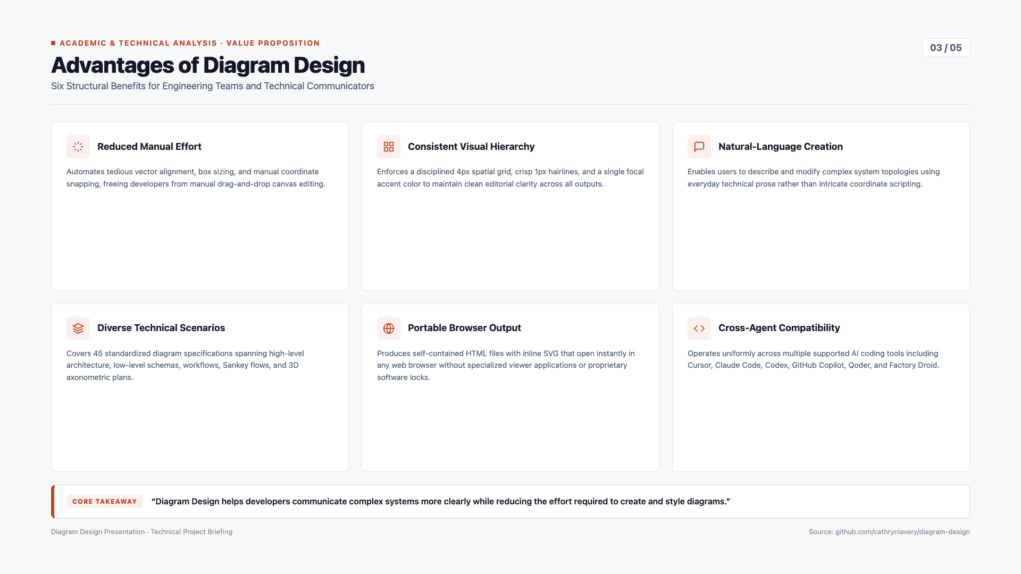
Notes:
Slide 3: Advantages of Diagram Design
Six Core Architectural and Practical Benefits:
1. Reduced manual drawing and formatting effort.
2. Consistent design and visual hierarchy on a strict 4px grid.
3. Easier diagram creation through natural-language prompts.
4. Support for diverse diagram types and technical scenarios.
5. Portable HTML/SVG output viewable immediately in any browser.
6. Cross-agent compatibility across Cursor, Claude Code, Codex, GitHub Copilot, Qoder, and Factory Droid.
Key Takeaway: Diagram Design helps developers communicate complex systems more clearly while reducing the effort required to create and style diagrams.

Slide 4
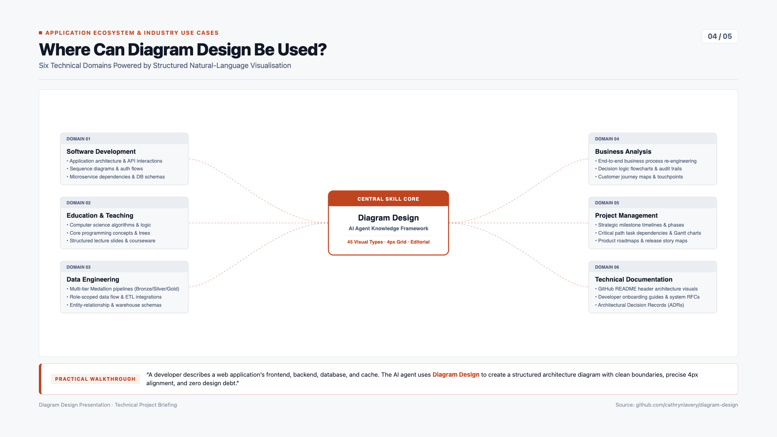
Notes:
Slide 4: Use Cases and Application Areas
Central Hub Architecture connecting 6 Core Technical Domains:
1. Software Development: Application architecture, API interactions, sequence diagrams, and DB schemas.
2. Education: Algorithms, core computer science concepts, and interactive lecture diagrams.
3. Data Engineering: Multi-tier Medallion pipelines (Bronze/Silver/Gold), ETL flows, and data models.
4. Business Analysis: Business process flows, decision flowcharts, and customer journeys.
5. Project Management: Strategic timelines, task dependency graphs, Gantt schedules, and story maps.
6. Technical Documentation: README architecture overviews, developer guides, and Architecture Decision Records (ADRs).
Practical Walkthrough Example: A developer describes a web application’s frontend, backend, database, and cache. The AI agent uses Diagram Design to create a structured architecture diagram.

Slide 5
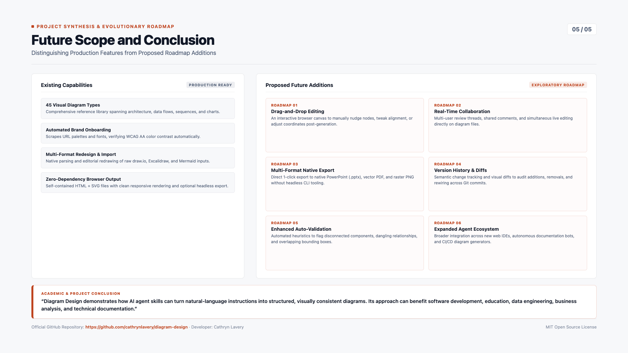
Notes:
Slide 5: Future Scope and Conclusion
Clear Distinction between Current Production Features and Proposed Future Additions:
• Current Capabilities: 45 diagram types, URL brand onboarding, multi-agent host compatibility, draw.io/Mermaid/Excalidraw imports, self-contained HTML/SVG.
• Proposed Future Roadmap:
1. Interactive drag-and-drop editing for post-generation canvas adjustments.
2. Real-time collaborative editing and shared review threads.
3. Convenient 1-click export to native PPTX, PDF, and high-res vector formats.
4. Diagram version history and Git-integrated visual diff tracking.
5. Enhanced automated validation for disconnected elements and overlapping boxes.
6. Expanded ecosystem integration with additional IDEs and CI/CD doc bots.
Conclusion: Diagram Design demonstrates how AI agent skills can turn natural-language instructions into structured, visually consistent diagrams. Its approach can benefit software development, education, data engineering, business analysis, and technical documentation.
Official Repository: https://github.com/cathrynlavery/diagram-design

