Slide 1
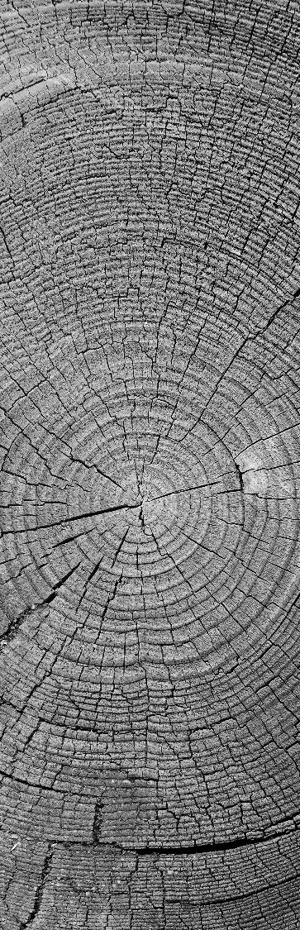
Methods in digital steganography
CSE/ECE 478 Digital Image Processing Project
By
Kiruthika Kannan
Ritu Srivatsava

Slide 2

Project Details
Project Id | 13
Title | Methods in digital steganography
Team Members | Kiruthika Kannan | 2018702001
 | Ritu Srivatsava | 2018701002
Github Link | https://github.com/kiruthika-kannan/Steganography.git

Slide 3
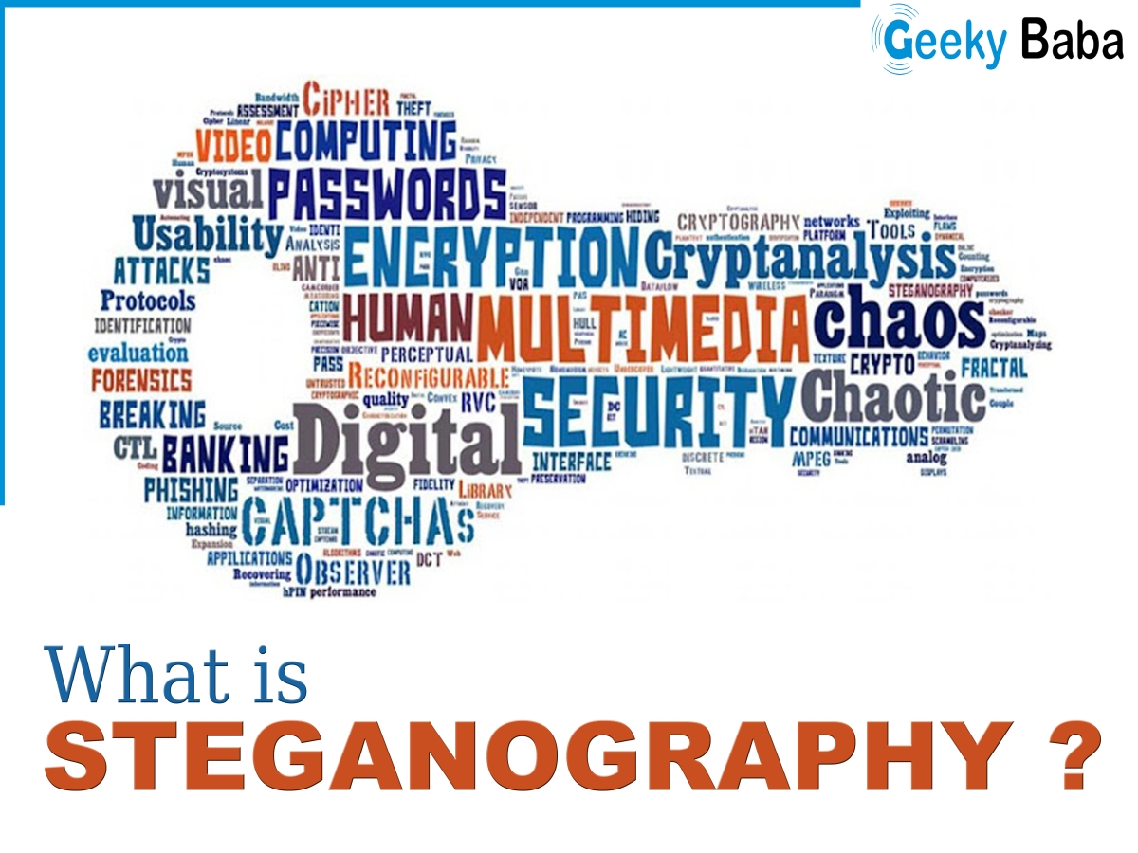
Main goals of the project
Exploring
Implementing
Comparing
different methods of digital image steganography:
Spatial-domain steganography
Frequency-domain steganography
Adaptive steganography

Slide 4

Problem definition
To efficiently conceal data in an image such that the hidden data (payload) in the stego-image is imperceptible to human vision system and the embedding is robust with respect to compression, cropping and image processing.

Slide 5
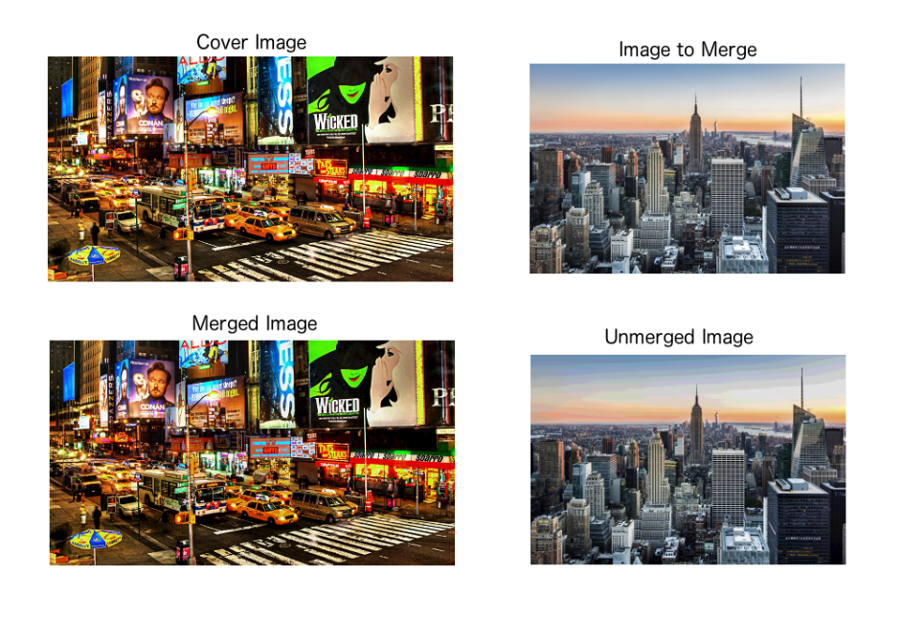
Results of the project
Stego-image output using different method of steganography for image in image embedding.
Comparison of the different methods.

Slide 6
tasks
Ritu
Kiruthika
Steganography in image frequency domain
Using DCT transform
Steganography in image spatial domain
Least significant bit substitution
Methods in Adaptive Steganography
Pixel Value Difference method
2018701002
ritu.srivatsava@research.iiit.ac.in
2018702001
kiruthika.k@research.iiit.ac.in

Slide 7
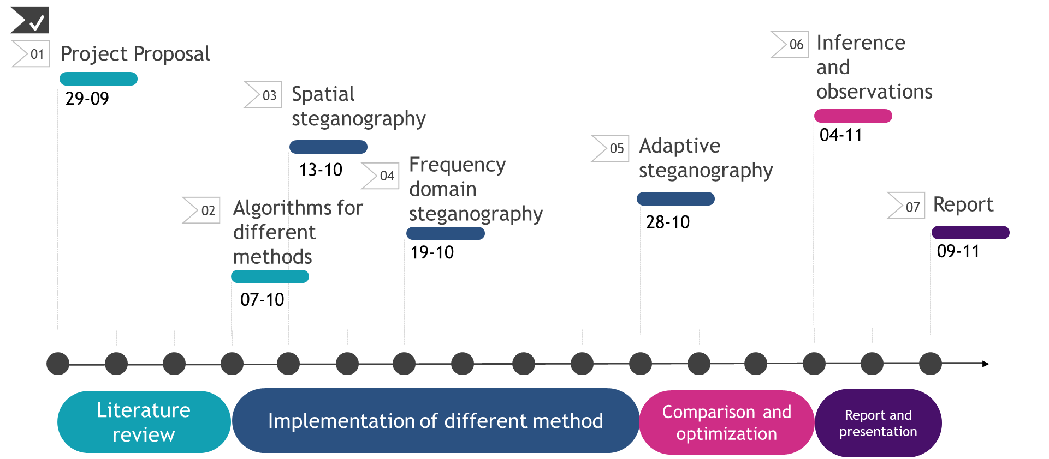
Project timeline

Slide 8
References
LSB:
Digital image steganography: Survey and analysis of current methods, Abbas Cheddad, Joan Condell, Kevin Curran, Paul Mc Kevitt.
PVD:
A steganographic method for images by pixel-value differencing, Da-ChunWua, Wen-Hsiang Tsaib.

