Slide 1
THE WORK BEHIND THE WORK
How can organisations detect
data-pipeline failures before they
disrupt business reporting?
Pipeline Sentinel
Team members:
Kiruthika J
Mahisha V
Hema Dharshini A S

Slide 2
Silent pipeline failures make stale reports look current
What happens today
Who feels the impact
A scheduled job fails or runs late. Teams find out after a dashboard looks wrong or a stakeholder asks why the numbers changed.
Data engineers lose time diagnosing issues. Finance, operations, and analytics users may make decisions using incomplete or outdated data.
The core question: how can teams detect trouble before reports go stale?

Slide 3
One view connects run health to data freshness
01
02
03
Monitor
Surface
Respond
Track run status, expected completion, and freshness.
Flag delayed and failed jobs in a visible signal feed.
Give owners a clear first action before users rely on stale reports.

Slide 4
A small, self-contained proof of concept
PIPELINE STATUS
Included in the demo
Finance daily load
Delayed · 12 min late
• Monitored pipeline summary
• Ownership and run status
• Freshness indicators
• Recent failure signals
• Incident simulation
Customer events
Healthy · 6 min ago
Inventory sync
Failed · 21 min ago
Marketing attribution
Healthy · 14 min ago

Slide 5
Earlier visibility can reduce avoidable surprise
Faster awareness
Surface a delay before a report consumer flags it.
Clearer ownership
Show the responsible domain beside the pipeline.
Better trust
Make freshness visible instead of implied.
Prototype outcome: a shared starting point for investigation and communication.

Slide 6
05 / NEXT STEPS
Connect the concept to real operational signals
1
Ingest scheduler and warehouse run metadata
2
Agree freshness targets with report owners
3
Route alerts to the pipeline owner
4
Track acknowledgement and time to recovery

Slide 7
Data-pipeline failures can make stale reports look current
WHO HAS THE PROBLEM
Data engineers responsible for pipeline reliability, and finance, operations, and analytics teams that depend on timely reports.
WHAT GOES WRONG
A scheduled pipeline fails, runs late, or delivers stale data. Teams may discover the issue only after someone questions a dashboard figure.
WHY IT MATTERS
Outdated data can delay decisions, create manual investigation, and weaken trust in shared reporting.

Slide 8
Pipeline Sentinel makes pipeline health visible
A lightweight monitoring demo that brings run status, expected completion, and data freshness into one view.
MONITOR
SURFACE
RESPOND
See run status, ownership, timing, and freshness for example data jobs.
Spot delayed or failed jobs in a recent-signal feed before reports go stale.
Review a suggested first action for a delayed finance load.
Scope: synthetic example records only. The prototype does not connect to a production scheduler, warehouse, or alert service.

Slide 9
Overview, setup, and usage
OVERVIEW
Pipeline Sentinel demonstrates an early-warning view for late, failed, or stale data pipelines.
SETUP
Download or clone the project, then open index.html in a current browser. No install, API key, server, or external service is required.
USAGE
Review pipeline status and freshness. Select “Simulate incident” to see the delayed finance load and its suggested response, then close the dialog.

Slide 10
04 / RUN AND DEPLOYMENT
Run locally or publish as a static site
LOCAL RUN
1. Open index.html in Chrome, Edge, Firefox, or Safari.
2. Review status and recent signals.
3. Select Simulate incident and read the suggested action.
GITHUB PAGES DEPLOYMENT
1. Push the repository to GitHub on the main branch.
2. Open Settings, then Pages, and choose Deploy from a branch.
3. Select main and /(root), save, then use the published URL shown in Pages.
The static demo needs no backend, database, credentials, or environment variables.

Slide 11
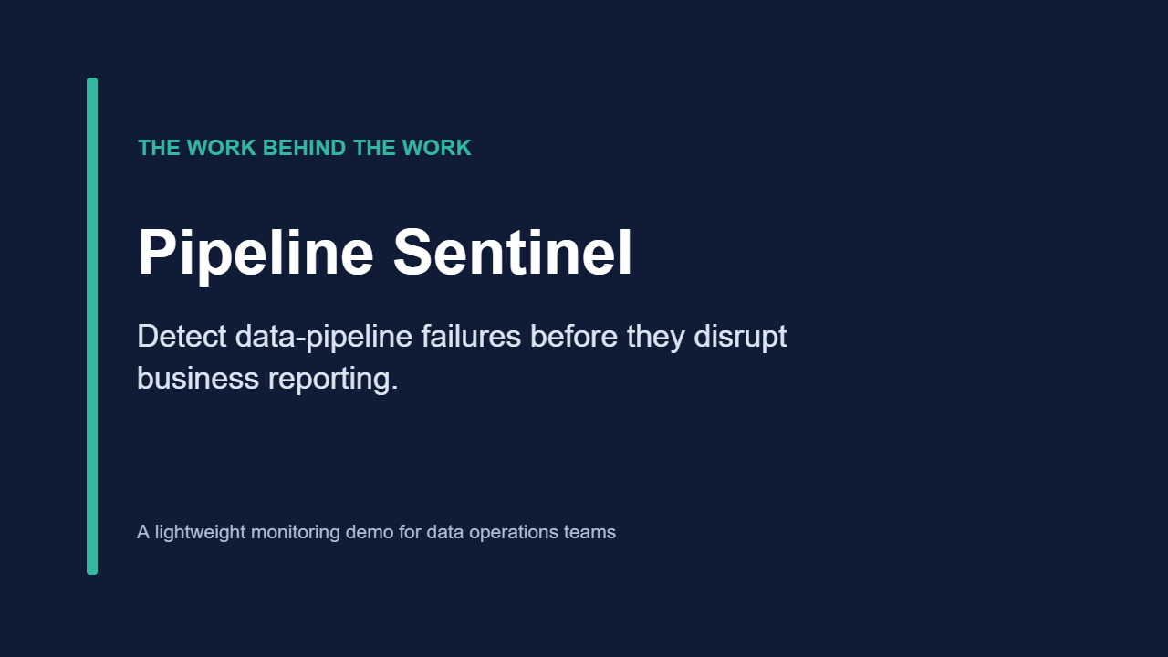
Pipeline Sentinel demo
.
.

