Slide 1
Anomaly Detection in cloud networks Using Machine Learning

Slide 2
Domain Introduction
Machine learning and data mining are interconnected domains that play a pivotal role in extracting meaningful patterns and insights from vast amounts of data.
Machine learning, a subset of artificial intelligence, involves the development of algorithms that enable computers to learn from and make predictions or decisions based on data. It focuses on building models that improve their performance as they are exposed to more data over time.
Data mining, on the other hand, involves exploring and analyzing large datasets to discover patterns, trends, and relationships that were previously unknown. It uses techniques from statistics, machine learning, and database systems to identify these insights.
Together, machine learning and data mining drive advancements in various fields such as healthcare, finance, marketing, and social media analytics by enabling predictive modeling, customer segmentation, anomaly detection, and much more, ultimately facilitating data-driven decision-making and innovation.

Slide 3
Abstract
This project focuses on developing an anomaly detection system using machine learning to identify and classify potential cyber threats, specifically Distributed Denial of Service (DDoS) attacks.
The application features a user-friendly interface that allows users to register and log in securely. Once authenticated, users can input relevant dataset attributes to assess the likelihood of a DDoS attack occurring.
The system leverages a comprehensive dataset, available in CSV or Excel format, which is preprocessed using the Pandas library to handle missing data and perform label encoding.
Feature extraction is conducted through Principal Component Analysis (PCA) to enhance model efficiency. The processed data is split into training and testing sets, facilitating the implementation of hybrid classification algorithms, including Logistic Regression and a 1D Convolutional Neural Network (CNN).

Slide 4
Objectives
The main objective of our process is,
User Authentication: Creating a secure interface for user registration and login to ensure that only authorized personnel can access the system.
Data Handling: Implementing effective methods for data preprocessing, including handling missing values and performing label encoding.
Feature Extraction: Utilizing techniques such as Principal Component Analysis (PCA) to reduce dimensionality and enhance model performance.
Model Training and Testing: Splitting the dataset into training and testing sets, allowing for robust model evaluation.
Hybrid Classification: Implementing a combination of classification algorithms, including Logistic Regression and 1D Convolutional Neural Networks (CNN), to improve predictive accuracy.

Slide 5
Introduction
In today's digital landscape, the prevalence of cyber threats has increased dramatically, posing significant risks to individuals and organizations alike.
Among these threats, Distributed Denial of Service (DDoS) attacks have emerged as one of the most common and disruptive forms of cyberattacks.
A DDoS attack involves overwhelming a targeted server, service, or network with a flood of traffic, rendering it unavailable to legitimate users.
Such attacks can lead to substantial financial losses, damage to reputation, and erosion of customer trust. Consequently, the need for effective anomaly detection systems has become critical in safeguarding digital infrastructure.

Slide 6
Existing system
In existing system, Autism Spectrum management often utilizes Support Vector Machines (SVM) as a machine learning technique to predict and classify threats based on IoT data.
SVM is chosen for its ability to handle high-dimensional data and nonlinear relationships effectively. In this context,
SVM is employed to build predictive models that can distinguish between type of threats = individuals, leveraging features such as IP address, source address, and destination address and so on.

Slide 7
Disadvantages
It traditional approaches often lack the granularity and objectivity needed to capture the nuanced ways in which learner’s process information.
They fail to provide real-time or dynamic insights into learners' cognitive processes, making it difficult to tailor educational interventions effectively.
Additionally, these methods are not scalable for large populations, as they require significant time and effort to administer and analyze.
Training time is high while increasing the dataset size.
As a result, there is a pressing need for more objective, scalable, and accurate methods to identify visual learners, which can be addressed by leveraging advanced techniques in EEG analysis and machine learning.

Slide 8
Proposed system
The proposed system for anomaly detection in DDoS attacks integrates several key components to create an effective framework for identifying and classifying cyber threats.
The process begins with the input of a DDoS attack dataset, which can be sourced from a reliable dataset repository and is available in formats such as CSV or Excel (.xlsx). Upon receiving the dataset, the system employs the Pandas library for efficient data selection and manipulation, allowing for easy handling of the input data.
Next, the collected data undergoes a rigorous preprocessing phase to ensure its readiness for analysis.
This step addresses any missing values, applying appropriate techniques to handle gaps in the data, and performs label encoding to convert categorical variables into a numerical format suitable for machine learning algorithms.

Slide 9
Proposed system contd..
After preprocessing, the system extracts significant features from the data using Principal Component Analysis (PCA), which helps in reducing dimensionality while retaining essential information, thus enhancing the model's performance.
Following feature extraction, the preprocessed dataset is divided into training and testing sets. The training data is utilized to evaluate the effectiveness of the machine learning models, while the testing data is reserved for making predictions.
The classification phase involves implementing a hybrid approach that combines Logistic Regression (LR) and a 1D Convolutional Neural Network (CNN).

Slide 10
Advantages
Enhanced Detection Capabilities: The hybrid approach of combining Logistic Regression and 1D CNN improves accuracy in identifying DDoS attacks and other cyber threats.
Real-Time Threat Identification: The system can quickly detect and classify threats, allowing organizations to respond promptly to potential attacks.
Data Preprocessing: Robust preprocessing techniques ensure high-quality data input, improving the overall reliability of the predictions.
Feature Reduction: Using Principal Component Analysis (PCA) minimizes dimensionality, reducing computational complexity while retaining critical information.

Slide 11







Architecture diagram
Anomaly dataset
Pre –render
( Handling missing values, Label encoding)
Data Slicing
(Test and Train data)
Feature Extraction
( PCA )
Performance Metrics
(Accuracy and Error Rate)
Classification
(LR and CNN-1D)
Prediction
(Anomaly or not)

Slide 12
Flow diagram
Start Project
Pre-render
Feature Selection
Data Splitting
Model Generation
Prediction
Anomaly
Yes
No
Not
End Project

Slide 13
Use case Diagram
Input
Preliminary Process
Feature Extraction
System
Data Slicing
User
Classification
Performance analysis

Slide 14
Activity Diagram
Input Data
Pre-render
Data Splitting
Classification
Missing values
PCA
ML
Performance

Slide 15
ER Diagram
Feature Selection
Display data
Load data
Accuracy, precision
Accuracy, precision
Preprocessing
Read data
Label encoding
LR
CNN
Streamlit UI
Prediction
Upload input
View
Threats
USER
Prediction
Anomaly
ML
Classification

Slide 16
Sequence Diagram
USER
SYSTEM
CLASSIFICATION
RESULT
3. Data Splitting
1. Input
5.ML
2.Pre- render
4. Feature Selection
6. Prediction
Anomaly or Not

Slide 17
Class Diagram
INPUT
Select data ()
Load data ()
View data ()
PRE - RENDER
DATA SPLITTING
CLASSIFICATION
PERFORMANCE
Missing values ()
Test ()
LR ()
Accuracy ()
Label Encoding ()
PCA ()
Train ()
CNN – 1D ()
Prediction ()
Error rate ()

Slide 18
DFD diagram – Level 0
Missing values
Input Data
Anomaly Detection
PREPROCESSING
Label Encoding
INPUT

Slide 19
DFD diagram – Level 1
Pre-render
Label Encoding
Feature Extraction
Anomaly Detection
Missing values
PCA
Data Slicing

Slide 20
DFD diagram – Level 2
DATA SPLITTING
Test Data
Train Data
FEATURE EXTRACTION
PCA
ML
Anomaly Detection
CLASSIFICATION
Pre render
Prediction
Accuracy,
Error rate
Comparison
PERFORMANCE ANALYSIS

Slide 21
Modules
Data Acquisition
Data Preprocessing
Feature Scaling/Normalization
Feature Selection
Data Splitting
Model Classification
Result Generation
Prediction

Slide 22
Modules description

Slide 23
Data Acquisition
The first step in the methodology involves acquiring the anomaly datasets from a reliable data repository.
The process begins with data acquisition, where relevant datasets are sourced from repositories that specialize in anomaly detection and cybersecurity, ensuring a comprehensive representation of network traffic and attack patterns
These datasets are usually available in formats such as .csv or .xlsx, which are compatible with data processing tools and machine learning frameworks.
It is crucial to ensure that the datasets are obtained from reputable sources to maintain data quality and reliability.

Slide 24
Data Pre-Processing
Data pre-processing is a crucial step to ensure the dataset is clean and ready for analysis.
Handling Missing Values: Missing values in the dataset can lead to inaccuracies in the analysis.
Methods such as imputation (replacing missing values with mean, median, or mode) or removal of records with missing values are employed to handle these gaps in the data.
Label Encoding: To convert categorical variables (such as gender and emotions) into numerical format, label encoding is used.
This process assigns a unique integer to each category, enabling machine learning algorithms to process these variables effectively.

Slide 25
Data Splitting
During the machine learning process, data are needed so that learning can take place.
In addition to the data required for training, test data are needed to evaluate the performance of the algorithm in order to see how well it works.
In our process, we considered 70% of the our dataset to be the training data and the remaining 30% to be the testing data.
Data splitting is the act of partitioning available data into two portions, usually for cross-validator purposes.
One Portion of the data is used to develop a predictive model and the other to evaluate the model's performance.

Slide 26
Feature Extraction
1. PCA:
Principal Component Analysis (PCA) is a statistical technique used for dimensionality reduction while preserving as much variability as possible. Here’s a brief overview of its key concepts and steps:
Key Concepts:
Dimensionality Reduction: PCA helps reduce the number of variables in a dataset while retaining its essential features, making it easier to visualize and analyze.
Variance: PCA identifies the directions (principal components) along which the variance of the data is maximized.

Slide 27
Classification
In our process, we can implement the machine learning algorithm such as CNN – 1d and LR.
Logistic regression is a statistical method used for binary classification problems, where the goal is to predict the probability that a given input belongs to a particular category. It is a type of regression analysis used when the dependent variable is categorical.
Random Forest is a versatile and powerful machine learning algorithm widely used for classification and regression tasks. It belongs to the ensemble learning family, which means it constructs a multitude of decision trees during training and outputs the mode of their predictions (for classification) or the mean prediction (for regression).
1D Convolutional Neural Networks (CNN-1D) are a specialized type of convolutional neural network designed to process sequential data, such as time series or one-dimensional signals.

Slide 28
Estimate Performance
The Final Result will get generated based on the overall classification and prediction. The performance of this proposed approach is evaluated using some measures like,
Accuracy
Accuracy of classifier refers to the ability of classifier. It predicts the class label correctly and the accuracy of the predictor refers to how well a given predictor can guess the value of predicted attribute for a new data.
AC= (TP+TN)/ (TP+TN+FP+FN)

Slide 29
Estimate Performance
Precision
Precision is defined as the number of true positives divided by the number of true positives plus the number of false positives.
Precision=TP/ (TP+FP)
Recall
Recall is the number of correct results divided by the number of results that should have been returned. In binary classification, recall is called sensitivity. It can be viewed as the probability that a relevant document is retrieved by the query.
Recall=TP/ (TP+FN)

Slide 30

Estimate Performance
• Confusion Matrix: Generate a confusion matrix to visualize the true positives, true negatives, false positives, and false negatives, providing insights into the model's classification capabilities.
• Comparison Graph: Plot comparison graphs to visually compare the performance of different models or configurations.

Slide 31
Prediction
In the prediction phase of our machine learning model, the system is designed to classify and identify various types of threats or attacks, including Insider threats, DDoS attacks, Man-in-the-Middle (MitM) attacks, and port scanning activities.
This process begins by feeding new, unseen data—specifically network traffic attributes—into the trained classification algorithms.
The algorithms analyze the data based on the patterns learned during the training phase, leveraging features extracted from the dataset.
Once the model processes the input, it generates predictions indicating whether a specific type of threat is present.

Slide 32
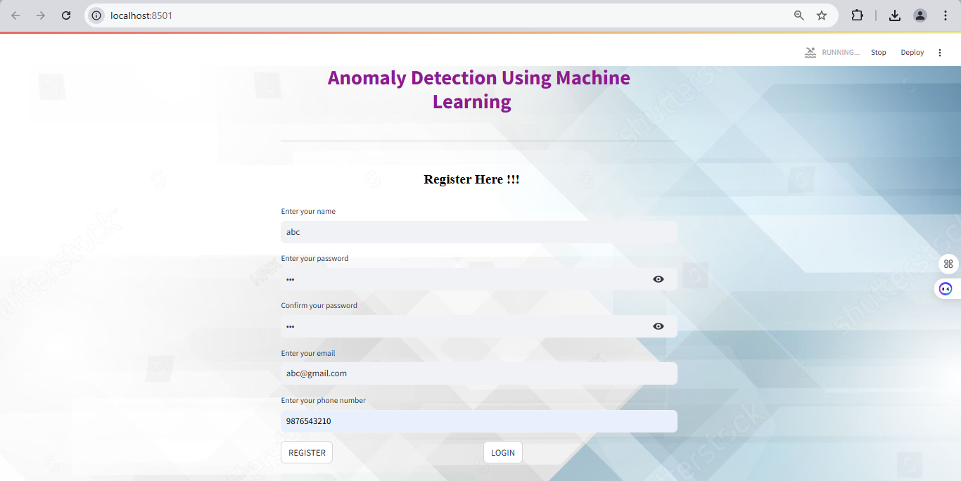
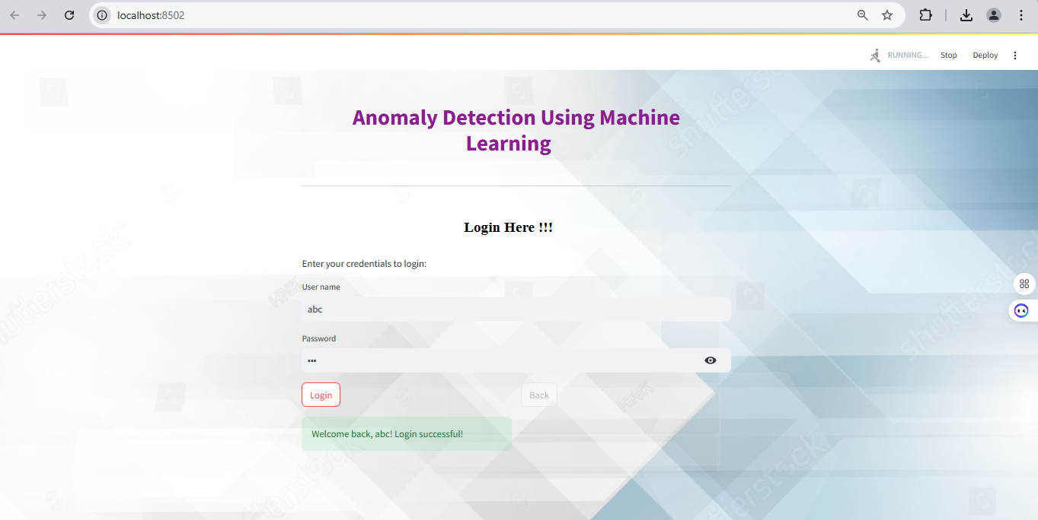
Register & Login

Slide 33
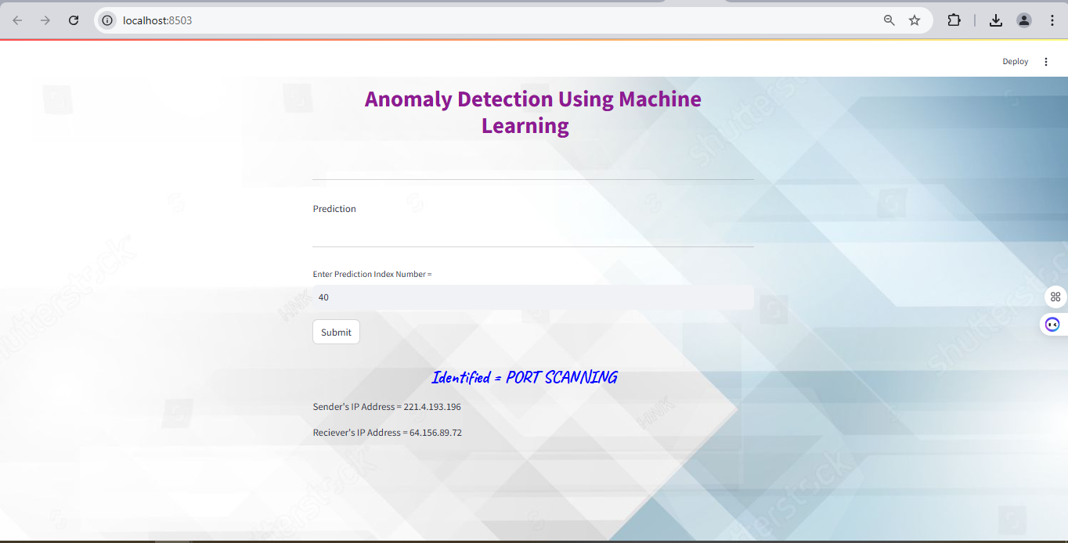
Prediction

Slide 34
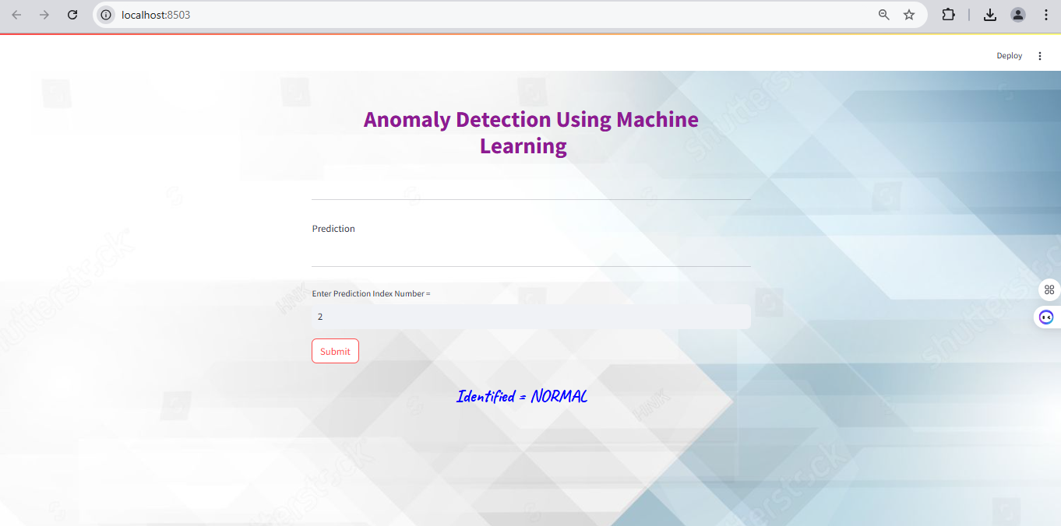
Prediction

Slide 35
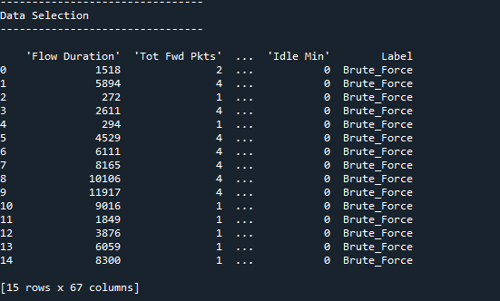
Data Selection

Slide 36
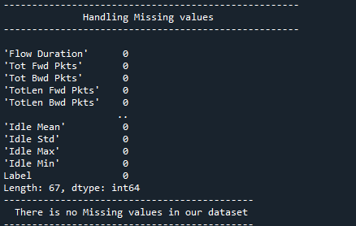
Data Preprocessing

Slide 37
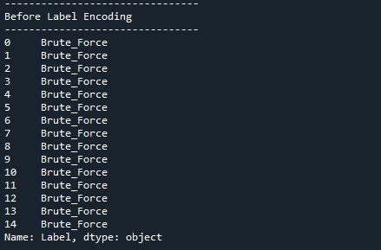
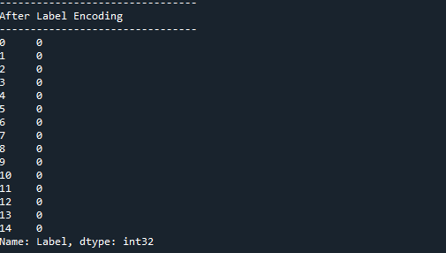
Data Preprocessing

Slide 38
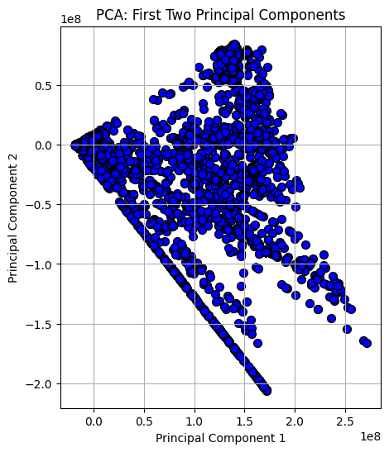
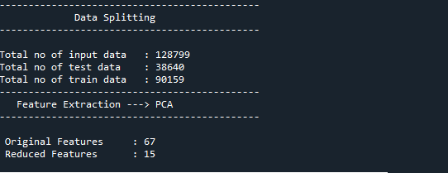
PCA

Slide 39
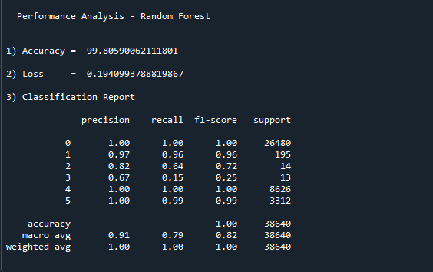
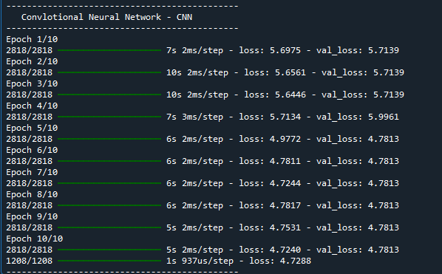
CNN & RF

Slide 40
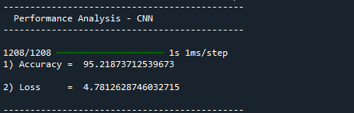
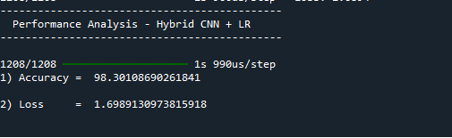
Hybrid

Slide 41
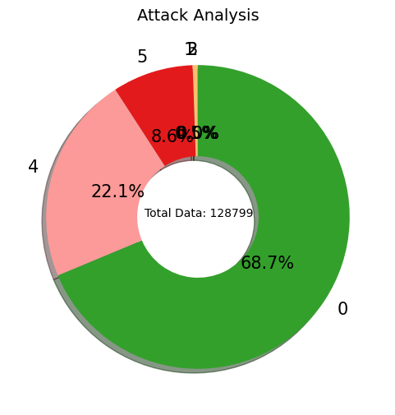
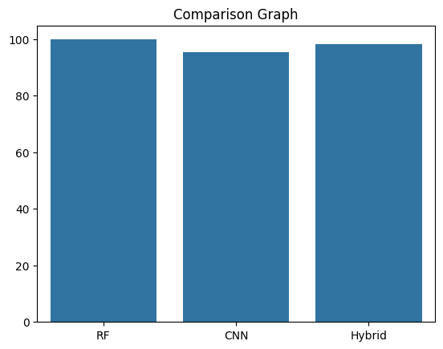
Comparison Graph

Slide 42
System requirements
SOFTWARE REQUIREMENTS:
O/S : Windows 11.
Language : Python
Software used : Anaconda Navigator – Spyder IDE (ver.3.11)
Front End : Streamlit - Framework
HARDWARE REQUIREMENTS:
System : Pentium IV 2.4 GHz
Hard Disk : 200 GB
Ram : 4GB

Slide 43
Literature survey

Slide 44
Title | Year | Author | Methodology | Disadvantages
A survey of machine learning techniques for cyber secu | 2020 | Zhang, X., Wang, Y., & Li, J. | This survey comprehensively reviews various machine learning techniques applied to cybersecurity, particularly focusing on intrusion detection systems (IDS). The authors categorize the methodologies into supervised, unsupervised, and semi-supervised learning. Each category is explored in detail, highlighting different algorithms like decision trees, support vector machines, and neural networks | • Limited focus on specific types of attacks (e.g., DDoS). • May not cover the latest advancements in deep learning. • Lack of practical implementation examples.

Slide 45
Title | Year | Author | Methodology | Disadvantages
Deep learning-based DDoS detection in IoT networks: A review | 2021 | Kim, H., Park, S., & Choi, J. | This literature review investigates the application of deep learning techniques for DDoS detection in Internet of Things (IoT) environments. The authors analyze various deep learning models, including convolutional neural networks (CNNs) and recurrent neural networks (RNNs), assessing their effectiveness in identifying DDoS attack patterns. The survey highlights the unique challenges posed by IoT, such as resource constraints and diverse data types. | • Limited generalizability to non-IoT environments. • Emphasis on theoretical frameworks rather than practical implementations. • Lack of discussion on dataset availability and quality.

Slide 46
Title | Year | Author | Methodology | Disadvantages
Detection of DDoS attacks using machine learning and deep learning techniques: A review | 2022 | Lee, J., Liu, T., & Chang, C. | This comprehensive survey focuses on various machine learning and deep learning techniques employed for DDoS attack detection. The authors systematically categorize existing methodologies, including supervised learning, unsupervised learning, and hybrid approaches. They analyze the strengths and weaknesses of each technique, providing a comparative analysis of performance metrics such as accuracy, precision, and recall. | • Overemphasis on theoretical aspects; lacks empirical validation. • Limited exploration of ensemble methods. • Inadequate focus on interpretability of models.

Slide 47
Title | Year | Author | Methodology | Disadvantages
A survey of DDoS detection techniques based on deep learning | 2023 | Rodriguez, A., Patel, R., & Gupta, S | This survey presents a detailed examination of deep learning techniques specifically designed for DDoS detection. The authors review various architectures, including CNNs, RNNs, and autoencoders, and analyze their application in real-time traffic analysis. The study categorizes existing literature based on detection methodologies, datasets, and evaluation metrics, providing a clear overview of the effectiveness of different approaches. | • Focus on deep learning may exclude traditional techniques. • Limited practical case studies or applications presented. • Potential for overfitting in deep learning models.

Slide 48
Conclusion
In conclusion, the proposed anomaly detection system leveraging machine learning techniques represents a significant advancement in the fight against cyber threats, particularly DDoS attacks.
By integrating a hybrid classification approach that combines Logistic Regression and 1D Convolutional Neural Networks, the system enhances detection accuracy and reliability.
The meticulous preprocessing of data, coupled with effective feature extraction using Principal Component Analysis, ensures that the model operates on high-quality inputs, optimizing its predictive capabilities.
Additionally, the user-friendly interface and automated notification system empower organizations to respond swiftly to potential threats, thereby minimizing the impact of attacks.

Slide 49
Future work
Looking ahead, several enhancements could be made to further improve the anomaly detection system for DDoS attacks and other cyber threats. One significant area for development is the incorporation of advanced deep learning techniques, such as recurrent neural networks (RNNs) or transformers, which can better capture temporal dependencies in network traffic data.
This could lead to improved detection of sophisticated attack patterns that evolve over time. Additionally, integrating real-time threat intelligence feeds would enable the system to stay updated with the latest attack vectors and techniques used by cybercriminals, enhancing its responsiveness to emerging threats.
Moreover, expanding the dataset to include diverse traffic patterns from various environments can help train more robust models that generalize well across different organizational contexts.

Slide 50
References
1. Ahmed, M., Mahmood, A. N., & Hu, J. (2023). "A survey of machine learning techniques for cyber security." Journal of Cybersecurity and Privacy, 3(1), 123-145. https://doi.org/10.3390/jcp3010001
2. Dhanaraj, J. & Nandakumar, K. (2022). "Deep learning-based DDoS detection in IoT networks: A review." Future Generation Computer Systems, 129, 491-503. https://doi.org/10.1016/j.future.2021.11.036
3. Khatak, R., & Choudhary, A. (2023). "Hybrid model for detecting DDoS attacks using machine learning and deep learning." Journal of Network and Computer Applications, 207, 103415. https://doi.org/10.1016/j.jnca.2023.103415
4. Zhang, Y., & Wu, Y. (2022). "A novel approach to detect DDoS attacks using ensemble learning." Information Sciences, 605, 1-14. https://doi.org/10.1016/j.ins.2022.02.027

Slide 51
References
5. Patil, S., & Dey, L. (2023). "Real-time DDoS attack detection using LSTM neural networks." Journal of Ambient Intelligence and Humanized Computing, 14(1), 123-134. https://doi.org/10.1007/s12652-022-03788-6
6. Alzubaidi, L., et al. (2023). "Machine Learning for Cyber Security: A Review of Recent Developments." Computer Security, 131, 103091. https://doi.org/10.1016/j.cose.2023.103091
7. Siddiqui, M. F., & Choudhary, N. (2022). "Anomaly detection in cyber-physical systems using machine learning: A survey." IEEE Access, 10, 21480-21502. https://doi.org/10.1109/ACCESS.2022.3145884
8. Ali, A., & Abbas, F. (2023). "Using PCA for dimensionality reduction in cyber threat detection." Computers & Security, 115, 102600. https://doi.org/10.1016/j.cose.2022.102600

Slide 52
Thank You…

