Slide 1
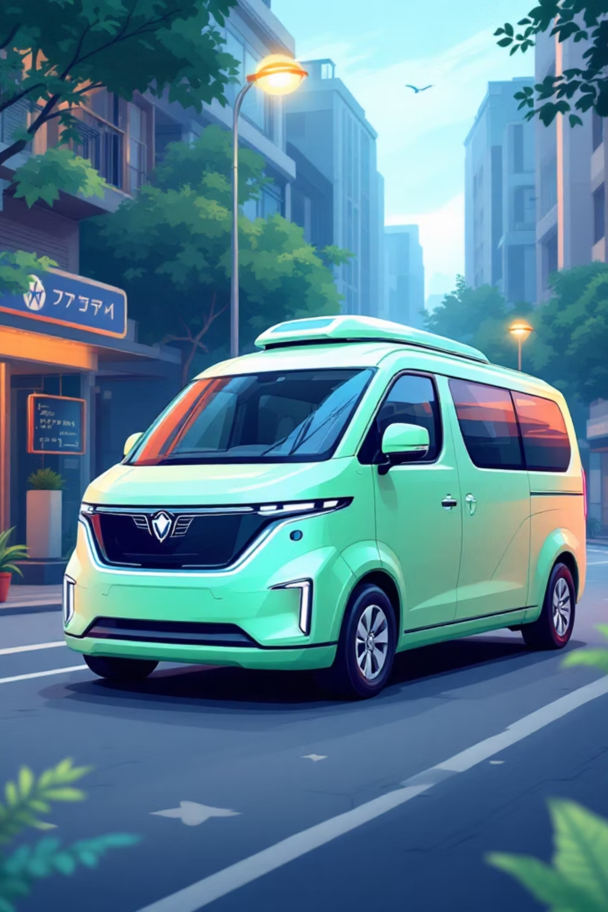
MSDB 2.O : The Future of Waste Management
Transforming urban waste into a sustainable ecosystem through mobile, solar-powered IoT technology. The Madurai Smart Drop Booth turns citizen participation into measurable environmental impact.

Slide 2

Smart Engineering at Scale
A sophisticated yet affordable IoT ecosystem built for real-world deployment in urban environments.
The Brain
Precision Sensors
Raspberry Pi 4 running Python-based logic for intelligent waste processing and data management
Load cells for accurate weight measurement and ultrasonic sensors for real-time bin level monitoring
Cloud Connectivity
Autonomous Power
Secure REST API synchronizes user rewards and tracking data to cloud infrastructure instantly
100W solar panels enable 24/7 operation without grid dependency, perfect for urban deployment

Slide 3
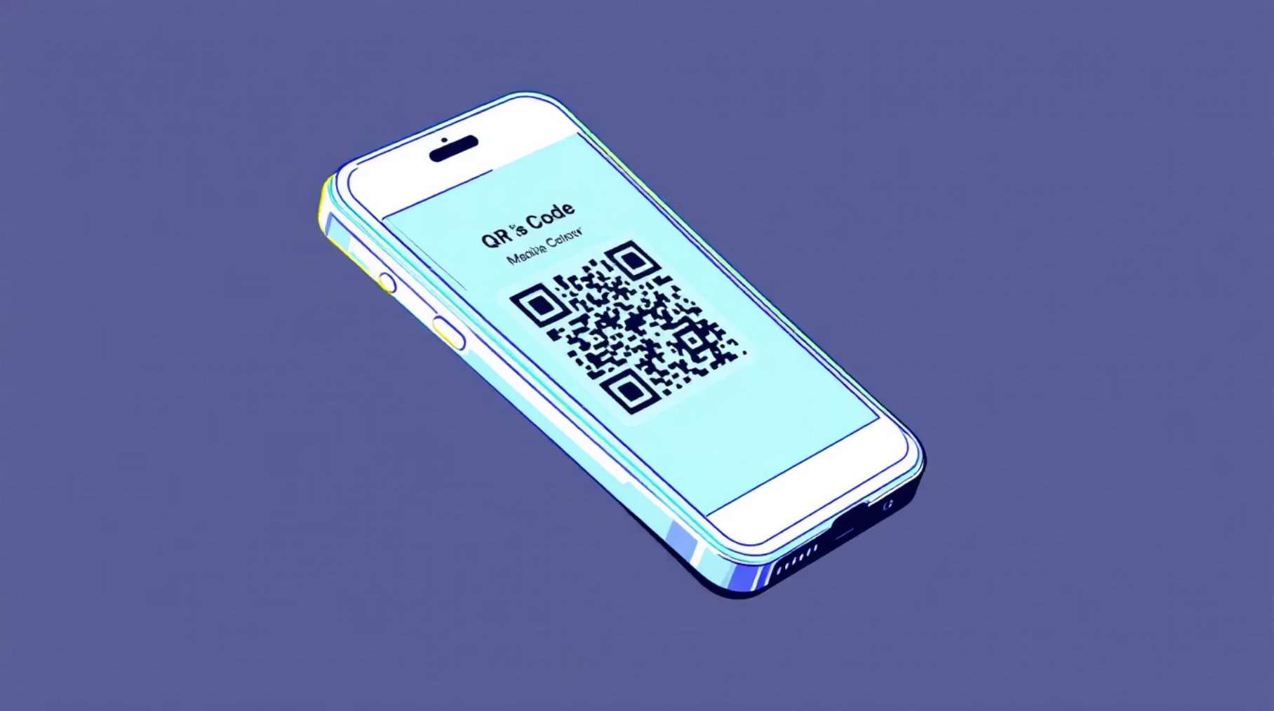
A Seamless User Experience
How Citizens Participate
The three-step process makes waste disposal rewarding and accessible to everyone.
01
02
03
Scan QR Code
Drop Waste
Get Points
Open app and scan booth identifier
Deposit properly segregated materials
Instant Green Credits appear in wallet
B2C Model
B2B Revenue
Points redeemable at partner Madurai shops, creating local economic circulation
100% segregated waste streams sold to industrial recyclers at premium rates

Slide 4



Smart Solutions for Real-World Problems
AI-Powered Security
Cost-Effective Design
Phased Rollout
Computer vision algorithms detect non-waste items and prevent fraudulent point accumulation in real-time
Prototype: ₹52,800 | Mass Production: ₹35,000 per unit, enabling scalable city-wide deployment
Starting with Anna Nagar district, Madurai, then expanding to full city coverage based on demand data

Slide 5

Together for a Cleaner Madurai
Team Name : THE NEURAL DUO
Rajadharani Marimuthu | dharanisara7@gmail.com
Kiruthiga Seenivasan | kkiru0812@gmail.com

