Slide 1



CP2
KREATIVE GENESIS 2026
TITLE PAGE
PROBLEM STATEMENT TITLE : AI-Based Medication Adherence Tracker
DOMAIN NAME : Health Care Technology
PROBLEM STATEMENT: AI-Based Medication Adherence Tracker
TEAM-ID: KGH224
TEAM NAME: Tech Tonic

Slide 2

CP2
AI-Based Medication Adherence Tracker
Problem Overview
Many patients forget to take their medicines on time or take the wrong dosage.
This leads to poor treatment results, health conditions, and sometimes serious complications.
An AI-based medication adherence tracker helps by reminding patients to take their medicines, monitoring their medication schedule, and alerting caregivers or doctors
if doses are missed.
This improves patient safety and treatment effectiveness.
Target users or beneficiaries
Elderly patients – Helps them remember to take medicines on time.
Patients with chronic diseases like Diabetes and Hypertension.
Caregivers / family members – Receive alerts if medication is missed.
Doctors and healthcare providers – Can monitor patient medication adherence.

Slide 3
CP2
AI-Based Medication Adherence Tracker
Solution Overview
The AI-based Medication Adherence Tracker is designed to help patients take their medicines on time.
The system uses a smart pillbox connected to a microcontroller such as the Arduino Uno or ESP32 and
a mobile application.
The user enters the medication schedule in the app, and the system provides reminders through
alarms or notifications.
Key Features or Capabilities of the System
Smart reminders to alert patients to take medicine on time.
Automatic pill detection using sensors when the box is opened.
AI monitoring to track medication habits and missed doses.
Caregiver alerts if the patient misses a medication.
Mobile app integration to manage schedules and reminders.

Slide 4
AI-Based Medication Adherence Tracker
CP2
Prototype Overview
Current Prototype Overview
A basic prototype of the AI-Based Medication Adherence Tracker has been developed to remind patients to take medicines on time.
The system provides alerts and displays medication information to improve adherence.
Application Interface
A simple interface is designed to set medicine schedules and reminder times.
The interface can show notification alerts and medication status.
Hardware Setup
The prototype hardware includes microcontroller, RTC module, display, buzzer, and voice module.
All components are assembled in a small medicine box structure.
Circuit Design
RTC module and OLED display are connected to the microcontroller using I2C communication.
Buzzer and sensor modules are connected to digital input/output pins.
System Modules
Reminder module generates alerts when it is time to take medicine.
Detection and monitoring modules track whether the medicine box is opened.

Slide 5
AI-Based Medication Adherence Tracker
CP2
Current Project Progress
Basic prototype hardware has been assembled and tested.
The reminder system is functioning and alerts the user at the scheduled time.
Application Screenshots
Screenshots show the interface for setting medicine reminders.
The application displays medicine name, time, and reminder notifications.
Hardware Setup Images
The prototype includes a microcontroller such as ESP8266 connected with other modules.
Hardware setup shows components like OLED Display, buzzer, and RTC module.
Circuit Diagram
Circuit diagram illustrates the connections between the microcontroller and sensors.
Modules like DS3231 RTC Module and display are connected through I2C communication.
Working Modules
Reminder module activates alerts when the medicine time is reached.
Display and voice modules show and announce medication information.

Slide 6
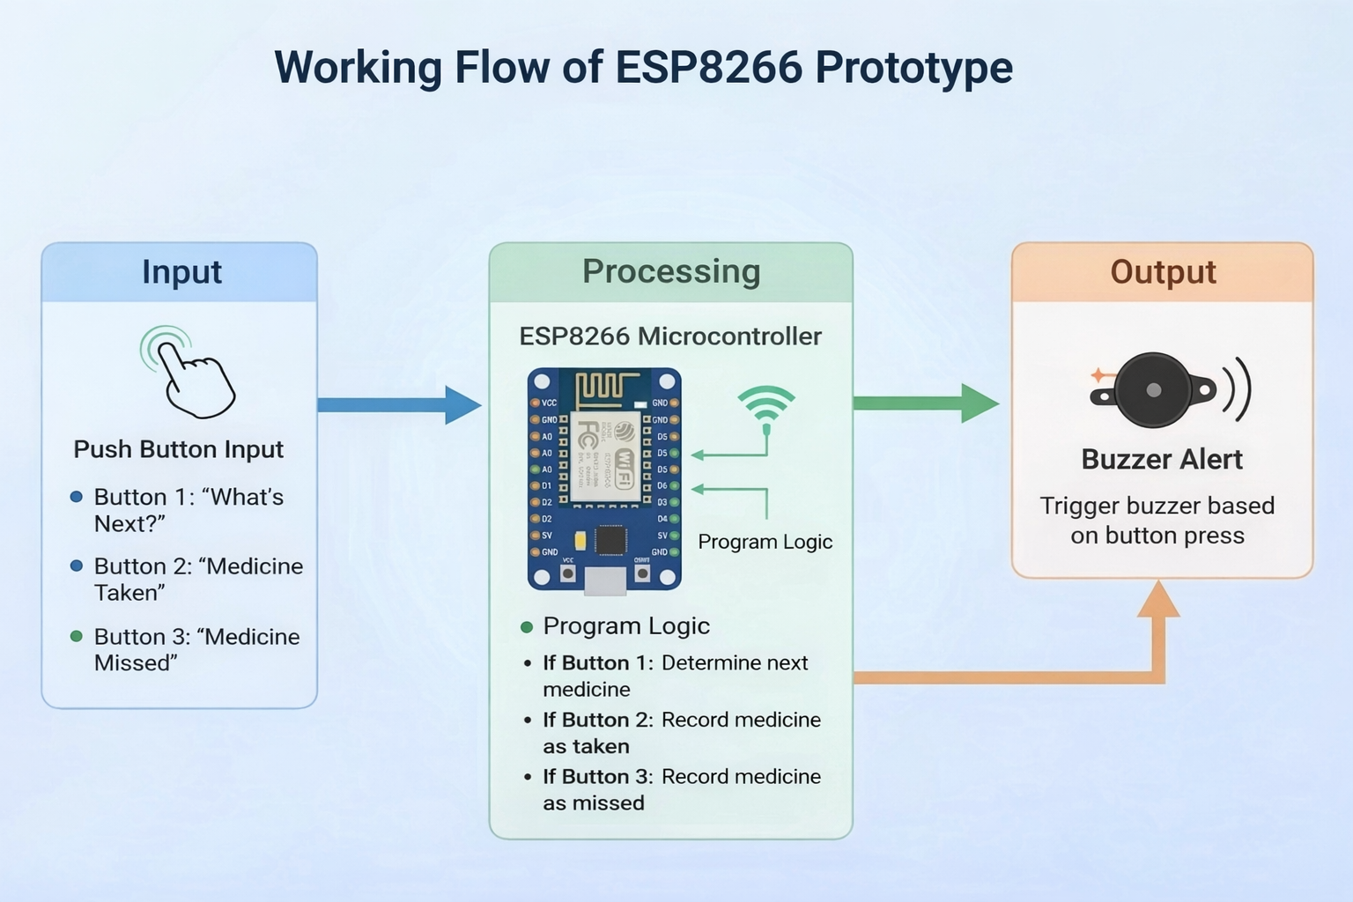
CP2
AI-Based Medication Adherence Tracker

Slide 7
CP2
AI-Based Medication Adherence Tracker
UI Development
Designed a simple user interface for elderly users with clear buttons for medicine reminders and status updates.
Integrated basic display elements to show medicine name, reminder time, and system status.
Backend Setup
Configured the cloud database (Google Sheets) to store medicine schedules and user response data.
Implemented communication setup between the device and the backend using internet connectivity.
Hardware Assembly
Assembled the main components including ESP8266, microphone module, speaker,
push buttons, and buzzer.
Completed wiring connections between sensors, display module, and controller board.
Module Integration
Integrated input modules like push buttons and microphone with the ESP8266 controller.
Connected output modules such as the speaker and buzzer to provide reminders and voice feedback.

Slide 8
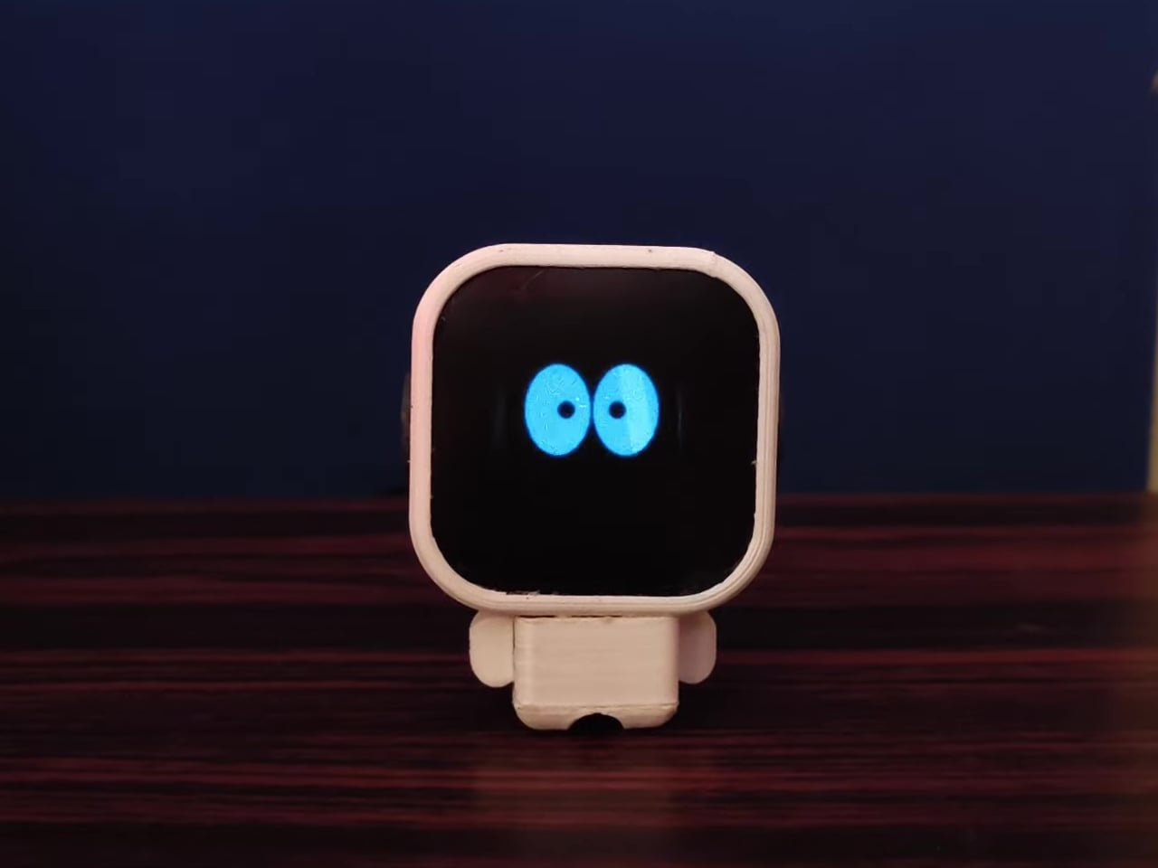
CP2
AI-Based Medication Adherence Tracker
Next Steps
Explain what remains to be completed before the final checkpoint.
Examples:
Feature implementation
Testing and optimization
Integration improvements

