Slide 1

EXPERIMENTAL INVESTIGATIONS ON MILLING OF ALUMINIUM SILICON CARBIDE METAL MATRIX COMPOSITES
Guided by Dr. KS.Vijaysekar
Done By :
1.Dheepak R
2.Gowtham V
3.Kaushik Kiran S
4.Kiruthiskiran V
Notes:
Student Notes:
When we order a pizza, we bother about the quality of the pizza and the delivery time. We are not bothered about how this is delivered; or, how it is prepared. Vendor might have used a gas fired or an electric oven. Vendor might have used a two or a four wheeler to deliver. As a customer, we only bother about the quality of the pizza and how quickly it is delivered. We bother about the output of a ‘service’ rendered by the vendor. Vendor has to focus on this output. This is the ‘value’ offered by the vendor to the customer.

Slide 2
MOTIVATION
Al-SiC MMC’s are widely used in aerospace and automobile industries because of the combined properties of Aluminium and SiC.
Al-SiC MMC’s have the combined properties of Al and SiC which resulted in high strength , high thermal application.
Al-SiC MMC’s have high strength to weight ratio, and possess superior physical and mechanical properties compared to un-reinforced alloys and traditional metals
The machining of MMC is hard to compared to conventional materials.

Slide 3
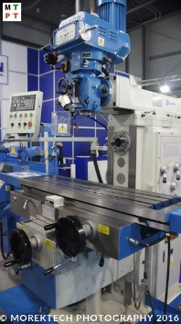
OBJECTIVE
To study milling parameters of Aluminium Silicon Carbide MMC and perform experimental analysis on Al-SiC.
The parameters include;
Cutting forces
Chip morphology & Thickness
Surface Roughness

Slide 4
LITERATURE SURVEY
Jain, P.K., Soni, S.C. and Baredar, P.V., 2014. Review on machining of aluminium metal matrix composites. Material science research India, 11(2), pp.114-120.
Machining characteristics depends on :
Reinforcement material
The distribution of particles.
% composition of the composite.
Hindrances to machining :
Tool wear due to abrasion.
Damage of the reinforcement in the subsurface of the machined zone.
Leads to stress concentrations in finished MMC part.

Slide 5
Sornakumar, T. and Kathiresan, M., 2010. Machining studies of die cast aluminum alloy-silicon carbide composites. International Journal of Minerals, Metallurgy, and Materials, 17(5), pp.648-653.
Built up edge is observed at lower cutting speeds.
Flank wear increases with increase in cutting speed.
(dominant factor)
60 -100 m/min nominal cutting speed.
Feed and depth of cut affects surface roughness and the subsurface of machined zone.
Generation of voids around the reinforcement particles which leads to microcracks.

Slide 6
Saravanan, C., Subramanian, K., Krishnan, V.A. and Narayanan, R.S., (2015),’ Effect of particulate reinforced aluminium metal matrix composite–a review’, Mechanics and Mechanical Engineering, Vol.19, No.1, pp.23-30.
Stir casting or vortex technique as the least expensive method for particulate reinforcement.
Stir casting provides a fairly uniform distribution of particles
This method is applicable for large scale production of aluminium based composites
Density of the composite increases with the addition of the hard ceramic reinforcement into the matrix material.

Slide 7
A.Fathy, M.Abdellhameed, F.shehata, (2012), “Effect of some Manufacturing parameters on machining of extruded Al-Al2O3 composites” , International Scholarly Research Notices, vol.2012, Article ID 748734.
Coated tools showed 5% decrease in flank wear size compared to uncoated tools.
Tool wear in carbide coated tool was significantly lesser than HSS and had better surface finish.
Tool wear observed in carbide coated tools was comparatively higher than that of PCD tools thus, making it suitable for observation of tool wear.

Slide 8
Lin, JT, Bhattacharyya D and Lane C, (1995). “Machinability of a silicon carbide reinforced aluminium metal matrix composite. Wear”, Vol.181, pp.883-888
The time required to reach the tool wear limit decreased with increases of speed and feed.
The volume of material removed before reaching the wear limit increased with the higher feed rate.
Built up edge was formed at low cutting speed.
Generation of voids were observed around the reinforced particles at high cutting speed which led to the crack formation.

Slide 9
METHODOLOGY
Preparation of composite
Machining
(Milling)
Observation of milling parameters
Analysis
Results

Slide 10
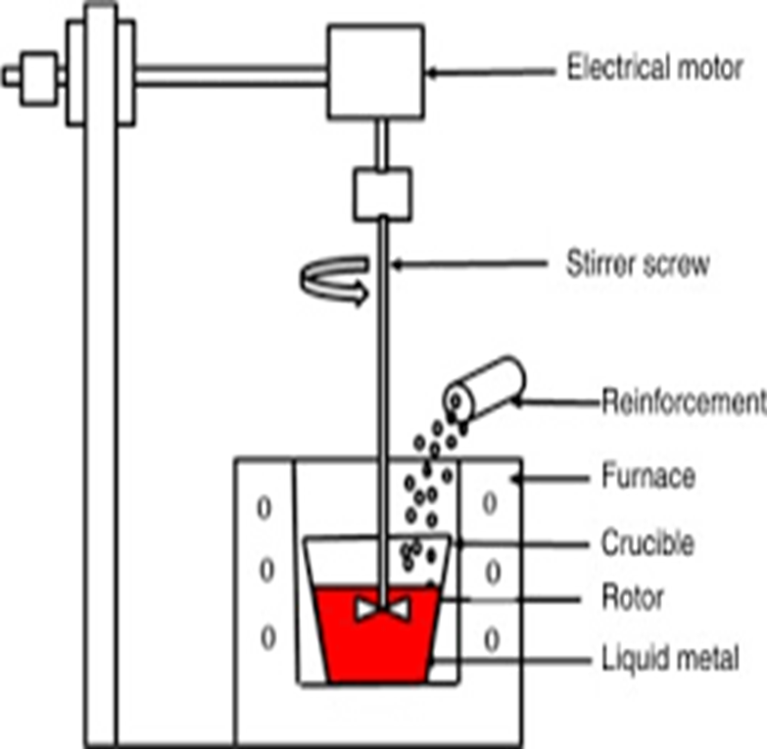
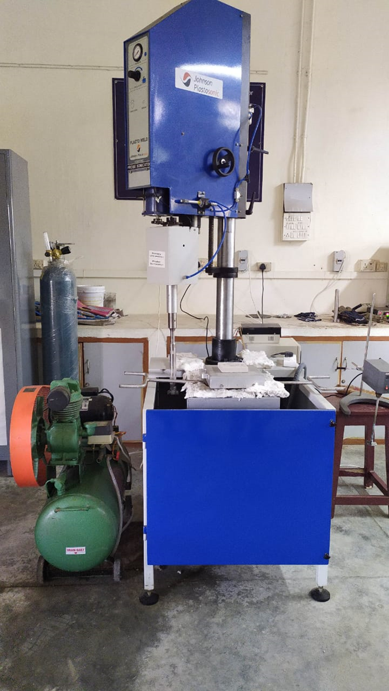
PREPARATION OF MATRIX
Conventional alloy | Al6061
MMC material | Matrix = Al6061 Reinforcement = SiC Particulate size = 70µm Weight percentage= 3.75% & 5%
Method of fabrication | Stir casting technique
Specification | Length= 150 mm Thickness= 10 mm Width = 100 mm
The MMC was fabricated using Stir casting technique.
Initially the Al6061 was melted , then Sic particles (which were preheated in oven at 300 degree Celsius) were added and the stirrer was made to run.
The prepared melt was then poured into the mould . After the cool down the plates were obtained.

Slide 11
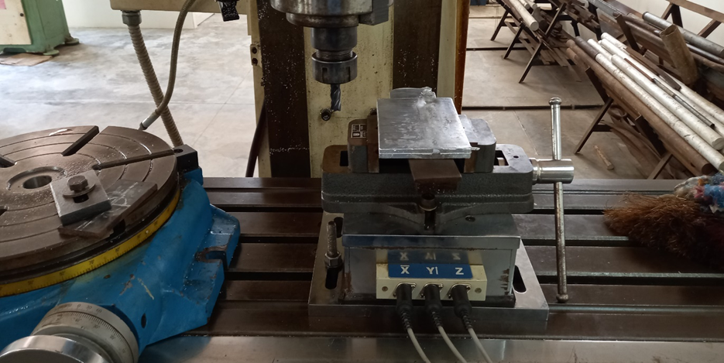
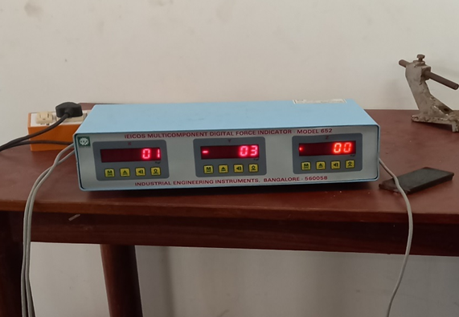
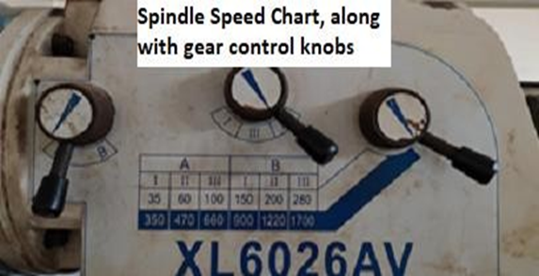
MACHINING
The machining was done using vertical milling machine with an end mill cutter of 12 mm diameter.
The machining was done at 3 different speeds and 3 different feed for each speed.
The plates were mounted on the dynamometer which recorded and displayed the values of force.

Slide 12
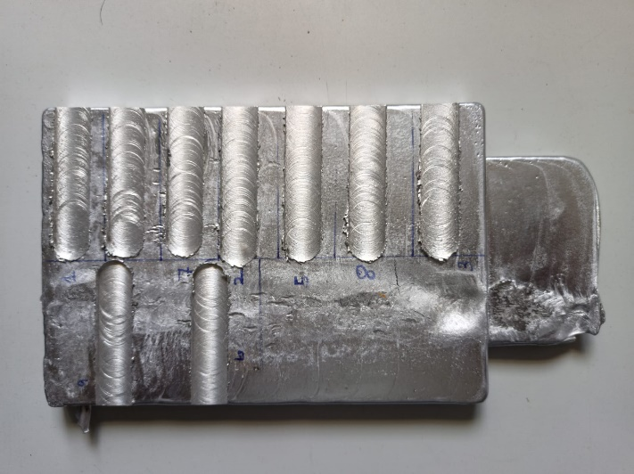
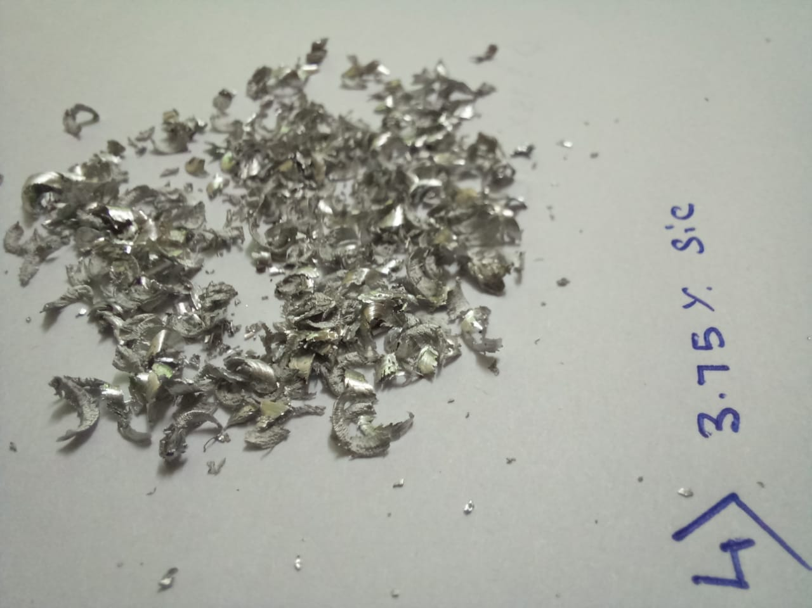
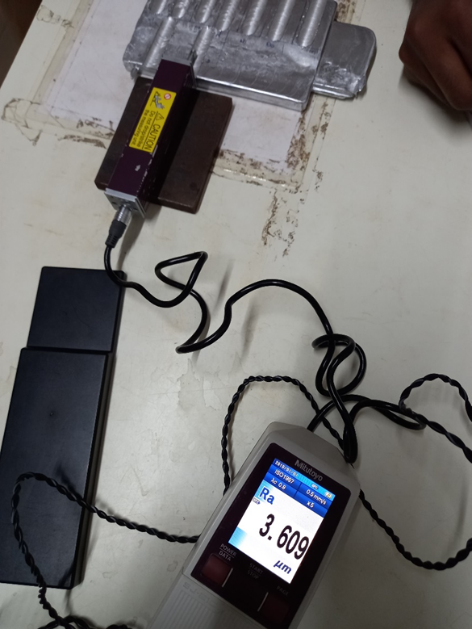
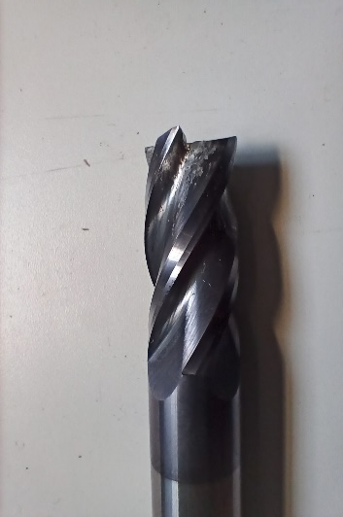
OBSERVATION
After machining the average surface roughness was measured using profilometer.
The chips formed during machining was taken to measure average thickness using micrometer.
The end mill cutter was also viewed under magnification to view the wear caused due to machining.

Slide 13
NUMERICAL WORK
For 5% Sic
S.no | Spindle Speed (rpm) | Cutting speed (m/min) | Feed (mm/min) | Fx (N) | Fy(N)
1 | 350 | 13 | 20 | 250 | 140
2 | 470 | 18 | 20 | 70 | 30
3 | 660 | 25 | 20 | 140 | 90
4 | 350 | 13 | 50 | 360 | 190
5 | 470 | 18 | 50 | 340 | 150
6 | 660 | 25 | 50 | 470 | 160
7 | 350 | 13 | 176 | 220 | 110
8 | 470 | 18 | 176 | 60 | 30
9 | 660 | 25 | 176 | 20 | 10
AVG Roughness (micro m)
9.2895
5.483
7.136
11.55925
9.439
13.215
10.25025
8.019
6.19675
Chip Thickness (mm)
0.72
0.88
0.84
0.76
0.73
0.3
1
0.9
0.54

Slide 14
NUMERICAL WORK AND OBSERVATION
For 3.75% Sic
S.no | Spindle Speed (rpm) | Cutting speed (m/min) | Feed (mm/min) | Fx(N) | Fy(N)
1 | 350 | 13 | 20 | 100 | 20
2 | 470 | 18 | 20 | 140 | 20
3 | 660 | 25 | 20 | 90 | 10
4 | 350 | 13 | 50 | 230 | 60
5 | 470 | 18 | 50 | 110 | 30
6 | 660 | 25 | 50 | 70 | 20
7 | 350 | 13 | 176 | 240 | 80
8 | 470 | 18 | 176 | 160 | 60
9 | 660 | 25 | 176 | 160 | 50
Avg Roughness (micro m)
5.4658
4.7794
3.664
6.738
4.2976
3.959
4.8472
6.5754
5.2938
Chip Thickness (mm)
0.54
0.64
0.56
1.03
0.45
0.97
0.91
0.56
0.8

Slide 15
COMPARISON GRAPHS (CONSTANT FEED) Cutting force (N) Vs Cutting Speed (m/min)
I)
II)
III)

Slide 16
GRAPH INTERPRETATION
Traditionally we could say that, for aluminium, as the cutting speed increases consequently cutting forces decreases.
From the graphs it is clear that, for 5% composition of SiC plate the pattern almost follows the traditional trend.
But for the 3.75% composition of SiC plate, the pattern is irregular and unpredictable.
The reason may be due to the presence of SiC particles at the tool and work piece interface which lead to the spike of cutting forces at that point.

Slide 17
COMPARISON GRAPHS (CONSTANT FEED) Cutting force(N) Vs Cutting Speed (m/min)
I)
II)
III)

Slide 18
GRAPH INTERPRETATION
These graphs represent the Y component of the cutting force ie which is orthogonal to the rotation of the tool.
We could interpret from the graphs that, as the cutting speed increases the orthogonal cutting force decreases except the graph 1.
The sudden spike in the graph 1 for the 5% SiC plate is clearly due to the Sic particles at that point which subsequently increases the cutting force.
So, from the X and Y component forces we could interpret that at the point of interface of tool with ceramic particles there is an increase in the cutting force. (SiC hardness > Al hardness)

Slide 19
COMPARISON GRAPHS(FEED constant) Roughness (micro mm) Vs Cutting Speed (m/min)
I)
II)
III)

Slide 20
GRAPH INTERPRETATION
Generally as the cutting speed increases, surface finish increases and hence the roughness decreases.
Here, we could see that in most of the cases, as the cutting speed increases, surface roughness decreases.
The sudden spike in the graph 1 and 2 is supposed to be due to the accumulation of particles at that point of tool work piece interface.

Slide 21
COMPARISON GRAPHS (feed constant) Chip thickness (micro m) Vs Cutting speed (m/min)
I)
II)
III)

Slide 22
GRAPH INTERPRETATION
The chip thickness changes as the depth of cut changes. But here we have constant depth of cut and we have measured the approximate chip thickness.
The chip thickness of 5% SiC plate is consistent in all the graphs which interprets that as the speed increases chip thickness decreases.
The chip thickness of 3.75% SiC plate is not in the trend and is assumed to be because of some irregularities in the plate and hence the particle distribution in the matrix.

Slide 23
COMPARISON GRAPHS (cutting speed constant) Chip thickness (mm) Vs Feed (m/min)
I)
II)
III)

Slide 24
GRAPH INTERPRETATION
When compared with cutting speed, feed has more impact on chip thickness than cutting speed.
The pattern of 5% SiC plate is more consistent than the curve of 3.75% SiC plate.
The chip thickness increases as the feed increases for the same cutting forces for 5% SiC plates which is opposite when interpreted from the graphs of 3.75% SiC.

Slide 25
CONCLUSION
Variation of cutting force with cutting speed was observed and it is concluded that 3.75% variant of MMC is preferred or recommended when cutting force is kept as an important parameter as it exhibited less cutting force than 5% variant.
In general tool life depends on cutting force thus, when tool life is kept as deciding parameter, 3.75% MMC is preferred as its variation of cutting force in par with the traditional trend of variation cutting force with speed. Thus, for lesser power consumption and higher productivity, MMC with lower percentage reinforcement is recommended.
Variation of Surface roughness with percentage composition and cutting speed was observed and it is concluded that 3.75% MMC is recommended for high-speed surface finish processes with lower feed rate, as the surface roughness of 5% MMC exhibited higher values though it decreased with cutting speed.

Slide 26
REFERENCES
Jain PK., Soni S.C. and Baredar,PV., (2014). ‘Review on machining of aluminium metal matrix composites’,Material science research India, Vol.11,No.2, pp.114-120.
Sornakumar T and Kathiresan M., (2010),’ Machining studies of die cast aluminium alloy-silicon carbide composites,’International Journal of Minerals, Metallurgy, and Materials, Vol.17, No.5, pp.648-653
A.Fathy, M.Abdellhameed, F.shehata, (2012), “Effect of some Manufacturing parameters on machining of extruded Al-Al2O3 composites” , International Scholarly Research Notices, vol.2012, Article ID 748734.
Suresh P, (2014), “Some studies on aluminium silicon Carbide graphite hybrid metal Matrix composites”, http://hdl.handle.net/10603/39751
Loganathan M, (2018),” Fabrication and evaluation of mechanical and metallurgical properties of AA 6061 metal matrix composites reinforced by SIC TIC B4C “, http://hdl.handle.net/10603/257771

Slide 27
Behera R, Kayal S, Mohanta N R and Sutradhar, G, (2013).” Study on machinability of aluminium silicon carbide metal matrix composites”.Mater. Today, Vol.5, pp.1-7.
Lin, JT, Bhattacharyya D and Lane C, (1995). “Machinability of a silicon carbide reinforced aluminium metal matrix composite. Wear”, Vol.181, pp.883-888
Mustafa Khaleel Ibrahim, Jamaliah Idris, (2014),’ The Effect of Milling Time on Aluminum- Silicon Carbide Composites Fabricated by Powder Metallurgy’, International Journal of Scientific & Engineering Research, Vol.5, No.12, pp.139
Kılıckap E, Cakır, O, Aksoy, Mustafa and Inan A, (2005), ‘Study of tool wear and surface roughness in machining of homogenised SiC-p reinforced aluminium metal matrix composite’, Journal of Materials Processing Technology, Vol.164, pp.862-867.\\
Narender Panwar, Amit Chauhan, (2018), ‘Fabrication methods of particulate reinforced Aluminium metal matrix composite-A review ‘, Materials Today Proceedings, Vol.5, No.2, pp 5933-5939

