Slide 1

WeatheryApp
Swift iOS --> Android Kotlin
Dorian Toth & Marvin Aichinger | BB-G1 | June 2026

Slide 2
Project Overview
iOS Source App
AI Tools
Android Target
WeatheryApp -- Swift + SwiftUI
CoreLocation & WeatherKit
Sidebar navigation
Claude Code (main driver)
GitHub Copilot (in-editor)
ChatGPT (research)
Kotlin + Jetpack Compose
MVVM + StateFlow
OpenWeatherMap API

Slide 3
The Original iOS App -- WeatheryApp (Swift)
Features
Tech Stack
Current weather via GPS
Hourly & 5-day forecast
Saved locations sidebar
City search + oC / oF toggle
Swift 5 + SwiftUI
CoreLocation
@State / @StateObject / @ObservedObject
UserDefaults

Slide 4
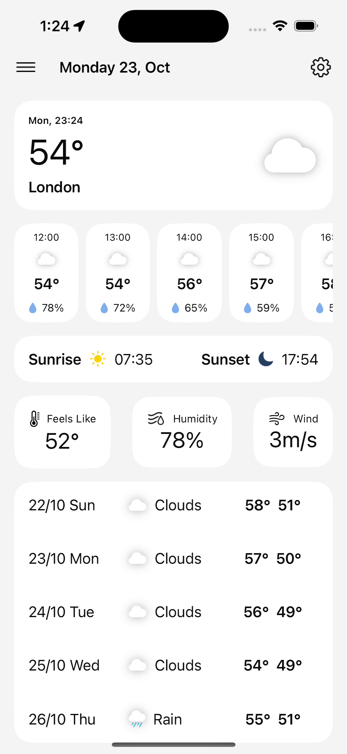
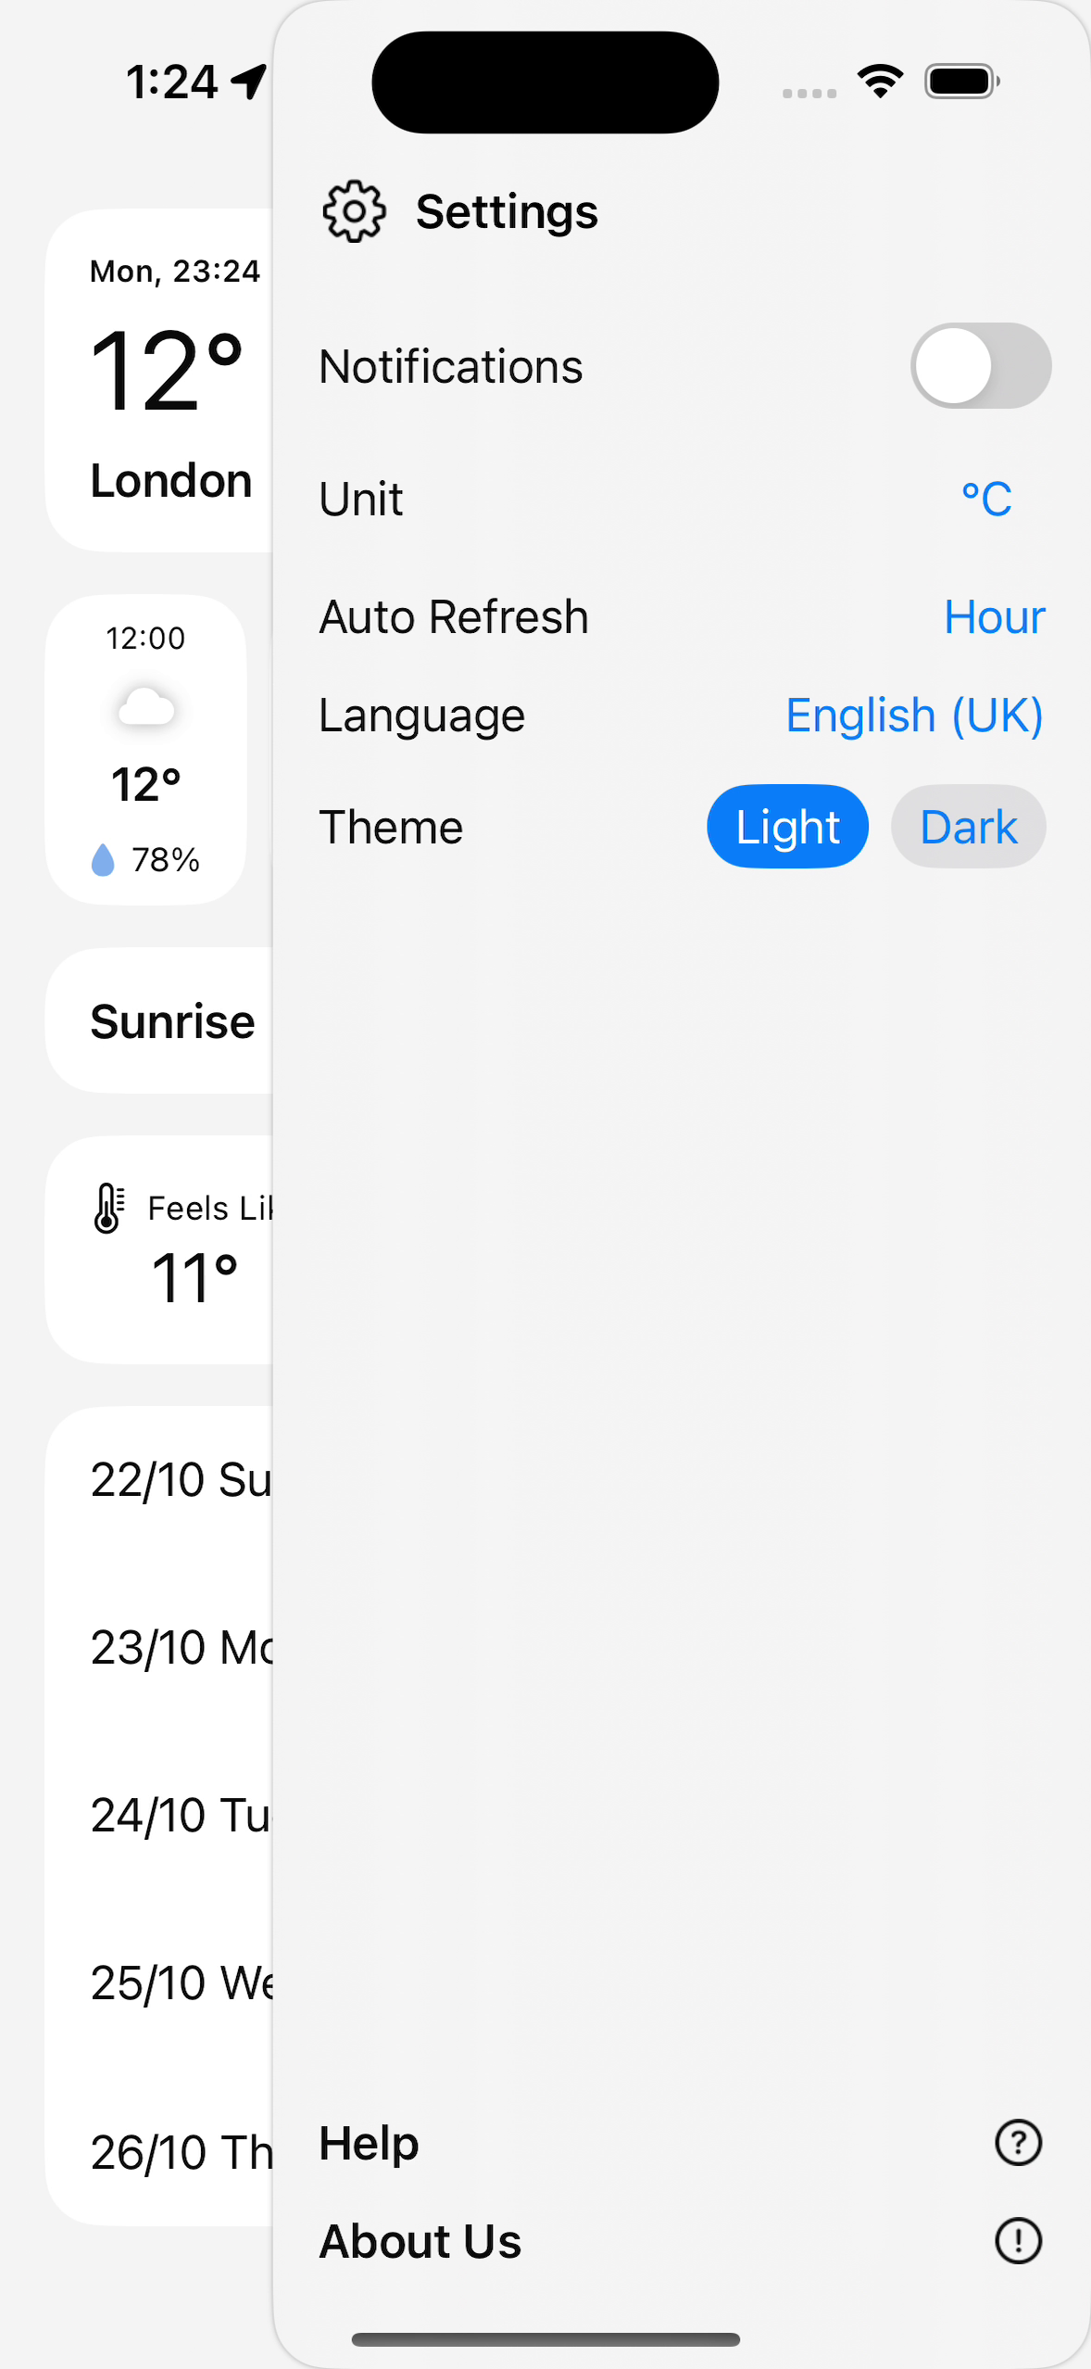
iOS App -- Screenshots

Slide 5
AI-Assisted Migration Workflow
1
2
3
4
5
6
Analyse Source
Plan
Data Layer
UI Layer
Human Review
Iterate & Fix
Read Swift files map structure
Map Swift to Kotlin spot gaps
Models + Retrofit WeatherKit --> OWM
SwiftUI --> Compose Sidebar --> Sheet
Validate & test on emulator
Re-prompt Claude until it works

Slide 6
The Created Android App -- WeatheryApp (Kotlin)
Features
Tech Stack
Current weather via GPS
Hourly & 5-day forecast with icons
City search + C° / F° toggle
Material 3 -- light & dark theme
Kotlin + Jetpack Compose + Material 3
Retrofit 2 + FusedLocationProvider
ViewModel + StateFlow + DataStore
Kotlin Coroutines (suspend fun)

Slide 7
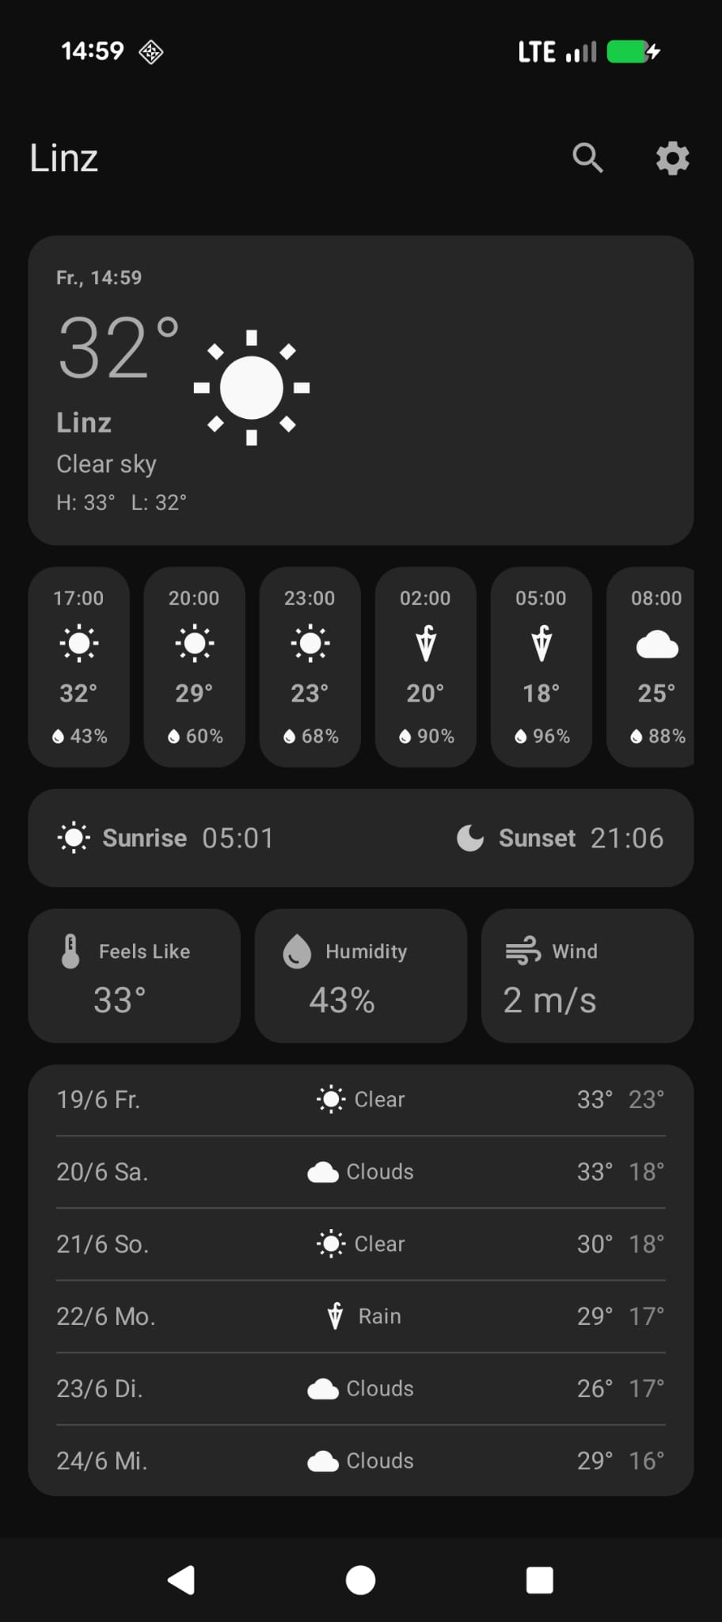
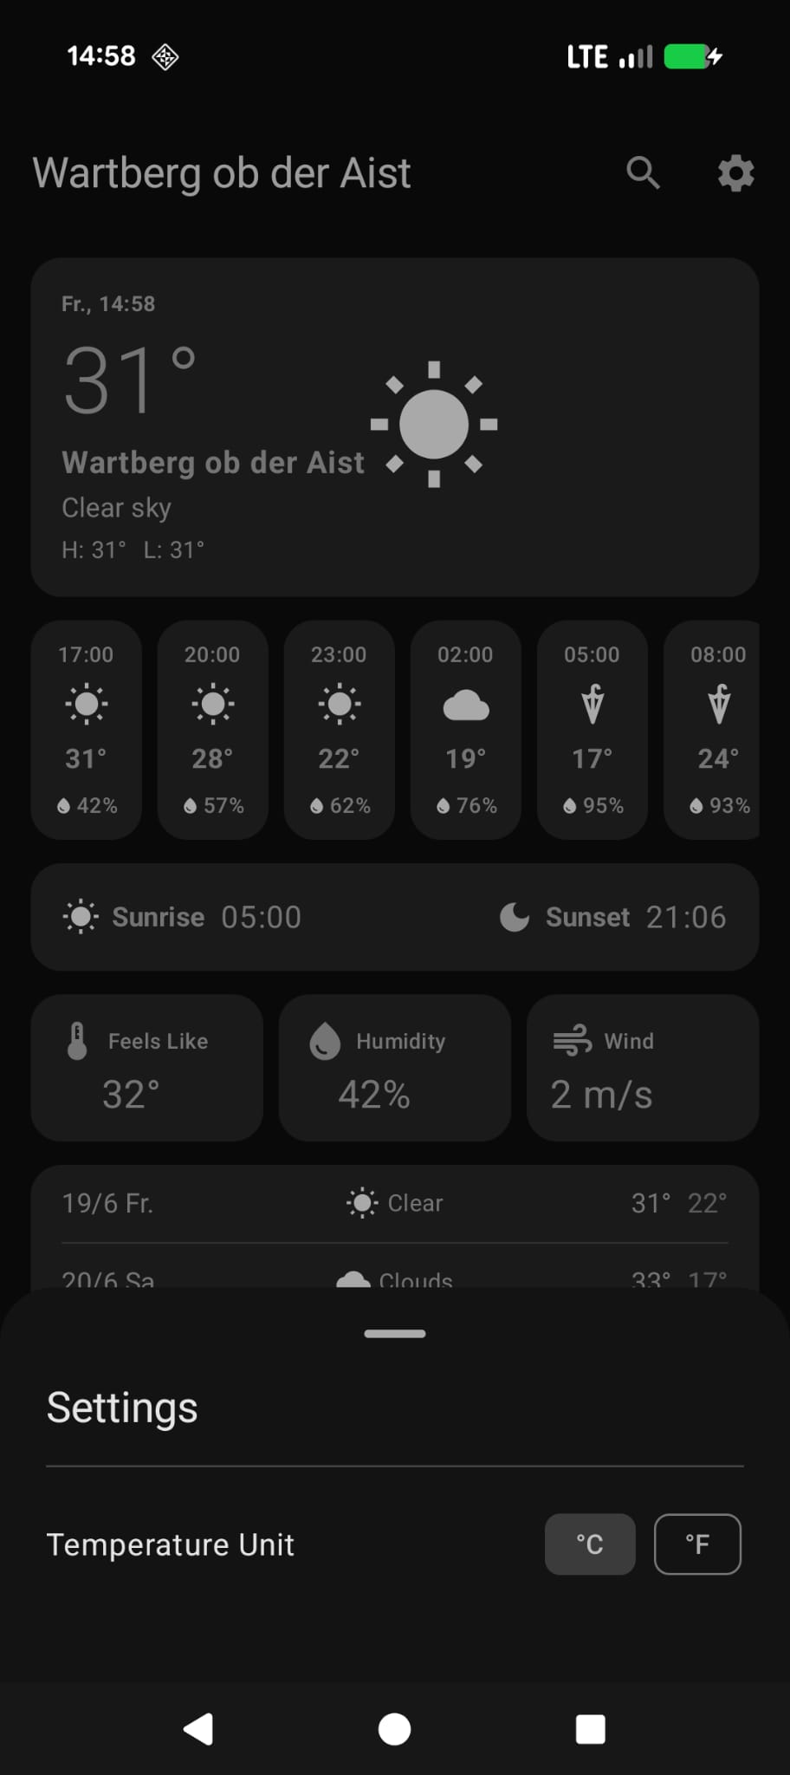
Android App -- Screenshots

Slide 8
Feature Comparison: iOS vs Android
Feature
iOS
Android
Weather data
WeatherKit
OpenWeatherMap API
GPS
CoreLocation
FusedLocationProvider
Hourly forecast
Horizontal scroll
LazyRow
5-day forecast
List view
Card list
City search
AddLocationView
AlertDialog
Saved locations
Left sidebar
Not ported
Settings
Right sidebar
ModalBottomSheet
Theme
Manual toggle
System Dynamic Color
Preferences
UserDefaults
DataStore

Slide 9
Working with AI -- Our Experience
What Worked Well
What Needed Human Input
Swift to Kotlin translation
SwiftUI to Compose: clean mapping, same mental model
Architecture (MVVM + StateFlow) applied correctly
errors fixed quickly by re-prompting
Wrong API
WeatherKit is Apple-only -- had to redirect AI
API key & SDK path always set up manually
Calculation of C/F and rerendering UI
(generation of things that are never used)
(supressing linter)

Slide 10
C/F Toggle Bug — Analysis & Fix
Root Cause
Why It Breaks
isCelsius: a dead parameter
Compose cannot track the StateFlow read
Passed to every child Composable (TopWeatherSection, HourlyForecastItem, DailyForecastRow, IndicatorsGrid) but never read in any body -- only viewModel.formatTemp() is called, which reads _isCelsius.value directly from a StateFlow.
Compose only re-renders when a State<T> value changes inside a composable body. Reading _isCelsius.value inside a plain Kotlin function is invisible to Compose -- so LazyRow items may silently skip recomposition.
Fix Applied
Bonus Fix
Pure functions with explicit isCelsius param
Unit label added to temperature output
convertTemp(celsius, isCelsius) and formatTemp(celsius, isCelsius) now take isCelsius as an explicit argument. All 4 child Composables actually read the parameter -- Compose tracks it and recomposes correctly on toggle.
formatTemp() previously returned "22°" with no C or F suffix, making it impossible to confirm which unit was active. Now returns "22°C" or "72°F" so the toggle is visually verifiable.

Slide 11
Key Challenges
WeatherKit not on Android
Sidebar navigation
Apple-exclusive API
No native drawer equivalent on Android
Used OpenWeatherMap REST API instead
Left sidebar --> search dialog / Right --> BottomSheet
Missing Version Catalog
State management
gradle/ was gitignored -- build broken
No @EnvironmentObject in Compose
Fixed .gitignore, recreated libs.versions.toml
ViewModel + StateFlow + collectAsState()

Slide 12
Results & Conclusion
10+
13
~95%
>400k
<1 week
Swift files analysed
Kotlin files created
Feature parity
tokens used
Migration time
What We Learned
Verdict
AI excels at translating between similar frameworks
Iterative prompting beats one-shot generation
Human oversight is still essential for config & APIs
AI made this migration feasible in under a week
Claude produced clean, idiomatic Kotlin
Workflow: AI drafts -- Human reviews -- AI fixes

Slide 13
Thank You
Questions?
Dorian Toth & Marvin Aichinger
KI-assisted Software Engineering | BB-G1 | FH | 2026

