Slide 1
WattWay: EV Guide to Breaks and Boosts

Slide 2
AGENDA
Problem
Solution
Architecture
Plan

Slide 3
Challenges to EV drivers
Inefficient trip planning
Lack of route optimization based on driving range and charging needs.
Impacts
Increased range anxiety
Longer travel times and inconvenience.

Slide 4
Solution
A smart web-based application that:
Computes EV routes dynamically.
Integrates real-time charging station data.
Offers multiple route and charging station options.
Simplifies planning by displaying estimated trip time, charging stops, and costs.

Slide 5
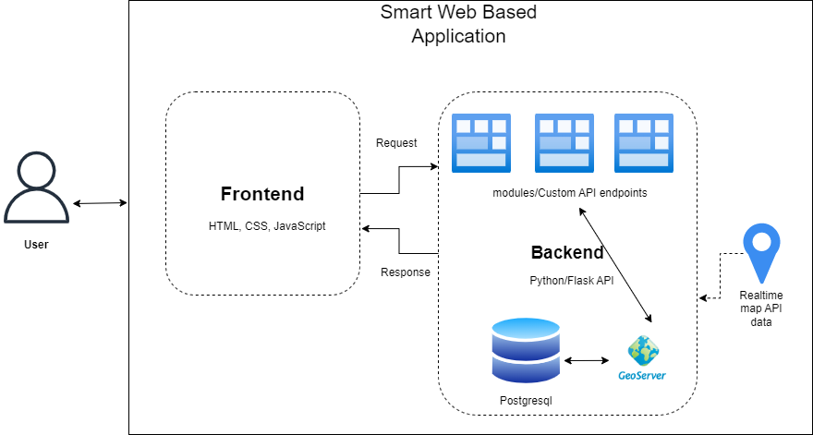
Architecture

Slide 6
Technical stack
Frontend: JavaScript, Leaflet.js, HTML/CSS
Backend: ? Unsure needs expert inputs
Database: PostgreSQL with PostGIS
Map Services: OSM Data, MapServer or Geoserver

Slide 7
Timeline
Milestone 1 Before Christmas
Set up GitHub repository and project environment.
Display charging stations on a base map.
Implement route planning for EVs with basic charging stops.
Create a basic frontend for user input and visualization.
Milestone 2 in January
Add live charging station availability.
Enhance route planning with energy consumption estimates.
Allow filtering of stations by user preferences.
Test the system with sample routes and deploy on a remote server.

Slide 8
Questions? Suggestions? Let’s collaborate!

Slide 9


THANK YOU
Team Wattway
Bhavin, Kisal, Sandys, Ravi

