Slide 1
MapReduce: Simplified Data Processing on Large Cluster
Authors: Jeffrey Dean and Sanjay Ghemawat
Presented by: Kisan Tamang,
Sunway Int'l B. School

Slide 2

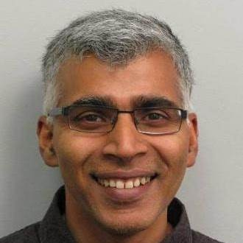
About the Authors

Slide 3
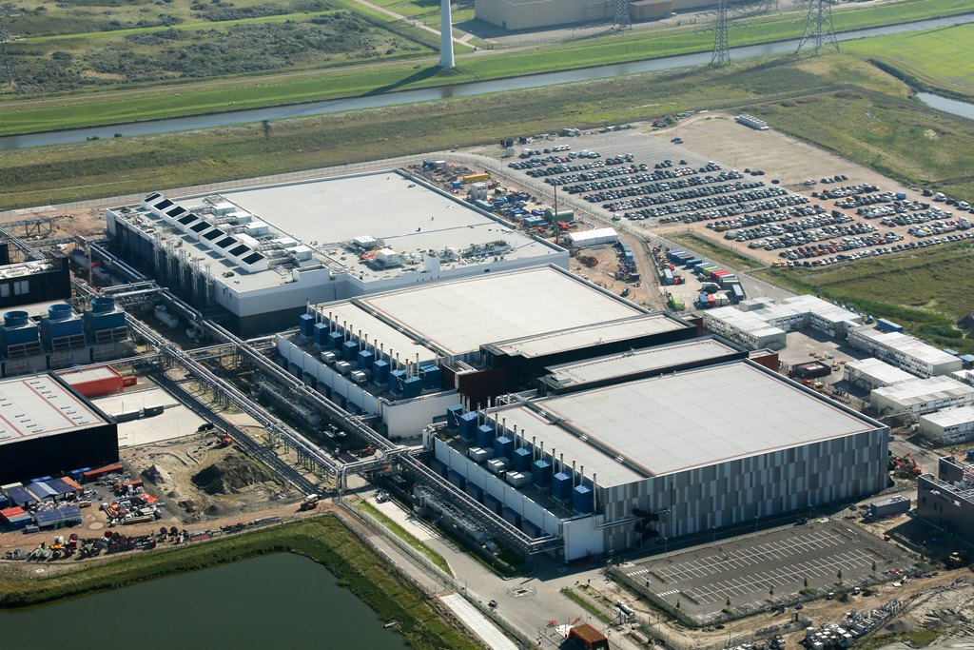
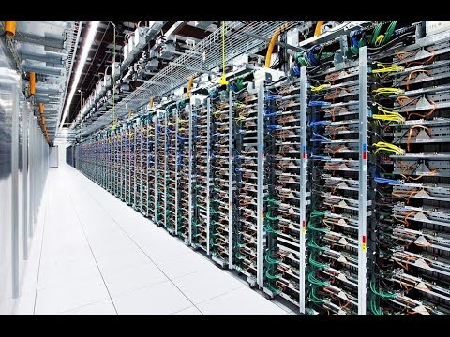
Big Data
Huge Challenge to Process it

Slide 4
Motivation
Challenge at google
Input data too large -> distributed computing
Most computations are straightforward(log processing, inverted index) -> boring work
Complexity of distributed computing
Machine failure
Scheduling

Slide 5
MapReduce
MapReduce is a programming model that allows to perform distributed and parallel processing on large data sets in a distributed environment

Slide 6
Solution: MapReduce
MapReduce as the distributed programing infrastructure
Simple Programming interface: Map + Reduce
Distributed implementation that hides all the messy details
Fault tolerance
I/O scheduling
parallelization

Slide 7
Map #‘length’ (() (a) (ab) (abc))
0 1 2 3
Reduce #‘+’ (0 1 2 3)
6

Slide 8
Programing Model
Programmer only need to specify two functions:
Map Function
map (in_key, in_value) -> list(out_key, intermediate_value)
Process input key/value pair
Produce set of output key/intermediate value pairs
Reduce Function
reduce (out_key, intermediate_value) -> list(out_value)
Process intermediate key/value pairs
Combines intermediate values per unique key
Produce a set of merged output values(usually just one)

Slide 9
Programming Model
[input (key, value)]
[Intermediate (key, value)]
[Unique key, output value list]
Map Function
Shuffle (merge sort by key)
Reduce function

Slide 10
Example: WordCount
Input
Split
Map
Shuffle
Reduce
Output
the small brown fox
a fox speaks to another fox
brown cow cross the road
<the, 1>
<small, 1>
<brown, 1>
<fox, 1>
the small brown fox
a, 1
another 1
brown, 2
cross, 1
cow, 1
fox, 3
Map
<brown, 1>
Reduce
<a, 1>
<fox, 1>
<fox, 1>
<speaks, 1>
<to, 1>
<another, 1>
a fox speaks to another fox
Map
road, 1
small, 1
speaks, 1
the, 2
to, 1
brown cow cross the road
<brown, 1>
Reduce
Map
<cow, 1>
<cross, 1>
<the, 1>
<road, 1>
Notes:
Hello word of MapReduce
Count the word frequency of a file

Slide 11
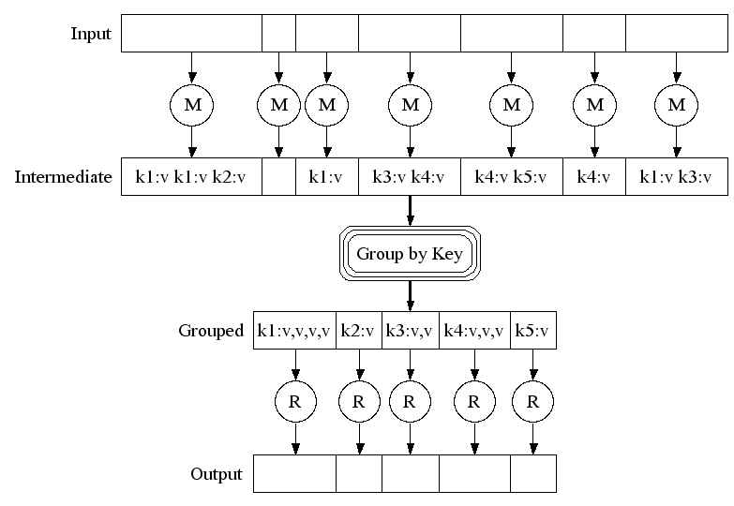
Execution

Slide 12
Control Flow and data flow
User
Program
submit
Scheduler
fork
fork
fork
allocate
Master
GFS
assign
map
assign
reduce
Notify location
of local write
GFS
Input Data
Worker
write
Output
File 0
local
write
Worker
Split 0
read
Split 1
Worker
Split 2
Output
File 1
Worker
Worker
remote
read,
sort

Slide 13
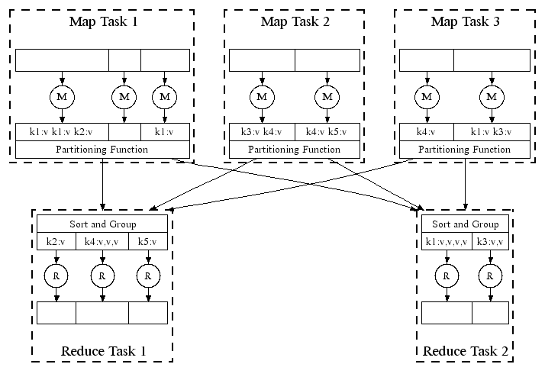
Parallel Execution

Slide 14
MapReduce Implementation
Google
Open Source
TensorFlow
MLib
SparkNet
GraphX
Spark Streaming
DataFlow Model(Apache Beam)
FlumeJava
MillWheel
Pregel
Tez
Spark
Storm
Giraph...
MapReduce
Hadoop MapReduce
MapReduce
DAG Computing
Graph Computing
Stream Processing
Machine Learning
General Model

Slide 15
map(String key, String value)
// key: document name
// value: document contents
for each word w in value
EmitIntermediate(w, "1")
reduce(String key, Iterator values):
// key: word
// values: a list of counts
for each v in values:
result += ParseInt(v);
Emit(AsString(result));

Slide 16
Thank You

