Slide 1
MapReduce
MapReduce is a programming model that allows to perform distributed and parallel processing on large data sets in a distributed environment

Slide 2


Slide 3
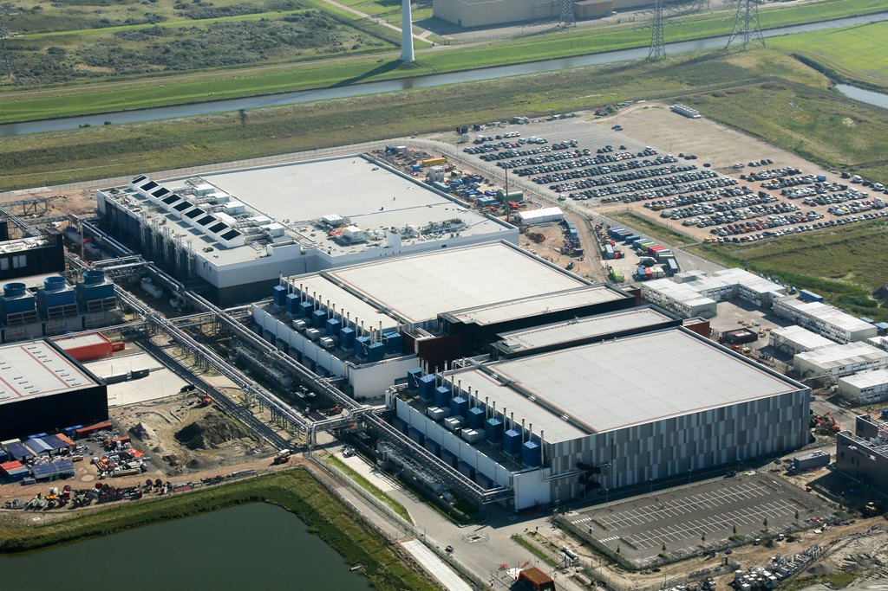
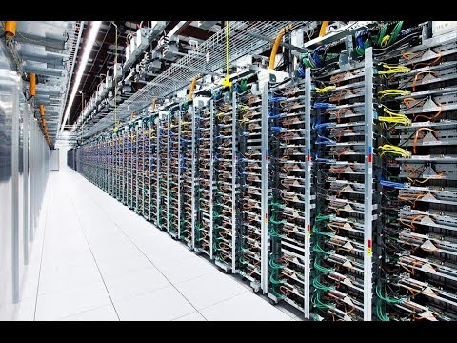

Slide 4
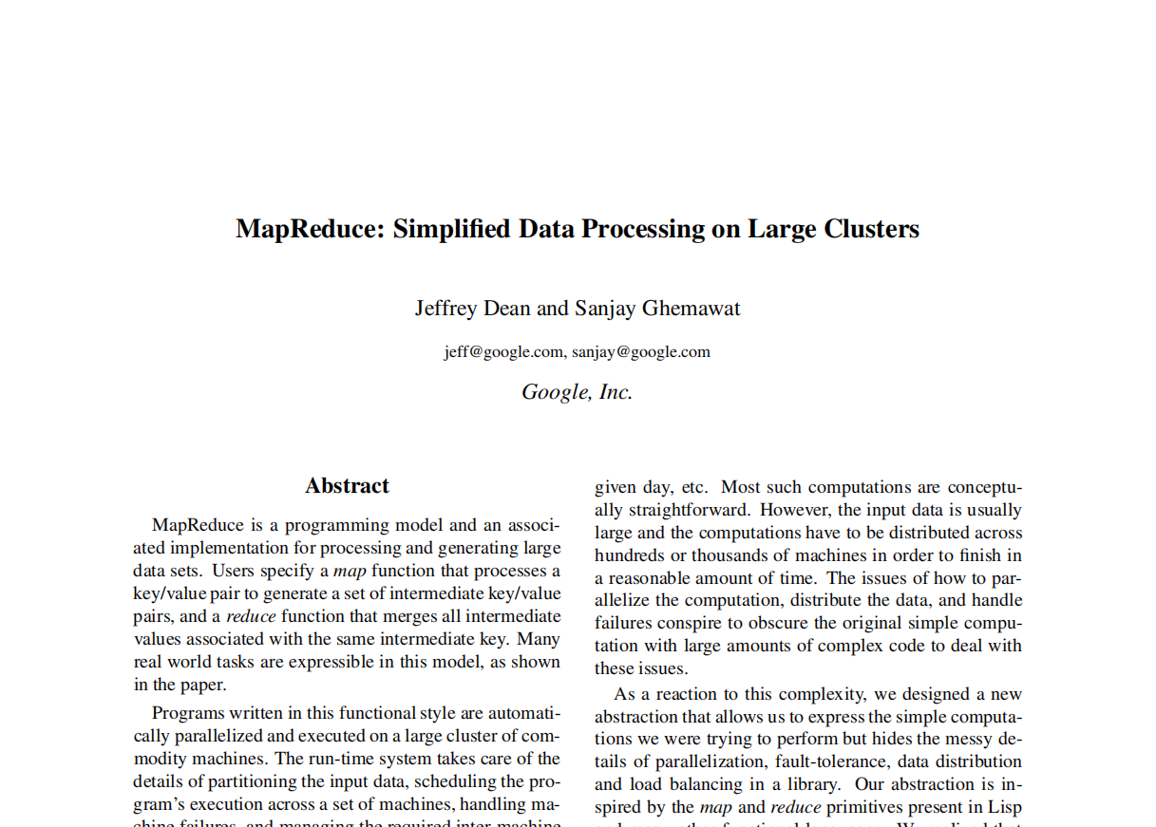

Slide 5
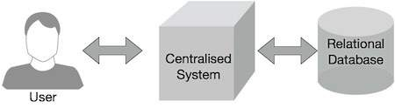
Why MapReduce?

Slide 6
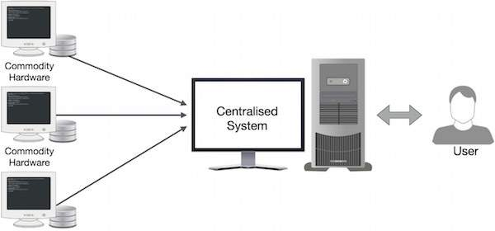

Slide 7
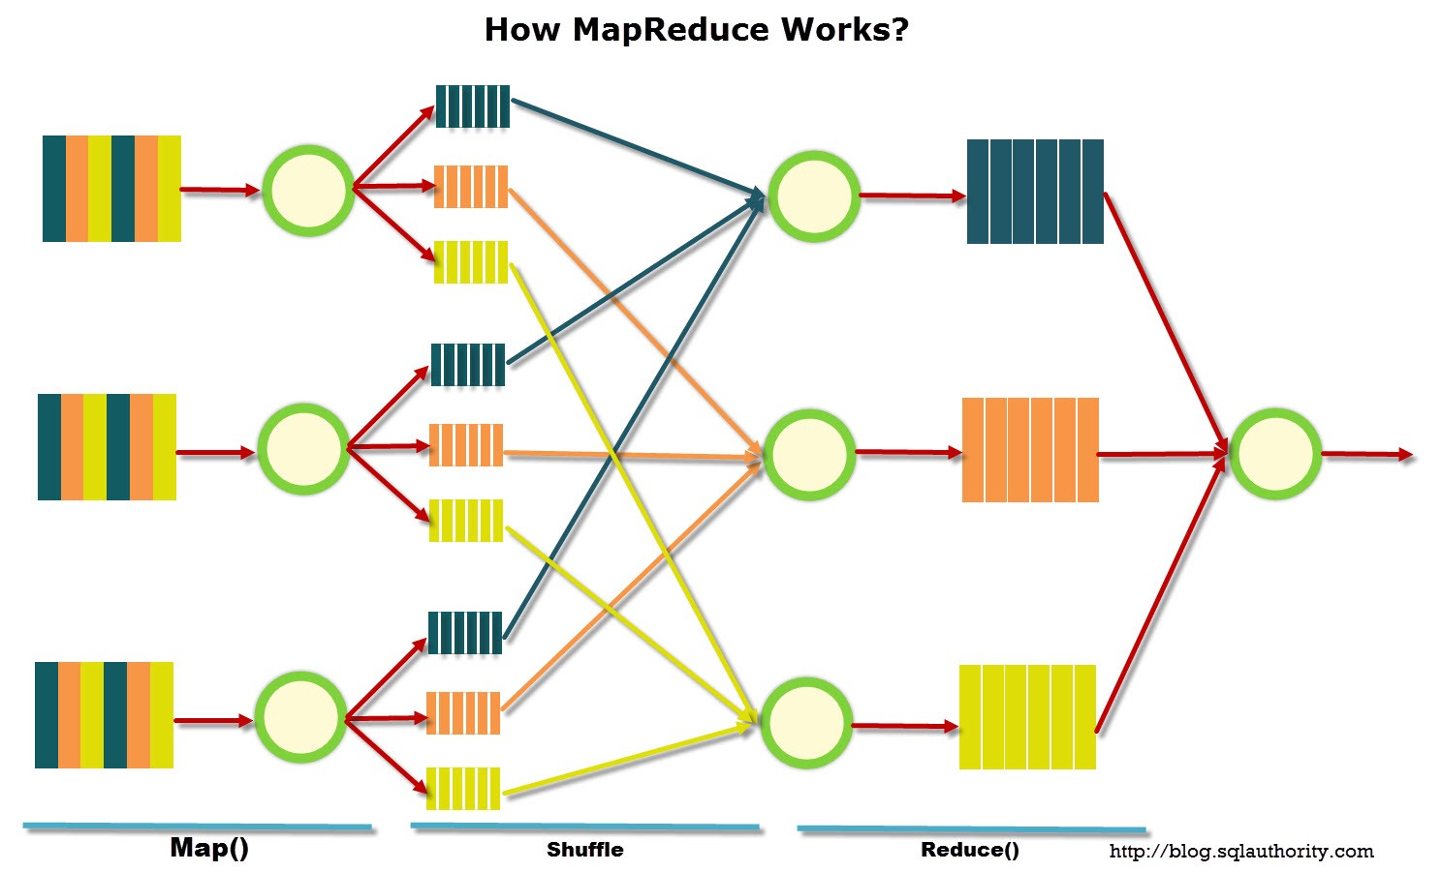

Slide 8
What the heck is MapReduce?

Slide 9
Adavantages
Scalability
Cost-effective solution
Flexibility
Fast
Parallel Processing
Simple

