Slide 1
MapReduce
MapReduce is a programming model that allows to perform distributed and parallel processing on large data sets in a distributed environment

Slide 2


Slide 3

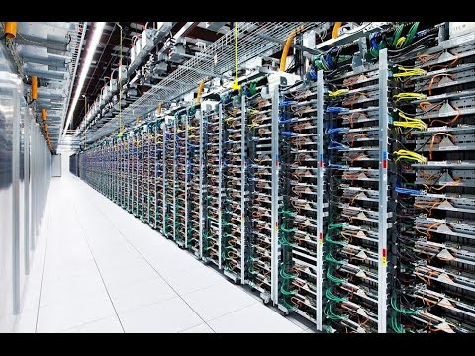
Big Data
Huge Challenge to Process it

Slide 4
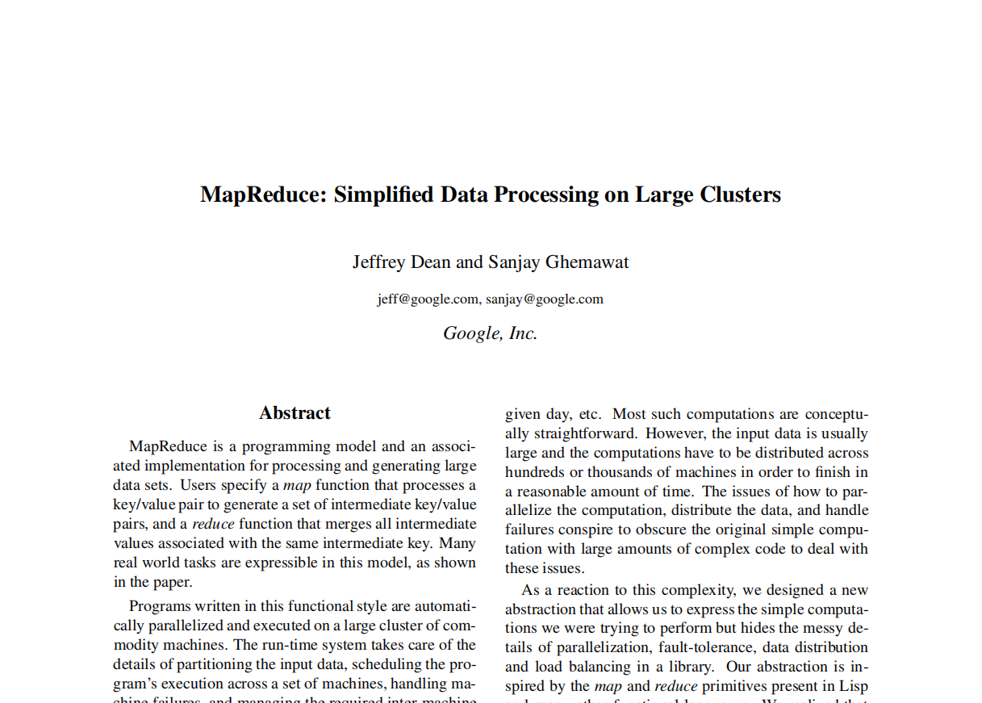

Slide 5
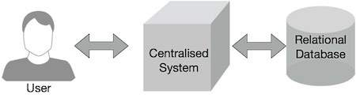
Why MapReduce?

Slide 6
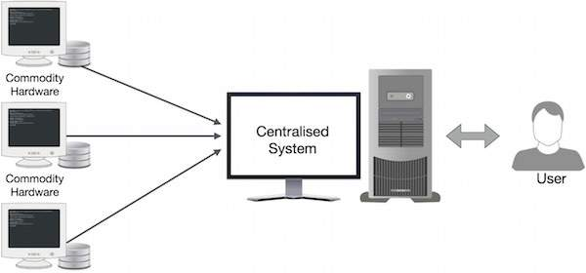

Slide 7
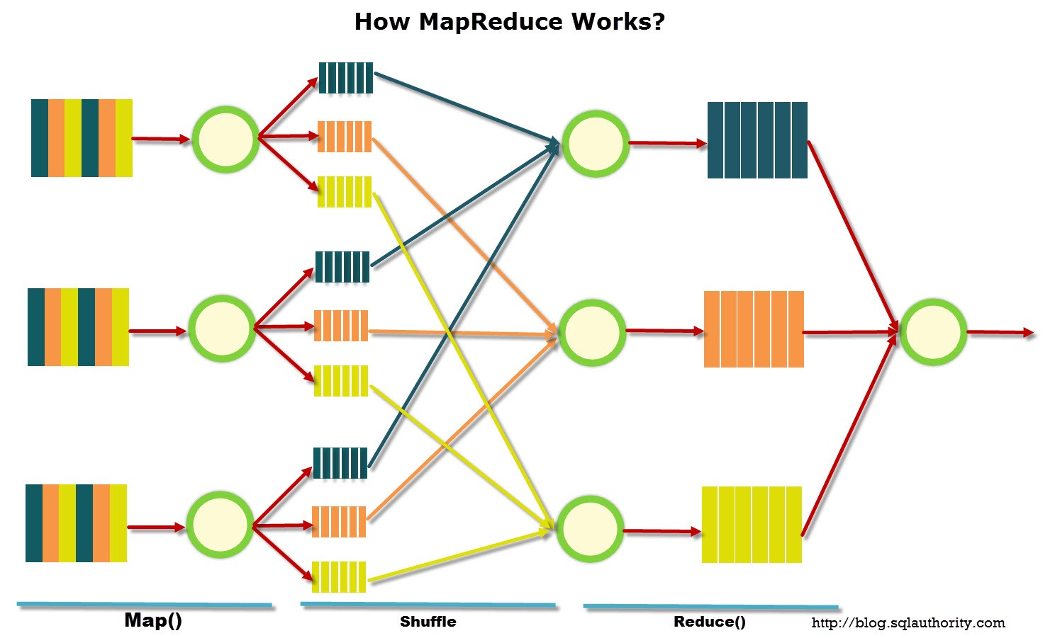

Slide 8
What the heck is MapReduce?

Slide 9
Adavantages
Scalability
Cost-effective solution
Flexibility
Fast
Parallel Processing
Simple

Slide 10
map(String key, String value)
// key: document name
// value: document contents
for each word w in value
EmitIntermediate(w, "1")
reduce(String key, Iterator values):
// key: word
// values: a list of counts
for each v in values:
result += ParseInt(v);
Emit(AsString(result));

