Slide 1

Introduction:
Kisan Mahat
Currently studying BCA
in Lumbini Engineering College.
A member of learn and
share and joined Android Applic-
-ation channel.

Slide 2
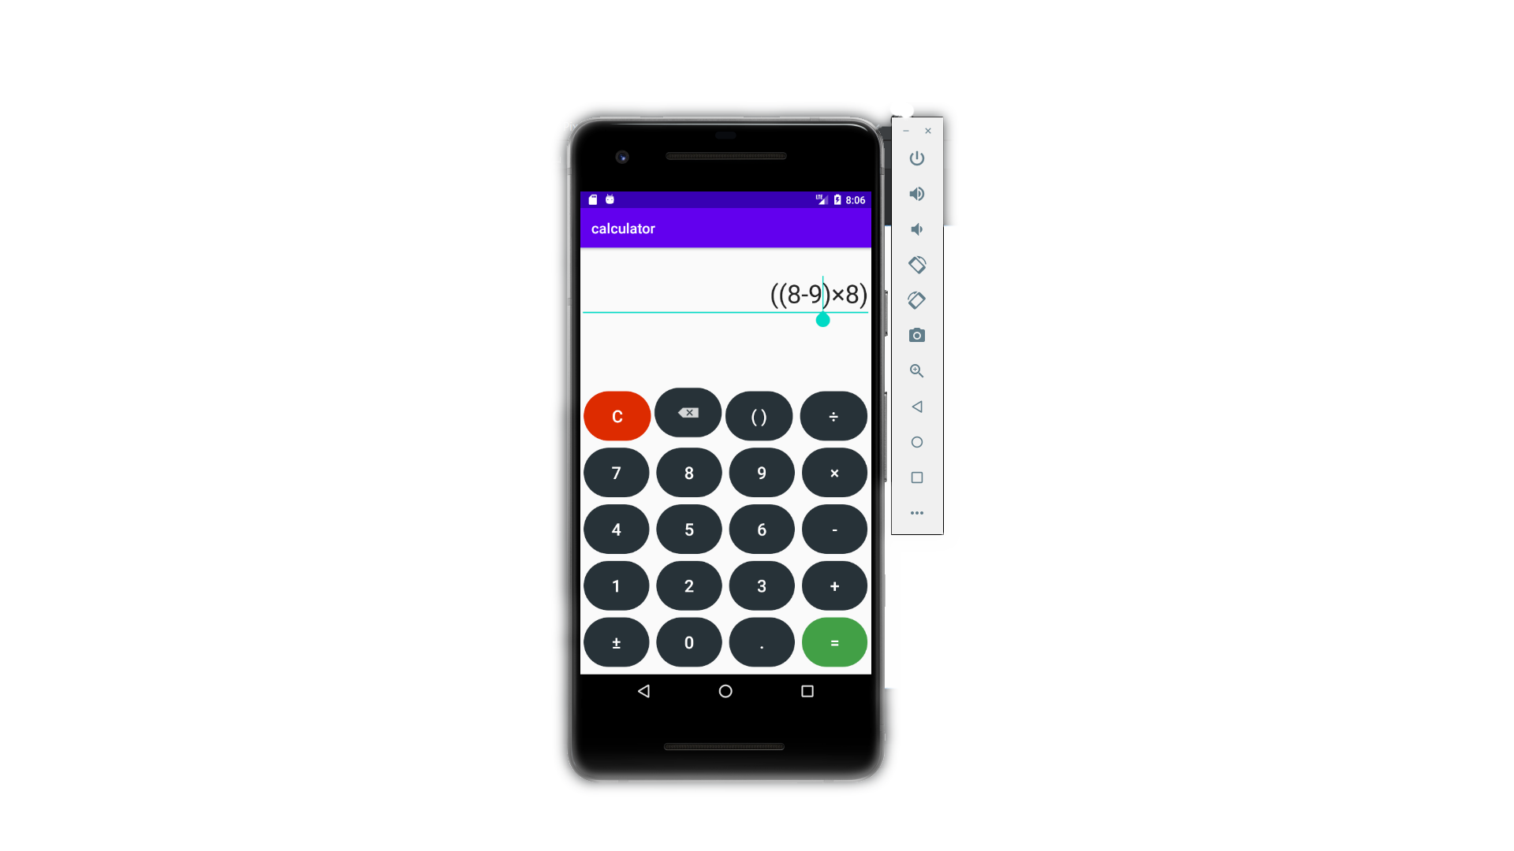
Project tittle:
Athematic Calculator

Slide 3

Android Application:
Android software development is the process by which applications are created for devices running the Android operating system. "Android apps can be written using Kotlin, Java, and C++ languages" using the Android software development kit (SDK), while using other languages is also possible. All non-JVM languages, such as Go, JavaScript, C, C++ or assembly, need the help of JVM language code, that may be supplied by tools, likely with restricted API support.

Slide 4

How to download and install jdk?
Download Amazon Corretto
Install by keeping the setting’s default
Open terminal(command prompt and type java –version to see the version

Slide 5
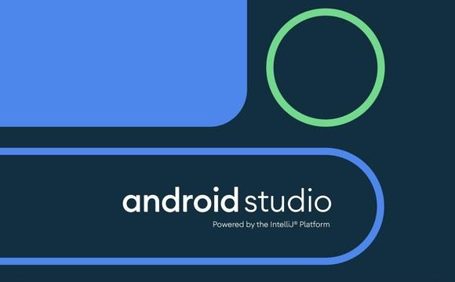
How to download and install android studio?
Download Android Studio
Install by keeping the setting’s default and choose install type standard

Slide 6
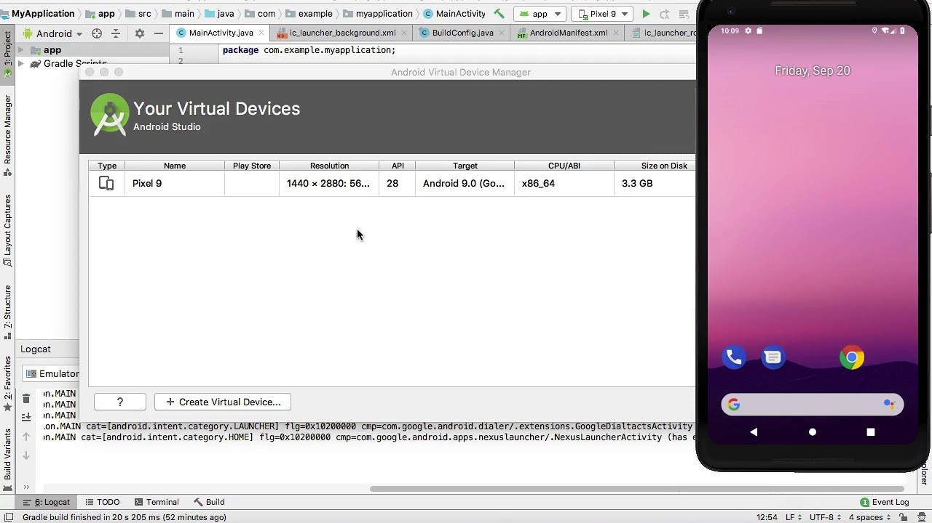
How to setup our virtual devices?
On the top near app, there is an option to choose device (no devices)
Click the option and select AVD manager
Click on add virtual device, then
a. Choose category and device
b. Choose system image (Download if not downloaded)
c. Verify and finish

