Slide 1
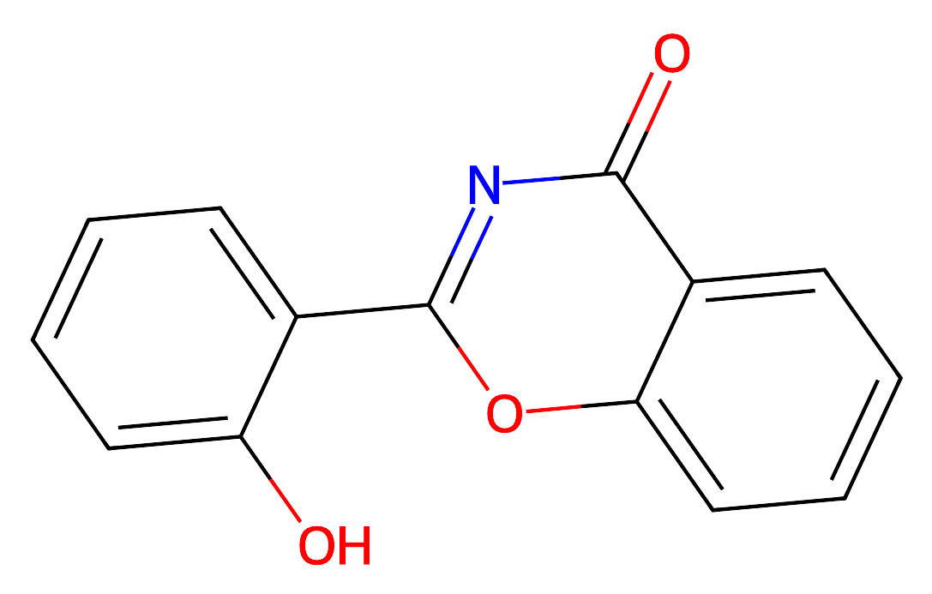
H165301
Reaction route summary
reactions
route #id
0
1
1 routes over 100 queries
Routes start at similarity of 0.92(1),
O=c1nc(-c2ccccc2O)oc2ccccc12

Slide 2
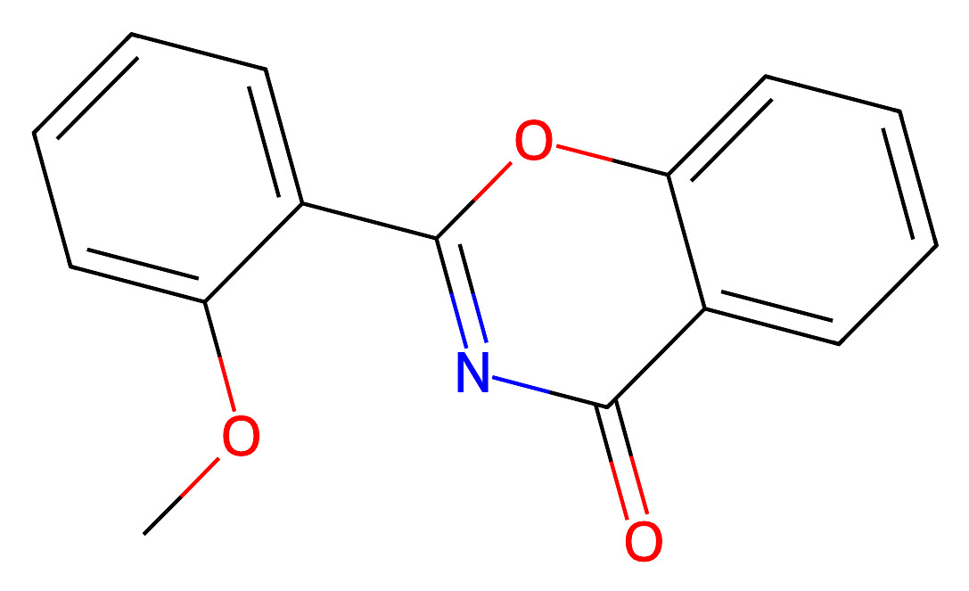
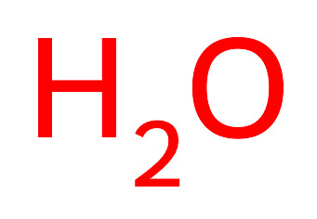
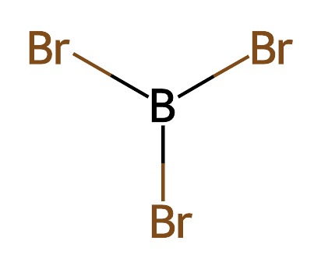
Route1

