Slide 1
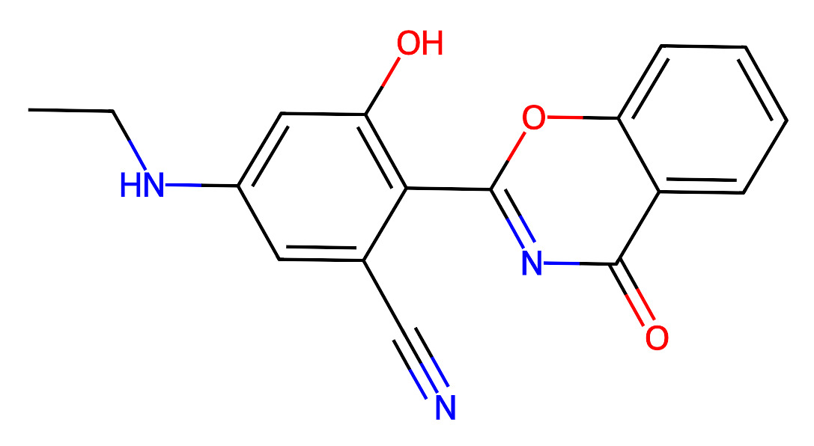
H165312
Reaction route summary
reactions
route #id
25
24
23
22
21
0
95
27
26
28
71,94
30
29
92
31
15,17,18,38,58,91
32
90
33
49,86
14
20
12-11
19-18
8
17-15
2
1
85
34
50,51,52,67,81,84
13
10-9
7-5
4-3
41,72,83
35
82
36
59,78,79
40
39
21,25,26,65,70
41
63
42
57
43
56
44
55
45
54
46
53
48
37
47
39
50
49
11,37
51
10,36
52
9,35
53
8,34
54
7,33
55
6,32
56
5,31
57
4,30
58
3,29
59
2,28
60
1,27
38
20
13
32 routes over 100 queries
Routes start at similarity of 0.65(13),0.68(20),0.66(27),0.66(28),0.66(29),0.66(30),0.66(31),
0.66(32),0.66(33),0.66(34),0.66(35),0.66(36),0.66(37),0.68(39),0.67(53),0.67(54),0.67(55),0.67(56),
0.67(57),0.67(63),0.68(70),0.68(79),0.65(82),0.68(83),0.66(84),0.68(85),0.68(86),0.68(90),0.68(91),
0.68(92),0.68(94),0.68(95),
CCNc1cc(O)c(-c2nc(=O)c3ccccc3o2)c(C#N)c1

Slide 2
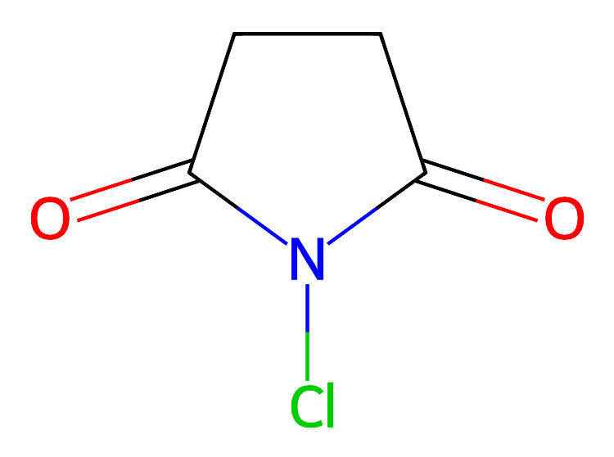
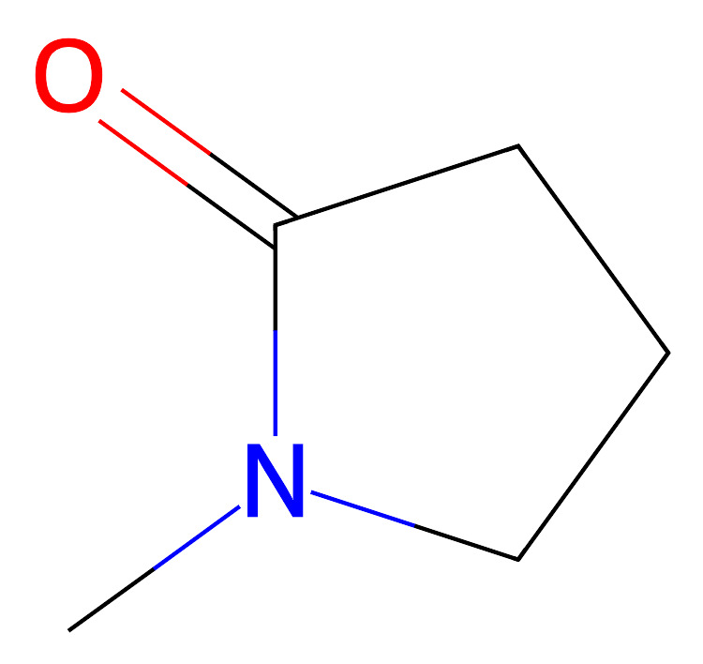
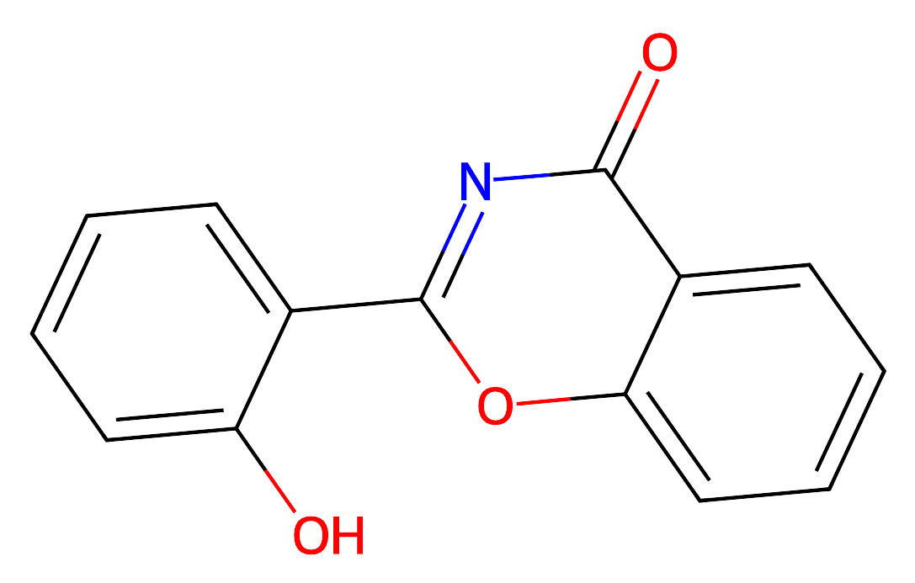
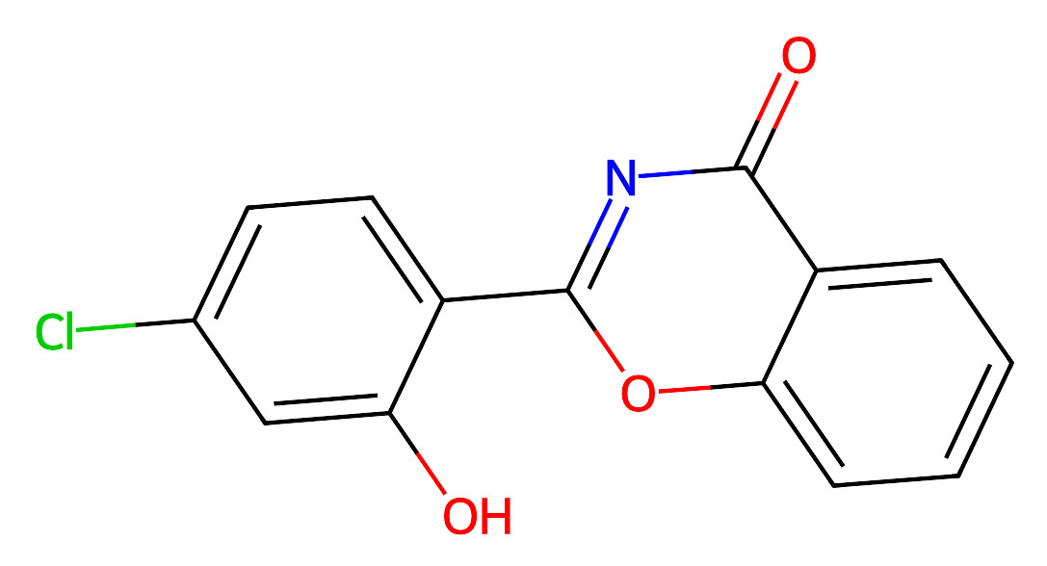
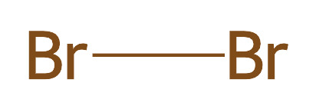
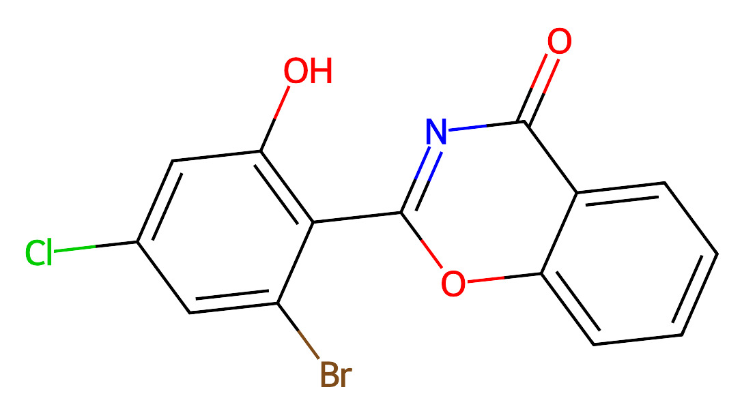
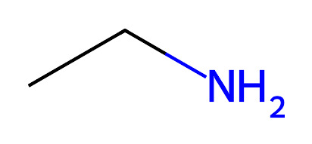
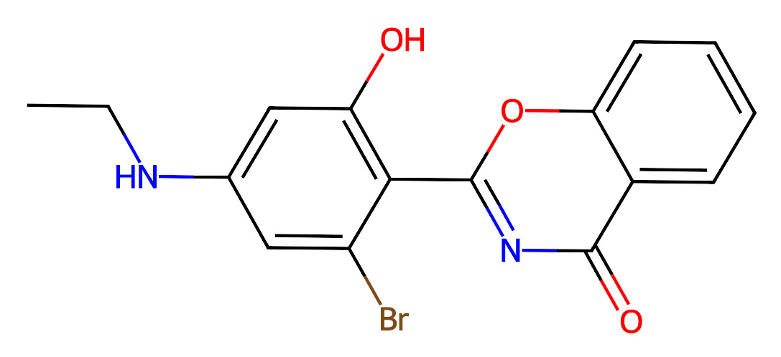
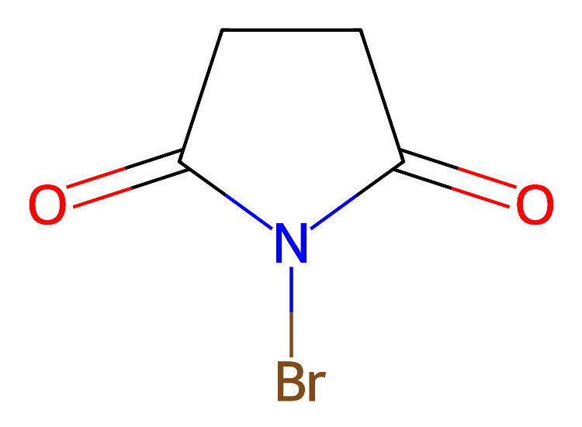
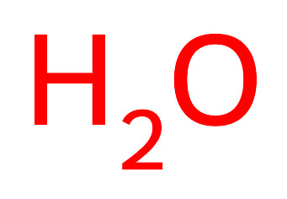
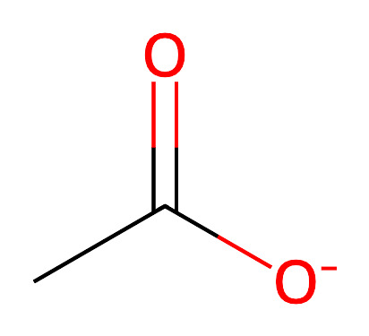
Route1
Route2
Route3
Route4

Slide 3
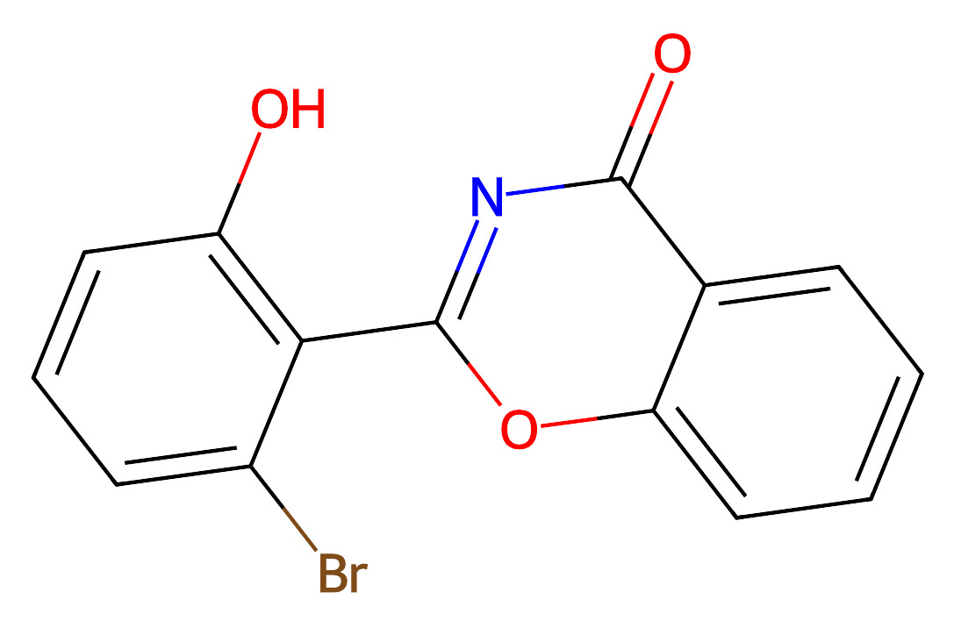
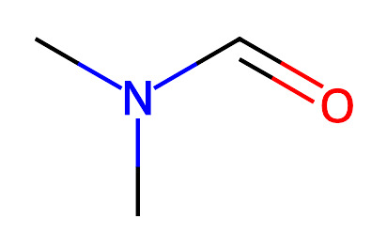
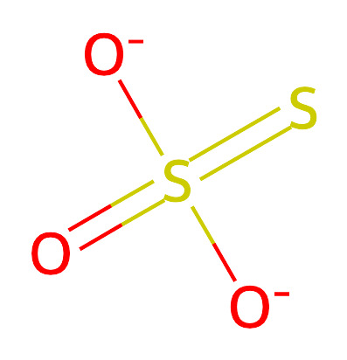
Route5
Route6
Route7
Route8

Slide 4
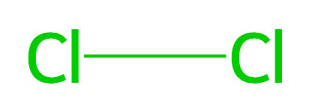
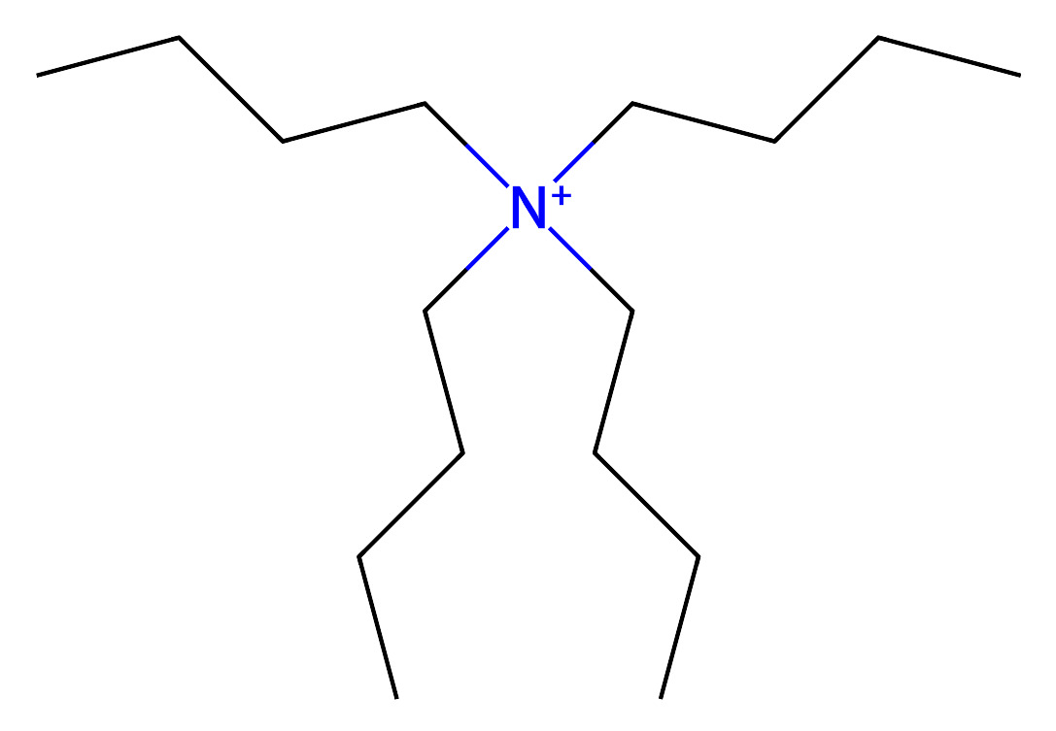
Route9
Route10
Route11

Slide 5
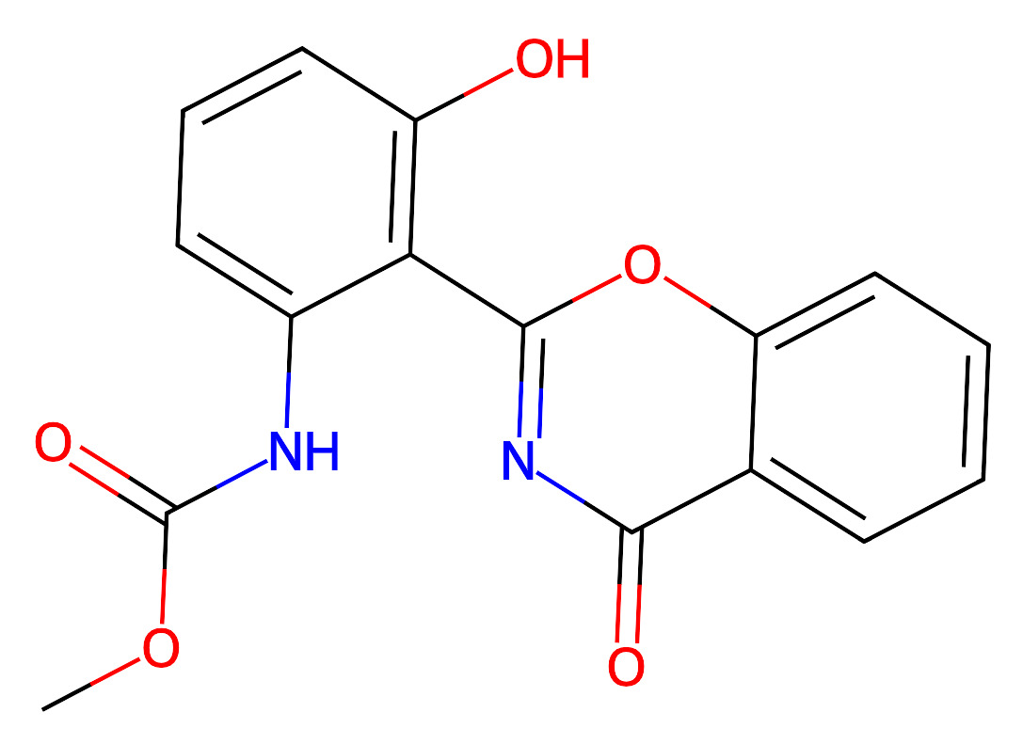
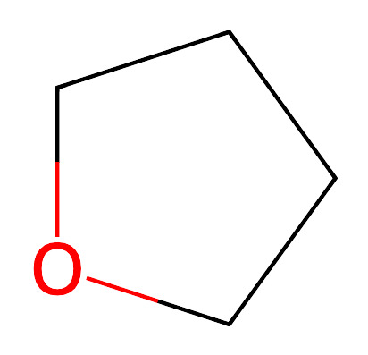
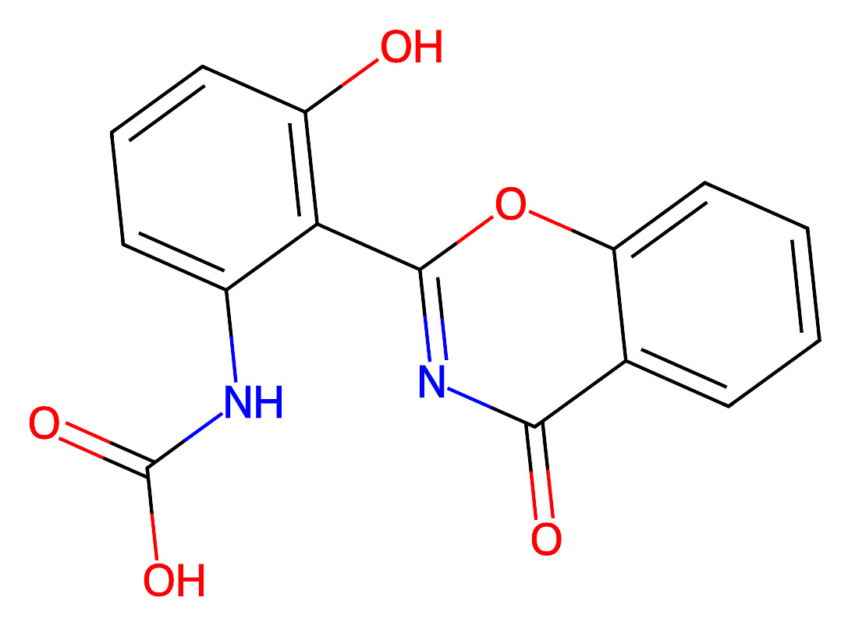
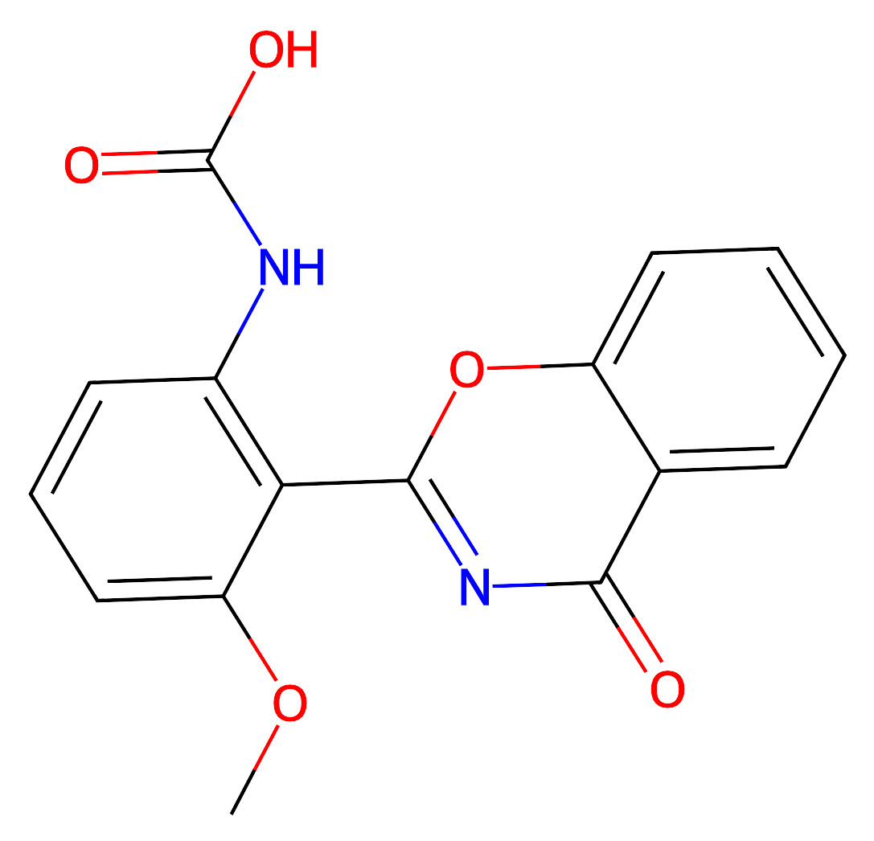
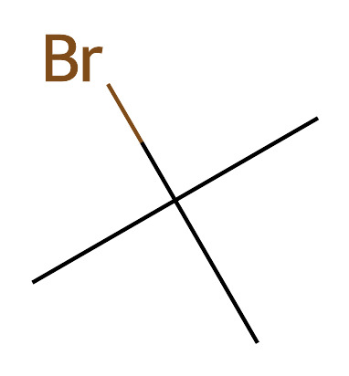
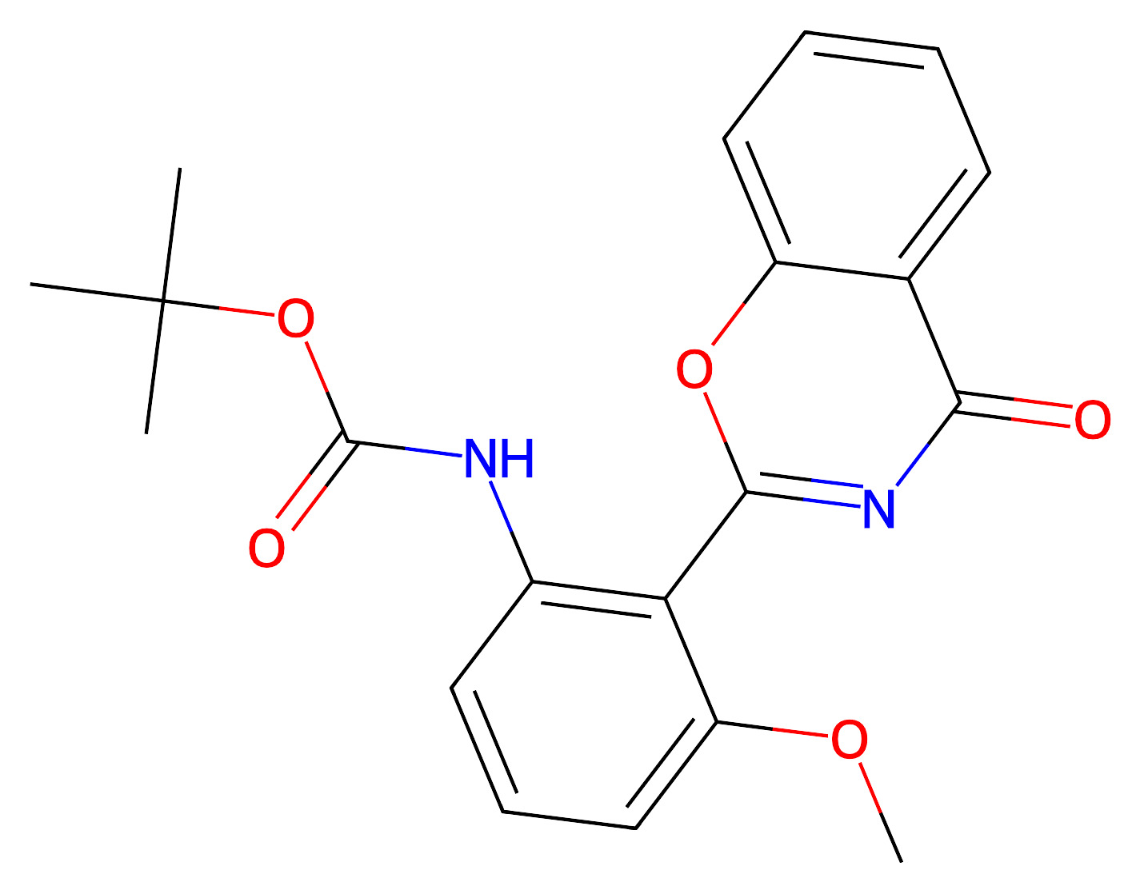
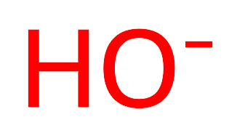
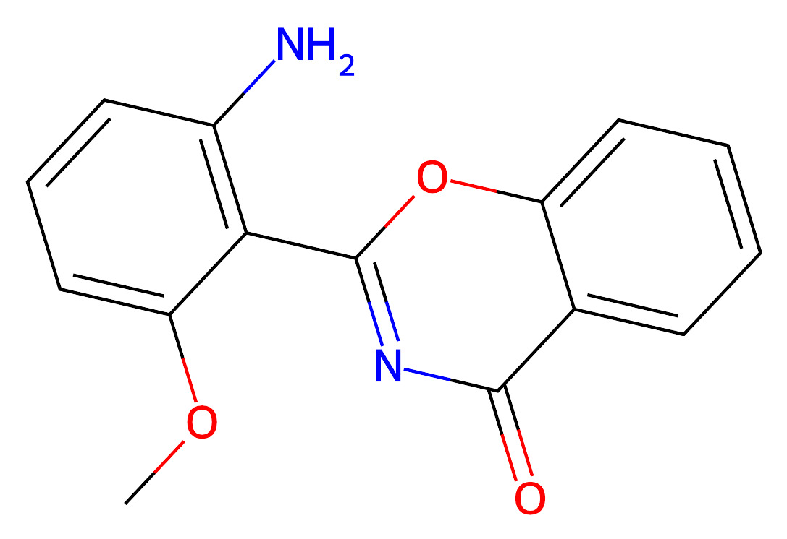
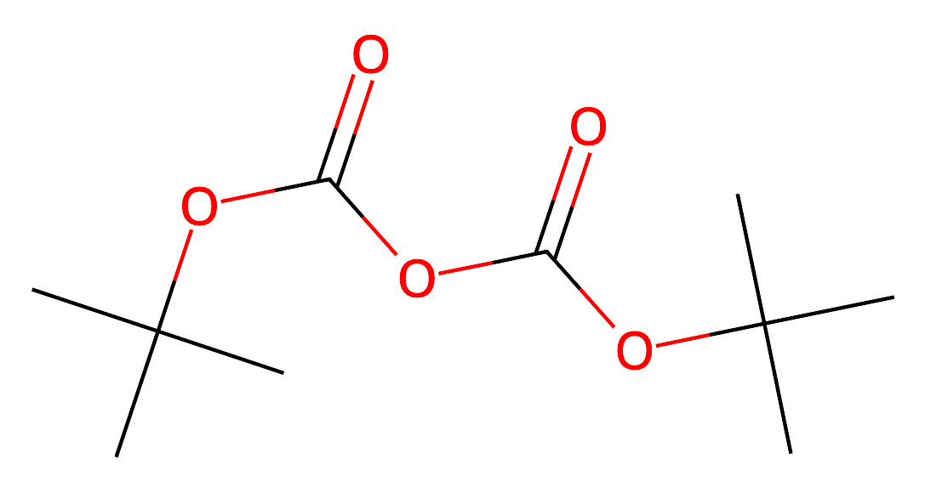
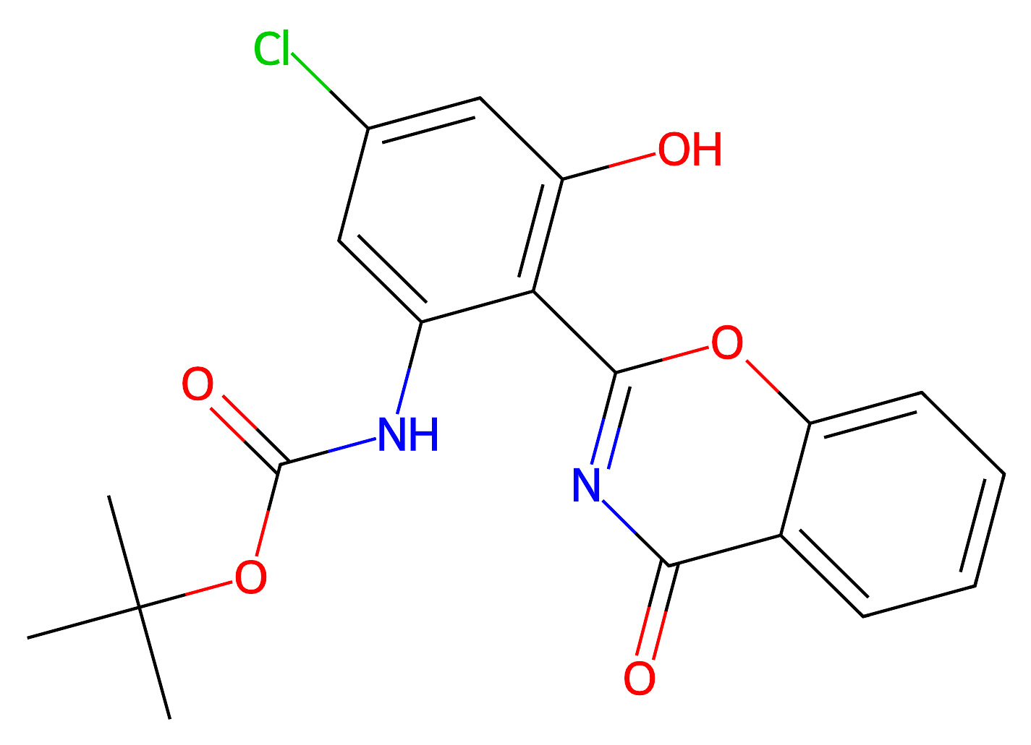
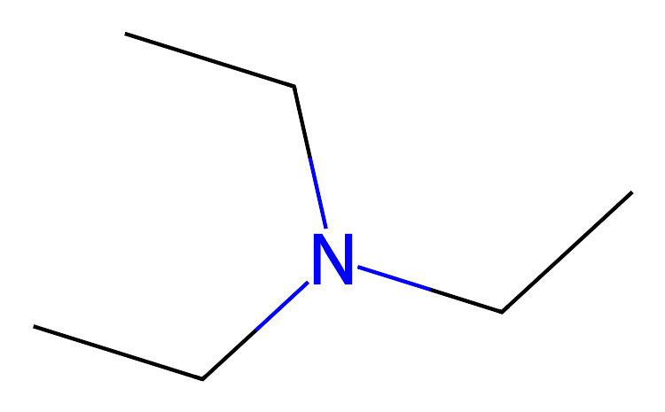
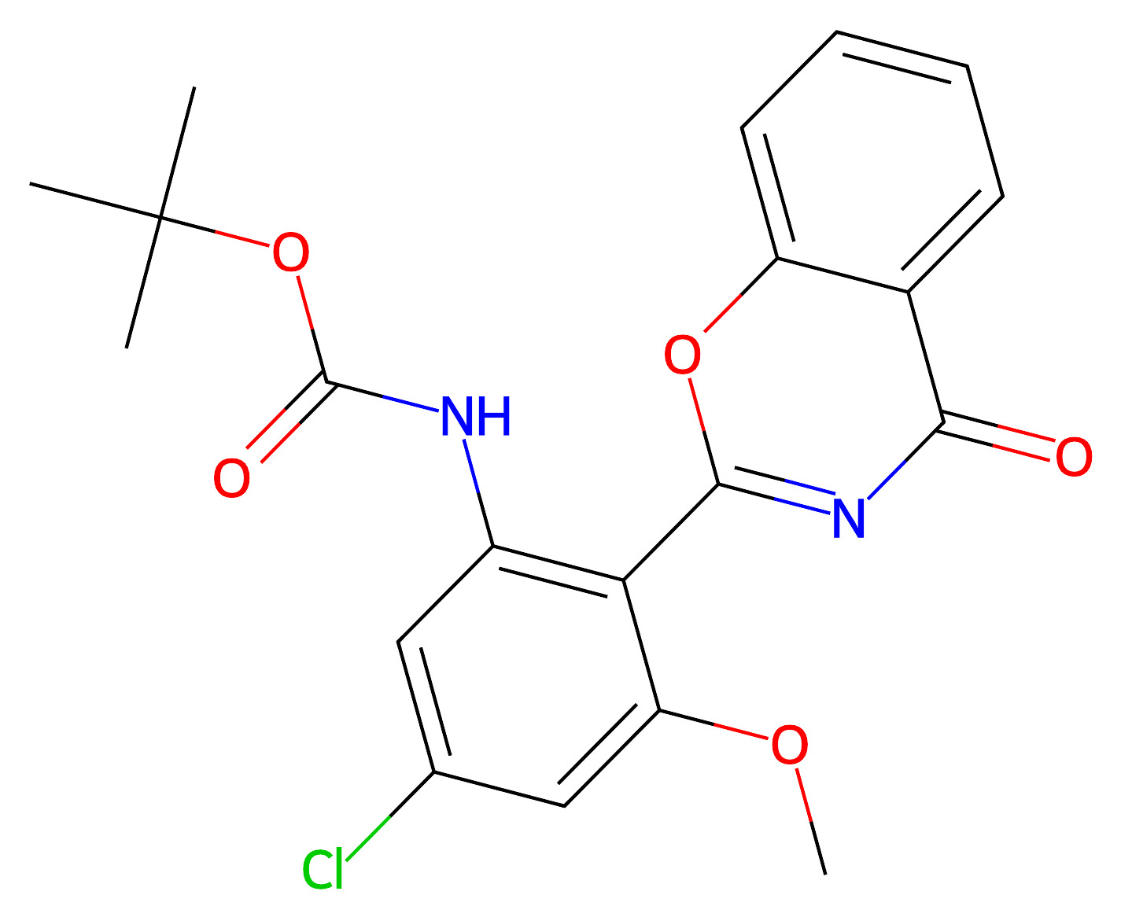
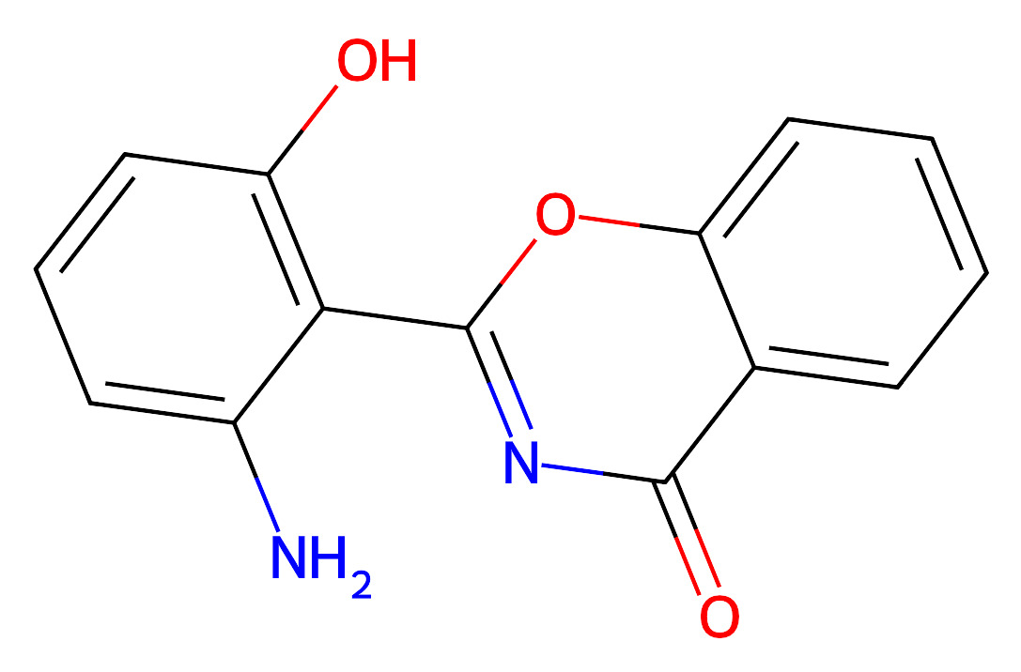
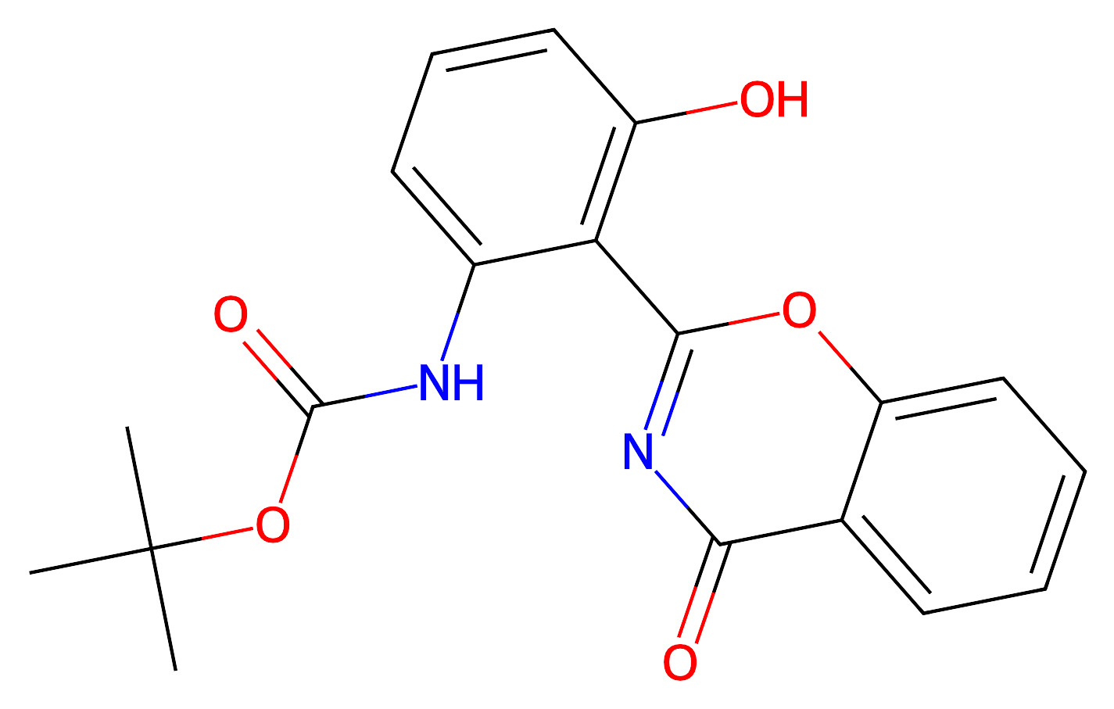
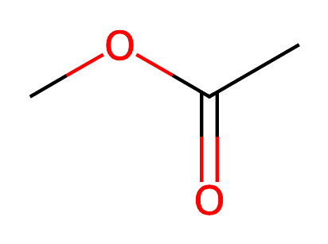
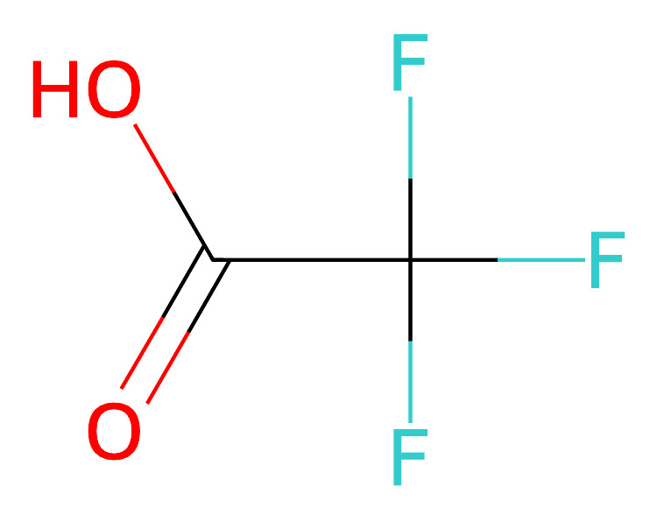
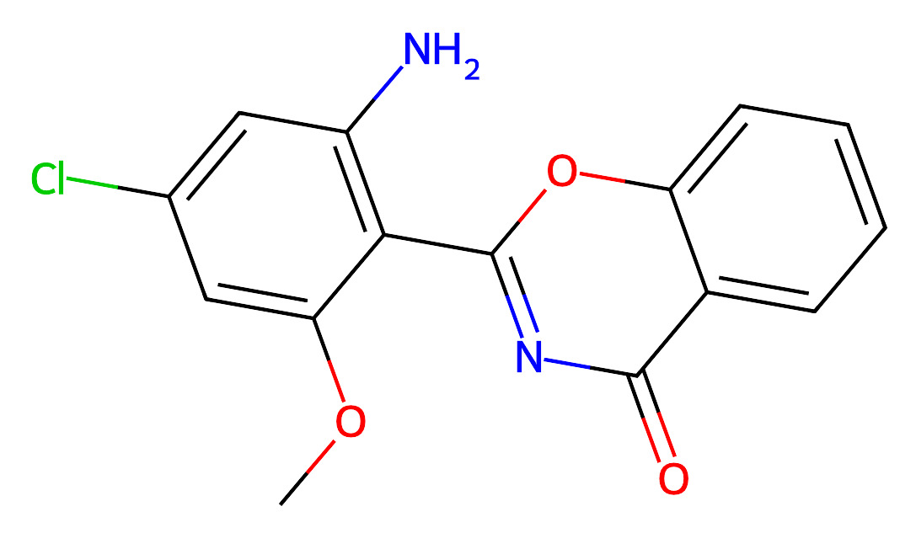
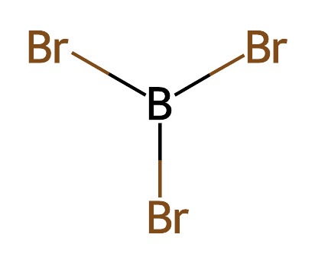
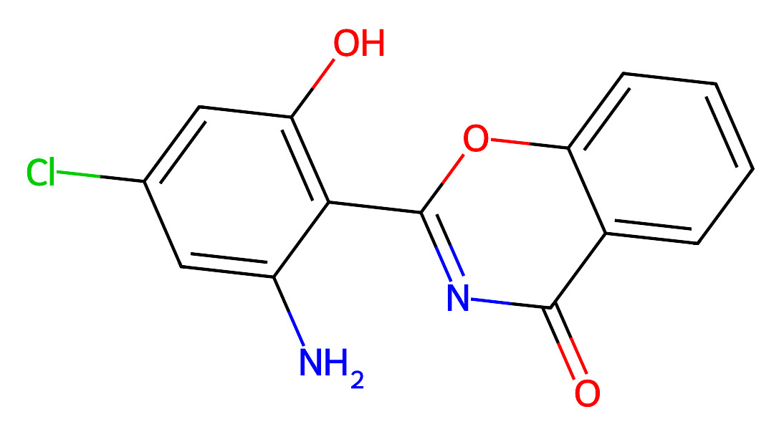

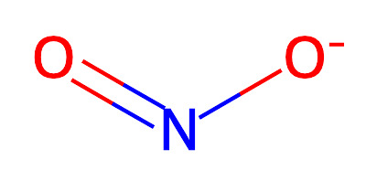
Route13

Slide 6
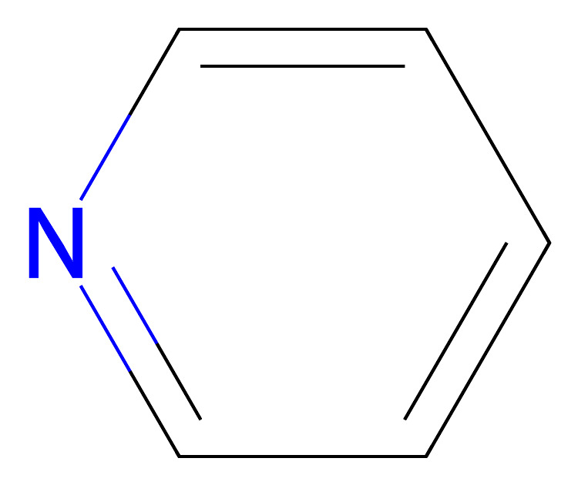
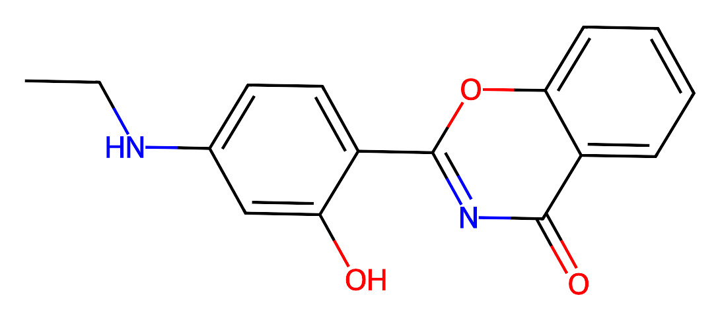
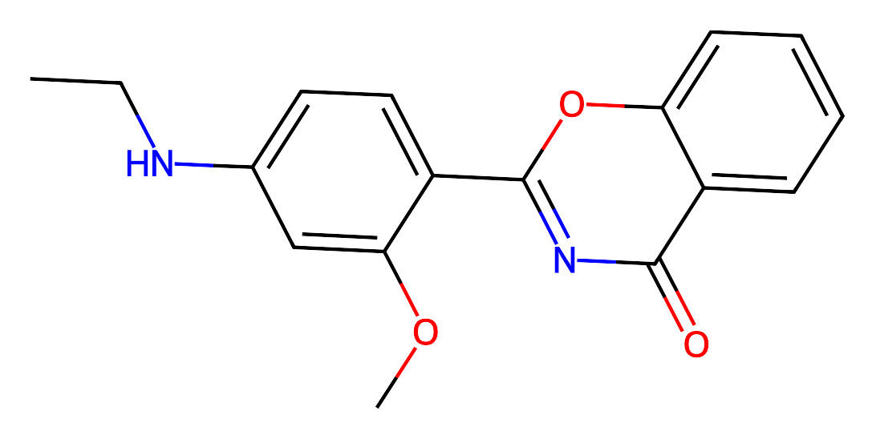
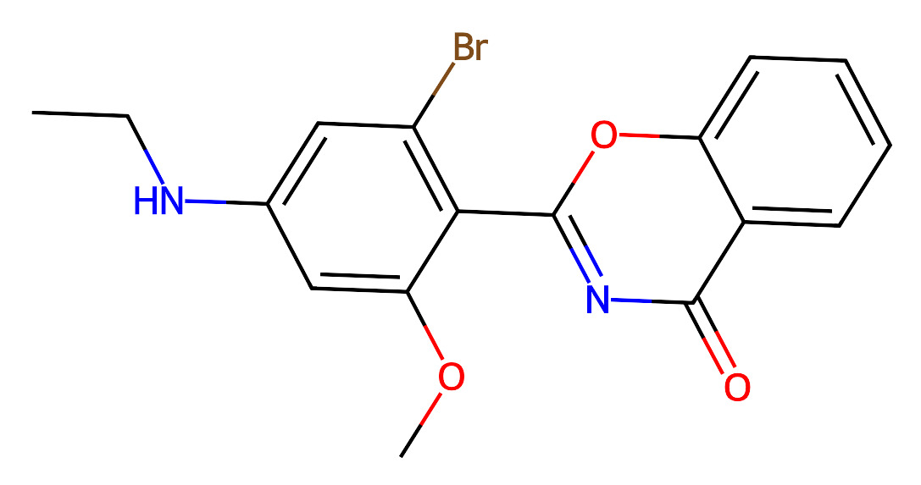
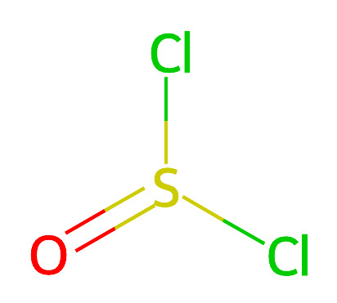
Route15
Route17

Slide 7
Route18
Route20
Route21

Slide 8
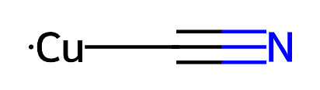
Route25
Route26
Route27

Slide 9
Route28
Route29
Route30
Route31

Slide 10
Route32
Route33
Route34
Route35

Slide 11
Route36
Route37
Route38

Slide 12

Route39
Route41

Slide 13
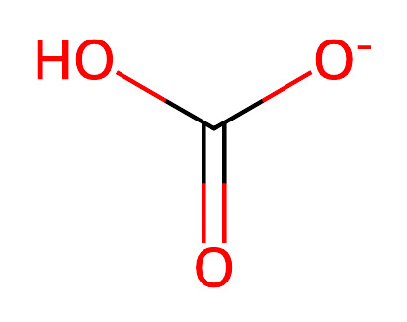
Route49
Route50

Slide 14
Route51
Route52

Slide 15
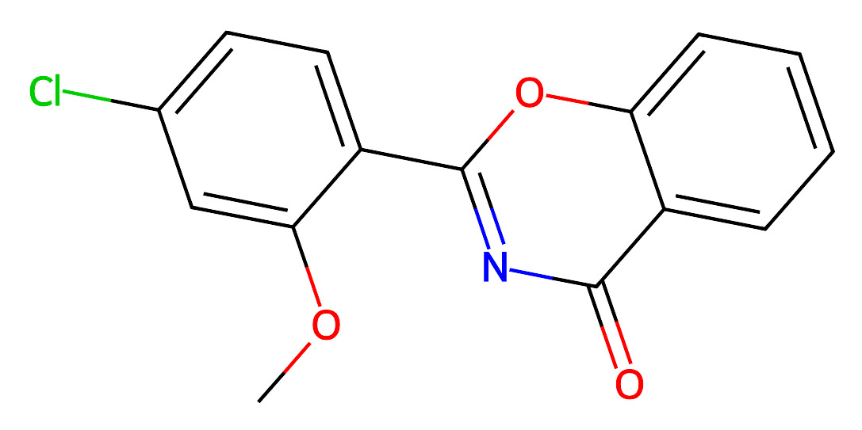
Route53
Route54

Slide 16
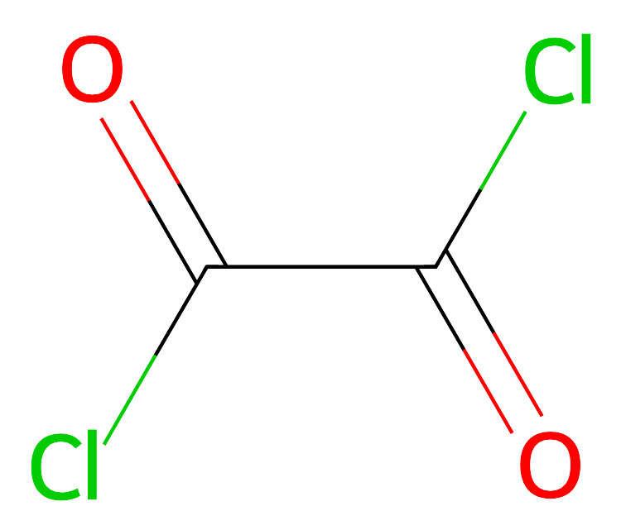
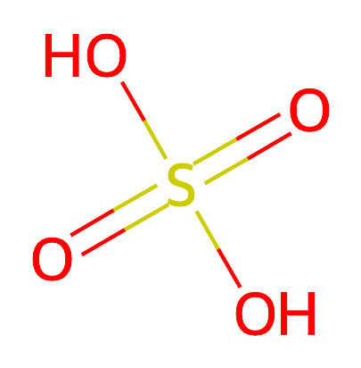
Route55
Route56

Slide 17
Route57
Route58

Slide 18

Route59
Route63

Slide 19
Route65

Slide 20
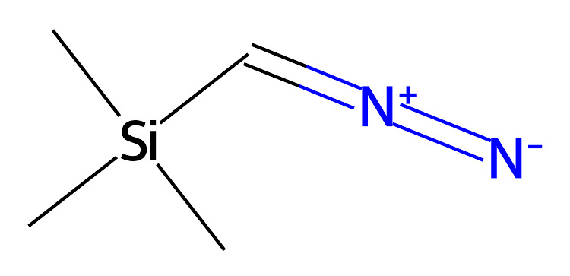
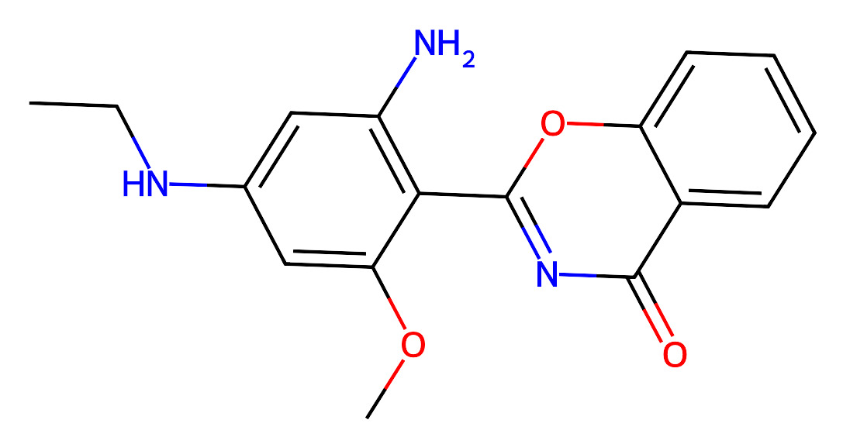
Route67

Slide 21
Route70
Route71

Slide 22
Route72
Route78

Slide 23
Route79
Route81

Slide 24
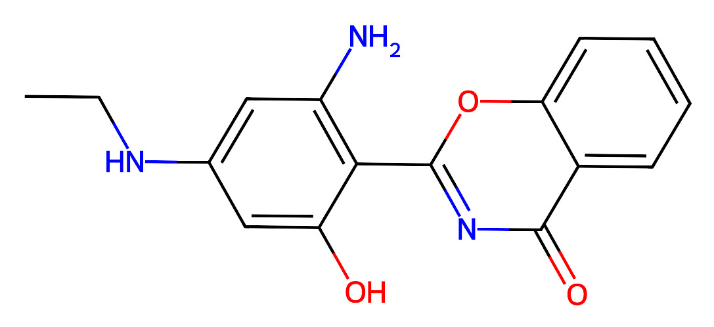
Route82

Slide 25
Route83

Slide 26
Route84

Slide 27
Route85
Route86
Route90

Slide 28
Route91
Route92

Slide 29
Route94
Route95

