Slide 1
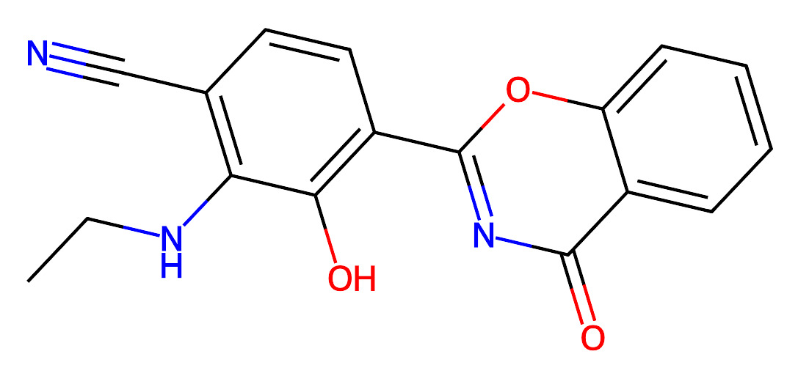
H165303
Reaction route summary
reactions
route #id
21
20
19
18
17
0
100
1
25
24
23
22
56,61,92,95
26
2,3,4,9,38,76,91
27
89
28
39,82,87
29
32,68,81
30
26,47,48,80
31
8,33,79
32
7,15,17,40,41,78
33
25,43,44,73,74,75
34
16,46,66
36
35
13,35,62
37
45
38
37
39
30
40
29
41
28
42
27
16-9
8-5
4-2
23
45-43
18
6
21 routes over 100 queries
Routes start at similarity of 0.69(100),0.49(18),0.69(23),0.68(27),0.68(28),0.68(29),0.68(30),
0.69(37),0.68(45),0.63(6),0.69(62),0.69(66),0.69(75),0.69(78),0.69(79),0.69(80),0.69(81),0.69(87),
0.69(89),0.69(91),0.69(95),
CCNc1c(C#N)ccc(-c2nc(=O)c3ccccc3o2)c1O

Slide 2
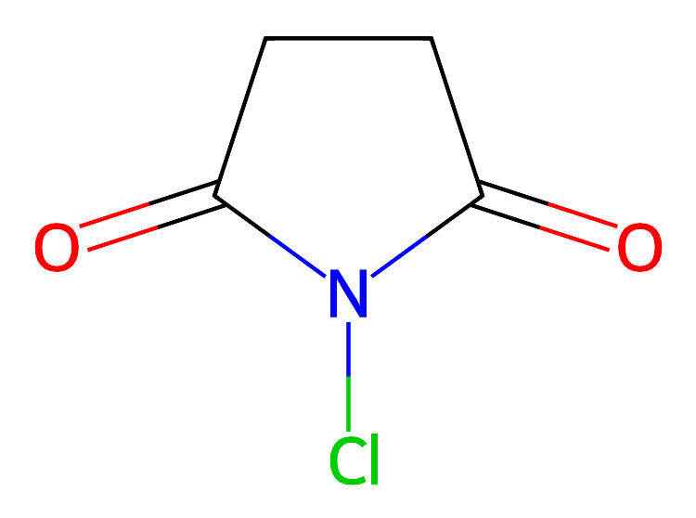
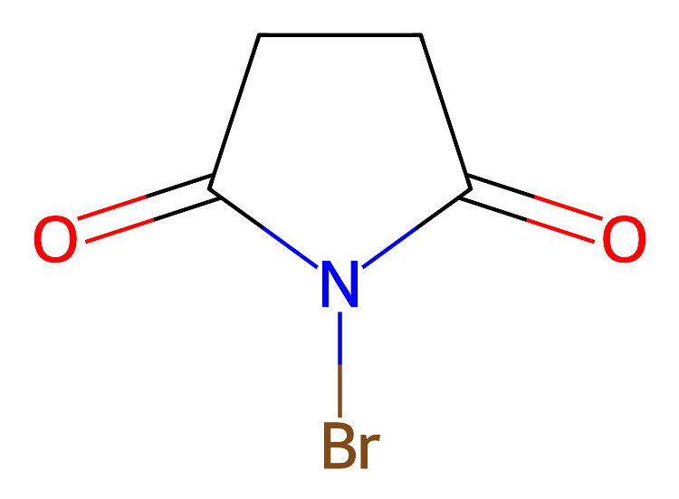
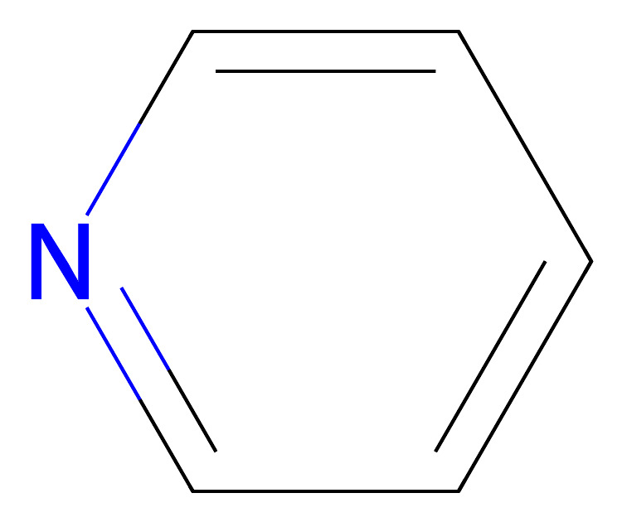
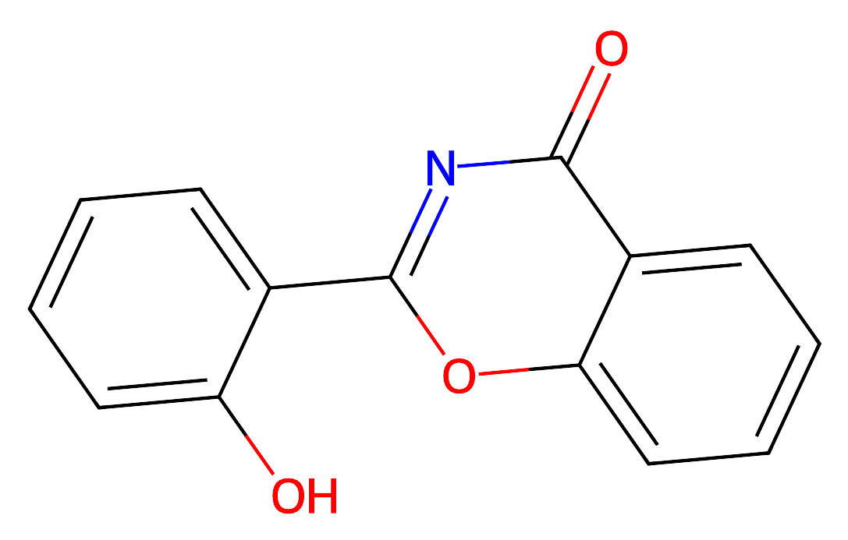
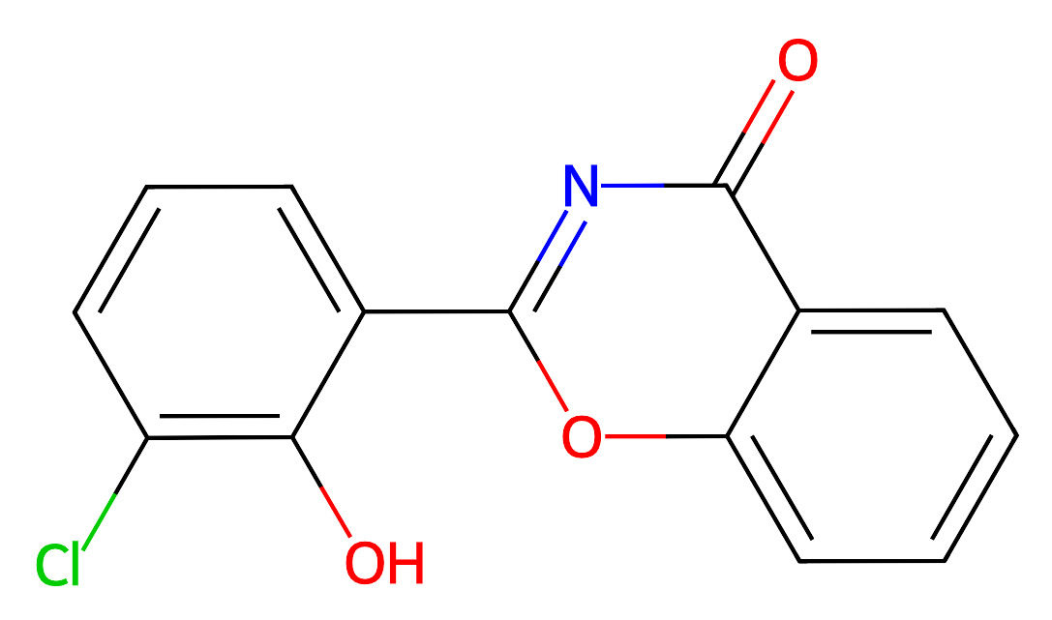
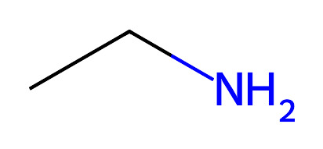
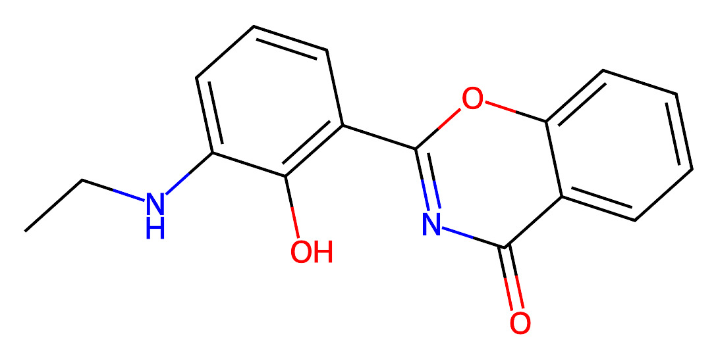
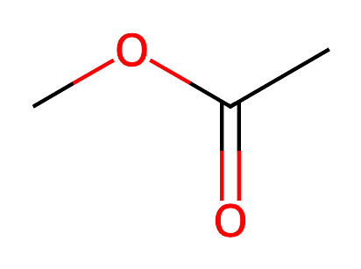
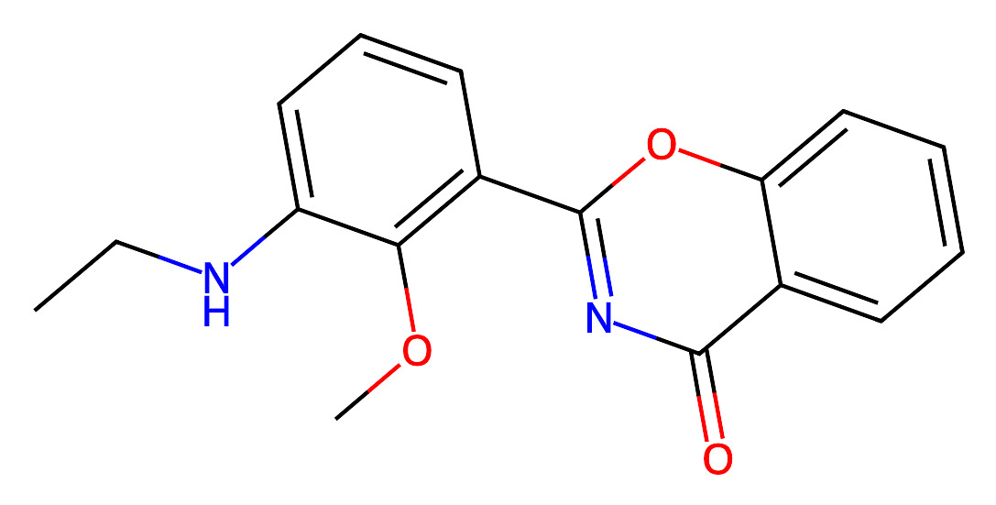
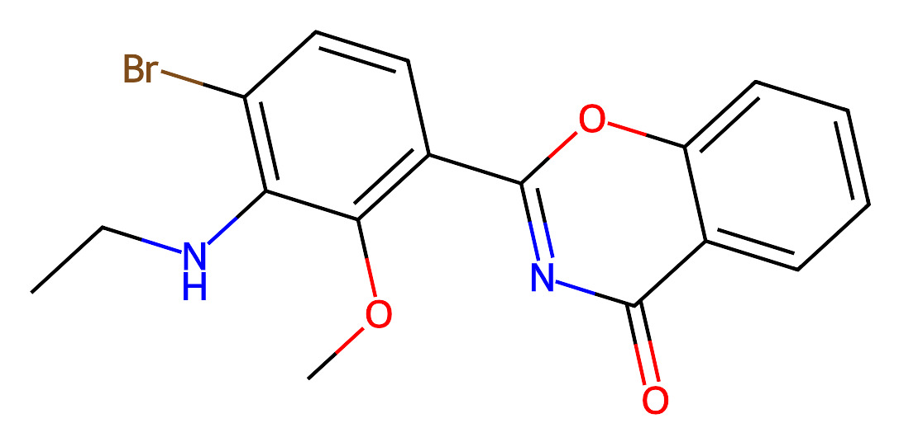
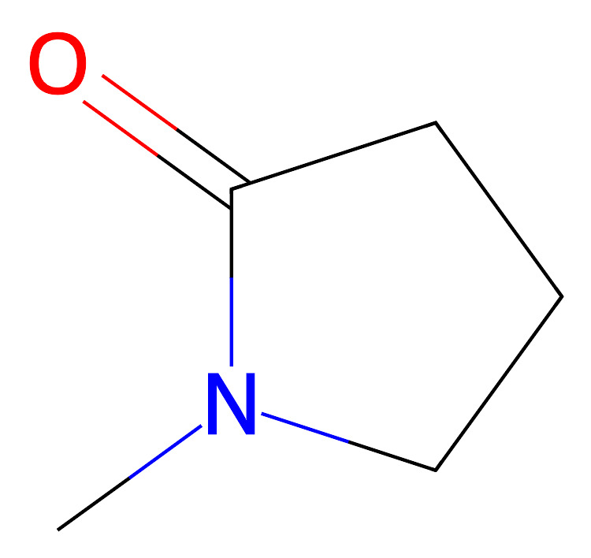
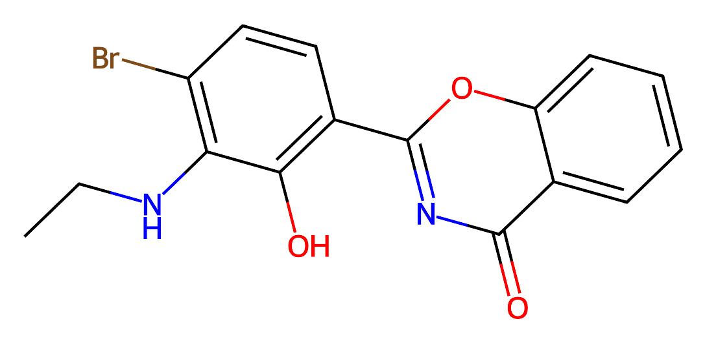
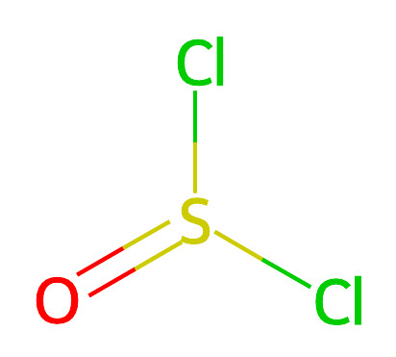
Route2
Route3

Slide 3
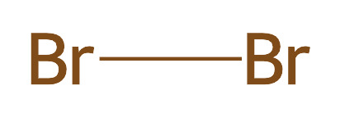
Route4

Slide 4
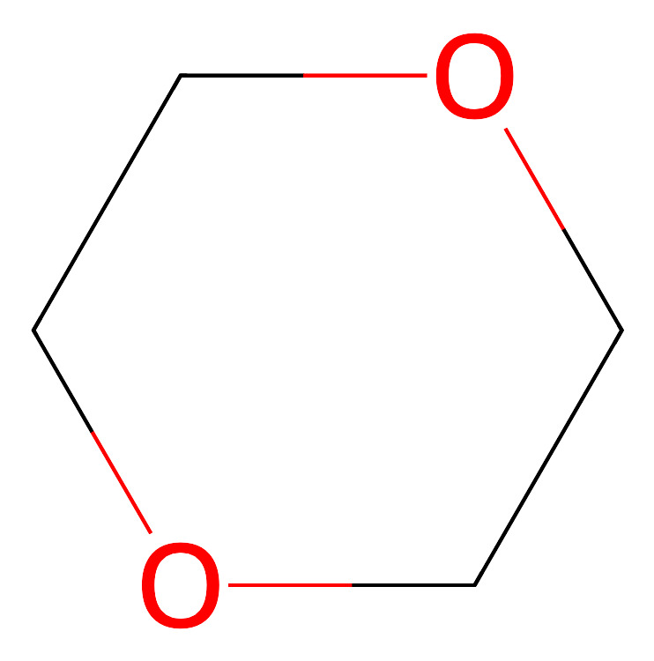
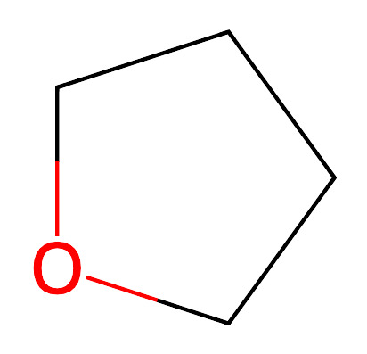
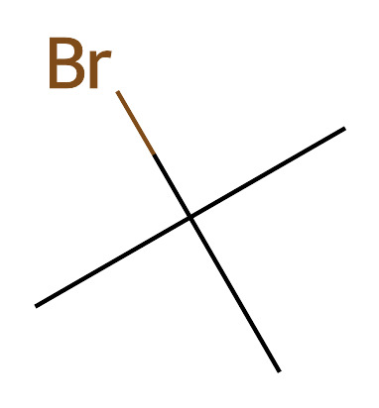
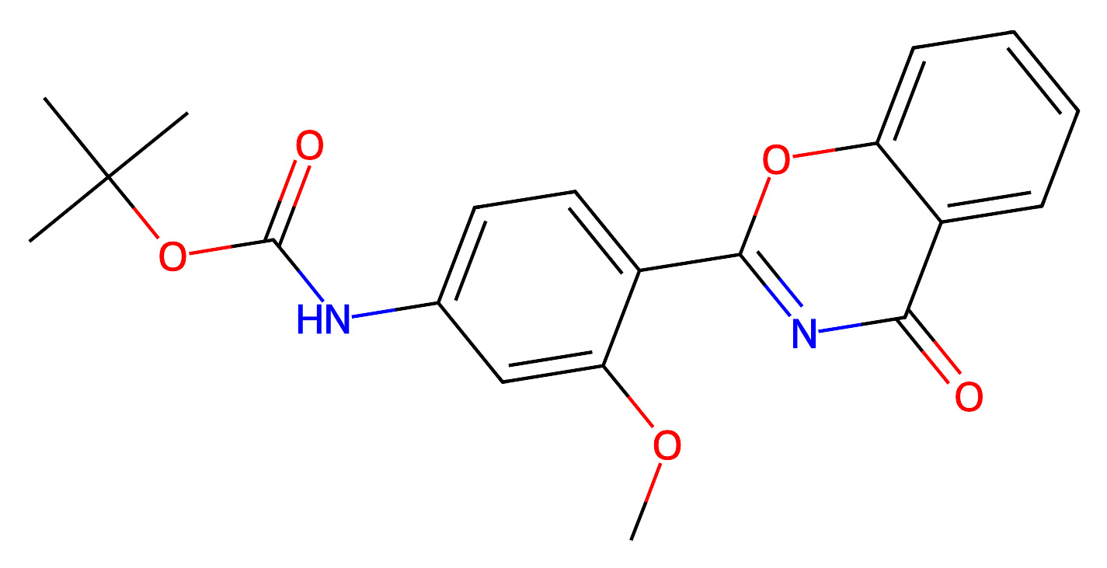
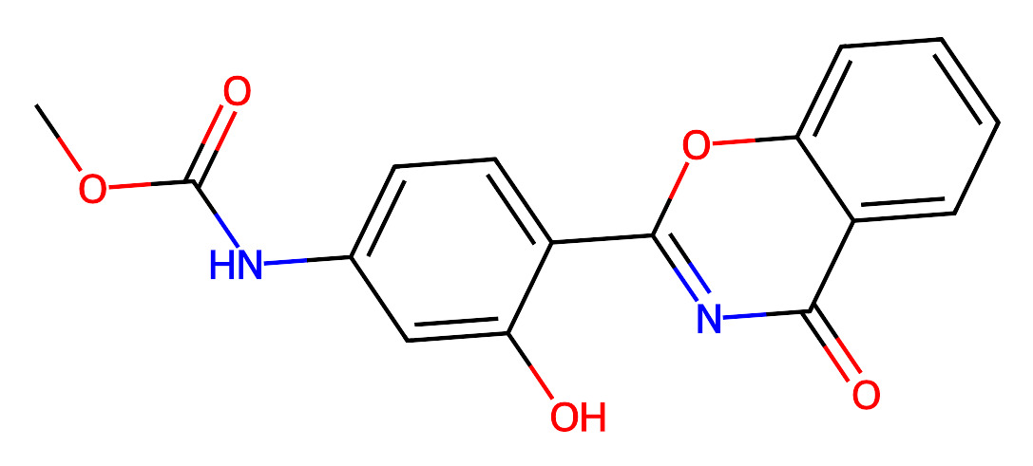
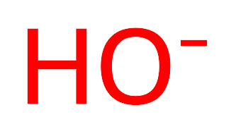
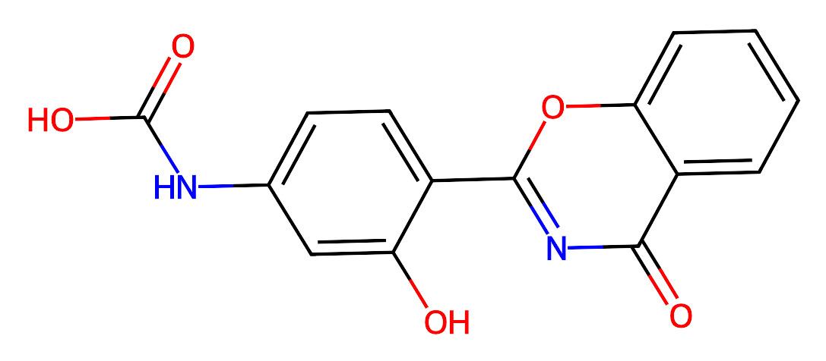
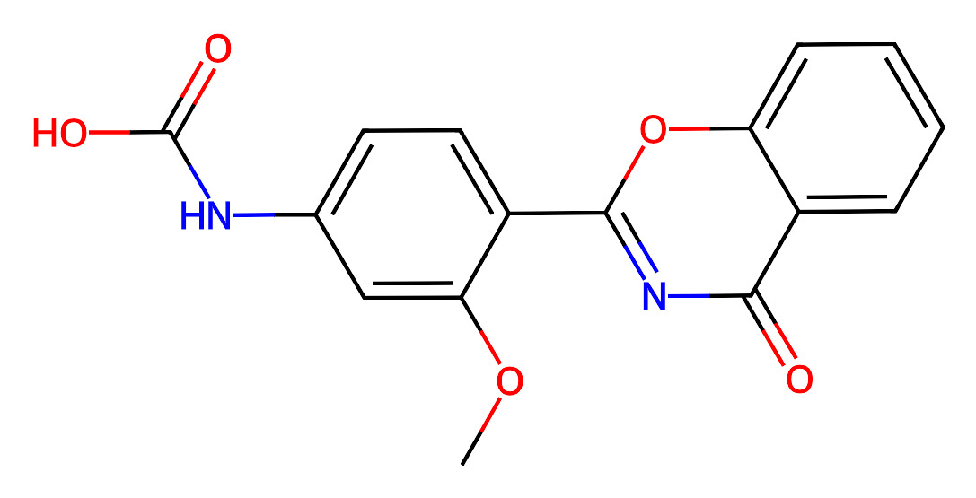

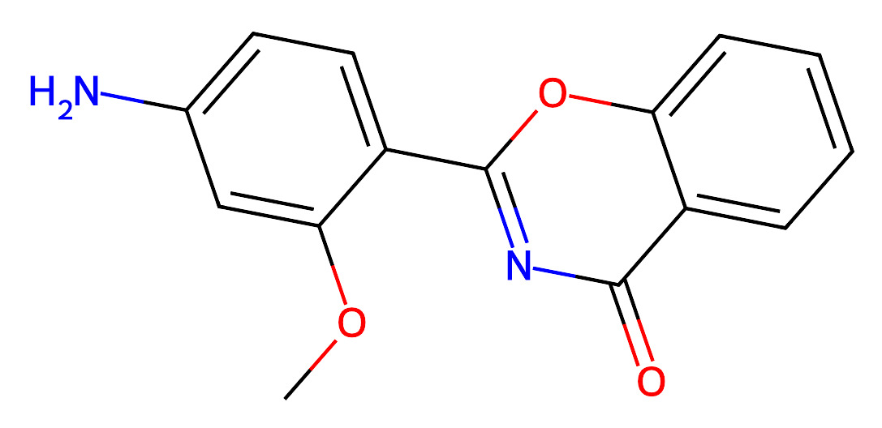
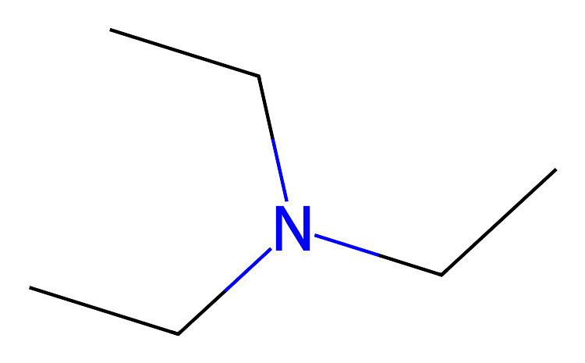
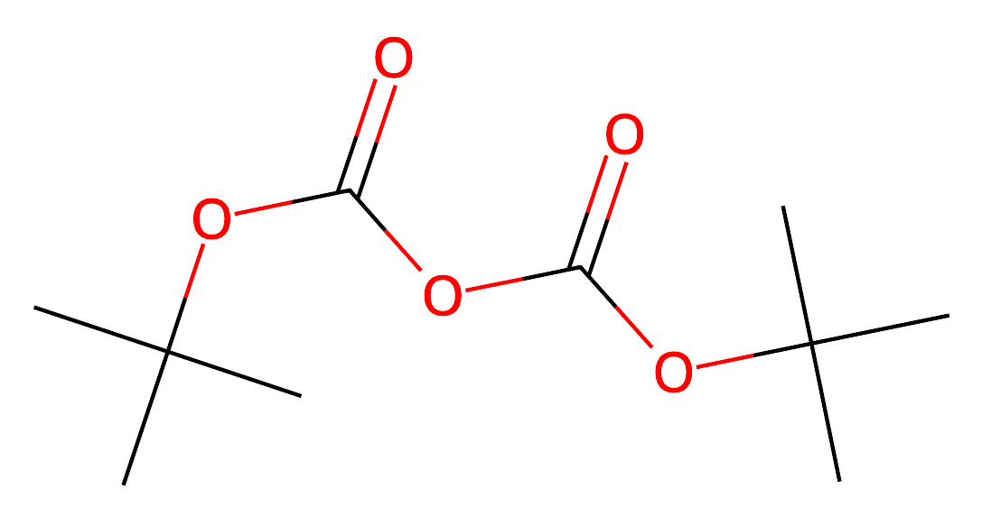
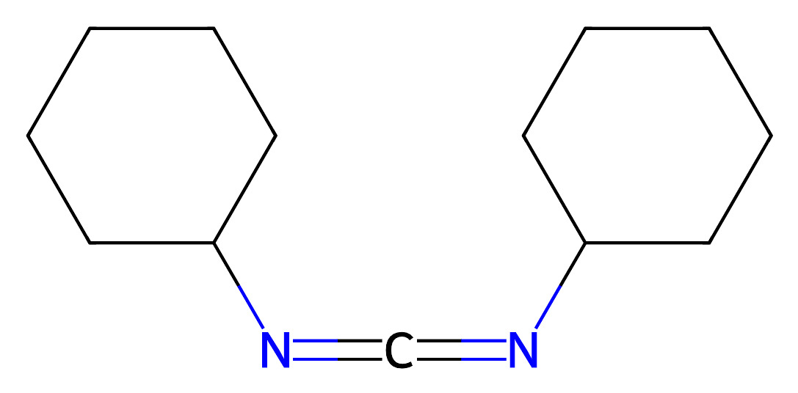
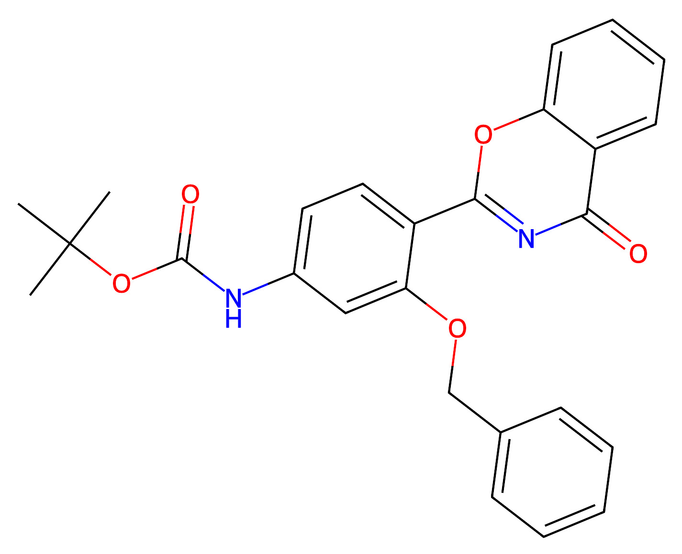
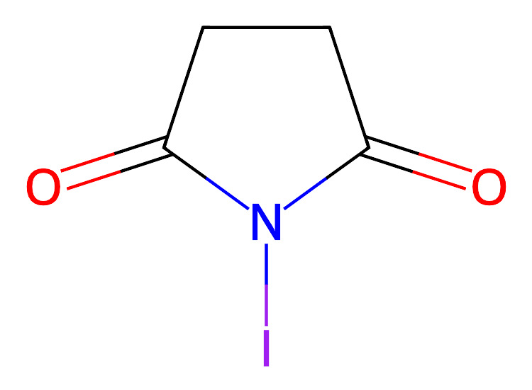
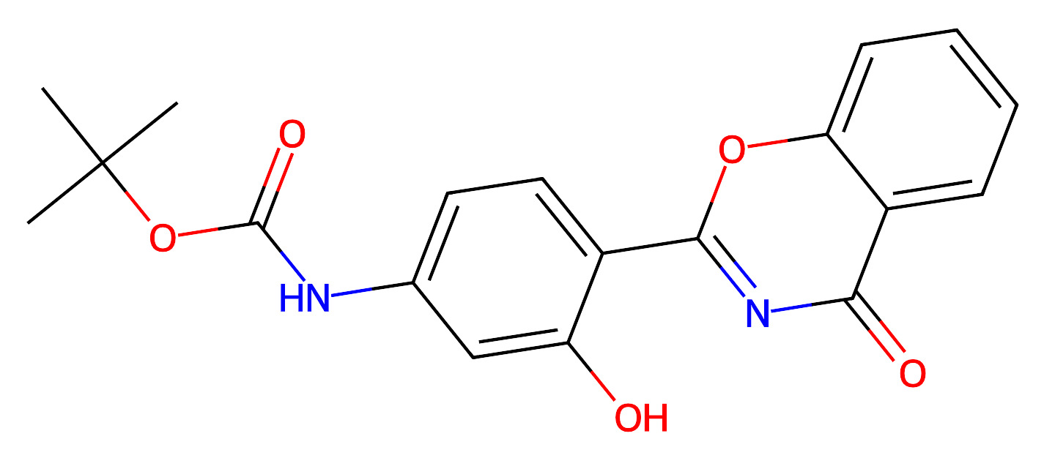
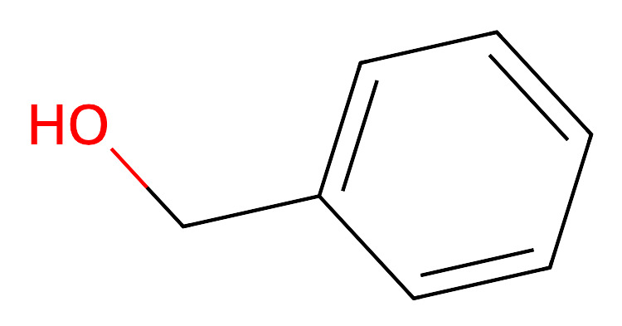
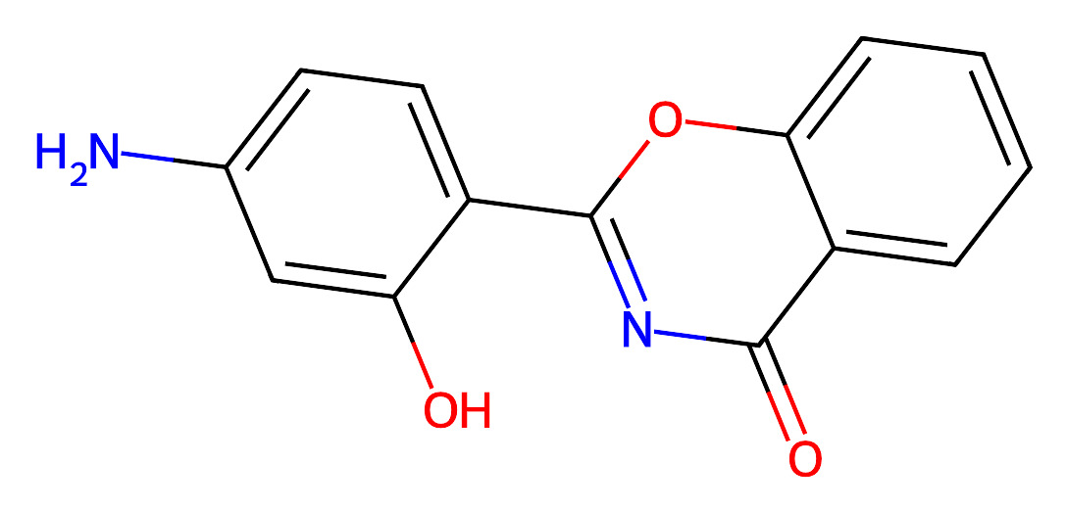
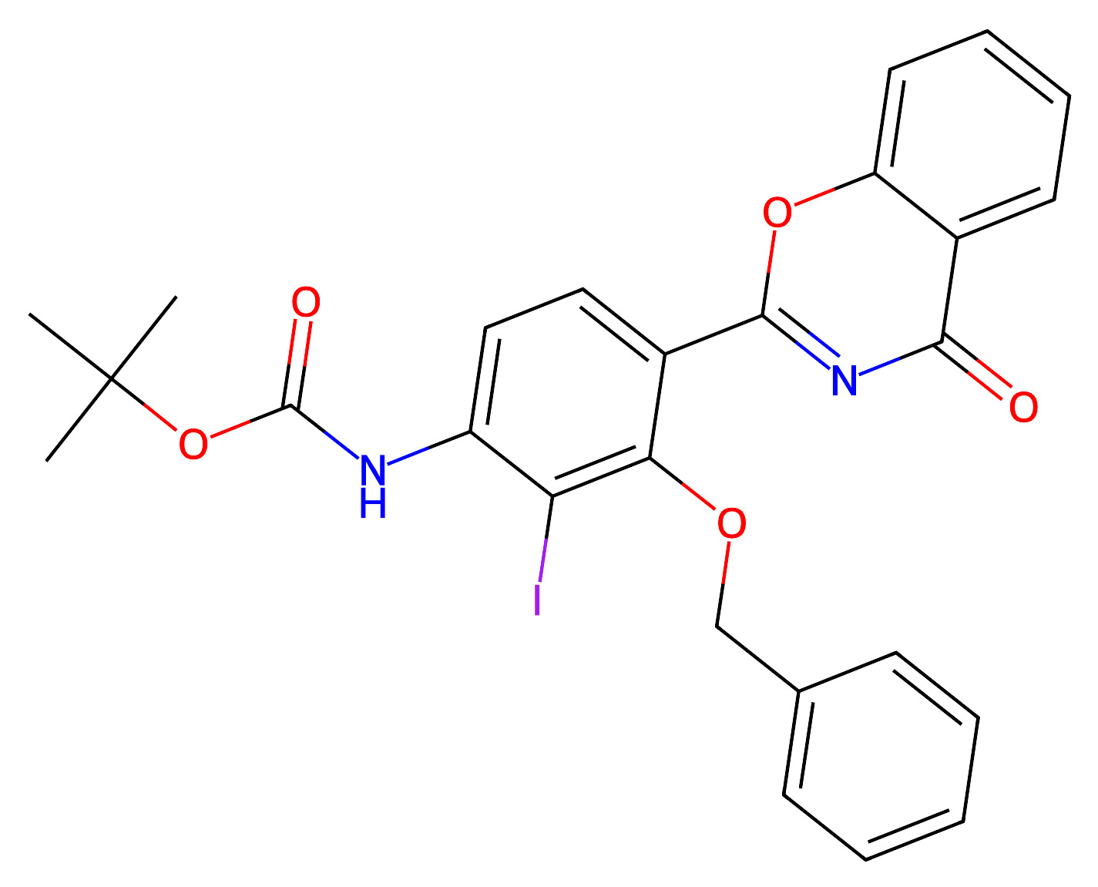
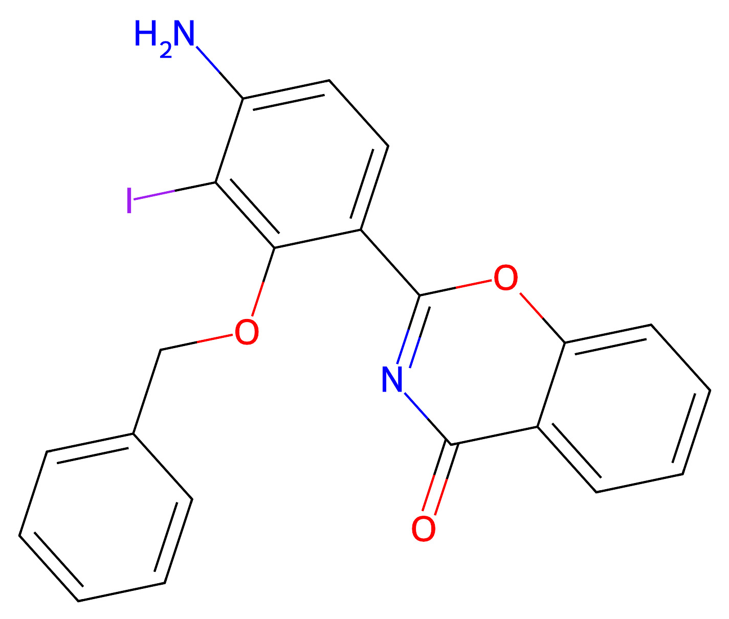
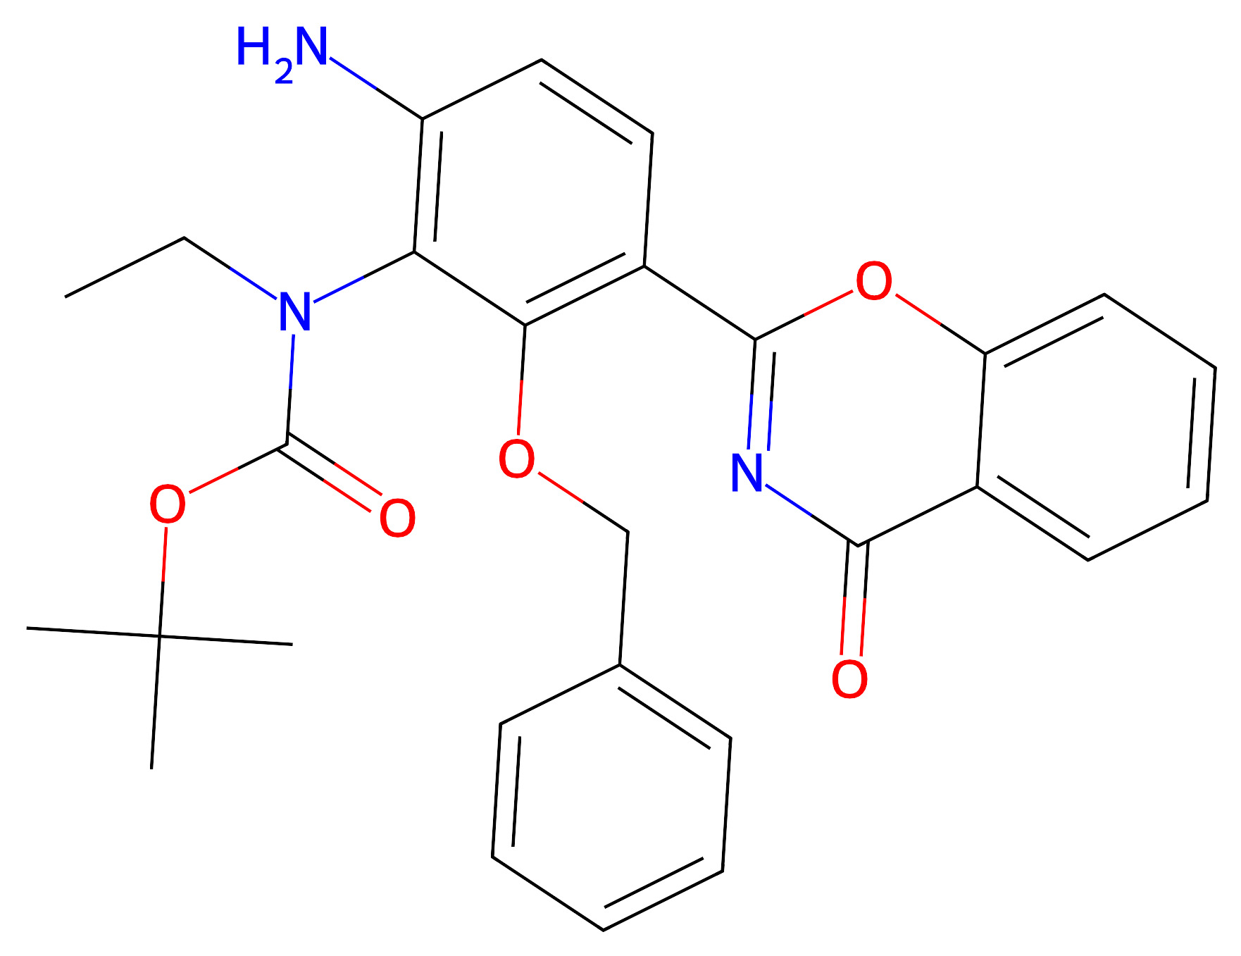
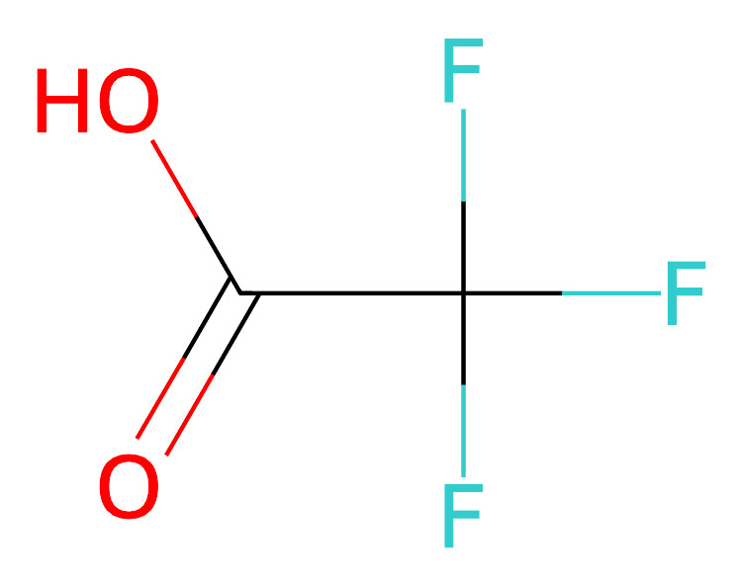
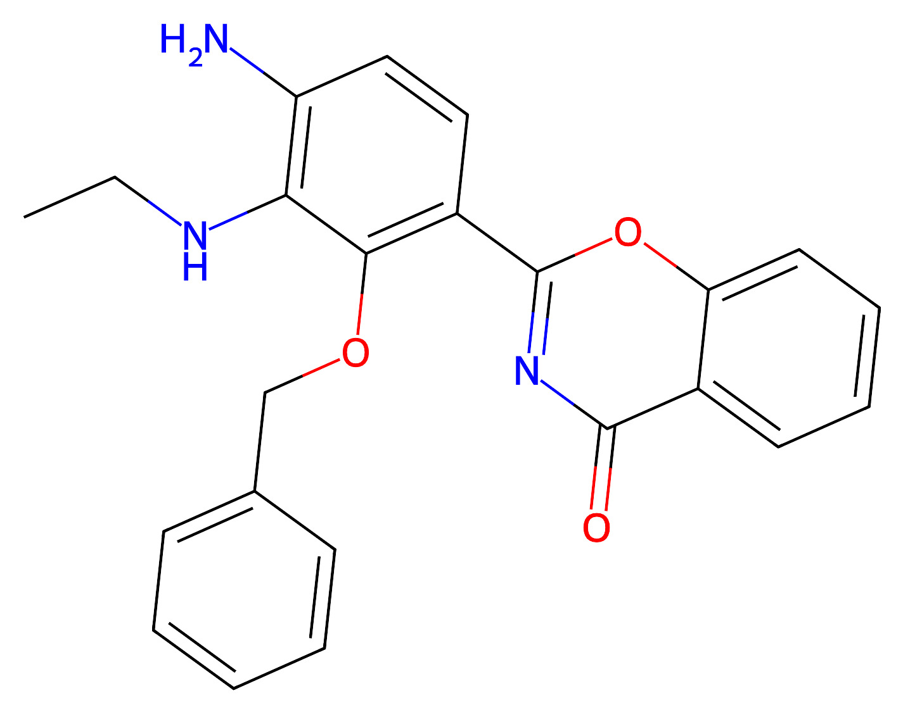
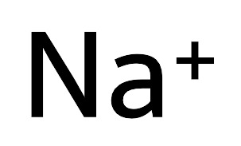
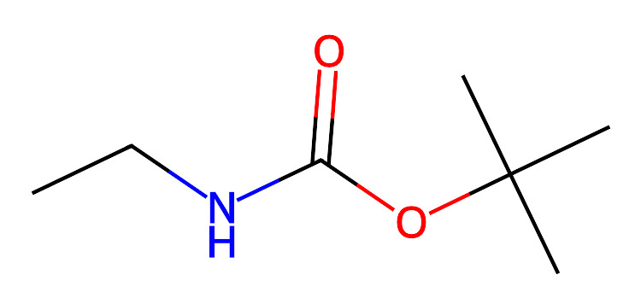
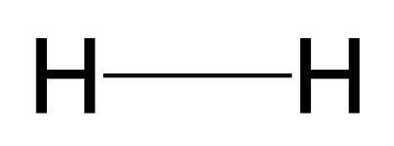
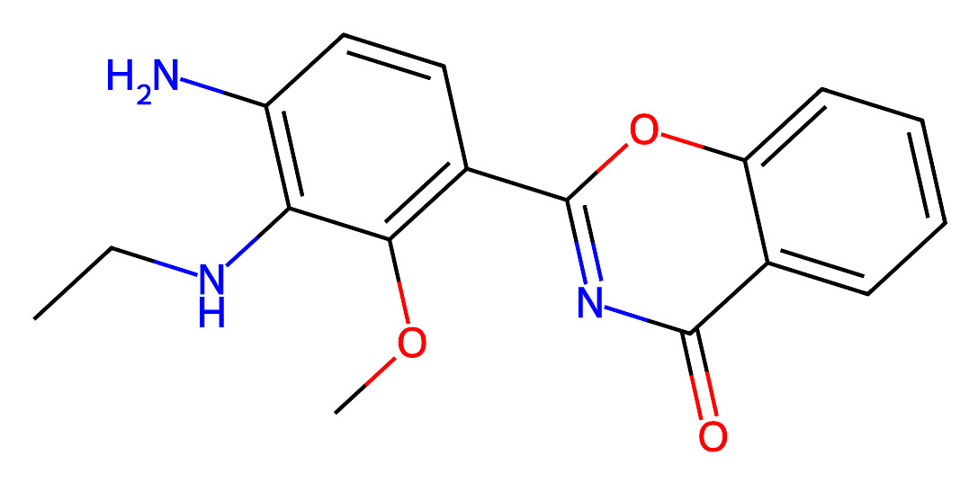
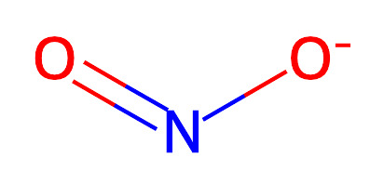
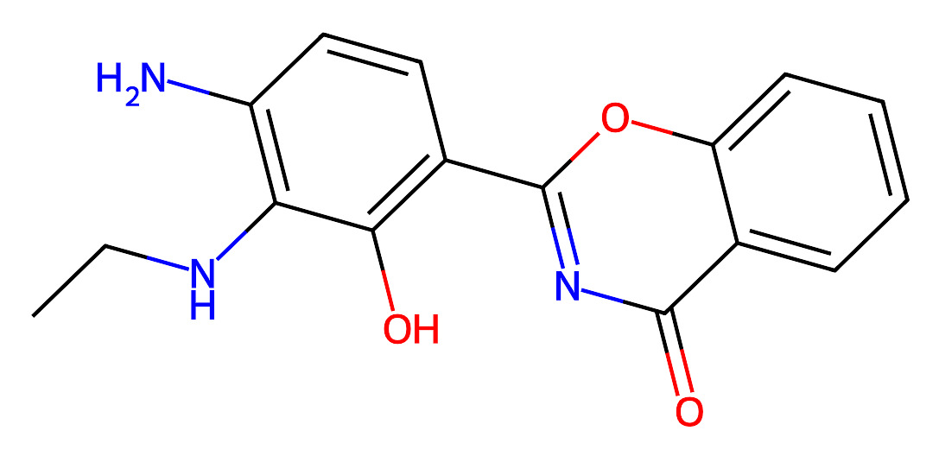

Route6

Slide 5
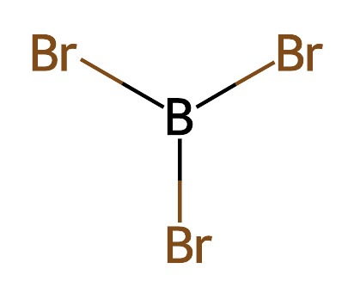
Route7
Route8

Slide 6
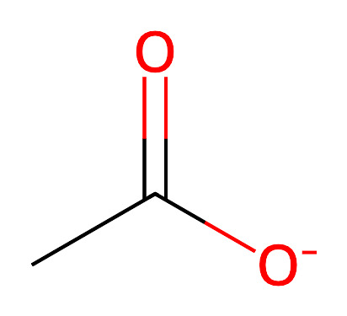
Route9
Route13

Slide 7
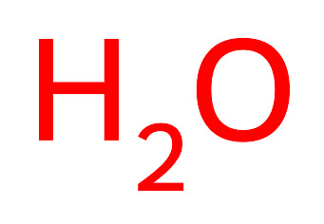
Route15
Route16

Slide 8
Route17

Slide 9
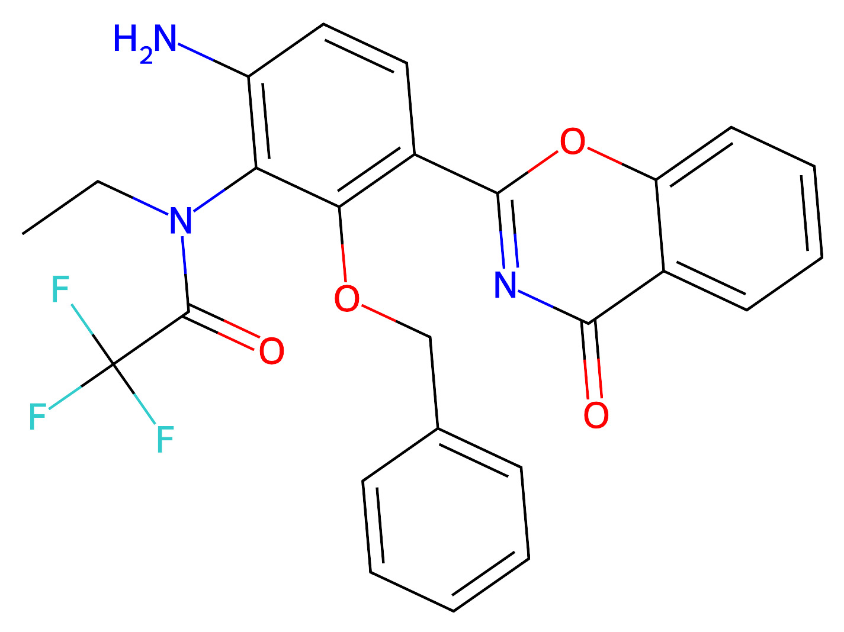
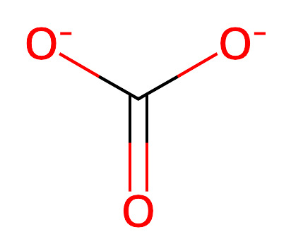
Route18

Slide 10

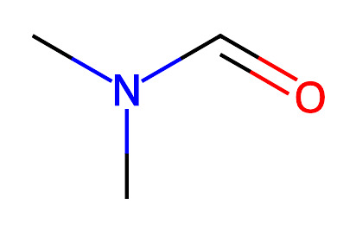
Route23
Route25
Route26

Slide 11
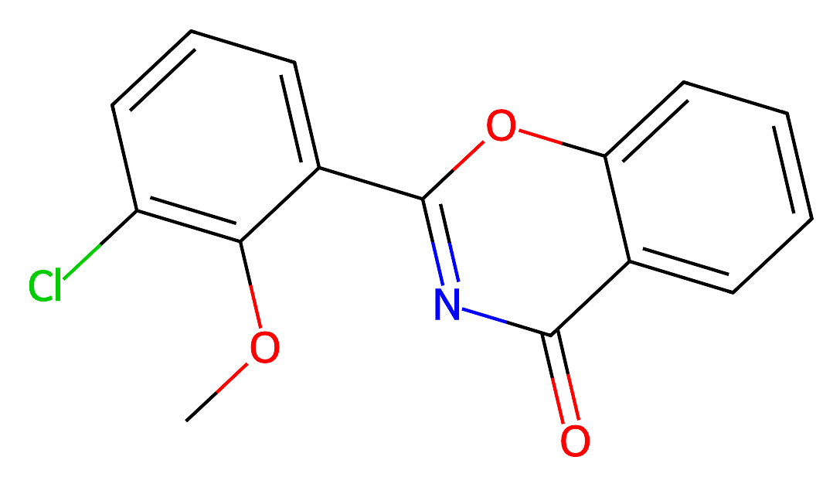

Route27
Route28

Slide 12

Route29
Route30

Slide 13

Route32
Route33

Slide 14

Route35
Route37
Route38

Slide 15
Route39
Route40

Slide 16
Route41
Route43
Route44

Slide 17
Route45
Route46

Slide 18
Route47
Route48

Slide 19
Route56
Route61

Slide 20
Route62
Route66

Slide 21
Route68
Route73
Route74

Slide 22
Route75
Route76
Route78

Slide 23
Route79
Route80

Slide 24
Route81
Route82

Slide 25
Route87
Route89
Route91

Slide 26
Route92
Route95

Slide 27
Route100

