Slide 1
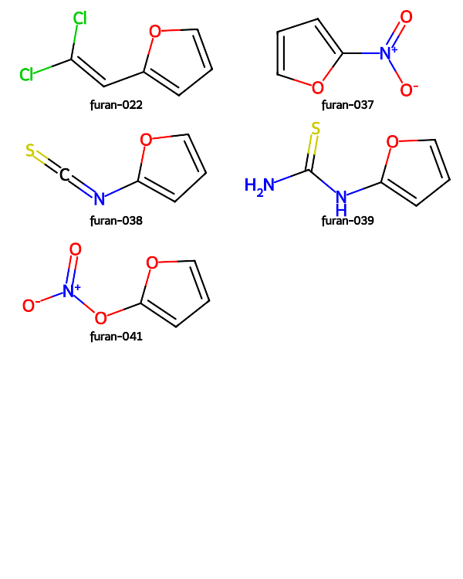
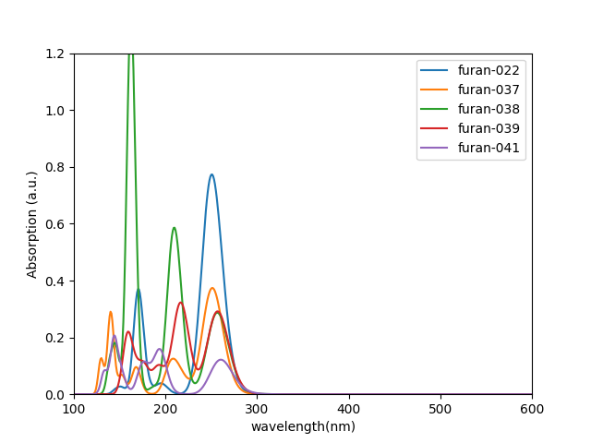
 | HOMO (eV) | LUMO (eV) | gap (eV) | λmax(nm)
furan-022 | -7.7825 | 0.7738 | 8.5563 | 251.0
furan-037 | -9.4839 | 0.9206 | 10.4045 | 404.0,251.0
furan-038 | -7.7896 | -0.0037 | 7.7859 | 257.0
furan-039 | -6.9318 | 1.0502 | 7.9820 | 330.0,257.0
furan-041 | -8.6485 | 0.8174 | 9.4660 | 260.0

