Slide 1
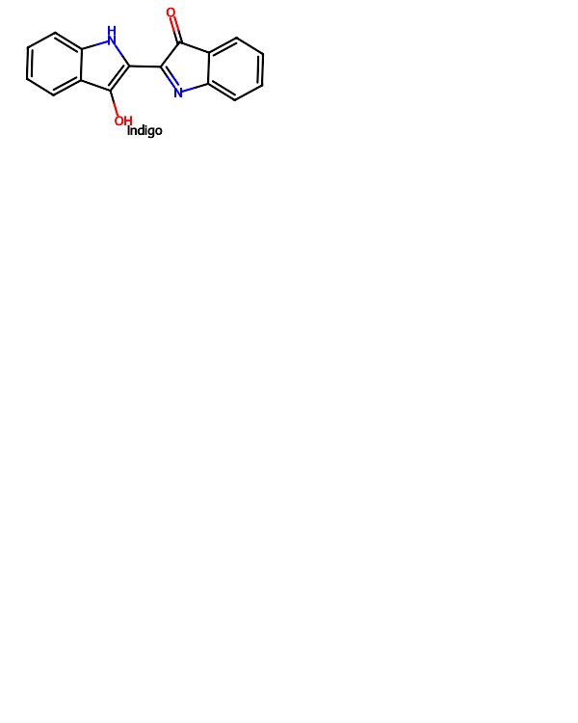
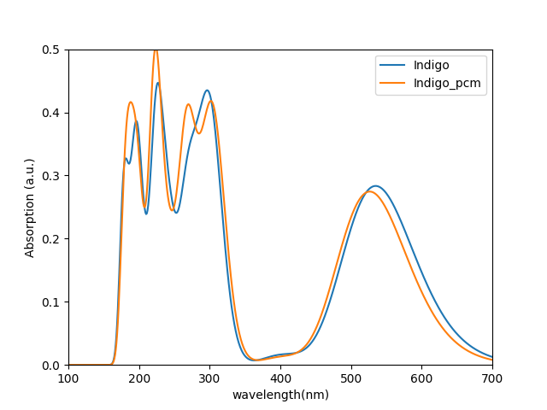
 | HOMO (eV) | LUMO (eV) | gap (eV) | λmax(nm)
Indigo | -6.8913 | -0.1628 | 6.7285 | 296.0
Indigo_pcm | -6.8965 | -0.1726 | 6.7239 | 302.0,270.0

