Slide 1
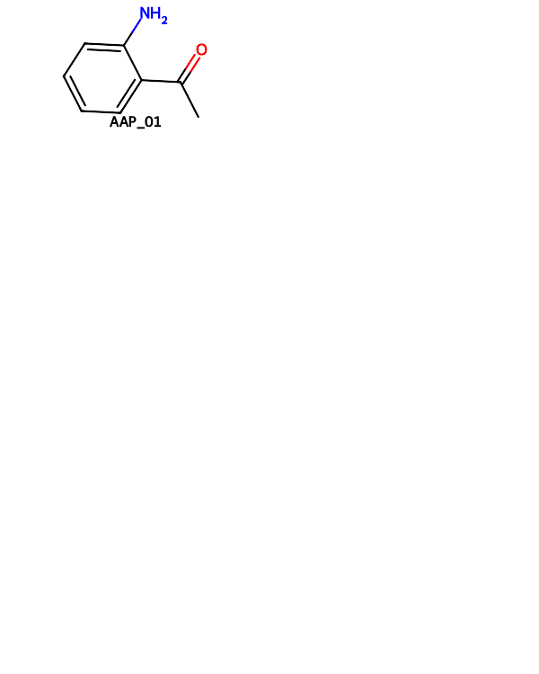
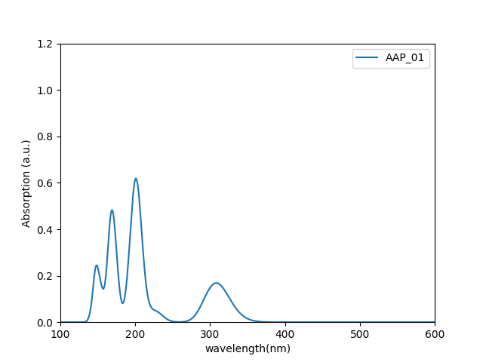
 | HOMO (eV) | LUMO (eV) | gap (eV) | λmax(nm)
AAP_01 | -7.1247 | 1.4239 | 8.5486 | 308.0

Slide 2


 | HOMO (eV) | LUMO (eV) | gap (eV) | λmax(nm)
AAP_02 | -7.1135 | 1.4295 | 8.5430 | 308.0

Slide 3

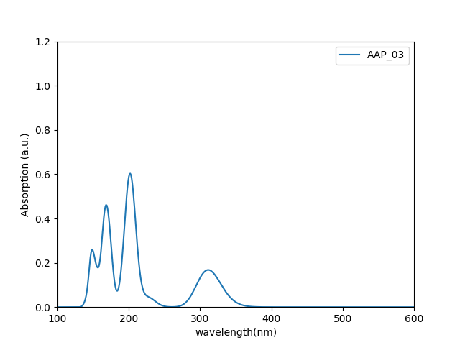
 | HOMO (eV) | LUMO (eV) | gap (eV) | λmax(nm)
AAP_03 | -7.0837 | 1.4455 | 8.5292 | 311.0

Slide 4


 | HOMO (eV) | LUMO (eV) | gap (eV) | λmax(nm)
AAP_04 | -7.0497 | 1.4655 | 8.5152 | 316.0

Slide 5

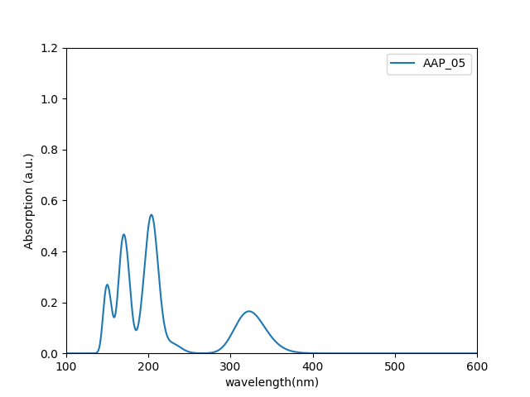
 | HOMO (eV) | LUMO (eV) | gap (eV) | λmax(nm)
AAP_05 | -7.0087 | 1.4923 | 8.5010 | 323.0

Slide 6

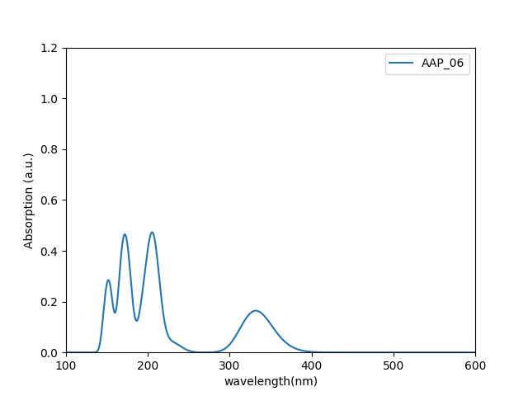
 | HOMO (eV) | LUMO (eV) | gap (eV) | λmax(nm)
AAP_06 | -6.9580 | 1.5300 | 8.4880 | 332.0

Slide 7

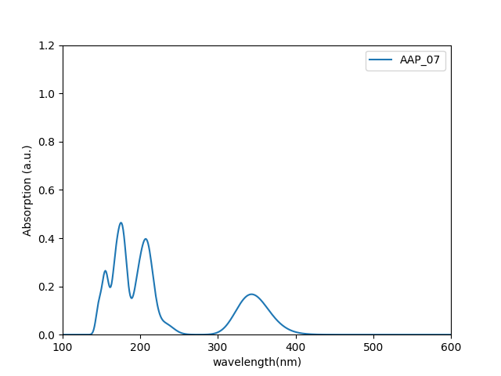
 | HOMO (eV) | LUMO (eV) | gap (eV) | λmax(nm)
AAP_07 | -6.9029 | 1.5811 | 8.4839 | 343.0

Slide 8


 | HOMO (eV) | LUMO (eV) | gap (eV) | λmax(nm)
AAP_08 | -6.8658 | 1.6323 | 8.4980 | 351.0

Slide 9

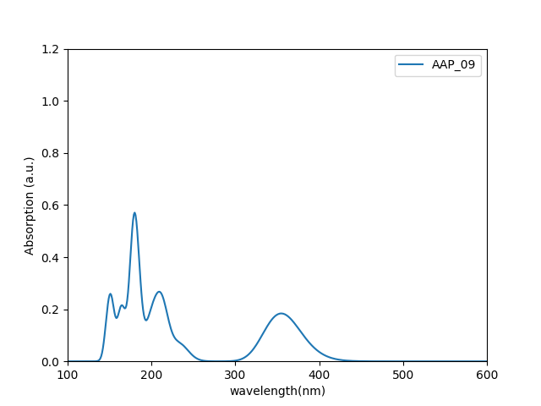
 | HOMO (eV) | LUMO (eV) | gap (eV) | λmax(nm)
AAP_09 | -6.8507 | 1.6702 | 8.5209 | 355.0

Slide 10

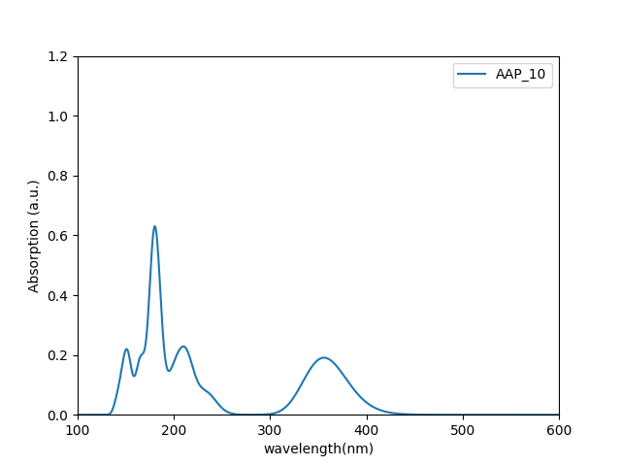
 | HOMO (eV) | LUMO (eV) | gap (eV) | λmax(nm)
AAP_10 | -6.8447 | 1.6975 | 8.5422 | 356.0

Slide 11

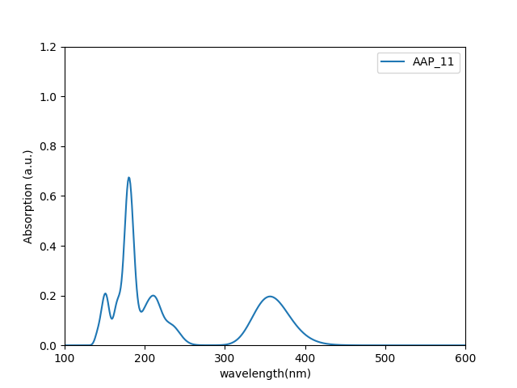
 | HOMO (eV) | LUMO (eV) | gap (eV) | λmax(nm)
AAP_11 | -6.8418 | 1.7184 | 8.5602 | 356.0

Slide 12


 | HOMO (eV) | LUMO (eV) | gap (eV) | λmax(nm)
AAP_12 | -6.8395 | 1.7356 | 8.5751 | 356.0

Slide 13


 | HOMO (eV) | LUMO (eV) | gap (eV) | λmax(nm)
AAP_13 | -6.8376 | 1.7503 | 8.5879 | 356.0

Slide 14


 | HOMO (eV) | LUMO (eV) | gap (eV) | λmax(nm)
AAP_14 | -6.8352 | 1.7633 | 8.5985 | 356.0

Slide 15


 | HOMO (eV) | LUMO (eV) | gap (eV) | λmax(nm)
AAP_15 | -6.8330 | 1.7751 | 8.6081 | 356.0

Slide 16


 | HOMO (eV) | LUMO (eV) | gap (eV) | λmax(nm)
AAP_16 | -6.8302 | 1.7860 | 8.6163 | 356.0,279.0

Slide 17

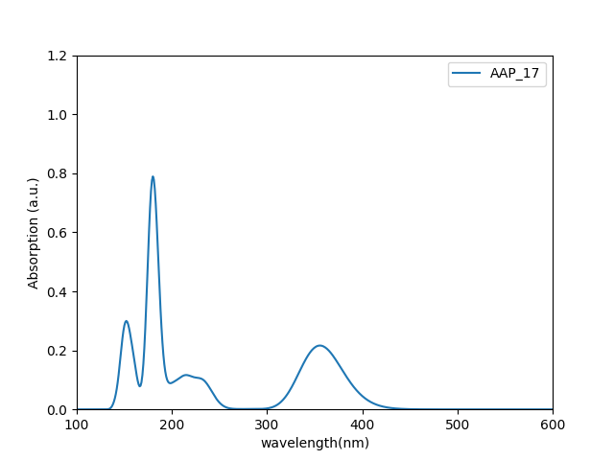
 | HOMO (eV) | LUMO (eV) | gap (eV) | λmax(nm)
AAP_17 | -6.8273 | 1.7961 | 8.6233 | 356.0,281.0

Slide 18

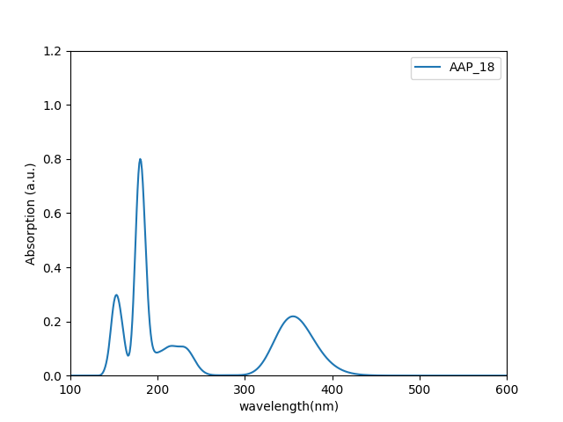
 | HOMO (eV) | LUMO (eV) | gap (eV) | λmax(nm)
AAP_18 | -6.8251 | 1.8062 | 8.6313 | 355.0,282.0

Slide 19


 | HOMO (eV) | LUMO (eV) | gap (eV) | λmax(nm)
AAP_19 | -6.8214 | 1.8147 | 8.6361 | 355.0

Slide 20


 | HOMO (eV) | LUMO (eV) | gap (eV) | λmax(nm)
AAP_20 | -6.8182 | 1.8233 | 8.6415 | 354.0

Slide 21


 | HOMO (eV) | LUMO (eV) | gap (eV) | λmax(nm)
AAP_21 | -6.8152 | 1.8314 | 8.6466 | 354.0

Slide 22

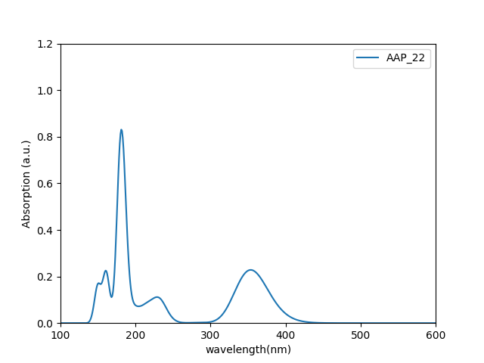
 | HOMO (eV) | LUMO (eV) | gap (eV) | λmax(nm)
AAP_22 | -6.8117 | 1.8390 | 8.6507 | 354.0

