Slide 1
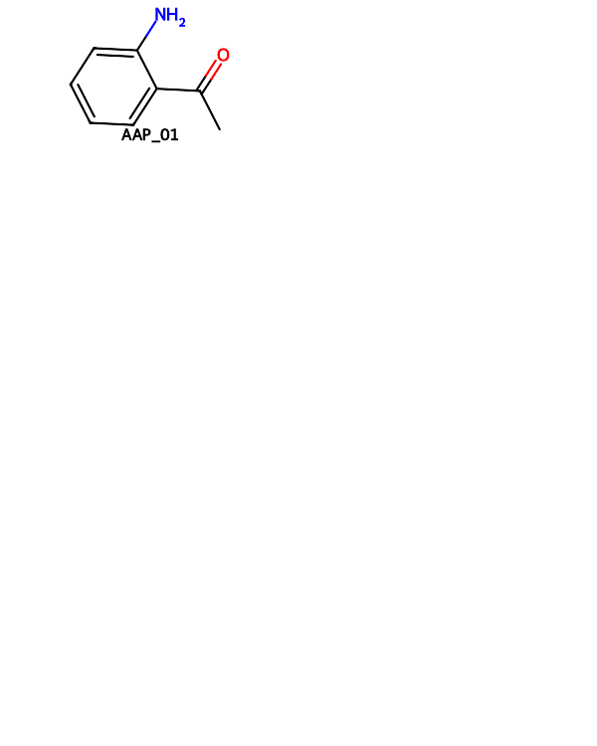
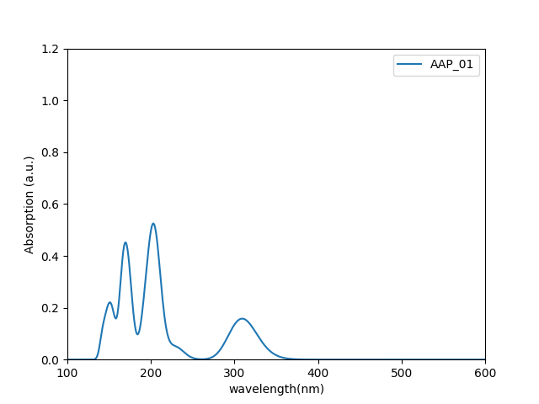
 | HOMO (eV) | LUMO (eV) | gap (eV) | λmax(nm)
AAP_01 | -7.1166 | 1.3966 | 8.5132 | 309.0

Slide 2


 | HOMO (eV) | LUMO (eV) | gap (eV) | λmax(nm)
AAP_02 | -7.1170 | 1.4027 | 8.5197 | 309.0

Slide 3


 | HOMO (eV) | LUMO (eV) | gap (eV) | λmax(nm)
AAP_03 | -7.1146 | 1.4077 | 8.5224 | 310.0

Slide 4


 | HOMO (eV) | LUMO (eV) | gap (eV) | λmax(nm)
AAP_04 | -7.1068 | 1.4104 | 8.5172 | 311.0

Slide 5


 | HOMO (eV) | LUMO (eV) | gap (eV) | λmax(nm)
AAP_05 | -7.1000 | 1.4142 | 8.5142 | 313.0

Slide 6

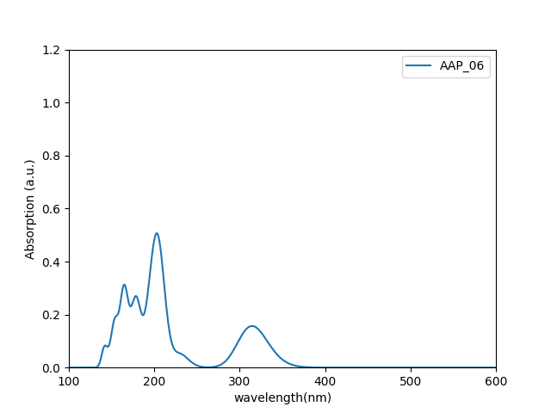
 | HOMO (eV) | LUMO (eV) | gap (eV) | λmax(nm)
AAP_06 | -7.0908 | 1.4190 | 8.5098 | 315.0

Slide 7

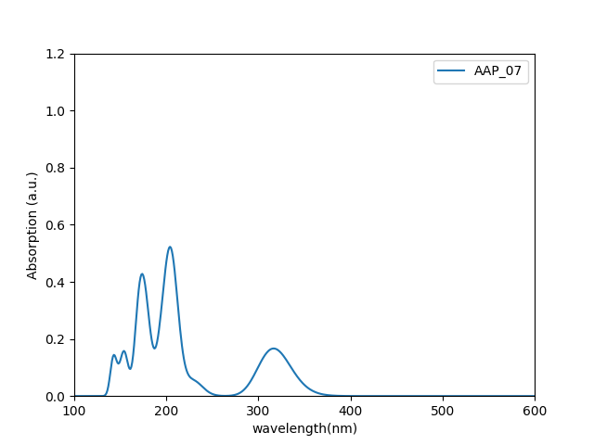
 | HOMO (eV) | LUMO (eV) | gap (eV) | λmax(nm)
AAP_07 | -7.0953 | 1.3823 | 8.4776 | 317.0

Slide 8


 | HOMO (eV) | LUMO (eV) | gap (eV) | λmax(nm)
AAP_08 | -7.0944 | 1.3823 | 8.4767 | 318.0

Slide 9

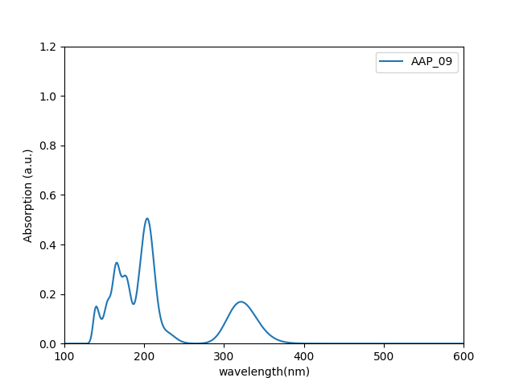
 | HOMO (eV) | LUMO (eV) | gap (eV) | λmax(nm)
AAP_09 | -7.0522 | 1.4129 | 8.4651 | 321.0

Slide 10

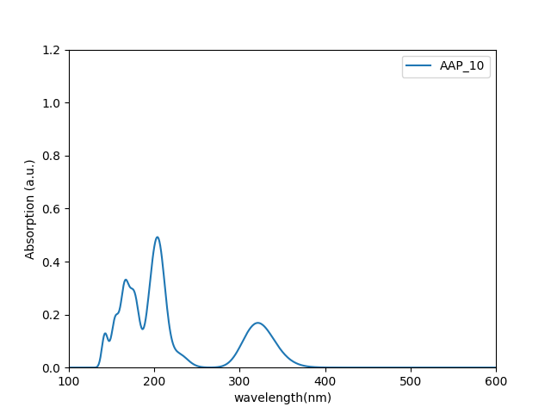
 | HOMO (eV) | LUMO (eV) | gap (eV) | λmax(nm)
AAP_10 | -7.0690 | 1.4111 | 8.4801 | 321.0

Slide 11

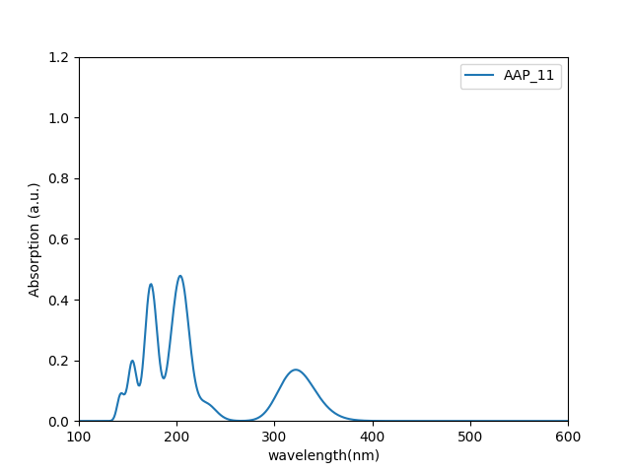
 | HOMO (eV) | LUMO (eV) | gap (eV) | λmax(nm)
AAP_11 | -7.0789 | 1.4120 | 8.4909 | 322.0

Slide 12


 | HOMO (eV) | LUMO (eV) | gap (eV) | λmax(nm)
AAP_12 | -7.0780 | 1.4166 | 8.4945 | 323.0

Slide 13


 | HOMO (eV) | LUMO (eV) | gap (eV) | λmax(nm)
AAP_13 | -7.0579 | 1.4282 | 8.4861 | 327.0

Slide 14


 | HOMO (eV) | LUMO (eV) | gap (eV) | λmax(nm)
AAP_14 | -6.9526 | 1.5795 | 8.5321 | 328.0

Slide 15


 | HOMO (eV) | LUMO (eV) | gap (eV) | λmax(nm)
AAP_15 | -6.9779 | 1.5764 | 8.5542 | 325.0

Slide 16


 | HOMO (eV) | LUMO (eV) | gap (eV) | λmax(nm)
AAP_16 | -6.9919 | 1.5761 | 8.5680 | 323.0

Slide 17

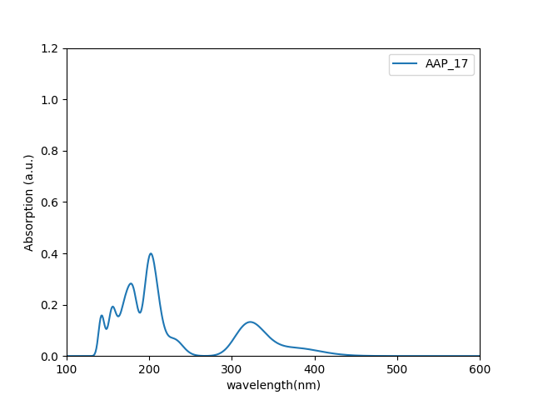
 | HOMO (eV) | LUMO (eV) | gap (eV) | λmax(nm)
AAP_17 | -6.9833 | 1.5840 | 8.5673 | 322.0

Slide 18


 | HOMO (eV) | LUMO (eV) | gap (eV) | λmax(nm)
AAP_18 | -6.9426 | 1.6089 | 8.5514 | 324.0

Slide 19

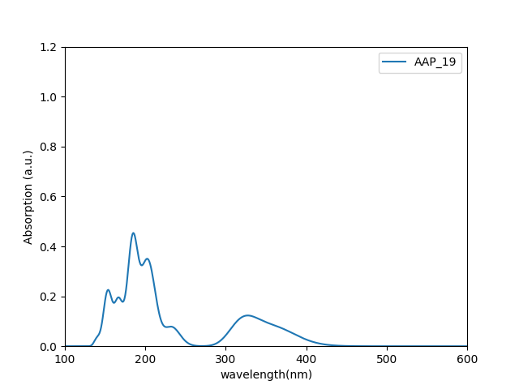
 | HOMO (eV) | LUMO (eV) | gap (eV) | λmax(nm)
AAP_19 | -6.9266 | 1.6226 | 8.5492 | 327.0

Slide 20

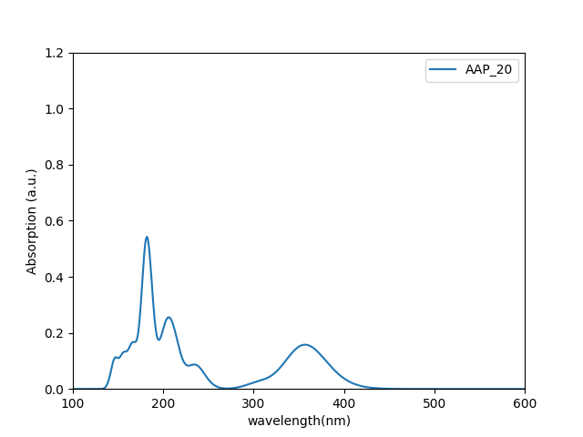
 | HOMO (eV) | LUMO (eV) | gap (eV) | λmax(nm)
AAP_20 | -6.8464 | 1.6639 | 8.5103 | 357.0

Slide 21


 | HOMO (eV) | LUMO (eV) | gap (eV) | λmax(nm)
AAP_21 | -6.7752 | 1.7049 | 8.4802 | 364.0,293.0

Slide 22

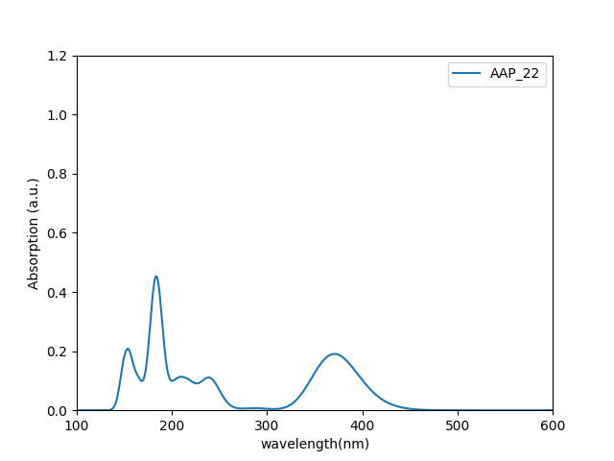
 | HOMO (eV) | LUMO (eV) | gap (eV) | λmax(nm)
AAP_22 | -6.7272 | 1.7327 | 8.4599 | 371.0,287.0

