Slide 1
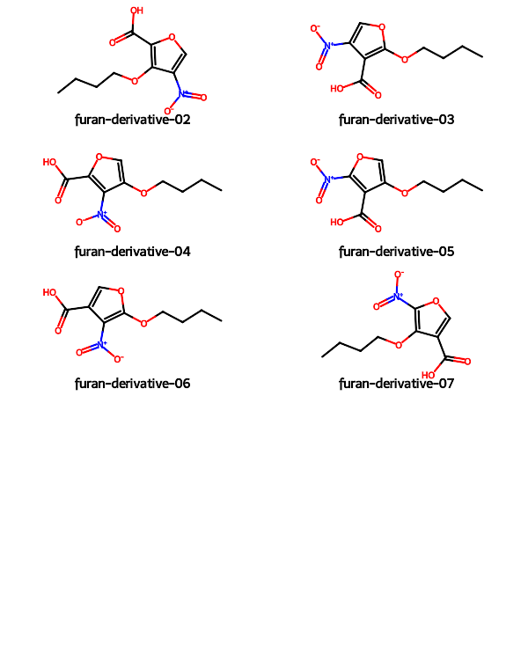
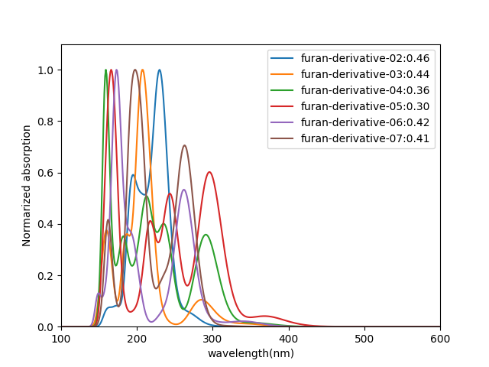
 | HOMO (eV) | LUMO (eV) | gap (eV) | λmax(nm)
furan-derivative-02 | -9.0728 | -1.0329 | 8.0398
furan-derivative-03 | -8.4279 | 0.2201 | 8.6480 | 285.0
furan-derivative-04 | -8.7432 | -0.2186 | 8.5246 | 291.0
furan-derivative-05 | -8.7822 | 0.2406 | 9.0228 | 368.0,296.0
furan-derivative-06 | -8.4348 | -0.3928 | 8.0421 | 339.0,262.0
furan-derivative-07 | -9.3206 | -0.8555 | 8.4650 | 263.0

Slide 2
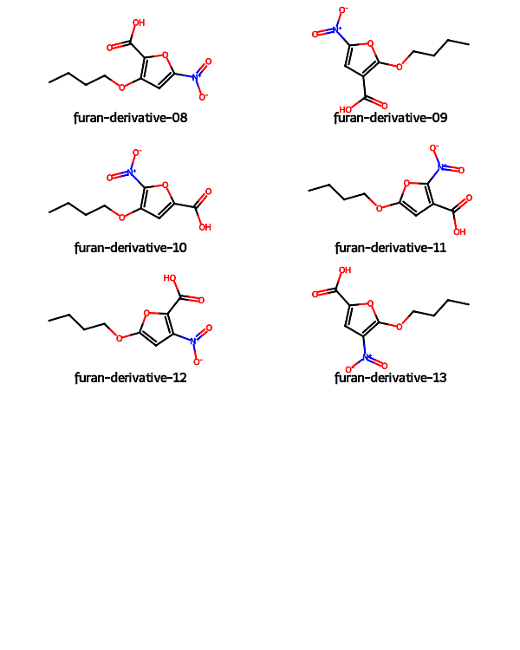
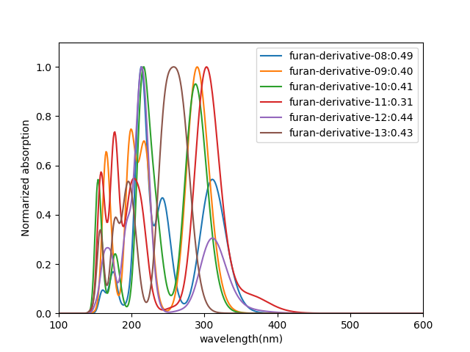
 | HOMO (eV) | LUMO (eV) | gap (eV) | λmax(nm)
furan-derivative-08 | -8.7584 | -0.1269 | 8.6315 | 311.0
furan-derivative-09 | -8.6095 | -0.1458 | 8.4637 | 290.0
furan-derivative-10 | -8.9181 | -0.3989 | 8.5192 | 288.0
furan-derivative-11 | -8.5418 | 0.3550 | 8.8967 | 303.0
furan-derivative-12 | -8.5531 | -0.0225 | 8.5305 | 311.0
furan-derivative-13 | -8.7000 | -0.8830 | 7.8169 | 258.0

