Slide 1

ALICE 13TeV
$\frac{1}{N_{trig}}\frac{d^{2}N_{pair}}{dΔηdΔφ}={\left.B\left(0,0\right)\frac{S\left(Δη,Δφ\right)}{B\left(Δη,Δφ\right)}\right|}_{p_{T, trig} , p_{T, assoc}}$ (3.1)
$\frac{1}{N_{trig}}\frac{dN_{pair}}{dΔφ}=\int_{1.6<\left|Δ η\right|<1.8}{\left(\frac{1}{N_{trig}}\frac{d^{2}N_{pair}}{dΔηdΔφ}\right)\frac{1}{δ_{Δη}}dΔη −C_{ZYAM}} (3.2)$
$δ_{Δη}=2×\left(1.8−1.6\right)=0.4 →$ normalization factor
$Y^{ridge}=\int_{\left|Δ φ\right|<\left|Δ φ_{min}\right|}{\frac{1}{N_{trig}}\frac{dN_{pair }}{dΔφ}dΔφ} (3.3)$
The minimum yield($C_{ZYAM}$) at $Δφ=Δφ_{min}$
Near-side : $\left|Δ φ\right|<1.28 →$(3.4) 위
$Y^{near} →$near-side jet-like peak yield

Slide 2

CMS, ALICE
Long-range : ALICE $→ 1.6<\left|Δ η\right|<1.8$
CMS $→ 2 <\left|Δ η\right|< 4$
High multiplicity : ALICE $→0\sim 0.1\%$
CMS $→ N_{trk}^{offline}≥105 →0\sim 0.03\%$
지금까지 CMS의 $Δ φ$ Correlation을 그릴 때에, 그냥 적분을 하였음.
ALICE의 (3.2)의 식을 이용하여 적분하여 다시 그려봐야 함.($δ_{Δη}$)
CMS의 $C_{ZYAM}$은 있지만, ALICE는 $C_{ZYAM}$이 없어 $1<p_{t}<4을$ 그릴 수 없음.

Slide 3
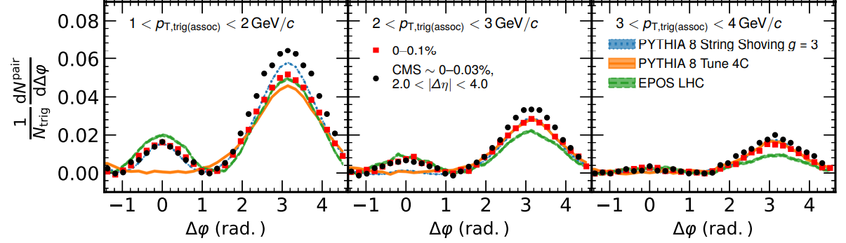
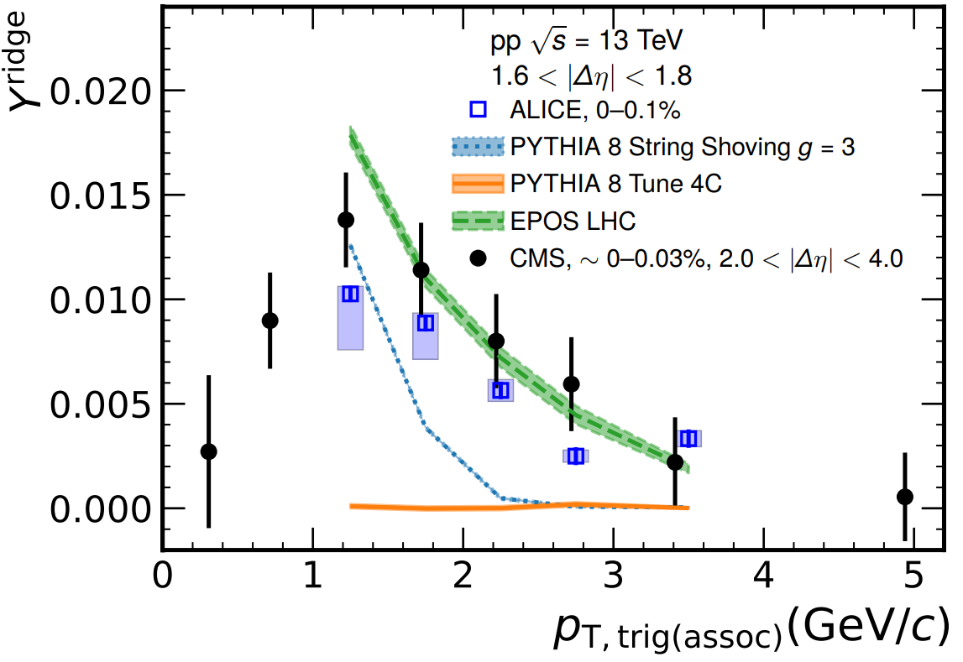

현재 계산식
$Δφ$Correlation : $\frac{1}{N_{trig}}\frac{dN_{pair}}{dΔφ}=\int_{1.6<\left|Δ η\right|<1.8}{\left[\int{\left(\frac{d^{2}F}{p_{T}dp_{T}dΔηdΔφ}\right)}\frac{1}{δ_{Δη}}p_{T}dp_{T}\right]dΔη −C_{ZYAM}}$
$Y^{ridge}=\int_{−1.28<\left|Δ φ\right|<1.28}{\left[\int_{1.6<\left|Δ η\right|<1.8}{\left(\int{\frac{d^{2}F}{p_{T}dp_{T}dΔηdΔφ}} p_{T}dp_{T}\right)\frac{1}{δ_{Δη}}dΔη}\right]dΔφ }$

Slide 4
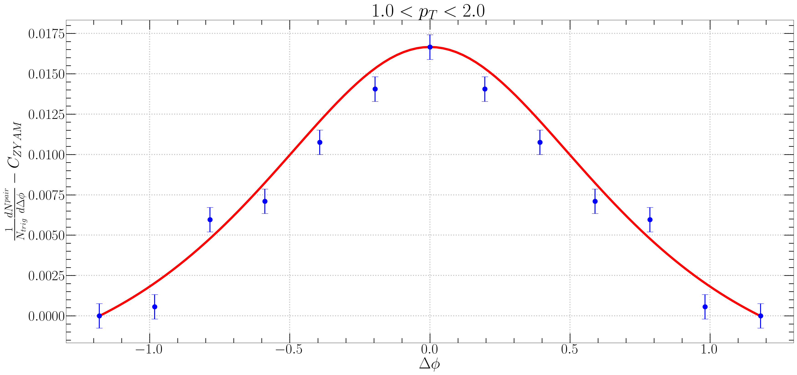
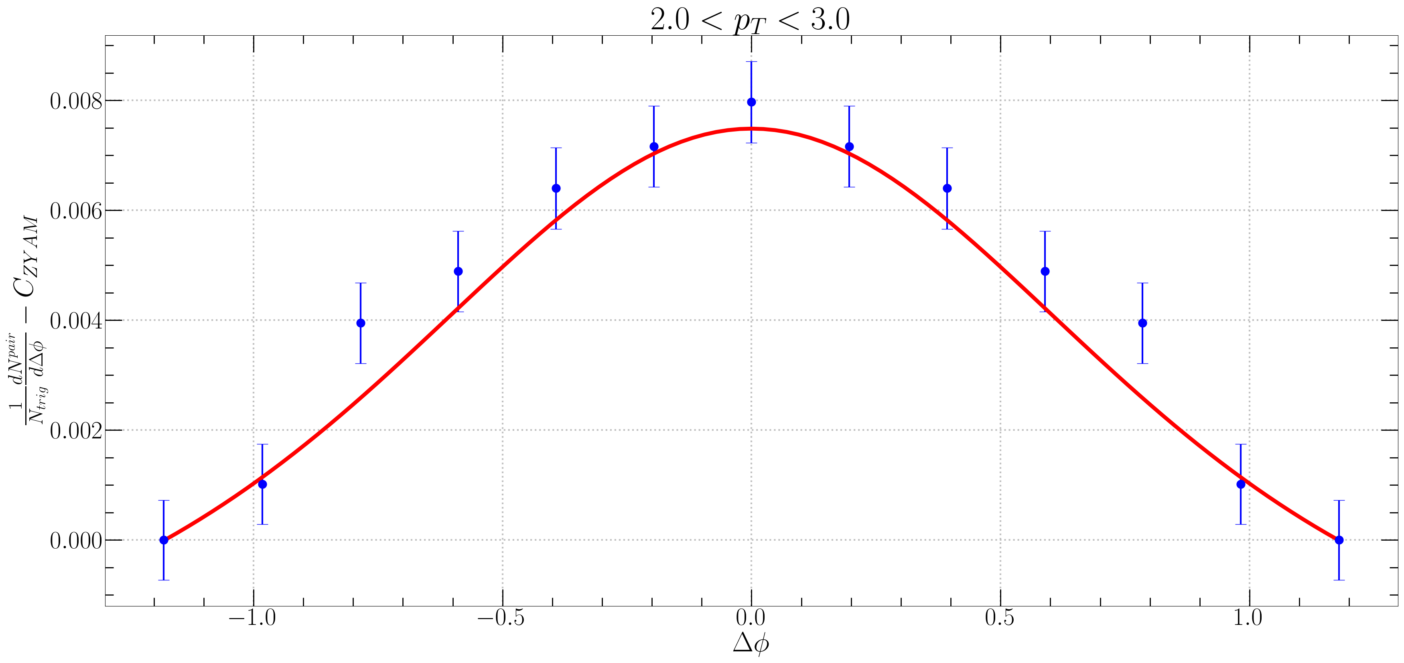
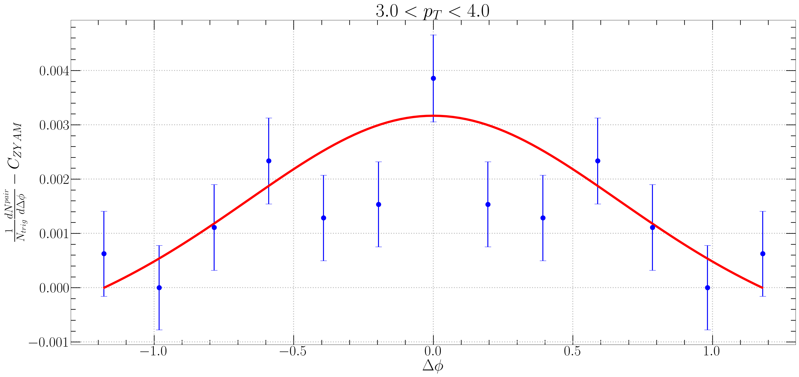
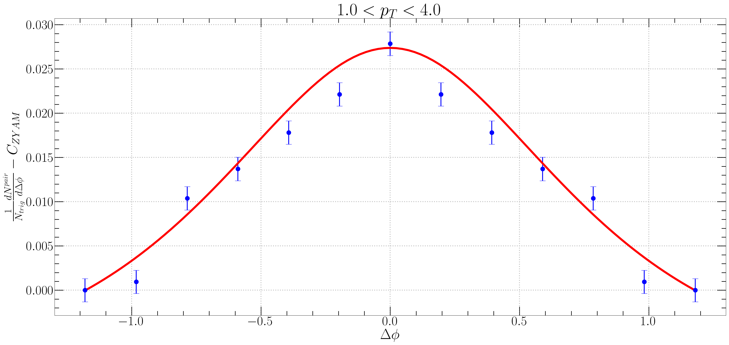

CMS
$f_{R}<N_{k}> =0.62e^{1.07p_{T}}$

Slide 5
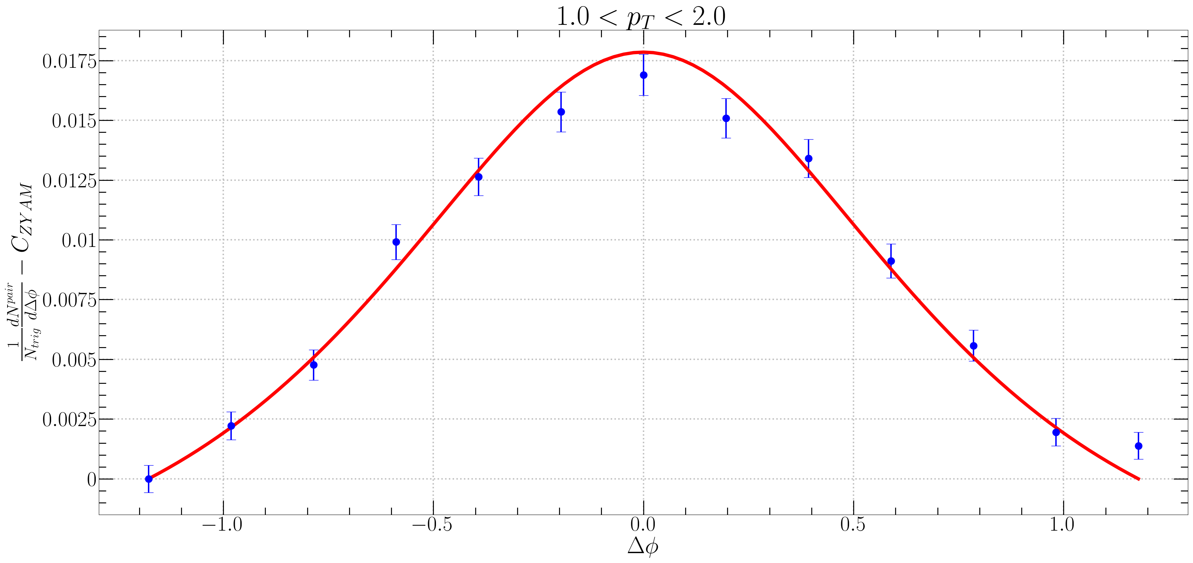
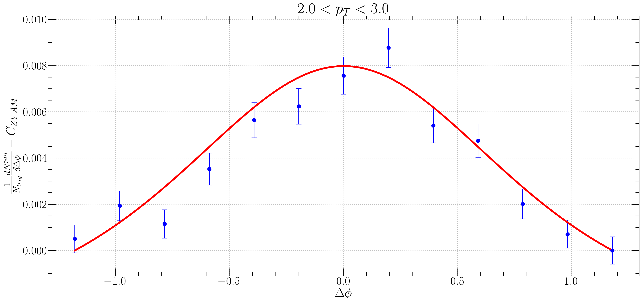
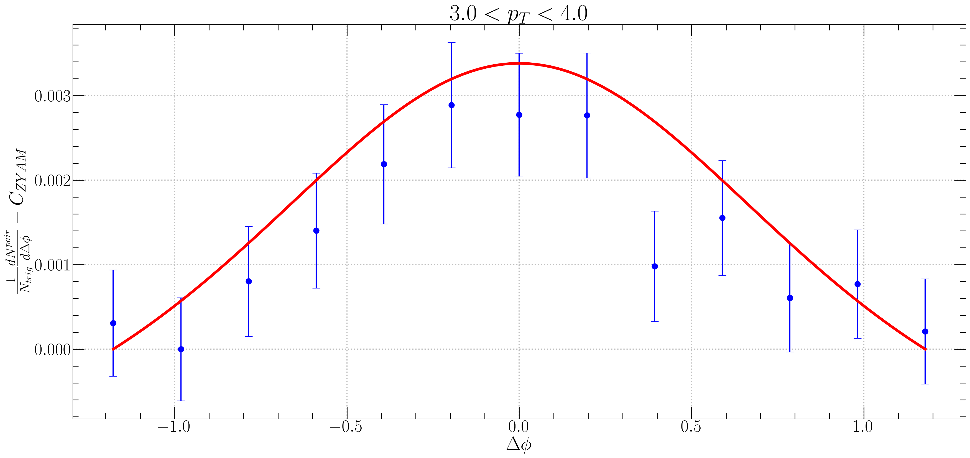

ALICE
$f_{R}<N_{k}> =0.62e^{1.07p_{T}}$

Slide 6
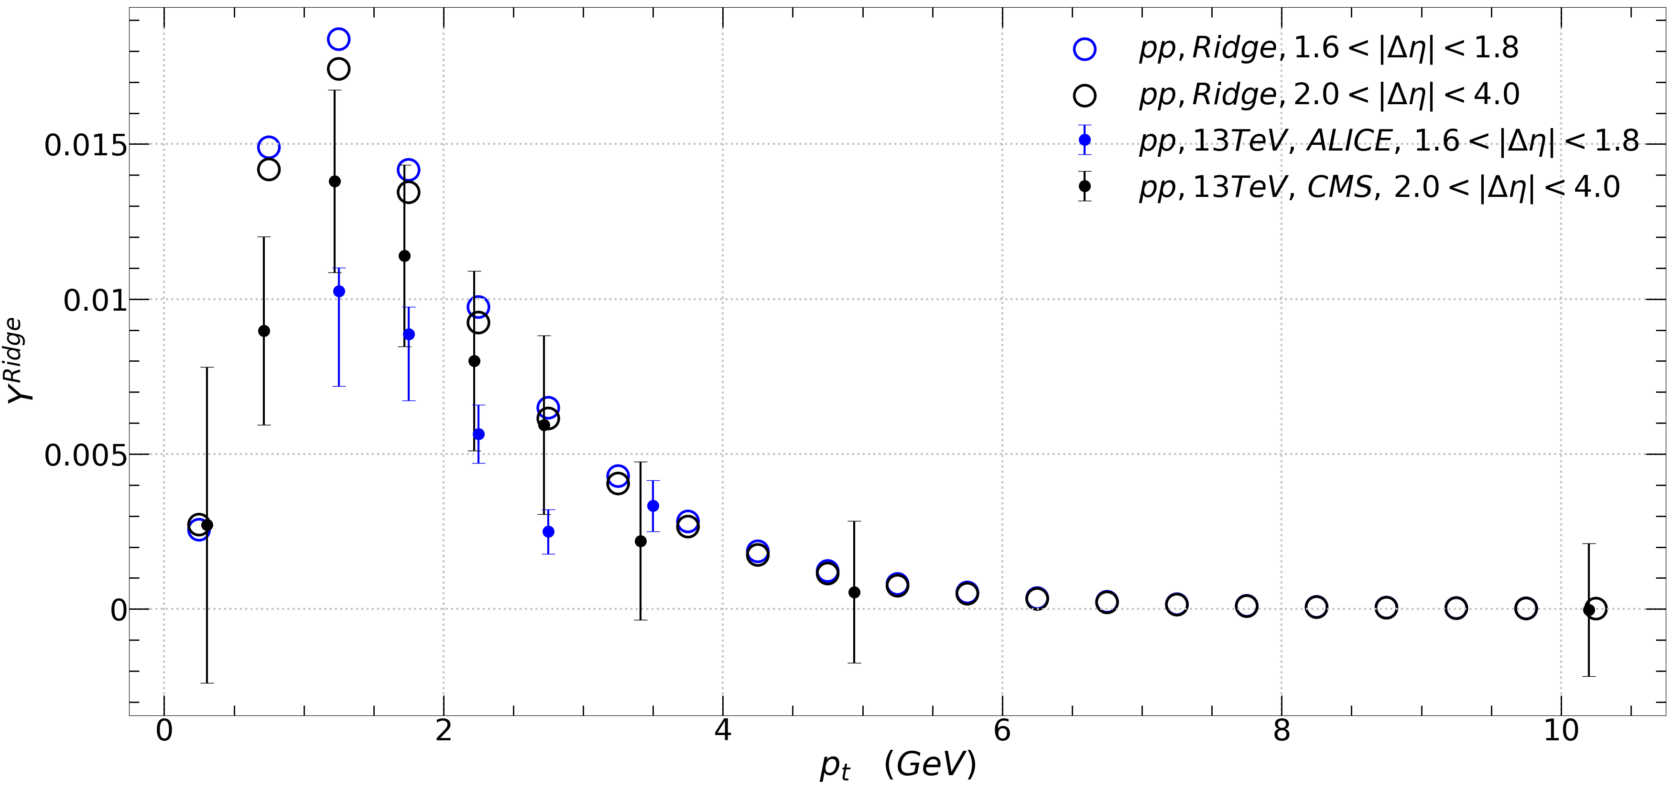

$$Y^{Ridge}$$
$$a=8 \\ T=0.55 GeV \\ q=0.7 GeV \\ m_{d}=0.9 GeV \\ \sqrt{S_{nn}}=13000 GeV \\ A_{ridge}=0.0507517$$
$f_{R}<N_{k}> =0.62e^{1.07p_{T}}$

Slide 7
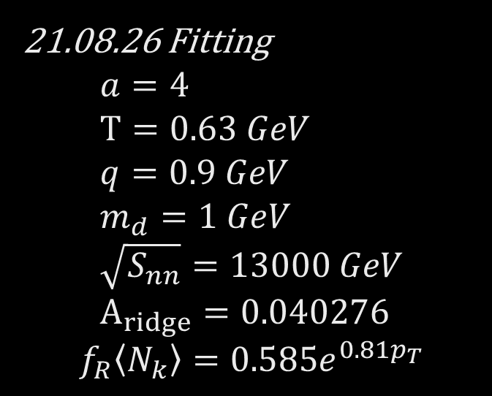

21.08.26 Fitting $$a=4 \\ T=0.63 GeV \\ q=0.9 GeV \\ m_{d}=1 GeV \\ \sqrt{S_{nn}}=13000 GeV \\ A_{ridge}=0.040276$$
$$f_{R}\left\langle N_{k}\right\rangle =0.585e^{0.81p_{T}}$$
$$a=8 \\ T=0.55 GeV \\ q=0.7 GeV \\ m_{d}=0.9 GeV \\ \sqrt{S_{nn}}=13000 GeV \\ A_{ridge}=0.0507517$$
$$f_{R}\left\langle N_{k}\right\rangle =0.62e^{1.07p_{T}}$$

Slide 8

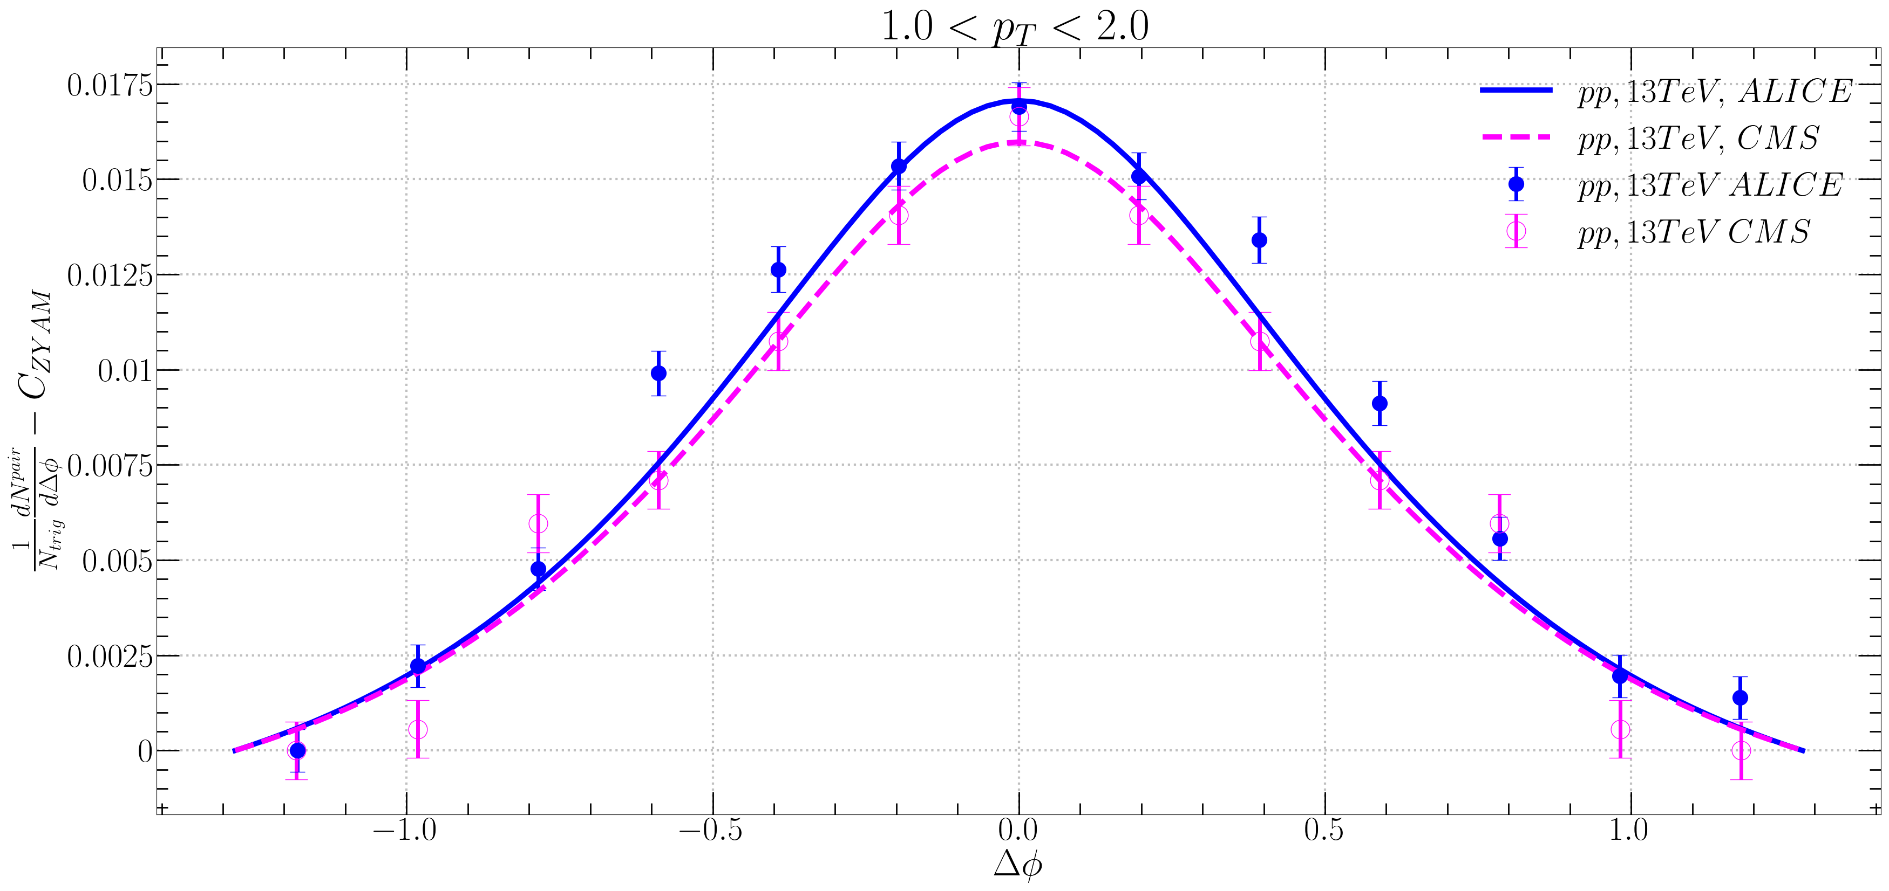

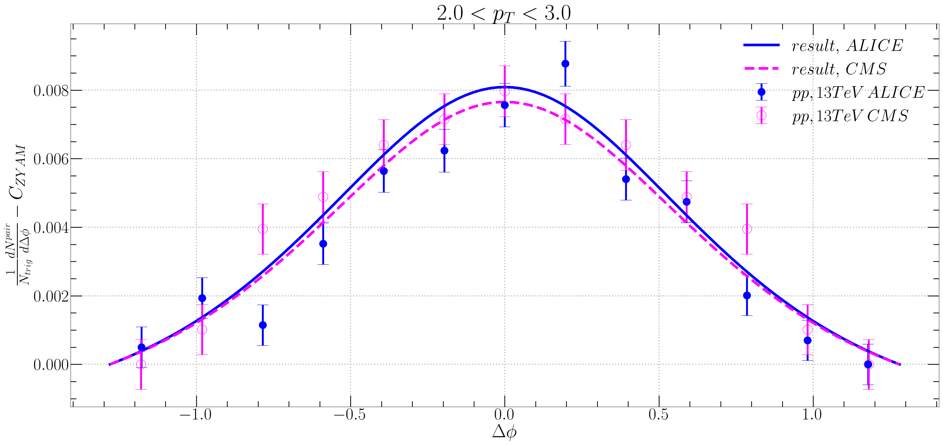


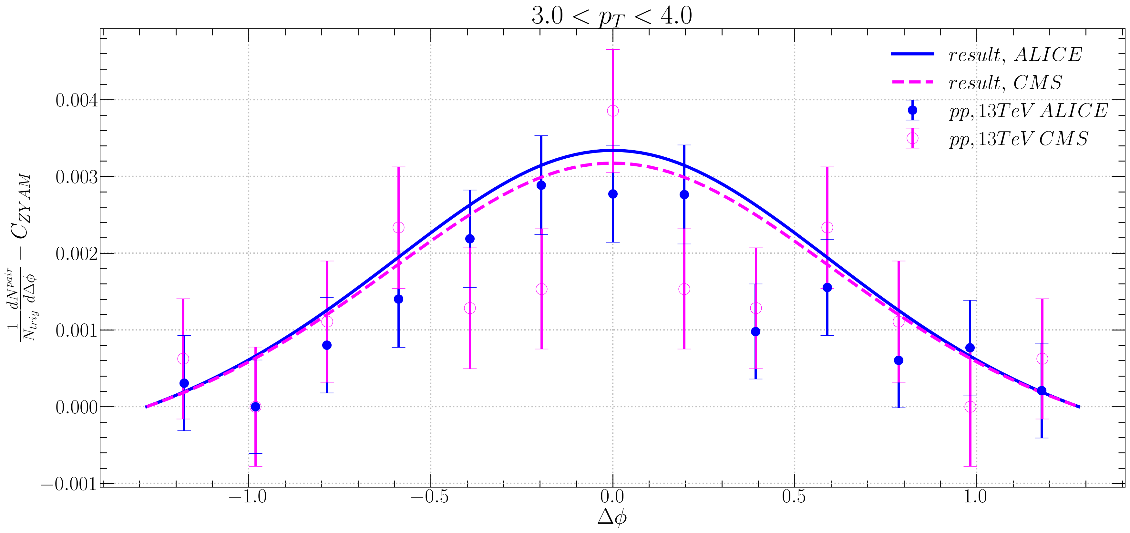




21.08.26 Fitting $$a=4 \\ T=0.63 GeV \\ q=0.9 GeV \\ m_{d}=1 GeV \\ \sqrt{S_{nn}}=13000 GeV \\ A_{ridge}=0.040276$$
$Δφ$ Correlation
$f_{R}\left\langle N_{k}\right\rangle =0.585e^{0.81p_{T}}$

Slide 9
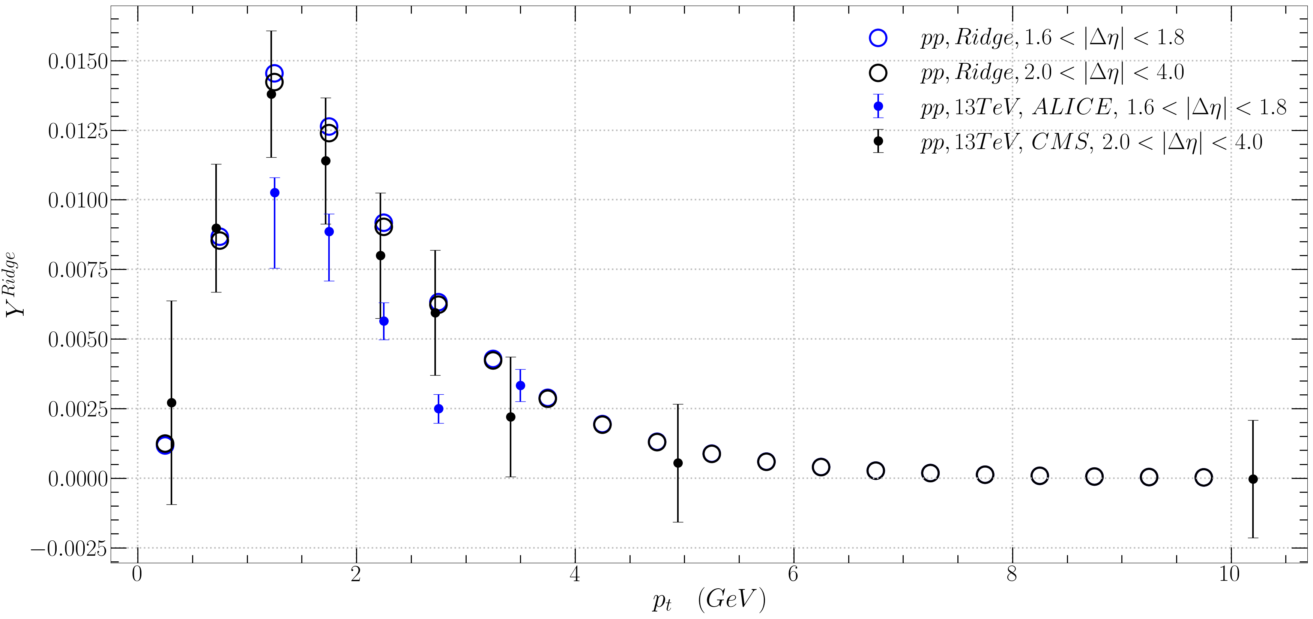
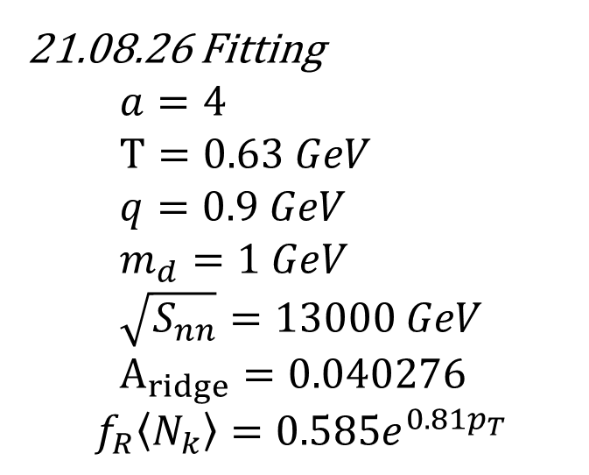
$$Y^{Ridge}$$
21.08.26 Fitting $$a=4 \\ T=0.63 GeV \\ q=0.9 GeV \\ m_{d}=1 GeV \\ \sqrt{S_{nn}}=13000 GeV \\ A_{ridge}=0.040276$$
$$f_{R}\left\langle N_{k}\right\rangle =0.585e^{0.81p_{T}}$$

Slide 12


$Y^{Ridge} →$ALICE
$$\frac{1}{N_{trig}}\frac{dN_{pair}}{dΔφ}=\int_{1.6<\left|Δ η\right|<1.8}{\left(\frac{1}{N_{trig}}\frac{d^{2}N_{pair}}{dΔηdΔφ}\right)\frac{1}{δ_{Δη}}dΔη −C_{ZYAM}} (3.2)$$
$$Y^{ridge}=\int_{\left|Δ φ\right|<\left|Δ φ_{min}\right|}{\frac{1}{N_{trig}}\frac{dN_{pair }}{dΔφ}dΔφ} (3.3)$$
$=\int_{\left|Δ φ\right|<\left|Δ φ_{min}\right|}{\left[\int_{1.6<\left|Δ η\right|<1.8}{\left(\frac{1}{N_{trig}}\frac{d^{2}N_{pair}}{dΔηdΔφ}\right)\frac{1}{δ_{Δη}}dΔη −C_{ZYAM}}\right]dΔφ}$

Slide 13


$Y^{Ridge} →$CMS
$$\frac{1}{N_{trig}}\frac{dN_{pair}}{dΔφ}=\int_{1.6<\left|Δ η\right|<1.8}{\left(\frac{1}{N_{trig}}\frac{d^{2}N_{pair}}{dΔηdΔφ}\right)\frac{1}{δ_{Δη}}dΔη −C_{ZYAM}} (3.2)$$
$$Y^{ridge}=\int_{\left|Δ φ\right|<\left|Δ φ_{min}\right|}{\frac{1}{N_{trig}}\frac{dN_{pair }}{dΔφ}dΔφ} (3.3)$$
$=\int_{\left|Δ φ\right|<\left|Δ φ_{min}\right|}{\left[\int_{1.6<\left|Δ η\right|<1.8}{\left(\frac{1}{N_{trig}}\frac{d^{2}N_{pair}}{dΔηdΔφ}\right)\frac{1}{δ_{Δη}}dΔη }\right]dΔφ}$

Slide 14
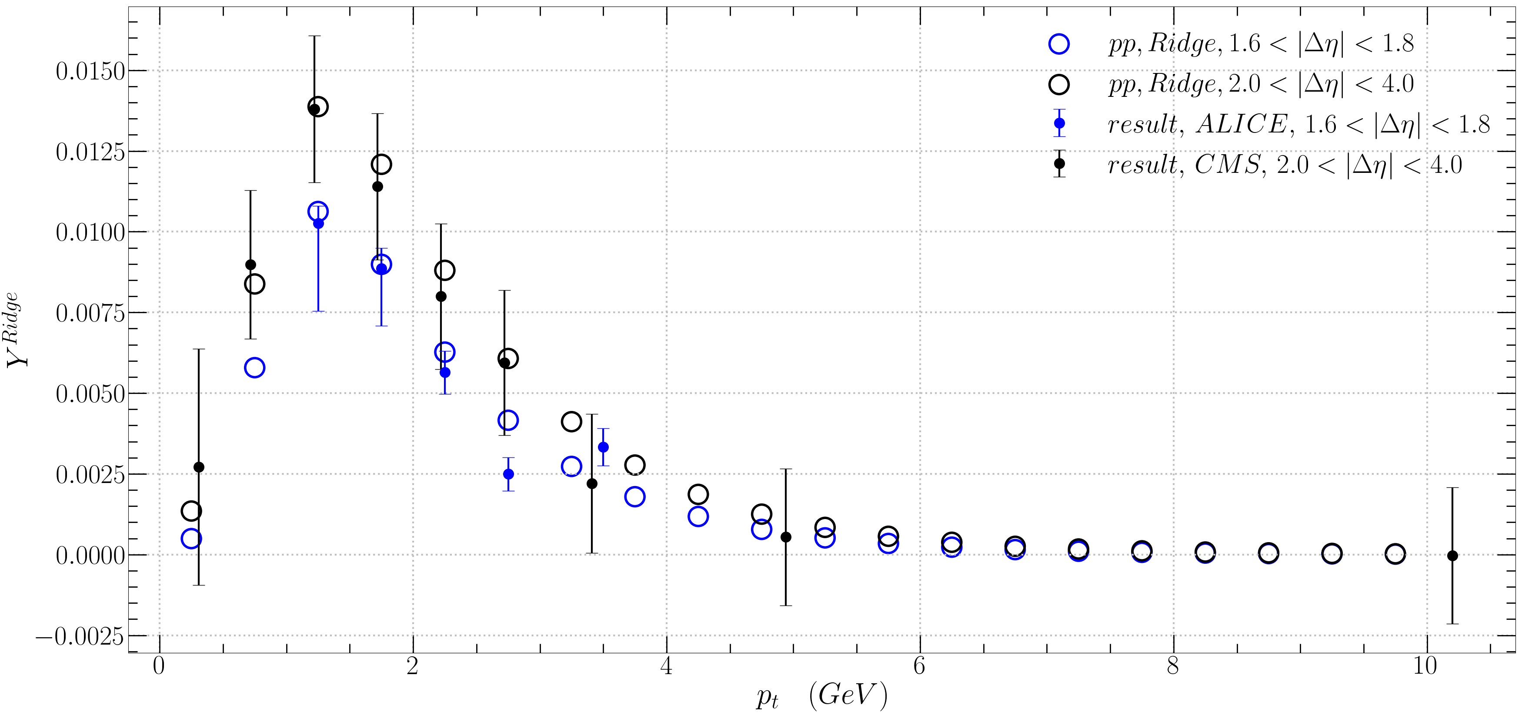
$$Y^{Ridge}$$
21.08.26 Fitting $$a=4 \\ T=0.63 GeV \\ q=0.9 GeV \\ m_{d}=1 GeV \\ \sqrt{S_{nn}}=13000 GeV \\ A_{ridge}=0.040276$$
$$f_{R}\left\langle N_{k}\right\rangle =0.585e^{0.81p_{T}}$$

Slide 15

$\left|Δ φ\right|<\left|Δ φ_{min}\right|$ 에서 $Δ φ_{min}=1.178 or 1.276272로$ 바꾸고 yield를 계산해보자.

