Slide 1
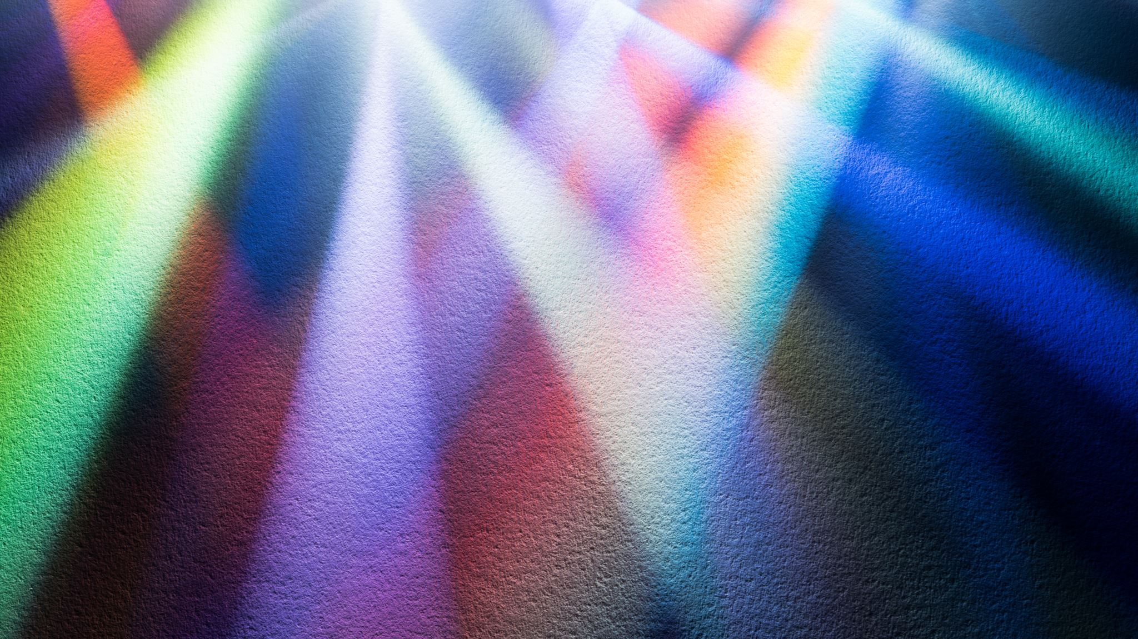
Light and color
Lecturer : Tanaboon Tongbuasirilai
Course : ICCS404
Week 6 : Light and color

Slide 2
Topics
Color
Lighting
Diffuse color
Specular color

Slide 3
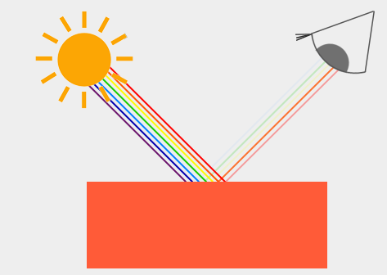
Color Representation and human perception
In the real world, colors are continuous, but in the digital world, they must be mapped to a limited set of digital values. This means not all real-world colors can be fully represented digitally.
Colors are digitally represented using three components: red, green, and blue (RGB). By combining these three values within a range of [0,1], most colors can be represented. For example, the coral color can be defined as an RGB vector (1.0f, 0.5f, 0.31f).
The color we perceive an object to have is the color that is reflected from it. Objects absorb certain wavelengths of light and reflect others, which determine the color we see. For instance, a blue toy reflects the blue part of the light and absorbs the other colors.
Example of Reflection: When white light (like sunlight) shines on an object, the object absorbs some colors and reflects others. The reflected colors are what we see, such as a coral-colored toy reflecting multiple colors with varying intensity.
Notes:
Explain how we see colors from materials.
- Light transport problem
RGB rough approximations → spectral colors or a band of colors.
Reflection → material property that CG works on.

Slide 4


Color Reflection in Graphics
In computer graphics, the principles of color reflection apply similarly to real life.
When defining a light source in OpenGL, you assign it a color. The perceived color of an object is determined by multiplying the light source's color with the object's color.
Calculating Perceived Color
The perceived color is calculated through component-wise multiplication of the light color and the object color vectors.
For example, a white light on a coral-colored object results in the object reflecting a portion of red, green, and blue light, matching its color.
Effect of Different Light Colors
If the light color changes, the reflected color also changes. For instance, under a green light, a coral-colored object appears dark green because only the green component is reflected.
Similarly, using a dark olive-green light will result in the object reflecting a mix of green and some red, resulting in a unique color.
Notes:
Light color * material color = final color → reflection
Steps
1 light color
2 reflection
3 perceived / reflected colors
Light intensity changed → result changed
Codes = examples when light intensity changed

Slide 5
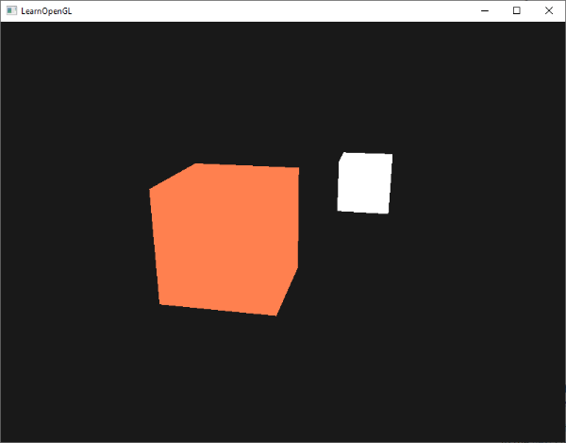
We want to setup a lamp in our scene.
Notes:
We need additional shaders (vertex and fragment) for handling the lighting (not the lamb). Why ?

Slide 6
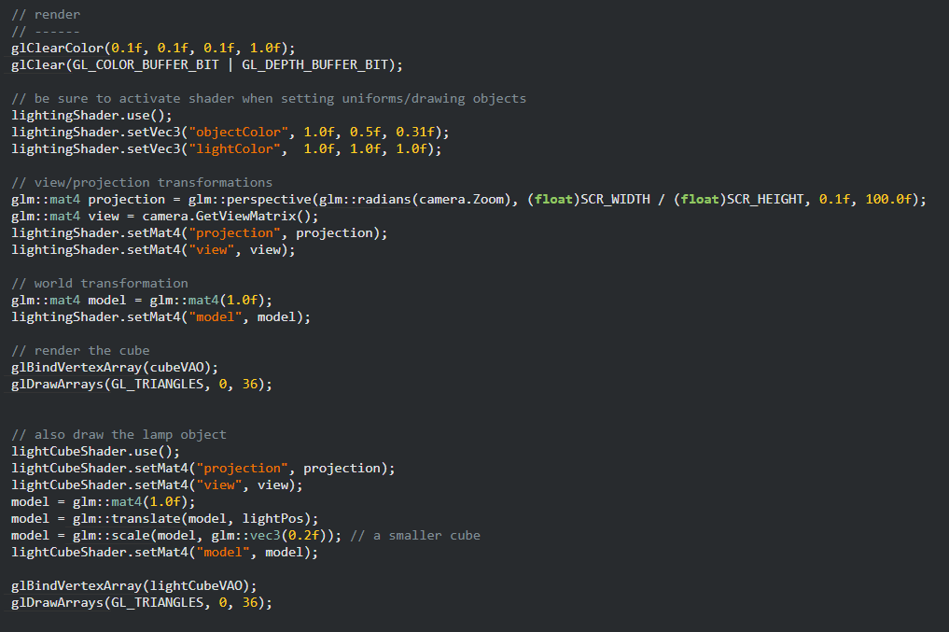
An orange cube
A white lamb cube
https://learnopengl.com/code_viewer_gh.php?code=src/2.lighting/1.colors/colors.cpp
Notes:
Since we can have multiple shaders, we can apply shaders according to our need for each object.

Slide 7
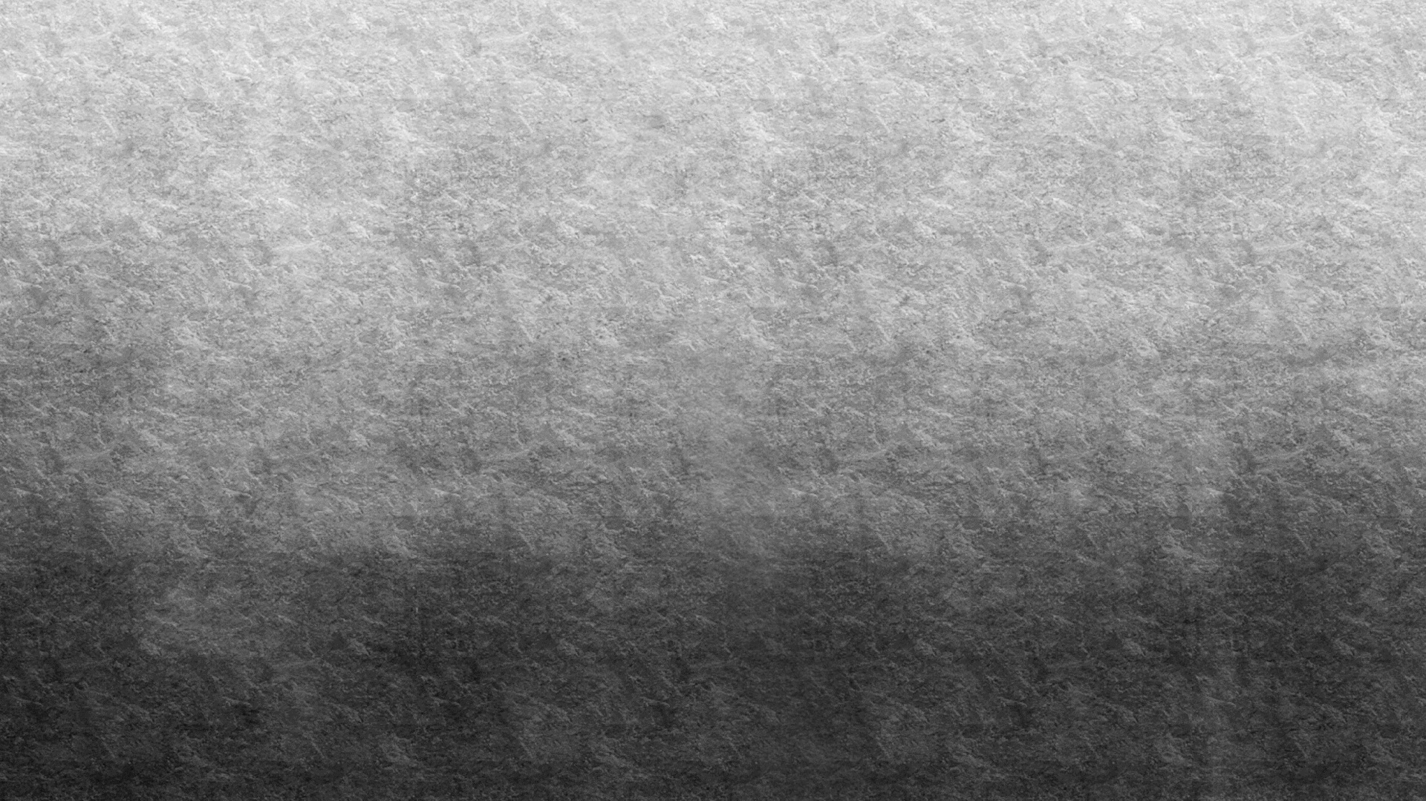
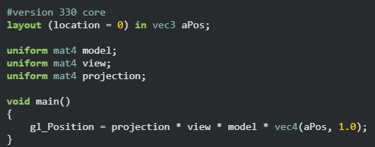
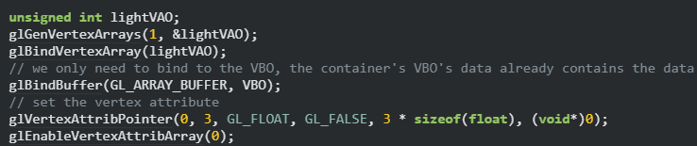
The vertex shader (previous setup)
We need to add a light into our scene.
Notes:
So, the first thing we'll need is a vertex shader to draw the container.
The vertex positions of the container remain the same (although we won't be needing texture coordinates this time)
so the code should be nothing new. We'll be using a stripped down version of the vertex shader from the last chapters:
Because we're also going to render a light source cube, we want to generate a new VAO specifically for the light source. We could render the light source with the same VAO and then do a few light position transformations on the model matrix, but in the upcoming chapters we'll be changing the vertex data and attribute pointers of the container object quite often and we don't want these changes to propagate to the light source object (we only care about the light cube's vertex positions), so we'll create a new VAO

Slide 8
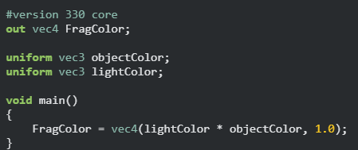

Lighting up with a fragment shader
A modified fragment shader
A new lighting shader is implemented.
We set the values for the lighting shader.
Notes:
Note that this part of the code is from previous lecture.
They provided a class for shader.

Slide 9
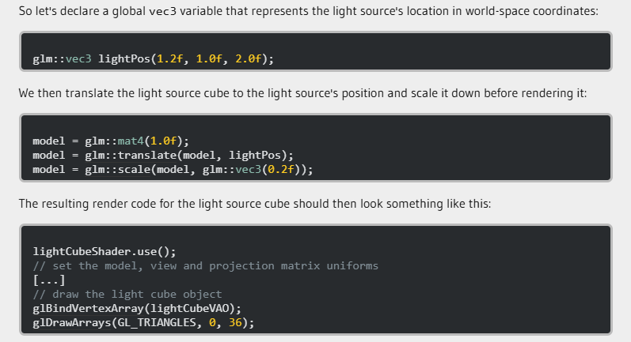
Adding a white lamb (cube)

Slide 10
An orange cube
A white lamb cube
https://learnopengl.com/code_viewer_gh.php?code=src/2.lighting/1.colors/colors.cpp
Notes:
We don’t see much of the lighting in this code.
As the mathematical expression of light simulation is still a naïve way.
The effect is so blunt and dull.
This lighting does not give us any clue about object’s depth.

Slide 11
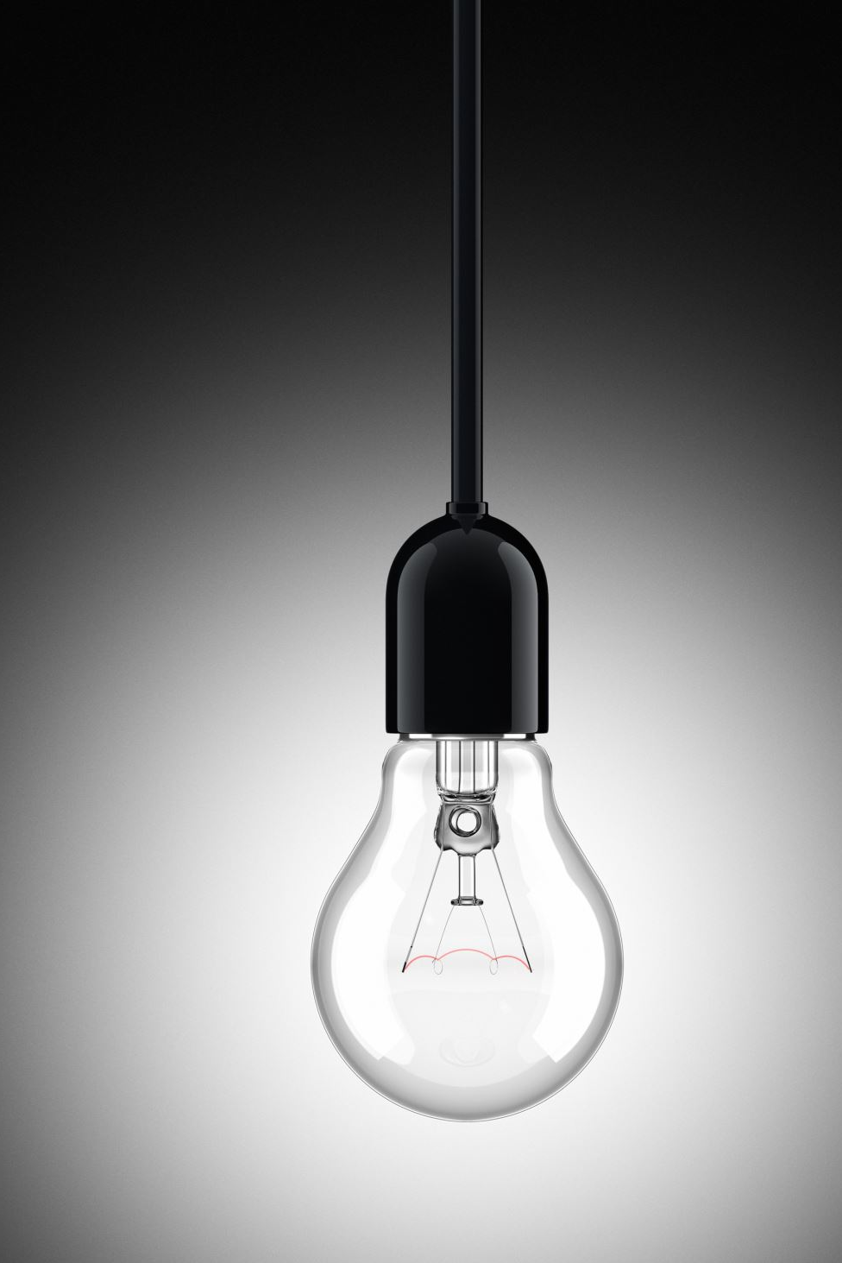

Basic lighting
Lighting in the real world is extremely complicated and depends on way too many factors, something we can't afford to calculate on the limited processing power we have.
Lighting in OpenGL is therefore based on approximations of reality using simplified models that are much easier to process and look relatively similar.
These lighting models are based on the physics of light as we understand it.
One of those models is called the Phong lighting model. The major building blocks of the Phong lighting model consist of 3 components: ambient, diffuse and specular lighting. Below you can see what these lighting components look like on their own and combined.
Notes:
Not just only a type of reflection !
But there are many types of reflections for each material.
But to model (imitate) how light interacts with surfaces are challenging.
We need to simplify light interactions.

Slide 12
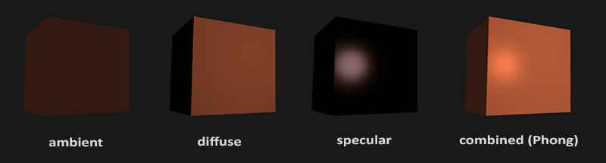
Ambient lighting
even when it is dark there is usually still some light somewhere in the world (the moon, a distant light) so objects are almost never completely dark. To simulate this we use an ambient lighting constant that always gives the object some color.
Diffuse lighting
simulates the directional impact a light object has on an object. This is the most visually significant component of the lighting model. The more a part of an object faces the light source, the brighter it becomes.
Specular lighting
simulates the bright spot of a light that appears on shiny objects. Specular highlights are more inclined to the color of the light than the color of the object.
Notes:
Ambient is not real thing. But it can represent an indirect illumination.

Slide 13
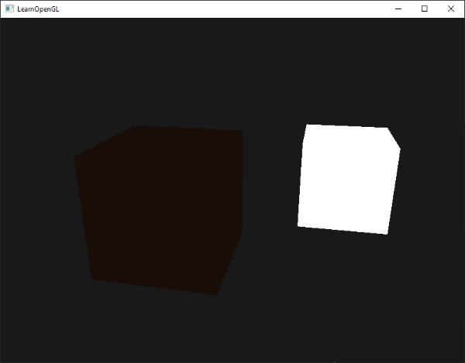
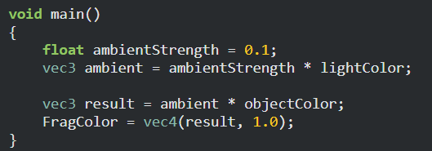
Ambient lighting
Light usually does not come from a single light source, but from many light sources scattered all around us, even when they're not immediately visible.
One of the properties of light is that it can scatter and bounce in many directions, reaching spots that aren't directly visible; light can thus reflect on other surfaces and have an indirect impact on the lighting of an object.
Algorithms that take this into consideration are called global illumination algorithms, but these are complicated and expensive to calculate.
Previously, we use a small constant (light) color that we add to the final resulting color of the object's fragments, thus making it look like there is always some scattered light even when there's not a direct light source.
Adding ambient lighting to the scene is really easy. We take the light's color, multiply it with a small constant ambient factor, multiply this with the object's color, and use that as the fragment's color in the cube object's shader.
Notes:
We don’t consider how light scattered on surfaces.
Ambient lighting calculation = scaled light intensity * material color
Ambient lighting does not give us much information about object’s depth. Why ? (nothing changed according to lights in the scene.)

Slide 14
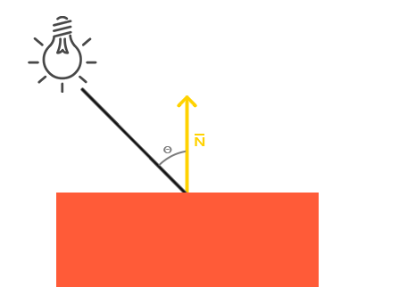
Diffuse lighting
Ambient vs. Diffuse Lighting - Ambient lighting alone doesn't create interesting visual effects, but diffuse lighting significantly impacts how an object appears by affecting its brightness based on the orientation of its surface fragments to the light source.
Impact of Light Orientation - The closer a fragment's surface is aligned to the light rays, the brighter it appears. The light has the greatest impact when it hits the object's surface perpendicularly.
Normal Vector and Angle Measurement - To measure the angle between the light ray and the object's surface, a normal vector (perpendicular to the surface) is used. The angle between the light ray and the normal vector can be calculated using the dot product.
Calculating Diffuse Lighting
Normal Vector: A vector perpendicular to the surface of the object.
Directed Light Ray: A vector calculated as the difference between the light's position and the fragment's position.
The dot product of the normal vector and the light ray vector determines the lighting impact on the fragment's color, influencing the overall visual effect based on the fragment's orientation towards the light.
Notes:
Diffuse lighting = light orientation is considered.

Slide 15
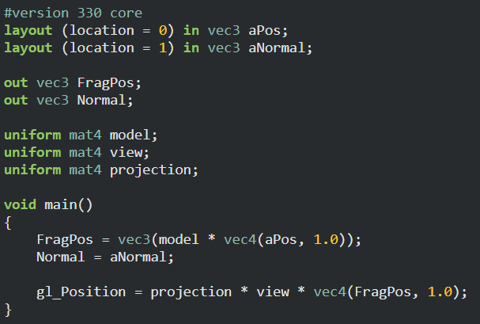
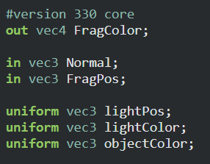
Normal in the shaders
Vertex shader
Fragment shader
Notes:
Updating both vertex and fragment shaders.
Manually input normal of each face and pass through a fragment shader (the box).
Set input normal (received from vertex shader)

Slide 16
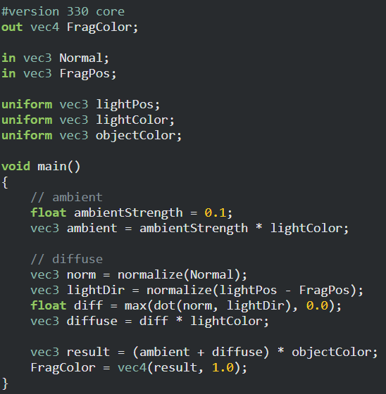
Calculating the diffuse color - 1
3
2
1
4
Vertex shader
Fragment shader
Notes:
Some calculations between shaders. (to obtain light direction)
1. Compute per-fragment position (from each vertex input)
2. Pass through per-fragment position to the fragment shader (box)
3. Receive the data from vertex shader
4. Calculate the light direction according to the position.

Slide 17
Calculating the diffuse color - 2
Fragment shader
1
2
3
Notes:
Previously we obtain a light direction associated to each vertex.
We further calculate
The cosine weighted value.
The diffuse value
The final color

Slide 18
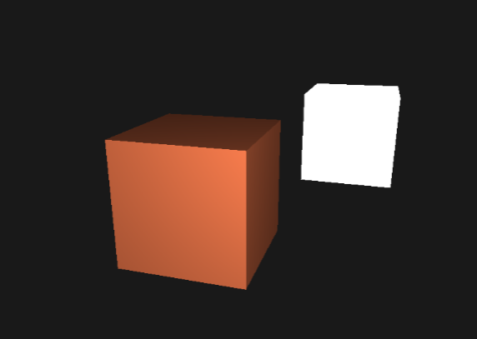
Result

Slide 19
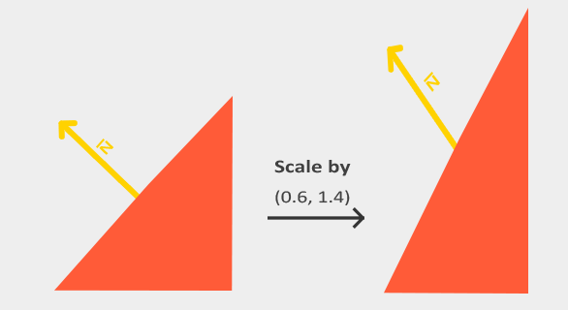
Normal != Normal
Any scaling does not work with a normal.
Notes:
Unfortunately, a normal vector on local coordinates does not work with scaling
Applying model matrix, model-view matrix does not preserve its property.

Slide 20




Normal vs Edge
$T=P_{2}$- $P_{1}$
$$T ∗ModelView=\left(P_{2}−P_{1}\right)∗ModelView$$
$$T∗ModelView=P_{2}∗ModelView −P_{1}∗ModelView$$
$T′=P_{2}′$- $P_{1}′$
$$N.T=0$$
$$N^{′}.T^{′}=0=\left(GN\right).\left(MT\right)={(GN)}^{T}∗\left(MT\right)=N^{T}G^{T}MT$$
If we carefully choose G matrix, we get a correct transformation.
$$G^{T}M=I ↔G={(M^{−1})}^{T}$$
Notes:
Edge → upper proof
Normal → lower proof
Normal is defined by a dot product of Normal and an edge = 0
Dot product = transpose of matrix multiplication.

Slide 21
Specular lighting
Specular Lighting Basis
Depends on the light direction, surface normal, and view direction (player’s perspective).
Simulates reflective surfaces, with highlights strongest where light is reflected toward the viewer.
Reflection Vector
Calculated by reflecting the light direction around the surface normal.
The angular distance between this reflection vector and the view direction determines the intensity of the specular highlight.
View Vector
Extra variable needed for specular lighting.
Calculated using the viewer’s world space position and the fragment’s position.
Specular Intensity
Intensity is based on how closely aligned the reflection and view vectors are.
This intensity is multiplied by the light color and added to the ambient and diffuse components for the final lighting result.

Slide 22
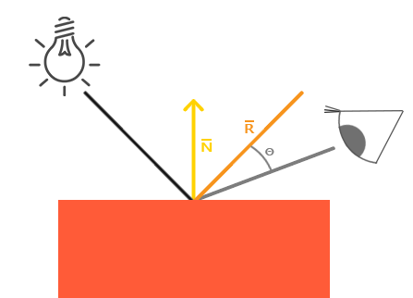
Specular reflection
Notes:
Essential components.
Normal vector
Reflection vector
Viewing vector
Light direction

Slide 23
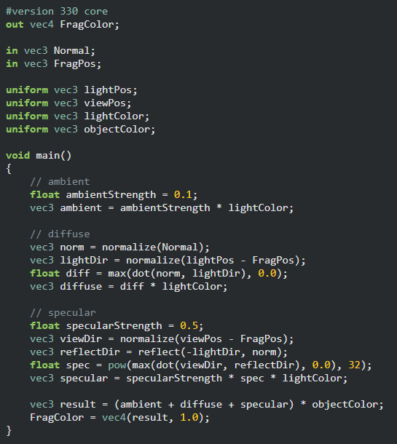
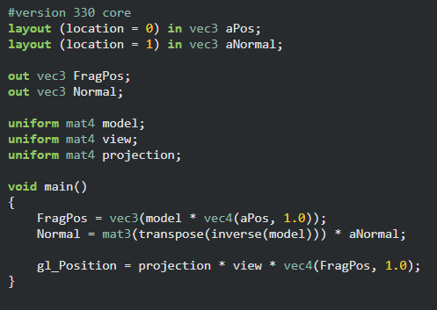
Calculating Specular lighting
2
3
1
4
Notes:
First of all, we change how normal is align if there is any scaling (1)
2. We inject viewing position (camera position) to the fragment shader.
3. We compute the viewing direction and reflection direction.
4. We compute the cosine weight from viewing and reflection directions. → note that in this case specular component is 32.
This component explains shininess.

Slide 24
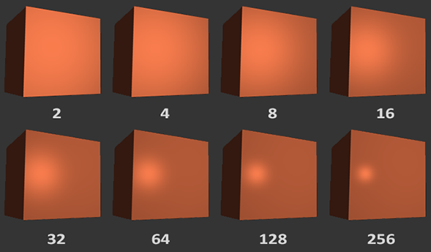
Specular components

Slide 25
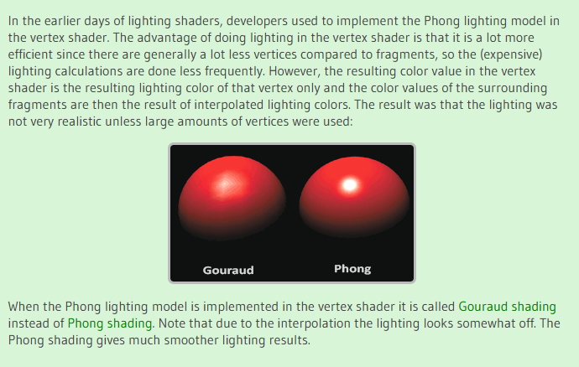
Shading in Vertex shader vs. Fragment shader

Slide 26
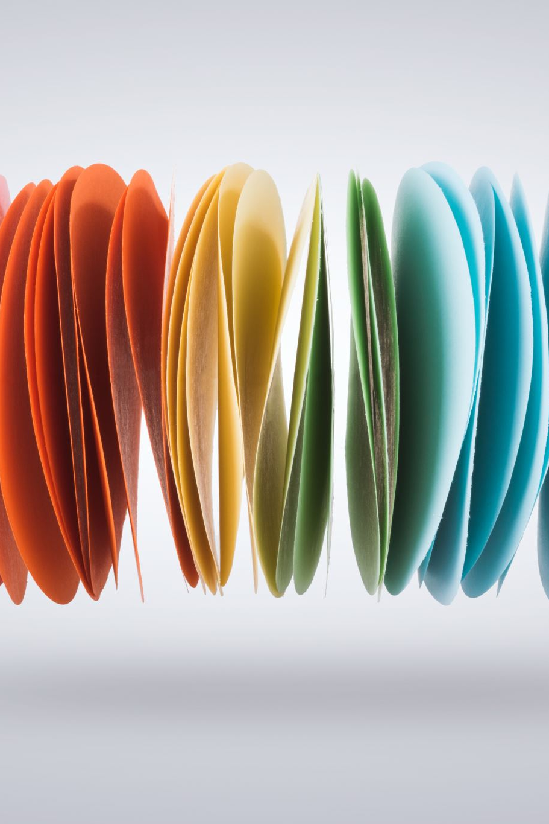
Other shading models
What we have learned so far is a simple shading model which can be used to express some classes of materials.
Phong shading is a simple and typical name found in shading model topic.
Phong reflection model ( Phong shading model ) considers the specular highlight occurs from reflection direction and viewing direction.
Blinn-Phong model uses half vector and normal vector instead.
There are so many reflection models (shading models) available in real-world applications.

