Slide 1
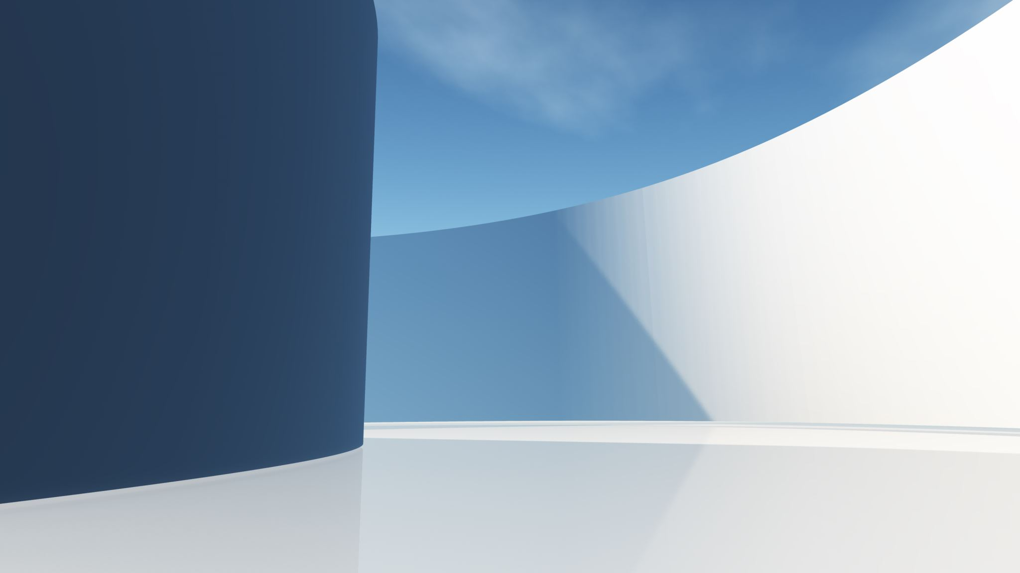
Creating 3D graphics with OpenGL
Lecturer : Tanaboon Tongbuasirilai
Course : ICCS404
Week 3 : OpenGL and Geometry

Slide 2
Topics
Introduction
OpenGL mechanism
GLFW
Shaders
VBO, VAO, EBO
Simple examples
Basic geometry : Sphere
Most of the content in this lecture is from https://learnopengl.com/Getting-started/OpenGL.

Slide 3
opengl
OpenGL (Open Graphics Library) is a widely used cross-language, cross-platform application programming interface (API) for creating 2D and 3D vector graphics. In simpler terms, it's a set of instructions that allows programmers to tell the computer's graphics card (GPU) how to draw things on the screen. Here are some key points about OpenGL
Efficiency - It leverages the GPU for faster rendering of graphics, leading to smoother animations and more visually complex scenes.
Versatility - It's not limited to a specific programming language or operating system, making it adaptable for various development environments.
Low-Level Control - Compared to some graphics frameworks, OpenGL provides a more fine-grained level of control over the graphics rendering process. This flexibility allows for customization but also requires a deeper understanding of graphics programming concepts.

Slide 4
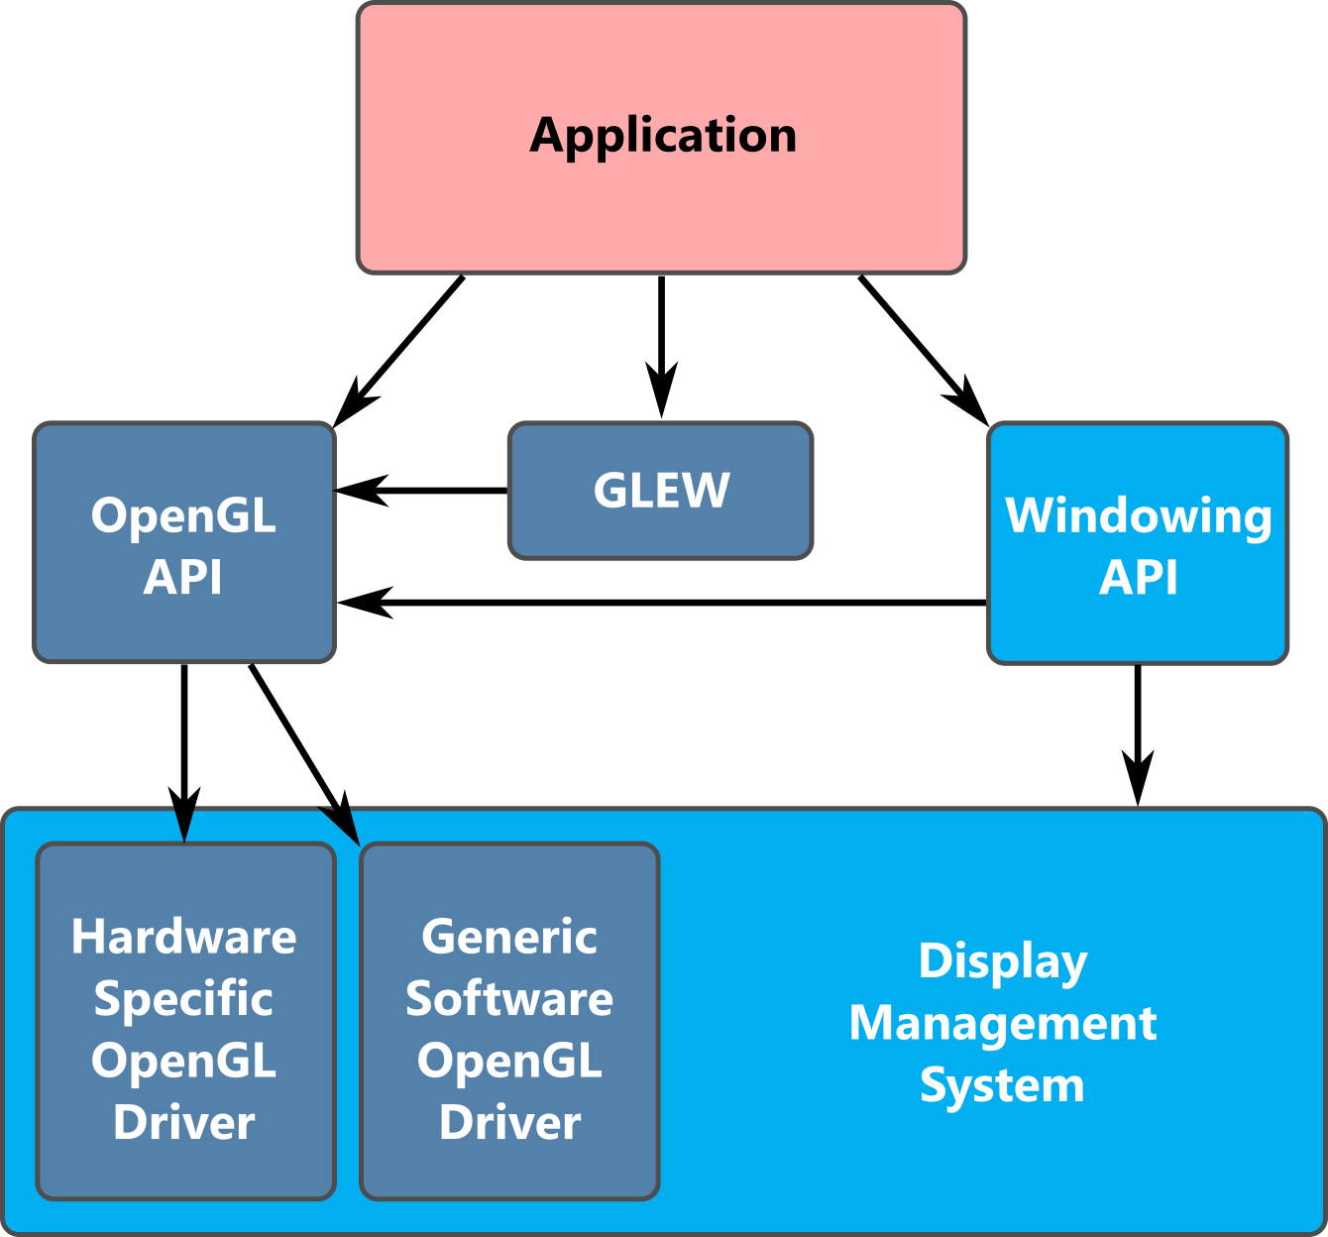
Block diagram of OpenGL
https://www.labs.cs.uregina.ca/315/WebGL2/Lab1/

Slide 5
GLEW (OpenGL Extension Wrangler Library)
A popular open-source C/C++ library used for managing OpenGL extensions.
Since OpenGL is continuously evolving, new features and functions are added in newer versions, but these updates are not always available on all hardware or platforms.
GLEW simplifies the process by allowing developers to check if specific OpenGL extensions are available at runtime.
Purpose
GLEW helps developers work with OpenGL's newer functions that might not be available across different systems, abstracting away platform-specific differences.
Functionality
It provides a unified interface for checking the availability of OpenGL extensions, loading function pointers, and querying the version of OpenGL supported by the system.
Usage
Typically, GLEW is initialized in an OpenGL program after creating a valid OpenGL context by calling glewInit(). This ensures that the available extensions and function pointers are set up correctly.
Notes:
Many extensions provided for OpenGL
GLEW, GLD, or its own update in OpenGL

Slide 6
OpenGL extensions
An OpenGL extension is an addition to the core OpenGL specification that provides new functionality, optimizations, or techniques for rendering graphics. These extensions are typically created by graphics hardware vendors to introduce new features and improvements that are not yet part of the official OpenGL standard.
Developers can use these extensions to access advanced or efficient rendering techniques without waiting for them to be included in future OpenGL versions.
The functionality provided by an extension can be used if the hardware supports it, enabling the use of new rendering techniques.
Popular and useful extensions often become part of future OpenGL versions.
Extensions can be vendor-specific (e.g., from NVIDIA, AMD) or standardized by the OpenGL Architecture Review Board (ARB). Vendor-specific extensions usually start with a prefix indicating the vendor (e.g., GL_NV_ for NVIDIA, GL_AMD_ for AMD).
https://www.khronos.org/opengl/wiki/OpenGL_Extension
Notes:
Extensions
A great feature of OpenGL is its support of extensions. Whenever a graphics company comes up with a new technique or a new large optimization for rendering this is often found in an extension implemented in the drivers. If the hardware an application runs on supports such an extension the developer can use the functionality provided by the extension for more advanced or efficient graphics. This way, a graphics developer can still use these new rendering techniques without having to wait for OpenGL to include the functionality in its future versions, simply by checking if the extension is supported by the graphics card. Often, when an extension is popular or very useful it eventually becomes part of future OpenGL versions.
The developer has to query whether any of these extensions are available before using them (or use an OpenGL extension library). This allows the developer to do things better or more efficient, based on whether an extension is available:

Slide 7
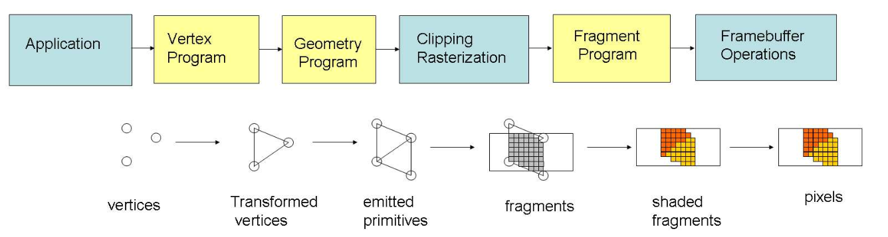
OpenGL pipeline
Non-rigid multi-modal registration on the GPU
March 2007Proceedings of SPIE - The International Society for Optical Engineering

Slide 8

OpenGL is a state machine.
A state machine is a computational model used to design algorithms and systems that can be in one of a finite number of states at any given time. The model represents a system in different situations (states) and how it transitions between them.
State machines are widely used in computer science, engineering, and various fields for modeling and controlling the behavior of systems.

Slide 9

Key Concepts of a State Machine
States
A state represents a particular condition or situation of the machine at a specific point in time. For example, in a traffic light, the states could be "Red", "Yellow", and "Green".
Transitions
A transition occurs when an event or input triggers a change from one state to another. Transitions are often conditional, meaning they only happen when specific criteria are met.
Events
Events or inputs are external or internal occurrences that cause the state machine to transition between states. These can be user inputs, sensor readings, timeouts, etc.
Initial State
The state machine must begin in a defined state when it starts operating. This is known as the initial state.
Final State
Some state machines may have a final state or accepting state that, when reached, terminates the operation of the machine.
Notes:
State = process
Transition = how it change from 1 state to another.
Event = what trigger the transition

Slide 10
How it affects to OpenGL mechanism ?
OpenGL is a large state machine, meaning it operates through a collection of variables defining its current state, referred to as the OpenGL context.
Developers manipulate the OpenGL context (state) by setting options, working with buffers and issuing rendering commands based on the current state to achieve desired rendering effects.
Any modification to the state (e.g., switching from drawing triangles to lines) affects subsequent rendering commands.
Recognizing OpenGL as a state machine helps in understanding its functionality and operations.

Slide 11
Key Concepts of a State Machine How OpenGL Functions as a State Machine
Global State
OpenGL maintains a collection of states (like the current color, textures, shaders, blend modes, etc.). When you set a state (e.g., enable blending or set the current shader), it affects all subsequent rendering operations until you modify it again.
State Transitions
As a state machine, OpenGL transitions between different states based on the commands you issue. For example, enabling lighting or changing the current texture binding modifies the state, which impacts how future rendering commands behave.
Examples of OpenGL States
Current Color
Active Texture
Depth Testing
Viewport
Notes:
Current Color: When you set the color using glColor*(), all subsequent vertices and primitives are drawn using this color until it is changed.
Active Texture: When you bind a texture using glBindTexture(), that texture remains active for all subsequent drawing commands.
Depth Testing: When you enable depth testing with glEnable(GL_DEPTH_TEST), it stays enabled until explicitly disabled.
Viewport: Once you set the viewport using glViewport(), OpenGL uses that setting until you change it again.

Slide 12
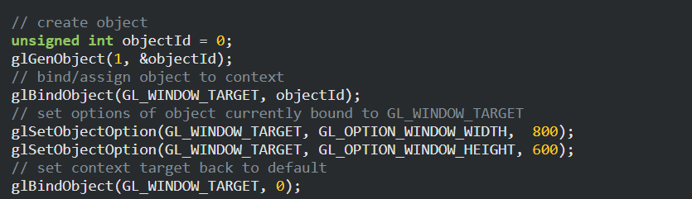
Example
We first create an object and store a reference to it as an id (the real object's data is stored behind the scenes).
Then we bind the object (using its id) to the target location of the context (the location of the example window object target is defined as GL_WINDOW_TARGET).
Next we set the window options and finally we un-bind the object by setting the current object id of the window target to 0.
The options we set are stored in the object referenced by objectId and restored as soon as we bind the object back to GL_WINDOW_TARGET.
Notes:
Setting a window
Create an object id
Bind an object to context ( window context )
Set parameters
Unbind the context

Slide 13
GLFW
GLFW is a free, Open Source, multi-platform library for OpenGL, OpenGL ES and Vulkan application development.
It provides a simple, platform-independent API for creating windows, contexts and surfaces, reading input, handling events, etc.
https://www.glfw.org/docs/latest/
Notes:
OpenGL does not provide any input and event handling.
GLFW = answer

Slide 14
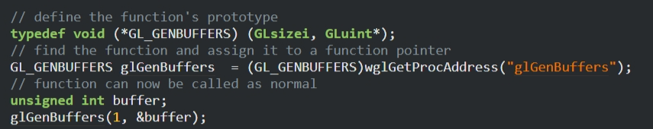
How to load up extensions of OpenGL ?
2. Create a function prototype.
3. Obtain a function pointer to ‘glGenBuffers’.
1. Want to use ‘glGenBuffers’ ?
Because OpenGL is only really a standard/specification it is up to the driver manufacturer to implement the specification to a driver that the specific graphics card supports.
Since there are many different versions of OpenGL drivers, the location of most of its functions is not known at compile-time and needs to be queried at run-time.
The best way to load required extensions is to use OpenGL Loading Library.
4. Call it as a typical function.
Notes:
Lots of redundant, tedious tasks to include all required extensions or specific functions.
OpenGL Loading Library steps in.

Slide 15

OpenGL Loading Library
By using a loading library, developers do not need to manually write code to query and load OpenGL functions. This reduces boilerplate code and potential errors, allowing developers to focus on the core functionality of their applications.
Modern OpenGL (version 3.0 and above) relies on dynamically loading function pointers at runtime rather than linking them at compile time. Loading libraries handle this dynamic loading process, ensuring that the correct function pointers are obtained and used.
Loading libraries often provide convenient functions for initializing OpenGL contexts and loading function pointers, streamlining the setup process for OpenGL applications.

Slide 16
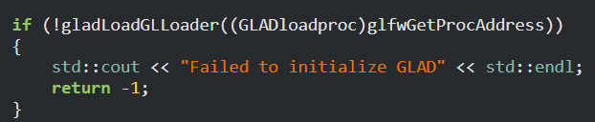
GLAD + GLFW
https://www.khronos.org/opengl/wiki/OpenGL_Loading_Library
Glad : glad.dav1d.de
Only one step to load up required functions.
Notes:
GLFW helps with GLAD to simplify the process.

Slide 17
It’s time to setup an environment for OpenGL !
Notes:
https://learnopengl.com/Getting-started/Creating-a-window
https://learnopengl.com/Getting-started/Hello-Window
Creating a template for later use.

Slide 18

Steps to create a window (an OpenGL application)
Initialize window properties
Setup viewport
Load up OpenGL functions
Render things
Terminate the created window
(Optional) handle input

Slide 19
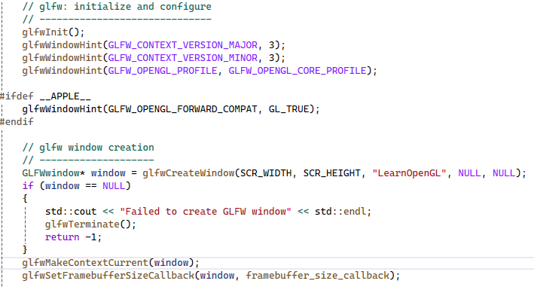
Stepping into the window creation
Initialize GLFW then define the window properties.
Create a window.
Bind the window to the context.
Bind a callback function to handle when the window size (frame buffer) changed.

Slide 20
GLFW - Setting up a window
https://www.glfw.org/docs/3.3/window_guide.html

Slide 21
Double buffer
When an application draws in a single buffer the resulting image may display flickering issues. This is because the resulting output image is not drawn in an instant but drawn pixel by pixel and usually from left to right and top to bottom. Because this image is not displayed at an instant to the user while still being rendered to, the result may contain artifacts.
To circumvent these issues, windowing applications apply a double buffer for rendering. The front buffer contains the final output image that is shown at the screen, while all the rendering commands draw to the back buffer. As soon as all the rendering commands are finished we swap the back buffer to the front buffer so the image can be displayed without still being rendered to, removing all the aforementioned artifacts.
Notes:
What is the display buffer ?

Slide 22
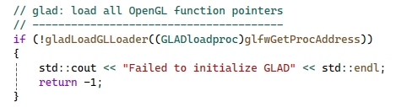
Load up OpenGL functions using GLAD

Slide 23
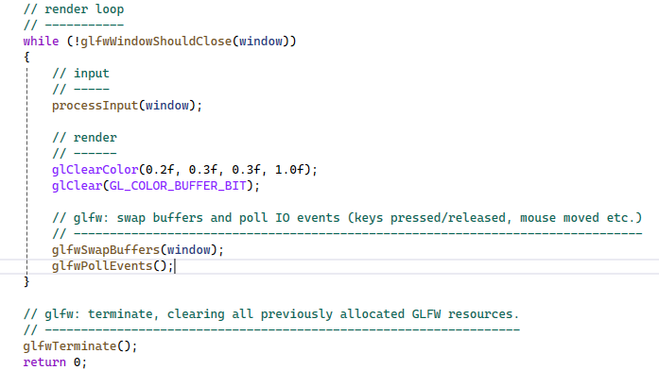
Rendering loop and terminating the window
The glfwWindowShouldClose function checks at the start of each loop iteration if GLFW has been instructed to close. If so, the function returns true and the render loop stops running, after which we can close the application.
The glfwPollEvents function checks if any events are triggered (like keyboard input or mouse movement events), updates the window state, and calls the corresponding functions (which we can register via callback methods).
The glfwSwapBuffers will swap the color buffer (a large 2D buffer that contains color values for each pixel in GLFW's window) that is used to render to during this render iteration and show it as output to the screen.

Slide 24
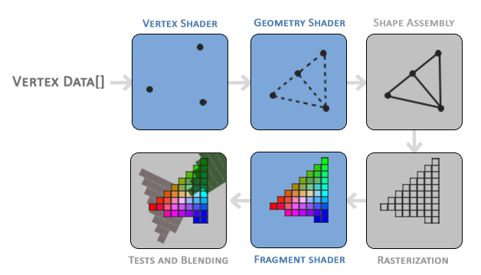
OpenGL shading pipeline

Slide 25
The pipeline
The main purpose of the vertex shader is to transform 3D coordinates into different 3D coordinates (more on that later) and the vertex shader allows us to do some basic processing on the vertex attributes.
The geometry shader takes as input a collection of vertices that form a primitive and has the ability to generate other shapes by emitting new vertices to form new (or other) primitive(s).
The primitive assembly stage takes as input all the vertices (or vertex if GL_POINTS is chosen) from the vertex (or geometry) shader that form one or more primitives and assembles all the point(s) in the primitive shape given; in this case two triangles.
The output of the primitive assembly stage is then passed on to the rasterization stage where it maps the resulting primitive(s) to the corresponding pixels on the final screen, resulting in fragments for the fragment shader to use. Before the fragment shaders run, clipping is performed. Clipping discards all fragments that are outside your view, increasing performance.
The main purpose of the fragment shader is to calculate the final color of a pixel, and this is usually the stage where all the advanced OpenGL effects occur. Usually, the fragment shader contains data about the 3D scene that it can use to calculate the final pixel color (like lights, shadows, color of the light and so on).
After all the corresponding color values have been determined, the final object will then pass through one more stage that we call the alpha test and blending stage. This stage checks the corresponding depth (and stencil) value (we'll get to those later) of the fragment and uses those to check if the resulting fragment is in front or behind other objects and should be discarded accordingly. The stage also checks for alpha values (alpha values define the opacity of an object) and blends the objects accordingly. So even if a pixel output color is calculated in the fragment shader, the final pixel color could still be something entirely different when rendering multiple triangles.

Slide 26
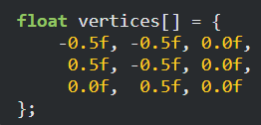
Vertex input
OpenGL only processes 3D coordinates when they're in a specific range between -1.0 and 1.0 on all 3 axes (x, y and z).
All coordinates within this so-called normalized device coordinates range will end up visible on your screen (and all coordinates outside this region won't).

Slide 27
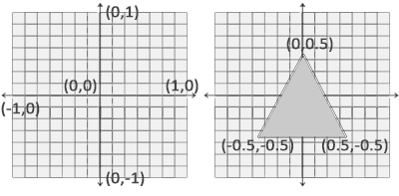
Normalized Device Coordinates (NDC)
Any coordinates that fall outside this range will be discarded/clipped and won't be visible on your screen.
Unlike usual screen coordinates the positive y-axis points in the up-direction and the (0,0) coordinates are at the center of the graph, instead of top-left.
Your NDC coordinates will then be transformed to screen-space coordinates via the viewport transform using the data you provided with glViewport. The resulting screen-space coordinates are then transformed to fragments as inputs to your fragment shader.

Slide 28
Sending vertices to GPU memory
Vertex Buffer Objects (VBOs) are areas of memory on the GPU specifically designed to store vertex data.
They allow sending large batches of vertex data to the GPU at once, improving efficiency compared to sending data one vertex at a time.
This is beneficial because transferring data between CPU and GPU is relatively slow.
Once data resides in GPU memory, the vertex shader can access it very quickly.
Notes:
We need vertex buffer objects to pass data to the GPU.
Sending data points one-by-one is a bottle neck.

Slide 29


Binding vertices to the buffer
A VBO is the first example of an OpenGL object encountered. Similar to other objects, it has a unique ID for identification.
The glGenBuffers function is used to generate a unique identifier for a new VBO.
the buffer type of a vertex buffer object is GL_ARRAY_BUFFER.
glBufferData is a function specifically targeted to copy user-defined data into the currently bound buffer.
Notes:
GL_STATIC_DRAW is in the next slide.

Slide 30

How GPU manages data in the memory.
The fourth parameter specifies how we want the graphics card to manage the given data. This can take 3 forms:
GL_STREAM_DRAW: the data is set only once and used by the GPU at most a few times.
GL_STATIC_DRAW: the data is set only once and used many times.
GL_DYNAMIC_DRAW: the data is changed a lot and used many times.
https://registry.khronos.org/OpenGL-Refpages/gl2.1/xhtml/glBufferData.xml
Notes:
GL_STATIC_DRAW tells OpenGL that you intend to only set the data in this buffer object once.
GL_STREAM_DRAW tells OpenGL that you intend to set this data constantly, generally once per frame.
GL_DYNAMIC_DRAW basically means "I may need to occasionally update this vertex data, but not every frame." This is the least common one. It's not really suited for most forms of animation since those usually require very frequent updates.
GL_STATIC_DRAW: Use when the data in the buffer will rarely (or never) change after it has been initially set.
GL_DYNAMIC_DRAW: Use when the data in the buffer will be updated frequently.
GL_STREAM_DRAW: Use when the data in the buffer will be updated every frame (or almost every frame).

Slide 31
GL_STATIC_DRAW – Use cases
Static geometry in games or simulations, such as terrain, buildings, or any object that does not move or change shape. Once the vertex data is loaded into the GPU, it's repeatedly used for rendering without changes.
Texture coordinates or vertex normals that remain the same across multiple frames.
Index buffers (EBO) for objects that don’t change over time (static models).

Slide 32
GL_DYNAMIC_DRAW – Use cases
Animated models, where the vertices or other attributes are frequently updated (e.g., character animations, vertex skinning).
Dynamic geometry such as particle systems, where the positions, velocities, or other attributes of the particles are updated frequently based on user input or physics.
UI elements where positions, colors, or sizes are updated based on user interaction.
Dynamic 2D or 3D shapes that frequently change size or position, such as interactive graphs or charts.

Slide 33
GL_STREAM_DRAW – Use cases
Streaming video data to a texture, where the content of the texture changes every frame.
Real-time sensor data or other data-driven applications where input is continuously updated (e.g., live simulation).
Procedural geometry generation where the geometry is recalculated every frame, such as terrain generation, particle effects, or crowd simulation.
Rendering a real-time simulation of objects that frequently change position, orientation, or size.
Particle systems where the entire system’s data (positions, colors, velocities) are recalculated every frame.

Slide 34
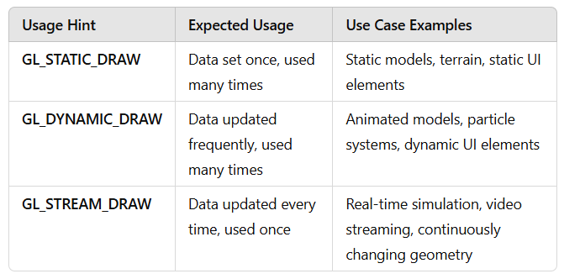
Summary of Use Cases

Slide 35
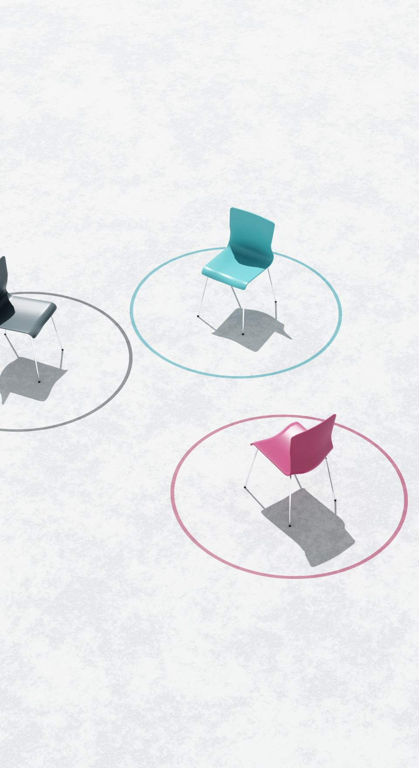
Vertex shader
Modern OpenGL requires that we at least set up a vertex and fragment shader if we want to do some rendering.
The shader language GLSL = OpenGL Shading Language.
GLSL has a vector datatype that contains 1 to 4 floats based on its postfix digit.
A vector in GLSL has a maximum size of 4 and each of its values can be retrieved via vec.x, vec.y, vec.z and vec.w respectively where each of them represents a coordinate in space.
It needs to be compiled before use.

Slide 36
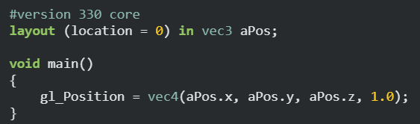
A simple vertex shader
What version we are going to use.
Create ‘aPos’ as a variable of vec3.
The starting point of the vertex shader.
The output of this vertex shader.
gl_Position is a predefined variable of vec4.

Slide 37
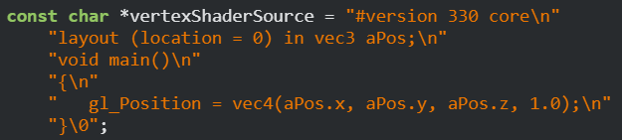
Compiling a shader
Source code
Create a shader
Binding the source code to the created shader
Compiling the shader
Notes:
Inside your main program.

Slide 38
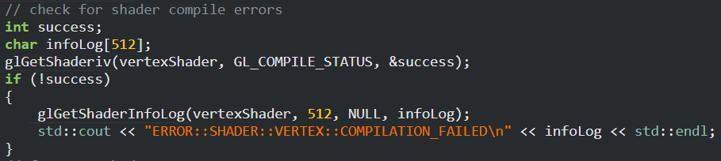
Check whether the compilation is failed or not.
https://registry.khronos.org/OpenGL-Refpages/es2.0/xhtml/glGetShaderiv.xml

Slide 39
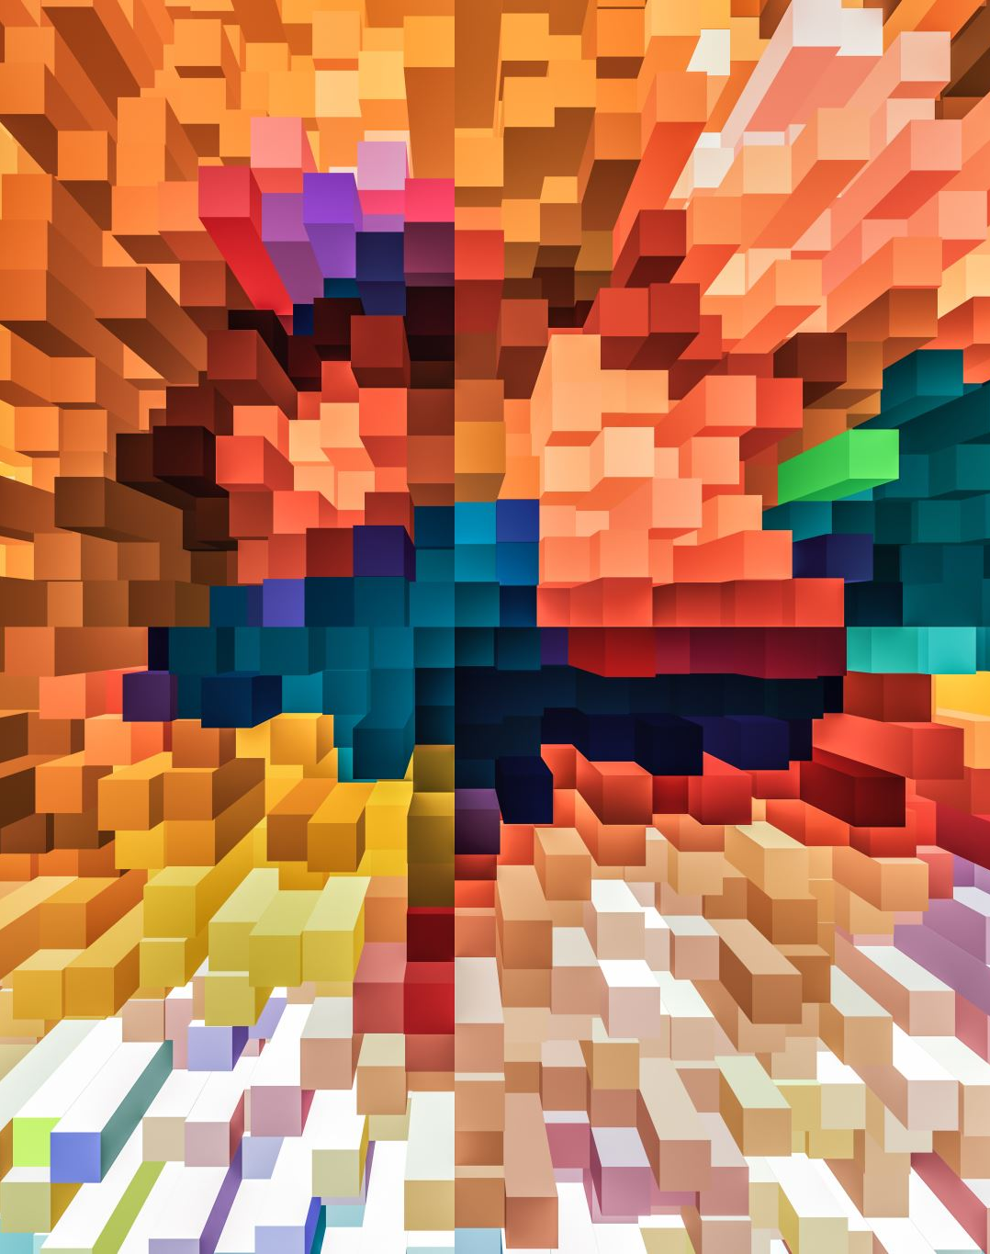
Fragment shader
The fragment shader is all about calculating the color output of your pixels.
Colors in computer graphics are represented as an array of 4 values: the red, green, blue and alpha (opacity) component, commonly abbreviated to RGBA.
When defining a color in OpenGL or GLSL we set the strength of each component to a value between 0.0 and 1.0.
Given those 3 color components we can generate over 16 million different colors!
Notes:
Vertex shader = process the vertices -> output = gl_Position
Fragment shader = process pixel color

Slide 40
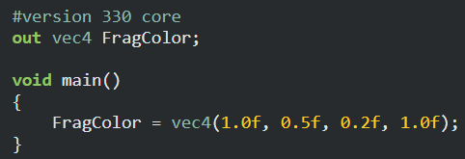
A simple fragment shader
What version we are going to use.
Declare output values with the out keyword.
The starting point of the vertex shader.
The output of this fragment shader.

Slide 41

A shader program
A shader program object is the final linked version of multiple shaders combined.
To use the recently compiled shaders we have to link them to a shader program object and then activate this shader program when rendering objects.
When linking the shaders into a program it links the outputs of each shader to the inputs of the next shader.

Slide 42


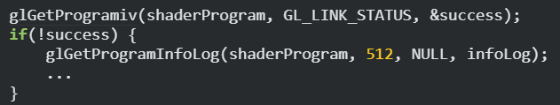


Steps to use the shader program
Create a shader program object.
Link the written shaders to the program object.
Check whether the link is failed or not.
Use the shader program.
Delete shaders. (no longer needed)

Slide 43
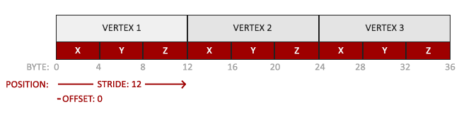
Our vertex data
Notes:
We need a batch of data to GPU.
We need to know how to arrange such data.

Slide 44
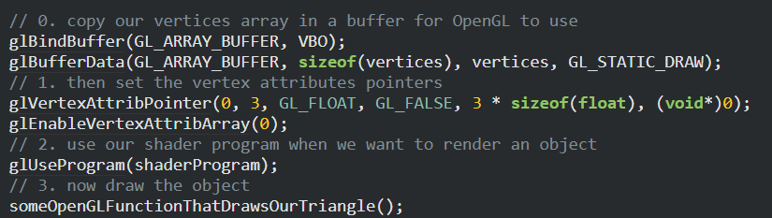
Defining vertex attributes (tell OpenGL how our vertex data is interpreted.)
The location of the vertex attribute
The size of the vertex attribute
Type of the data
Is data normalized ?
vec
Layout (location = 0)
vec3
stride
offset
Notes:
Passing vertices to vertex buffer. (vertex shader)
Binding VBO = move data
glVertexAttribPointer = setting up how vertex data works in GPU.

Slide 45
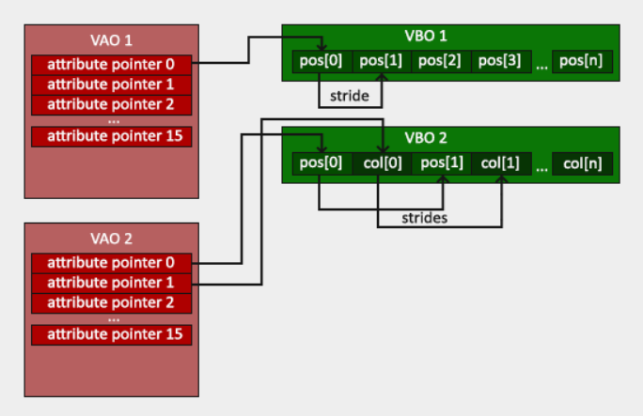
Vertex Array Object (VAO)
Vertex Array Objects (VAOs) are essential in OpenGL for managing and organizing vertex data efficiently.
Without VAOs, each time you render, you would need to re-specify all the vertex attribute pointers and buffer bindings.
VAOs simplify this by allowing you to set up these configurations once and then simply bind the VAO to reuse those configurations.

Slide 46

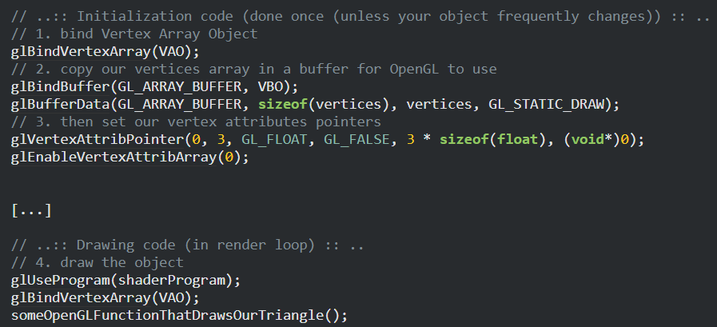
VAO in actions
Create a VAO and get an id.
Binding things to VAO once.
Note that this part is in the rendering loop.

Slide 47
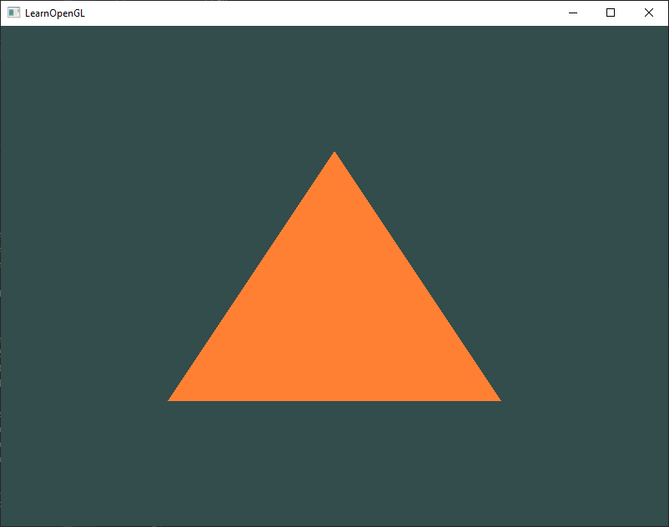

A simple triangle
https://docs.gl/gl3/glDrawArrays

Slide 48
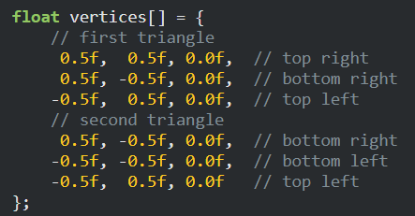
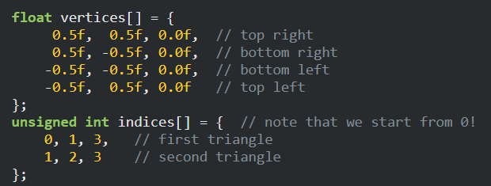
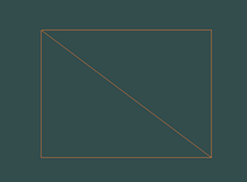
Reuse vertex data with Element Buffer Object (EBO)
An Element Buffer Object (EBO), also known as an Index Buffer Object (IBO), is an OpenGL object that allows you to specify indices to reuse vertex data, which can lead to more efficient memory usage and improved rendering performance.
Example : drawing 2 connected triangles (a rectangle) with only 4 vertices.
3
0
Note that the indices must follow the culling mode.
Check out : https://learnopengl.com/Advanced-OpenGL/Face-culling
2
1
Notes:
Drawing a rectangle with triangles ?
Reuse vertex data for such case.

Slide 49

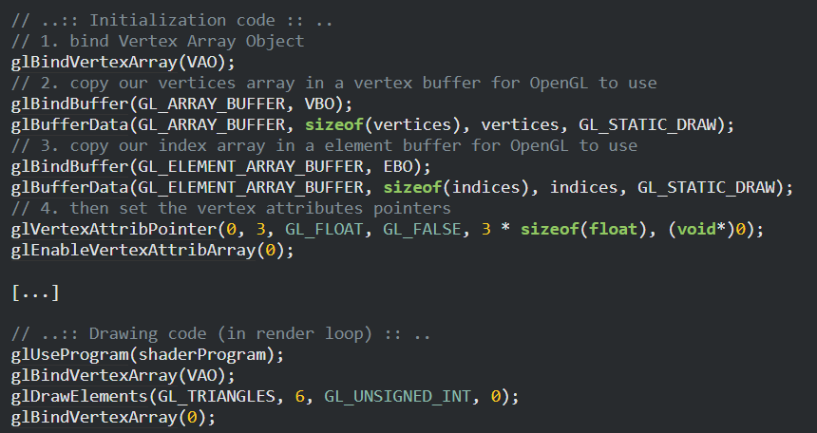
EBO in actions
Create an EBO and get an id.
Bind indices to EBO.
Use glDrawElements() instead of glDrawArrays()
Notes:
glGenBuffers -> VBO , EBO

Slide 50
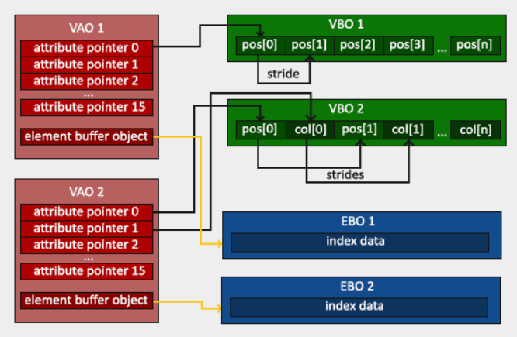
VBO, VAO, EBO connections

Slide 51
Examples :
Create the same 2 triangles using two different VAOs and VBOs for their data.
https://learnopengl.com/code_viewer_gh.php?code=src/1.getting_started/2.4.hello_triangle_exercise2/hello_triangle_exercise2.cpp
Create two shader programs where the second program uses a different fragment shader that outputs the color yellow; draw both triangles again where one outputs the color yellow
https://learnopengl.com/code_viewer_gh.php?code=src/1.getting_started/2.5.hello_triangle_exercise3/hello_triangle_exercise3.cpp
Notes:
How to use arrays for VAO and VBO.
How to change the color using fragment shaders.

Slide 52
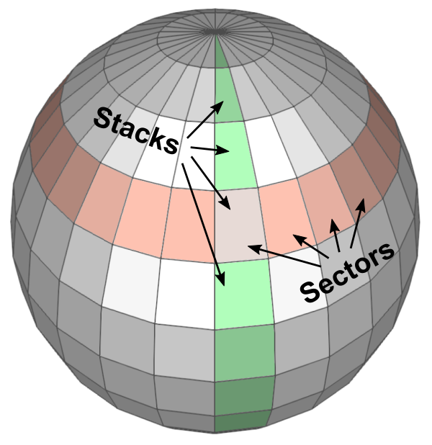
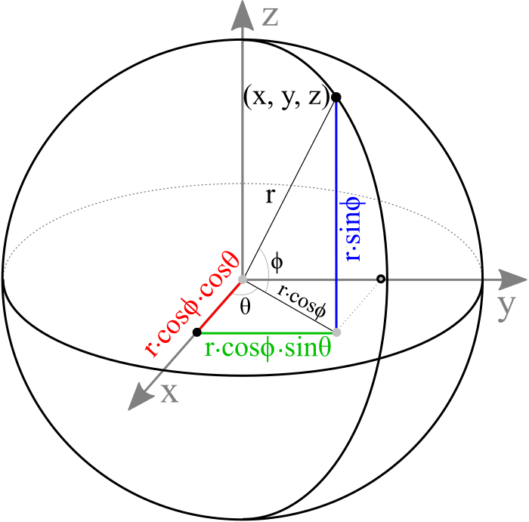

Basic geometry : Sphere
Mathematically, a sphere can be defined by an implicit function $x^{2}+y^{2}+z^{2}=r^{2}$.
Since we cannot draw all the points on a sphere, we only sample a limited number of points by dividing the sphere by sectors (longitude) and stacks (latitude). Then connect these sampled points together to form surfaces of the sphere.
https://www.songho.ca/opengl/gl_sphere.html#sphere

Slide 53
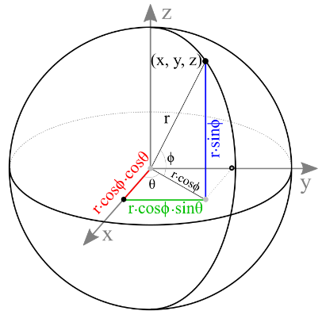
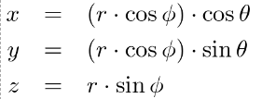
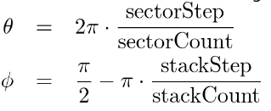
Creating vertices
A sphere representation in spherical coordinates.
Theta (θ) defines sectors.
Phi (ϕ) defines stacks.

Slide 54
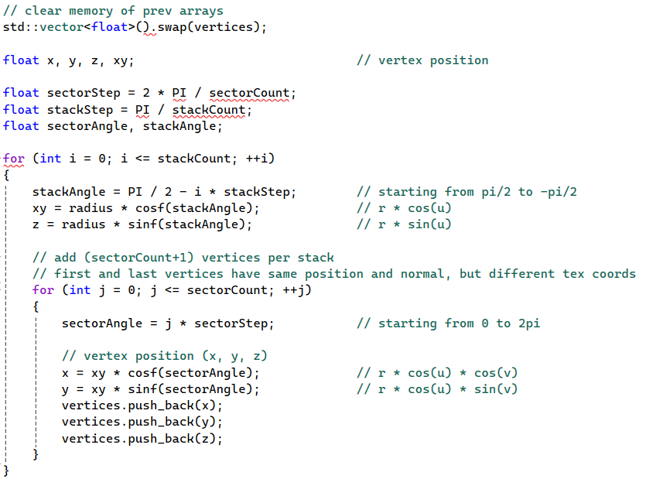

Slide 55
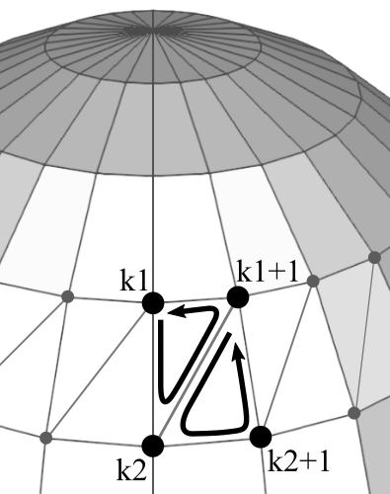
Creating indices
In order to draw the surface of a sphere in OpenGL, you must triangulate adjacent vertices to form polygons. It is possible to use a single triangle strip to render the whole sphere.
However, if the shared vertices have different normals or texture coordinates, then a single triangle strip cannot be used.
Each sector in a stack requires 2 triangles. If the first vertex index in the current stack is k1 and the next stack is k2, then the counterclockwise orders of vertex indices of 2 triangles are
k1 ⟶ k2 ⟶ k1+1
k1+1 ⟶ k2 ⟶ k2+1

Slide 56
