Slide 1
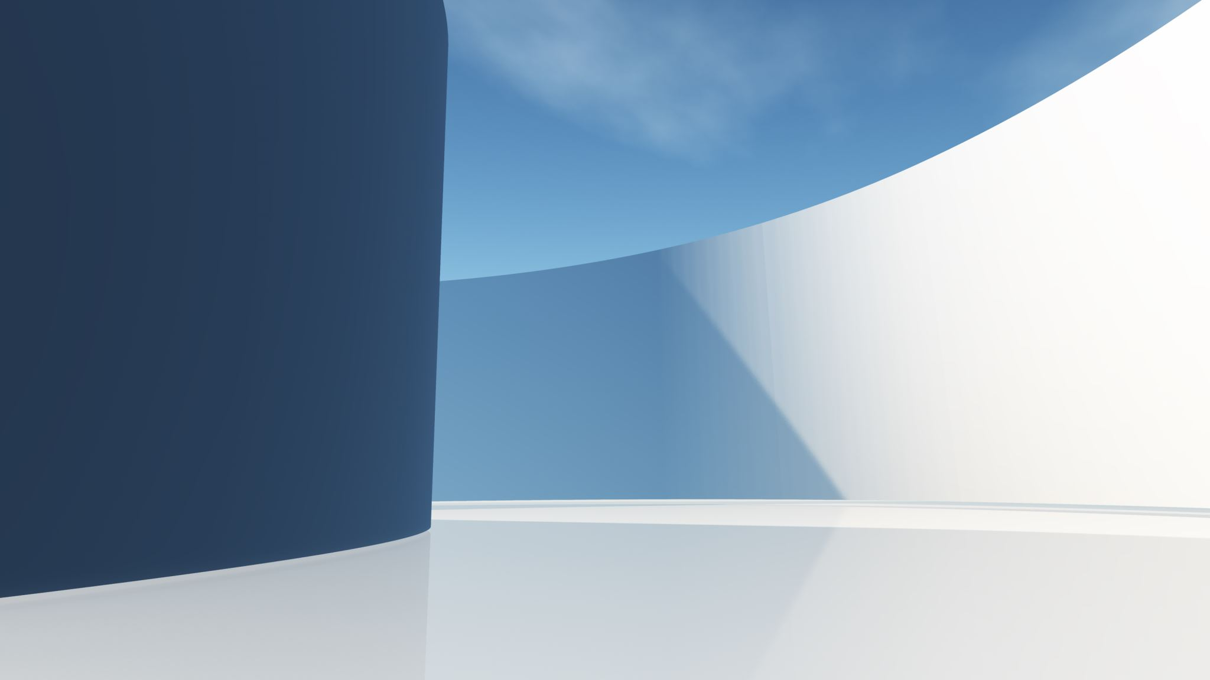
Shader and Texture
Lecturer : Tanaboon Tongbuasirilai
Course : ICCS404
Week 4 : 3D Graphics

Slide 2
Topics
GLSL
GLSL variables
Shader examples
Texture
Loading images
Setting up textures
Applying textures
Most of the content in this lecture is from https://learnopengl.com/Getting-started/OpenGL.

Slide 3

GLSL
Shaders are written in the C-like language GLSL.
GLSL is tailored for use with graphics and contains useful features specifically targeted at vector and matrix manipulation.
Shaders always begin with a version declaration, followed by a list of input and output variables, uniforms and its main function.
Each shader's entry point is at its main function where we process any input variables and output the results in its output variables.
Notes:
Class discussion… why C-like ?
C Language – low level – better for kernel development
GLSL – parallel computations of matrix / vector operations.
Structure – Input, output, variables, main function

Slide 4
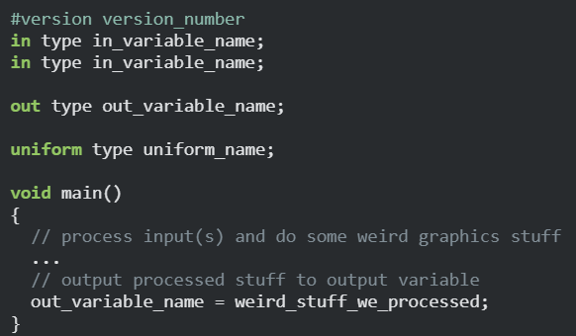
A shader structure
Notes:
A typical structure of a shader

Slide 5
Max input
Each input variable is also known as a vertex attribute.
There is a maximum number of vertex attributes we're allowed to declare limited by the hardware.
OpenGL guarantees there are always at least 16 4-component vertex attributes available, but some hardware may allow for more which you can retrieve by querying GL_MAX_VERTEX_ATTRIBS.
Notes:
Class discussion
Is this related to Vertex attribute pointer ?

Slide 6
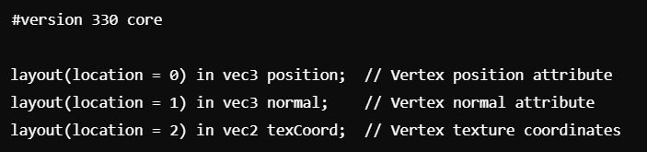
Vertex attributes Vs. Vertex attribute pointers
Vertex attributes refer to data associated with each vertex that you pass to the vertex shader. These can include things like
Position (vec3 or vec4)
Color (vec3 or vec4)
Normals (vec3)
Texture Coordinates (vec2)
glVertexAttribPointer is a function used to tell OpenGL how the vertex attributes are stored in memory (specifically, in a Vertex Buffer Object, or VBO). It describes the layout of the attribute data in the buffer so that OpenGL can correctly interpret it when rendering.
The attribute index (which corresponds to the location in the vertex shader)
The number of components in each attribute (e.g., 3 for a vec3 position)
The data type of each component (e.g., GL_FLOAT for floating-point data)
The stride (the byte offset between consecutive vertices).The offset where the data for that attribute starts within each vertex.

Slide 7
Variable type
GLSL has most of the default basic types we know from languages like C: int, float, double, uint and bool.
GLSL also features two container types that we'll be using a lot, namely vectors and matrices.
Types of variables
Vector
Ins and Outs
Uniforms
https://www.khronos.org/opengl/wiki/Built-in_Variable_(GLSL)
Notes:
GLSL provides Built-in data types.
Vectors and matrices are container types.

Slide 8

Vector
A vector in GLSL is a 2,3 or 4 component container for any of the basic types just mentioned.
They can take the following form (n represents the number of components)
vecn: the default vector of n floats.
bvecn: a vector of n booleans.
ivecn: a vector of n integers.
uvecn: a vector of n unsigned integers.
dvecn: a vector of n double components.
Most of the time we will be using the basic vecn since floats are sufficient for most of our purposes.

Slide 9

Accessing vector values
Components of a vector can be accessed via vec.x where x is the first component of the vector.
You can use .x, .y, .z and .w to access their first, second, third and fourth component respectively.
GLSL also allows you to use rgba for colors or stpq for texture coordinates, accessing the same components.
The vector datatype allows for some interesting and flexible component selection called swizzling
Notes:
Accessing values can be mixed up ! -> swizzling
4 examples of accessing vector values.

Slide 10
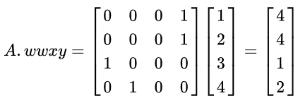
Swizzling
https://en.wikipedia.org/wiki/Swizzling_(computer_graphics)
Notes:
How swizzling works.
A vector of [1 2 3 4] → with a matrix defining locations
A system of linear equations

Slide 11

Creating a vector
You can use any combination of up to 4 letters to create a new vector (of the same type) as long as the original vector has those components.
We can also pass vectors as arguments to different vector constructor calls, reducing the number of arguments required.
Notes:
3 examples of vector creation.

Slide 12
Ins and Outs
GLSL defined the in and out keywords specifically so that we can move stuff around shaders.
Each shader can specify inputs and outputs using those keywords and wherever an output variable matches with an input variable of the next shader stage they're passed along.
The vertex shader differs in its input, in that it receives its input straight from the vertex data.
To define how the vertex data is organized we specify the input variables with location metadata so we can configure the vertex attributes on the CPU.
Notes:
In, out = keywords of GLSL → specify input and output data
Inputs and outputs should be matched !
Vertex shader inputs are from a core app. (vertex data)
We need to specify ‘location’ where the vertex data resides in the memory !

Slide 13
Associating ins and outs
The fragment shader requires a vec4 color output variable, since the fragment shaders needs to generate a final output color.
If we fail to specify an output color in your fragment shader, the color buffer output for those fragments will be undefined (which usually means OpenGL will render them either black or white).
If we want to send data from one shader to the other, we'd have to declare an output in the sending shader and a similar input in the receiving shader.
When the types and the names are equal on both sides OpenGL will link those variables together and then it is possible to send data between shaders (this is done when linking a program object).
Notes:
Fragment shader output = vec4
It needs to be specified otherwise black color may be rendered out.
Sending data between shaders must be associated to each other.

Slide 14
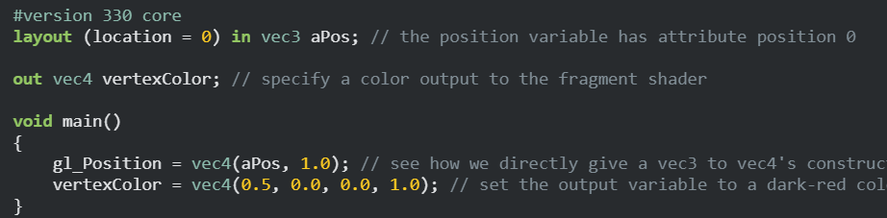
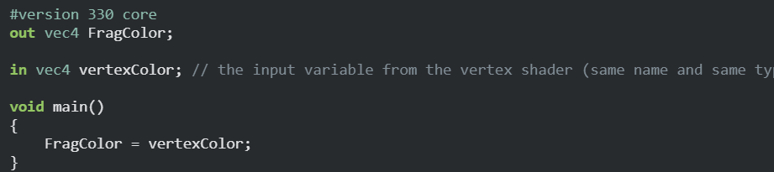
Example: in, out
Vertex shader
Fragment shader
Notes:
A simple example passing data.
Update the variable inside the shader.

Slide 15
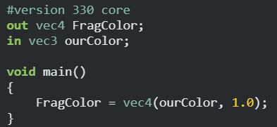
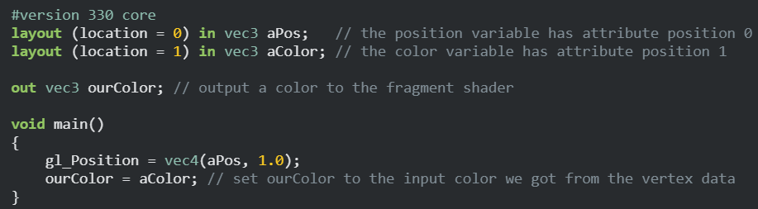
Example : Adding colors to vertices
Notes:
Class discussion -
Which one is vertex shader and which one is fragment shader?
How do you determine which one is what?
.
Passing data from CPU to fragment shader.

Slide 16
Uniforms
Uniforms are another way to pass data from our application on the CPU to the shaders on the GPU.
Uniforms are however slightly different compared to vertex attributes.
Uniforms are global meaning that a uniform variable is unique per shader program object and can be accessed from any shader at any stage in the shader program.
Whatever you set the uniform value to, uniforms will keep their values until they're either reset or updated.
To declare a uniform in GLSL we simply add the uniform keyword to a shader with a type and a name.
Notes:
2nd variable type = uniform
Uniforms are used to pass data from the core application (CPU) to shaders (GPU).
Uniforms = global variables = accessed by any shaders.
This is like injecting data to the pipeline freely.
Use the keyword -> uniform

Slide 17
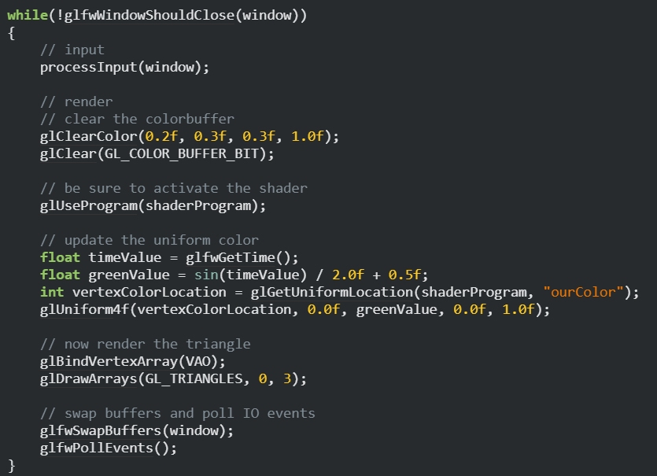
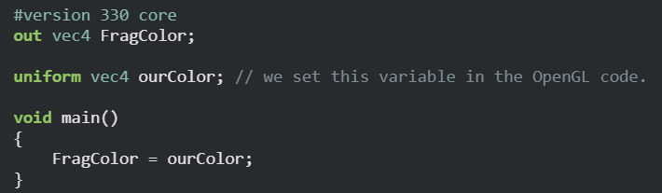
Example: Uniform
Create a shader program.
1
2
Get a uniform location and set the value.
Notes:
Example using uniform

Slide 18
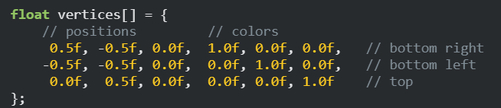
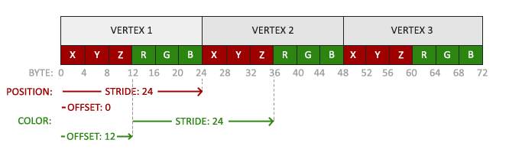
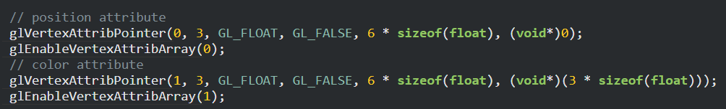
Defining both vertex positions and colors
Notes:
Updating our vertices variable from last time.
(adding color)
Binding vertex locations and colors to different vertex attribute pointers.

Slide 19
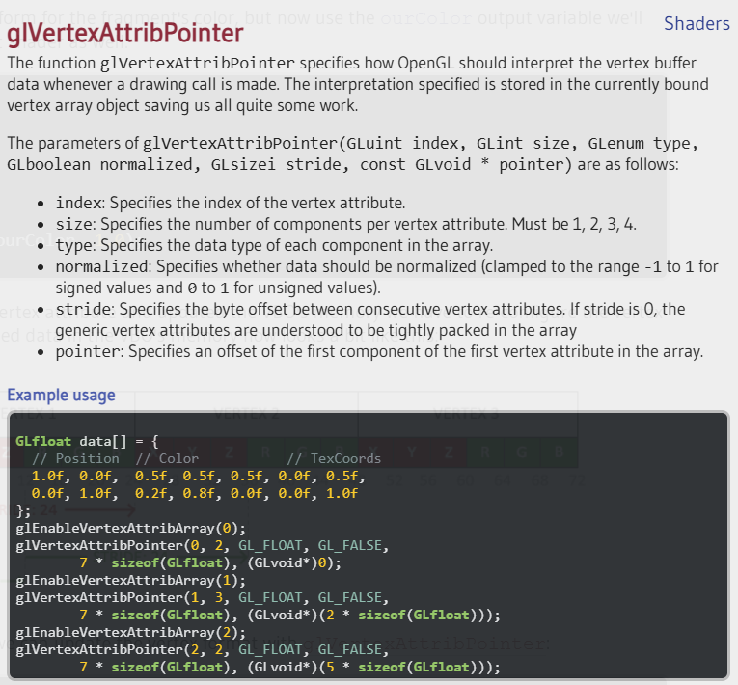
glVertexAttribPointer reference
Notes:
An example when we have more vertex data → position, color, texture, normal, etc…

Slide 20
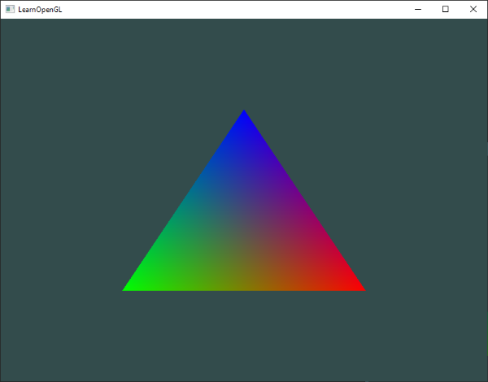
Interpolated colors
This is all the result of something called fragment interpolation in the fragment shader.
When rendering a triangle, the rasterization stage usually results in a lot more fragments than vertices originally specified.
The rasterizer then determines the positions of each of those fragments based on where they reside on the triangle shape.
Based on these positions, it interpolates all the fragment shader's input variables.
Notes:
In the example, we define 3 colors on each vertices.
Notice that colors are interpolated.
This is done in the fragment shader.
We will learn how to work with fragment shaders later in week6.

Slide 21

More examples
Adjust the vertex shader so that the triangle is upside down.
https://learnopengl.com/code_viewer_gh.php?code=src/1.getting_started/3.4.shaders_exercise1/shaders_exercise1.cpp
Specify a horizontal offset via a uniform and move the triangle to the right side of the screen in the vertex shader using this offset value.
https://learnopengl.com/code_viewer_gh.php?code=src/1.getting_started/3.5.shaders_exercise2/shaders_exercise2.cpp
Notes:
Copy & paste codes to show results.
Explain codes.

Slide 22
Shader art
https://www.youtube.com/watch?v=f4s1h2YETNY

Slide 23
Texturing

Slide 24
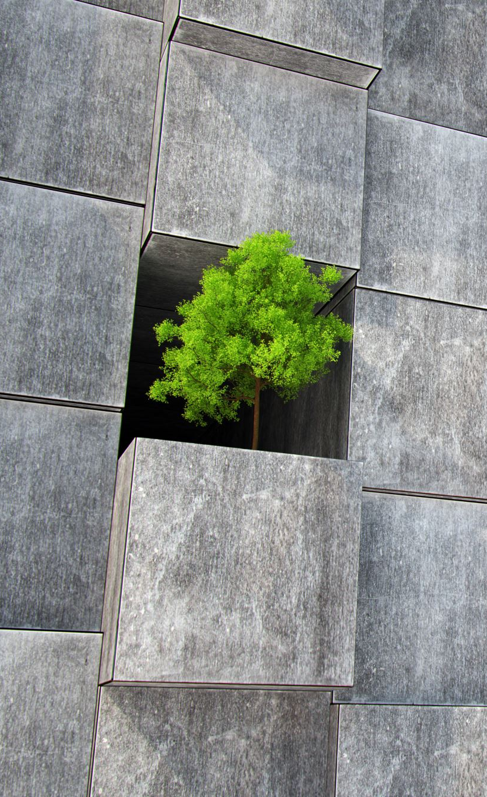
Texture
A texture is a 2D image (even 1D and 3D textures exist) used to add detail to an object.
Think of a texture as a piece of paper with a nice brick image (for example) on it neatly folded over your 3D house so it looks like your house has a stone exterior.
Because we can insert a lot of detail in a single image, we can give the illusion the object is extremely detailed without having to specify extra vertices.
Notes:
Texturing is a method to add visual details / contents on an object.
Typically → 2D but it can be 1D or 3D data.
Like a poster on a cardboard / a billboard.
Benefit → intuitive to drawing, painting arts.
Many drawing, painting techniques can be applied on textures → creating illusions or natural or surreal effects according to our needs.

Slide 25

Loading textures
Using textures requires loading up images into memory.
Loading an image can be implemented easily by stb_image.h.
Check it out from https://github.com/nothings/stb-imv.
Notes:
Before using textures in an OpenGL application, we need to load them up.

Slide 26
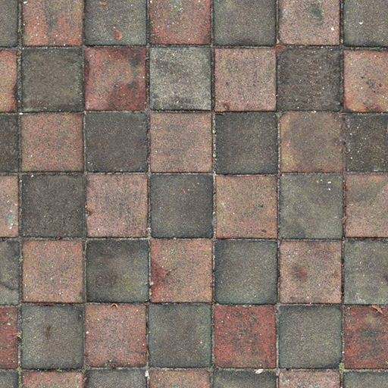
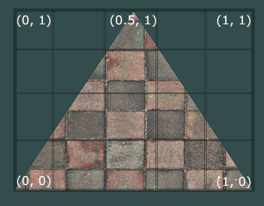
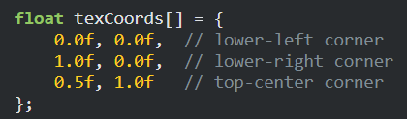
Texture coordinates (U-V or S-T coordinates)
Texture coordinates range from 0 to 1 in the x and y axis (remember that we use 2D texture images).
Retrieving the texture color using texture coordinates is called sampling.
Texture coordinates start at (0,0) for the lower left corner of a texture image to (1,1) for the upper right corner of a texture image.
Notes:
Texture coordinates have to be specified on a 2D image.
The coordinates range from (0,1) in both x-y axes. (but we use U-V or S-T instead.)

Slide 27

What happens if we specify coordinates outside the range ? (Texture Wrapping)
Each of the options have a different visual output when using texture coordinates outside the default range.
GL_REPEAT: The default behavior for textures. Repeats the texture image.
GL_MIRRORED_REPEAT: Same as GL_REPEAT but mirrors the image with each repeat.
GL_CLAMP_TO_EDGE: Clamps the coordinates between 0 and 1. The result is that higher coordinates become clamped to the edge, resulting in a stretched edge pattern.
GL_CLAMP_TO_BORDER: Coordinates outside the range are now given a user-specified border color.
https://registry.khronos.org/OpenGL-Refpages/gl4/html/glTexParameter.xhtml
Notes:
Specifying coordinates outside the range, OpenGL can handle that with some options.

Slide 28
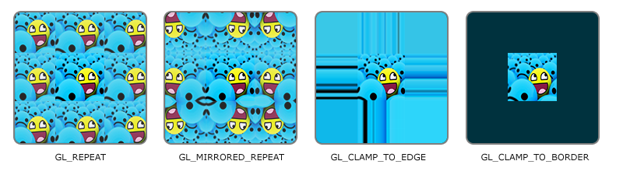
Notes:
We set how it handle cases for each axis (S and T).

Slide 29
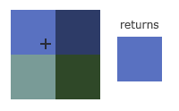
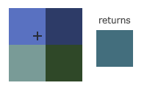
Texture Filtering
Resolution mismatch
Texture coordinates – Texture pixel (texel) mapping
Ex. Large object with a low resolution texture.
GL_NEAREST (also known as nearest neighbor or point filtering) is the default texture filtering method of OpenGL. When set to GL_NEAREST, OpenGL selects the texel that center is closest to the texture coordinate.
GL_LINEAR (also known as (bi)linear filtering) takes an interpolated value from the texture coordinate's neighboring texels, approximating a color between the texels. The smaller the distance from the texture coordinate to a texel's center, the more that texel's color contributes to the sampled color.
Notes:
Sometime, we may have a large object but low resolution images.
Textures will be upsampling according to the mapping.
Texture filtering is applied in such case.

Slide 30
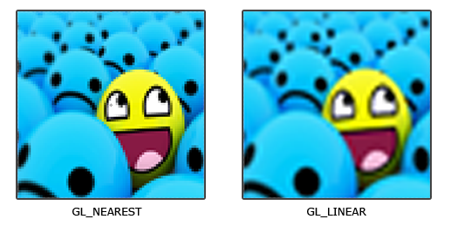

Slide 31
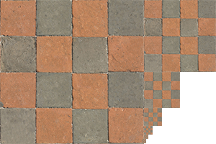
Mipmaps
A method to handle texture sampling more efficiently. This is a case where objects are far away from an observer.
This will produce visible artifacts on small objects, not to mention the waste of memory bandwidth using high resolution textures on small objects.
OpenGL has difficulties retrieving the right color value for its fragment from the high resolution texture, since it has to pick a texture color for a fragment that spans a large part of the texture.
Mipmap is basically a collection of texture images where each subsequent texture is twice as small compared to the previous one.
After a certain distance threshold from the viewer, OpenGL will use a different mipmap texture that best suits the distance to the object.
Notes:
If we apply the same texture on objects further away and very close to an observer, it is better to have different image resolutions.
It may also create some artifacts when resolution mismatching occurs.
Waste memory bandwidth.
Mipmap = a collection of different resolution textures

Slide 32
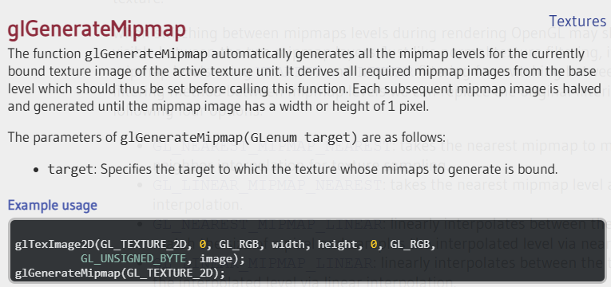
Generating mipmaps
Creating a collection of mipmapped textures for each texture image is cumbersome to do manually, but luckily OpenGL is able to do all the work for us with a single call to glGenerateMipmap after we've created a texture.
GL_NEAREST_MIPMAP_NEAREST: takes the nearest mipmap to match the pixel size and uses nearest neighbor interpolation for texture sampling.
GL_LINEAR_MIPMAP_NEAREST: takes the nearest mipmap level and samples that level using linear interpolation.
GL_NEAREST_MIPMAP_LINEAR: linearly interpolates between the two mipmaps that most closely match the size of a pixel and samples the interpolated level via nearest neighbor interpolation.
GL_LINEAR_MIPMAP_LINEAR: linearly interpolates between the two closest mipmaps and samples the interpolated level via linear interpolation.
Notes:
To use a mipmap, we need to generate the mipmap using the command.
There are 4 options for interpolating the mipmap.

Slide 33
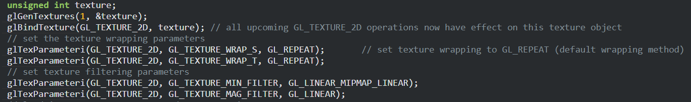
Usage : 1. Setting up textures
1. Generate texture ID and bind it.
2. Set texture wrapping
3. Set texture filtering and mipmap properties
Notes:
It’s time to go into steps of texturing.

Slide 34
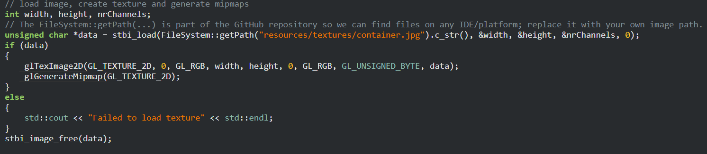
2. Loading images and generating textures
Color format and type of input source
Color format of output
Texture target
The input source
Automatically generate mipmaps

Slide 35
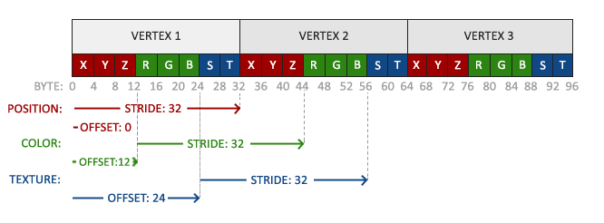
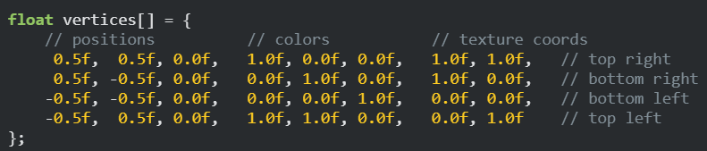
3. Applying textures
Define the texture coordinates.
Set texture coordinates to vertex attributes.
Notes:
This time we add more vertex data to the array of vertices.

Slide 36
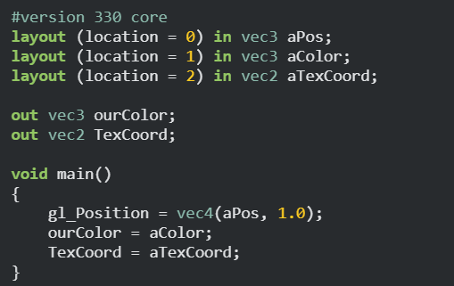
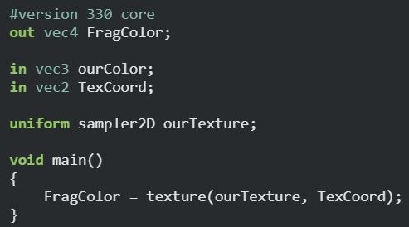
4. Textures in shaders
Texture data
The coordinates
Passing texture coordinates to the fragment shader
Sampling texture to a pixel
Notes:
the vertex shader to accept the texture coordinates as a vertex attribute and then forward the coordinates to the fragment shader:
GLSL has a built-in data-type for texture objects called a sampler that takes as a postfix the texture type we want e.g. sampler1D, sampler3D or in our case sampler2D. We can then add a texture to the fragment shader by simply declaring a uniform sampler2D that we later assign our texture to.

Slide 37
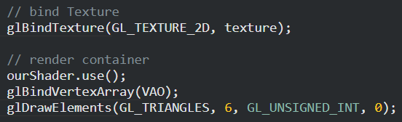
5. Drawing

Slide 38
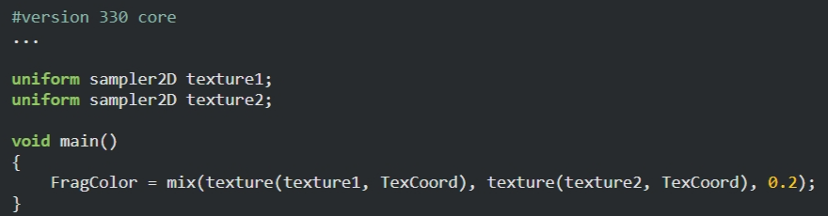
Using multiple textures in a shader
OpenGL should have a at least a minimum of 16 texture units for you to use which you can activate using GL_TEXTURE0 to GL_TEXTURE15.
Activate the texture unit to be used.
Bind it accordingly.
We can have multiple textures in a single shader.

Slide 39
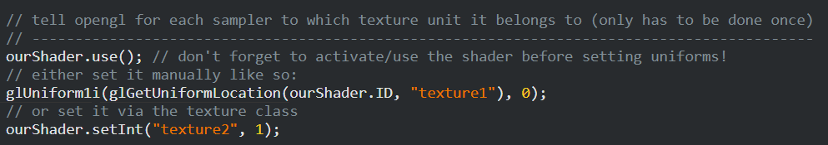
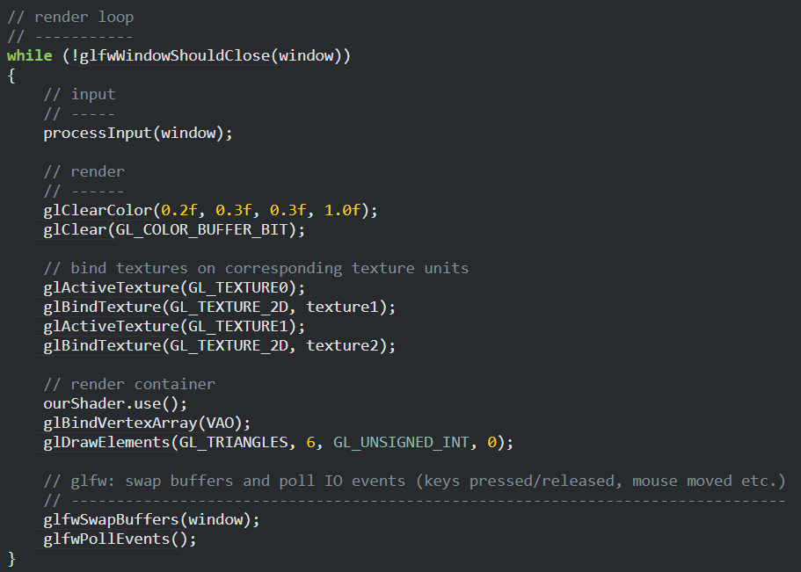
Rendering
Before the render loop (set it once)
- We set the uniform for each texture unit.
In the render loop
We activate each texture unit.
We bind each of them.
Notes:
We also have to tell OpenGL to which texture unit each shader sampler belongs to by setting each sampler using glUniform1i. We only have to set this once, so we can do this before we enter the render loop:

Slide 40
Examples
A single texture
https://learnopengl.com/code_viewer_gh.php?code=src/1.getting_started/4.1.textures/textures.cpp
Multiple textures
https://learnopengl.com/code_viewer_gh.php?code=src/1.getting_started/4.2.textures_combined/textures_combined.cpp

Slide 41
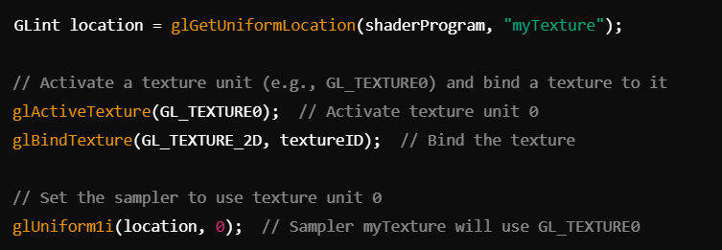
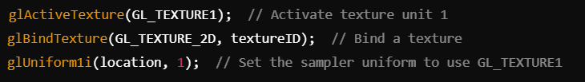
glUniform1i

