Slide 1

JavaScript
Made by Gergely Jenő Kis

Slide 2

What is JavaScript ?
JavaScript is a object oriented programing language.
JavaScript is used in websites.

Slide 3
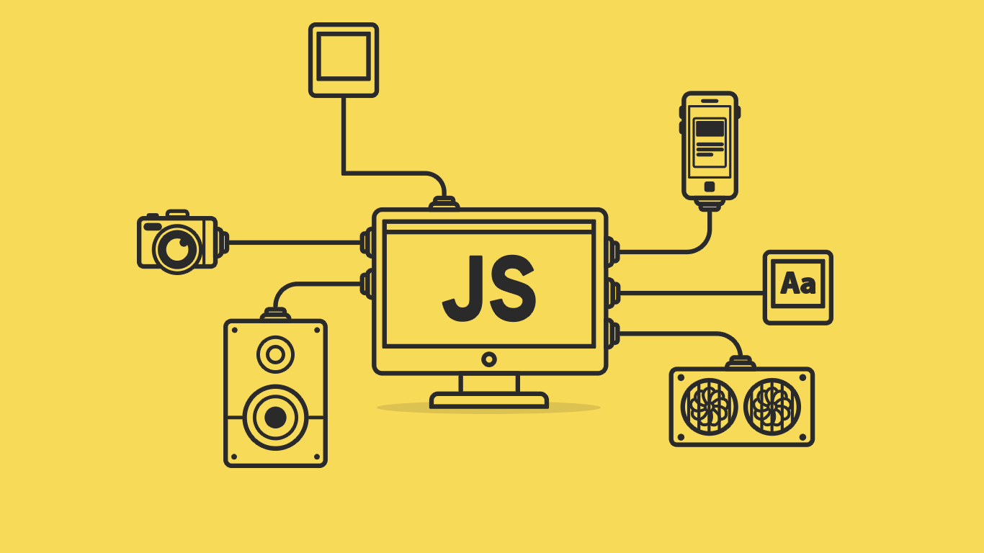
Why we use JavaScript ?
JavaScript can be used in all kind of websites, it's really flexible and can be used for a lot of things.
JavaScript can help in a lot of things because it can be used in both front and back end (its not always optimal to use it like that).
JavaScript can make your website interactive, add forms, pop-ups and many more.

Slide 4

What tools we need to use JavaScript?
We need a text editor like visual studio code but you can use anything even the pre installed notepad.
We need a web browser like google chrome, it can be any browser.
(your needs can depend on what do you make with JavaScript)

Slide 5
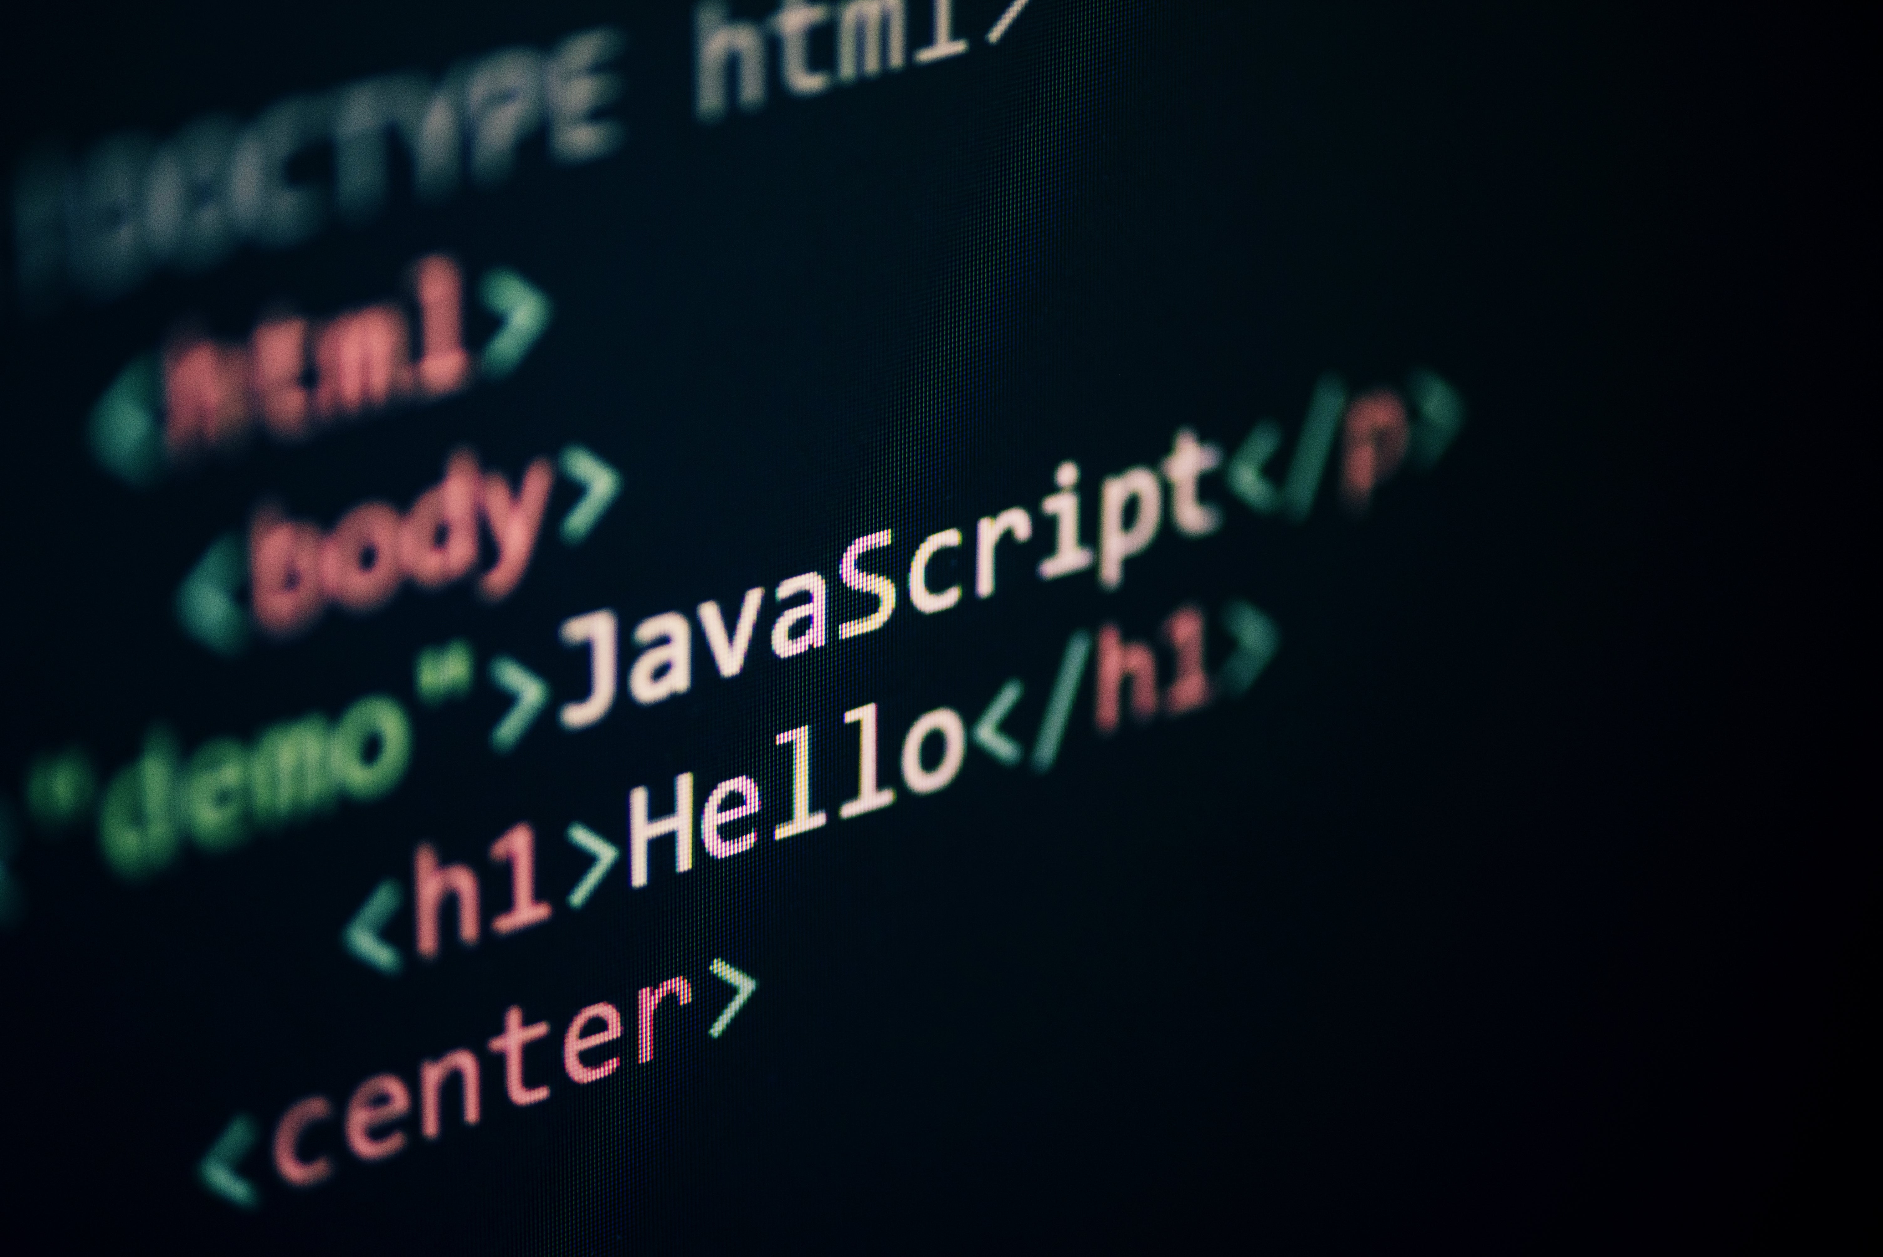
How to use JavaScript?
Add <script> </script> tags to your html page and beetwen these two tags you can write your JavaScript code.
You can also write your JavaScript code in a .js file.
Run it in a web browser.

Slide 6
Thank you for your attention

