Slide 1
String Replacement
Created By: Gergely jenő kis

Slide 2
What is our task?
We need to make a program that will replace a string with another string in a longer text.

Slide 3
Where can we find solotions?
We can just search on googlespecific websites or we can use specific websites.
What are those specific websites ?
GITHUB OR STACKOVERFLOW

Slide 4
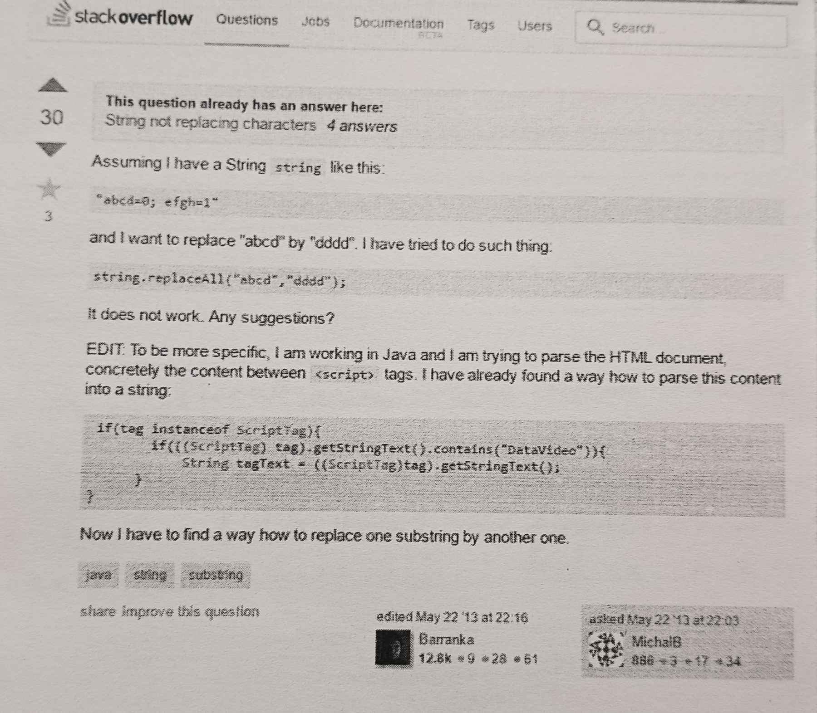
HOW CAN WE MAKE OUR REPLACEMENT PROGRAM?
We assume that we have strings like in the picture.
We can replace the text with the "string.replaceALL" tag. Inside the tag we need to add what we want to change to what.

Slide 5
HOW CAN WE MAKE OUR REPLACEMENT PROGRAM?
The if condition check the text and if it contains a specific text or not, if it contains the text it will replace with other text.

Slide 6
Thank you for your attention

