Slide 1







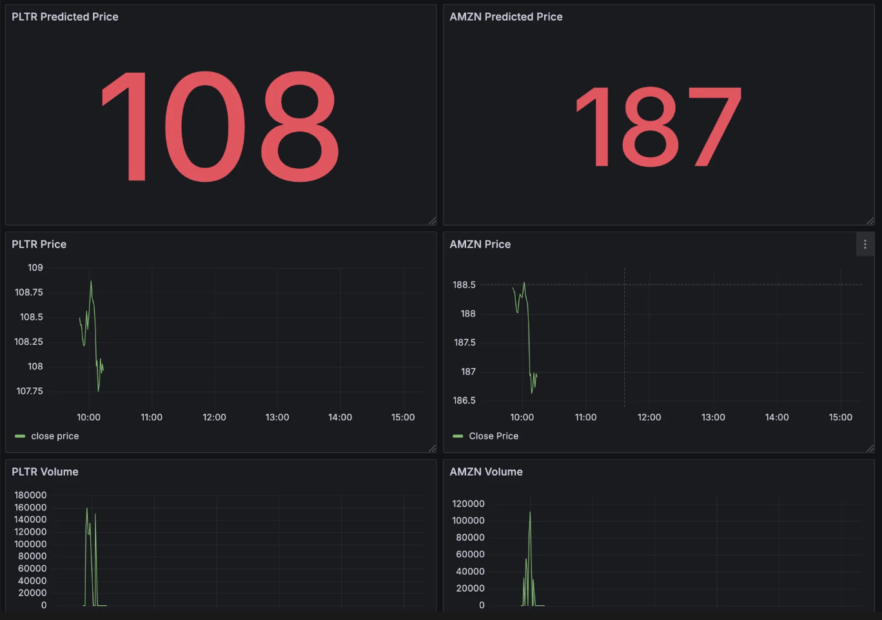
RealTime Stock Data

